Slide 1

Orthodox Global Online Sunday School (OGOSS)

Slide 2
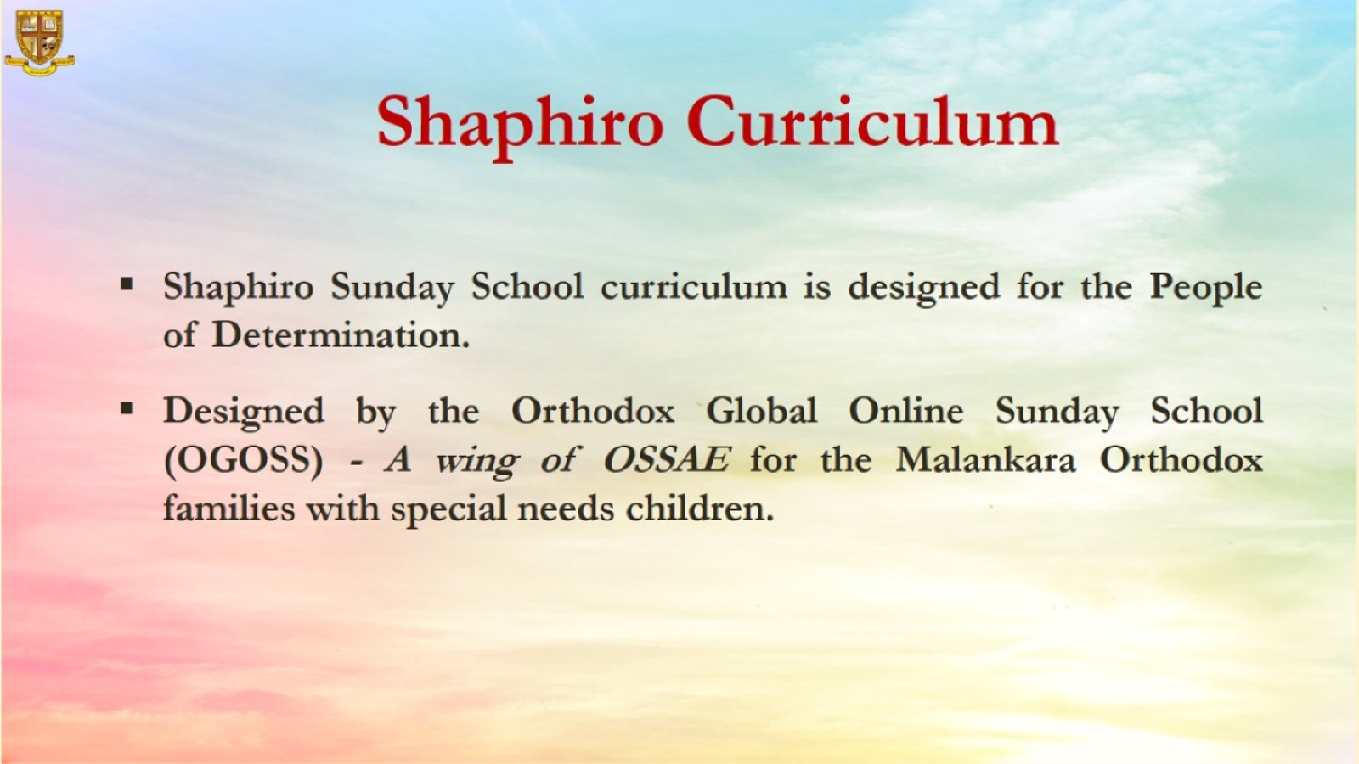

Slide 3


Slide 4
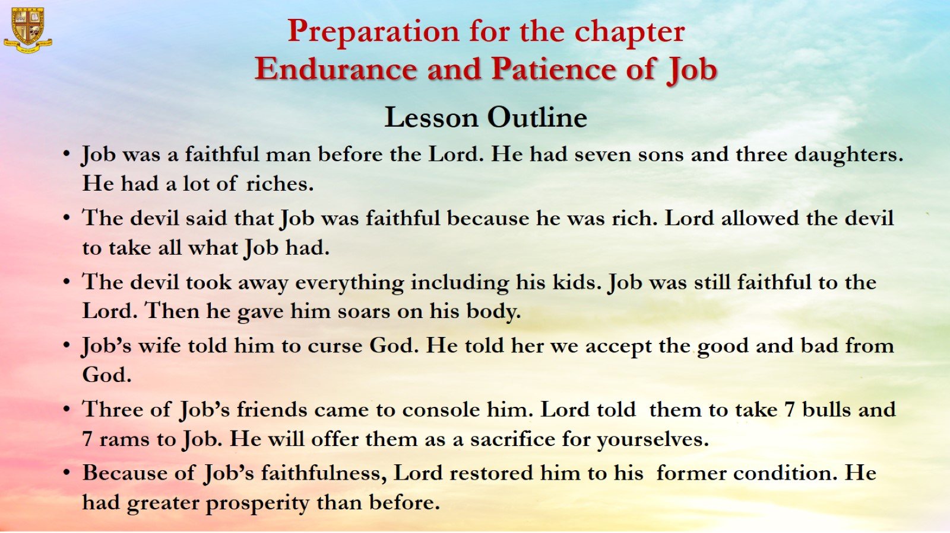
Preparation for the chapter
Endurance and Patience of Job
Lesson Outline

Slide 5
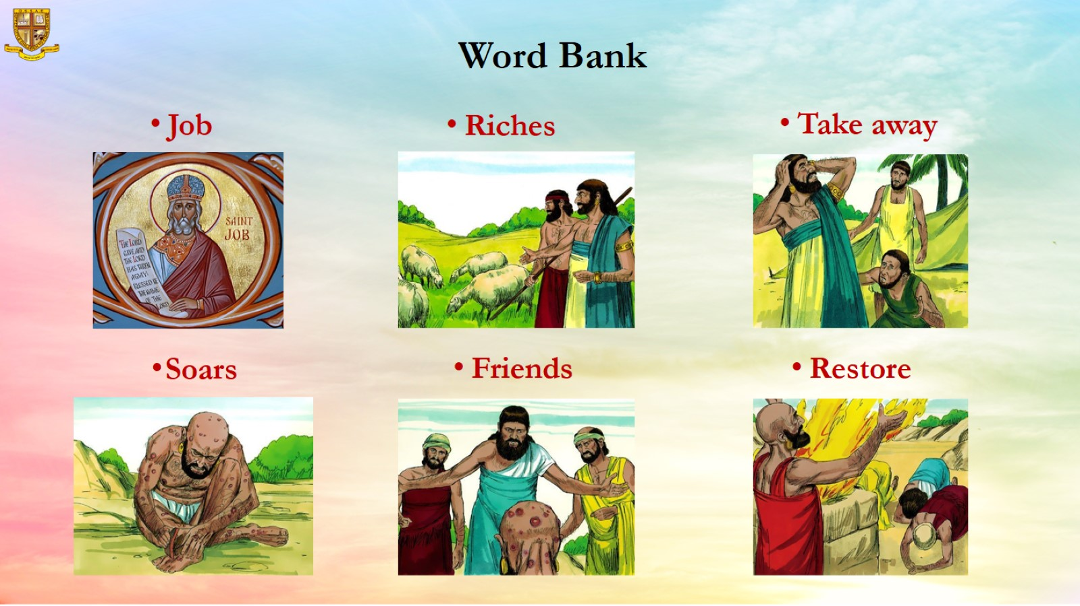
Word Bank

Slide 6
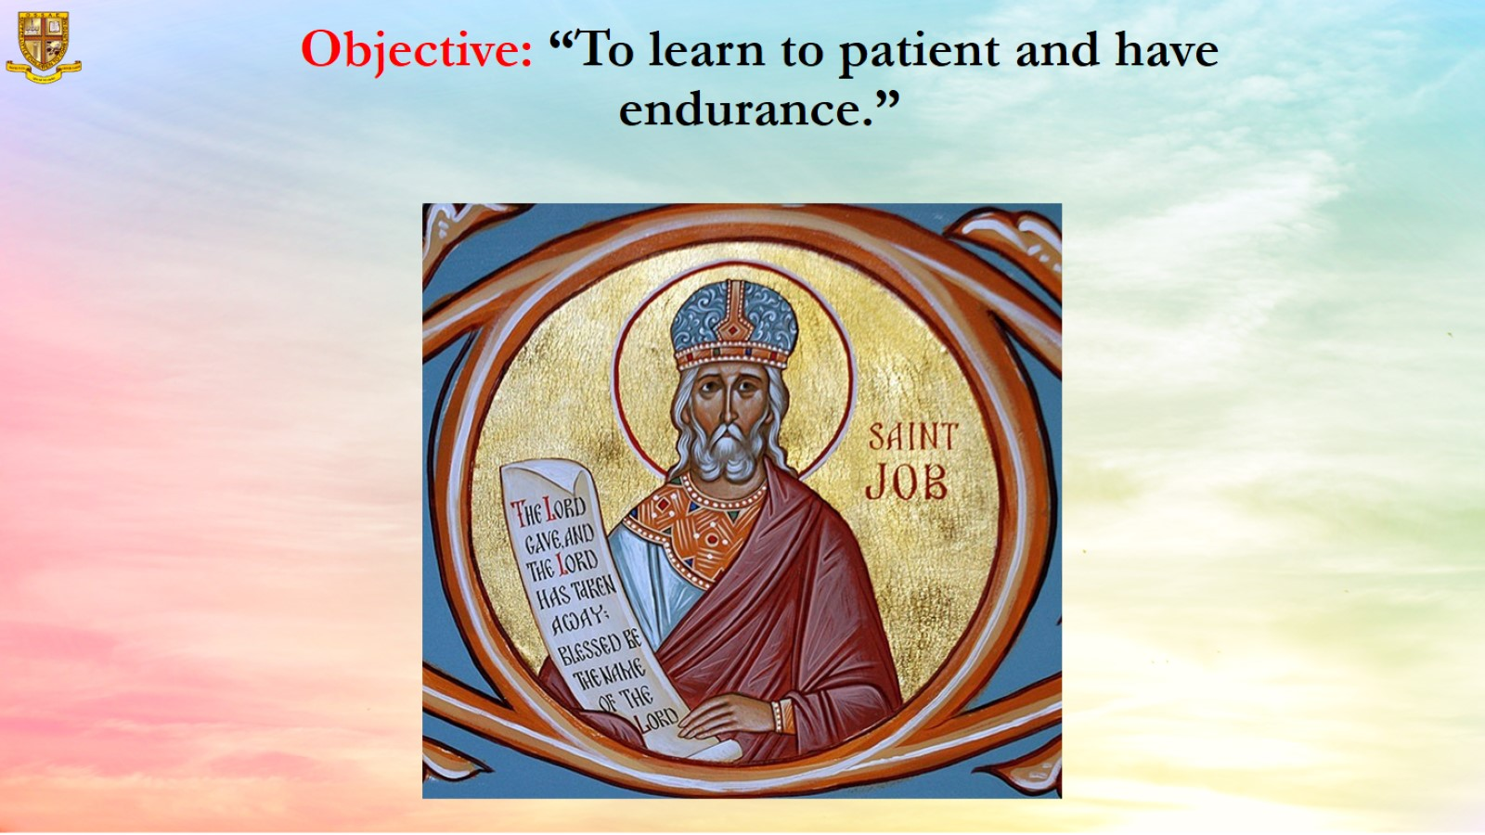
Objective: “To learn to patient and have endurance.”

Slide 7
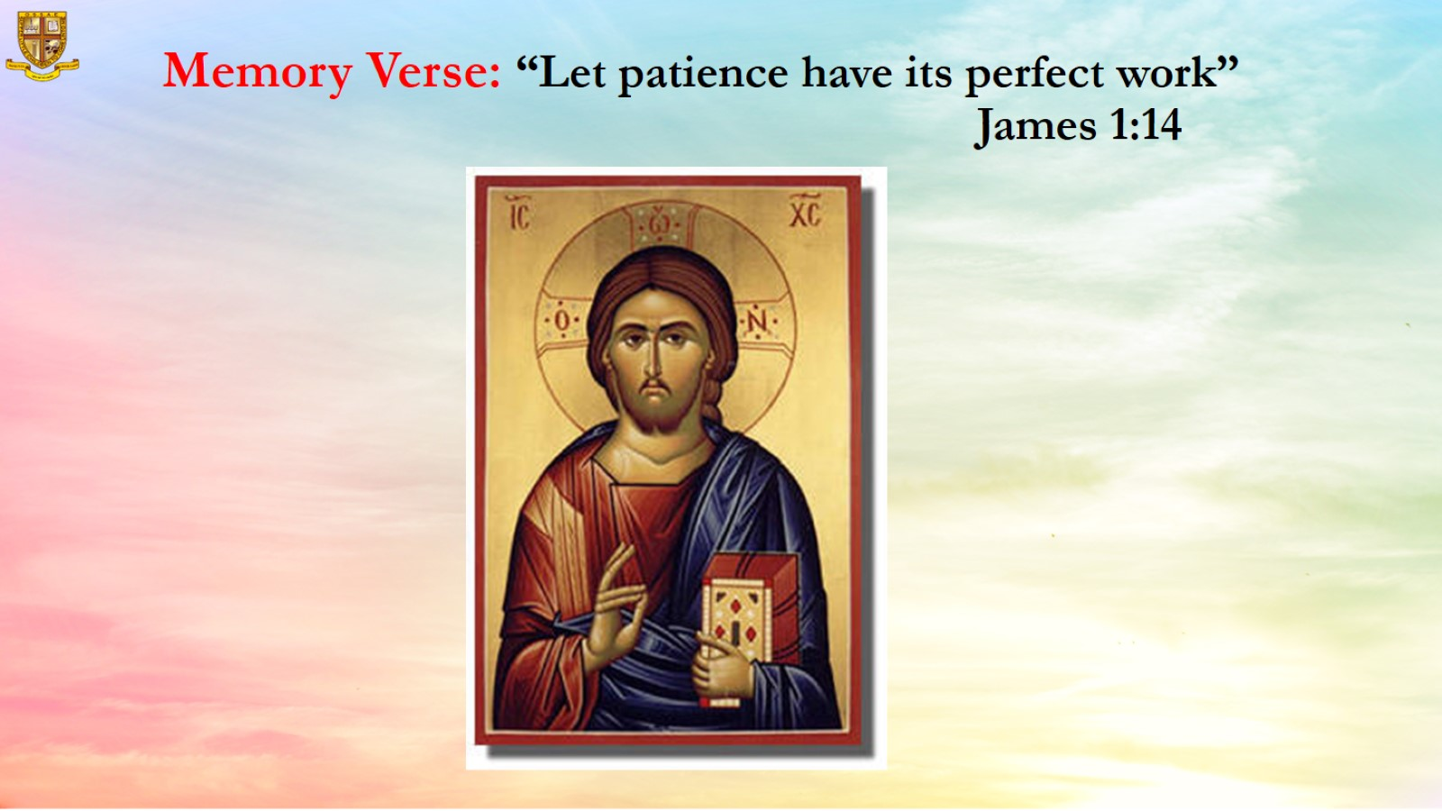
Memory Verse: “Let patience have its perfect work”
James 1:14

Slide 8
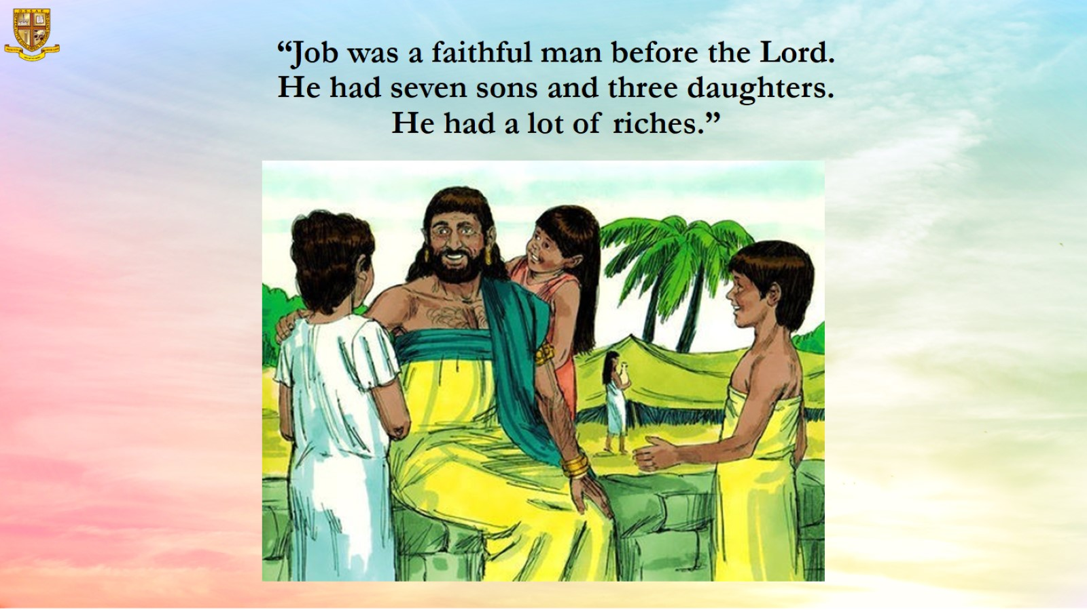
“Job was a faithful man before the Lord.
He had seven sons and three daughters.
He had a lot of riches.”

Slide 9
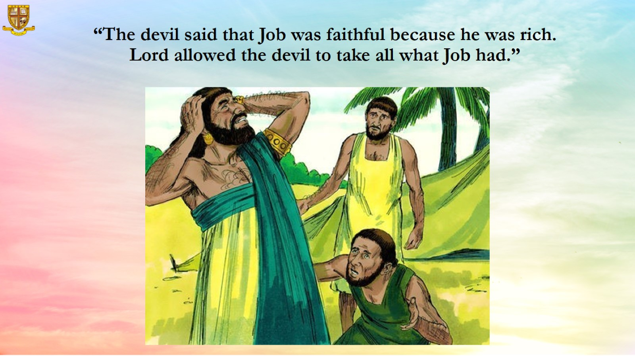
“The devil said that Job was faithful because he was rich.
Lord allowed the devil to take all what Job had.”

Slide 10
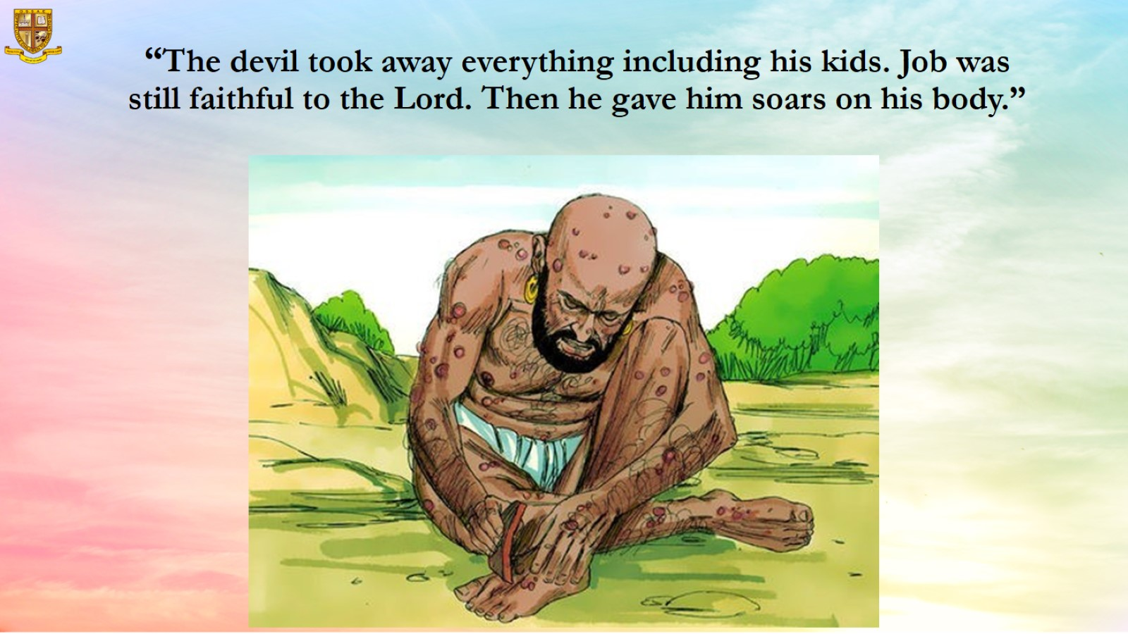
“The devil took away everything including his kids. Job was still faithful to the Lord. Then he gave him soars on his body.”

Slide 11
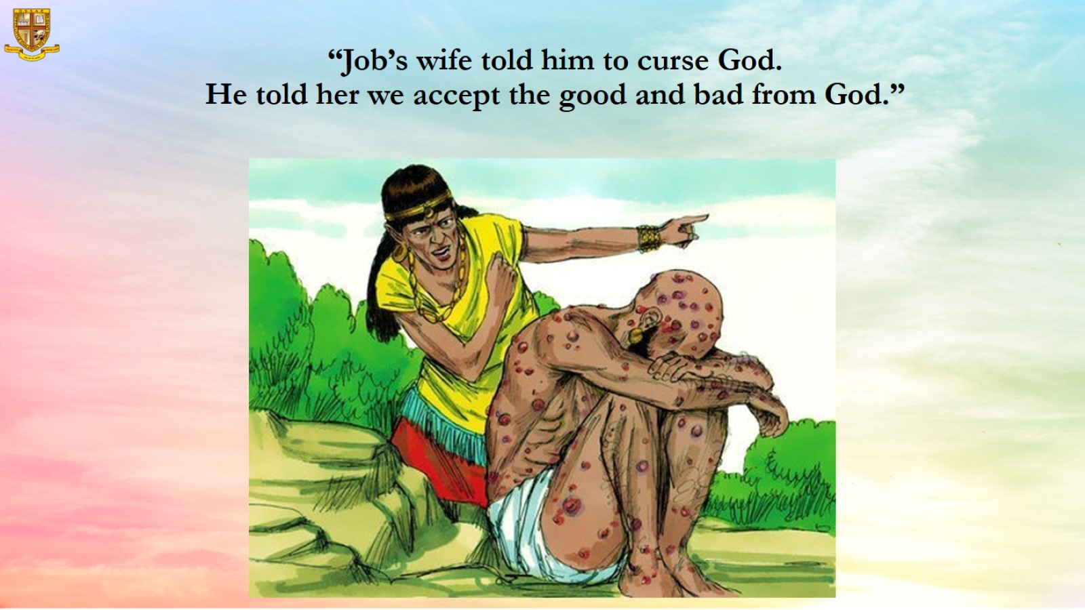
“Job’s wife told him to curse God.
He told her we accept the good and bad from God.”

Slide 12
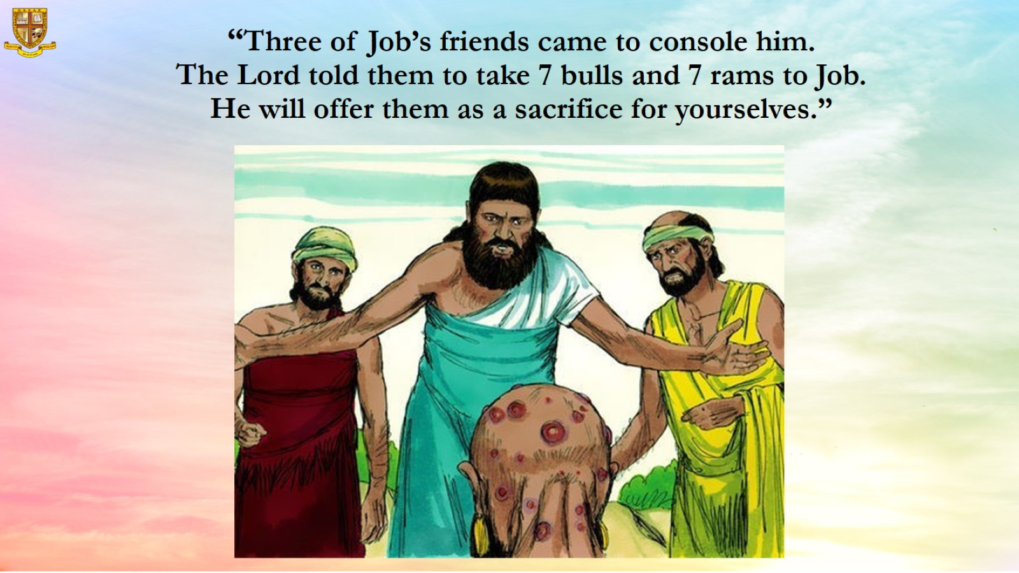
“Three of Job’s friends came to console him.
The Lord told them to take 7 bulls and 7 rams to Job.
He will offer them as a sacrifice for yourselves.”

Slide 13
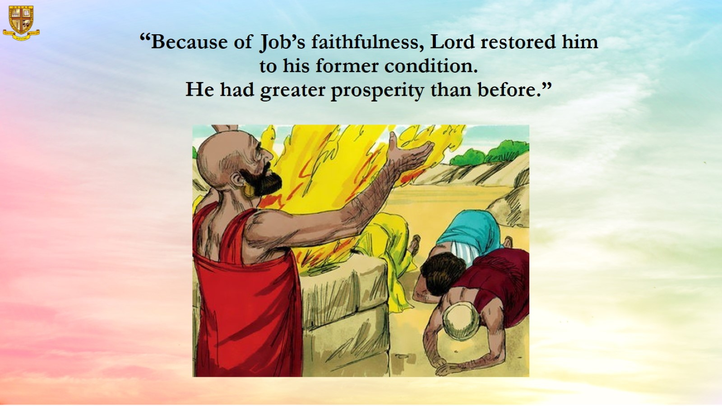
“Because of Job’s faithfulness, Lord restored him to his former condition.
He had greater prosperity than before.”

Slide 14
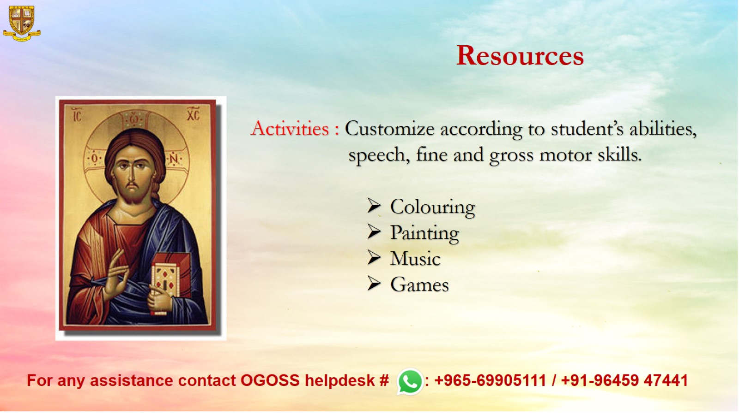
Resources

