Slide 1


Slide 2


Slide 3


Grade 1
Chapter 9
Feeding the Five Thousand

Slide 4
Preparation for the chapter
Feeding the Five Thousand
Lesson Outline
Wherever Jesus went people gathered to listen to Him.
The people were there for a long time. They were hungry. Jesus asked His disciples to bring them food.
The disciples said that there is not enough food. There was only 5 loaves of bread and 2 fish.
He said to seat every 50 people together. Jesus gave thanks to God and gave it to the people.
They ate as much they wanted. There were five thousand men.
Jesus asked the disciples to collect the leftover. They collected 12 baskets.

Slide 5
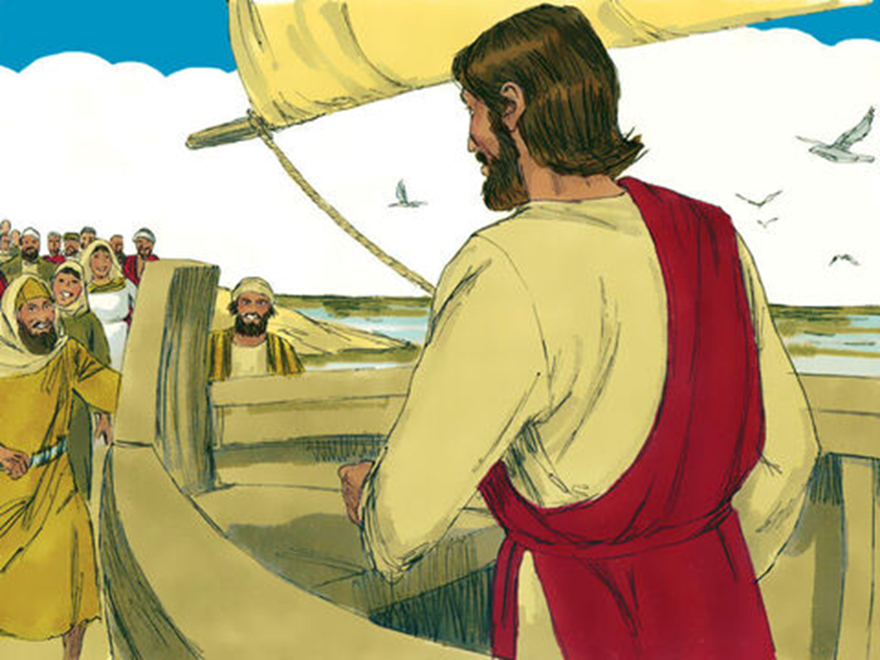
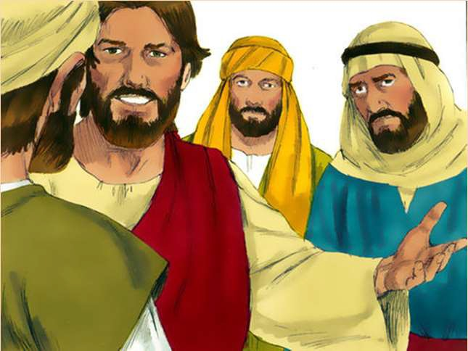
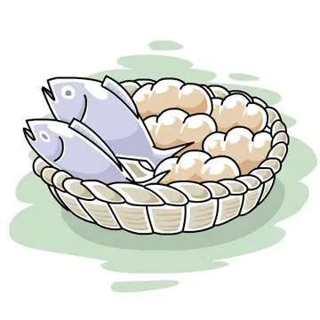
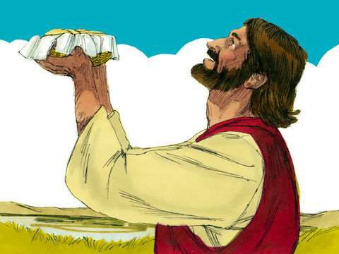
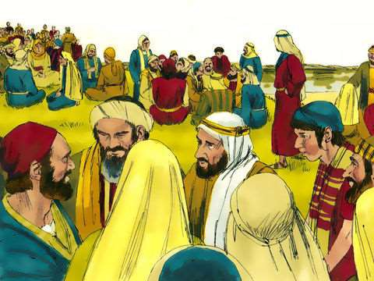
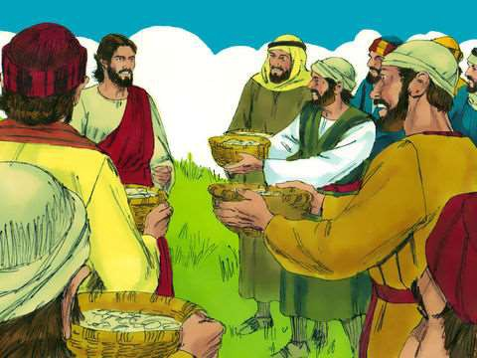
Word Bank
Gathered
Ask
Not enough
Thank
Sit
Collect

Slide 6
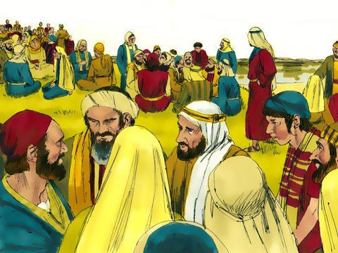
Objective: God takes care of all His children who follow Him.

Slide 7
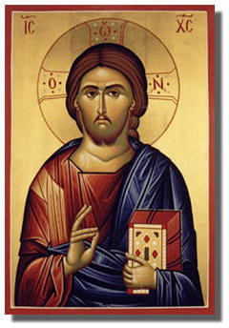
Memory Verse: “So they all ate and were filled”
(St. Matthew 14:20)

Slide 8

Wherever Jesus went people gathered to listen to Him.

Slide 9

The people were there for a long time.
They were hungry.
Jesus asked His disciples to bring them food.

Slide 10

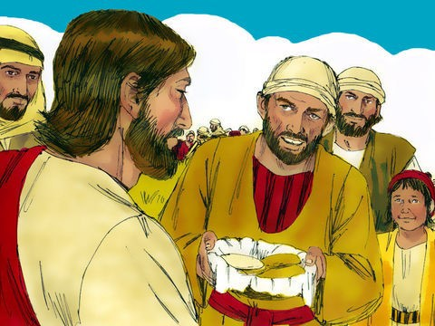
The disciples said that there is not enough food.
There is only five loaves of bread and two fish.

Slide 11

He said to seat every 50 people together.
Jesus gave thanks to God and gave it to the people.

Slide 12

They ate as much they wanted.
There were five thousand men.

Slide 13

Jesus asked the disciples to collect the leftover.
They collected 12 baskets.

Slide 14
