Slide 1


Slide 2


Slide 3


Grade 1
Chapter 6
Four men carry the paralytic

Slide 4
Preparation for Four Men Carry the Paralytic
Lesson Outline
Preparation for the chapter
Four men carry the paralytic
Lesson Outline
Jesus was in a village called Capernaum teaching people in one of the houses.
There was a paralytic man whose friends wanted to bring him in.
The house was full of people and the friends couldn’t walk in.
The friends decided to bring the man in from the roof.
Jesus healed the paralytic man.
Cooperating in service brings joy to God.

Slide 5
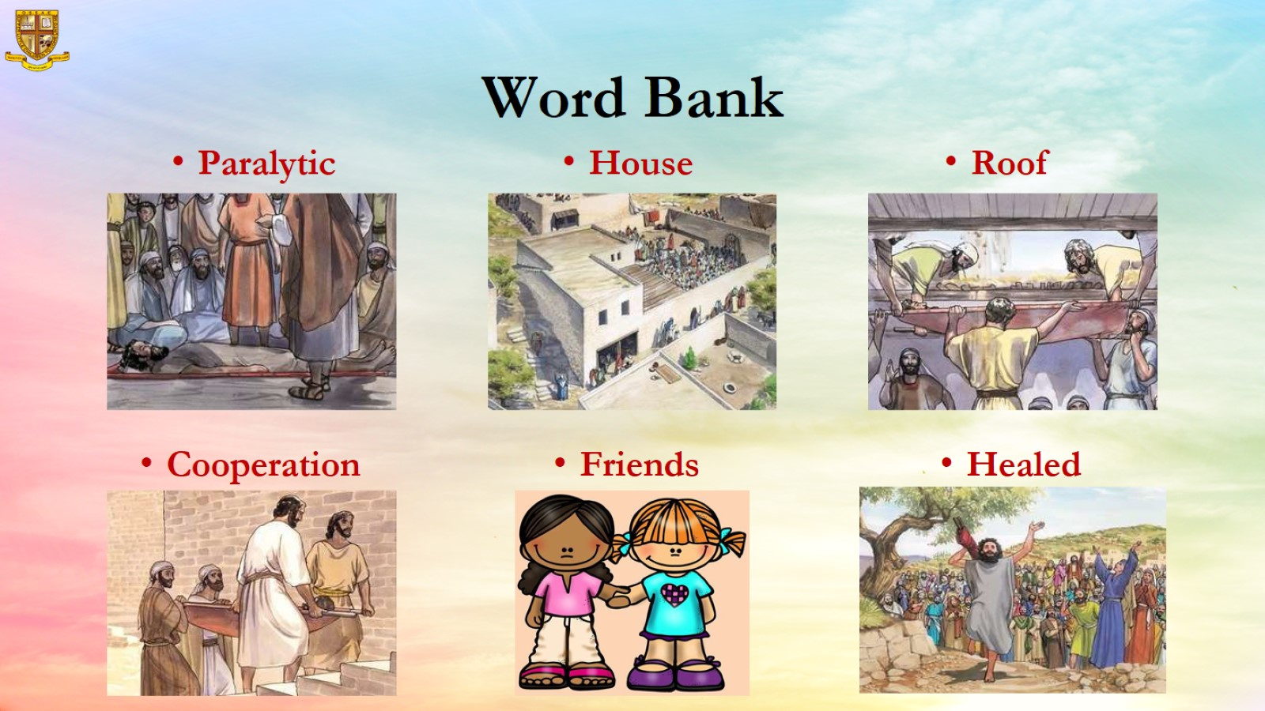
Word Bank

Slide 6
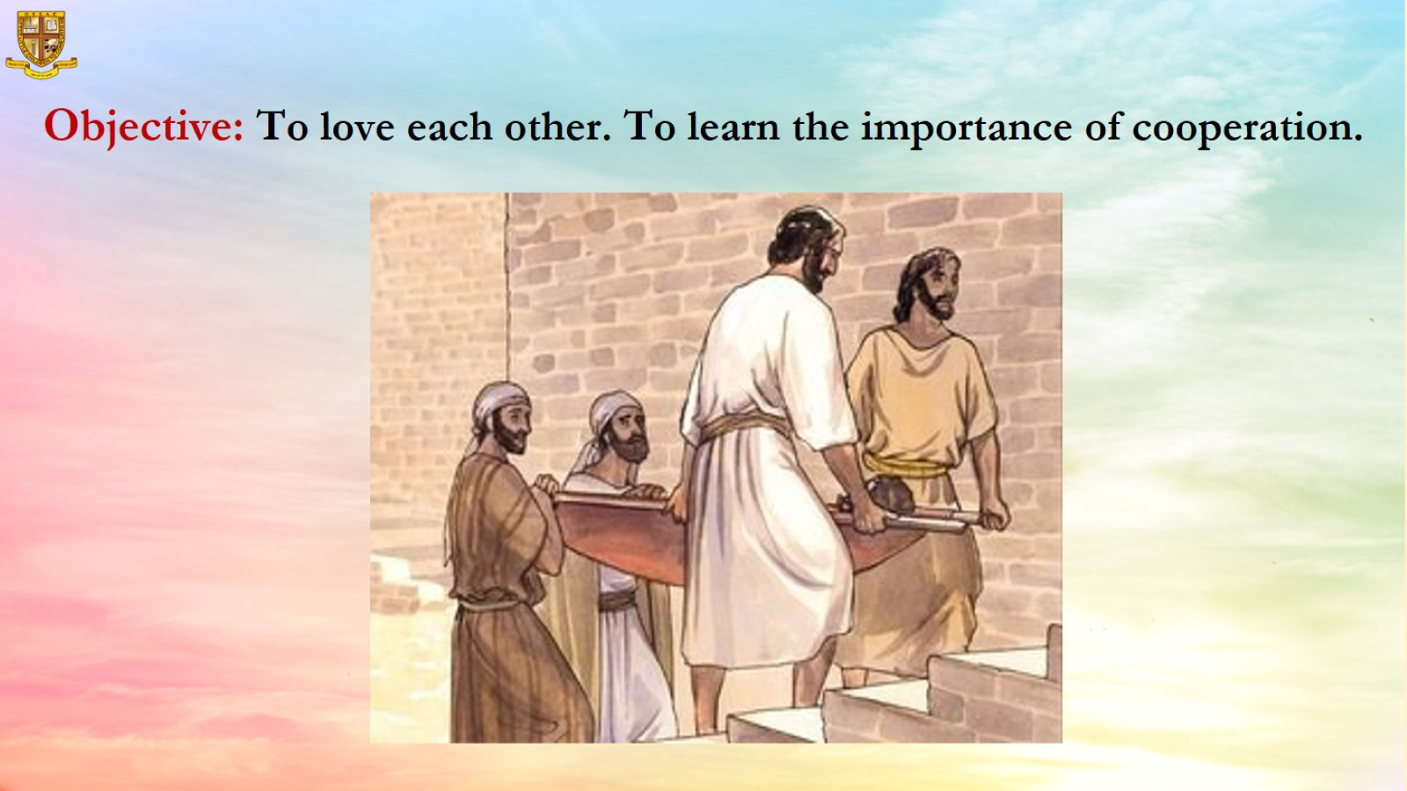
Objective: To love each other. To learn the importance of cooperation.

Slide 7
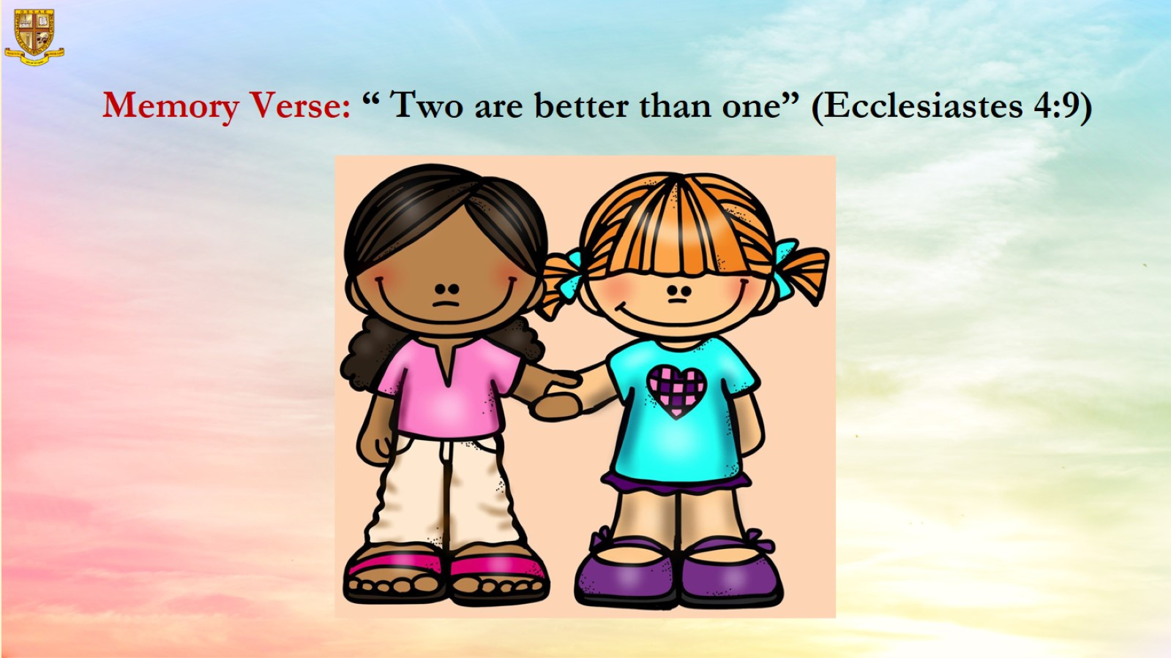
Memory Verse: “ Two are better than one” (Ecclesiastes 4:9)

Slide 8
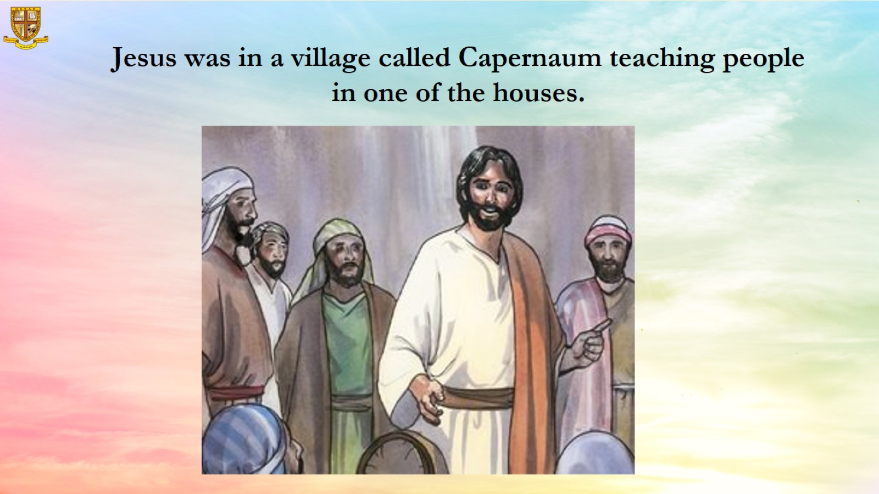
Jesus was in a village called Capernaum teaching people in one of the houses.

Slide 9
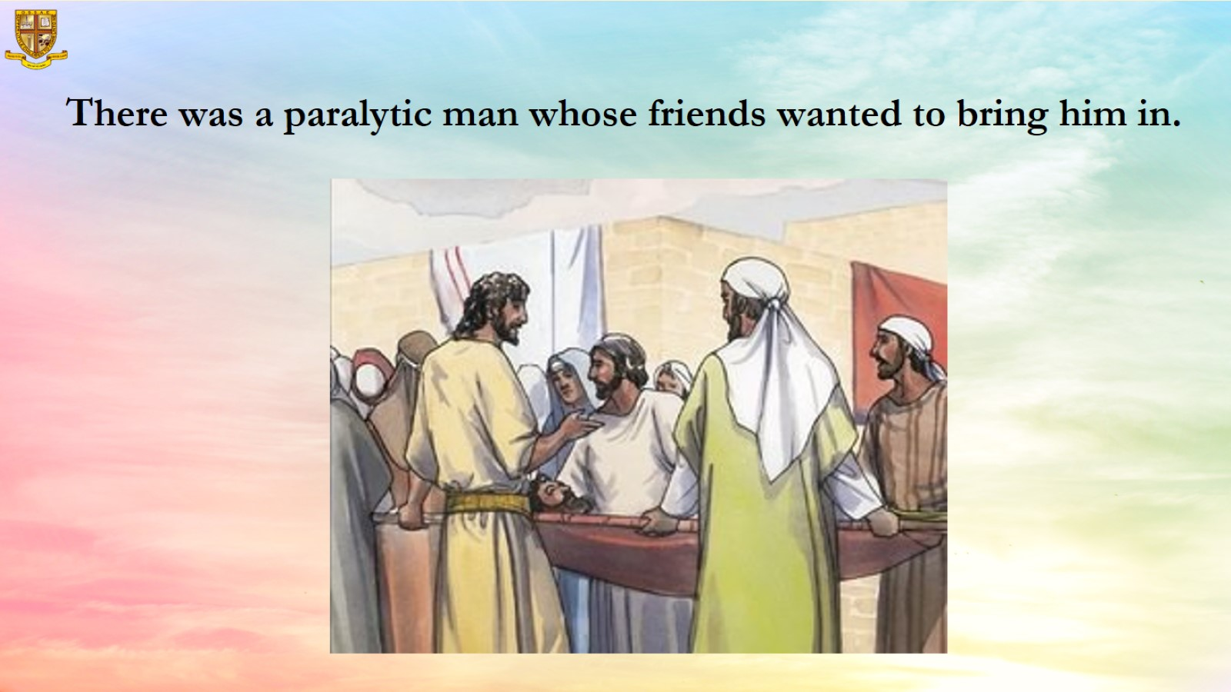
There was a paralytic man whose friends wanted to bring him in.

Slide 10
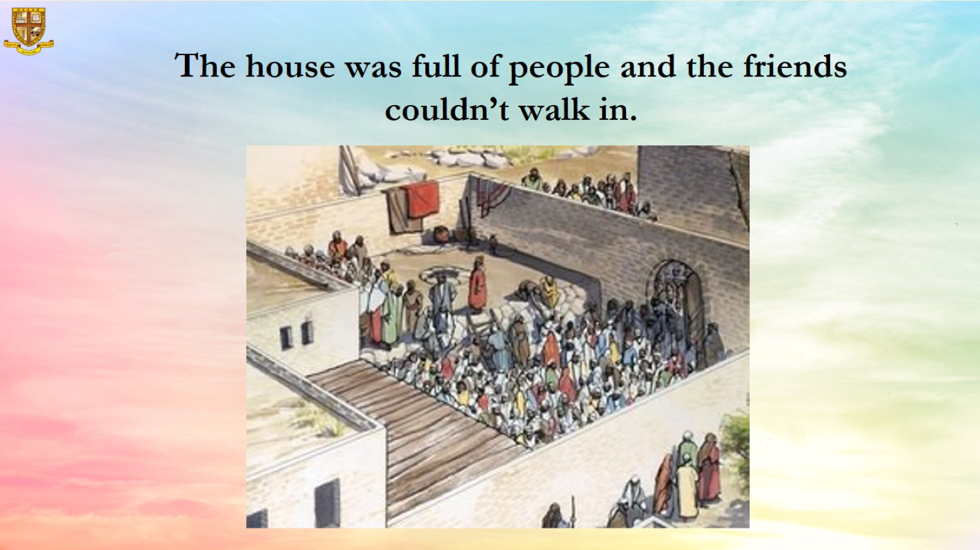
The house was full of people and the friends couldn’t walk in.

Slide 11
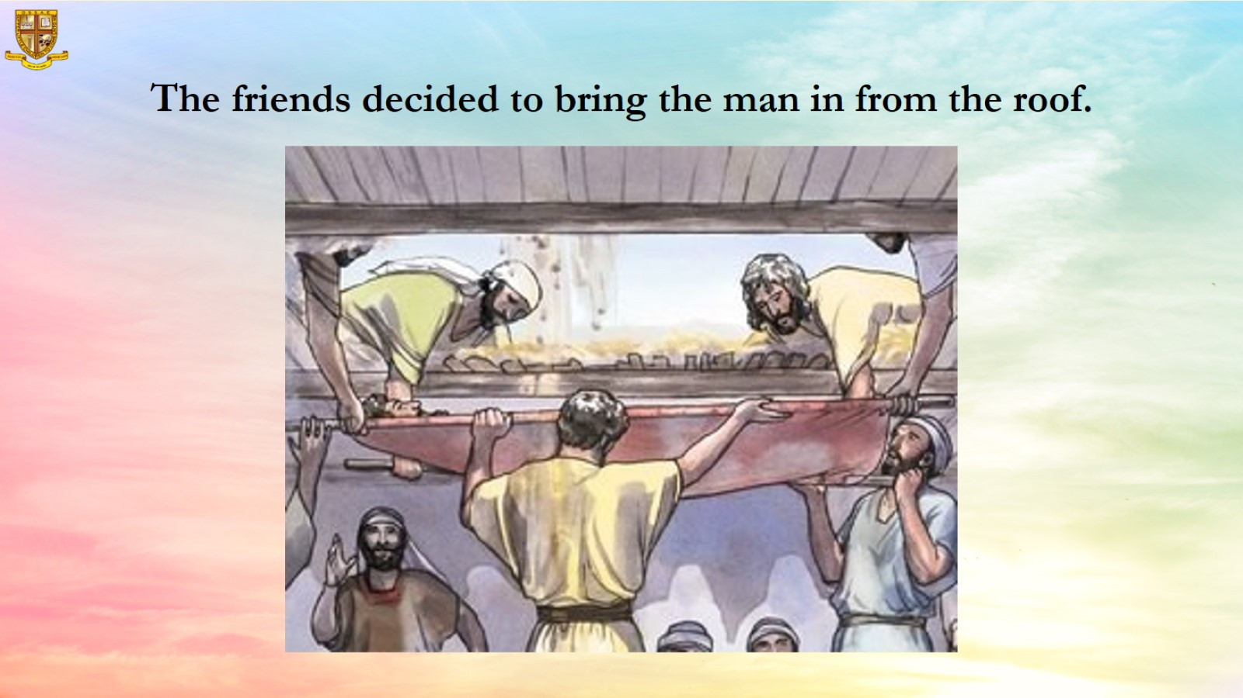
The friends decided to bring the man in from the roof.

Slide 12
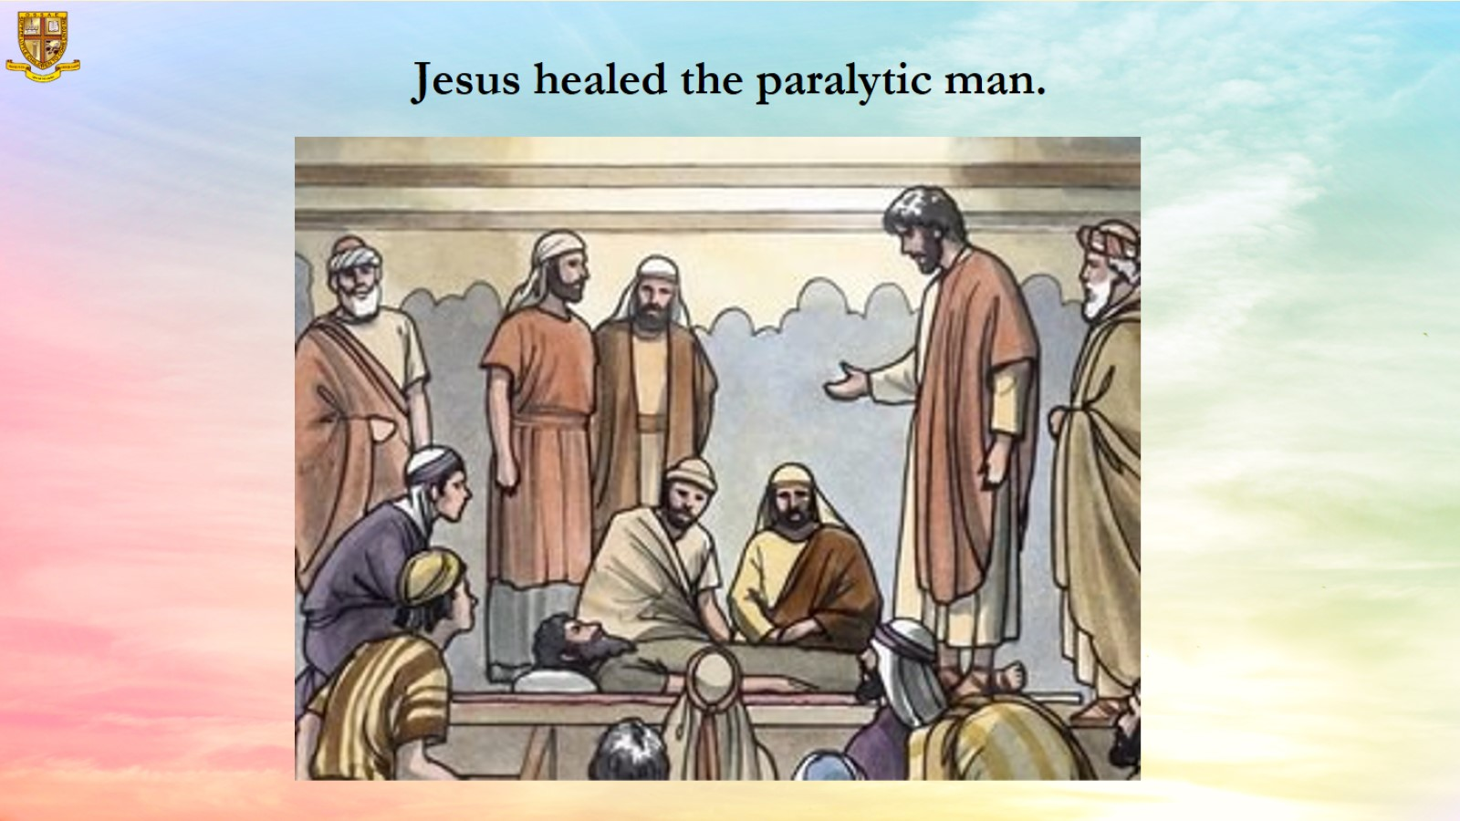
Jesus healed the paralytic man.

Slide 13
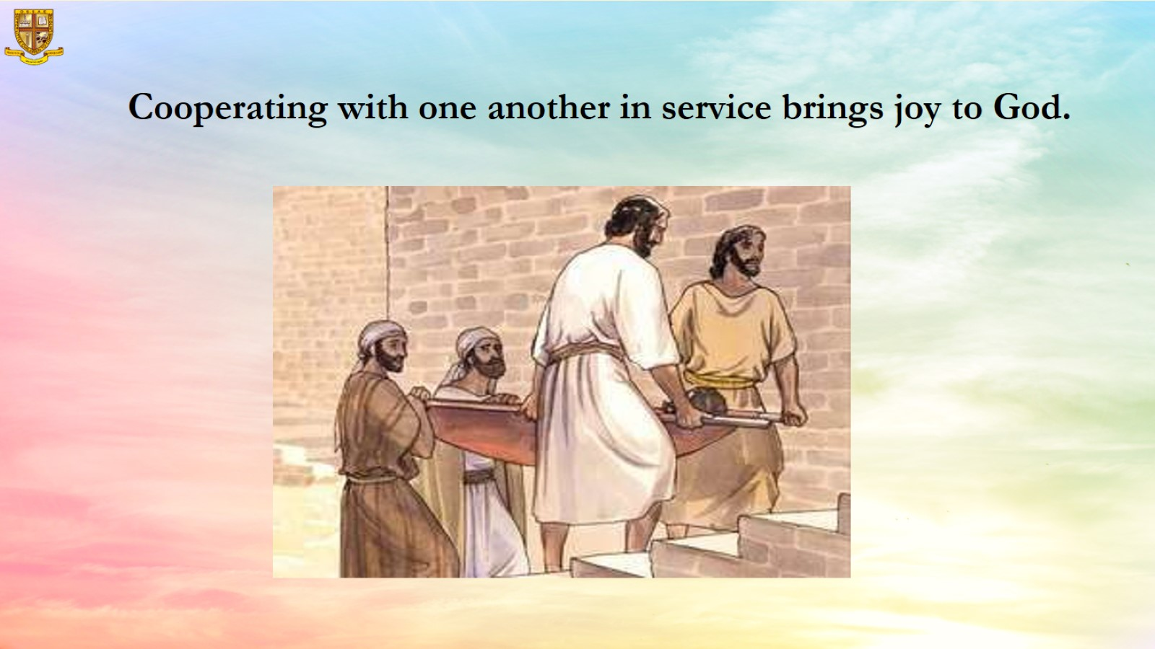
Cooperating with one another in service brings joy to God.

Slide 14
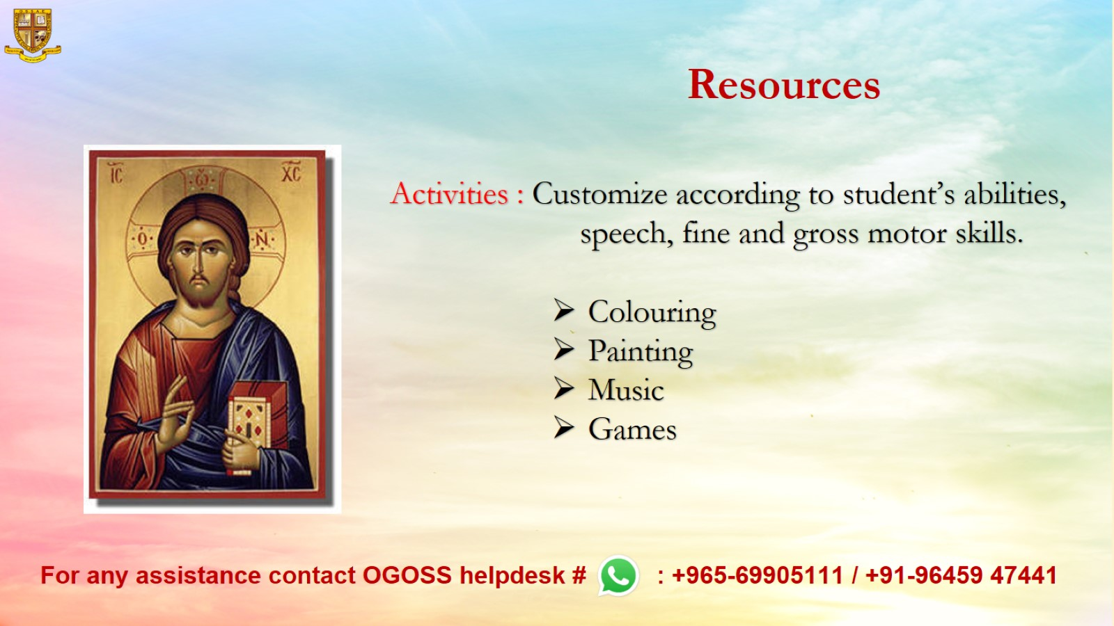
Resources

