Slide 1
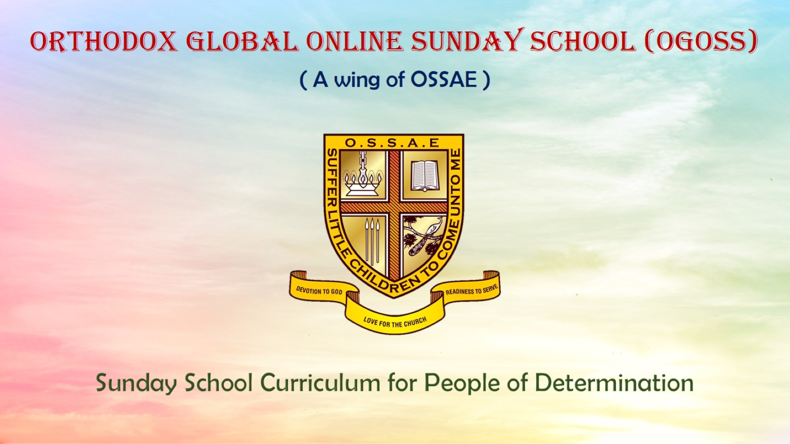
Orthodox Global Online Sunday School (OGOSS)

Slide 2
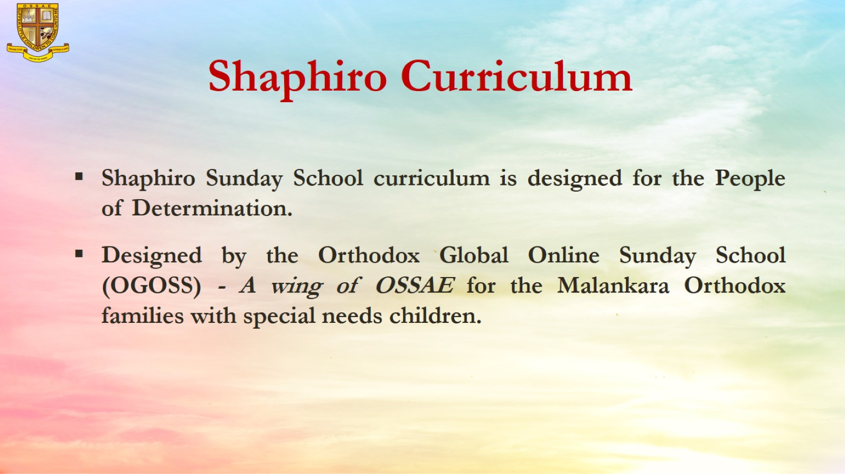

Slide 3


Slide 4
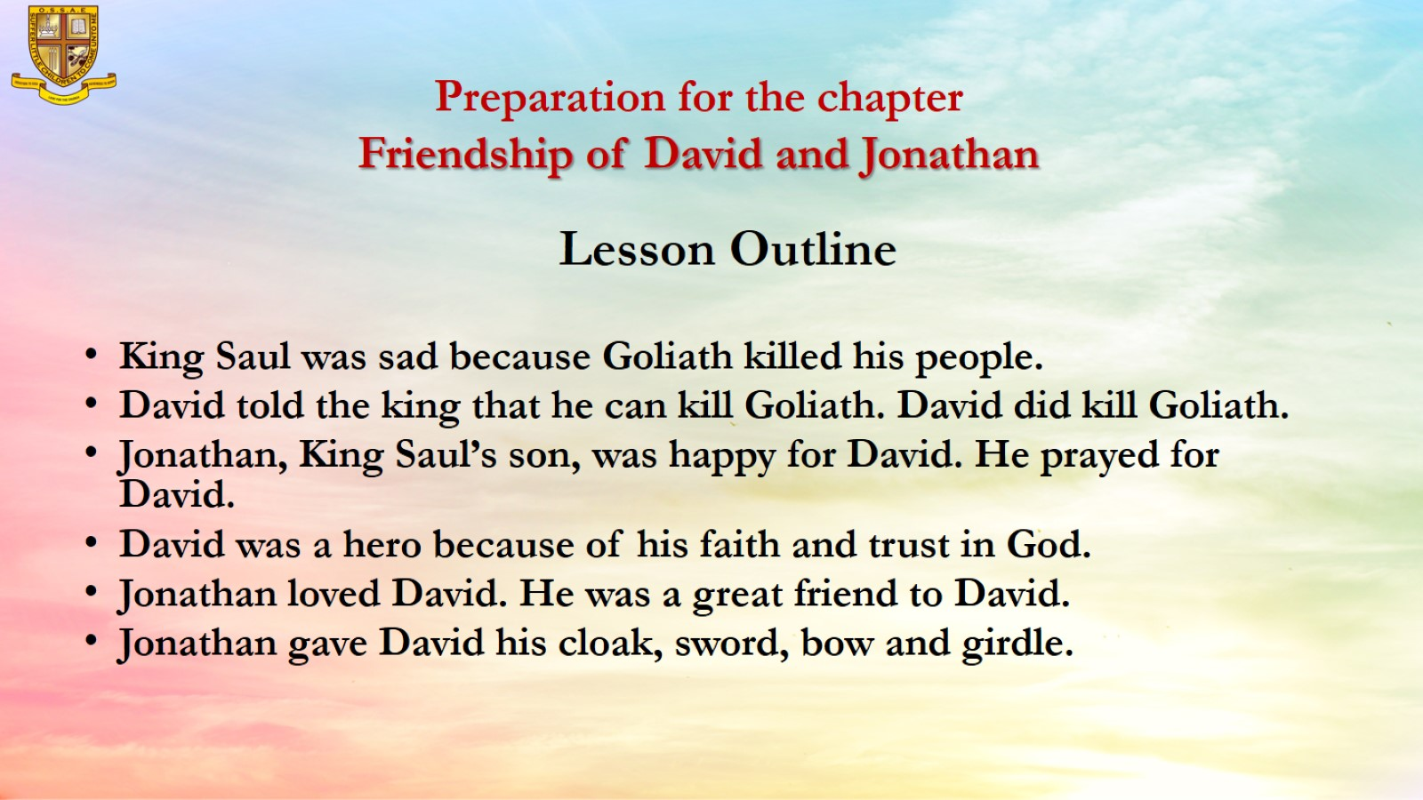
Preparation for the chapter
Friendship of David and Jonathan

Slide 5
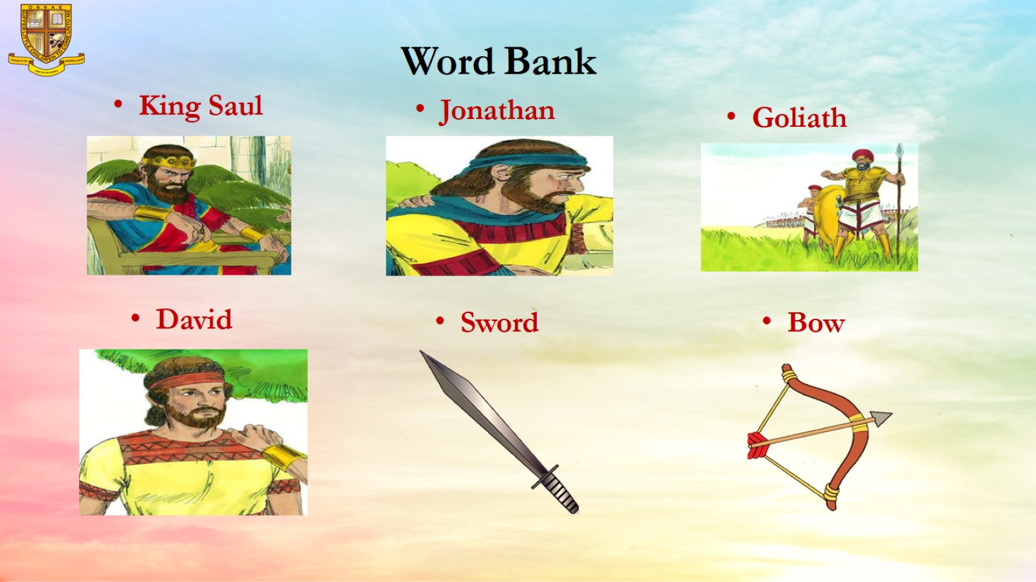
Word Bank

Slide 6
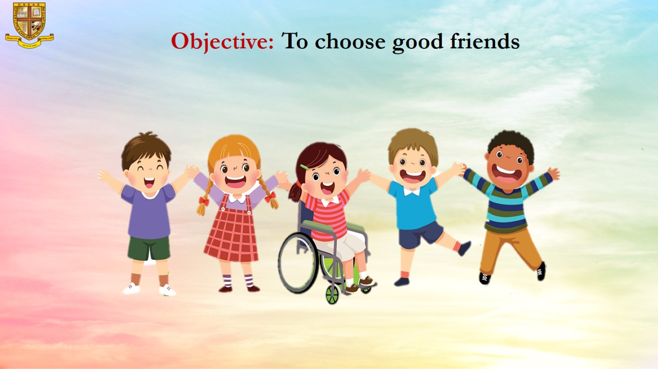
Objective: To choose good friends

Slide 7
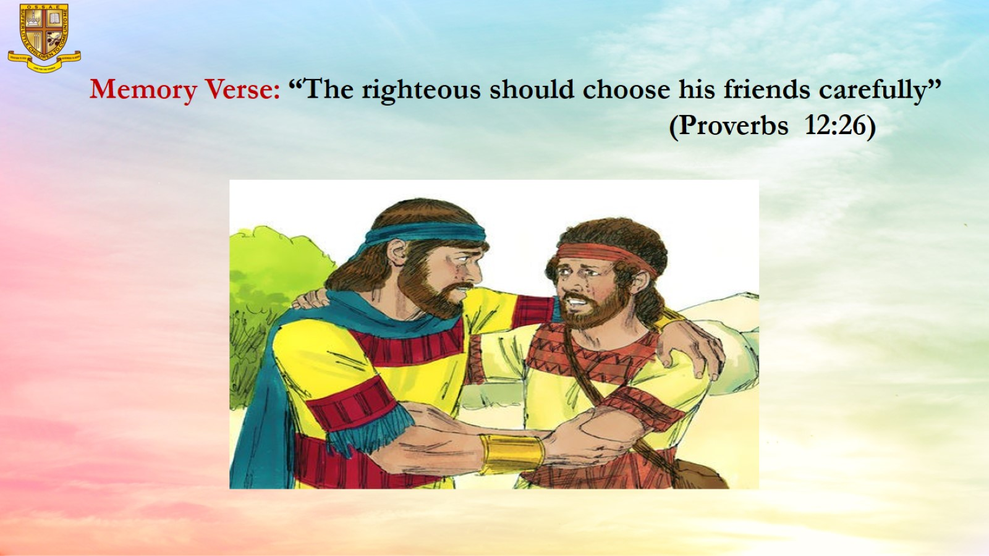
Memory Verse: “The righteous should choose his friends carefully” (Proverbs 12:26)

Slide 8
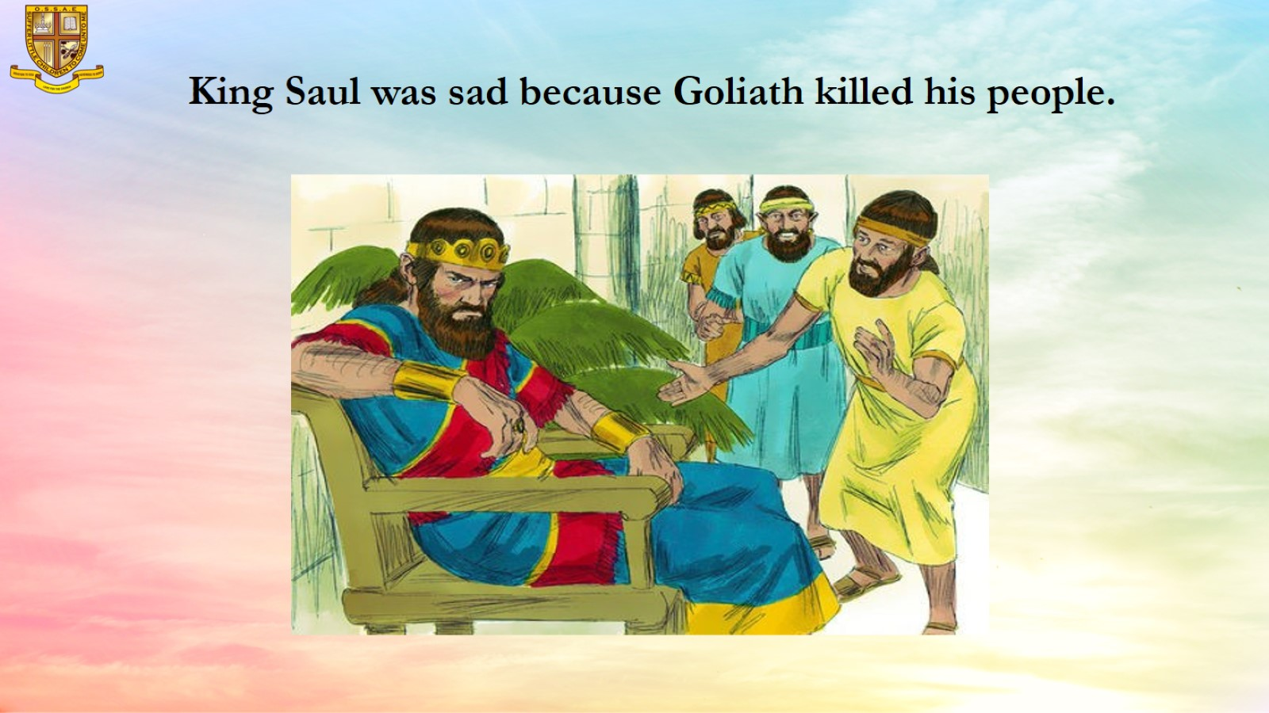
King Saul was sad because Goliath killed his people.

Slide 9
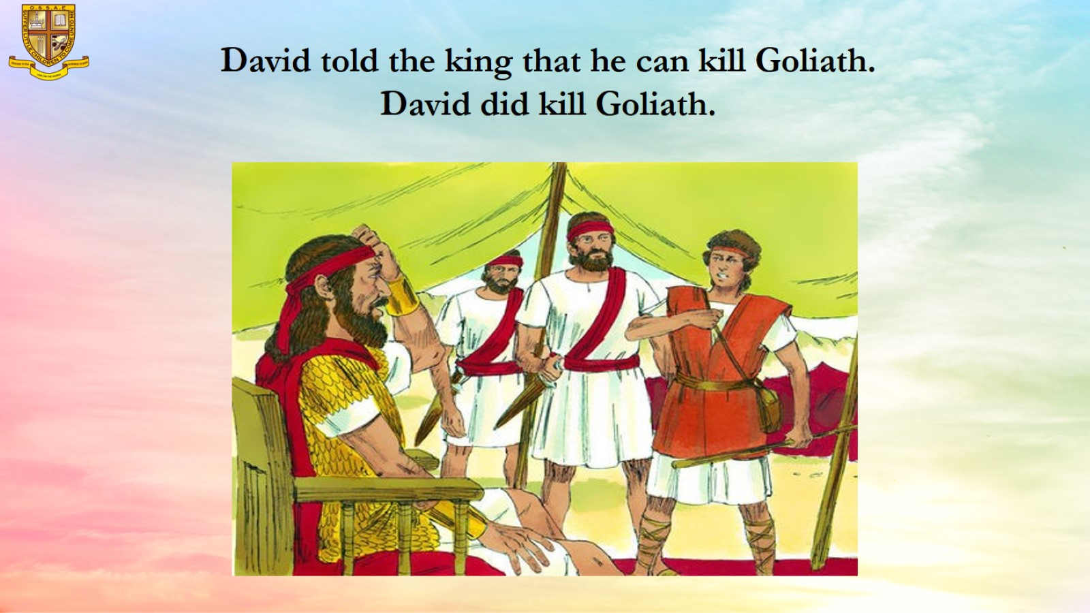
David told the king that he can kill Goliath.
David did kill Goliath.

Slide 10
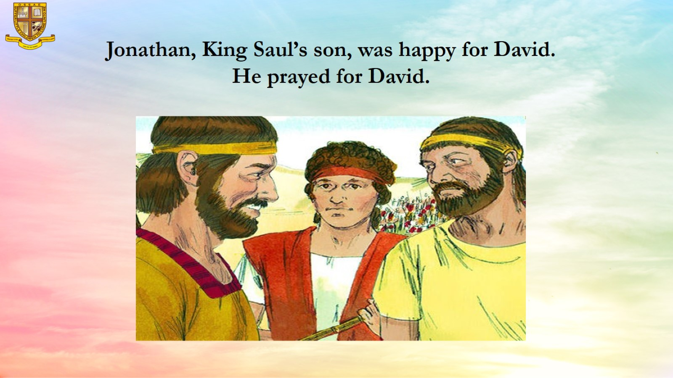
Jonathan, King Saul’s son, was happy for David.
He prayed for David.

Slide 11
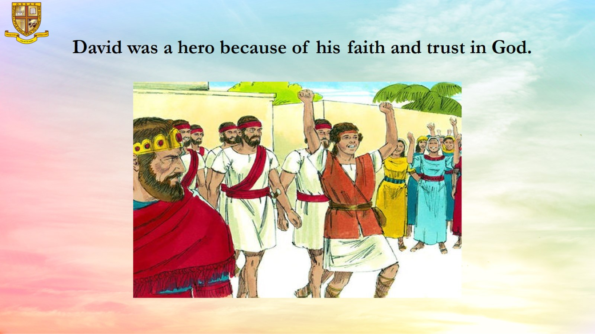
David was a hero because of his faith and trust in God.

Slide 12
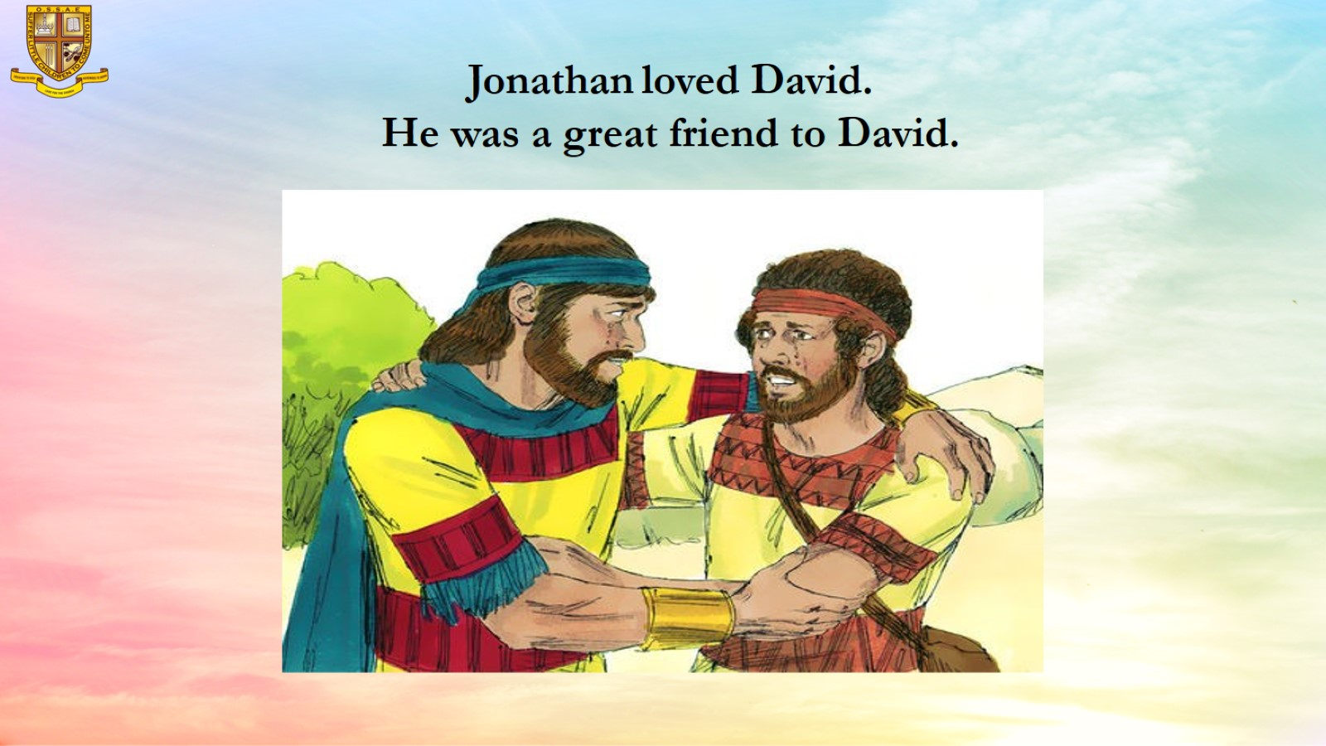
Jonathan loved David.
He was a great friend to David.

Slide 13
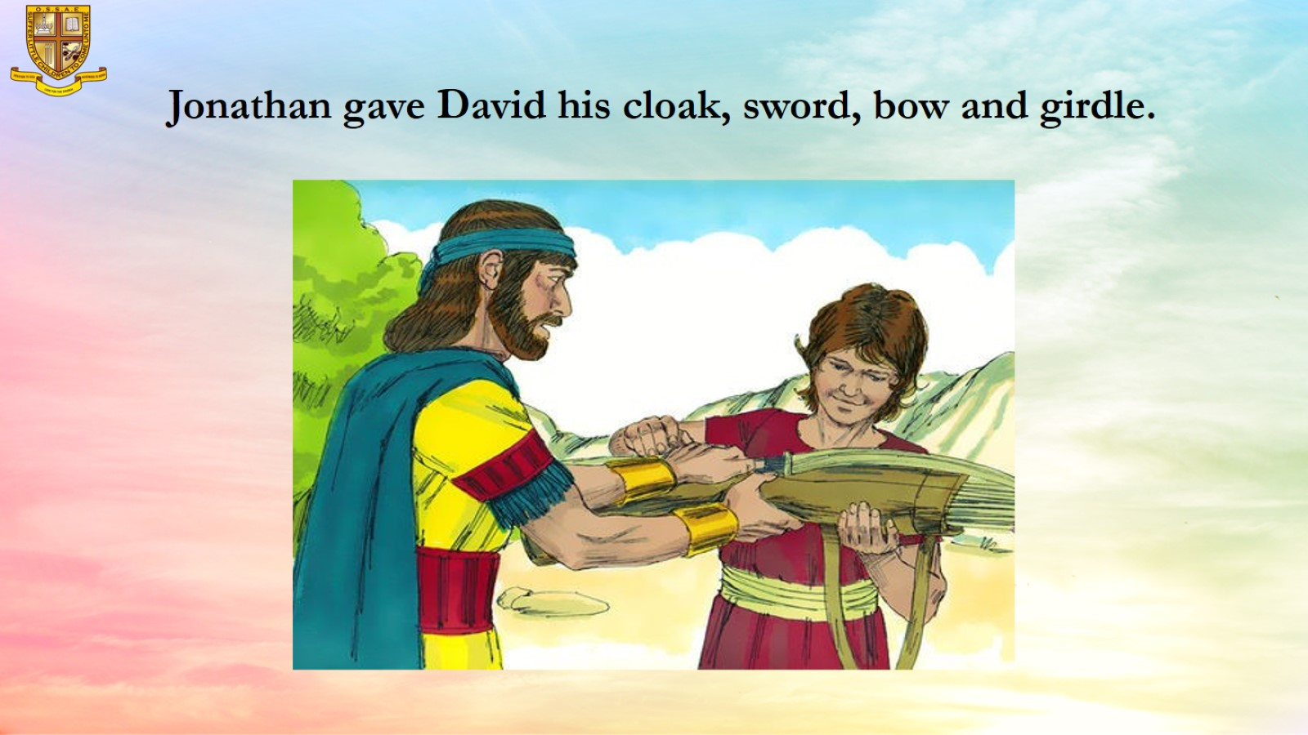
Jonathan gave David his cloak, sword, bow and girdle.

Slide 14
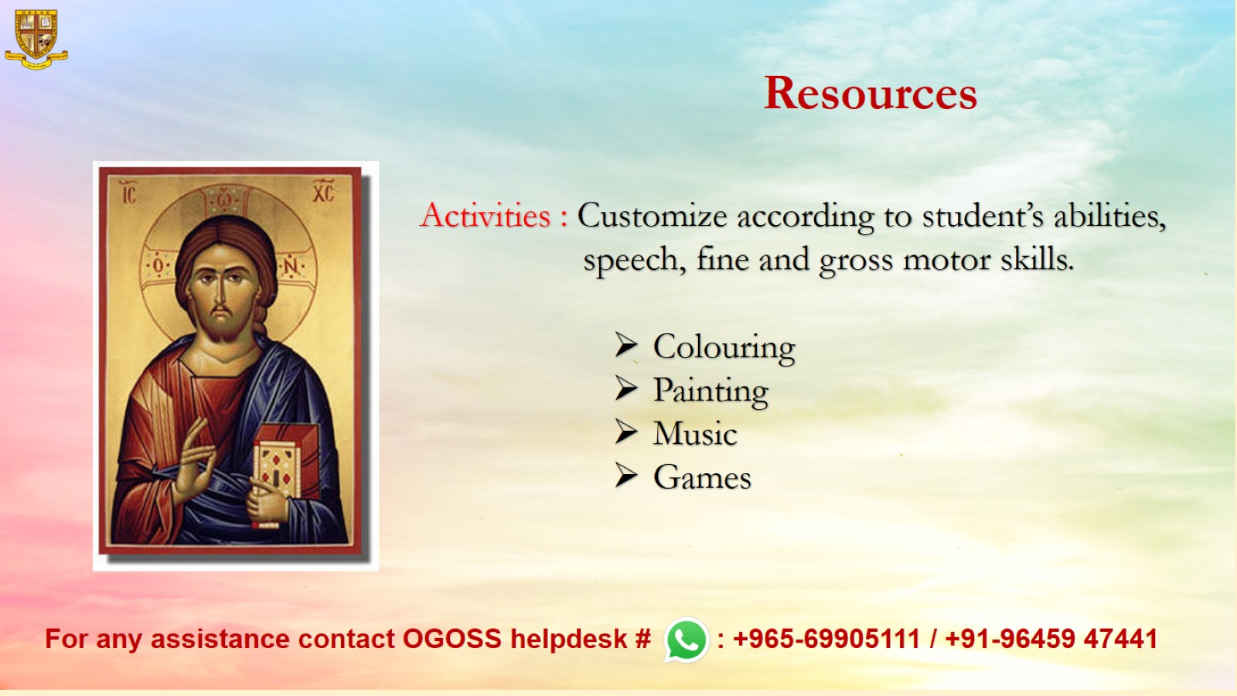
Resources

