Slide 1

Orthodox Global Online Sunday School (OGOSS)

Slide 2
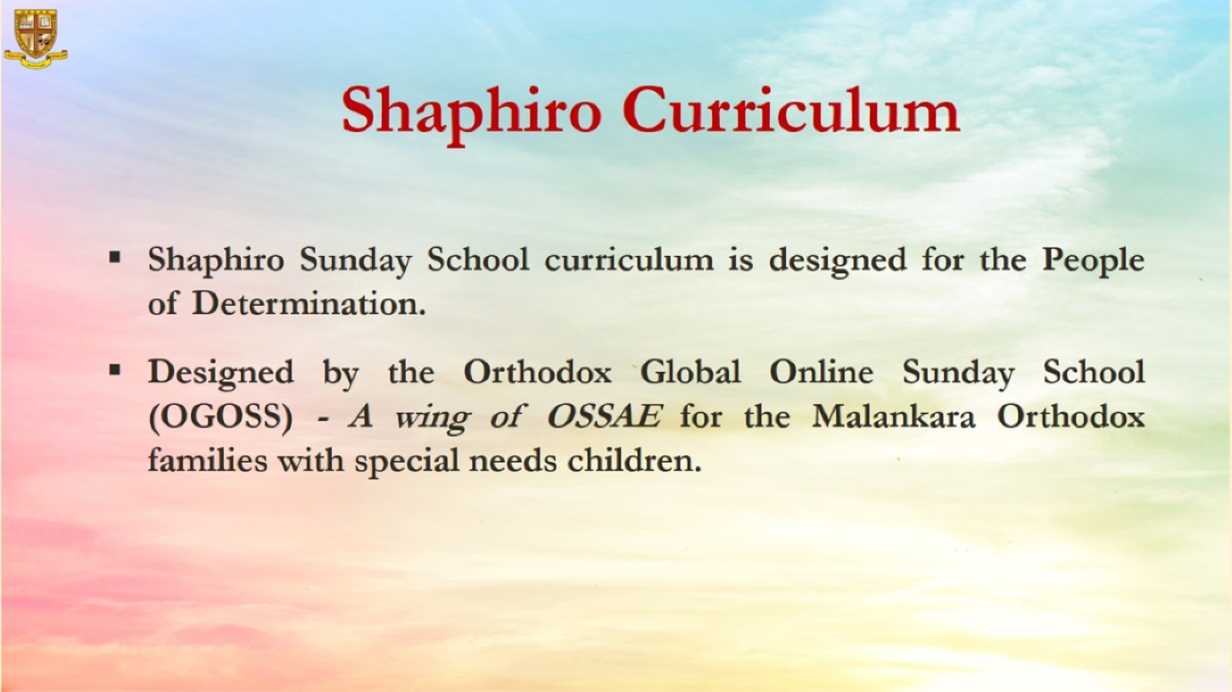

Slide 3


Slide 4
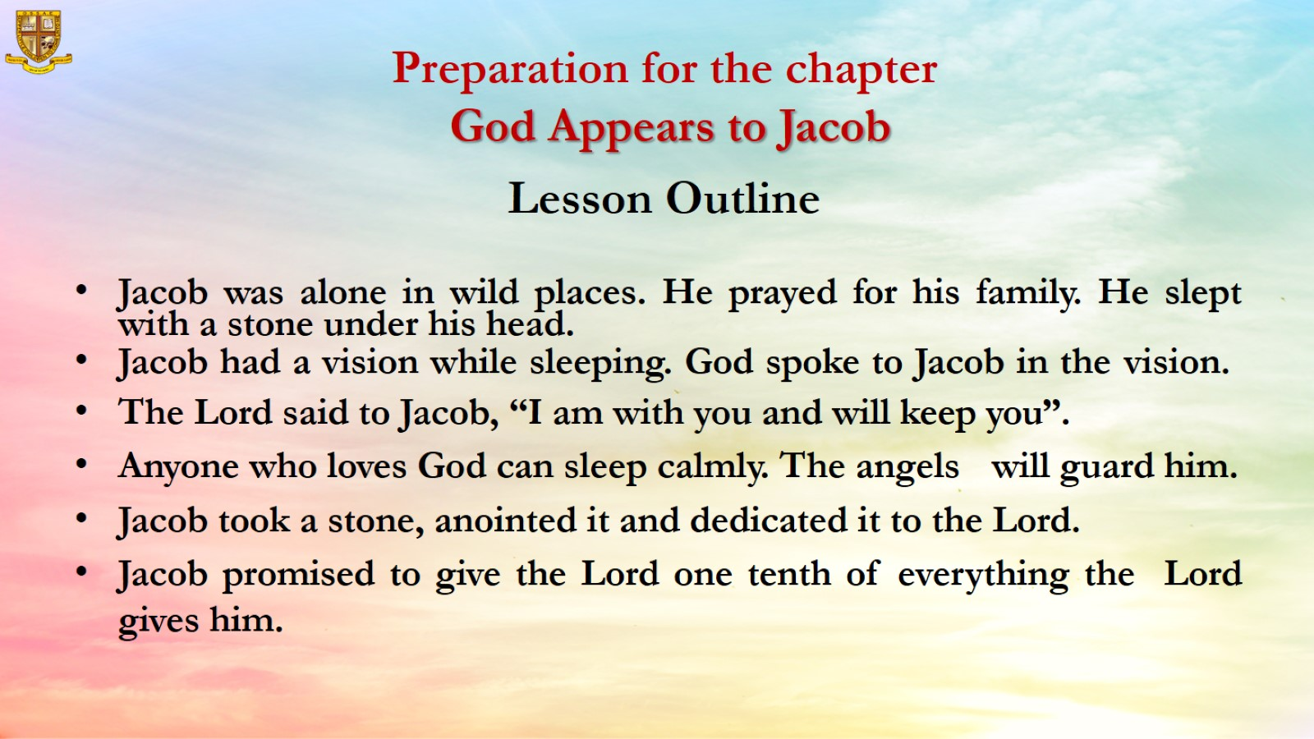
Preparation for the chapter
God Appears to Jacob

Slide 5
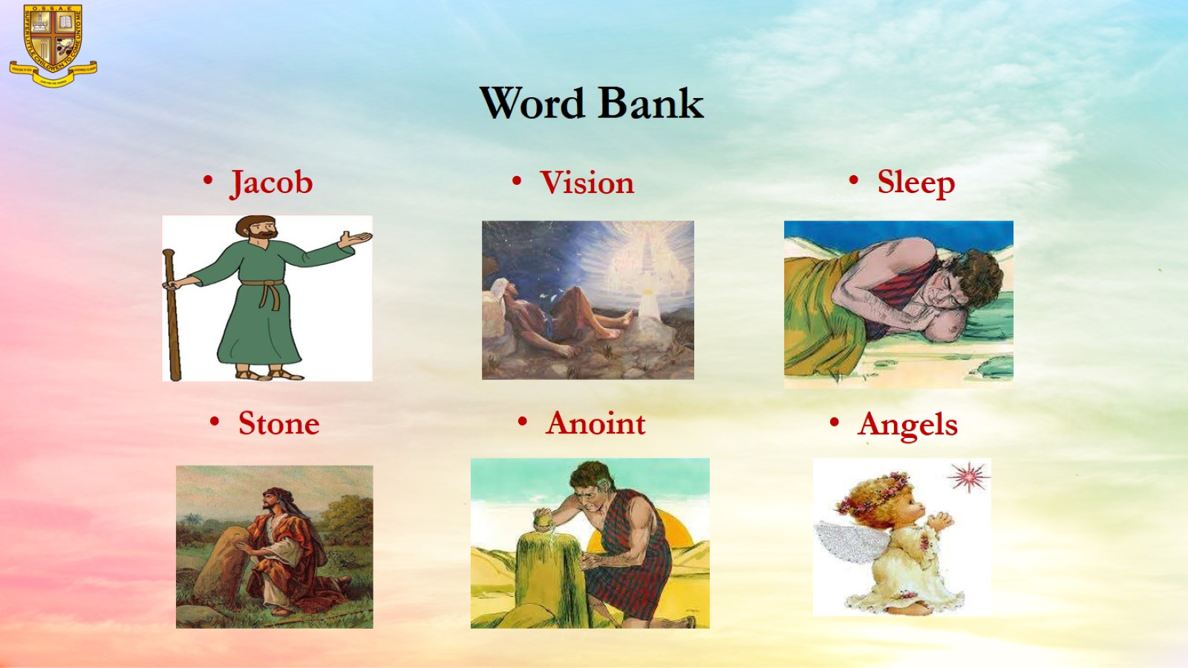
Word Bank

Slide 6
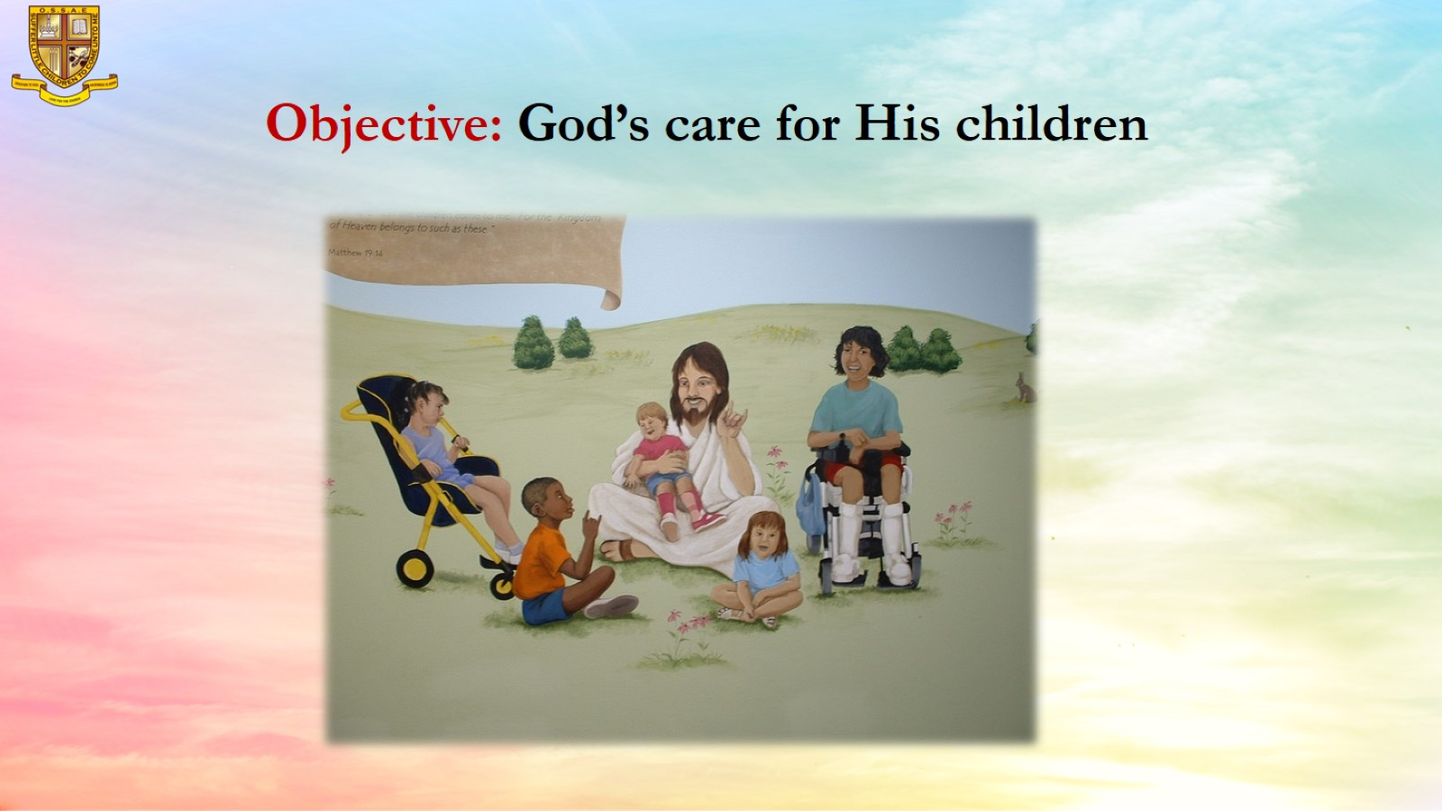
Objective: God’s care for His children

Slide 7
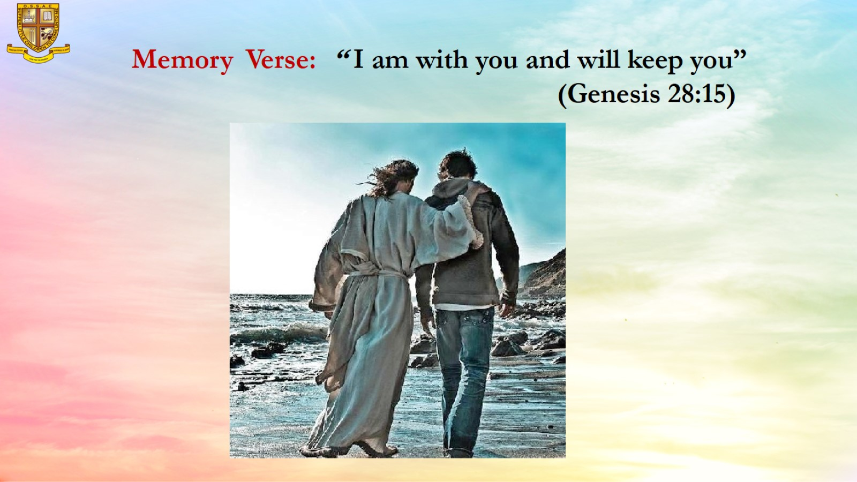
Memory Verse: “ I am with you and will keep you”
(Genesis 28:15)

Slide 8
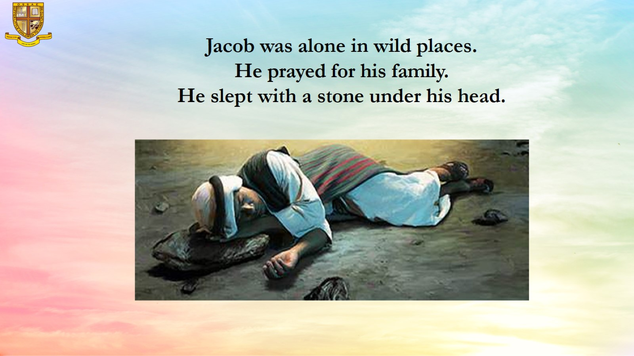
Jacob was alone in wild places.
He prayed for his family.
He slept with a stone under his head.

Slide 9
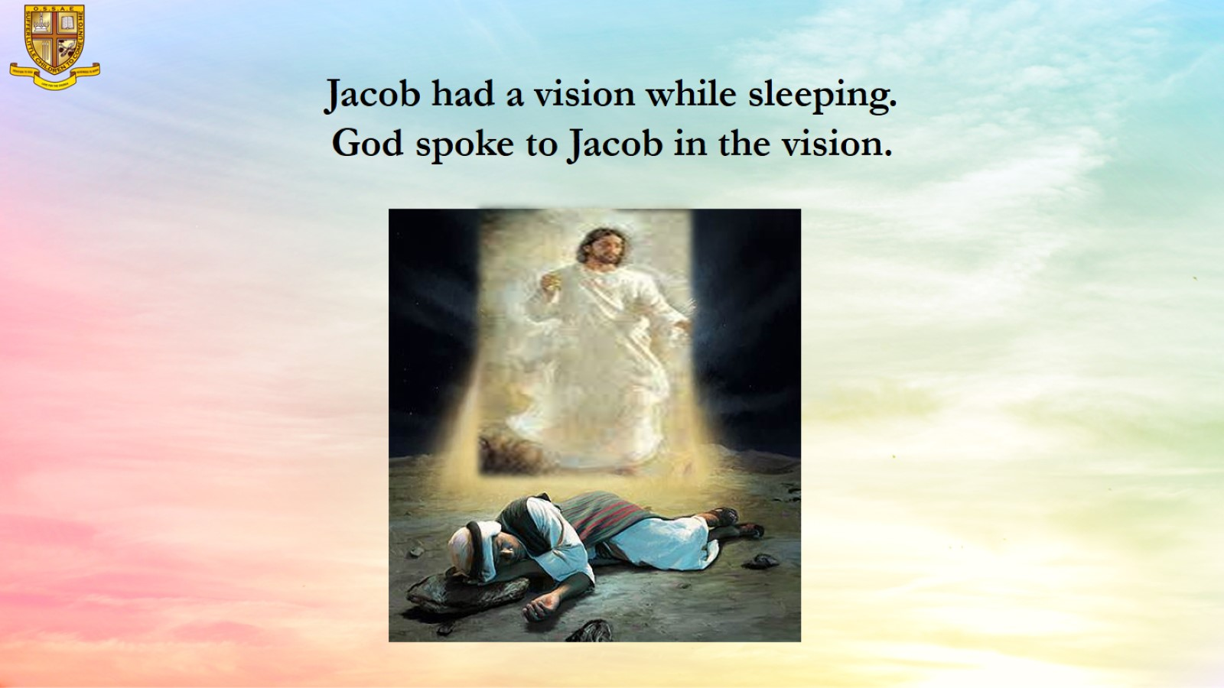

Slide 10
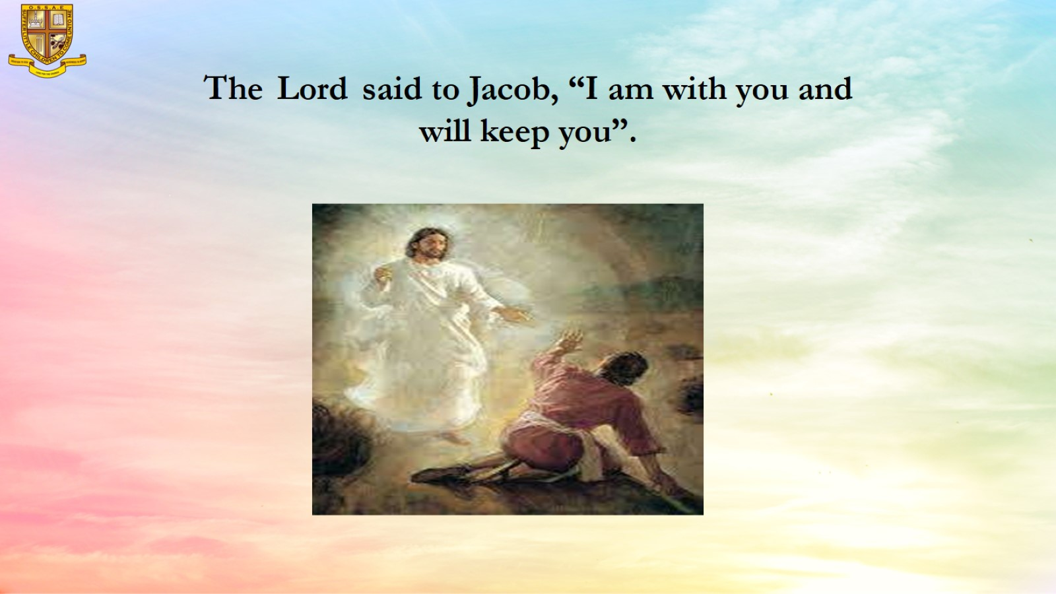
The Lord said to Jacob, “I am with you and will keep you”.

Slide 11
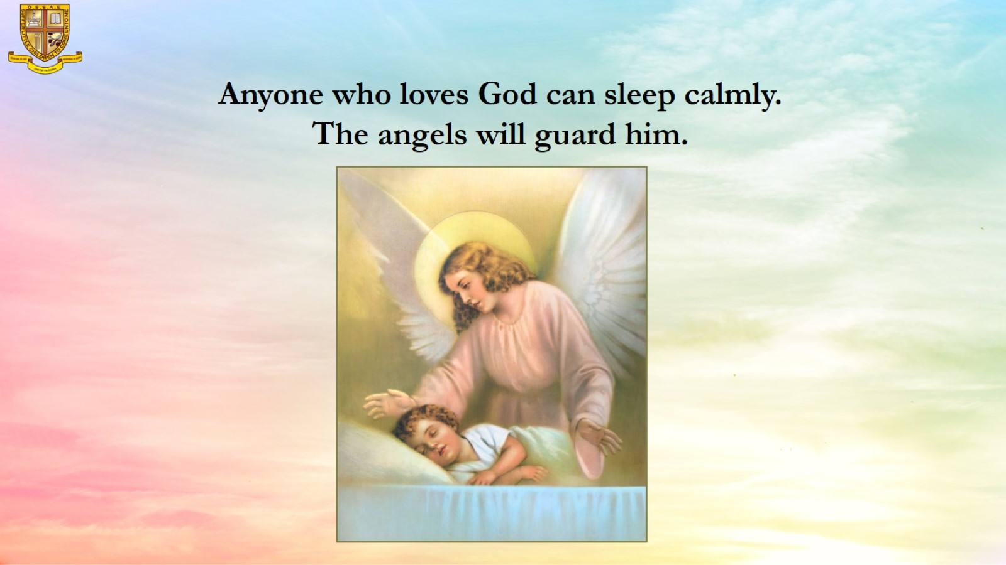
Anyone who loves God can sleep calmly. The angels will guard him.

Slide 12
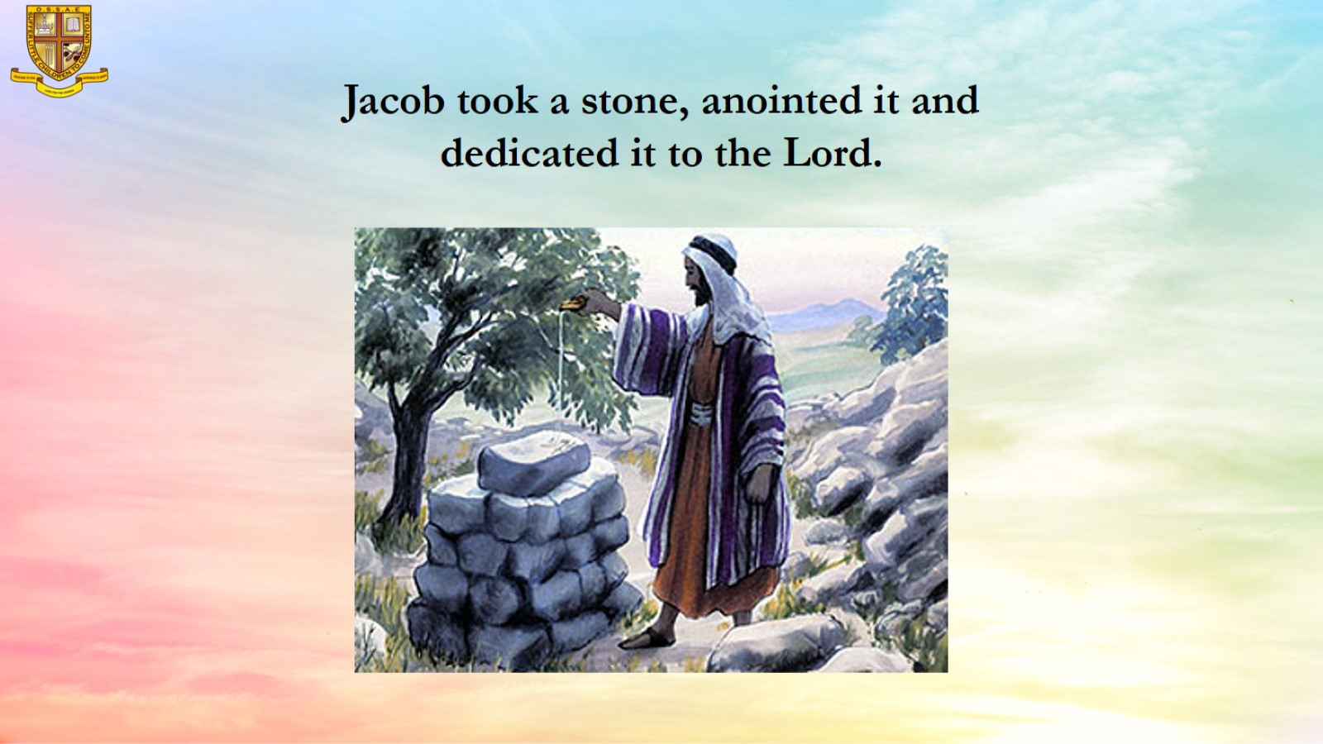
Jacob took a stone, anointed it and dedicated it to the Lord.

Slide 13
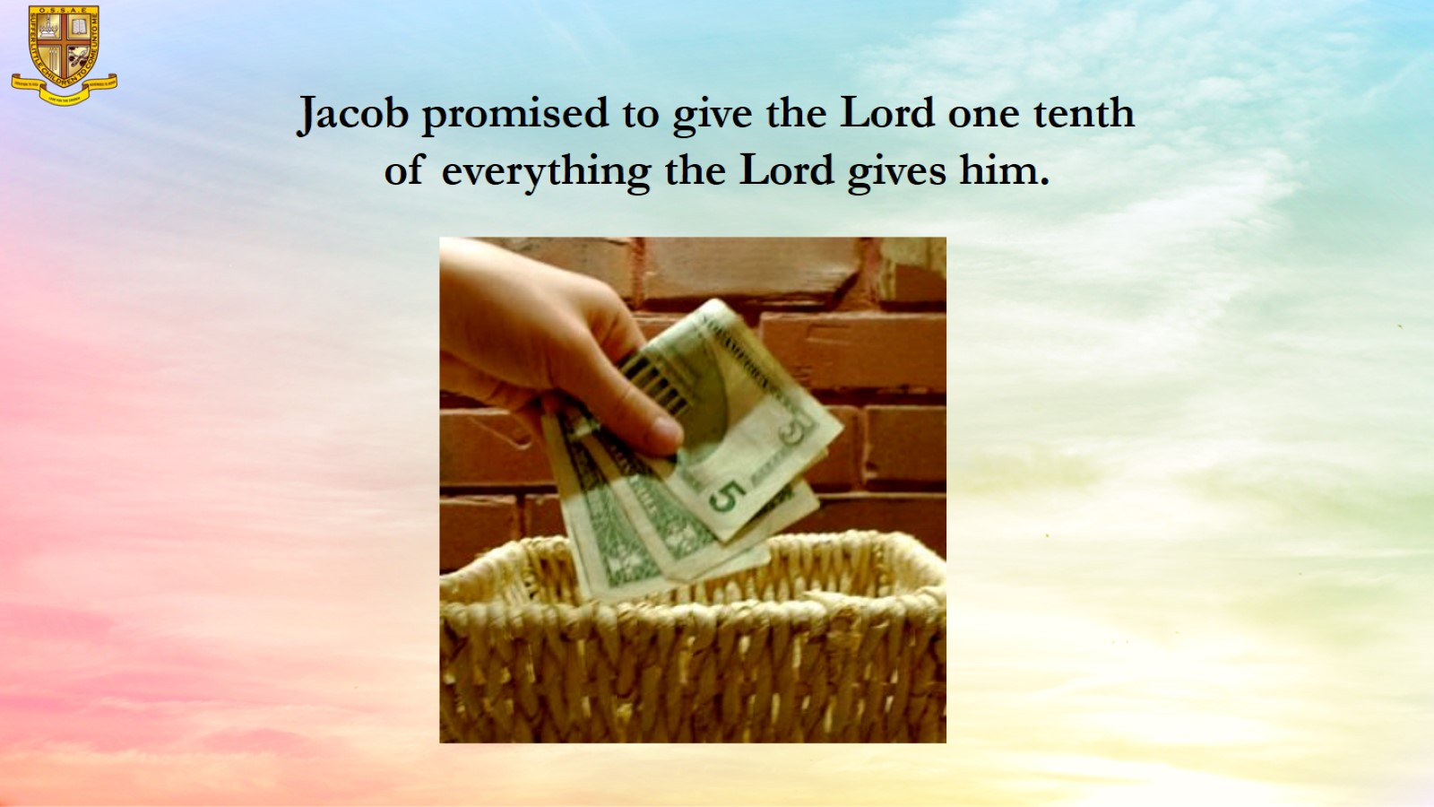
Jacob promised to give the Lord one tenth of everything the Lord gives him.

Slide 14
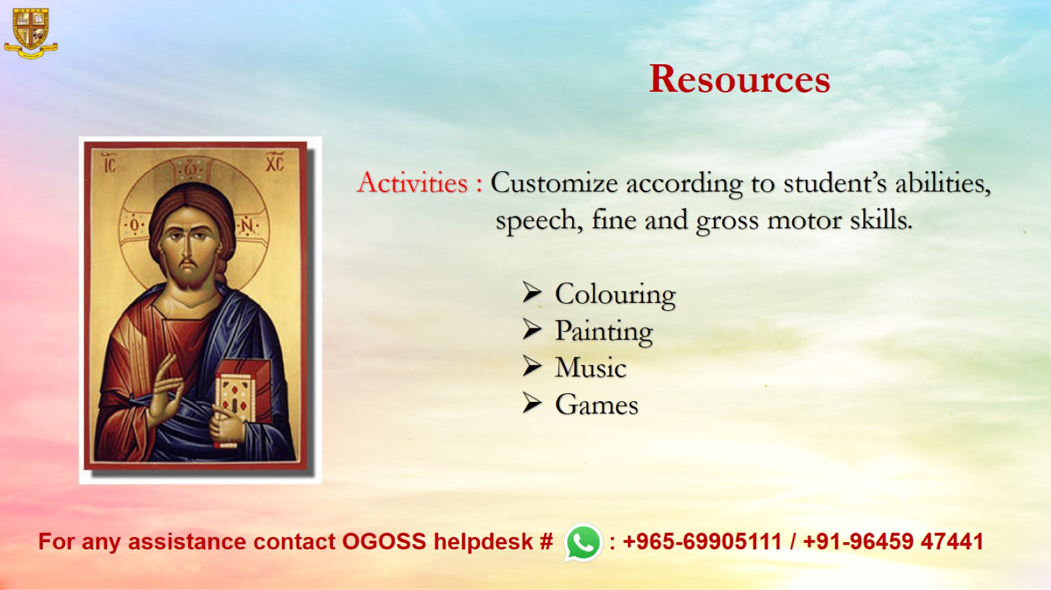
Resources

