Slide 1

Orthodox Global Online Sunday School (OGOSS)

Slide 2
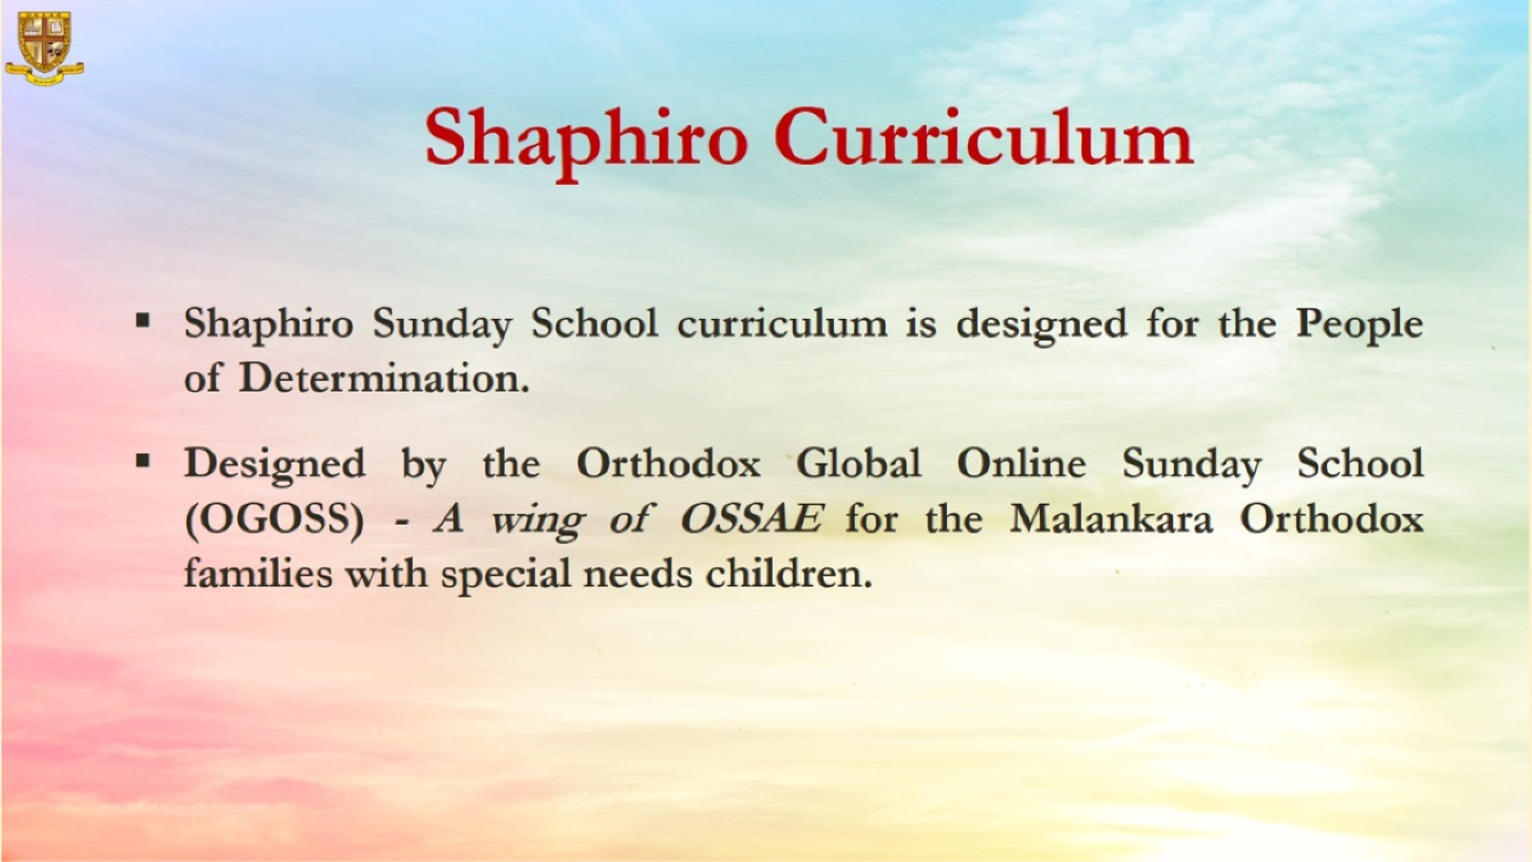

Slide 3


Slide 4
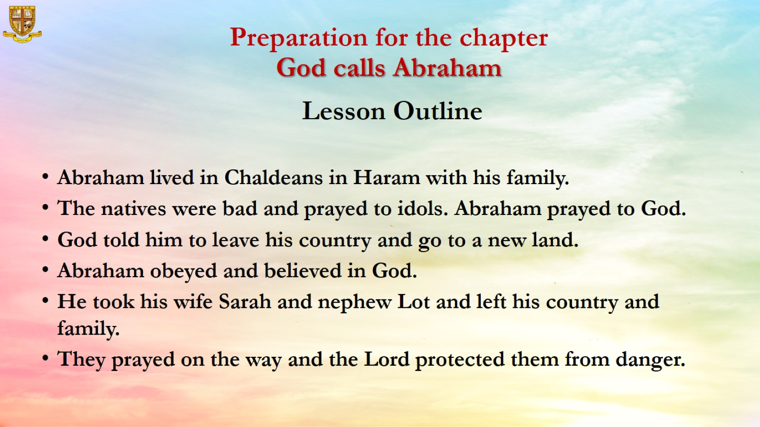
Preparation for the chapter
God calls Abraham
Lesson Outline

Slide 5
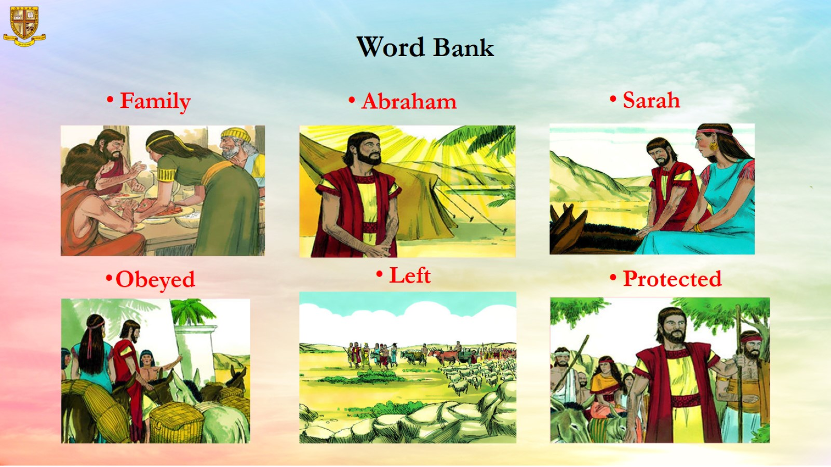
Word Bank

Slide 6
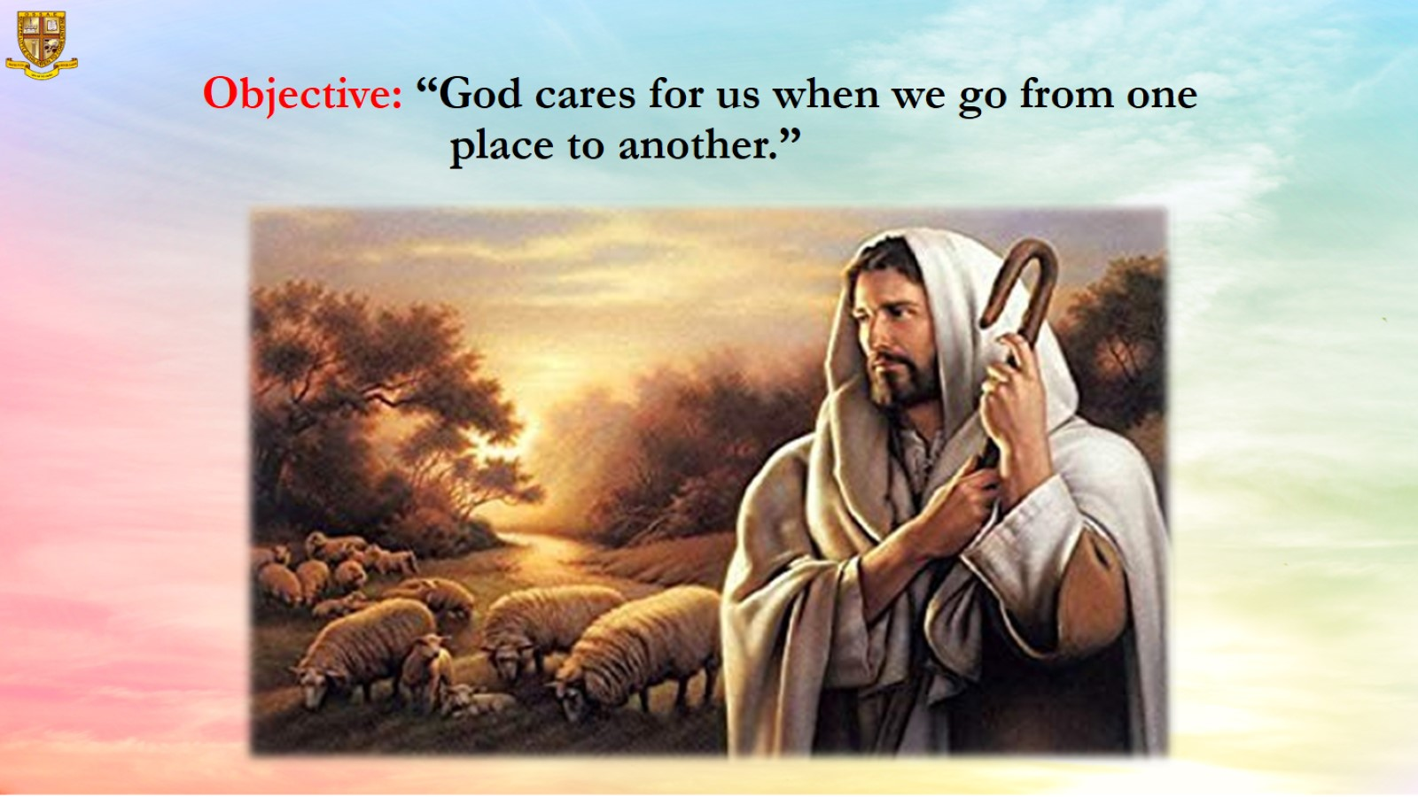
Objective: “God cares for us when we go from one place to another.”

Slide 7

Memory Verse: “Have faith in God” (St. Mark 11:22)

Slide 8
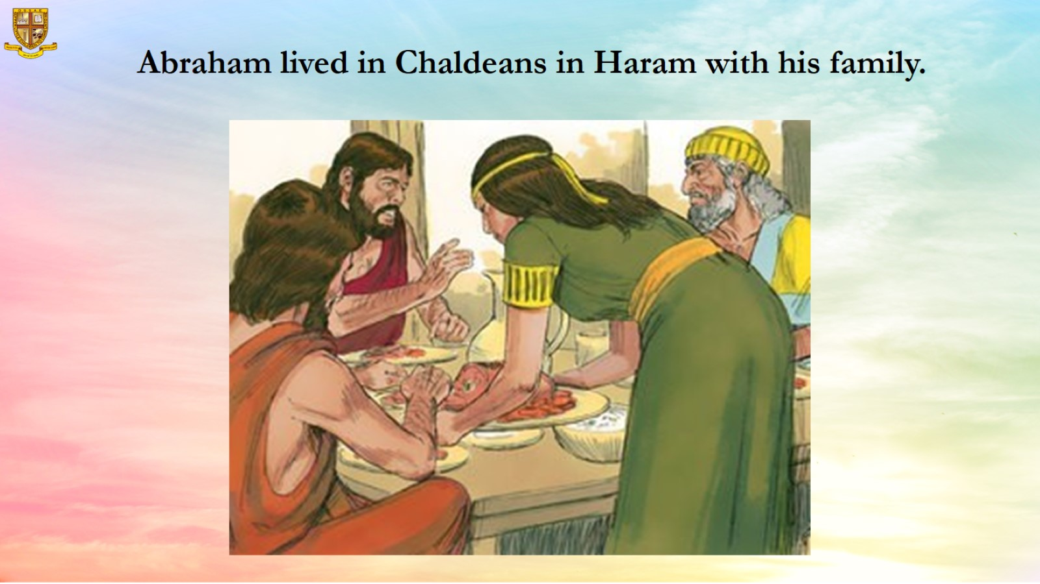
Abraham lived in Chaldeans in Haram with his family.

Slide 9
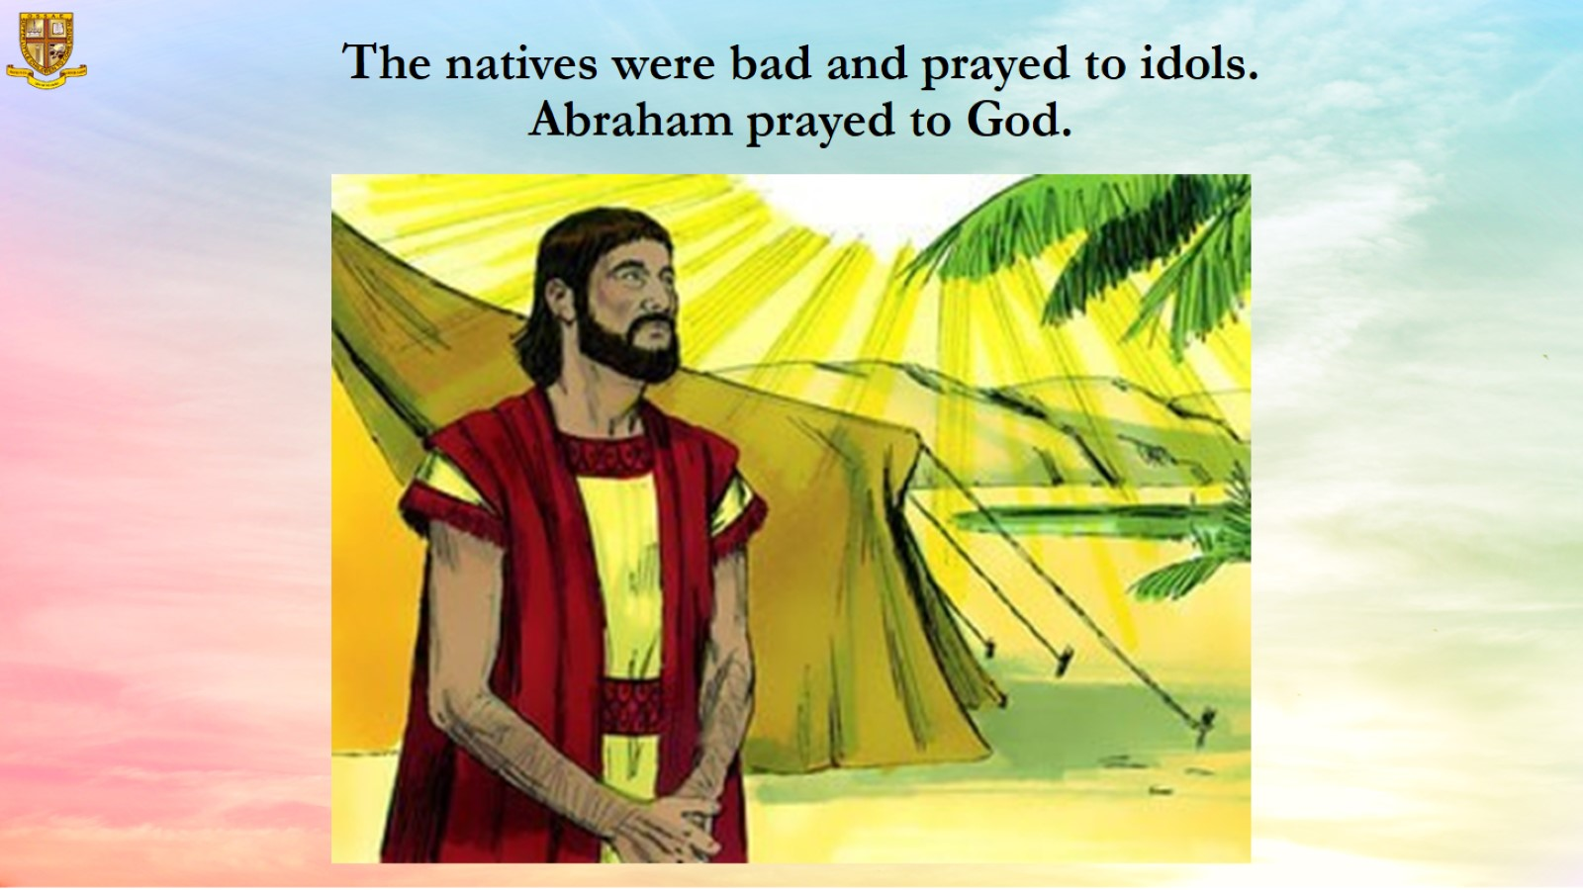
The natives were bad and prayed to idols.
Abraham prayed to God.

Slide 10
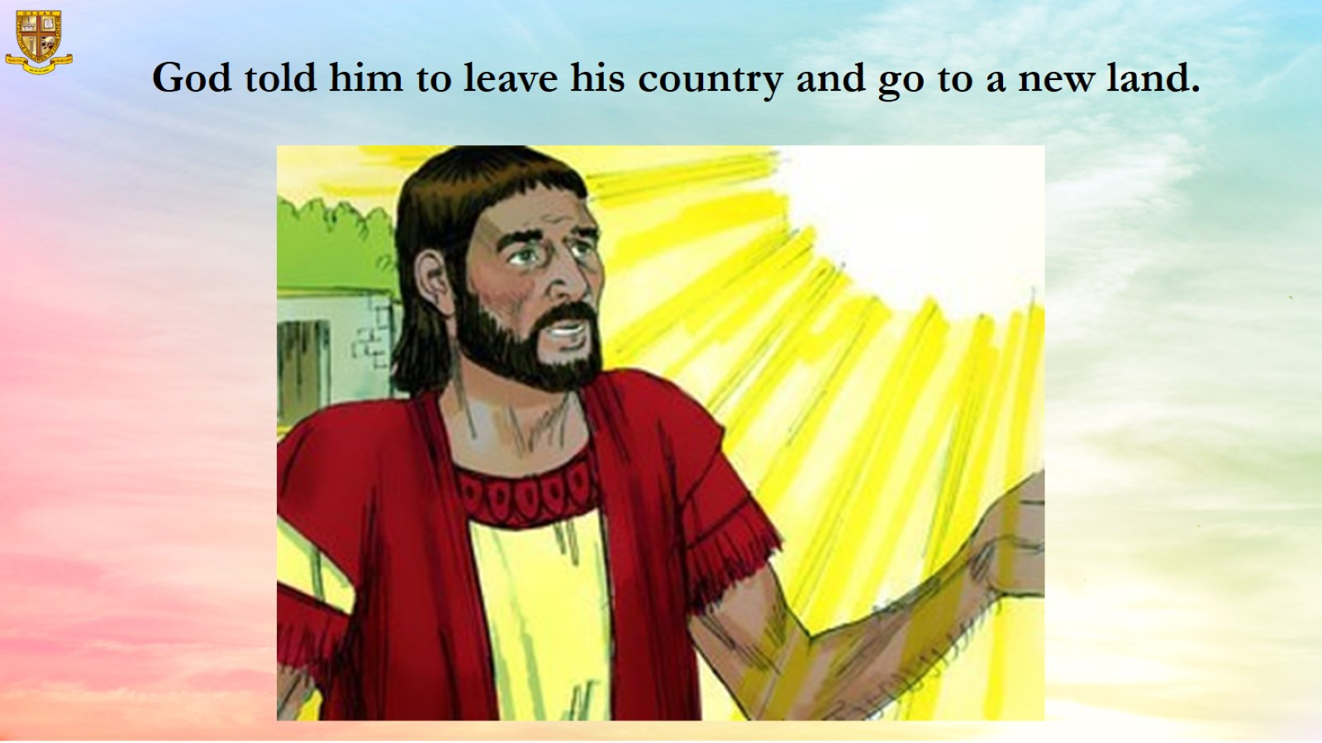
God told him to leave his country and go to a new land.

Slide 11
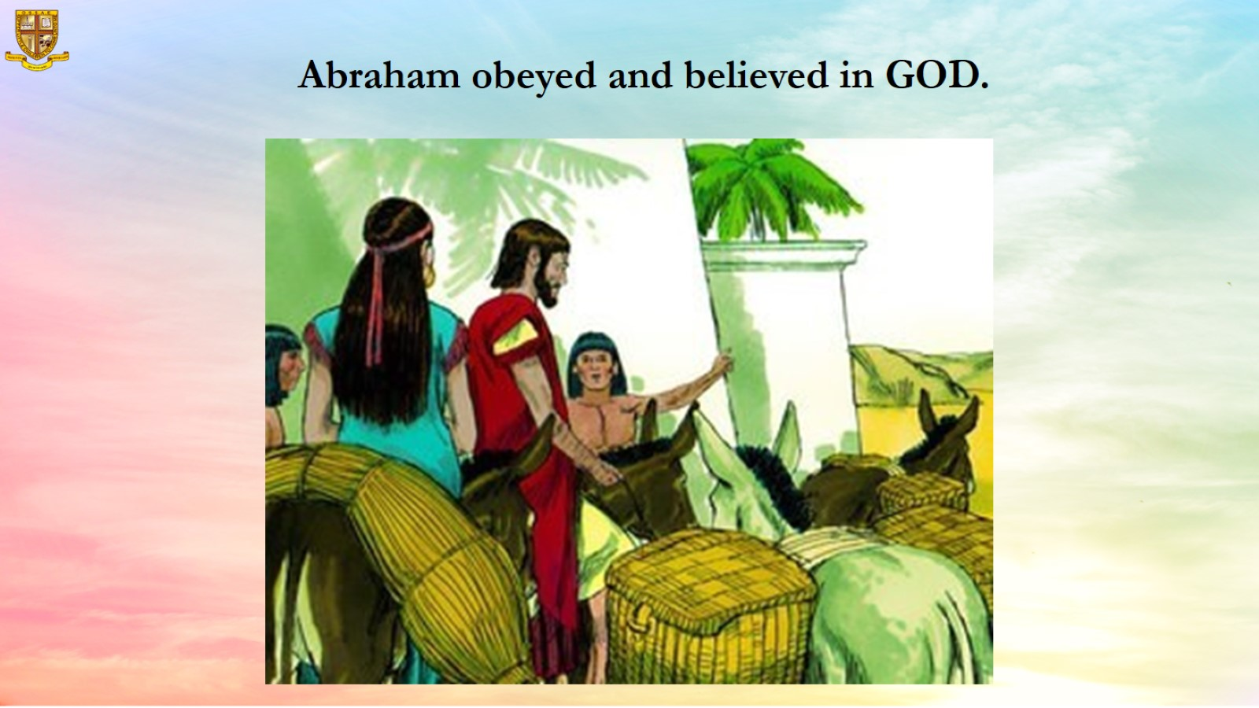
Abraham obeyed and believed in GOD.

Slide 12
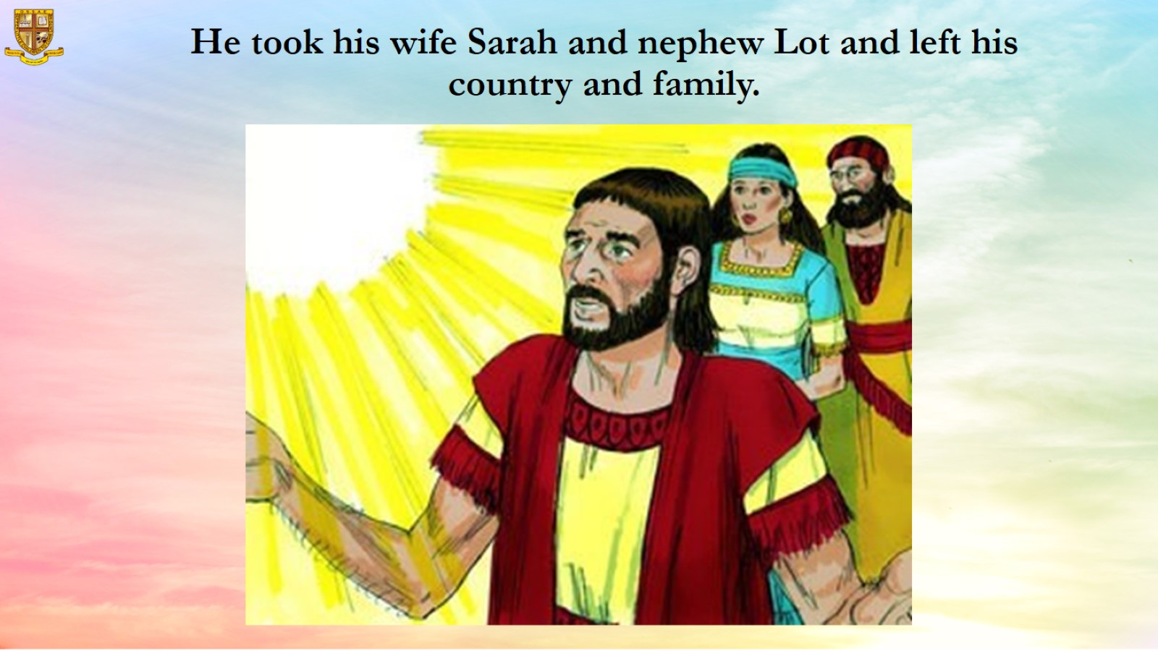
He took his wife Sarah and nephew Lot and left his country and family.

Slide 13
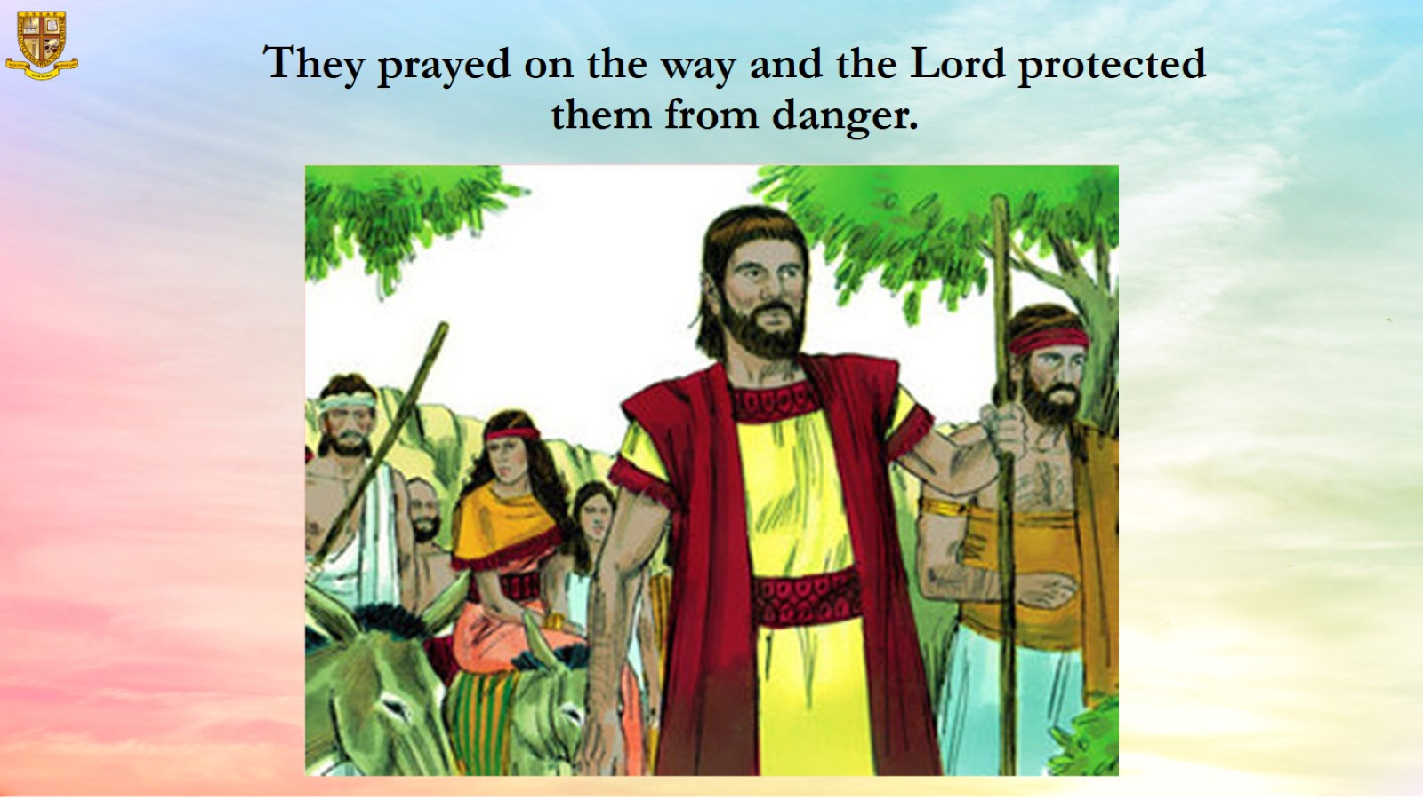
They prayed on the way and the Lord protected them from danger.

Slide 14
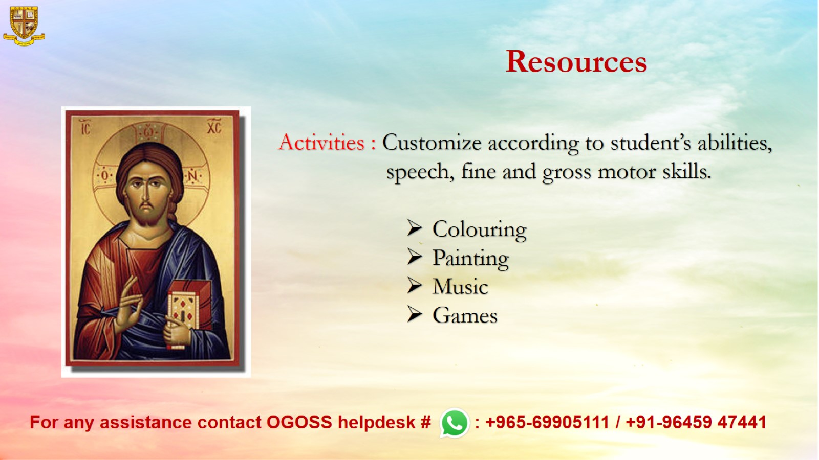
Resources

