Slide 1
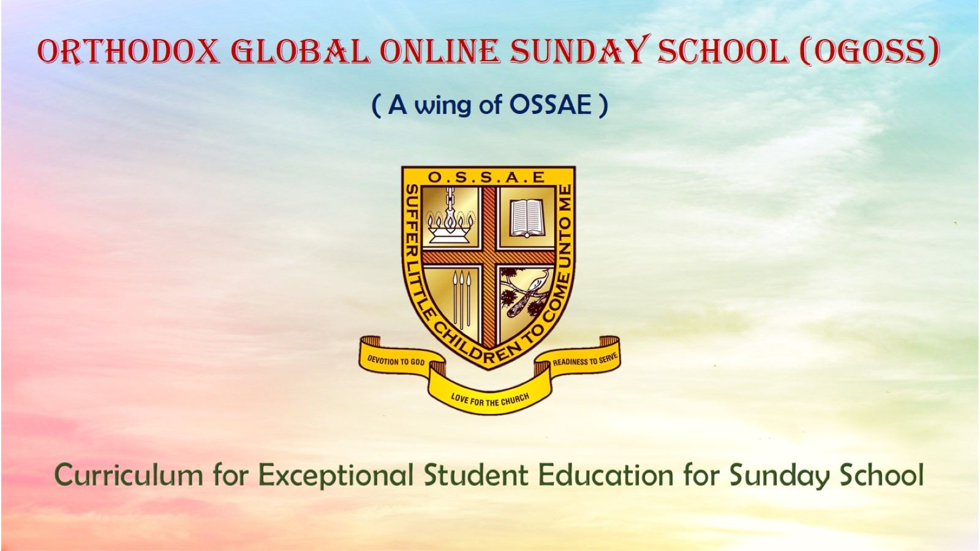
Orthodox Global Online Sunday School (OGOSS)

Slide 2
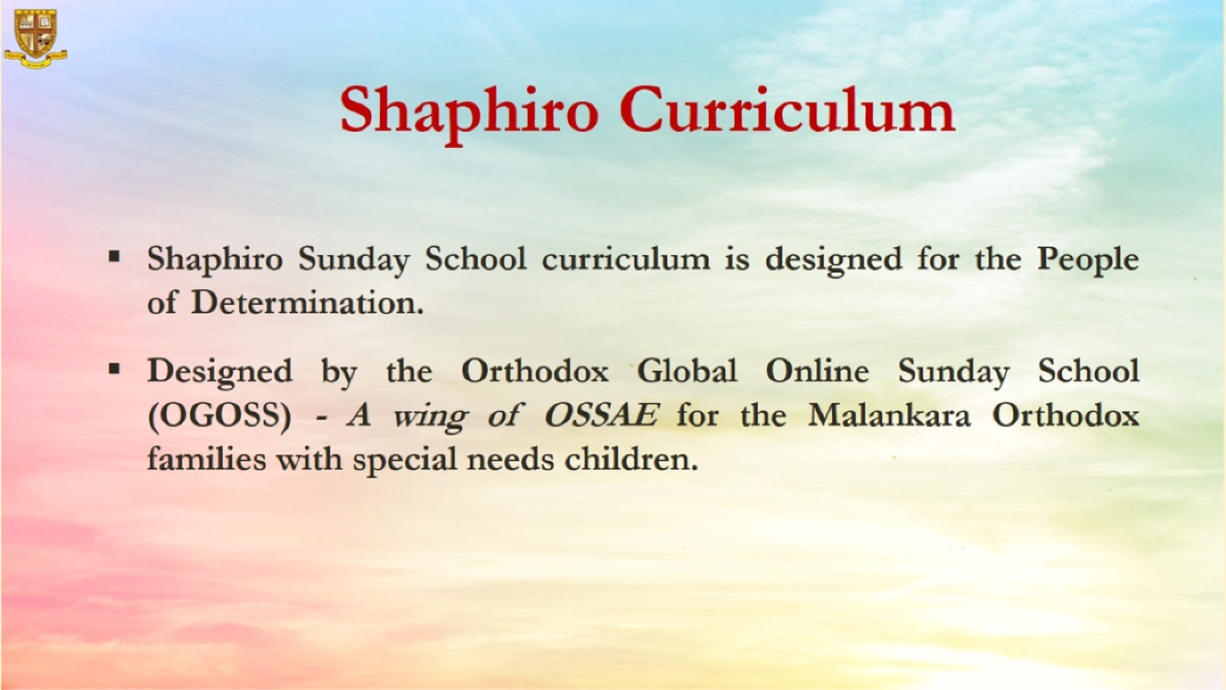

Slide 3
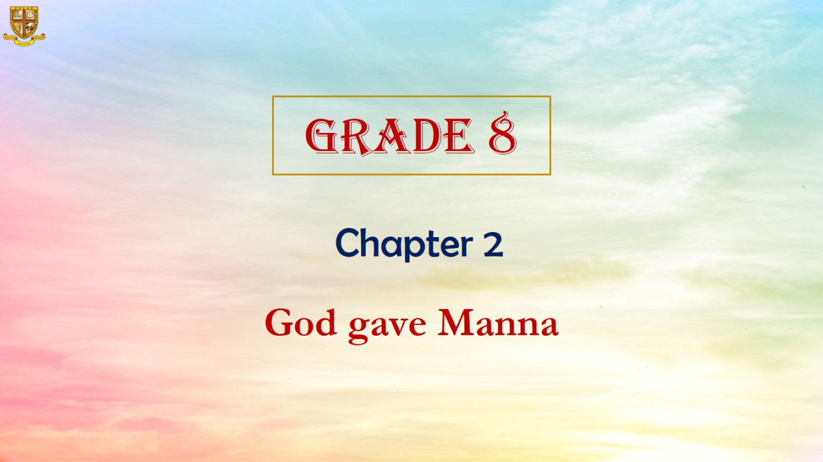

Slide 4
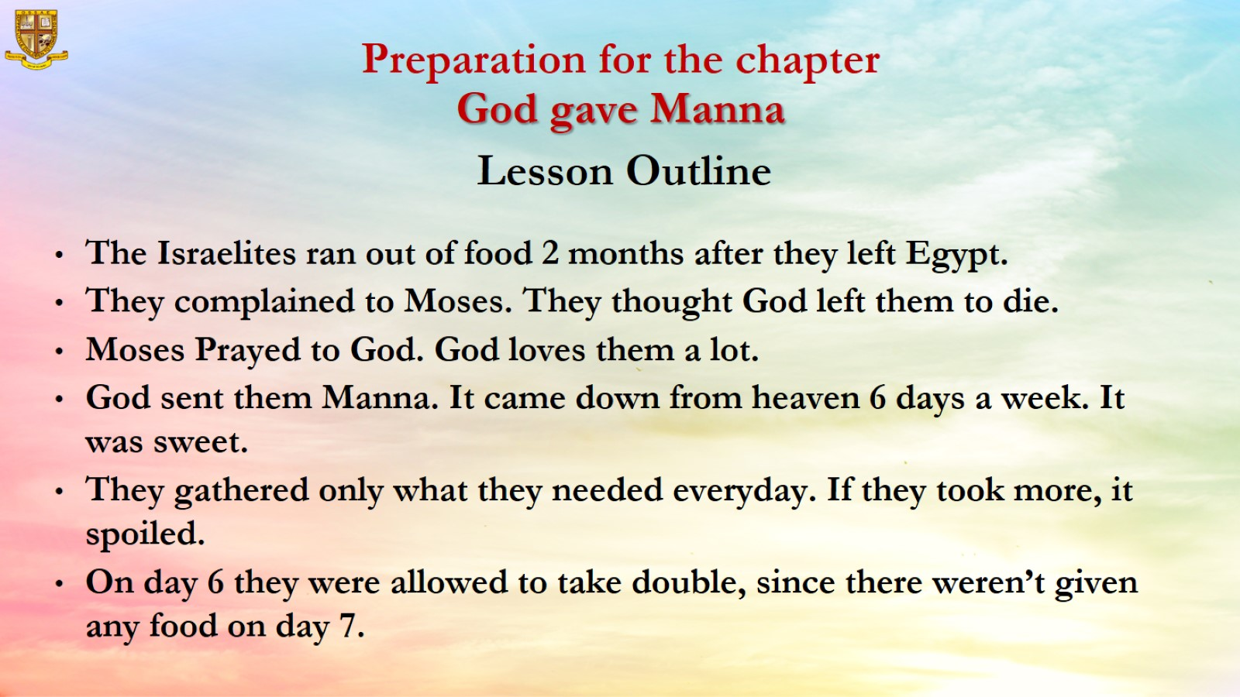

Slide 5
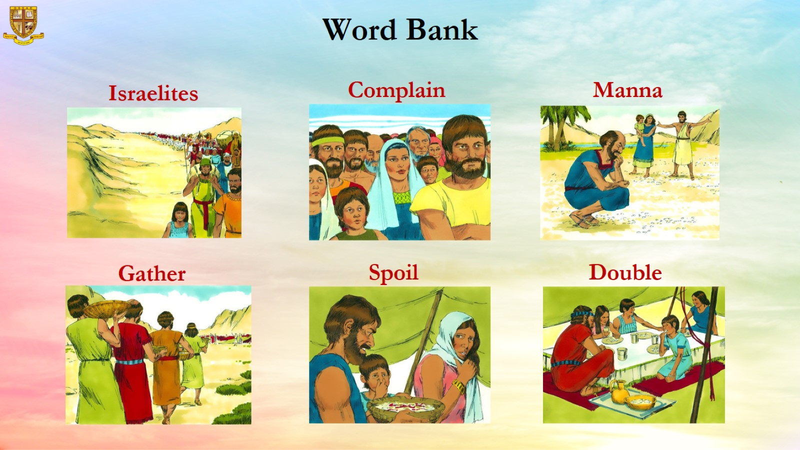

Slide 6
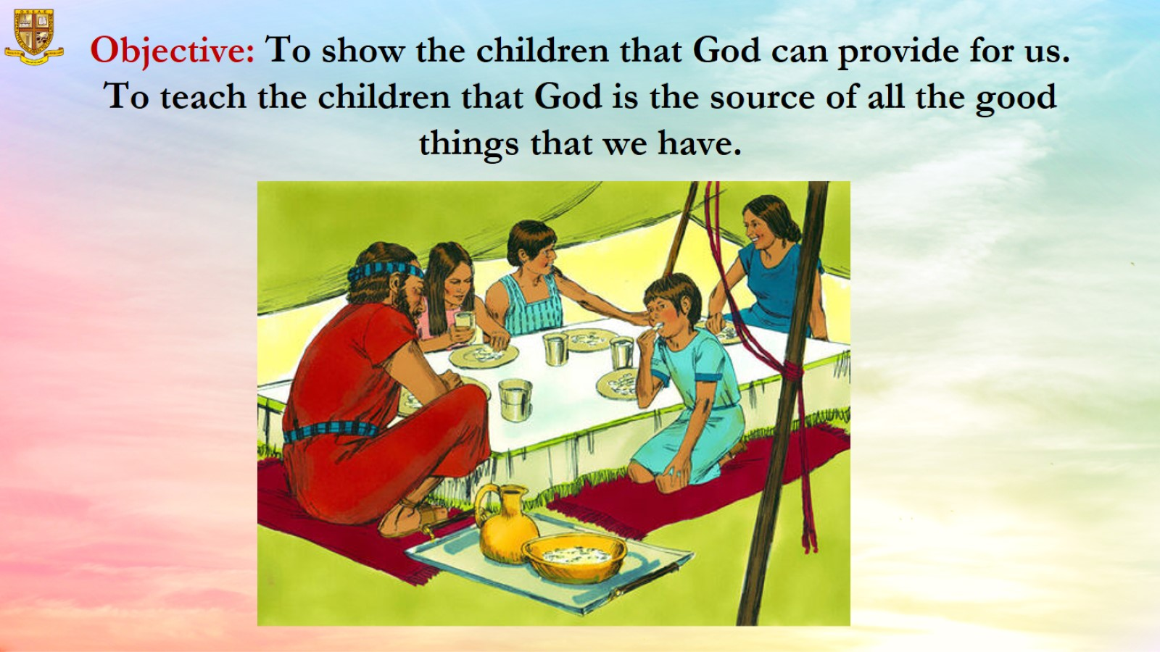
Objective: To show the children that God can provide for us. To teach the children that God is the source of all the good things that we have.

Slide 7
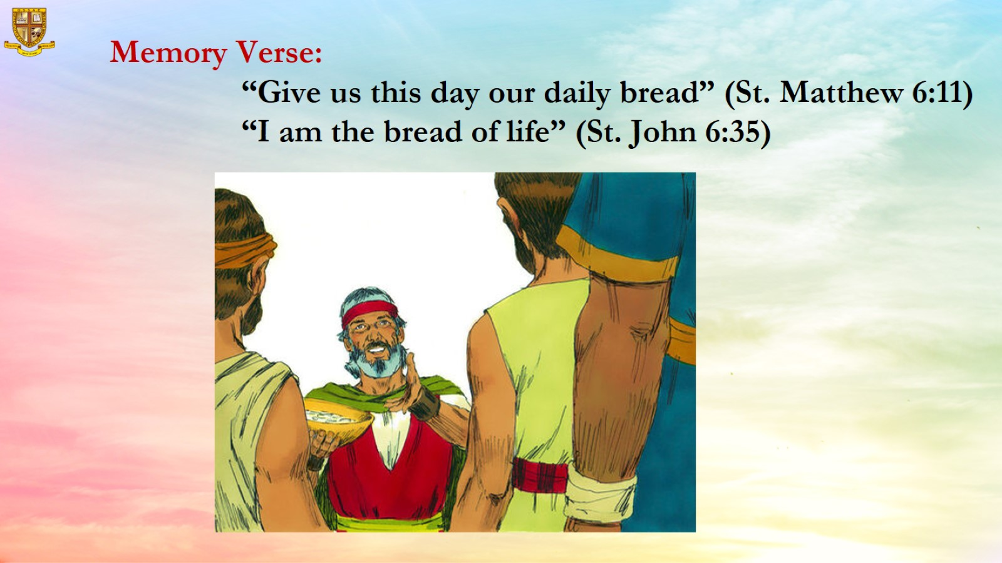
Memory Verse:
“Give us this day our daily bread” (St. Matthew 6:11)
“I am the bread of life” (St. John 6:35)

Slide 8
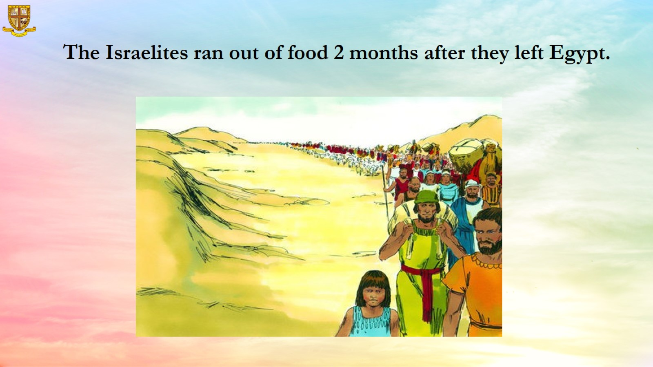
The Israelites ran out of food 2 months after they left Egypt.

Slide 9
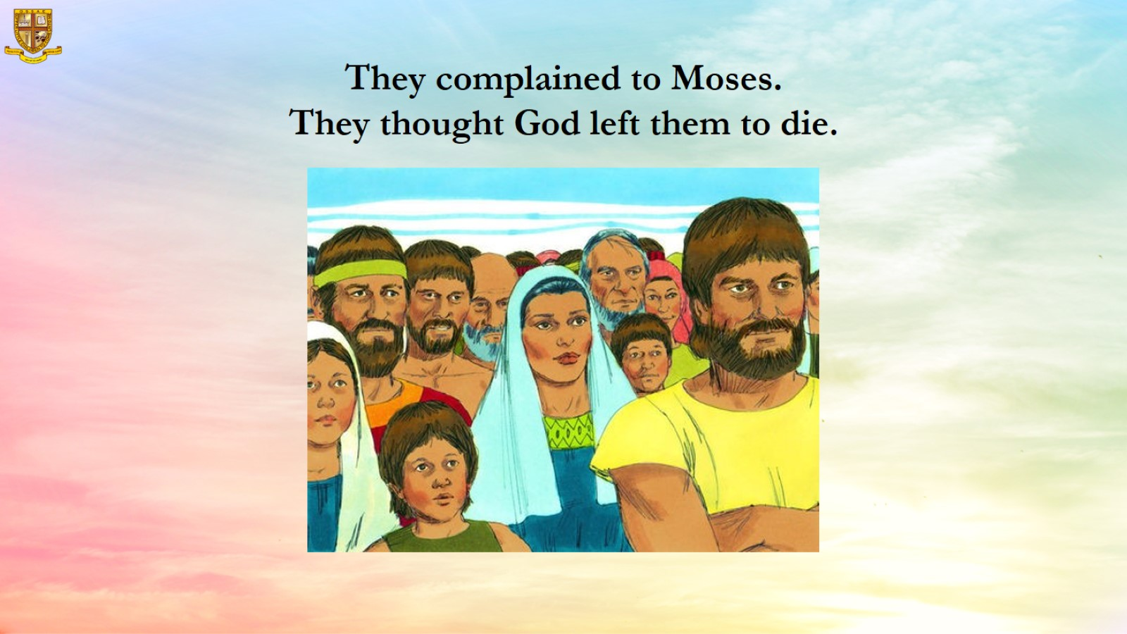

Slide 10
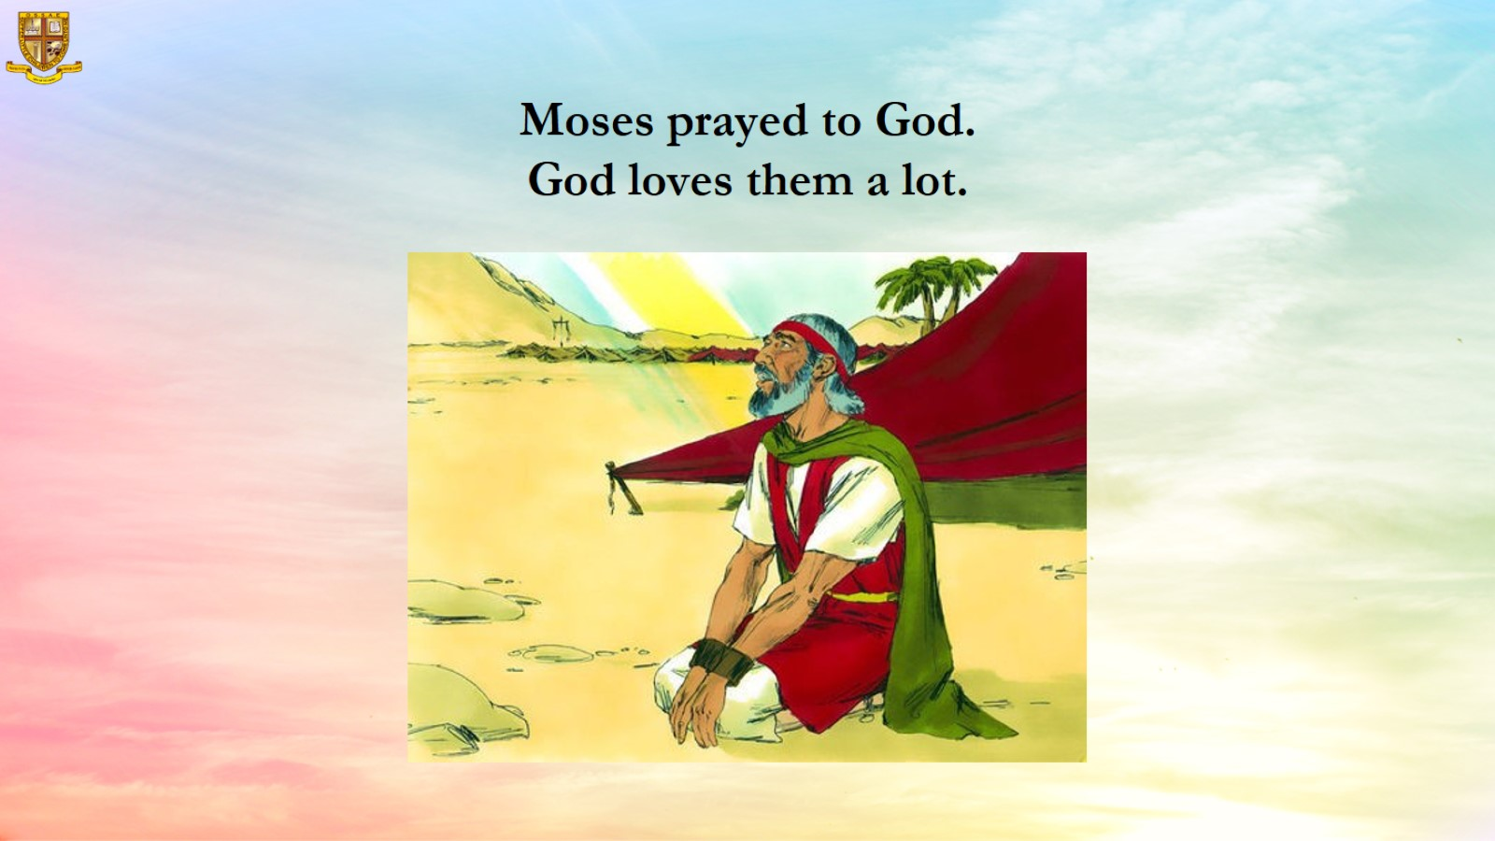

Slide 11
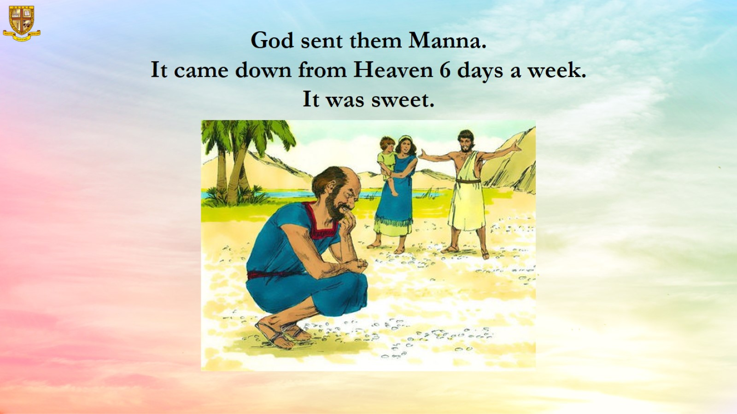
God sent them Manna.
It came down from Heaven 6 days a week.
It was sweet.

Slide 12
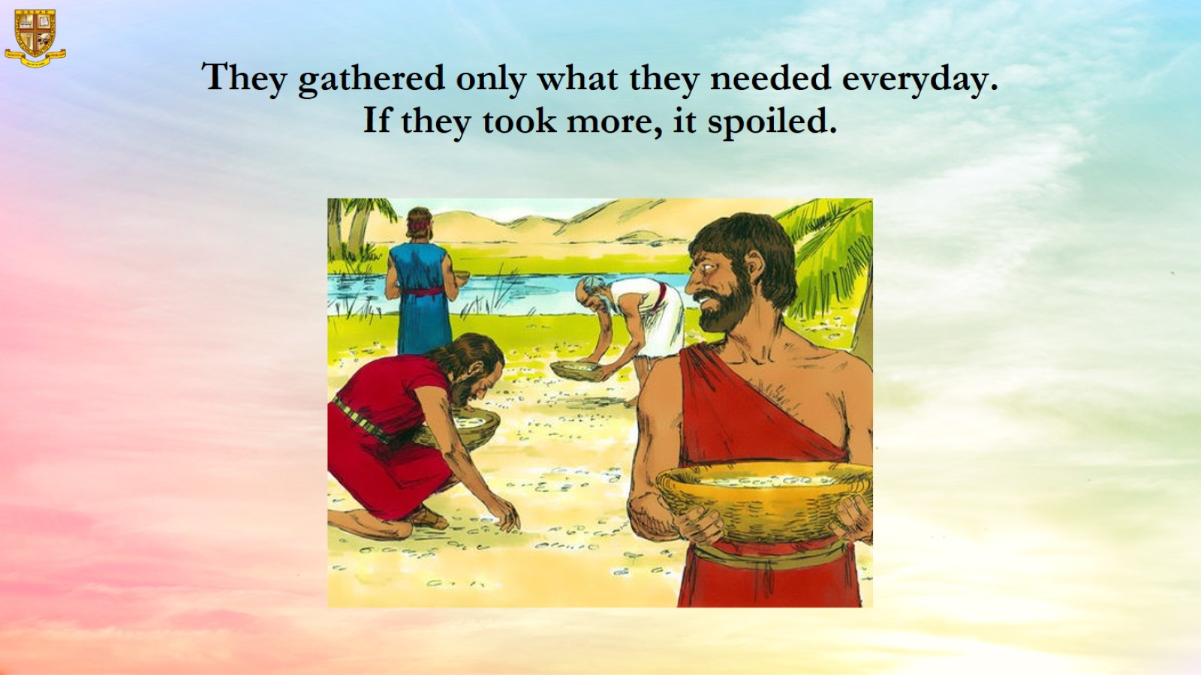

Slide 13
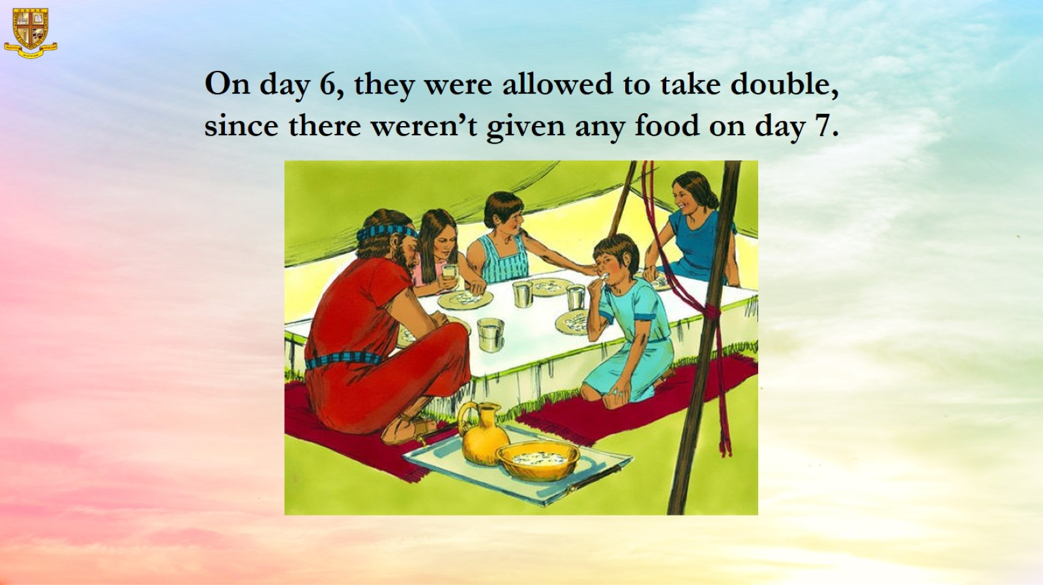
On day 6, they were allowed to take double, since there weren’t given any food on day 7.

Slide 14
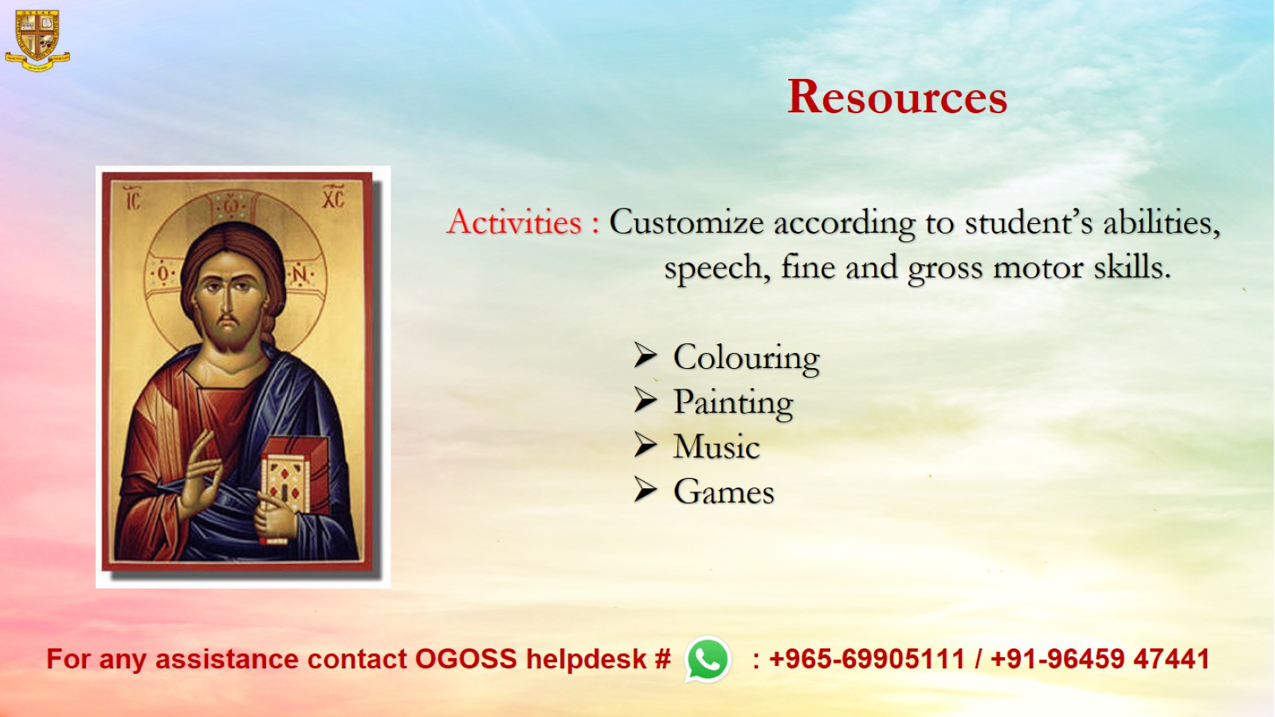
Resources

