Slide 1

Orthodox Global Online Sunday School (OGOSS)

Slide 2
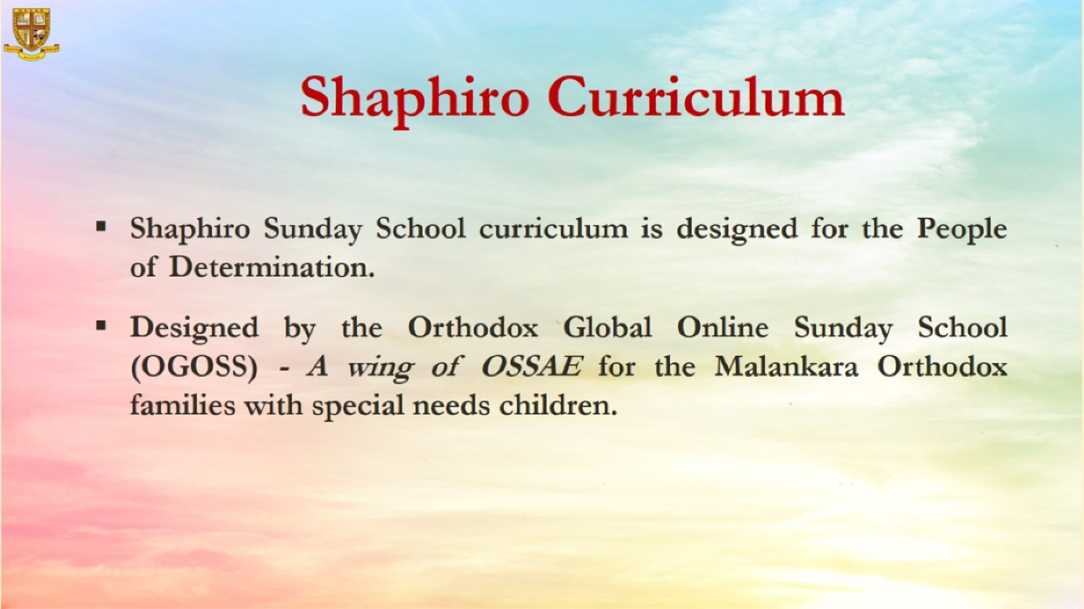

Slide 3
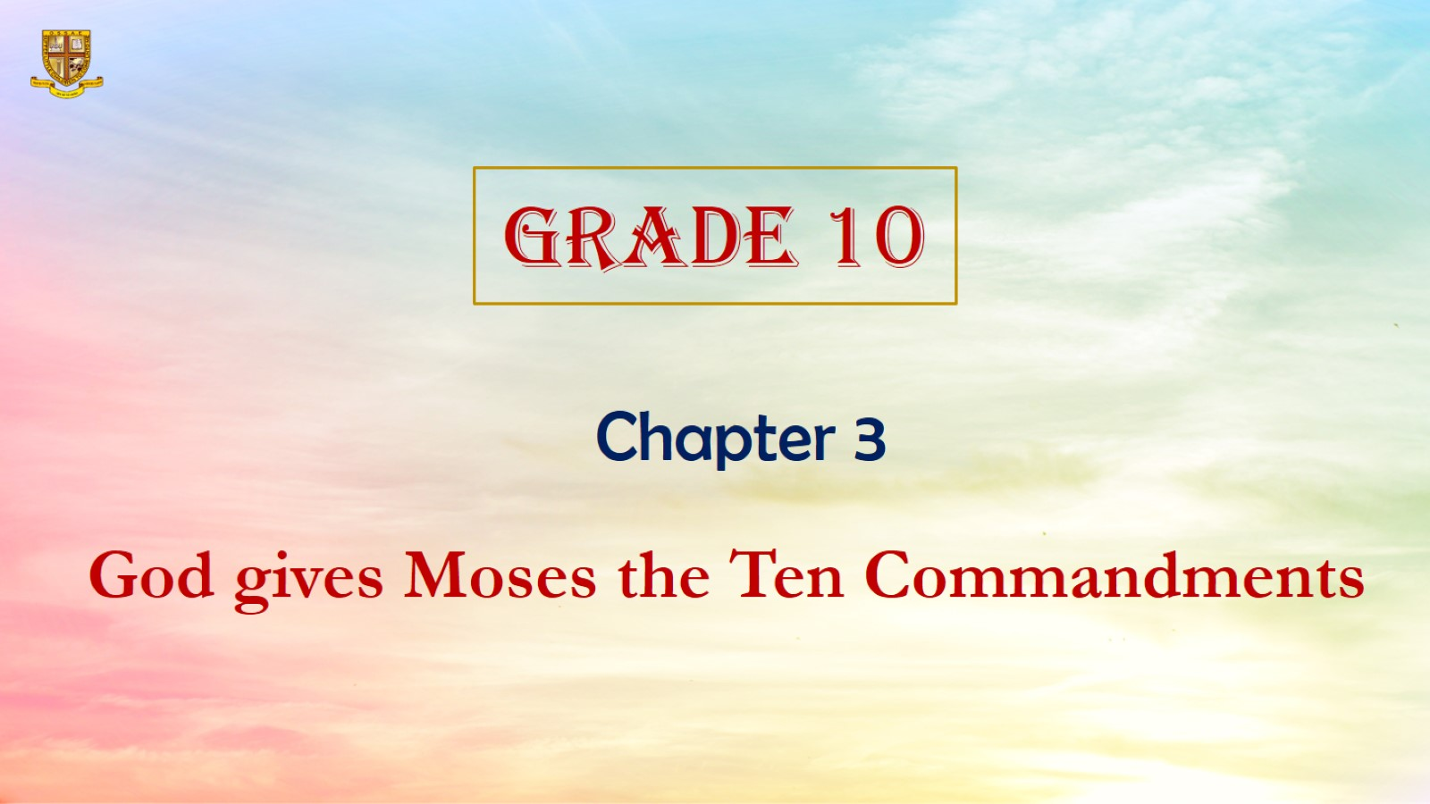

Slide 4
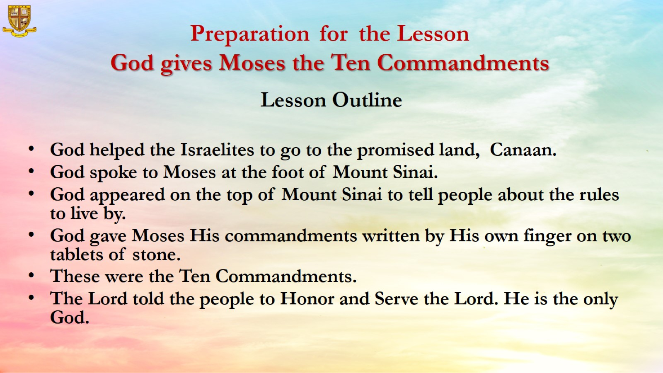
Preparation for the Lesson
God gives Moses the Ten Commandments

Slide 5
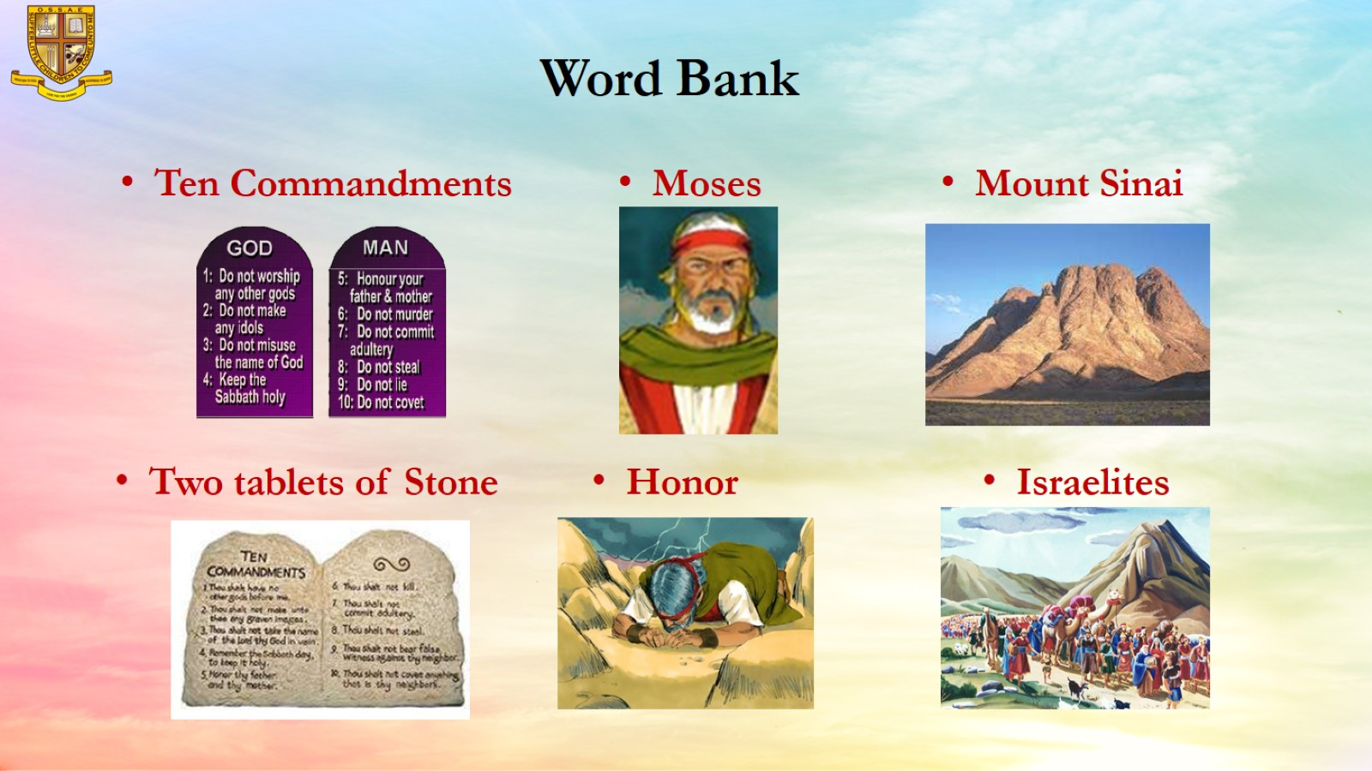
Word Bank

Slide 6
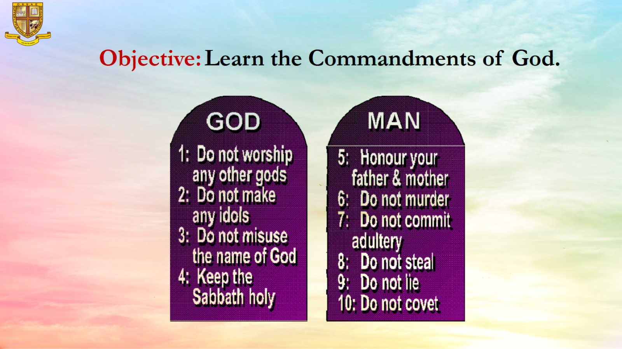
Objective: Learn the Commandments of God.

Slide 7
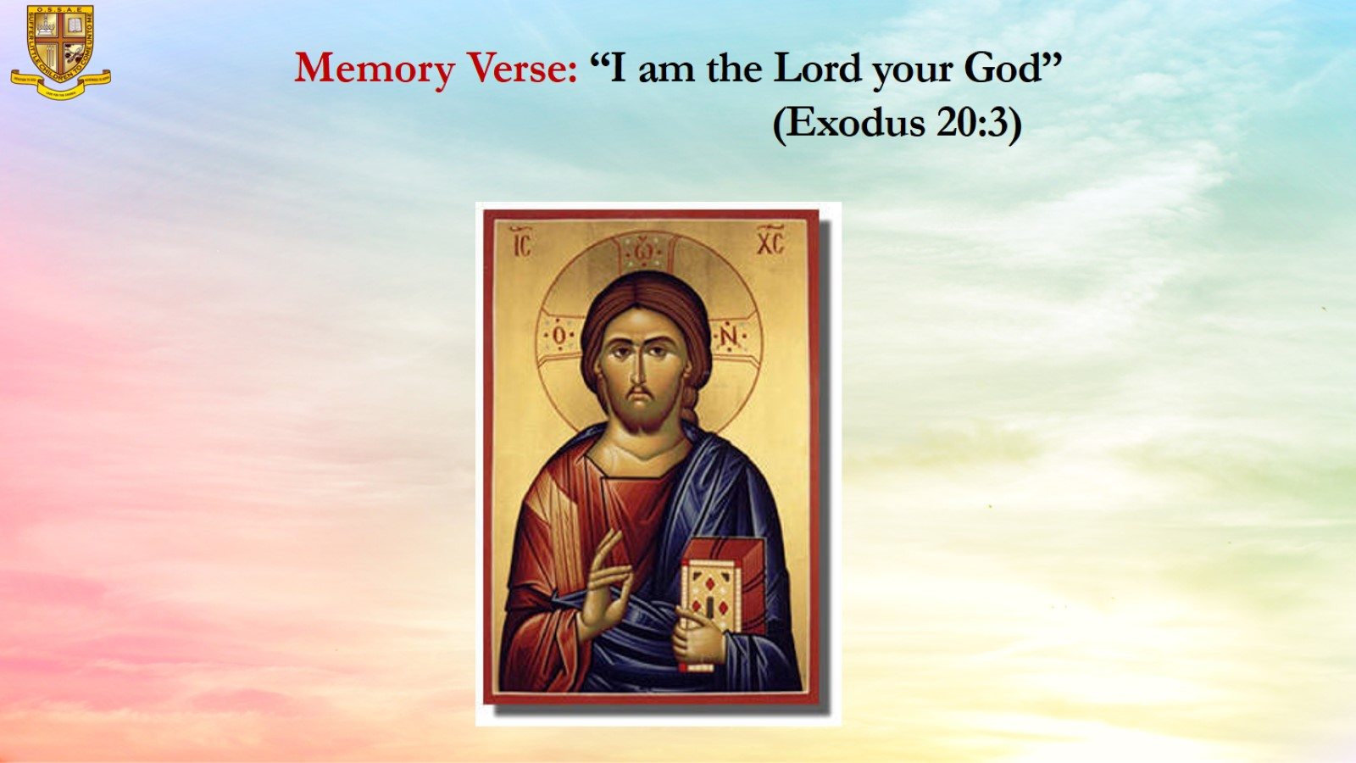
Memory Verse: “I am the Lord your God”
(Exodus 20:3)

Slide 8
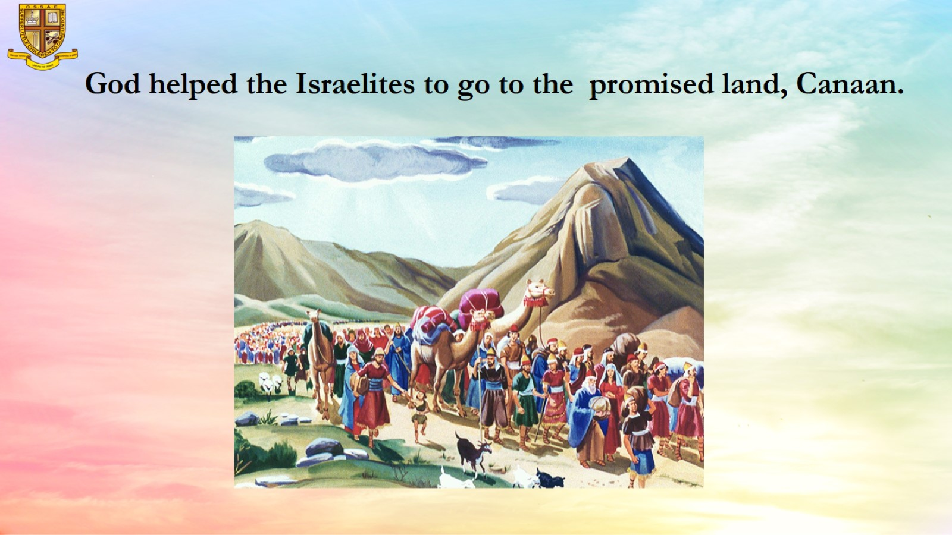
God helped the Israelites to go to the promised land, Canaan.

Slide 9
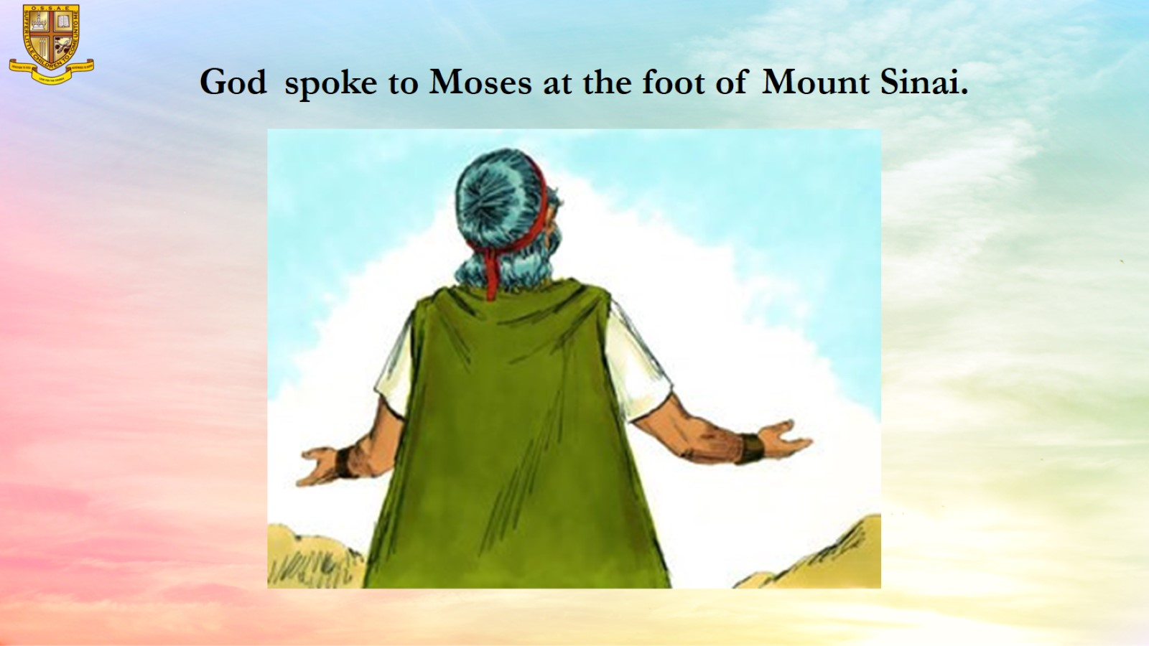
God spoke to Moses at the foot of Mount Sinai.

Slide 10
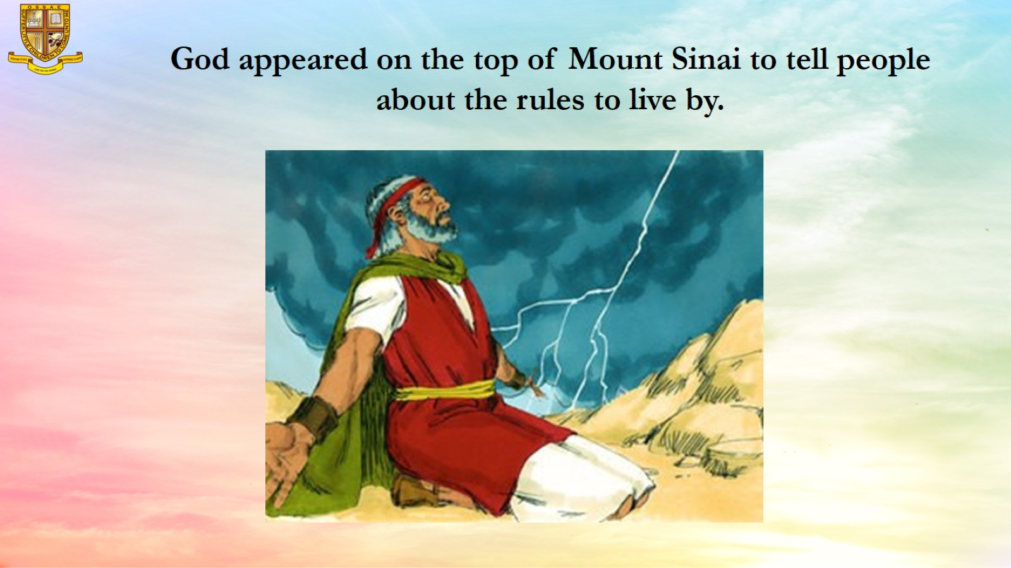
God appeared on the top of Mount Sinai to tell people about the rules to live by.

Slide 11
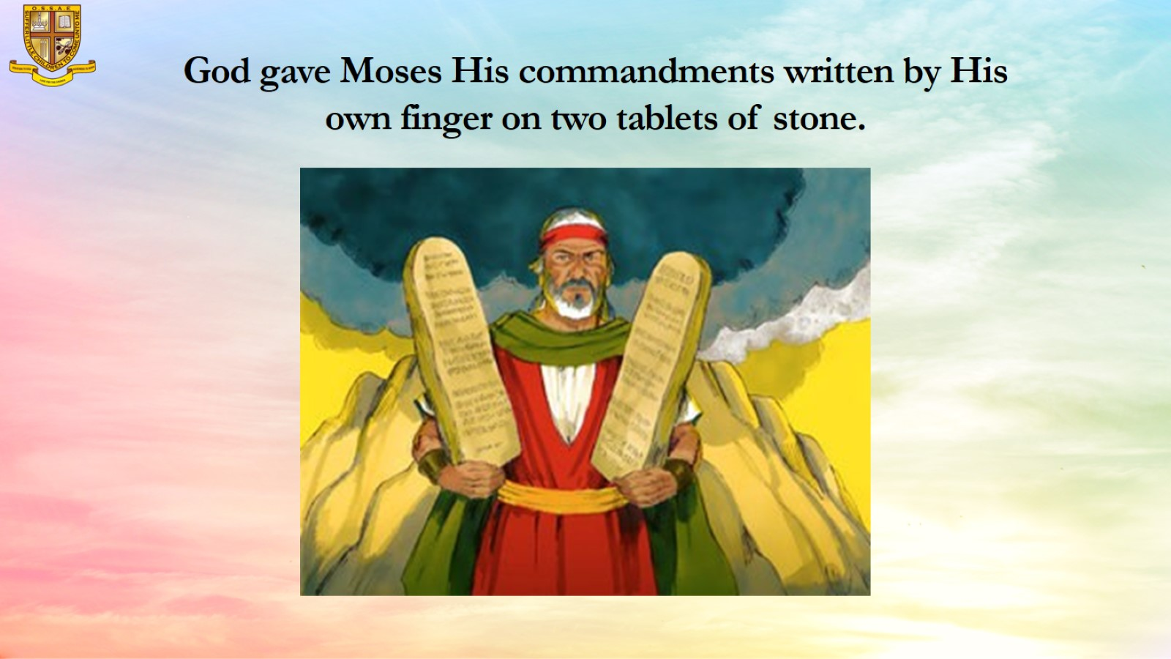
God gave Moses His commandments written by His own finger on two tablets of stone.

Slide 12
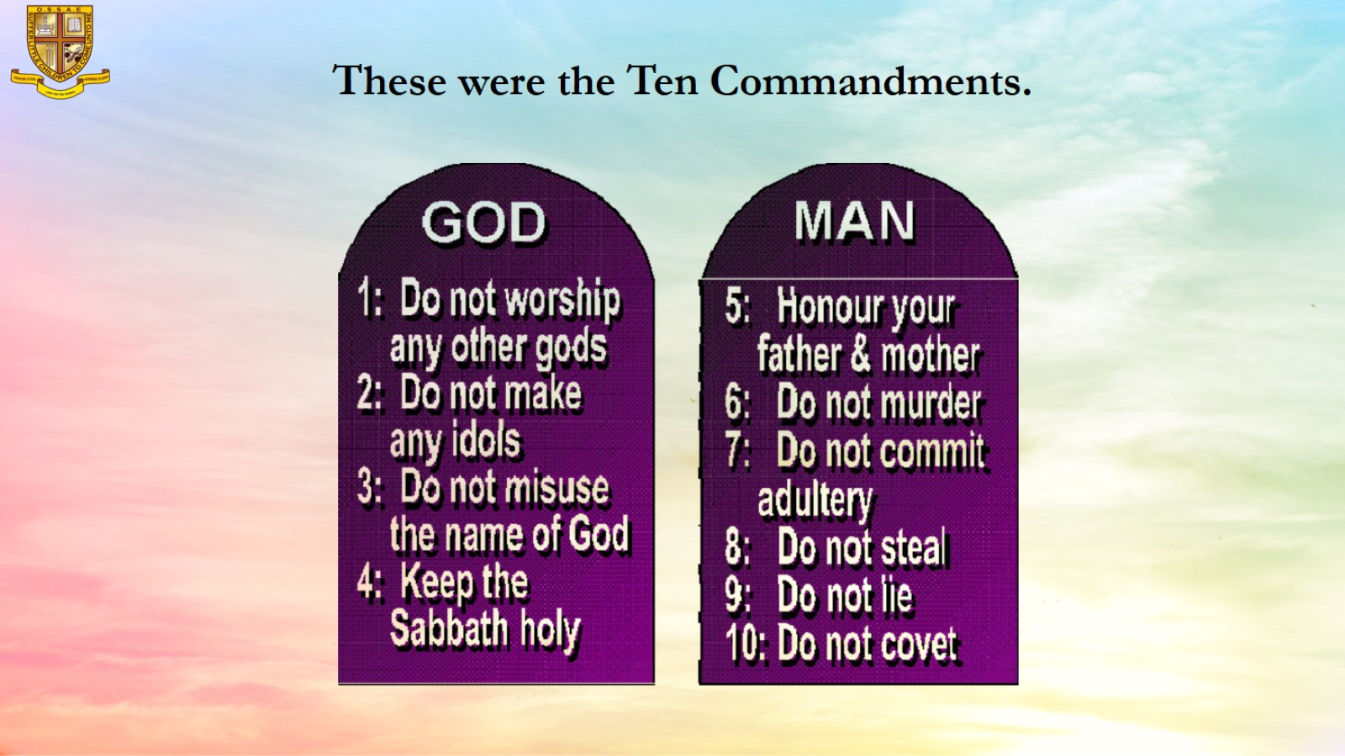
These were the Ten Commandments.

Slide 13
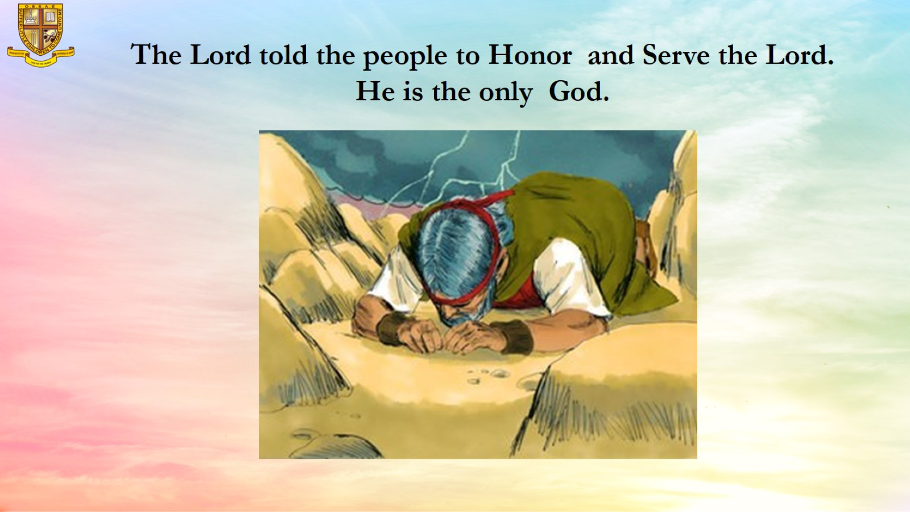
The Lord told the people to Honor and Serve the Lord. He is the only God.

Slide 14
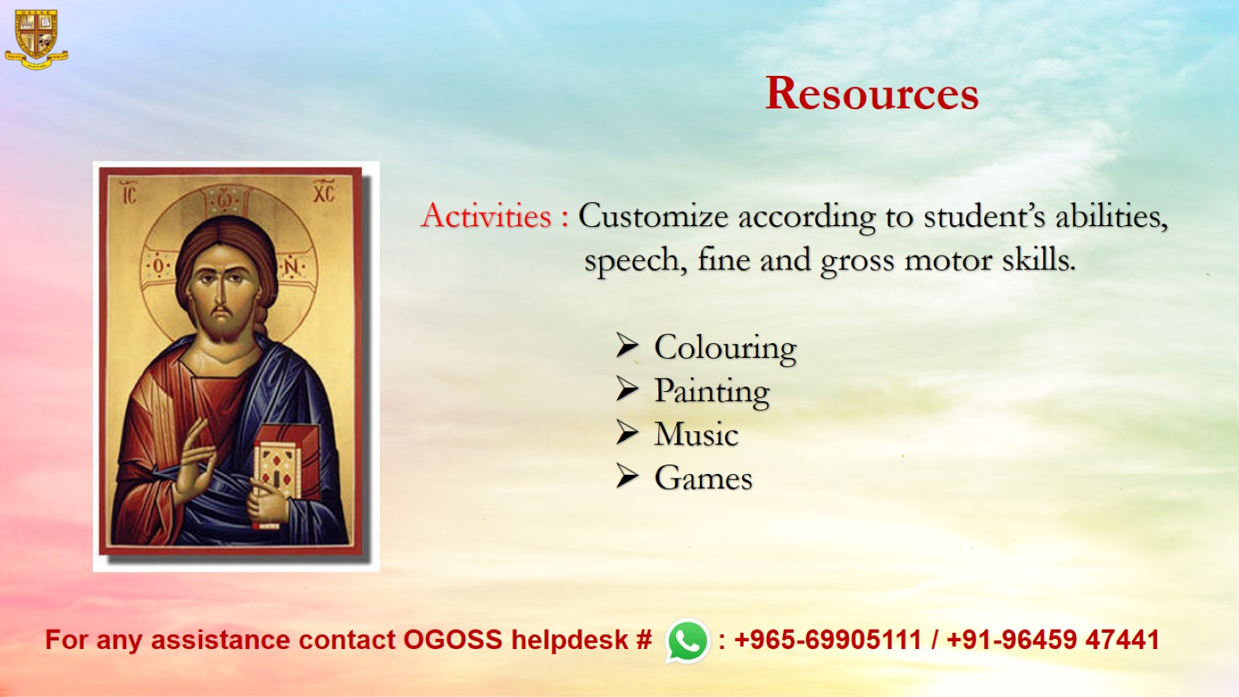
Resources

