Slide 1


Slide 2


Slide 3


Slide 4
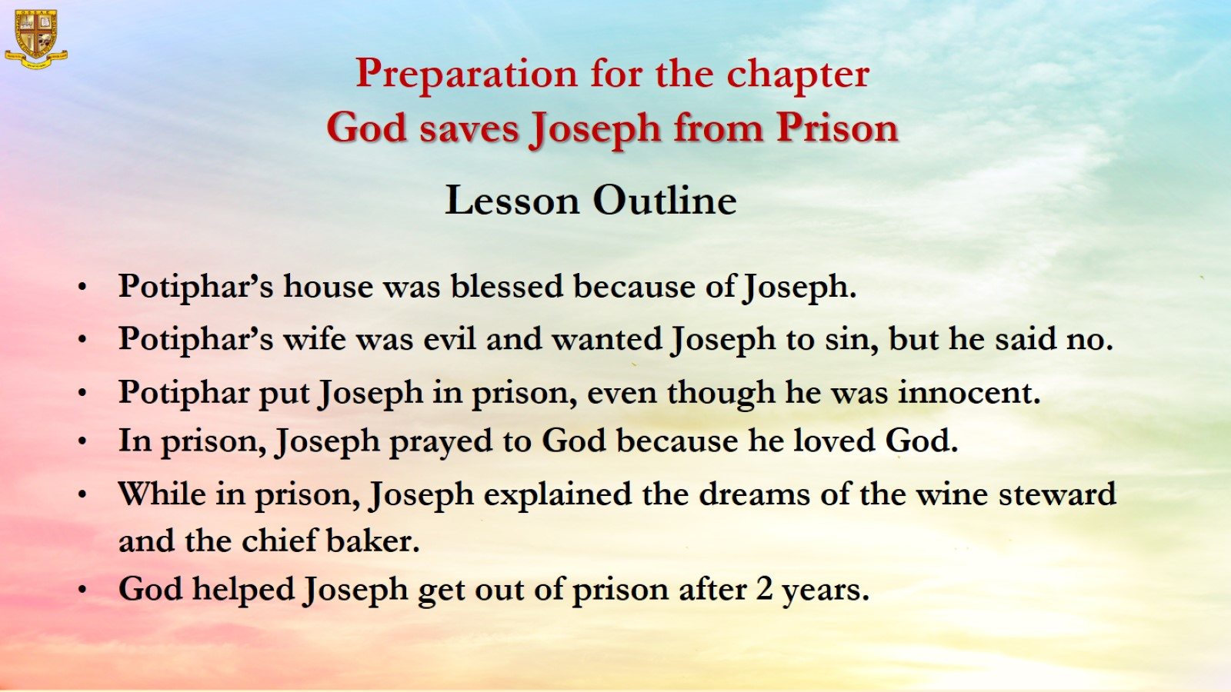
Preparation for the chapter
God saves Joseph from Prison

Slide 5
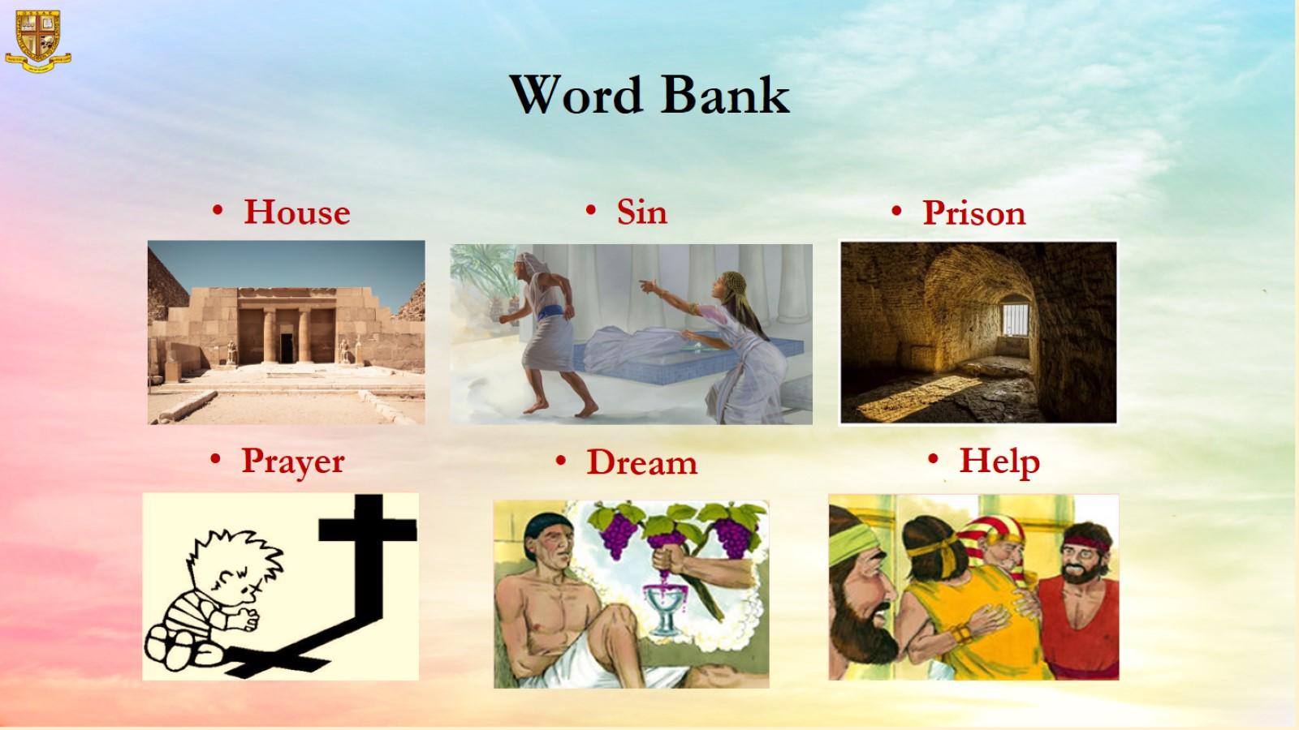
Word Bank

Slide 6
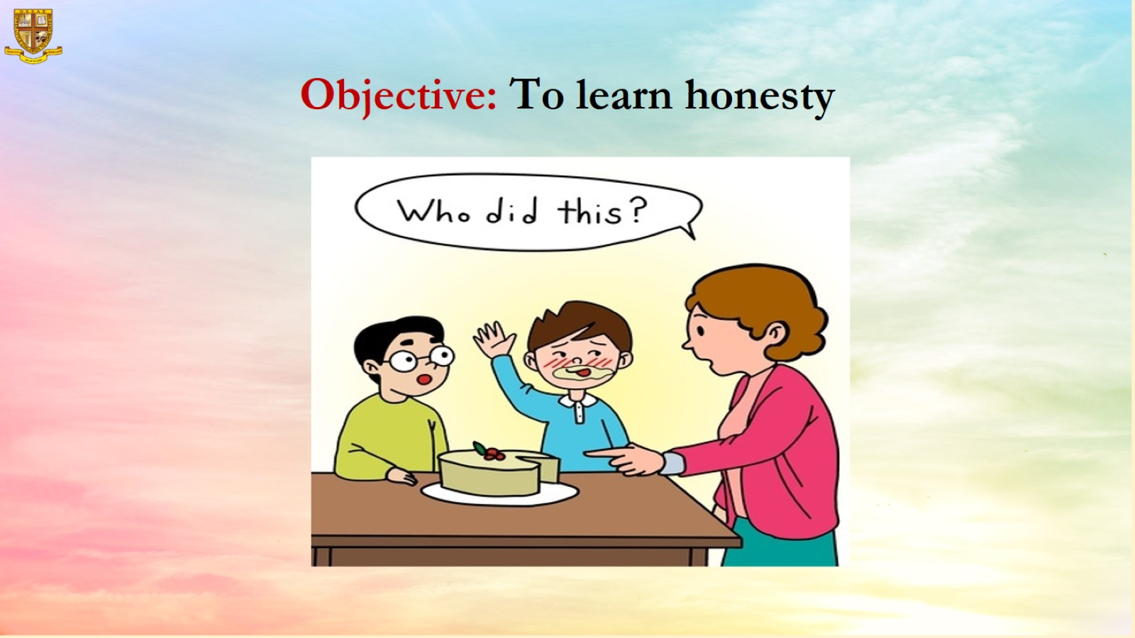
Objective: To learn honesty

Slide 7
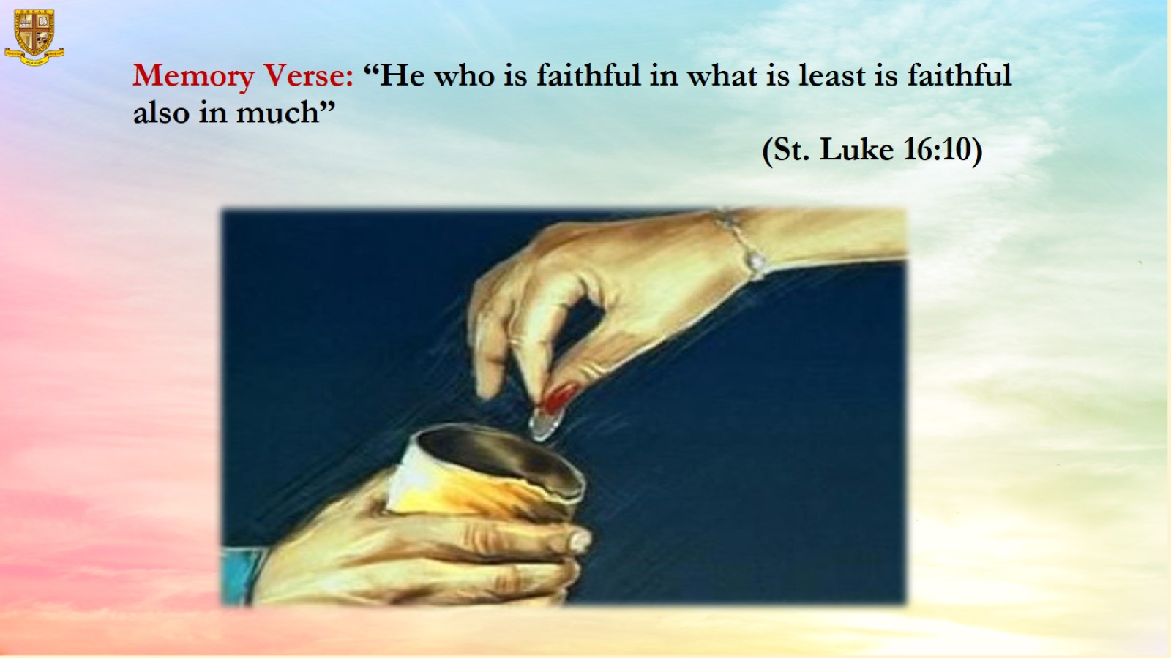
Memory Verse: “He who is faithful in what is least is faithful also in much”
(St. Luke 16:10)

Slide 8
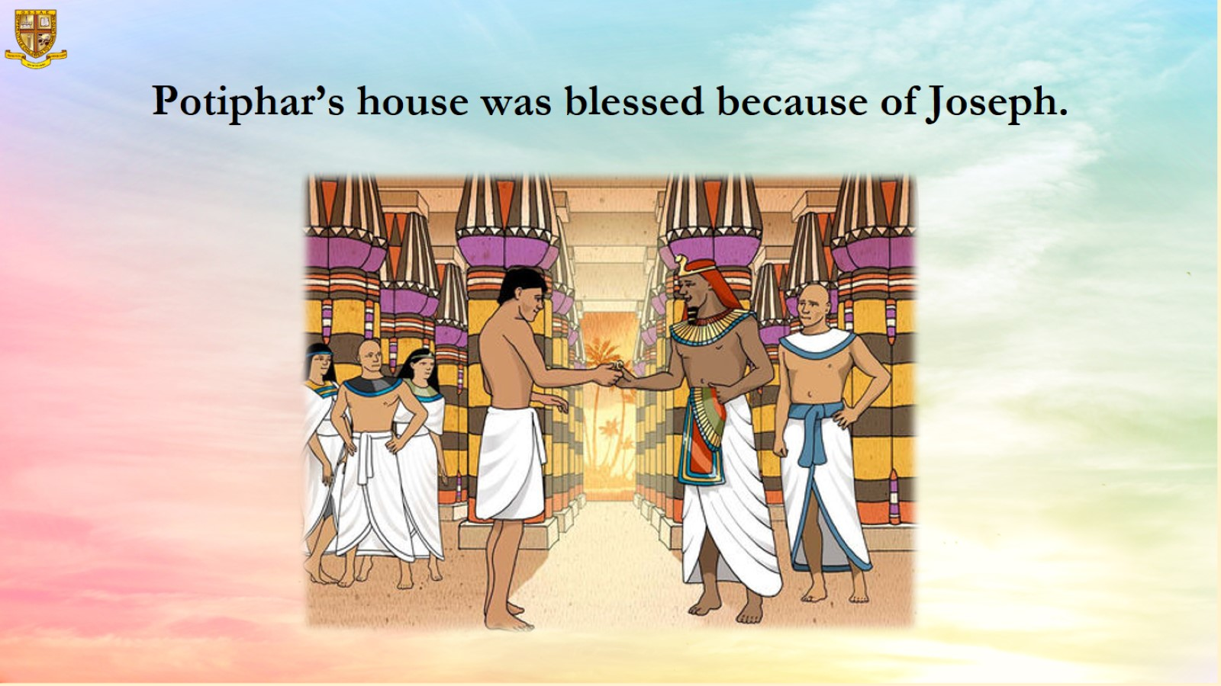
Potiphar’s house was blessed because of Joseph.

Slide 9
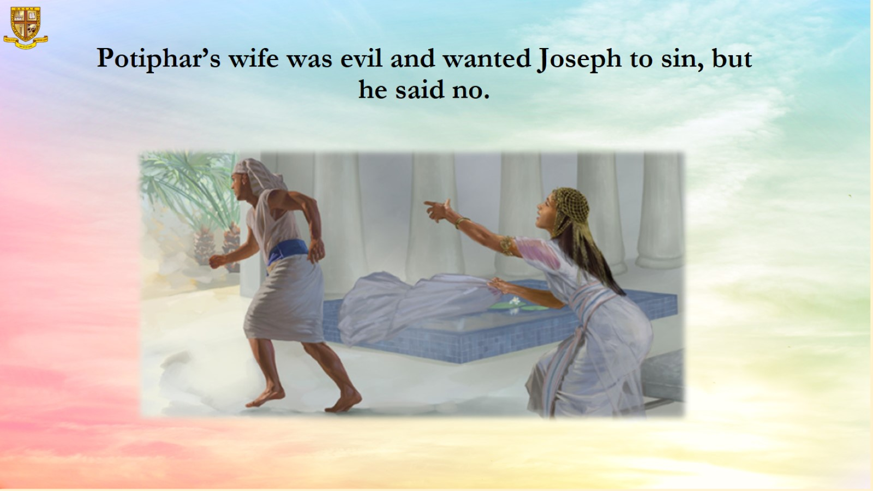
Potiphar’s wife was evil and wanted Joseph to sin, but he said no.

Slide 10
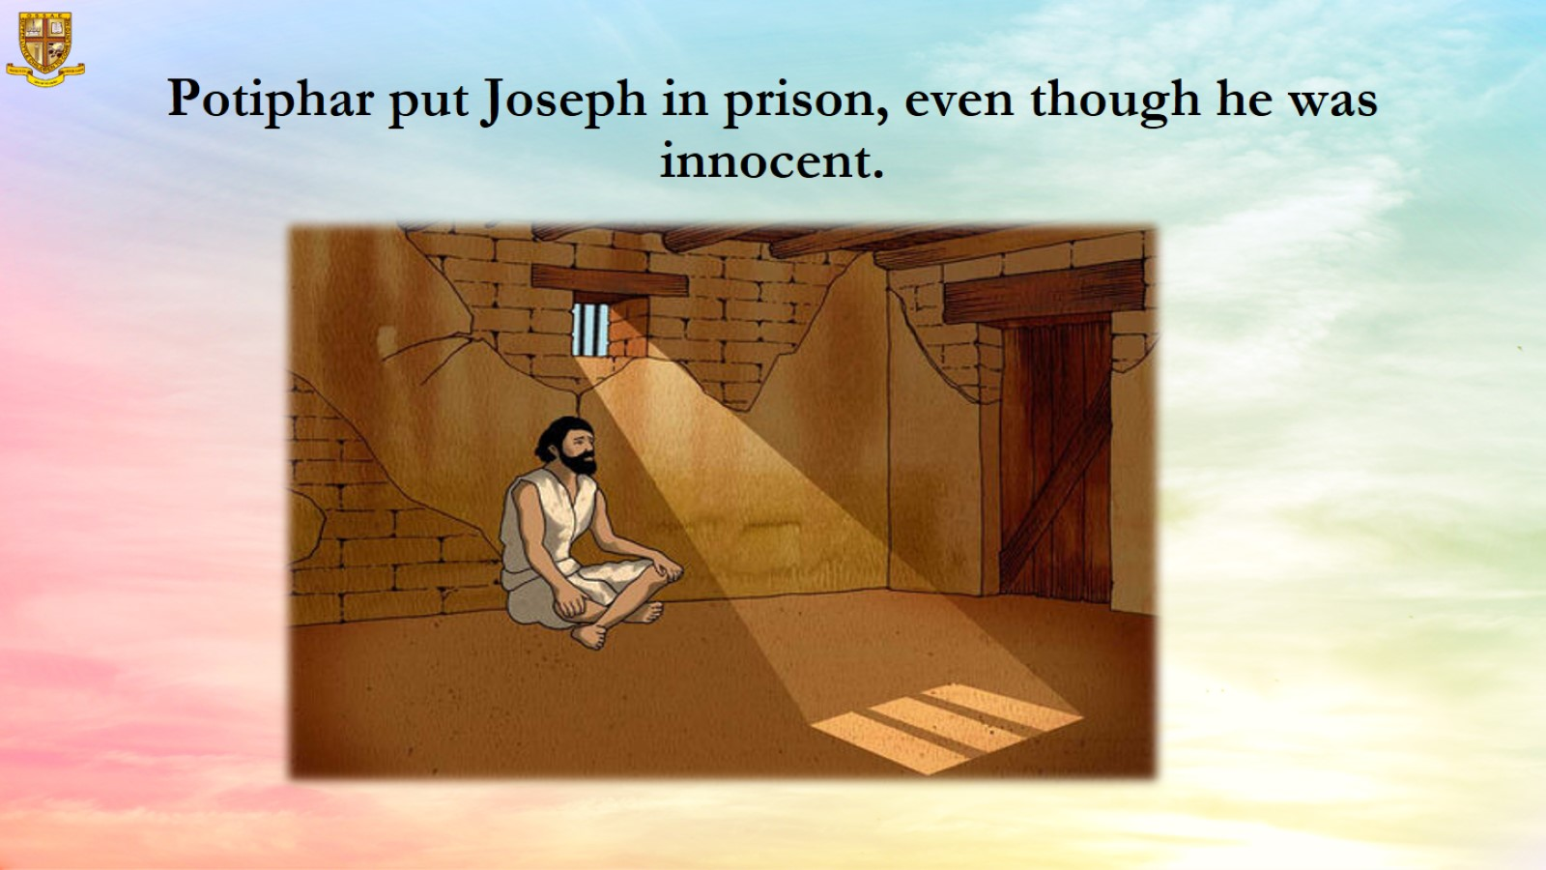
Potiphar put Joseph in prison, even though he was innocent.

Slide 11
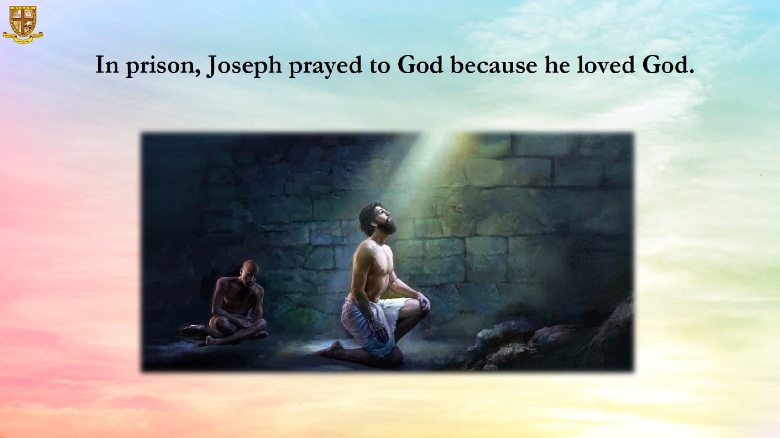
In prison, Joseph prayed to God because he loved God.

Slide 12
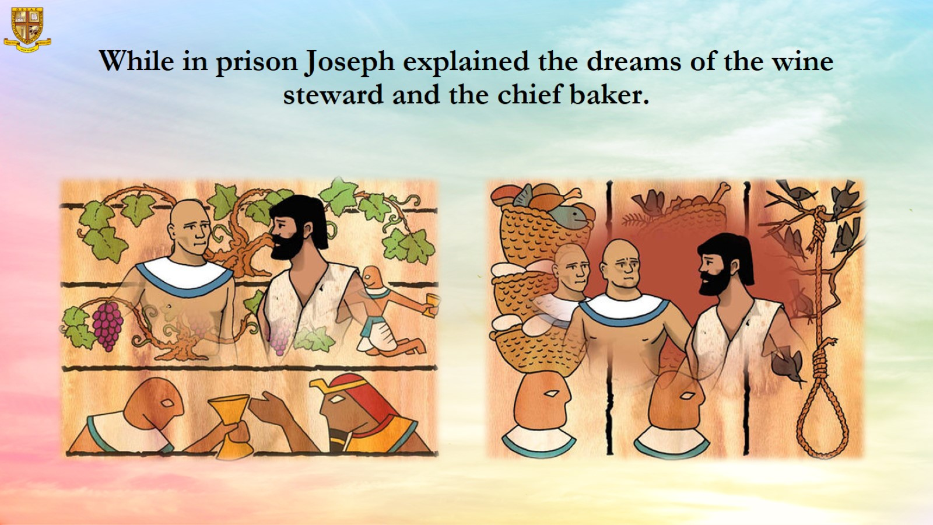
While in prison Joseph explained the dreams of the wine steward and the chief baker.

Slide 13
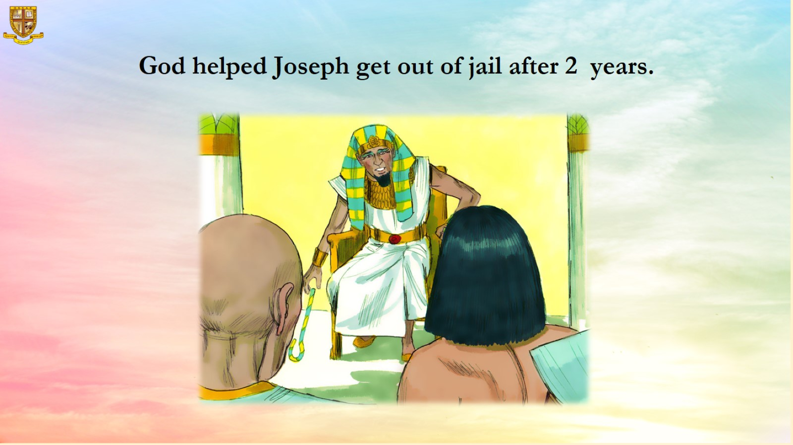
God helped Joseph get out of jail after 2 years.

Slide 14
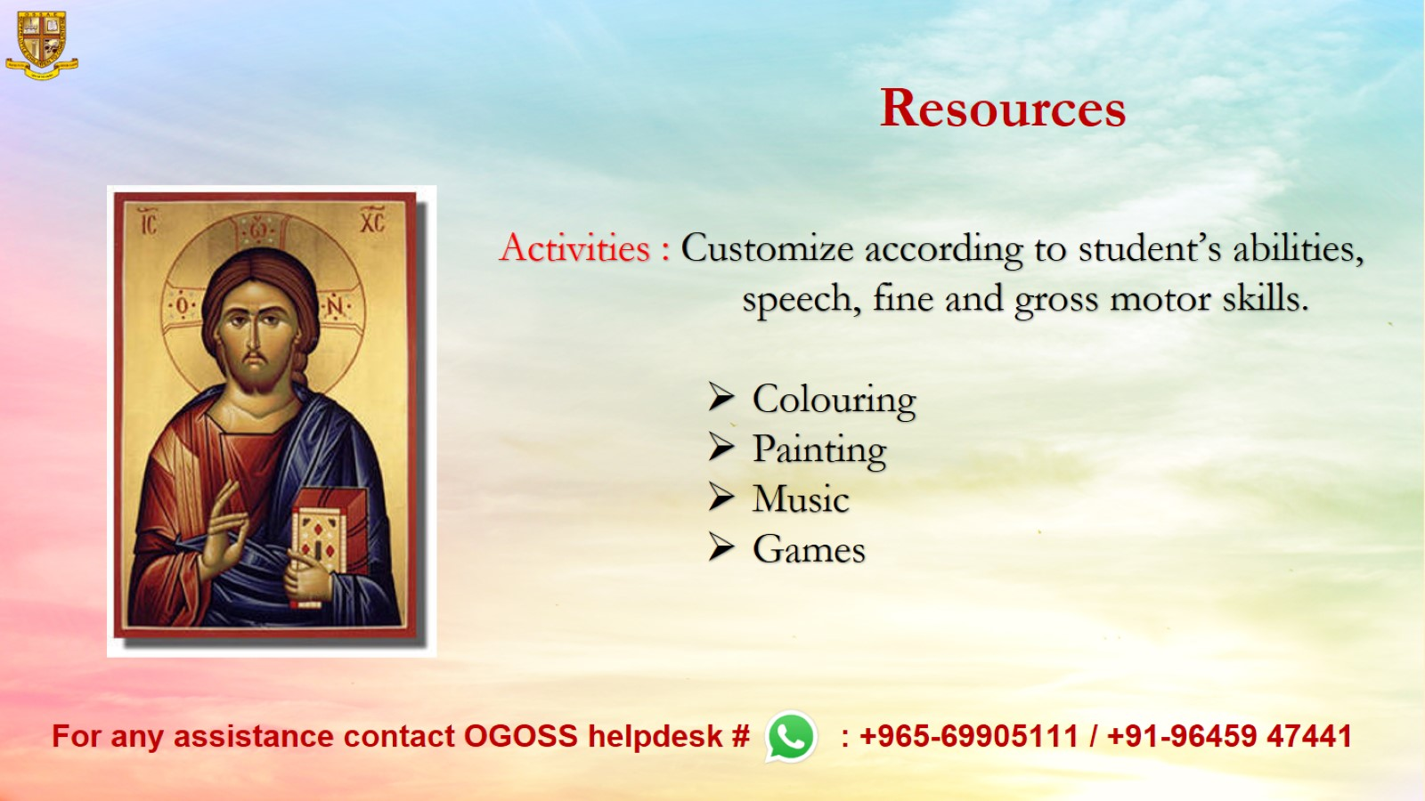
Resources

