Slide 1

Orthodox Global Online Sunday School (OGOSS)

Slide 2
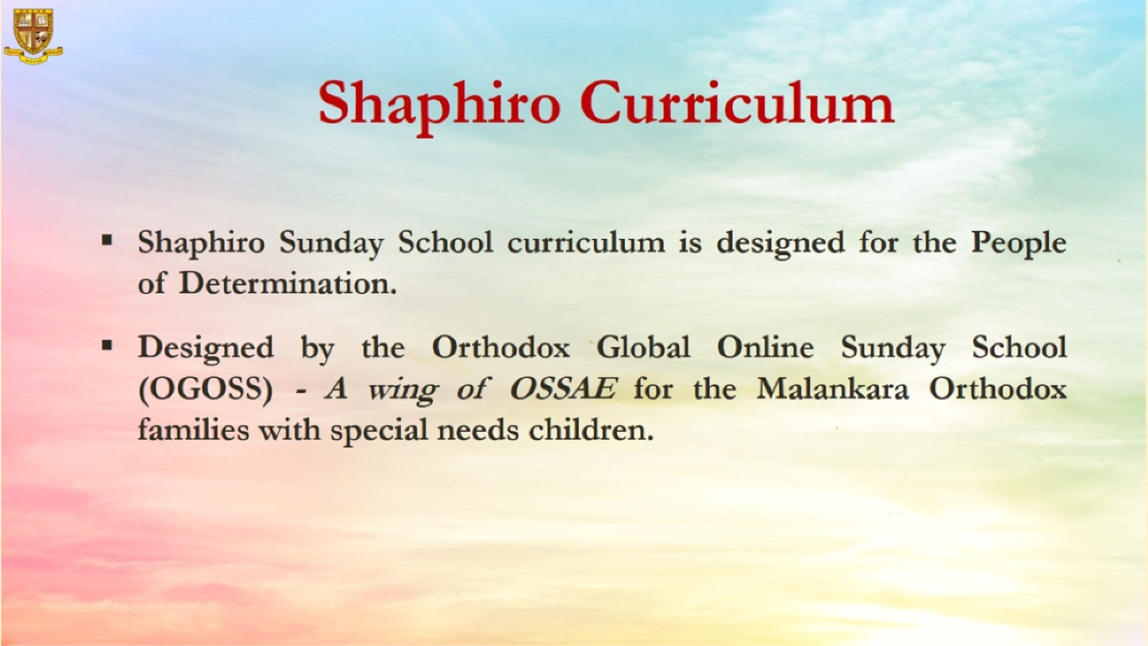

Slide 3
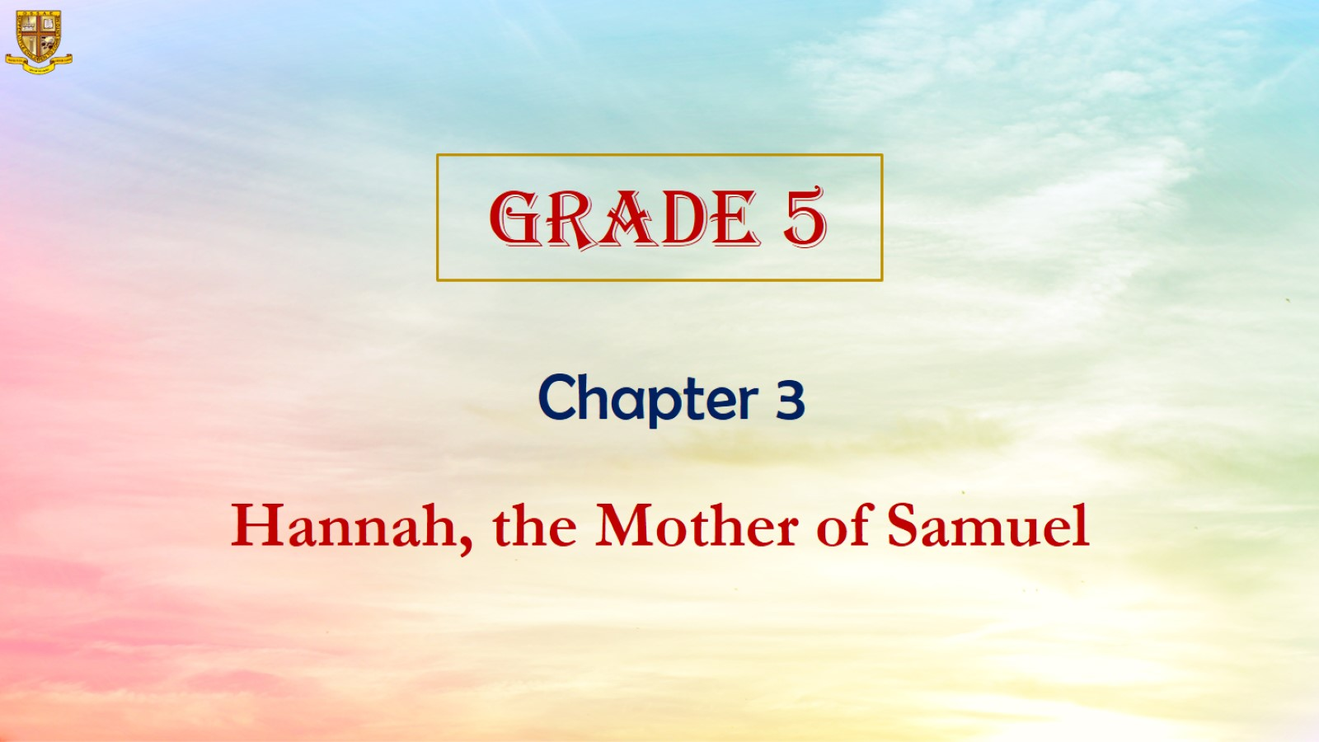

Slide 4
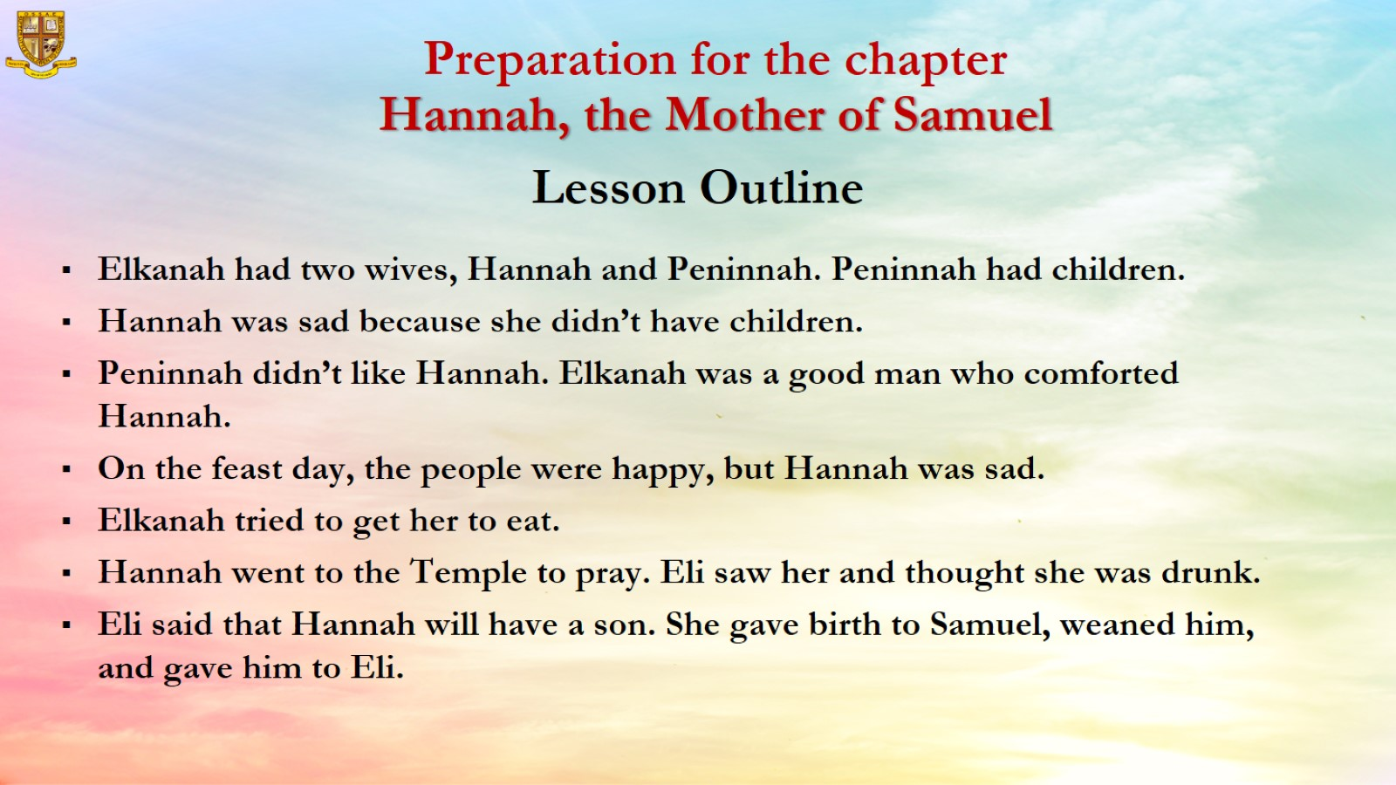

Slide 5
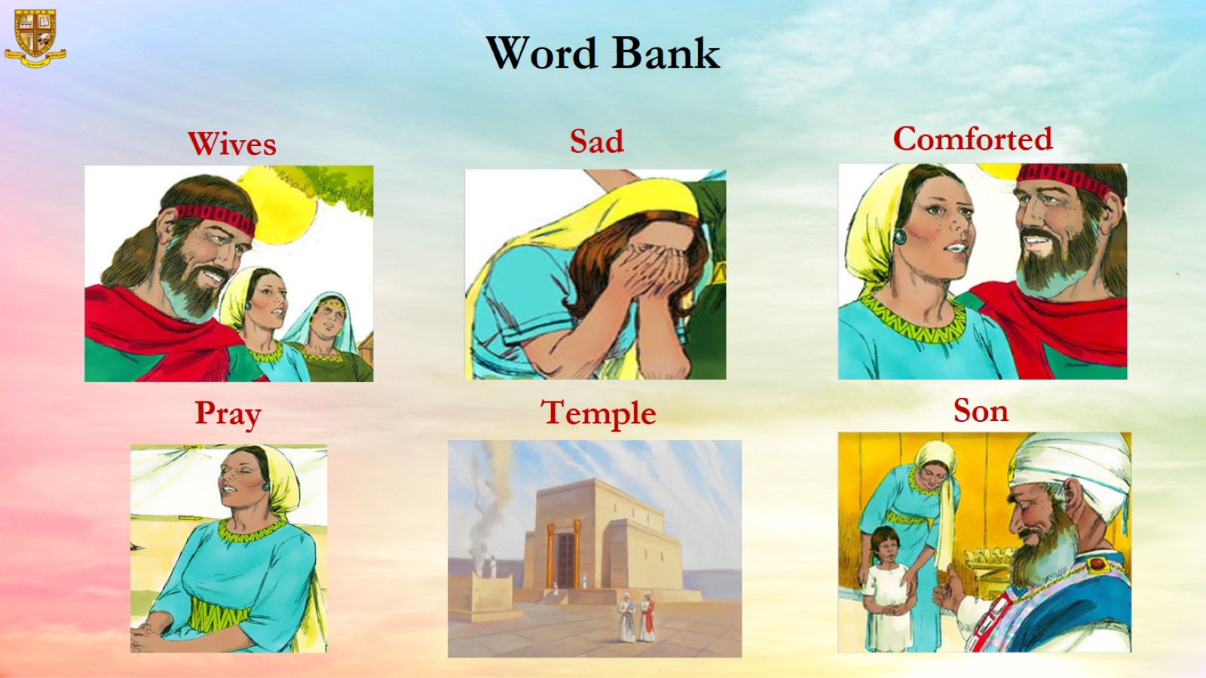

Slide 6
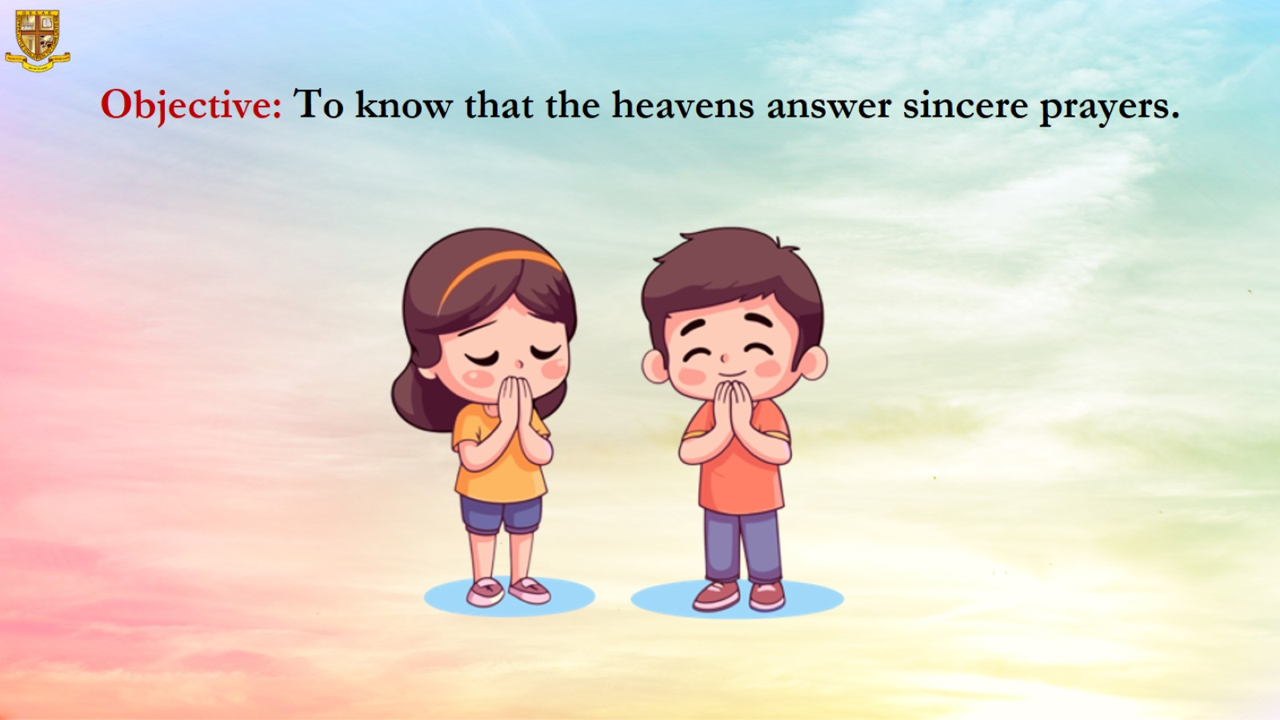
Objective: To know that the heavens answer sincere prayers.

Slide 7
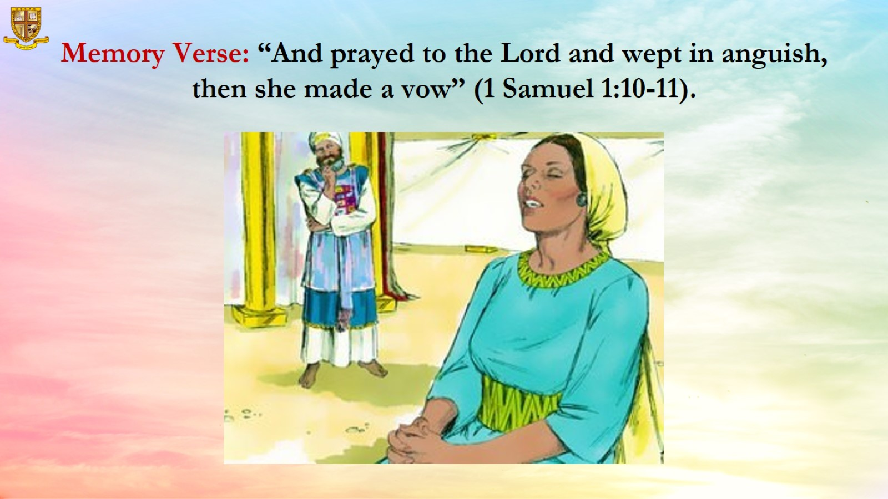
Memory Verse: “And prayed to the Lord and wept in anguish, then she made a vow” (1 Samuel 1:10-11).

Slide 8
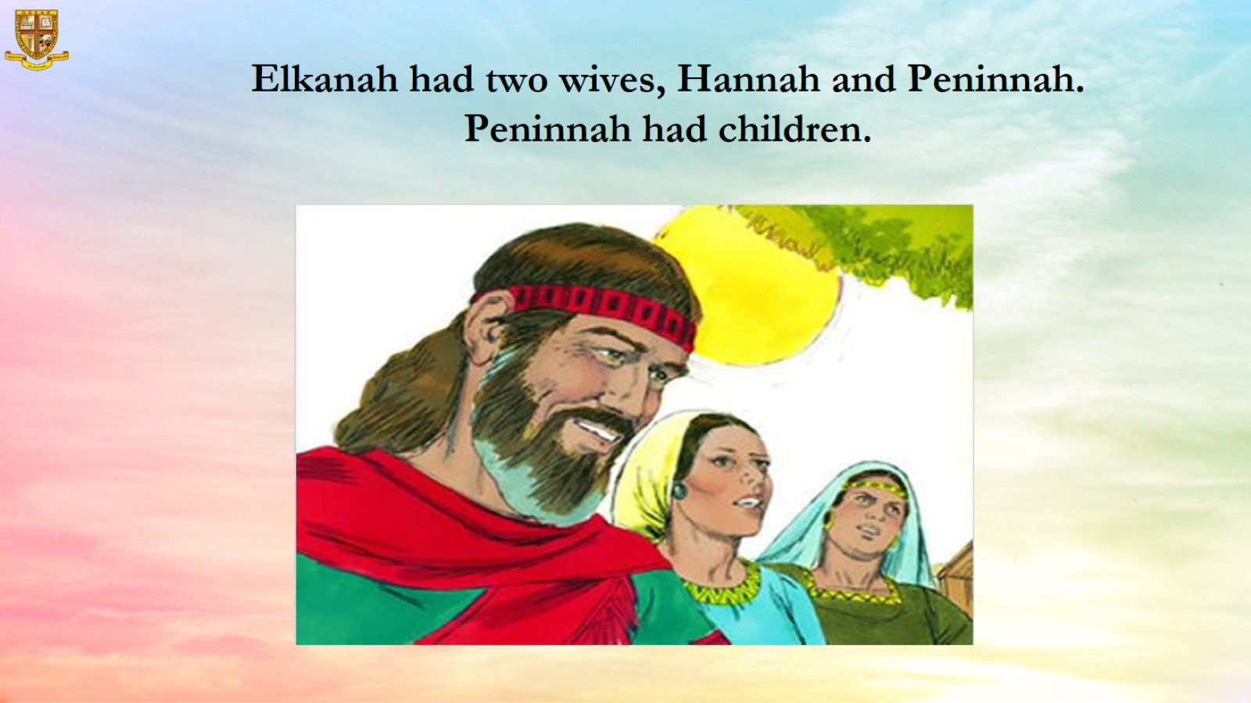
Elkanah had two wives, Hannah and Peninnah. Peninnah had children.

Slide 9
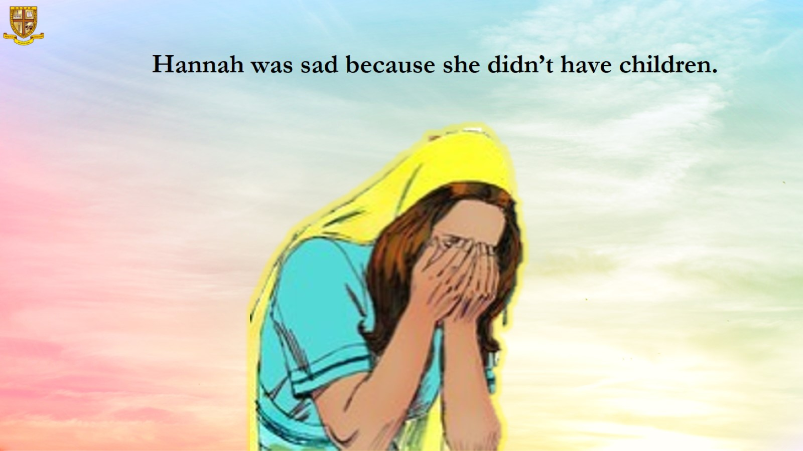
Hannah was sad because she didn’t have children.

Slide 10
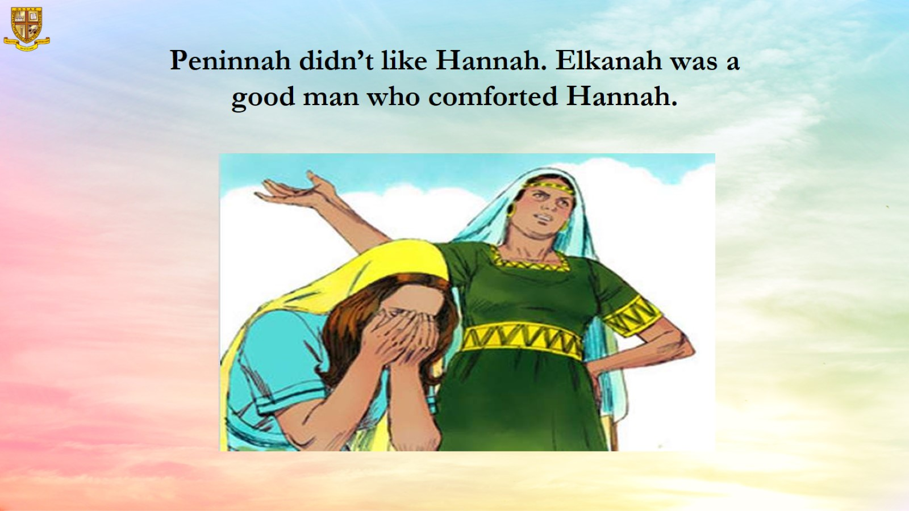
Peninnah didn’t like Hannah. Elkanah was a good man who comforted Hannah.

Slide 11
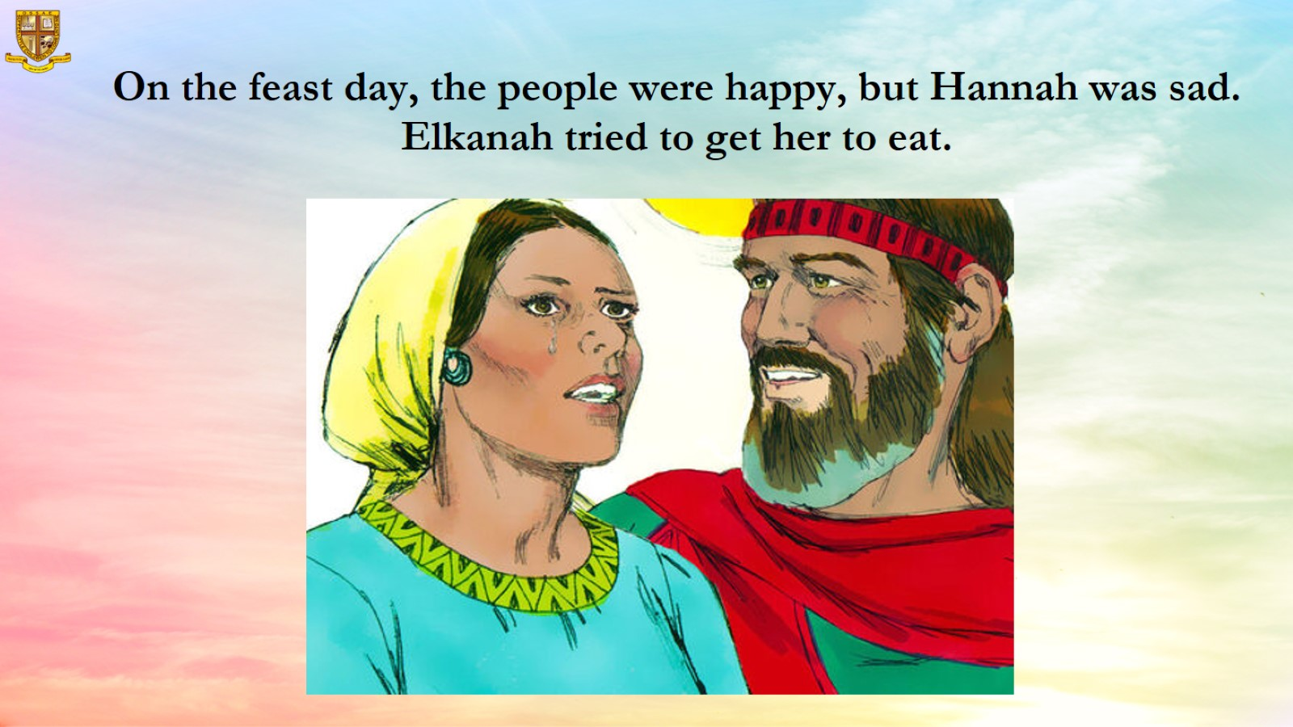
On the feast day, the people were happy, but Hannah was sad. Elkanah tried to get her to eat.

Slide 12
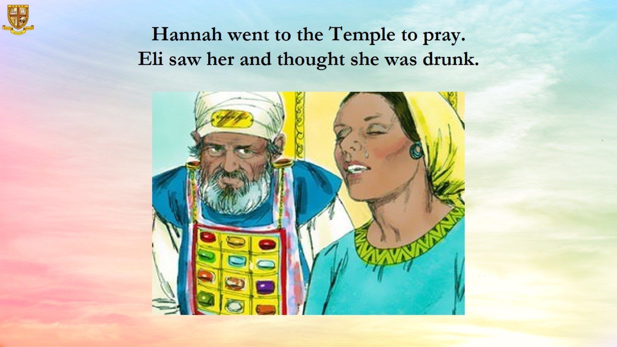
Hannah went to the Temple to pray.
Eli saw her and thought she was drunk.

Slide 13
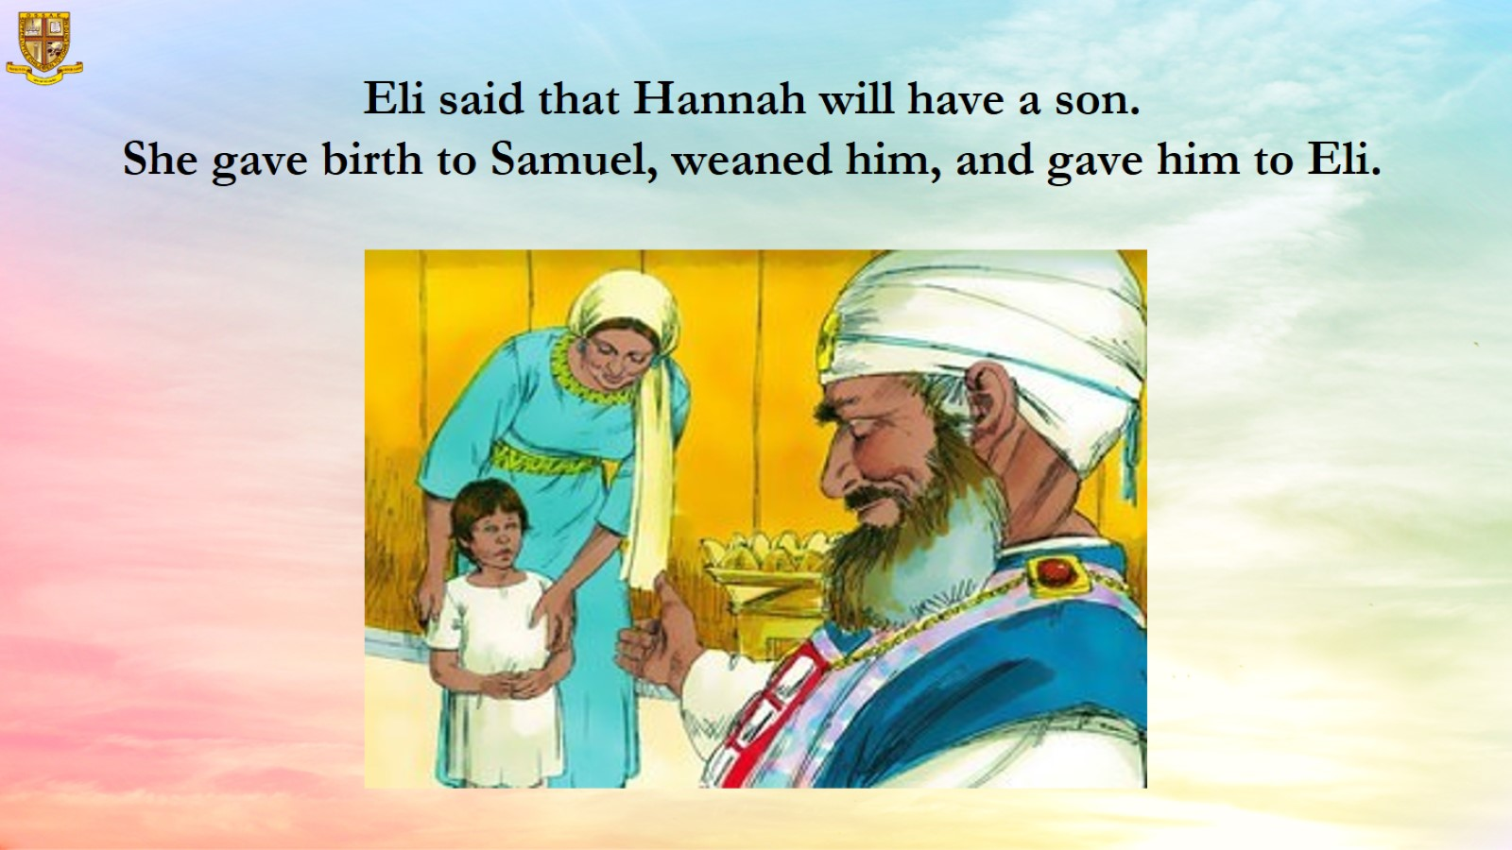
Eli said that Hannah will have a son.
She gave birth to Samuel, weaned him, and gave him to Eli.

Slide 14
