Slide 1
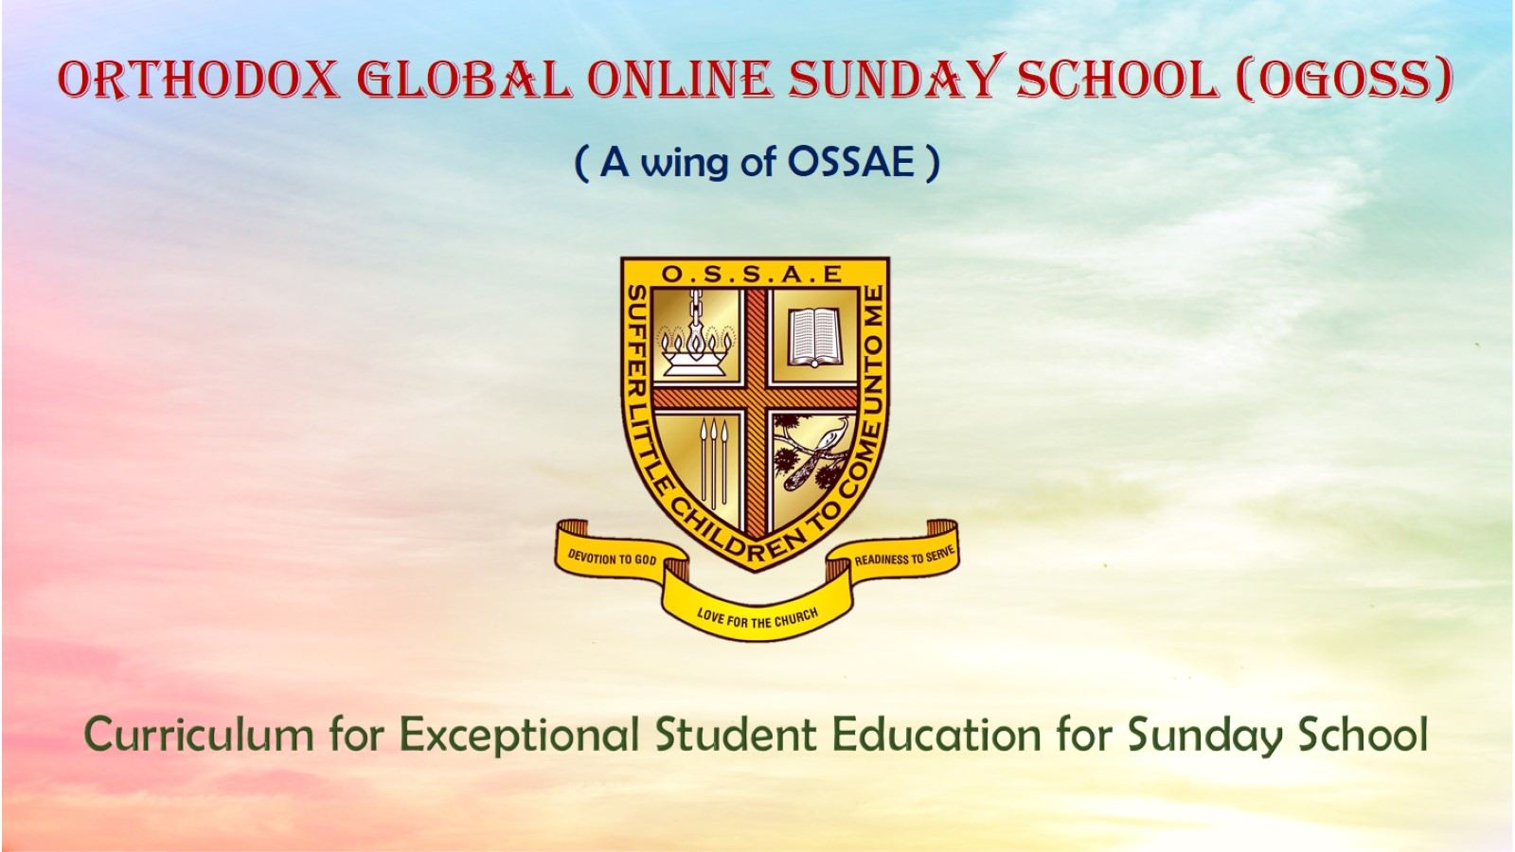
Orthodox Global Online Sunday School (OGOSS)

Slide 2
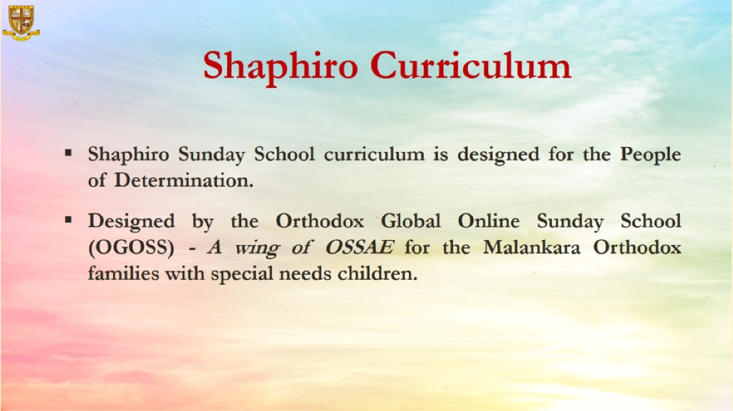

Slide 3
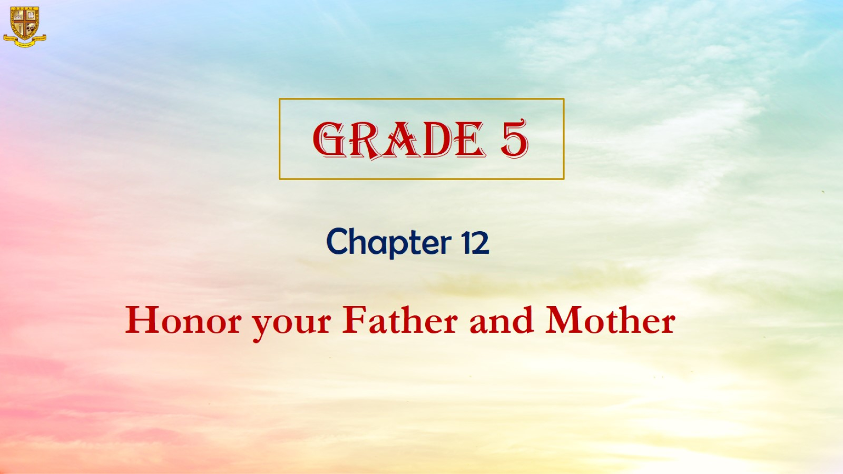

Slide 4
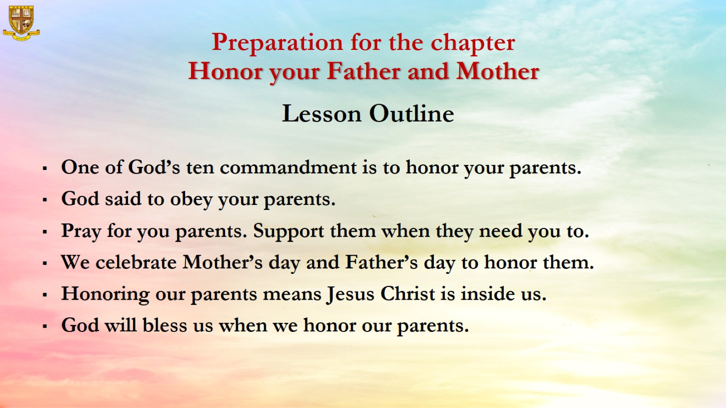

Slide 5
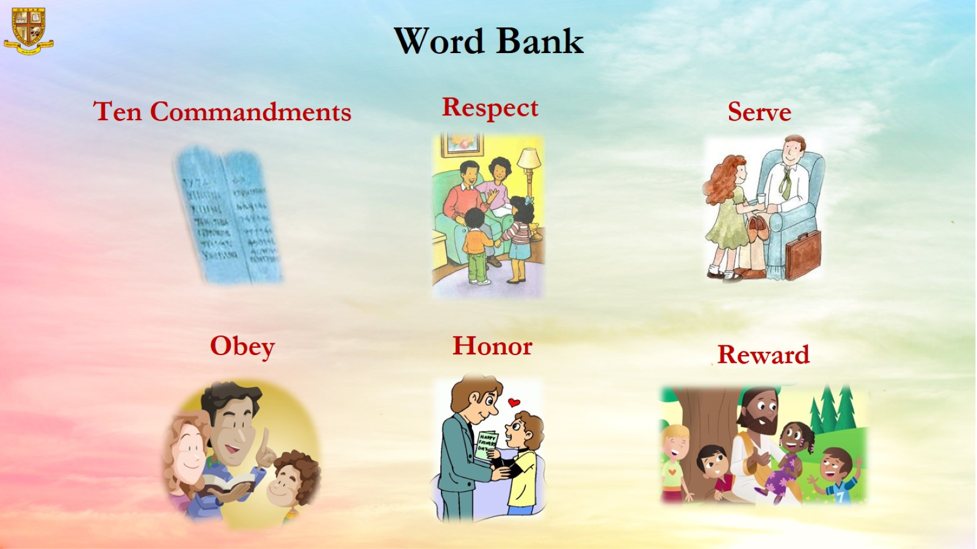

Slide 6
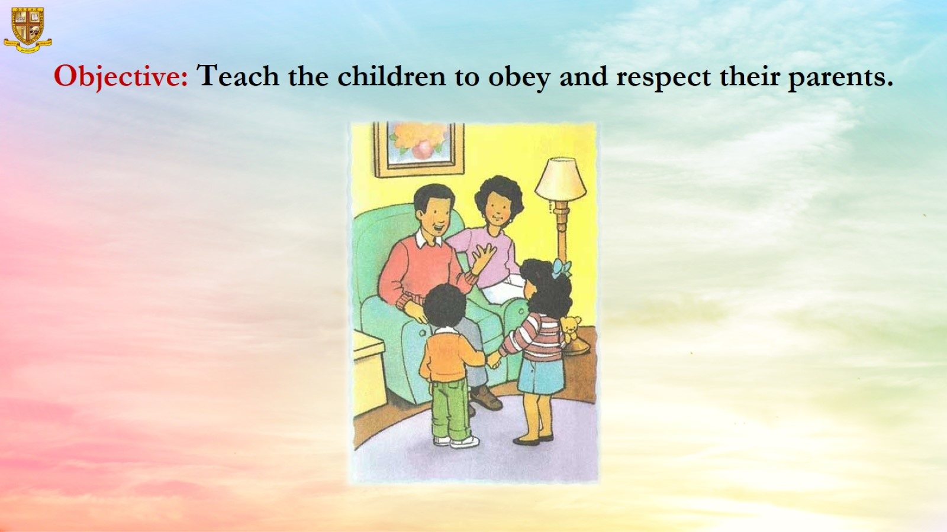
Objective: Teach the children to obey and respect their parents.

Slide 7
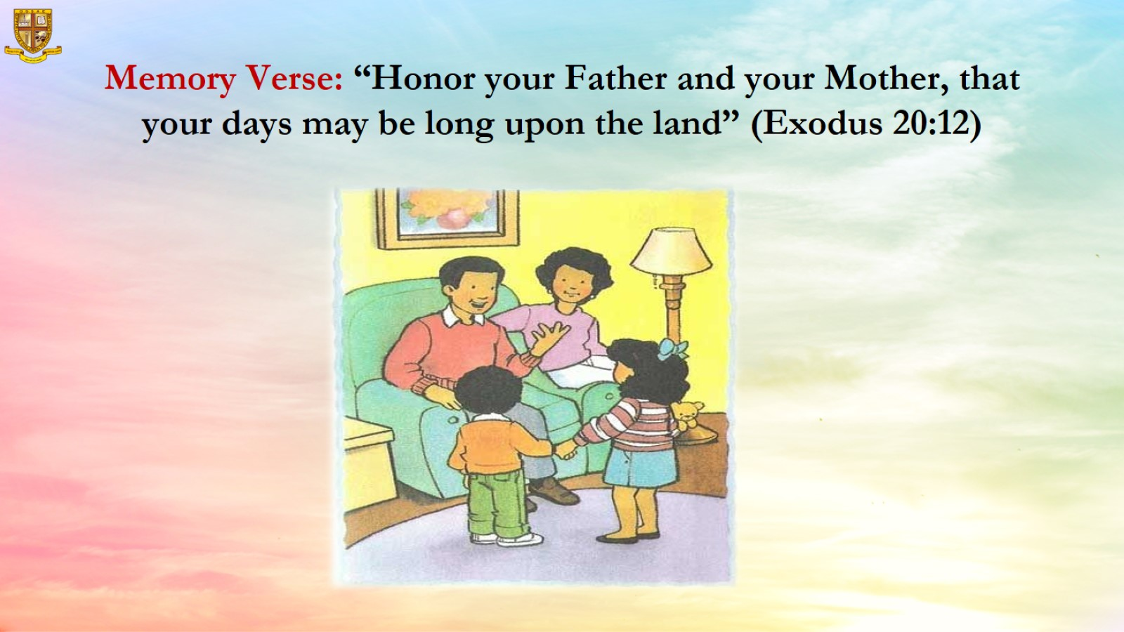
Memory Verse: “Honor your Father and your Mother, that your days may be long upon the land” (Exodus 20:12)

Slide 8
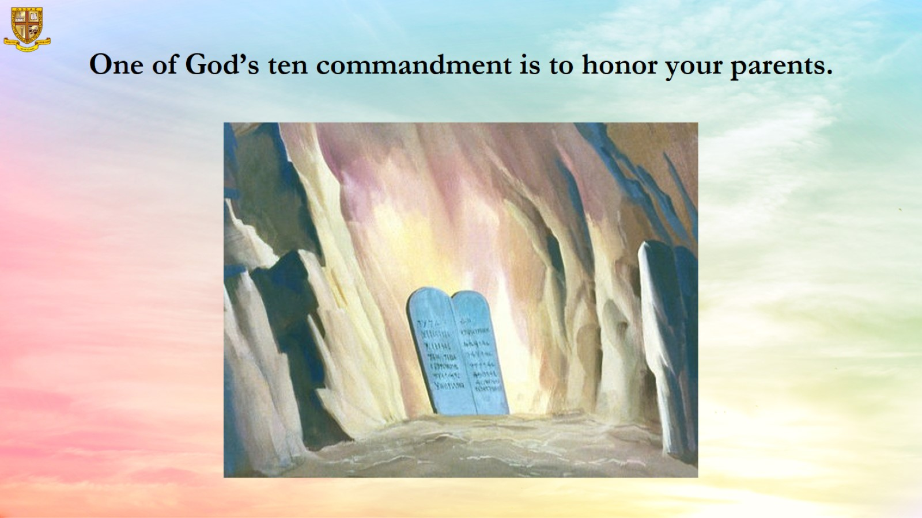
One of God’s ten commandment is to honor your parents.

Slide 9

God said to obey your parents.

Slide 10
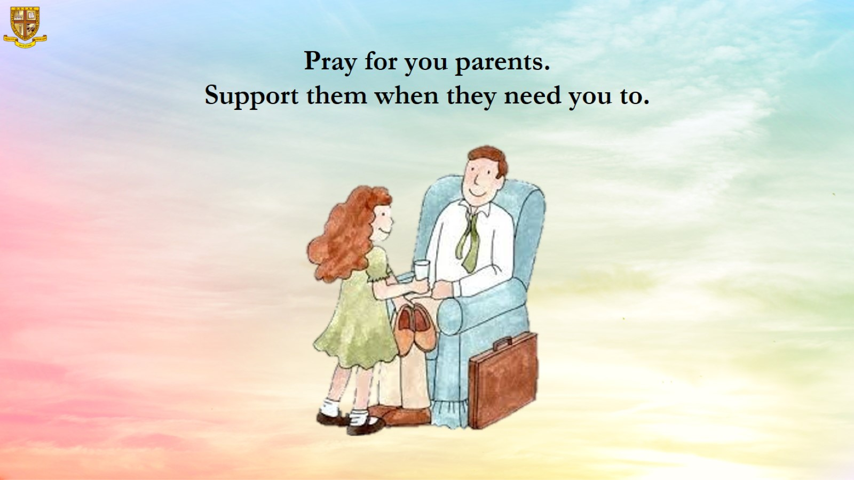
Pray for you parents.
Support them when they need you to.

Slide 11

We celebrate Mother’s day and Father’s day to honor them.

Slide 12
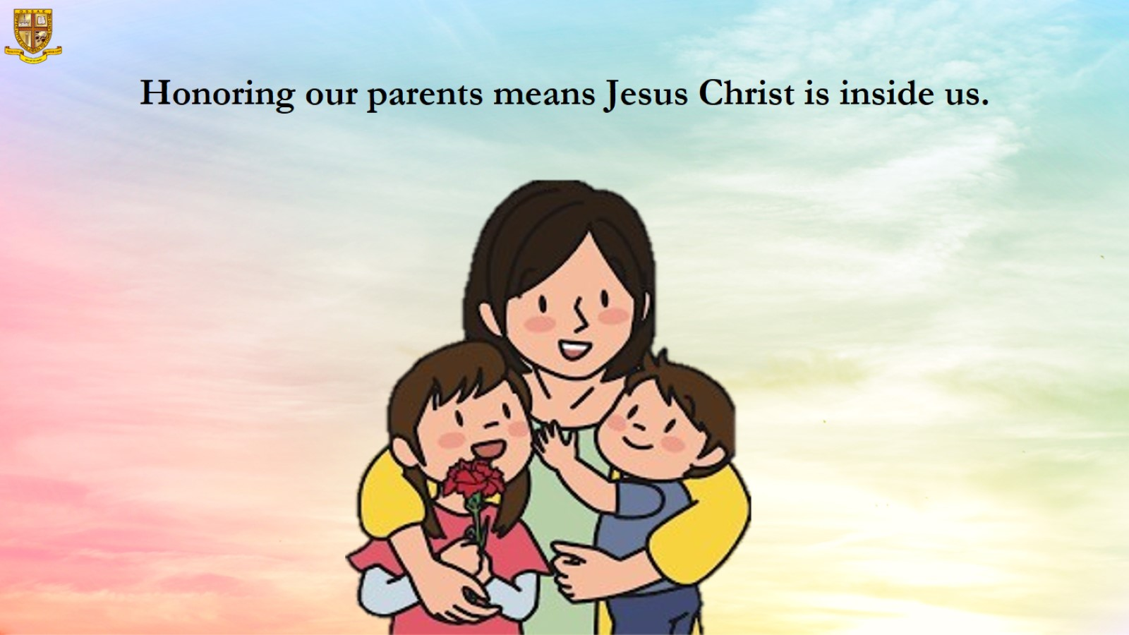
Honoring our parents means Jesus Christ is inside us.

Slide 13
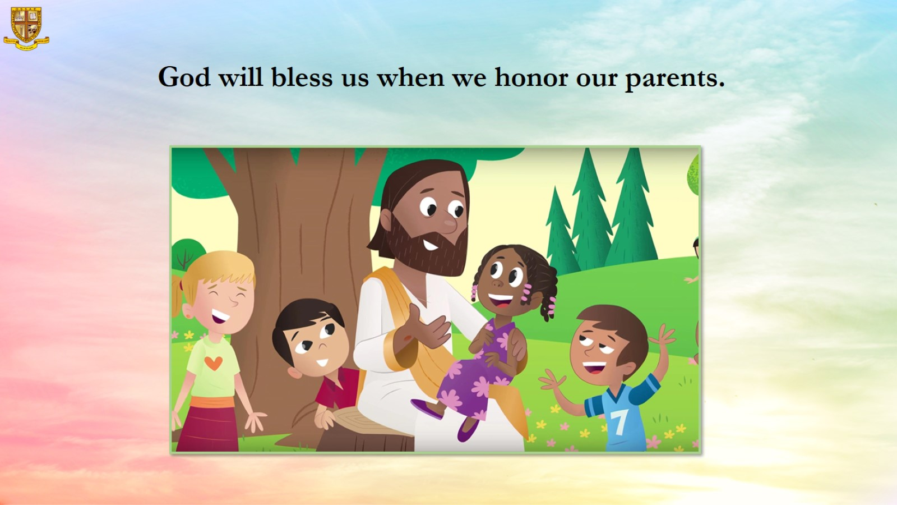
God will bless us when we honor our parents.

Slide 14
