Slide 1


Slide 2


Slide 3


Grade 1
Chapter 10
Hosanna

Slide 4
Preparation for Hosanna
Lesson Outline
Preparation for the chapter
Hosanna
Lesson Outline
Jesus Christ was with His disciples on a mountain.
He asked two of His disciples to bring a donkey for him to ride on.
The disciples found the donkey just as He had said. They did just as Jesus had commanded.
The people of Jerusalem heard of Jesus’ coming. They spread their clothes on the road to welcome Jesus Christ saying HOSANNA!
They all carried branches of palm trees as they went out to meet Jesus.
Jesus rode the donkey and entered Jerusalem like a true King, as was prophesied. There was joy in heaven and on earth.

Slide 5
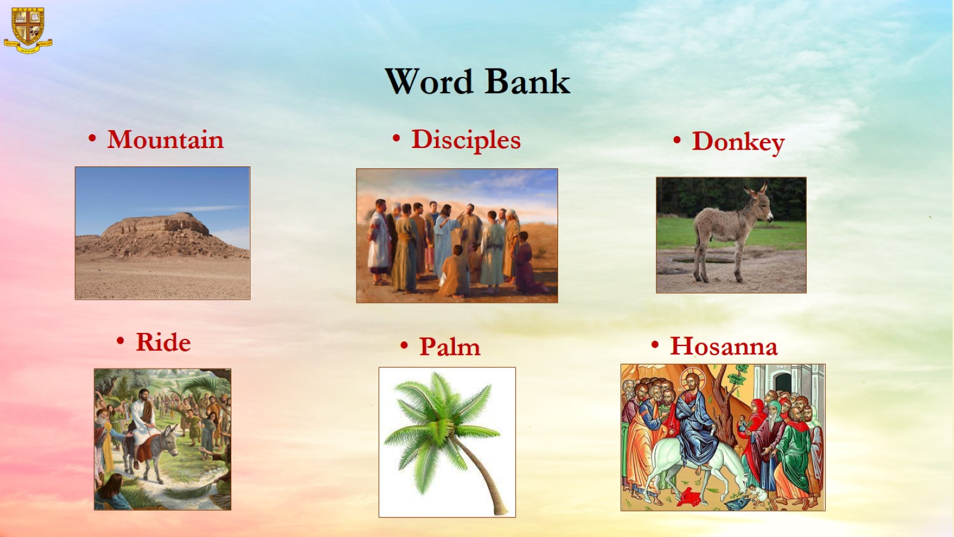
Word Bank

Slide 6
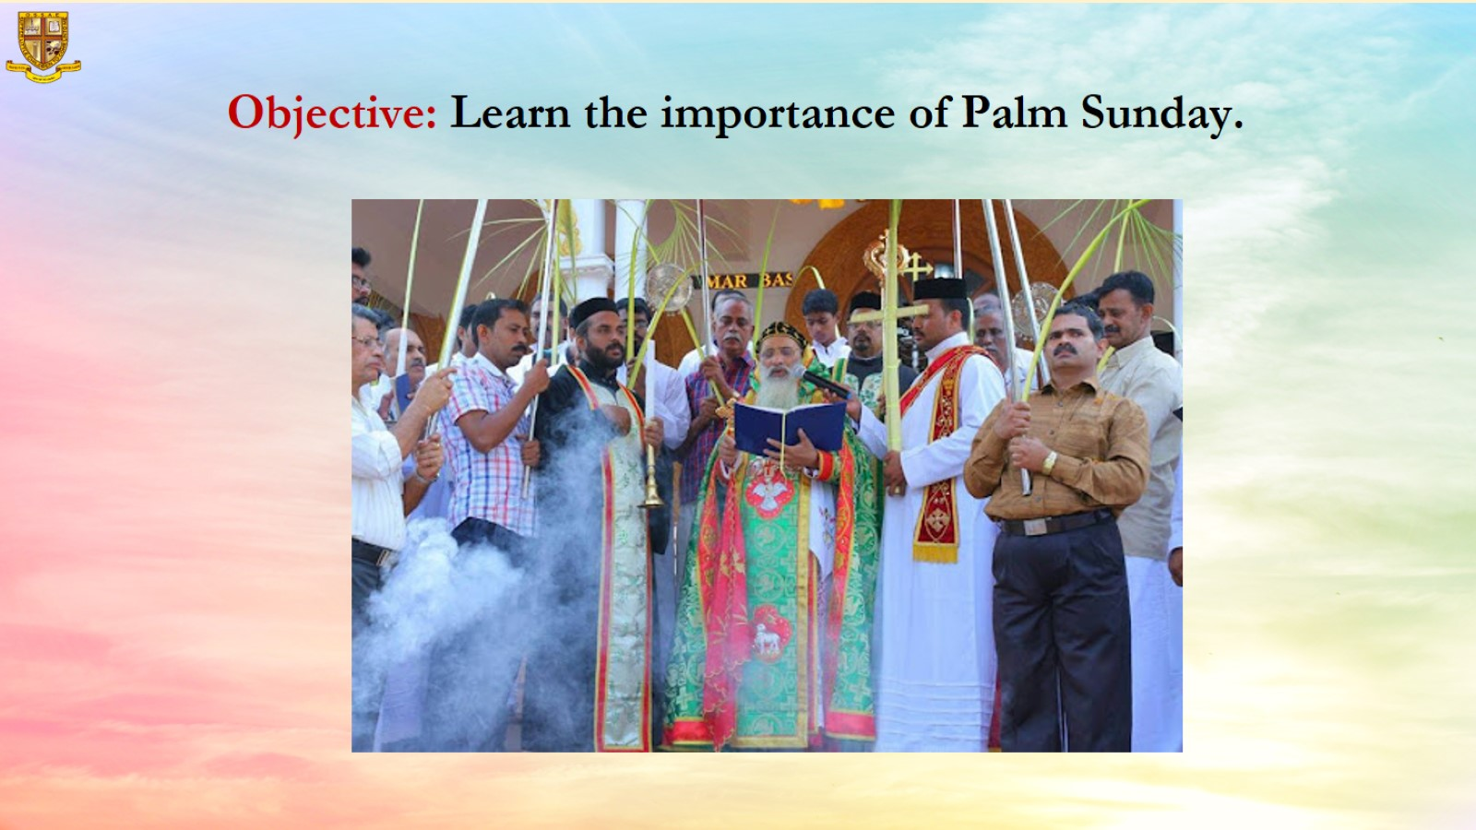

Slide 7
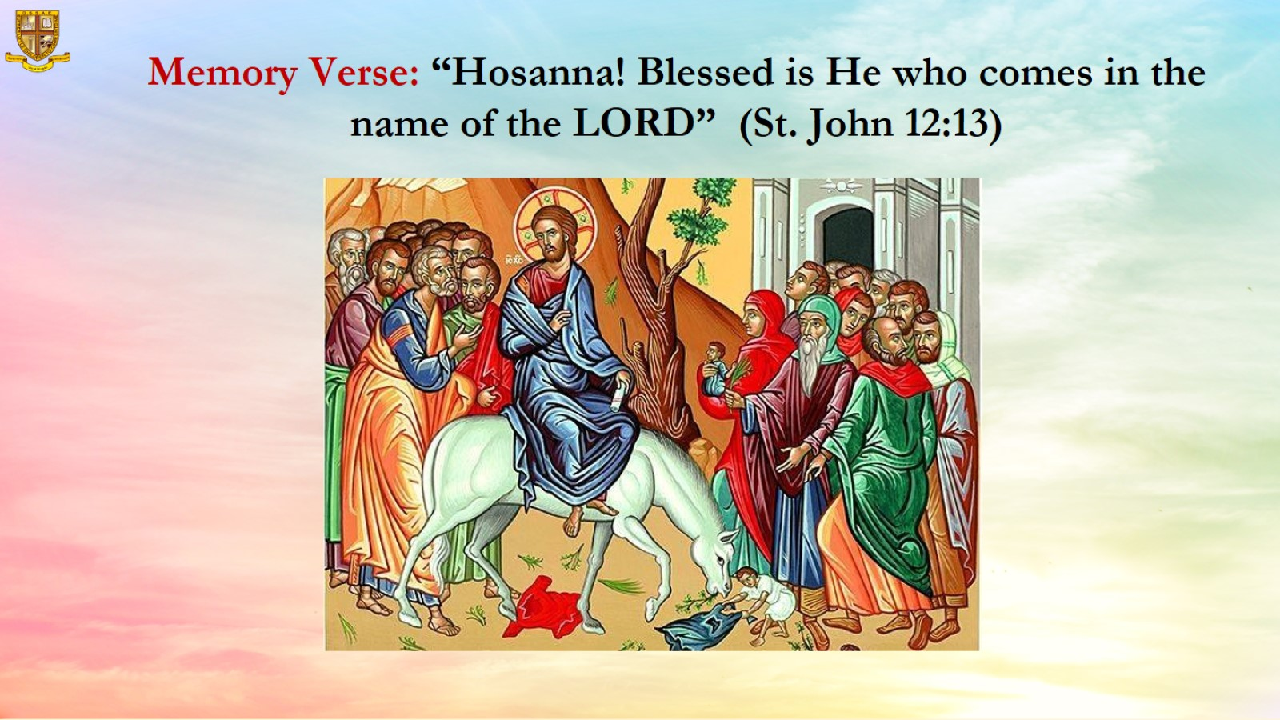

Slide 8
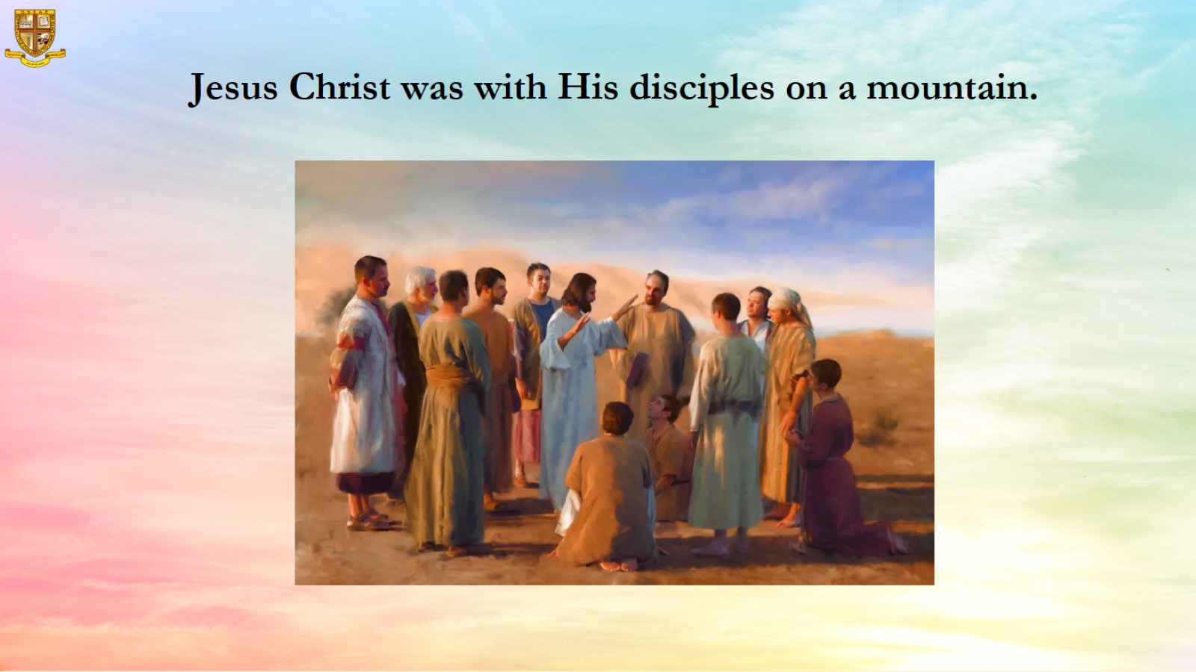

Slide 9
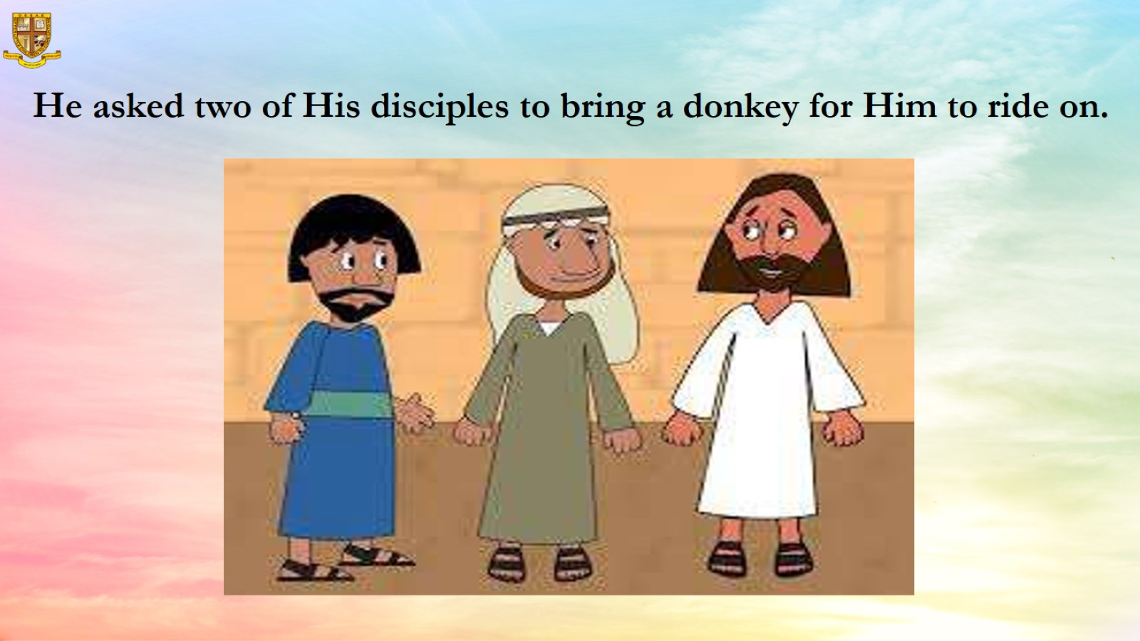

Slide 10
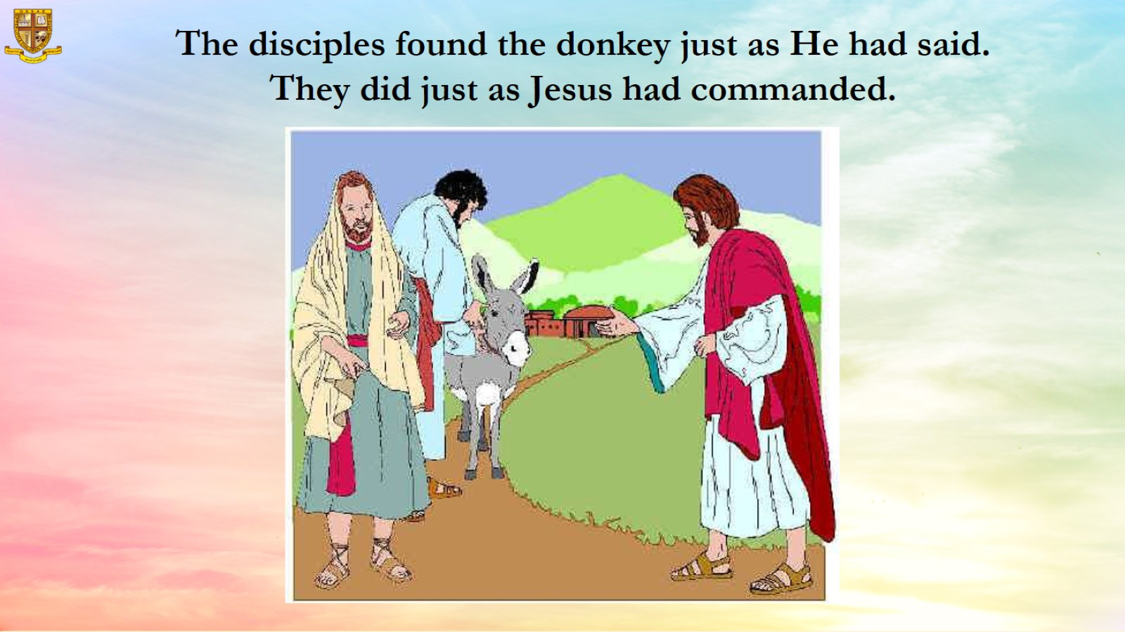

Slide 11
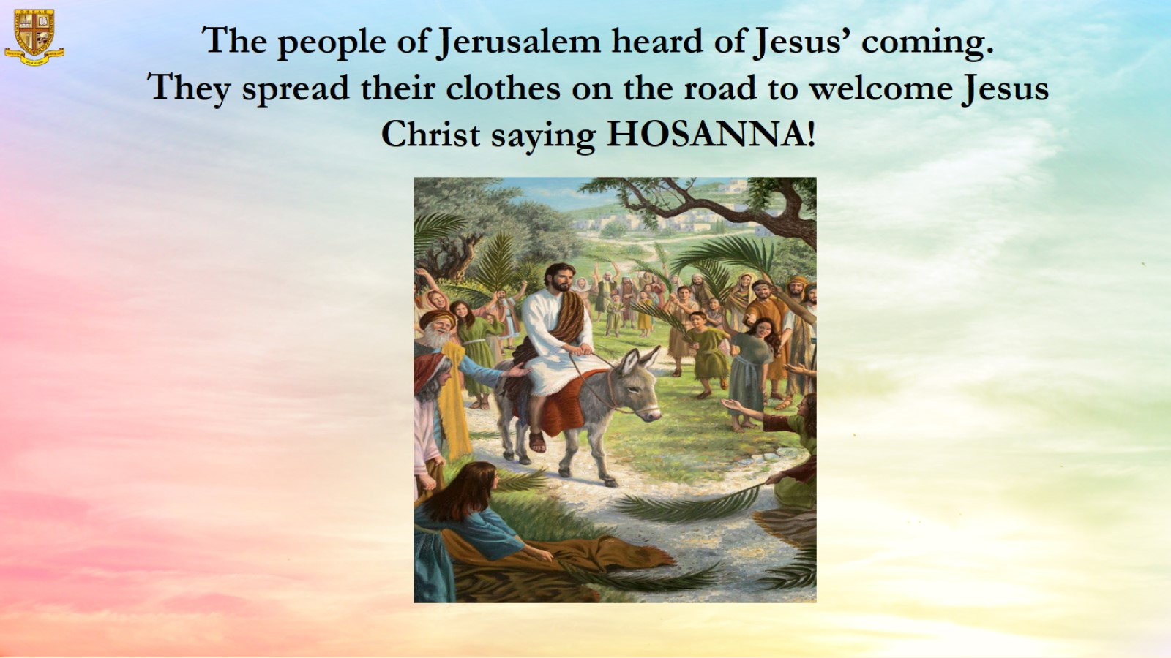

Slide 12
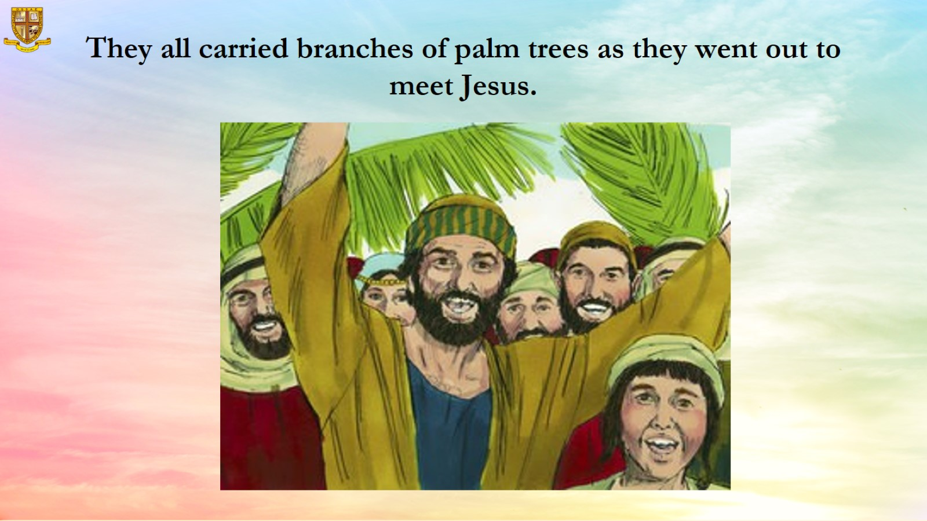

Slide 13
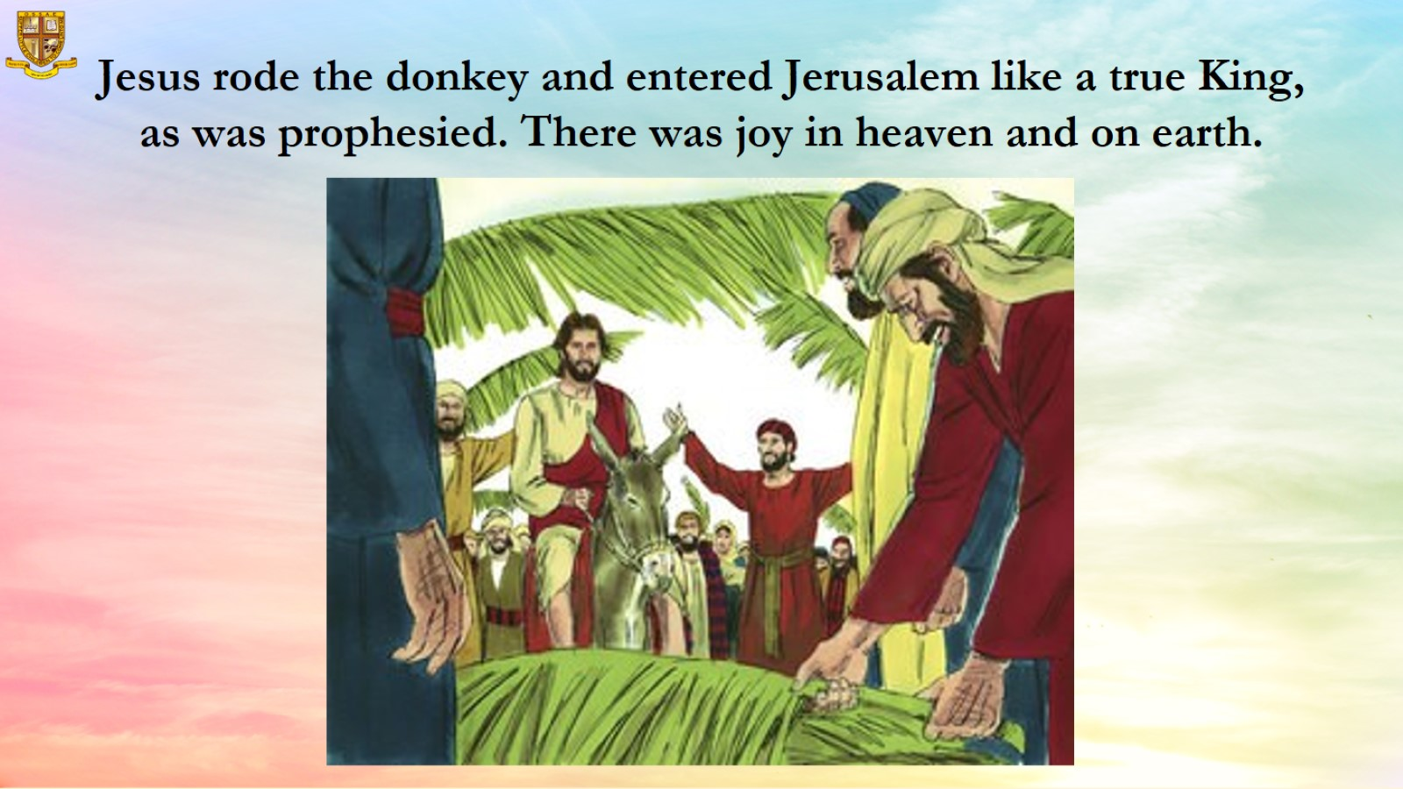

Slide 14
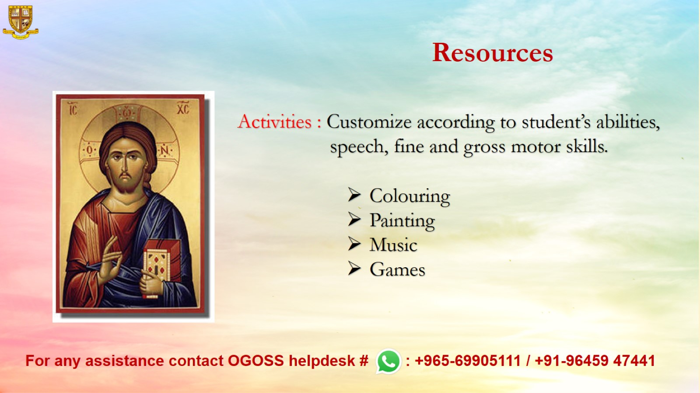
Resources

