Slide 1


Slide 2


Slide 3


Grade 1
Chapter 11
How to pray?

Slide 4
Preparation for the chapter
How to pray?
Lesson Outline
  We should pray everyday. We start and end with the Sign of the Cross using 3 fingers (Holy Trinity).
  We stand up in front of God. We pray with respect.
  We thank God for everything. We should pray for others and then ask Him for things we need.
  We listen when the priest or bishop is praying.
  At the end we pray the Lord’s prayer, "Our Father who art in Heaven…”
  Jesus taught us The Lord’s Prayer.

Slide 5
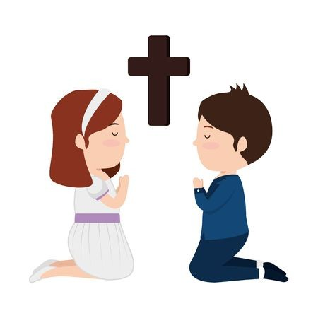
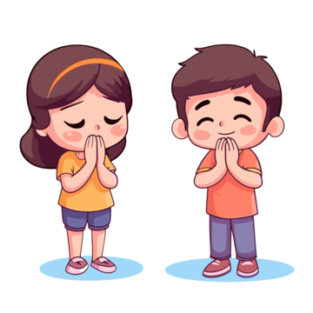
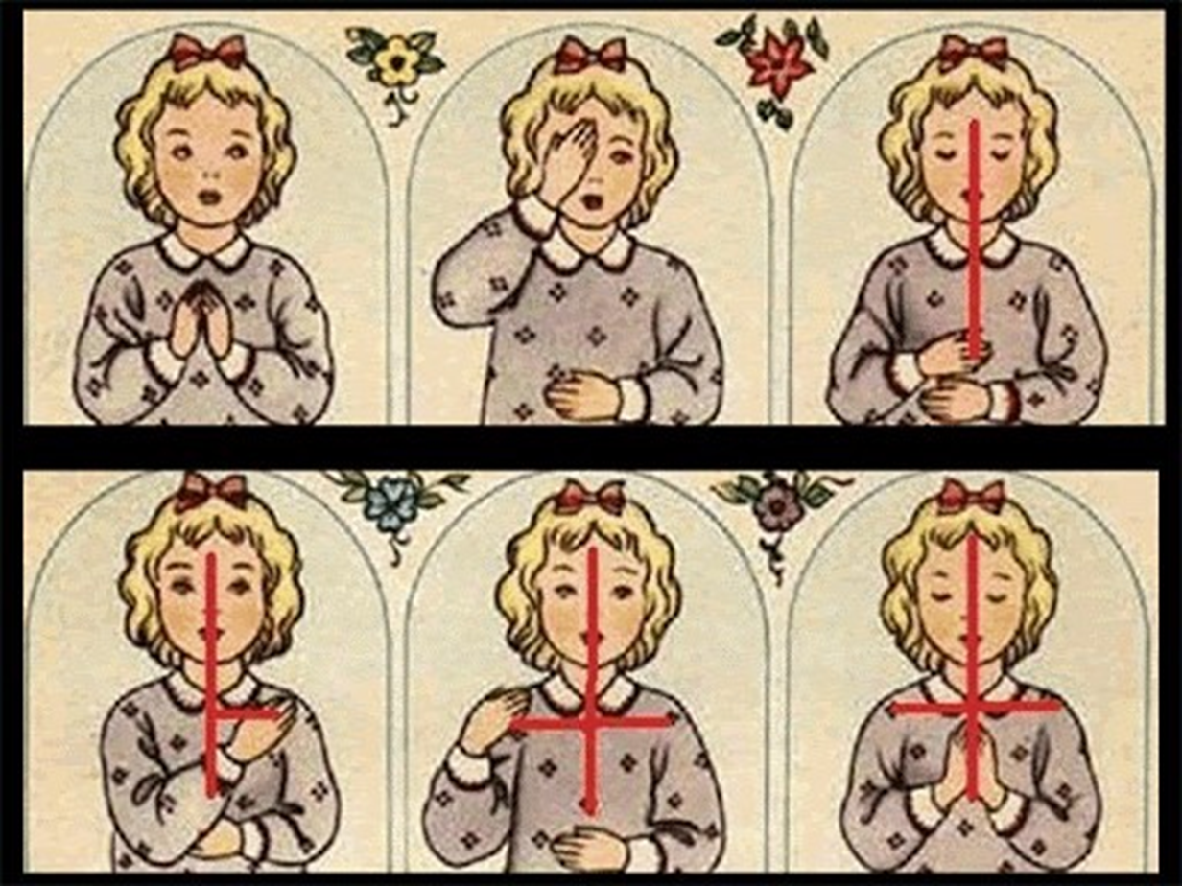
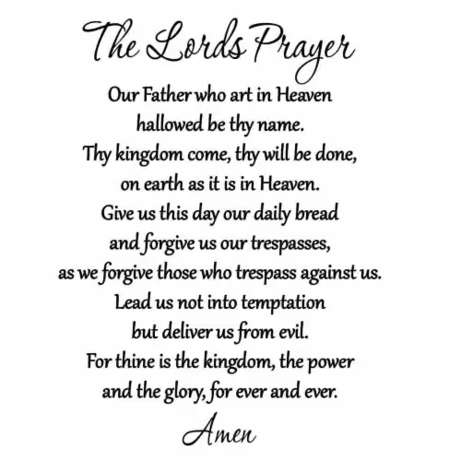
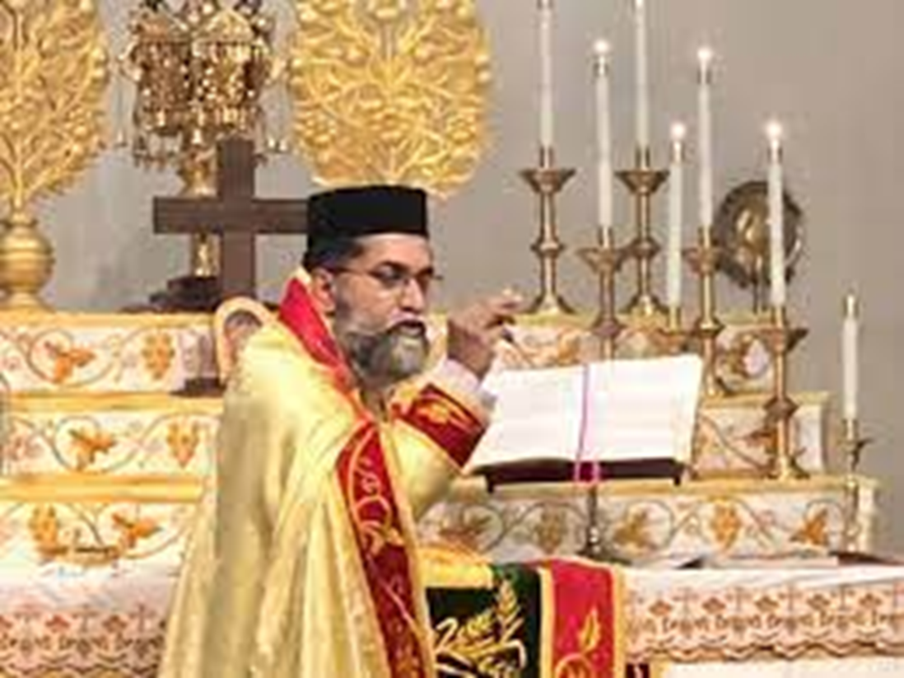
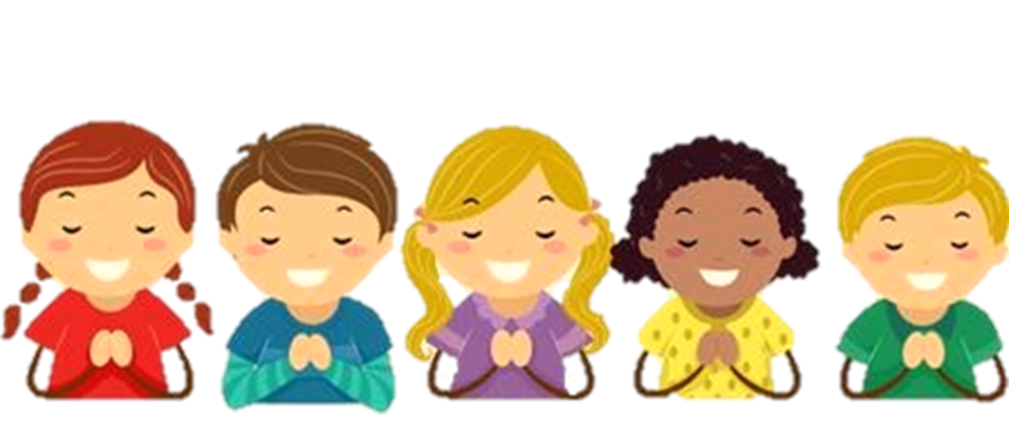
Word Bank
Pray
Sign of the Cross
Stand
Listen
Lord’s Prayer
Respect

Slide 6

Objective: To teach the children how to PRAY.

Slide 7

Memory Verse: “Pray continually, in everything give thanks.” (1 Thessalonians 5:17-18)
Thank You God!

Slide 8
We should pray everyday. We start and end with the Sign of the Cross using 3 fingers (Holy Trinity).

Slide 9
We stand up in front of God. We pray with respect.

Slide 10
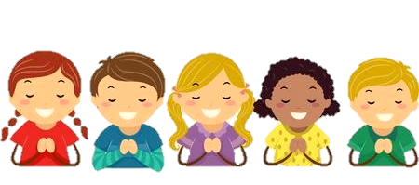
We thank God for everything.
We should pray for others and then
ask Him for things we need.

Slide 11

We listen when the priest or bishop is praying.

Slide 12
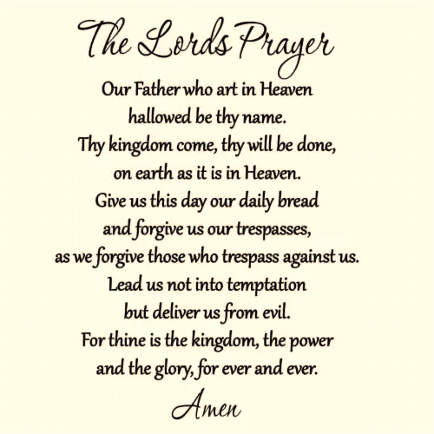
At the end we pray the Lord’s prayer, "Our Father who art in Heaven…”

Slide 13
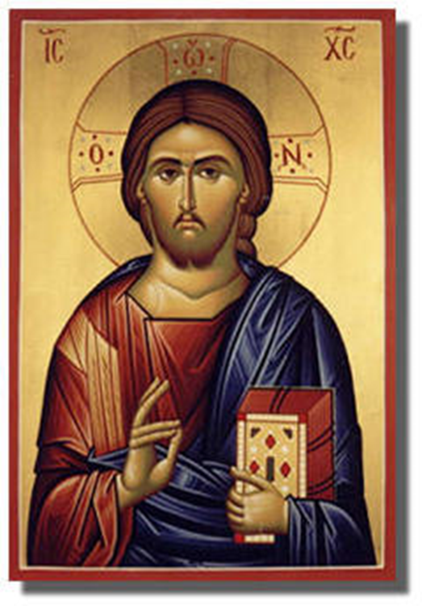
Jesus taught us The Lord’s Prayer.

Slide 14
