Slide 1


Slide 2
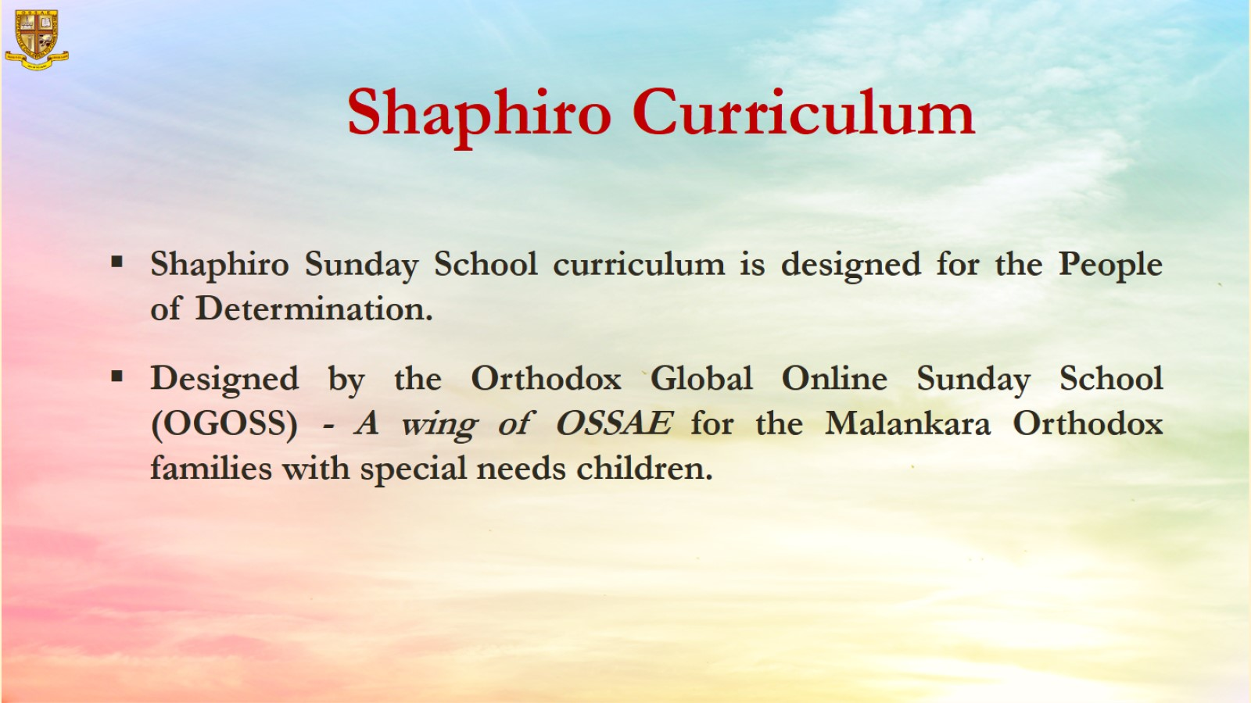


Curriculum
This curriculum is for Exceptional Student Education for Sunday School. It is designed by the Orthodox Global Online Sunday School (OGOSS) ESE team for Malankara Orthodox families with special needs children.
This is a modified Sunday School Curriculum designed for children with special needs.

Slide 3
Grade 1
Chapter 8
Jesus heals the blind man

Slide 4

Preparation for the chapter
Jesus heals the blind man
Lesson Outline
  The pool of Bethesda healed one person per year.
  A paralyzed man was waiting there for 38 years.
  Jesus saw him. He asked him if he wanted to be healed.
  He told Jesus “ Yes, I have been waiting for 38 years ”.
  Jesus told him to get up, take his mat and walk.
  Immediately, he was able to get up and walk.

Slide 5
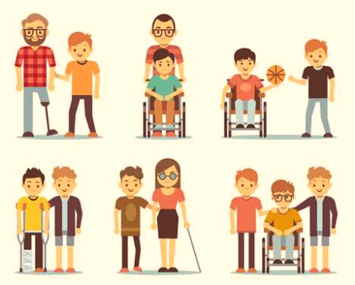
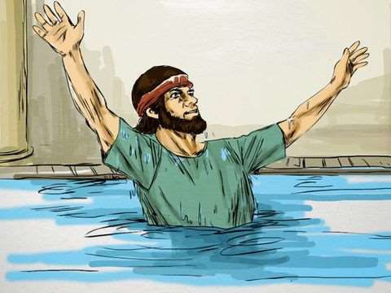
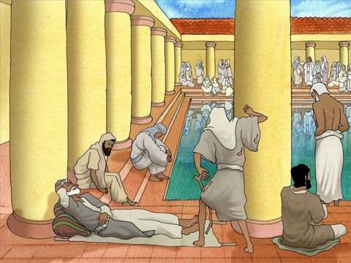
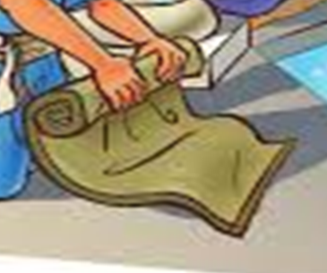
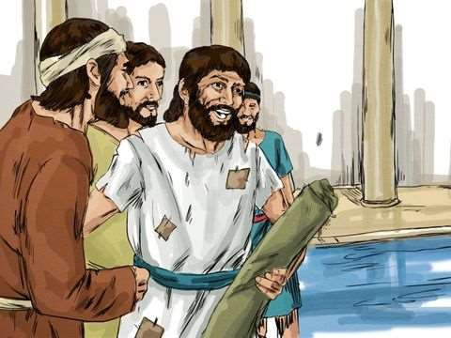
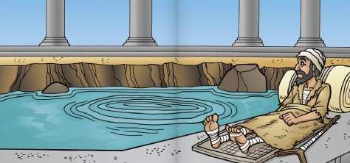
Word Bank
Disabled
Heal
Waiting
Mat
Walk
Pool of Bethesda

Slide 6

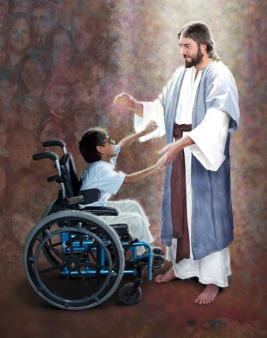
Objective: Show the students the kindness of Jesus Christ
to the Disabled

Slide 7

Memory Verse: “Rise, take up your bed, and walk” (St. John 5:8)

Slide 8

The pool of Bethesda healed one person per year.

Slide 9

A paralyzed man was waiting there for 38 years.

Slide 10
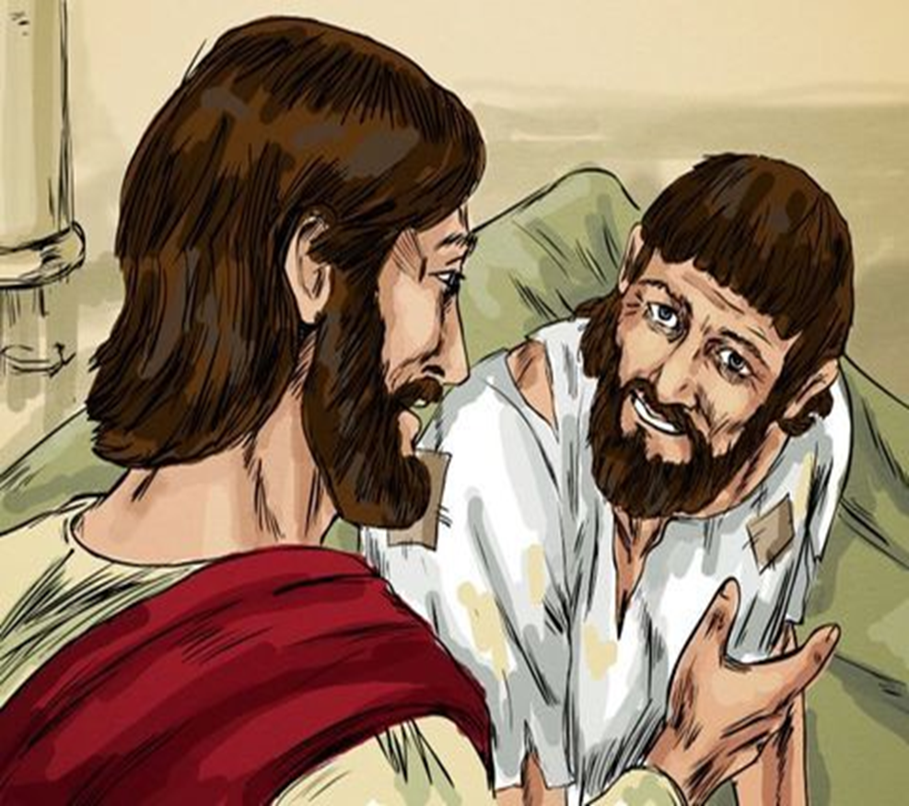
Jesus saw him. He asked him if he wanted to be healed.

Slide 11
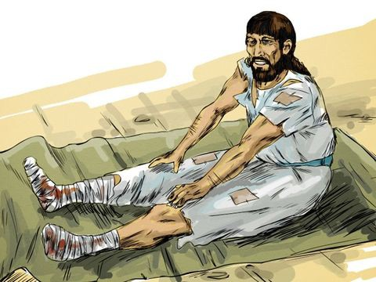
He told Jesus “ Yes, I have been waiting for 38 years.”

Slide 12
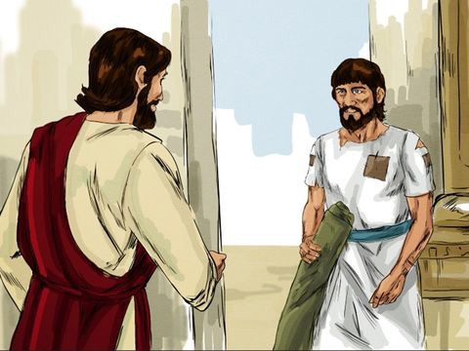
Jesus told him to get up, take his mat and walk.

Slide 13

Immediately, he was able to get up and walk.

Slide 14
