Slide 1
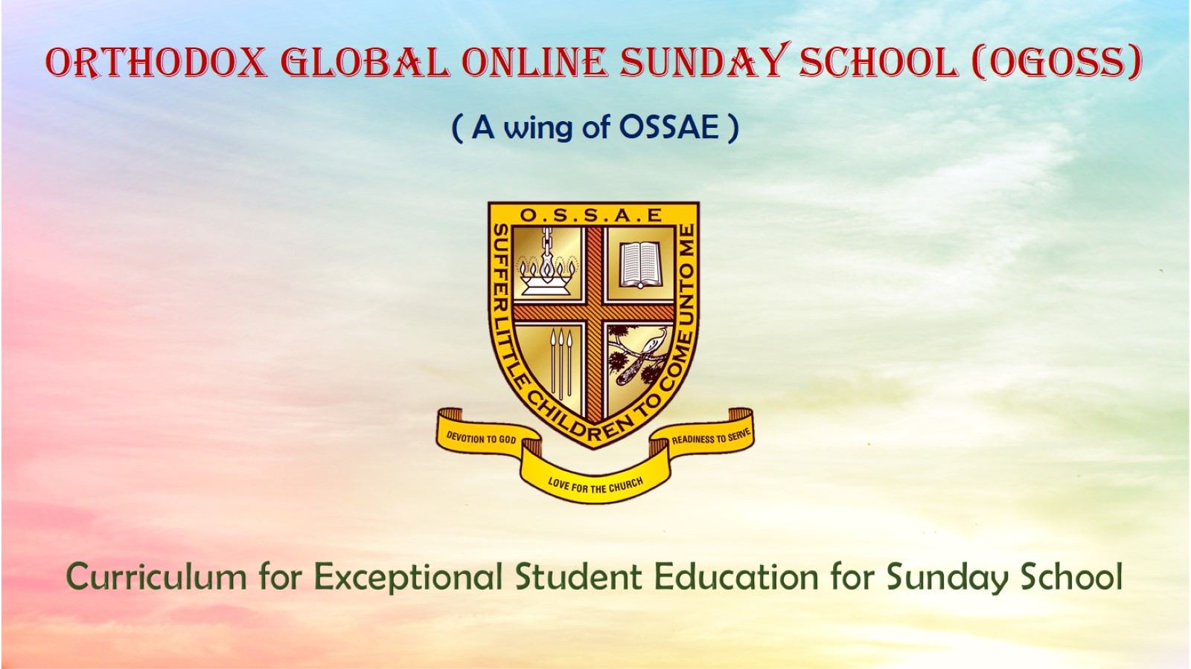
Orthodox Global Online Sunday School (OGOSS)

Slide 2
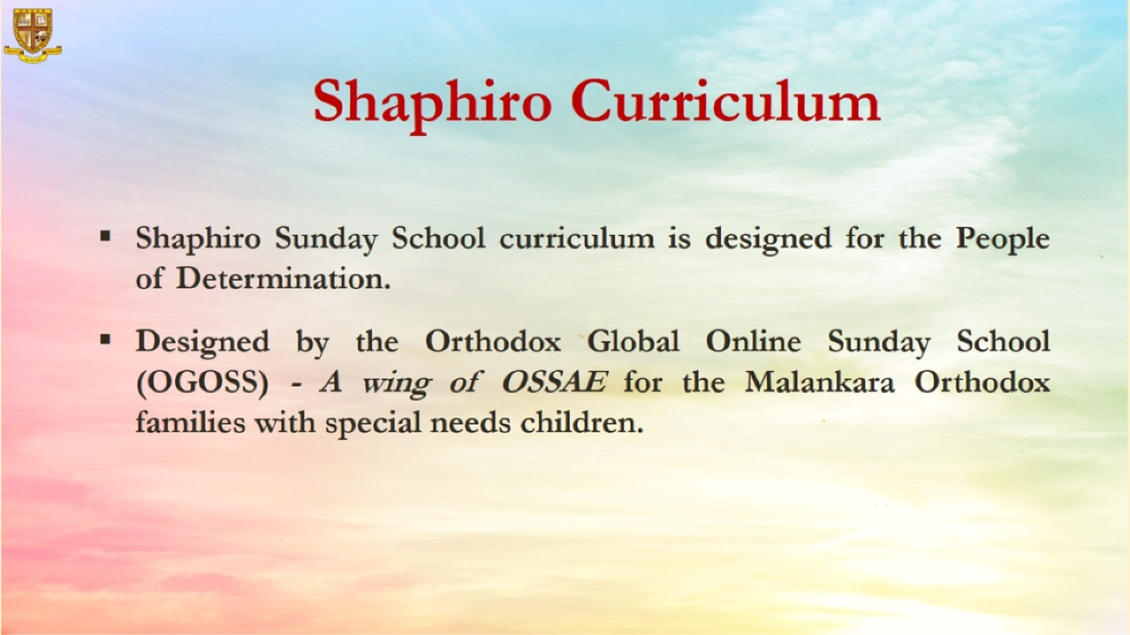

Slide 3


Slide 4
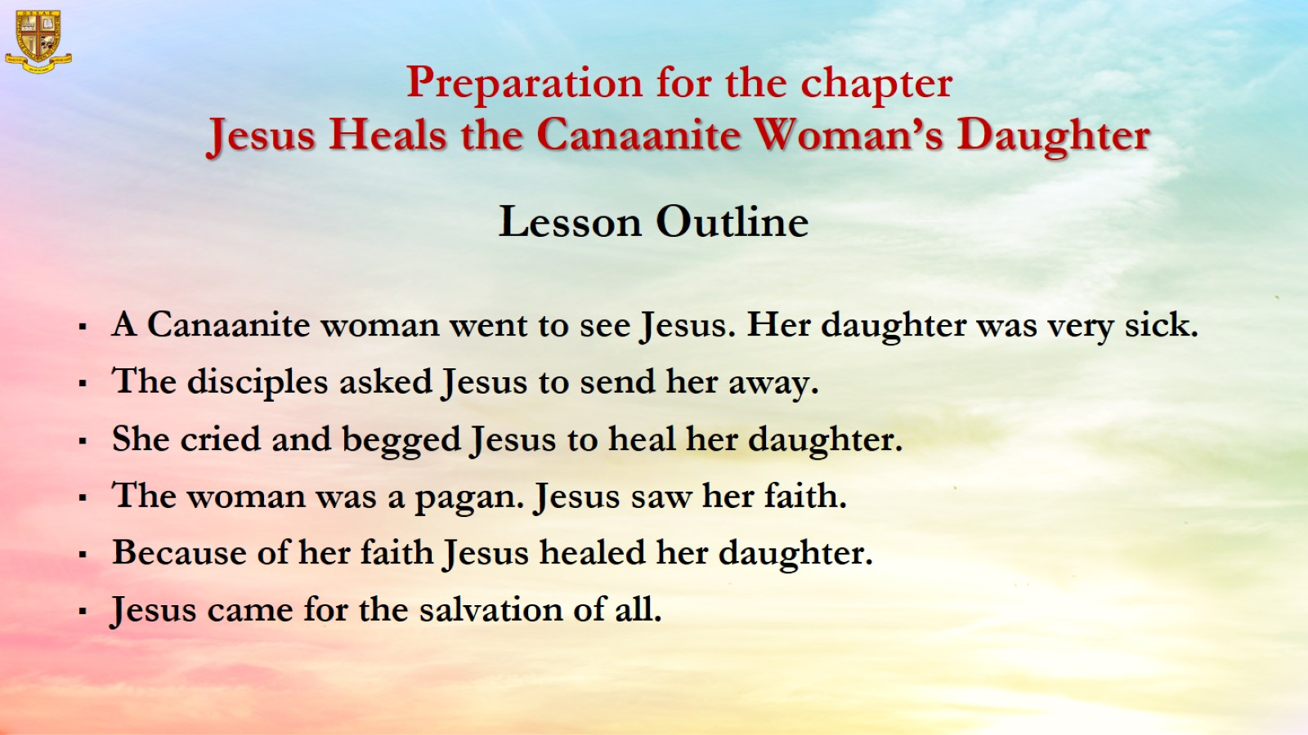

Slide 5
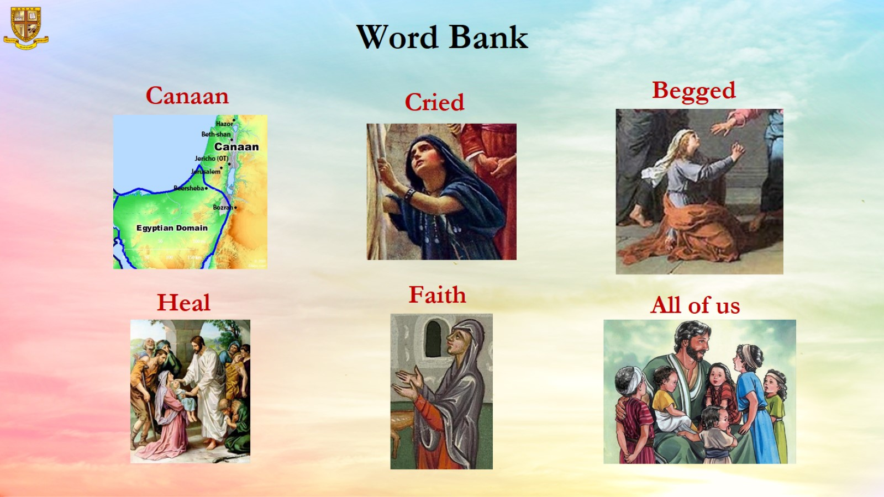

Slide 6
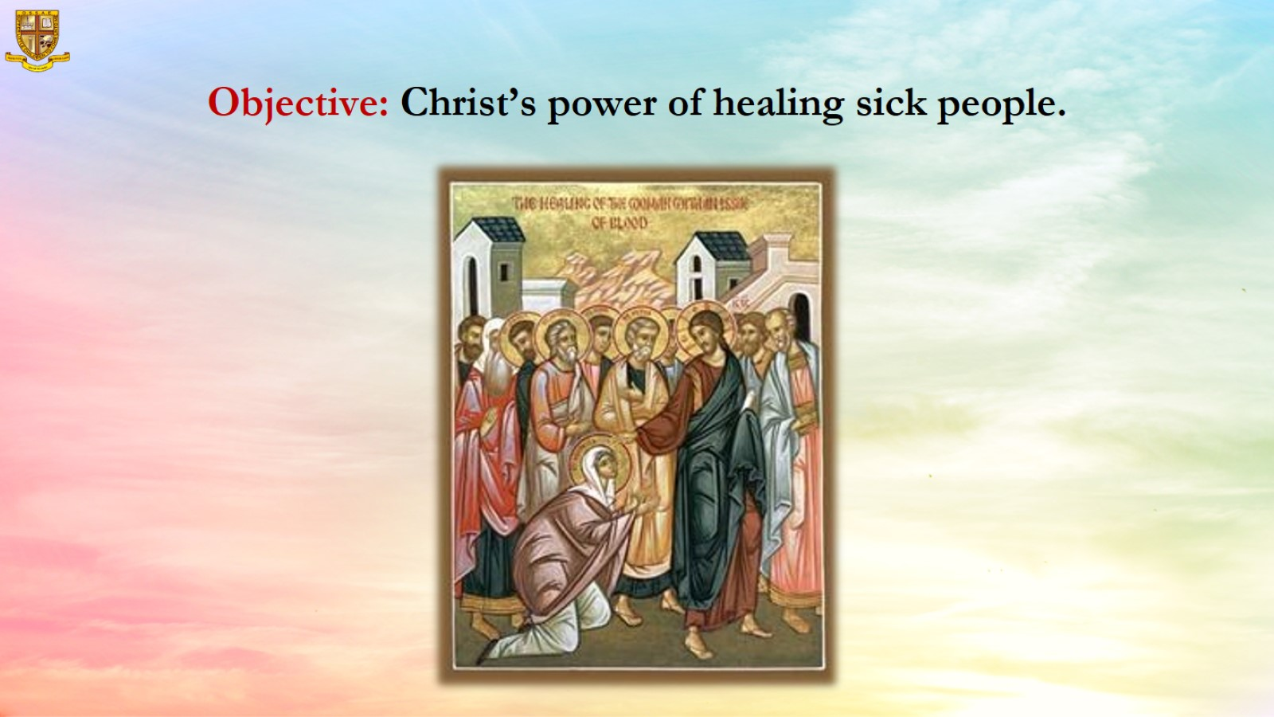
Objective: Christ’s power of healing sick people.

Slide 7
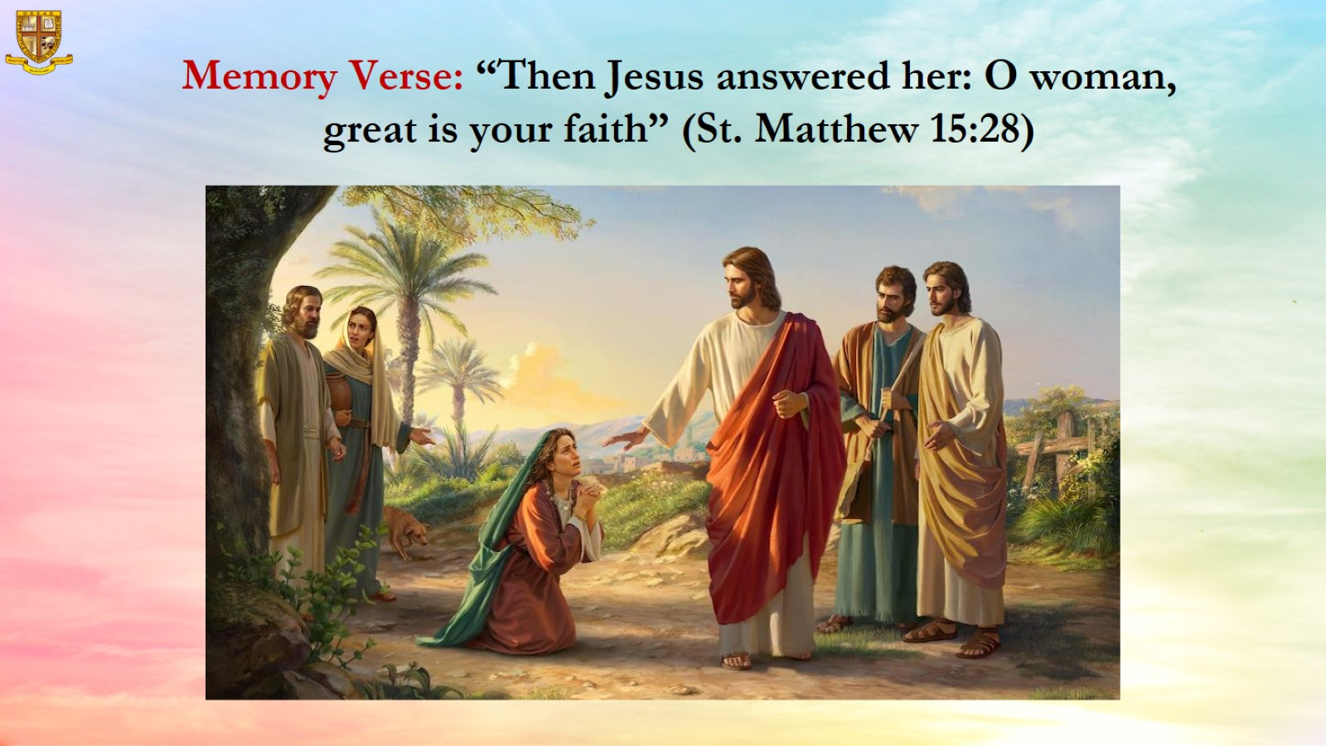
Memory Verse: “Then Jesus answered her: O woman, great is your faith” (St. Matthew 15:28)

Slide 8
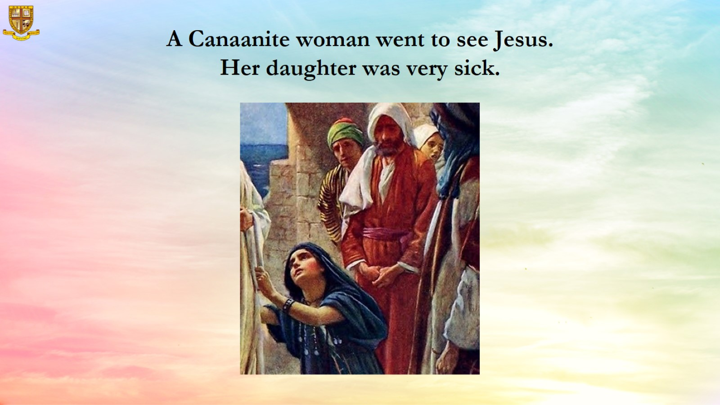

Slide 9
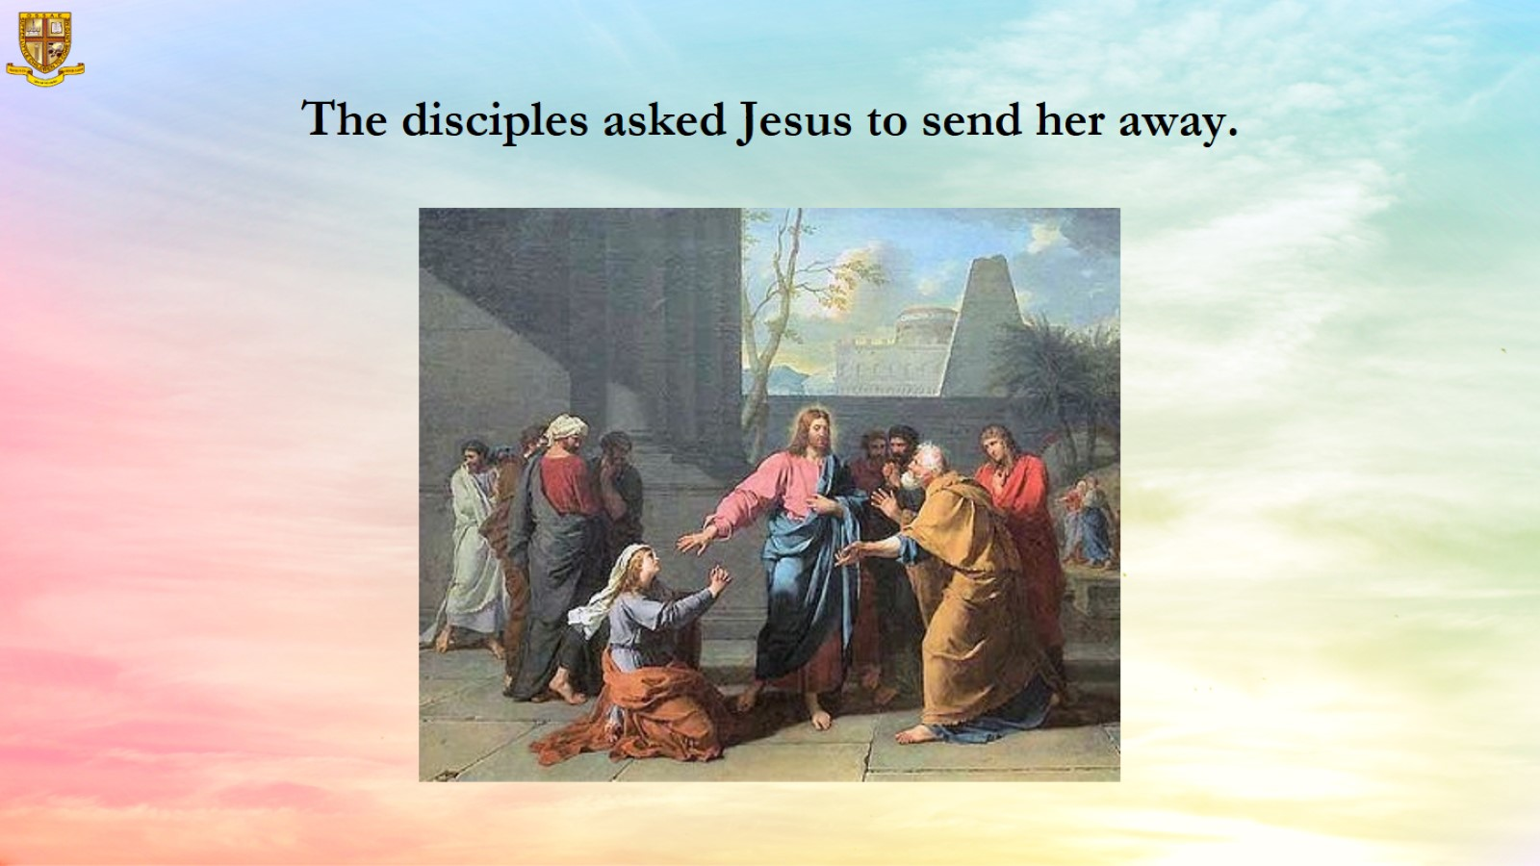
The disciples asked Jesus to send her away.

Slide 10
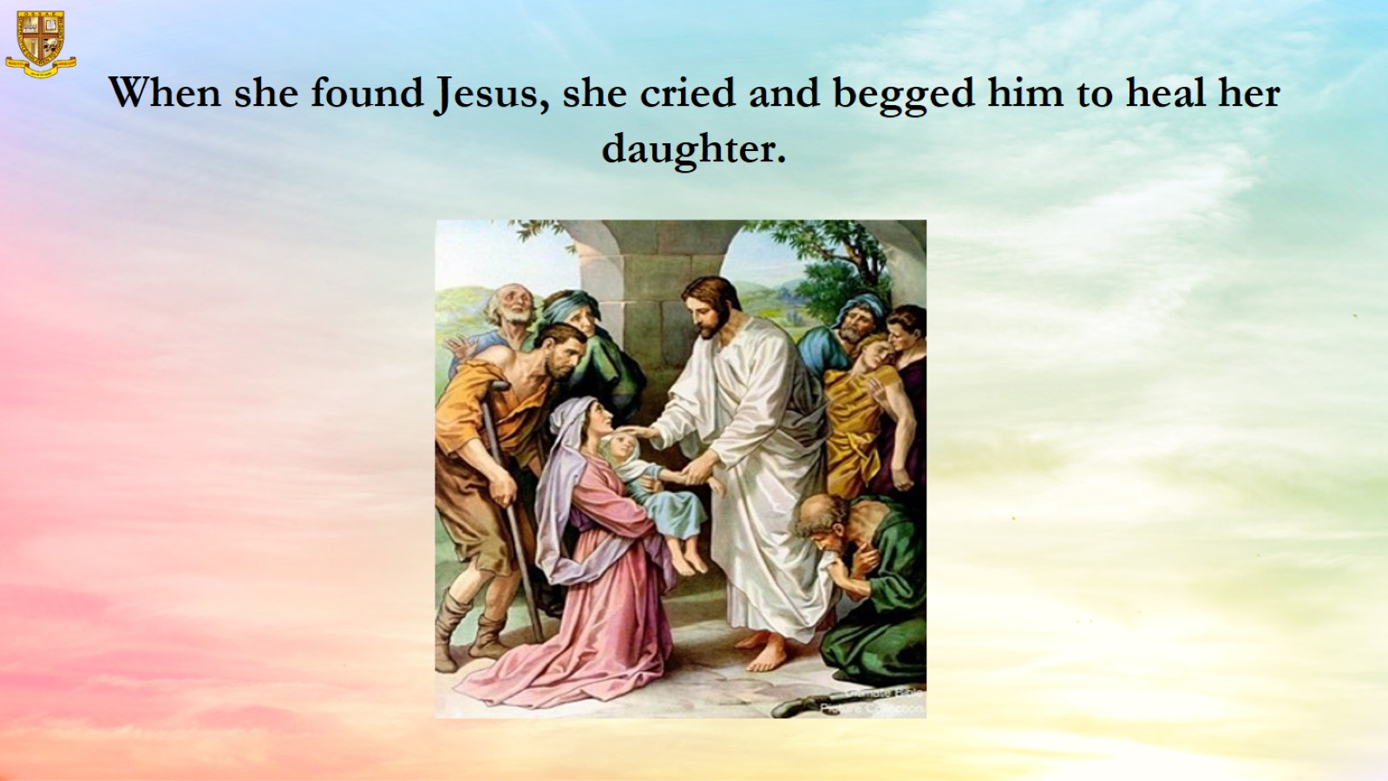
When she found Jesus, she cried and begged him to heal her daughter.

Slide 11
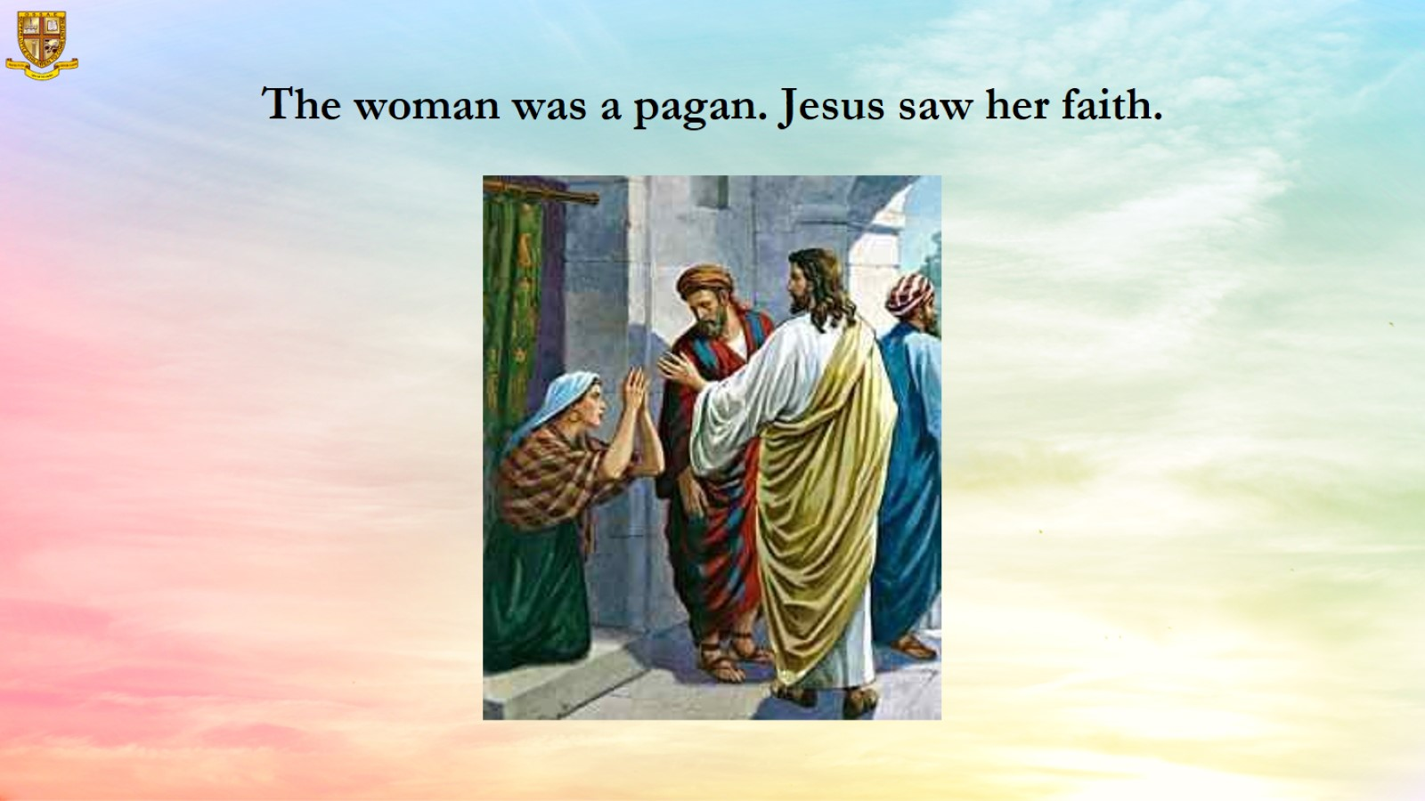
The woman was a pagan. Jesus saw her faith.

Slide 12
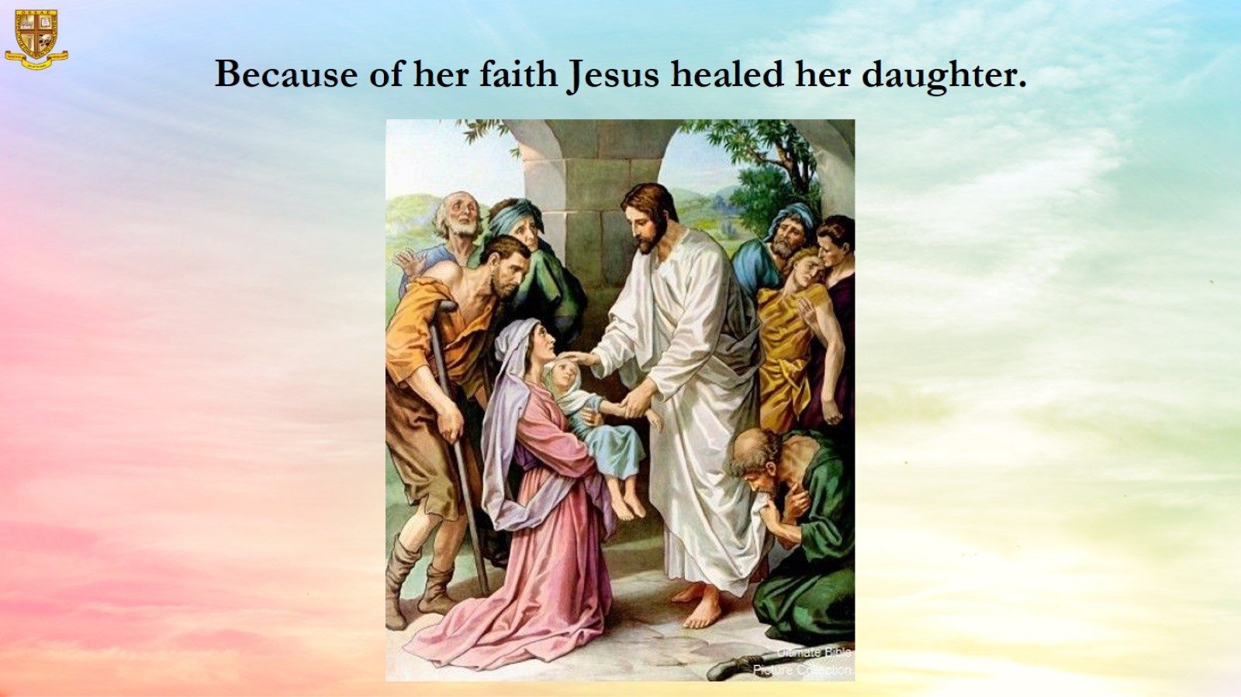
Because of her faith Jesus healed her daughter.

Slide 13
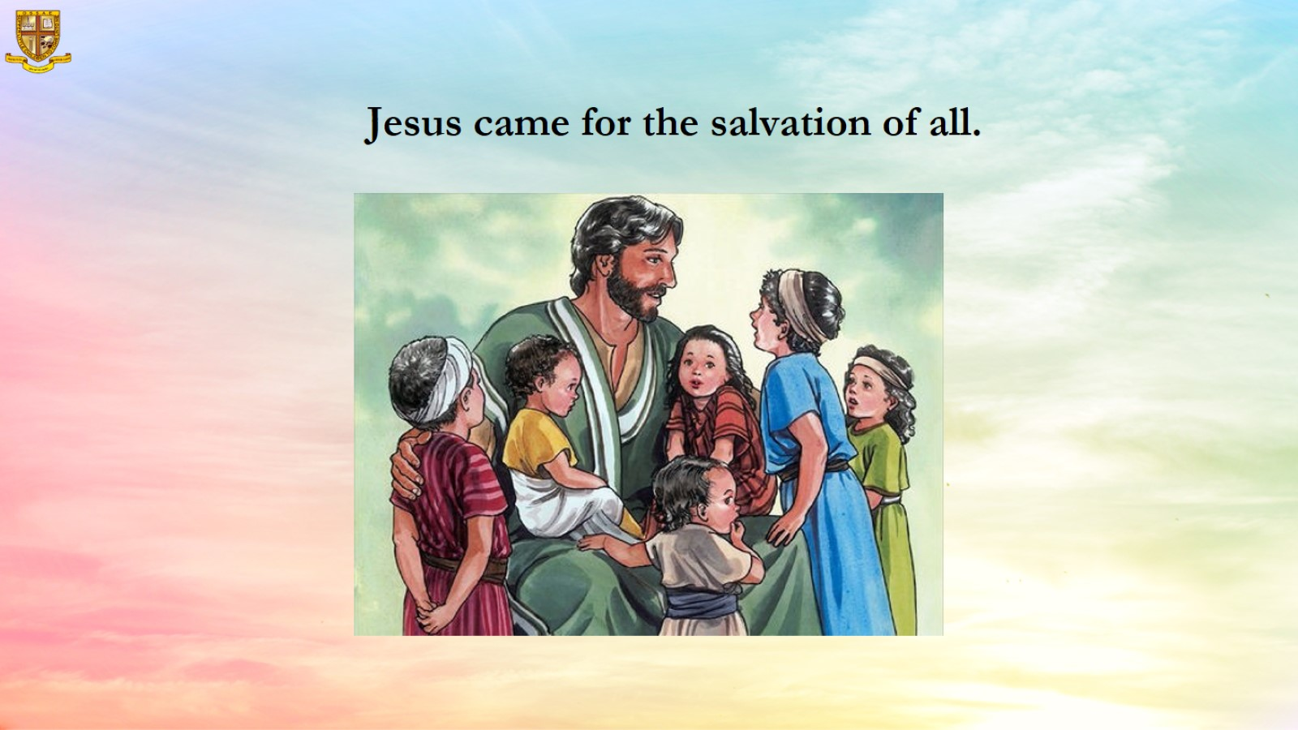
Jesus came for the salvation of all.

Slide 14
