Slide 1
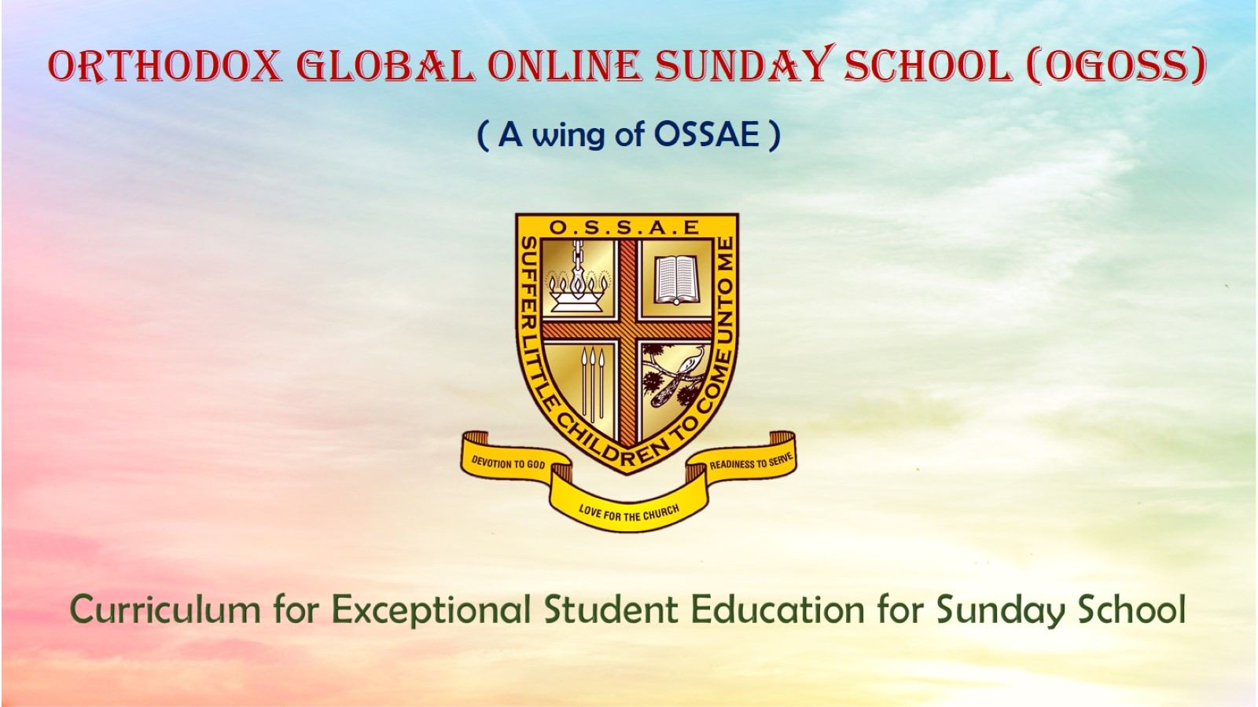
Orthodox Global Online Sunday School (OGOSS)

Slide 2
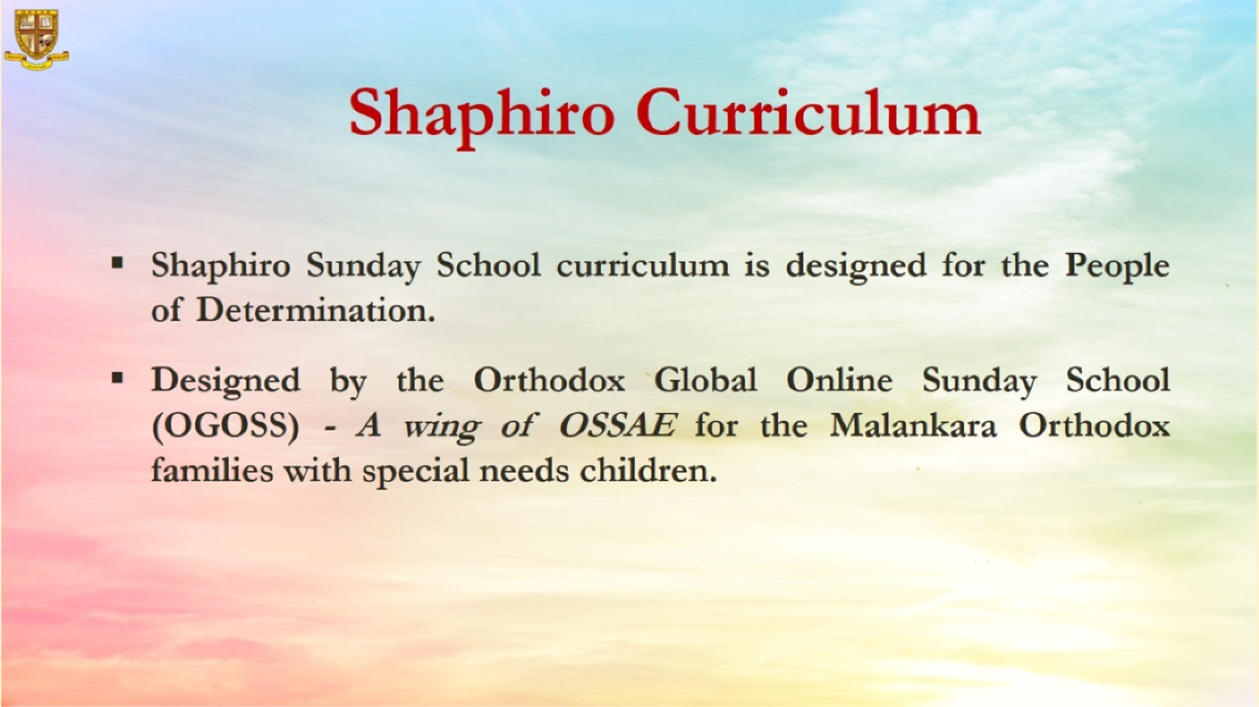

Slide 3
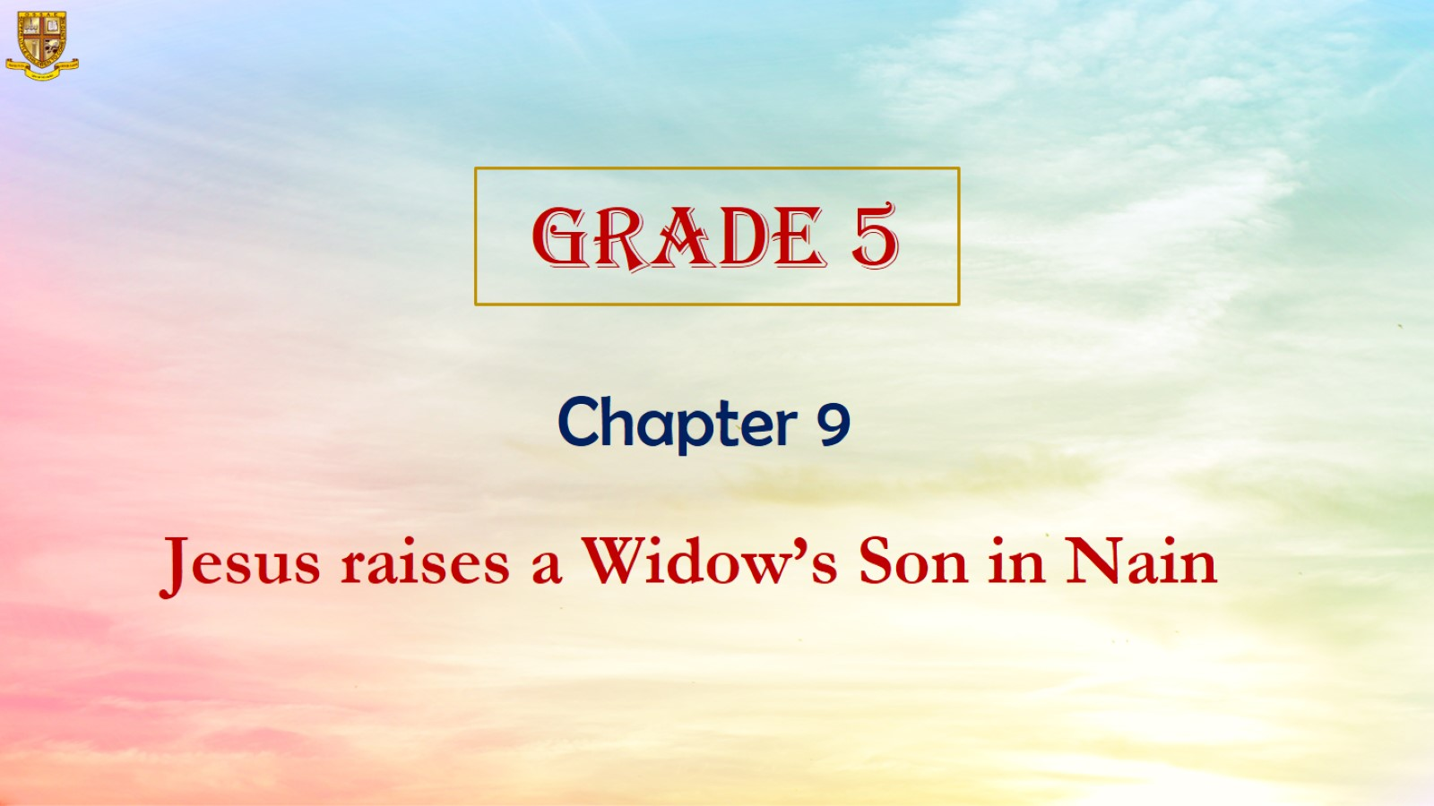

Slide 4
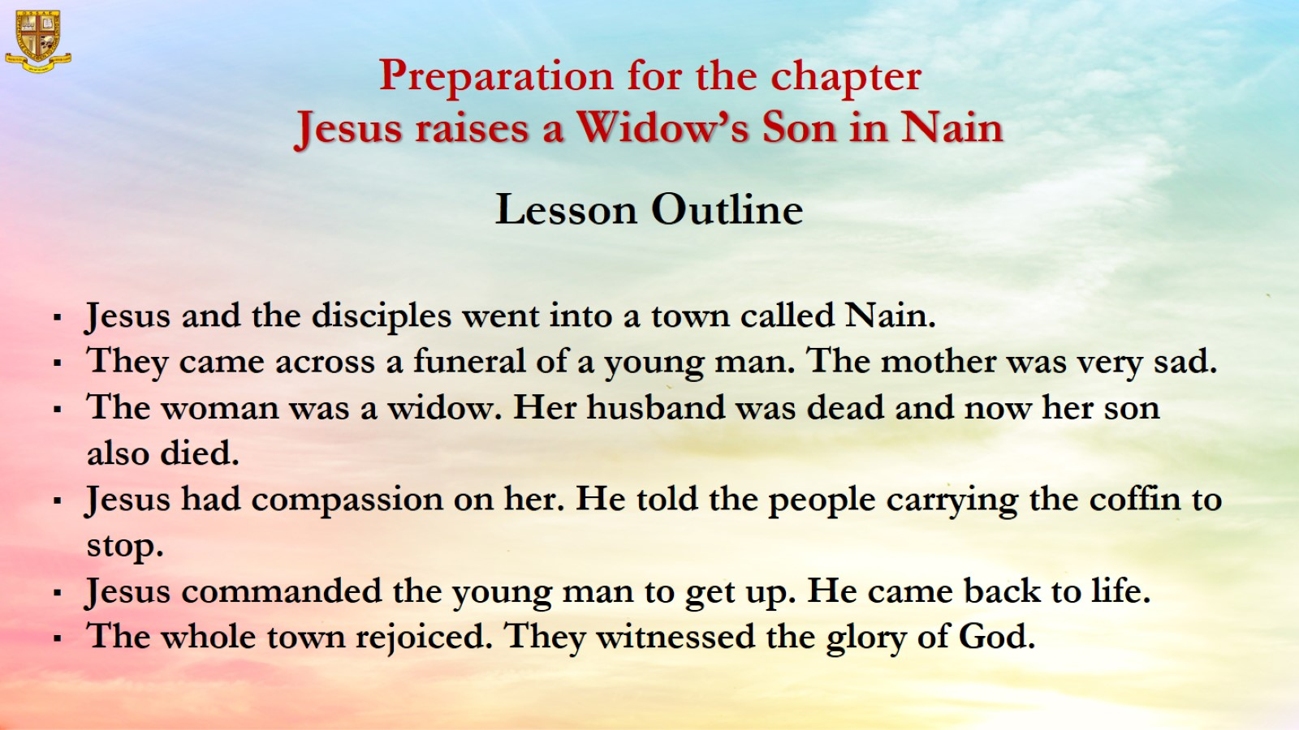

Slide 5
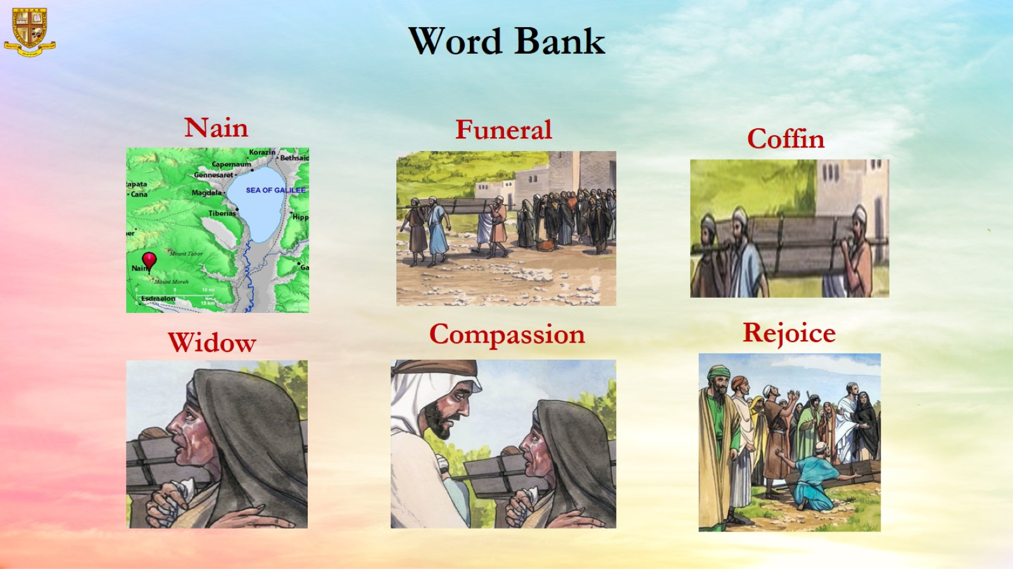

Slide 6
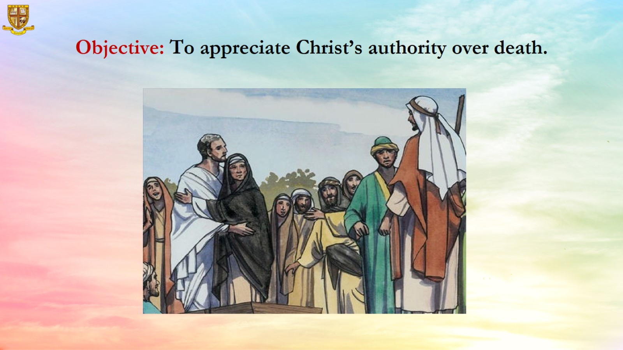
Objective: To appreciate Christ’s authority over death.

Slide 7
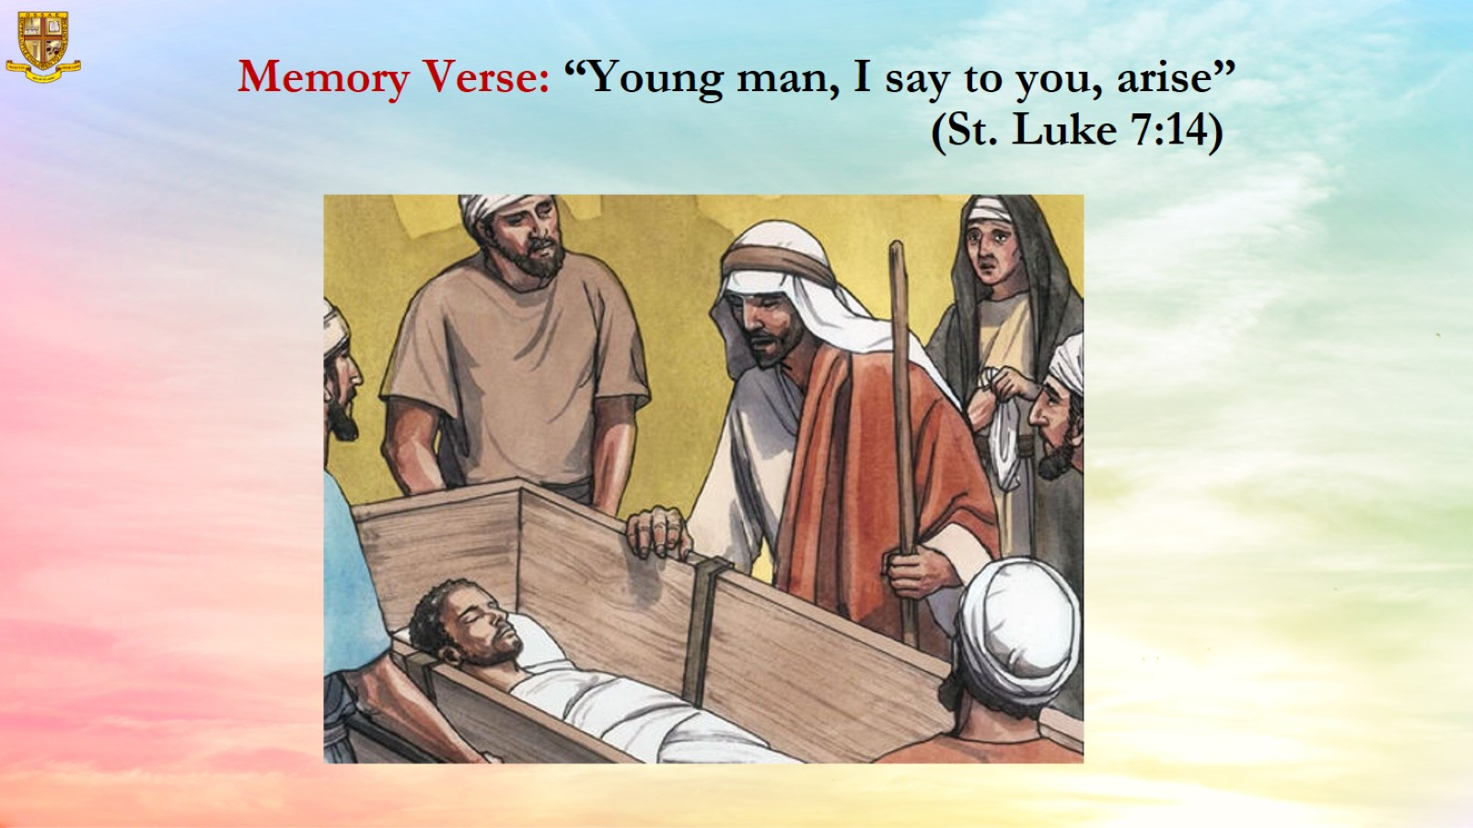
Memory Verse: “Young man, I say to you, arise” (St. Luke 7:14)

Slide 8
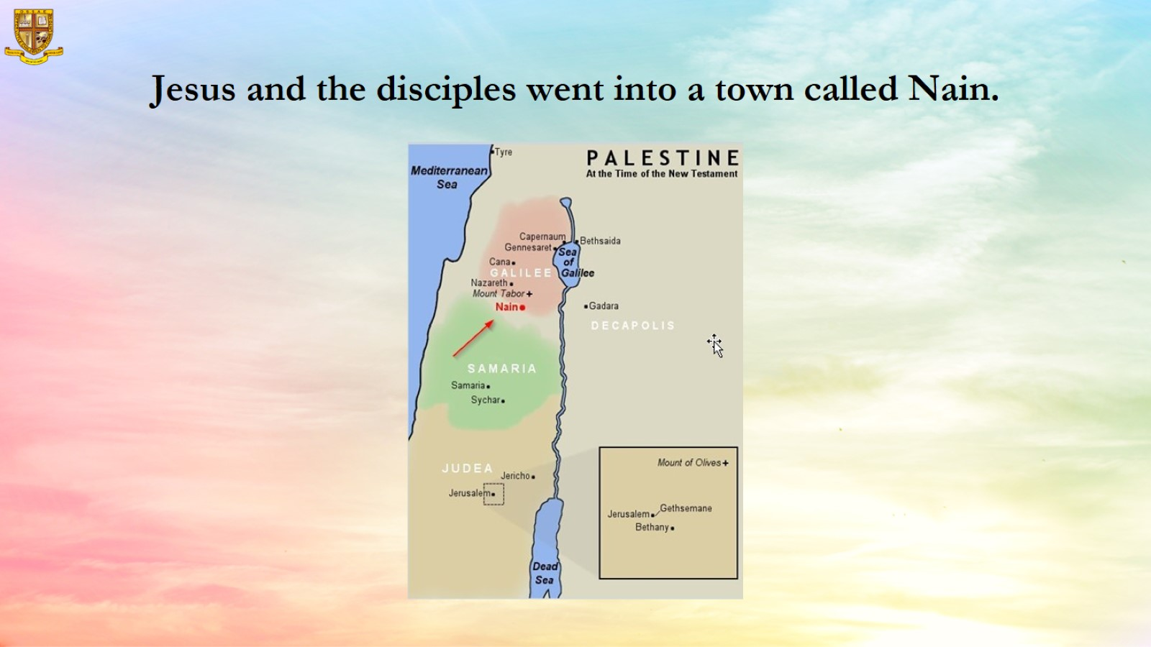
Jesus and the disciples went into a town called Nain.

Slide 9
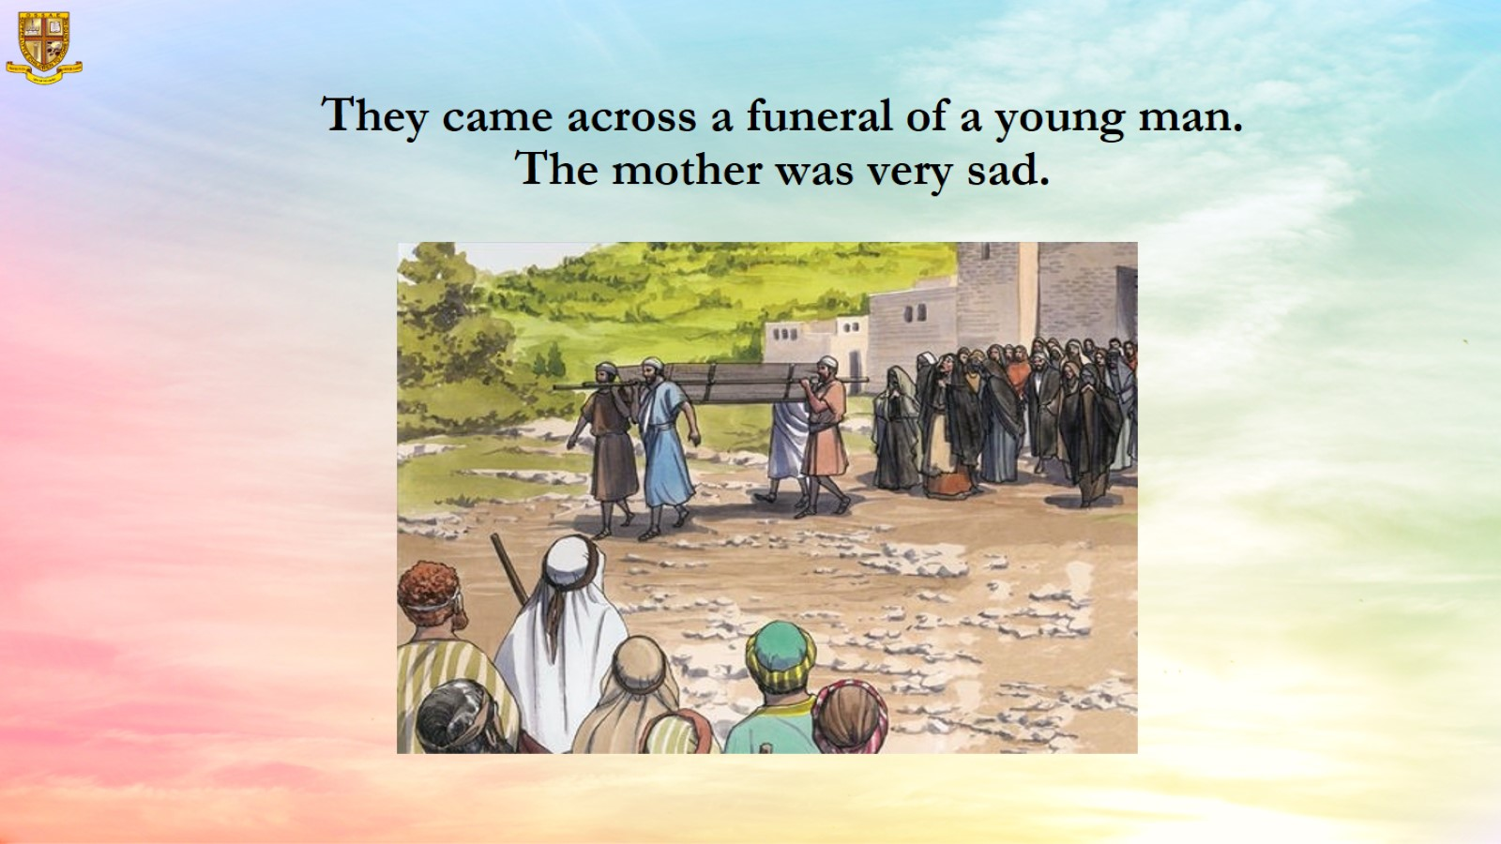
They came across a funeral of a young man. The mother was very sad.

Slide 10
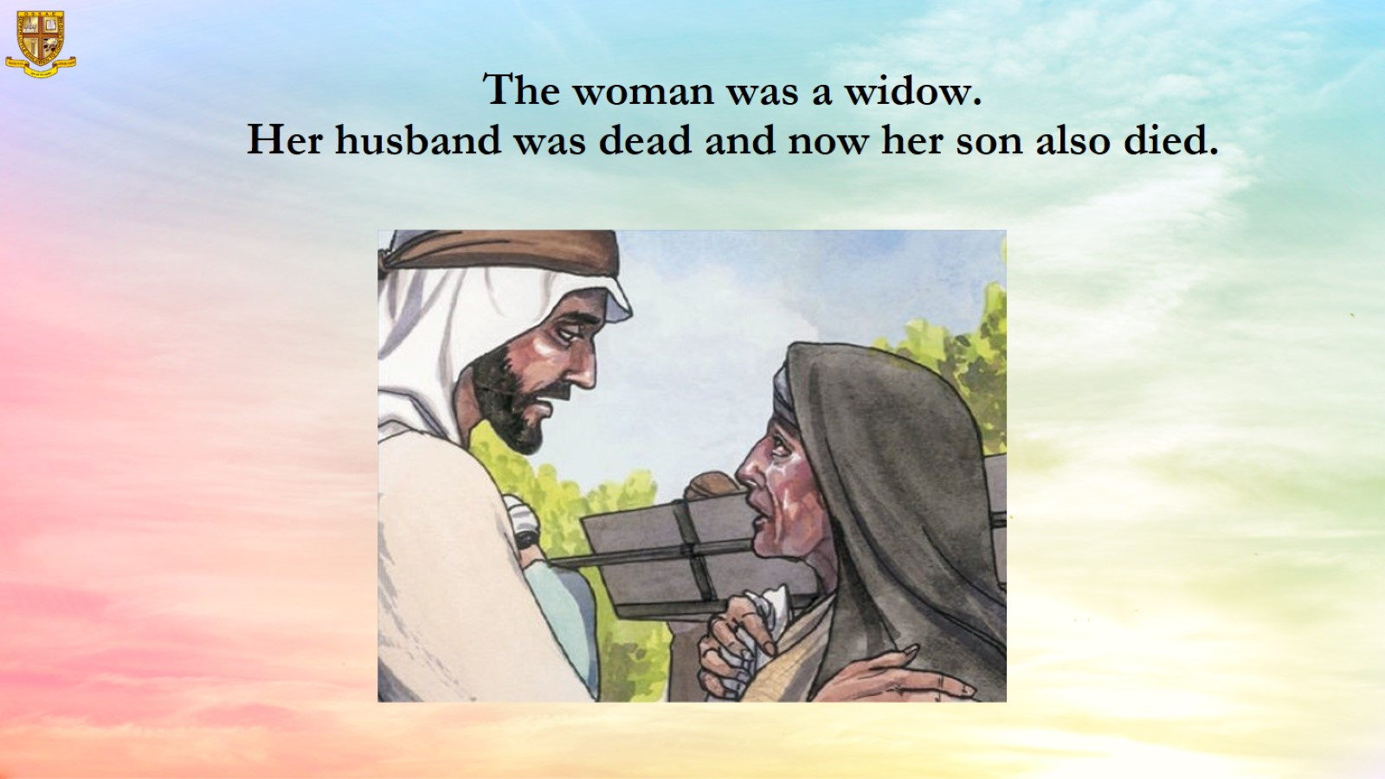
The woman was a widow.
Her husband was dead and now her son also died.

Slide 11
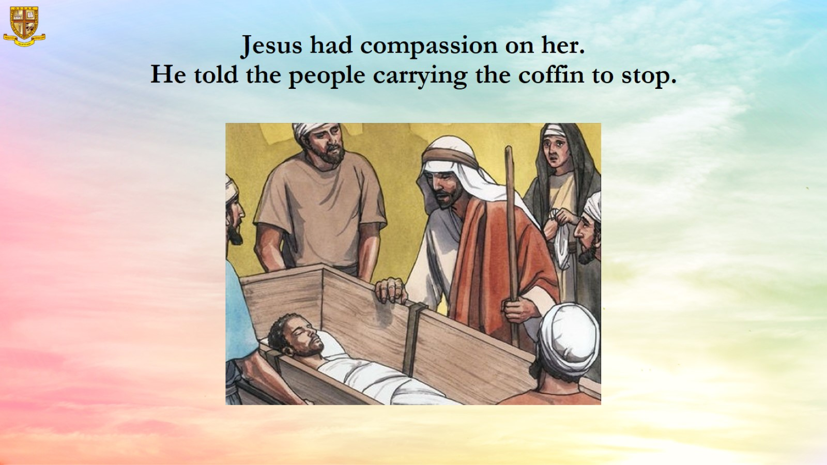
Jesus had compassion on her.
He told the people carrying the coffin to stop.

Slide 12
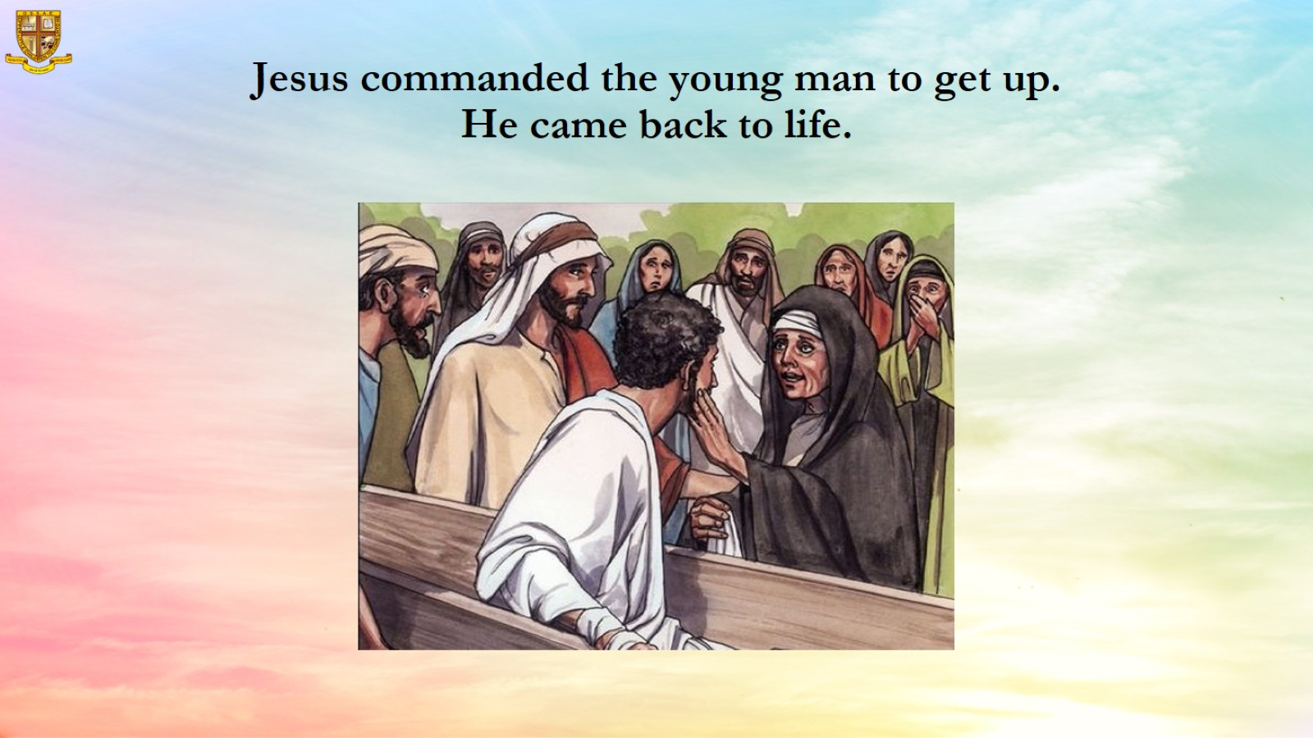
Jesus commanded the young man to get up.
He came back to life.

Slide 13
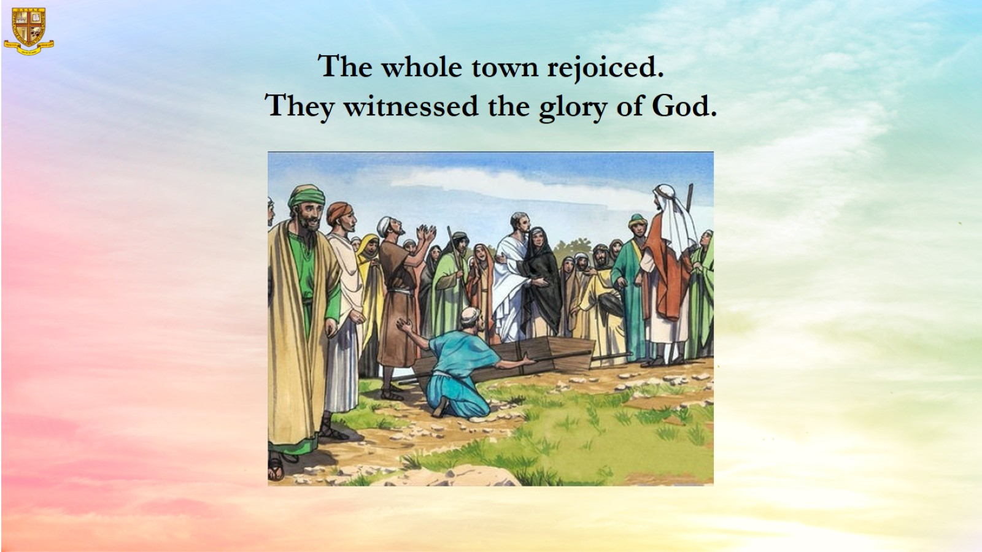

Slide 14
