Slide 1
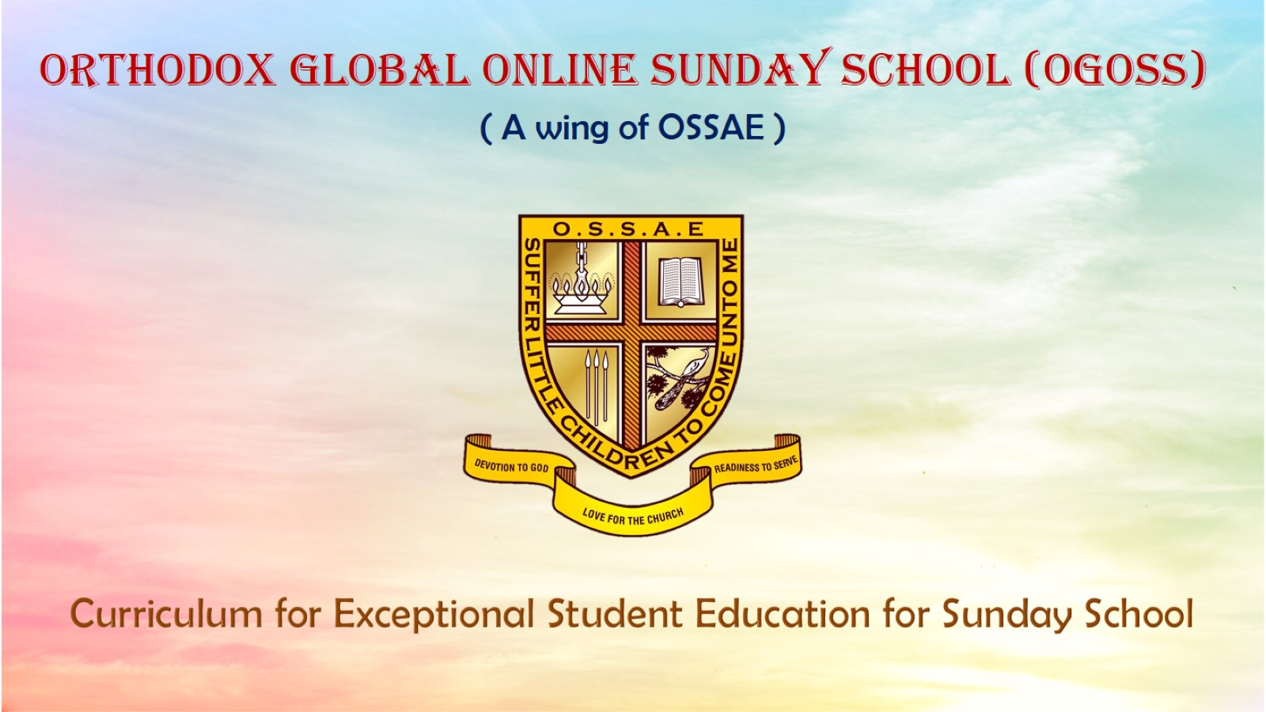
Orthodox Global Online Sunday School (OGOSS)

Slide 2
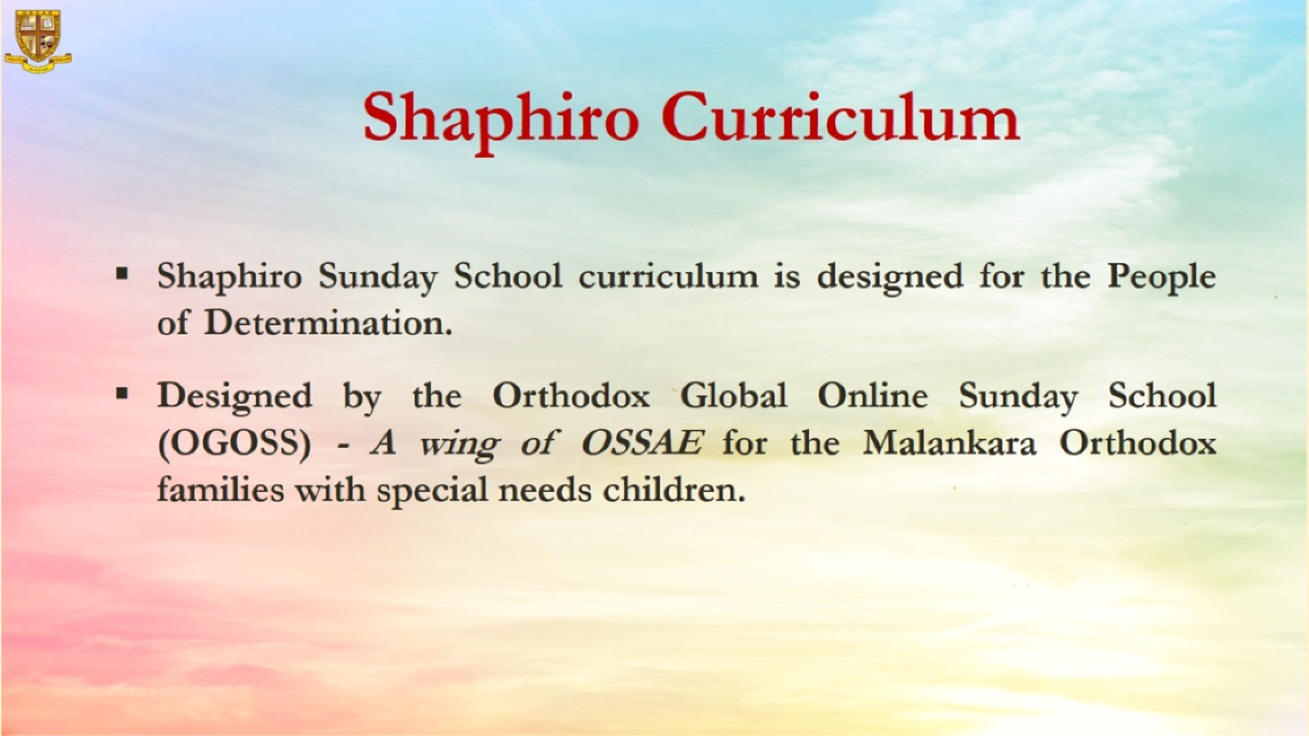

Slide 3


Slide 4
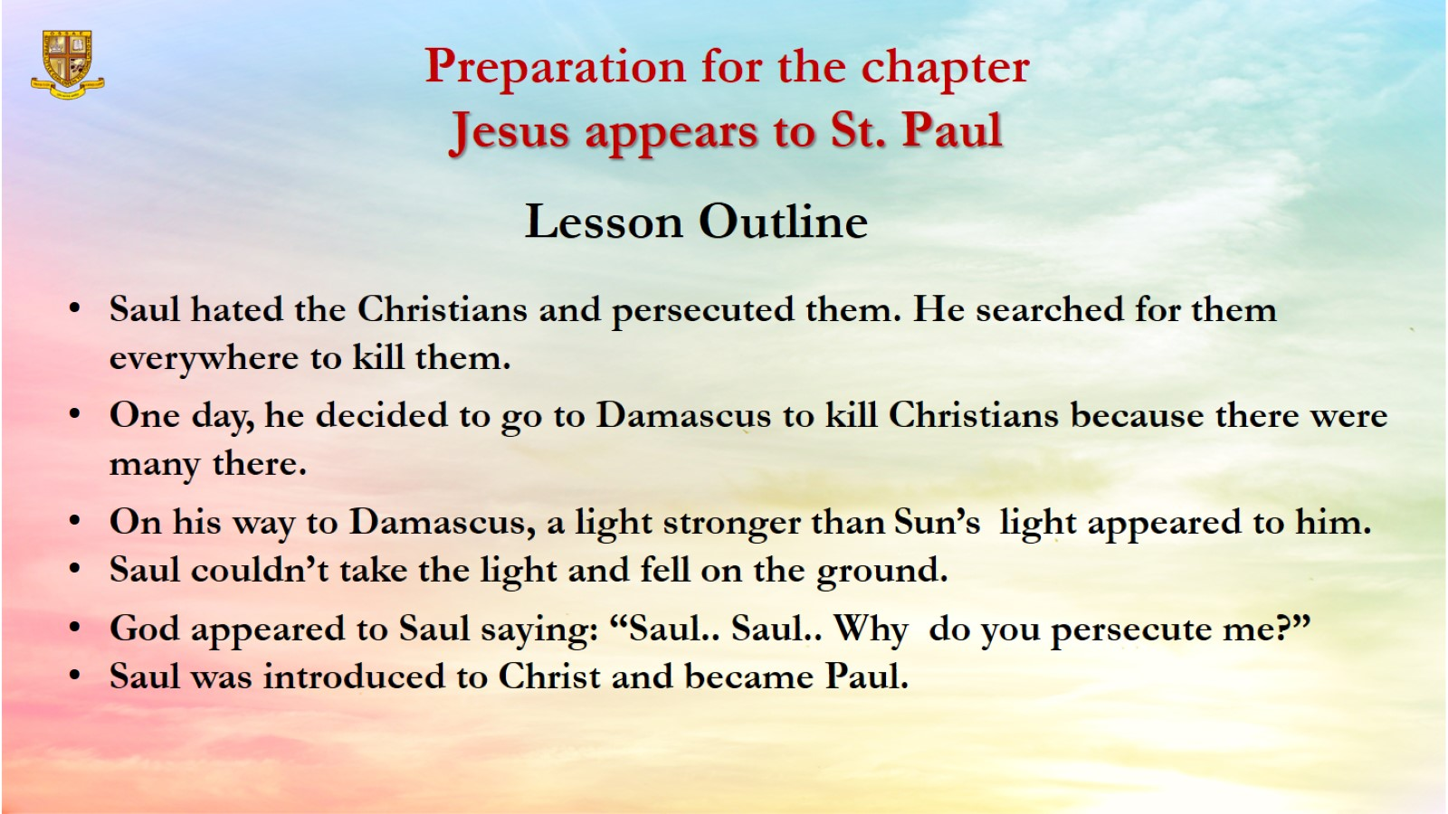
Preparation for the chapter
Jesus appears to St. Paul

Slide 5
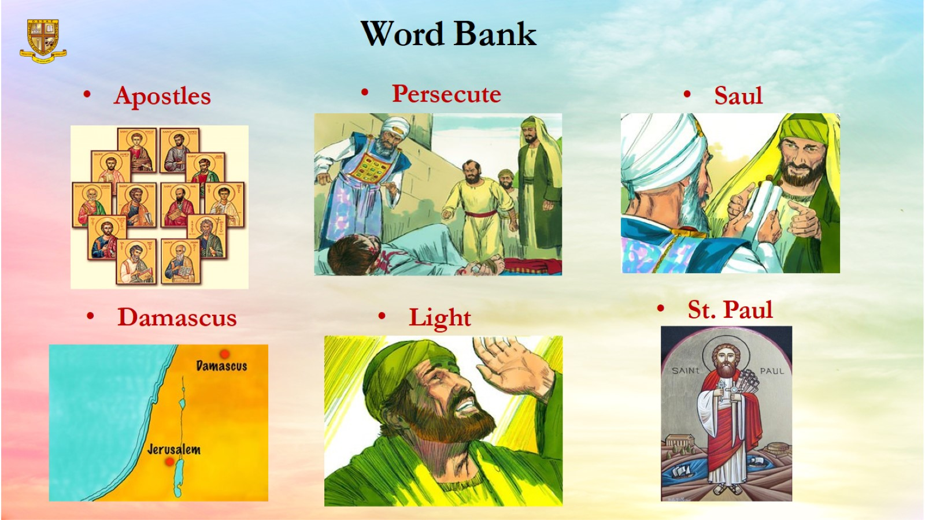
Word Bank

Slide 6
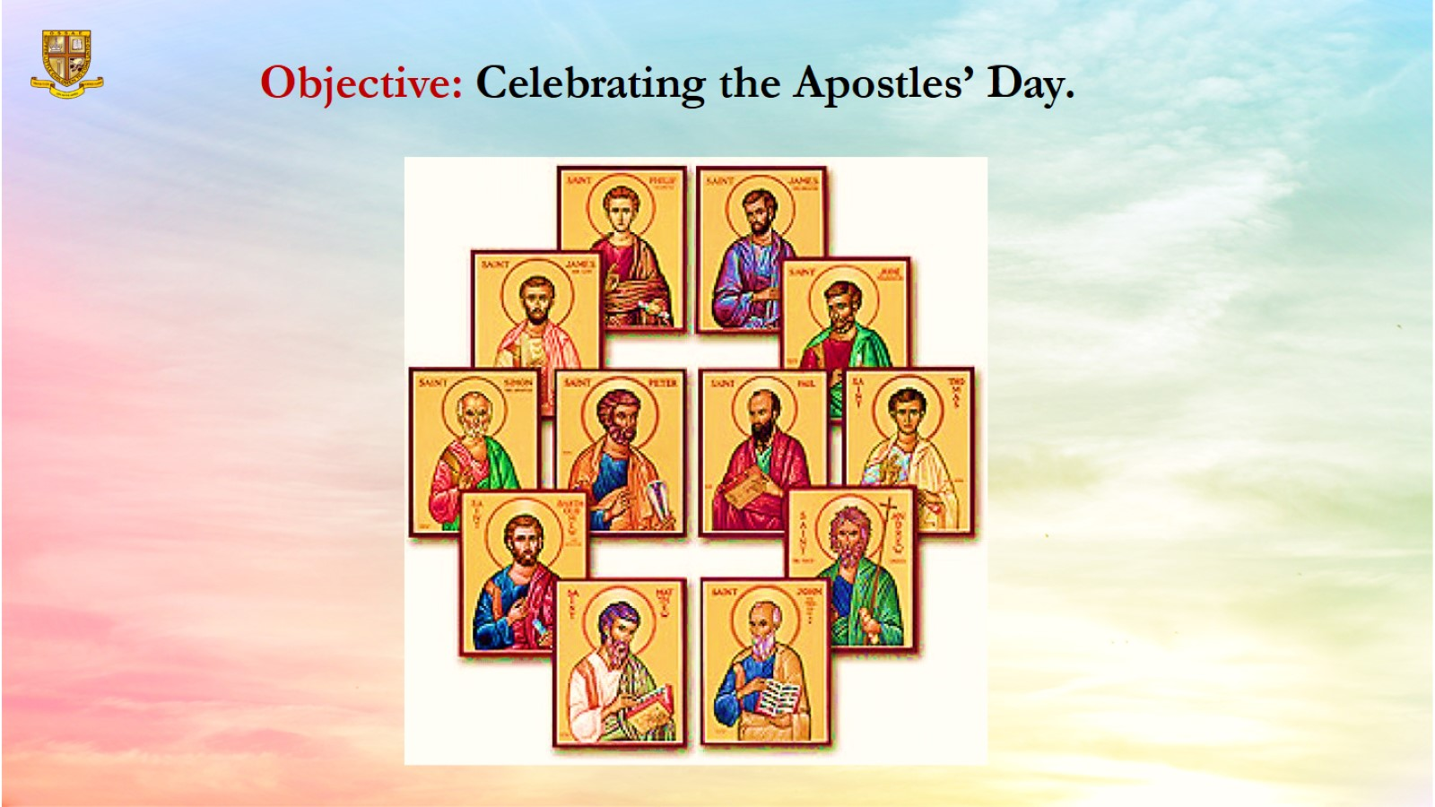
Objective: Celebrating the Apostles’ Day.

Slide 7
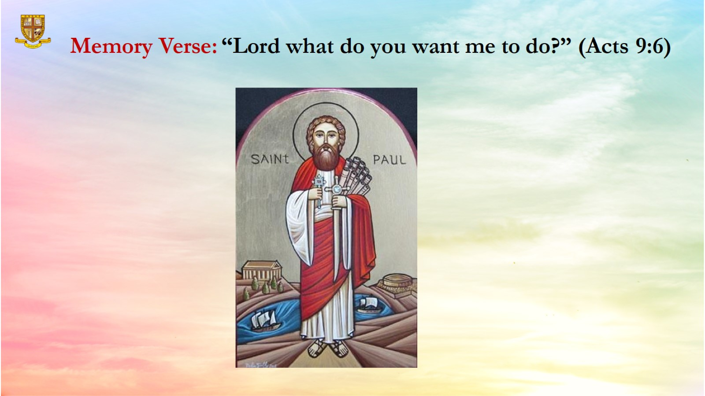
Memory Verse: “Lord what do you want me to do?” (Acts 9:6)

Slide 8
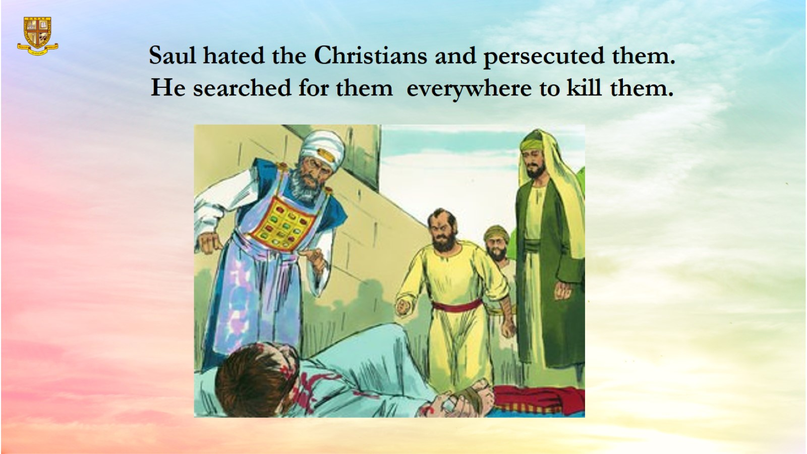
Saul hated the Christians and persecuted them.
He searched for them everywhere to kill them.

Slide 9
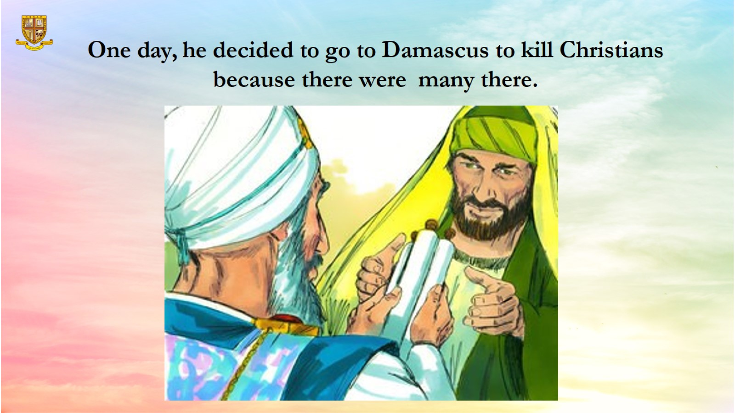
One day, he decided to go to Damascus to kill Christians because there were many there.

Slide 10
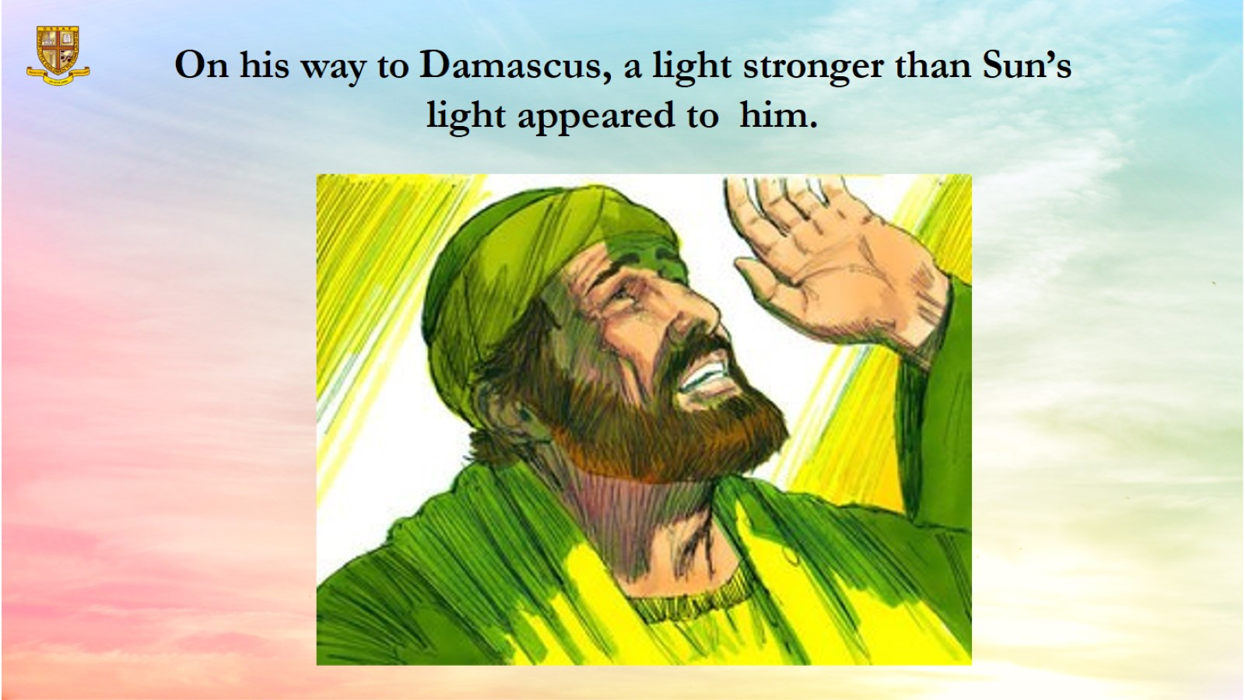
On his way to Damascus, a light stronger than Sun’s light appeared to him.

Slide 11
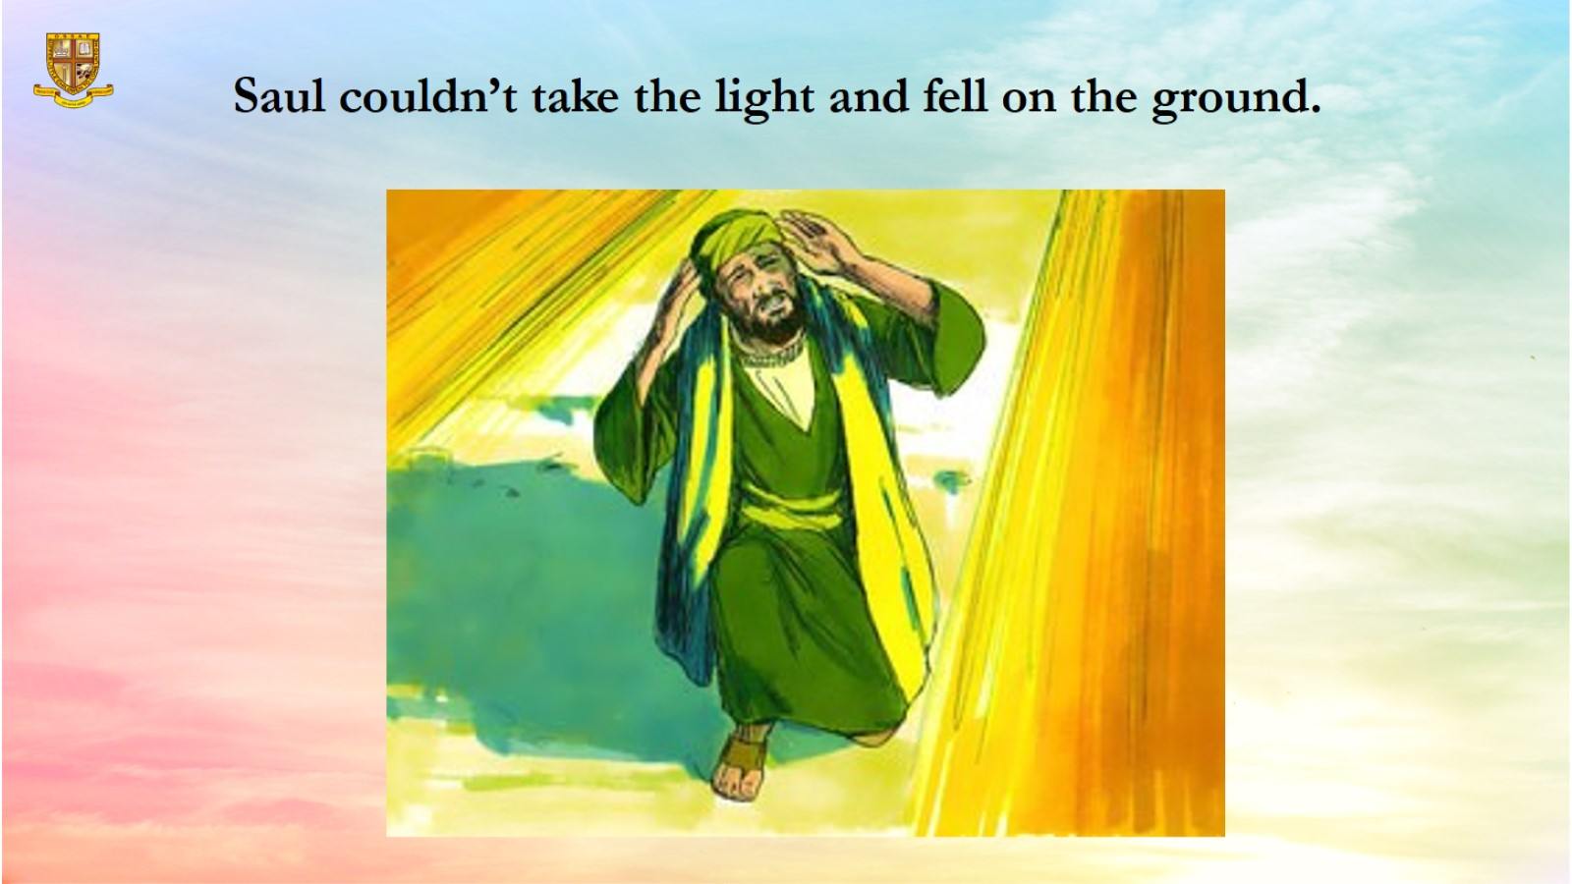
Saul couldn’t take the light and fell on the ground.

Slide 12
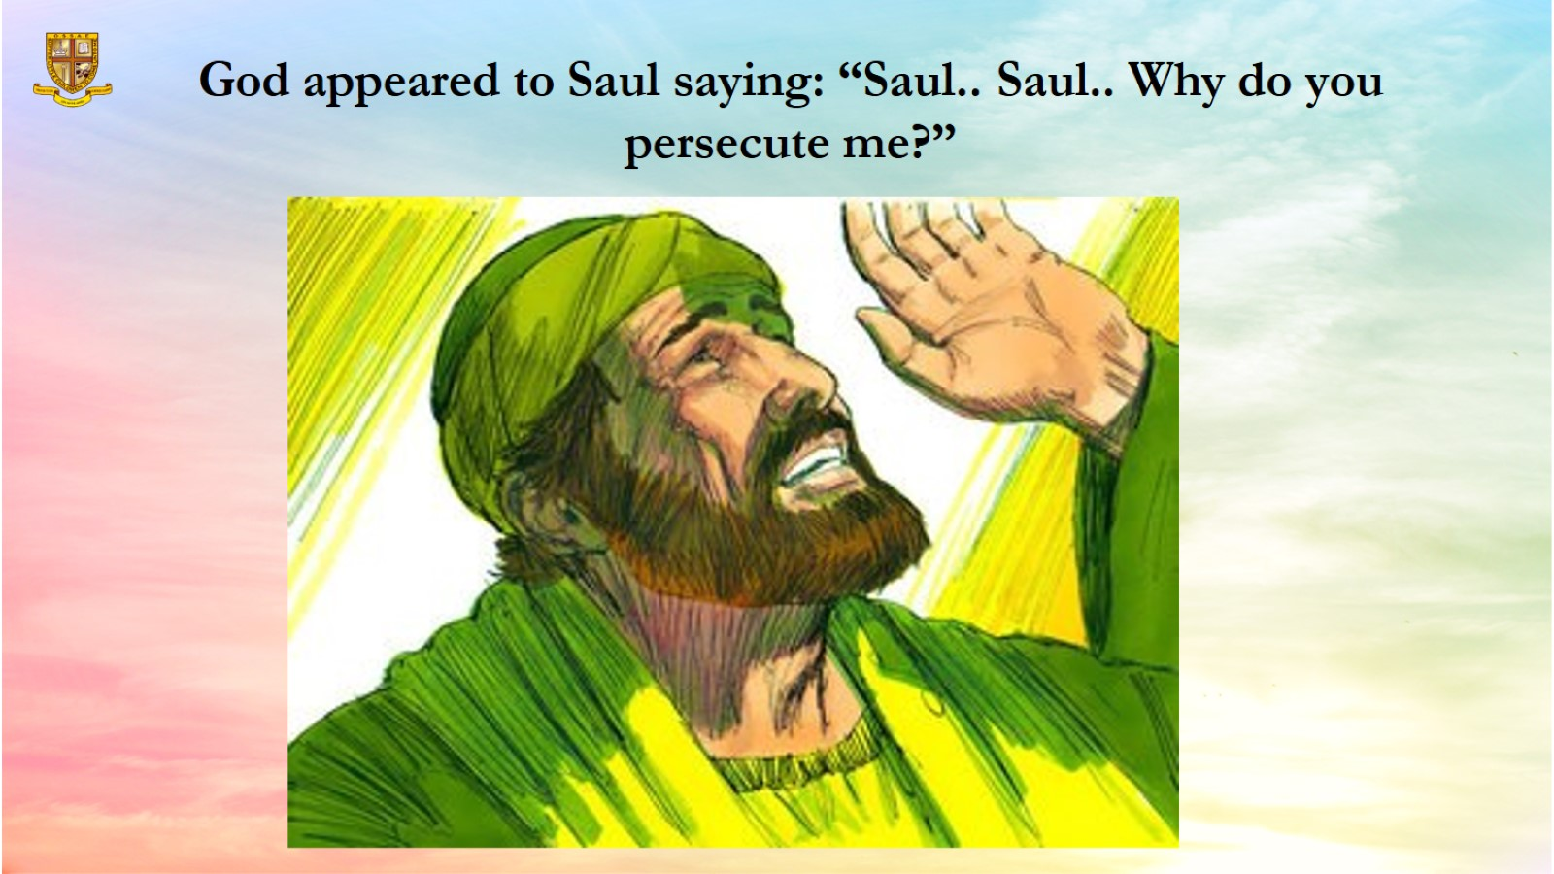
God appeared to Saul saying: “Saul.. Saul.. Why do you persecute me?”

Slide 13
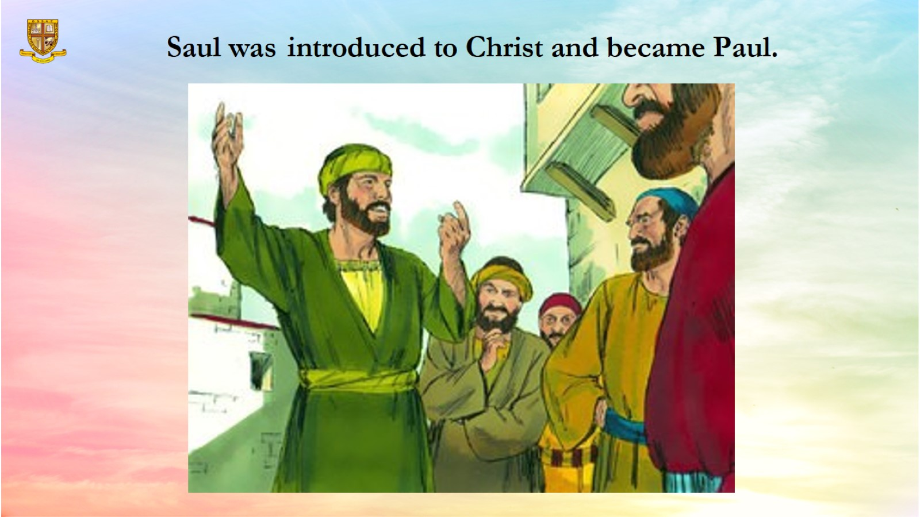
Saul was introduced to Christ and became Paul.

Slide 14
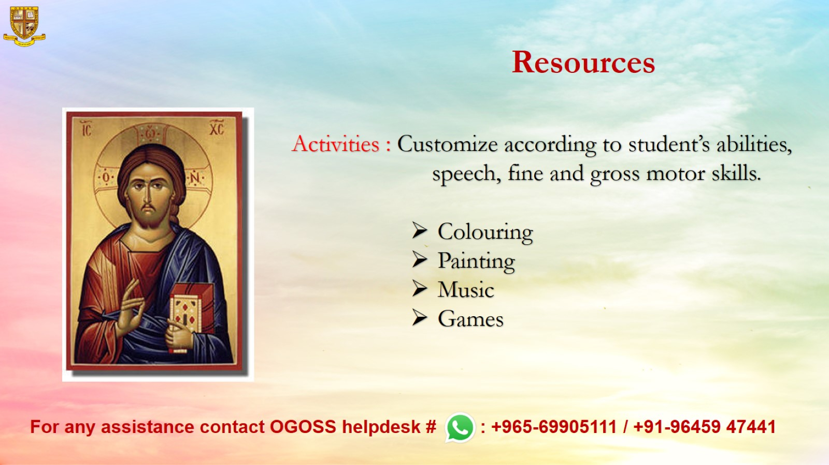
Resources

