Slide 1

Orthodox Global Online Sunday School (OGOSS)

Slide 2
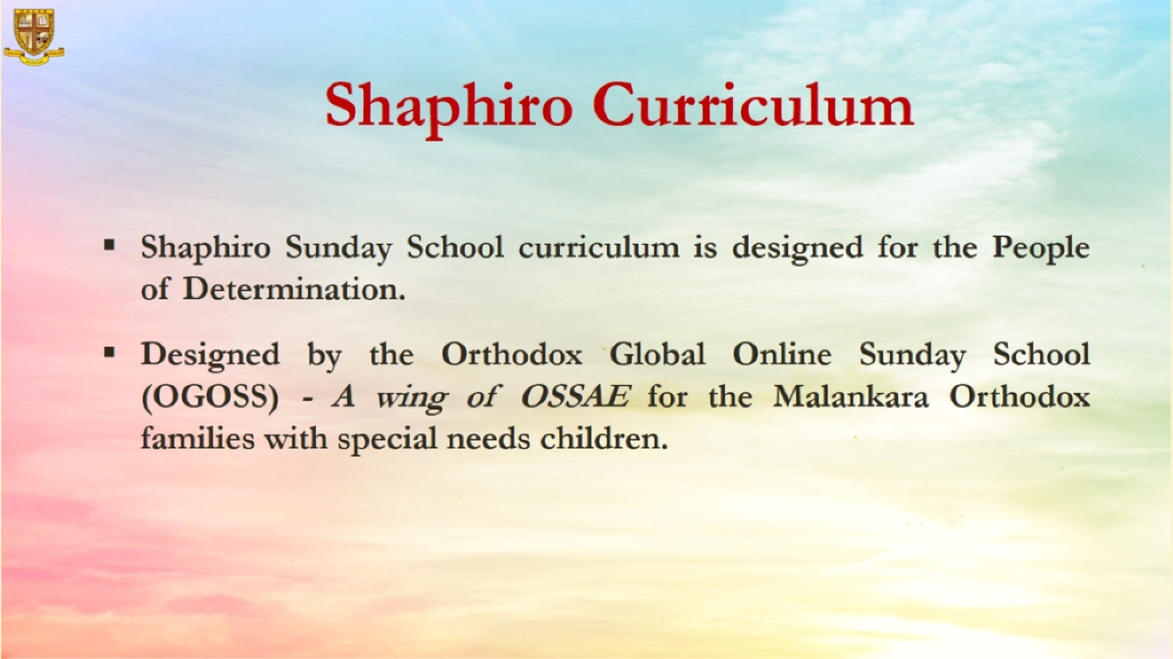

Slide 3
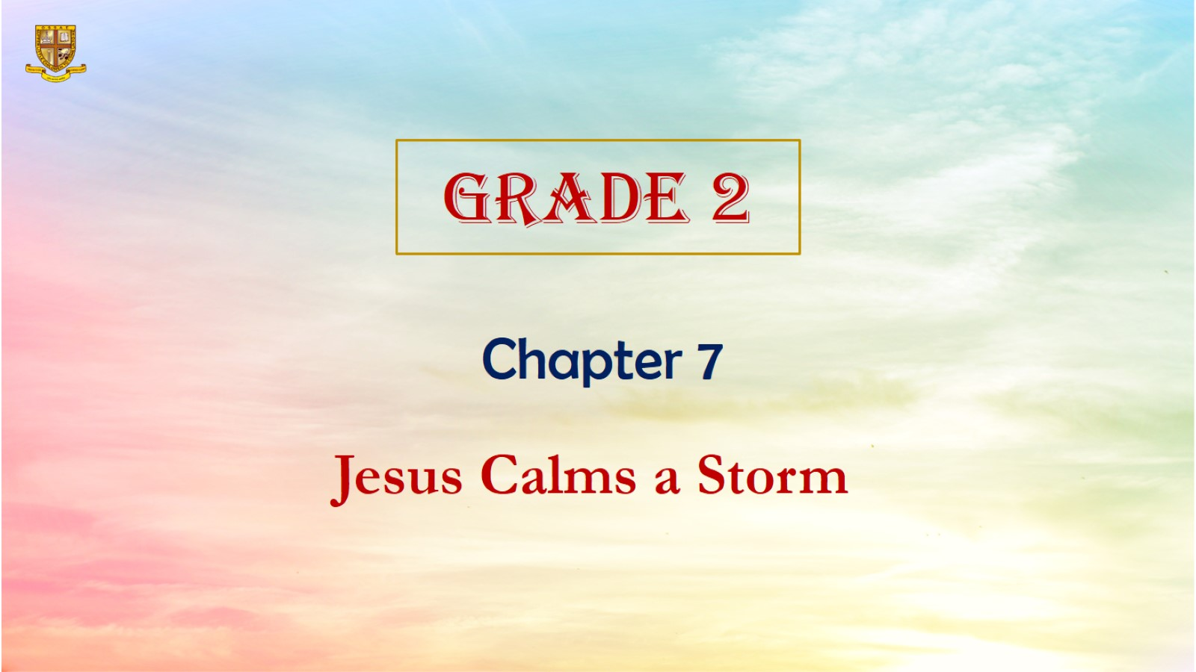

Slide 4
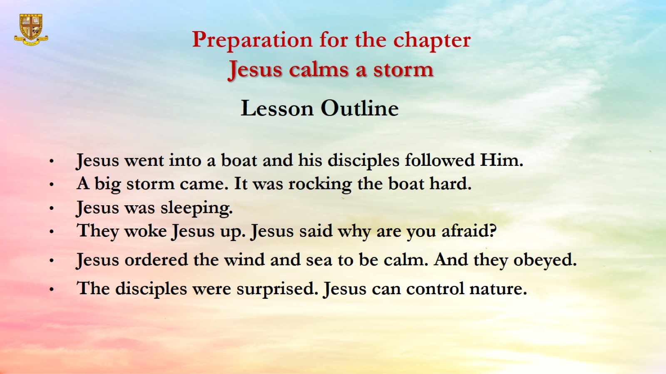
Preparation for the chapter
Jesus calms a storm

Slide 5
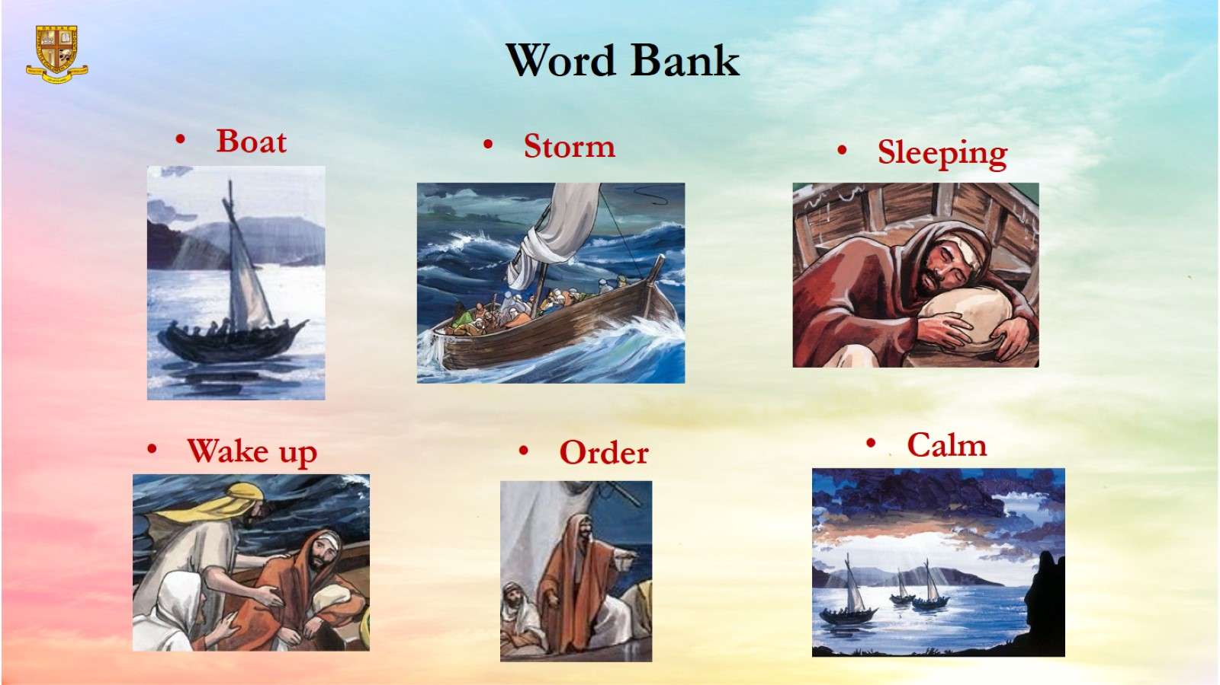
Word Bank

Slide 6
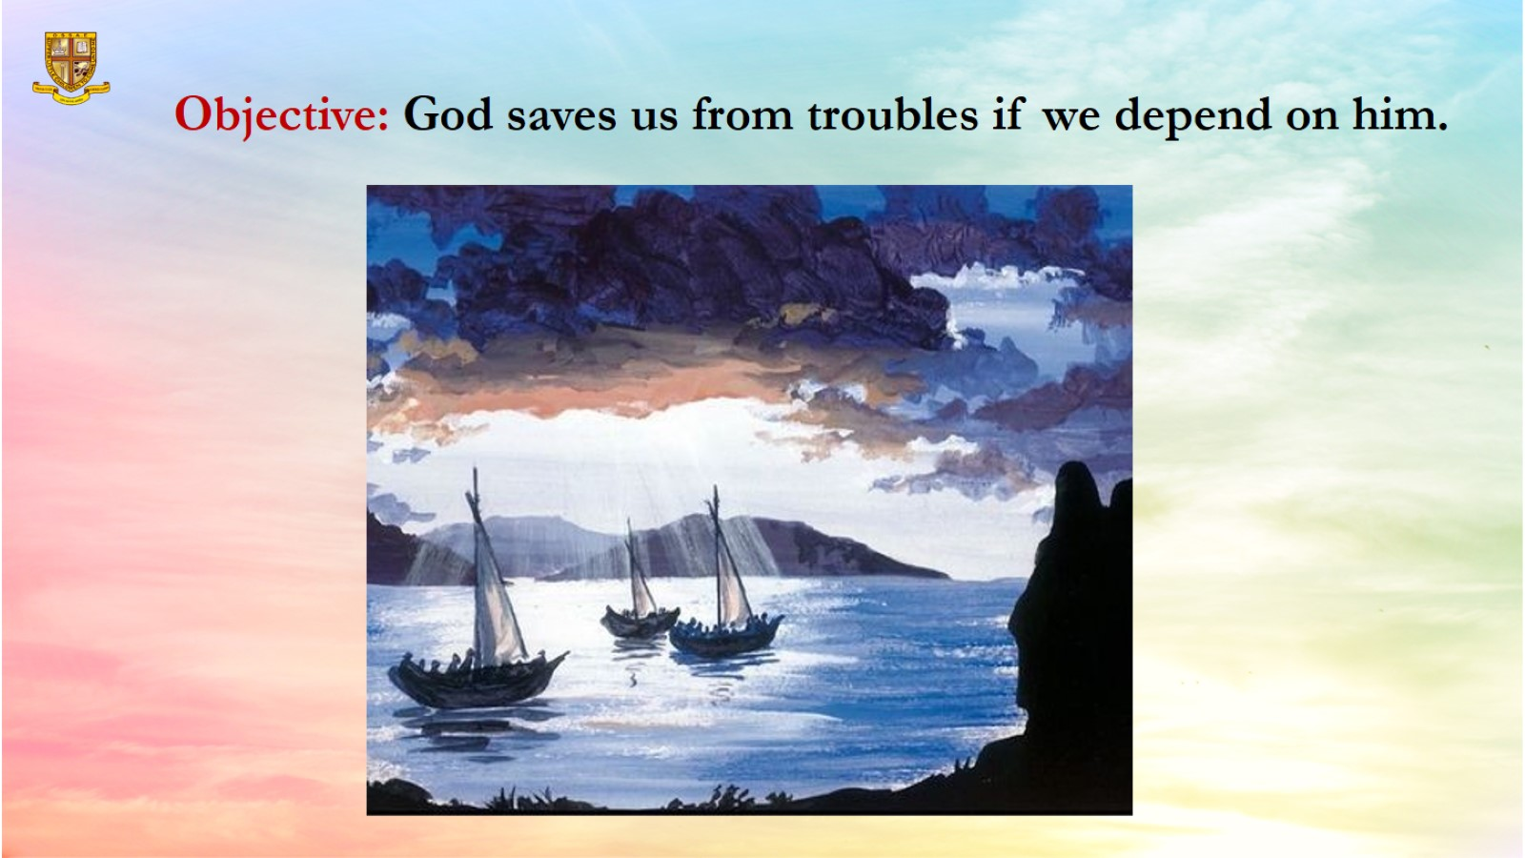
Objective: God saves us from troubles if we depend on him.

Slide 7
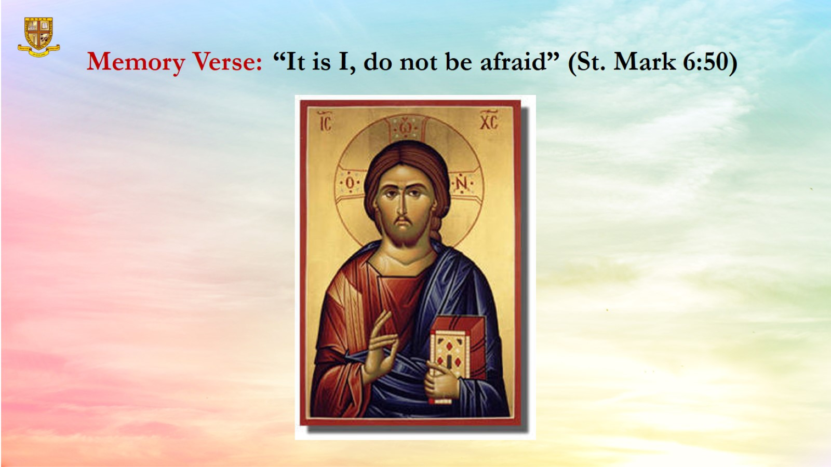
Memory Verse: “It is I, do not be afraid” (St. Mark 6:50)

Slide 8
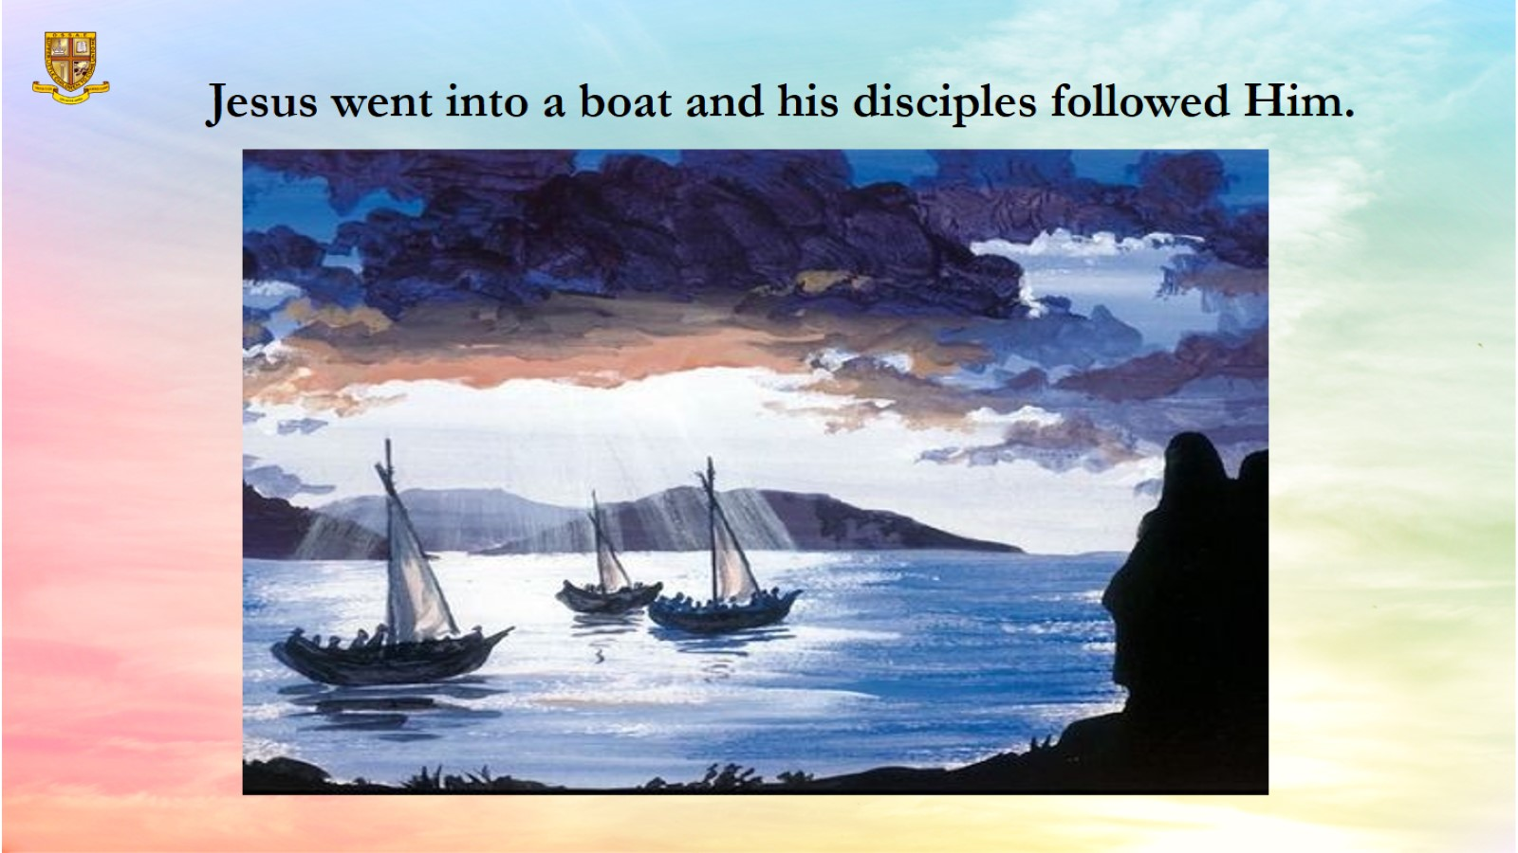
Jesus went into a boat and his disciples followed Him.

Slide 9
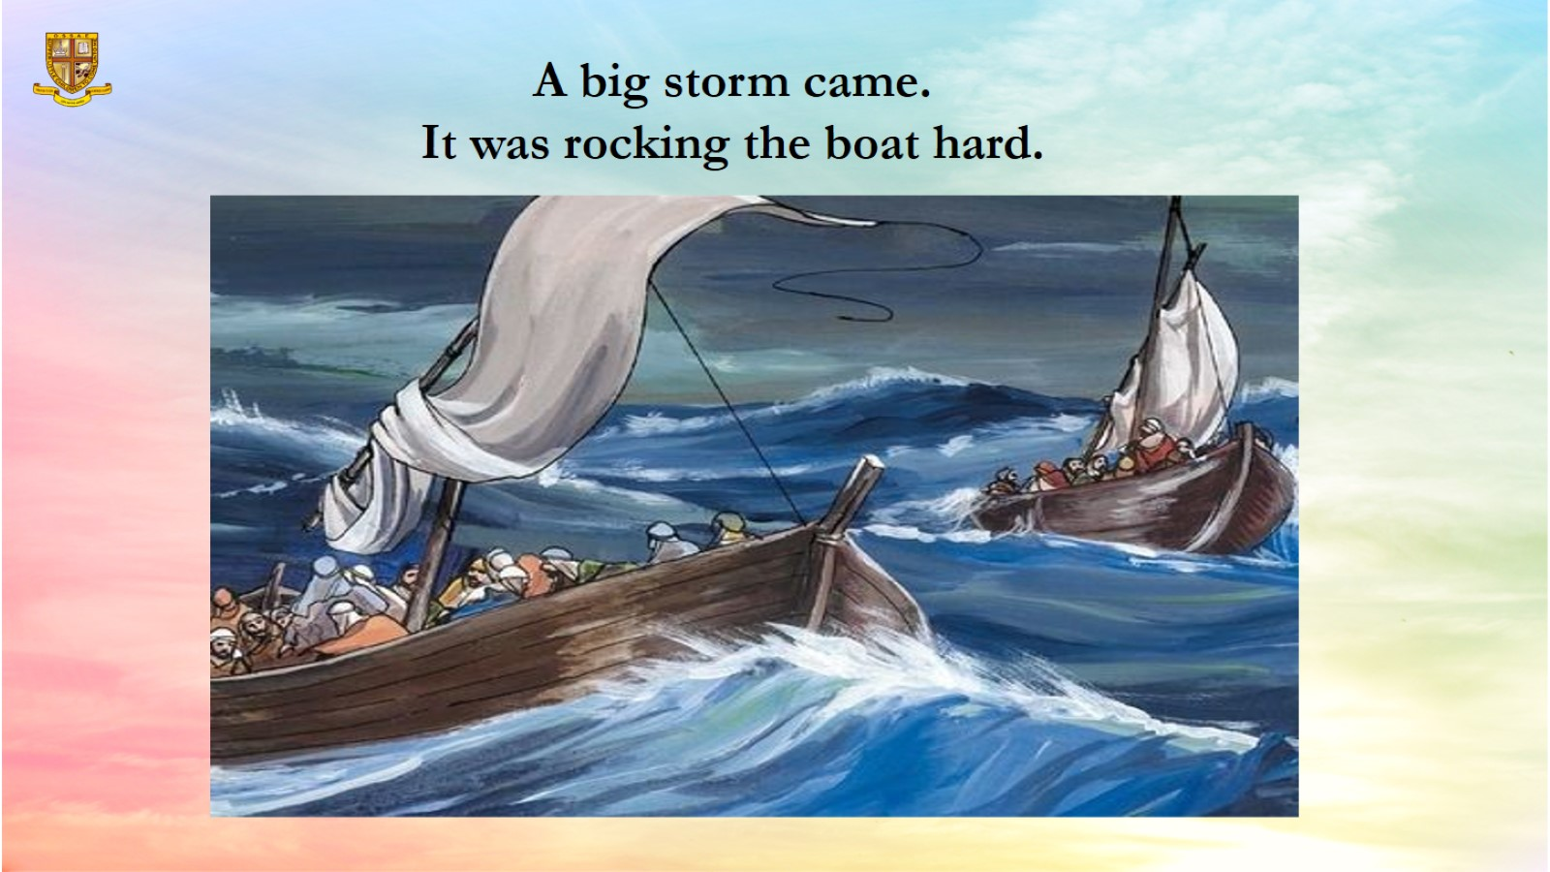

Slide 10
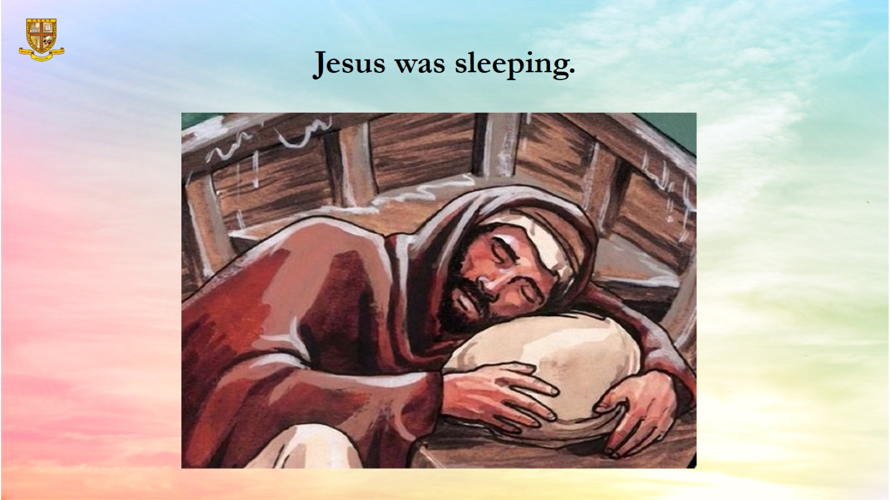
Jesus was sleeping.

Slide 11
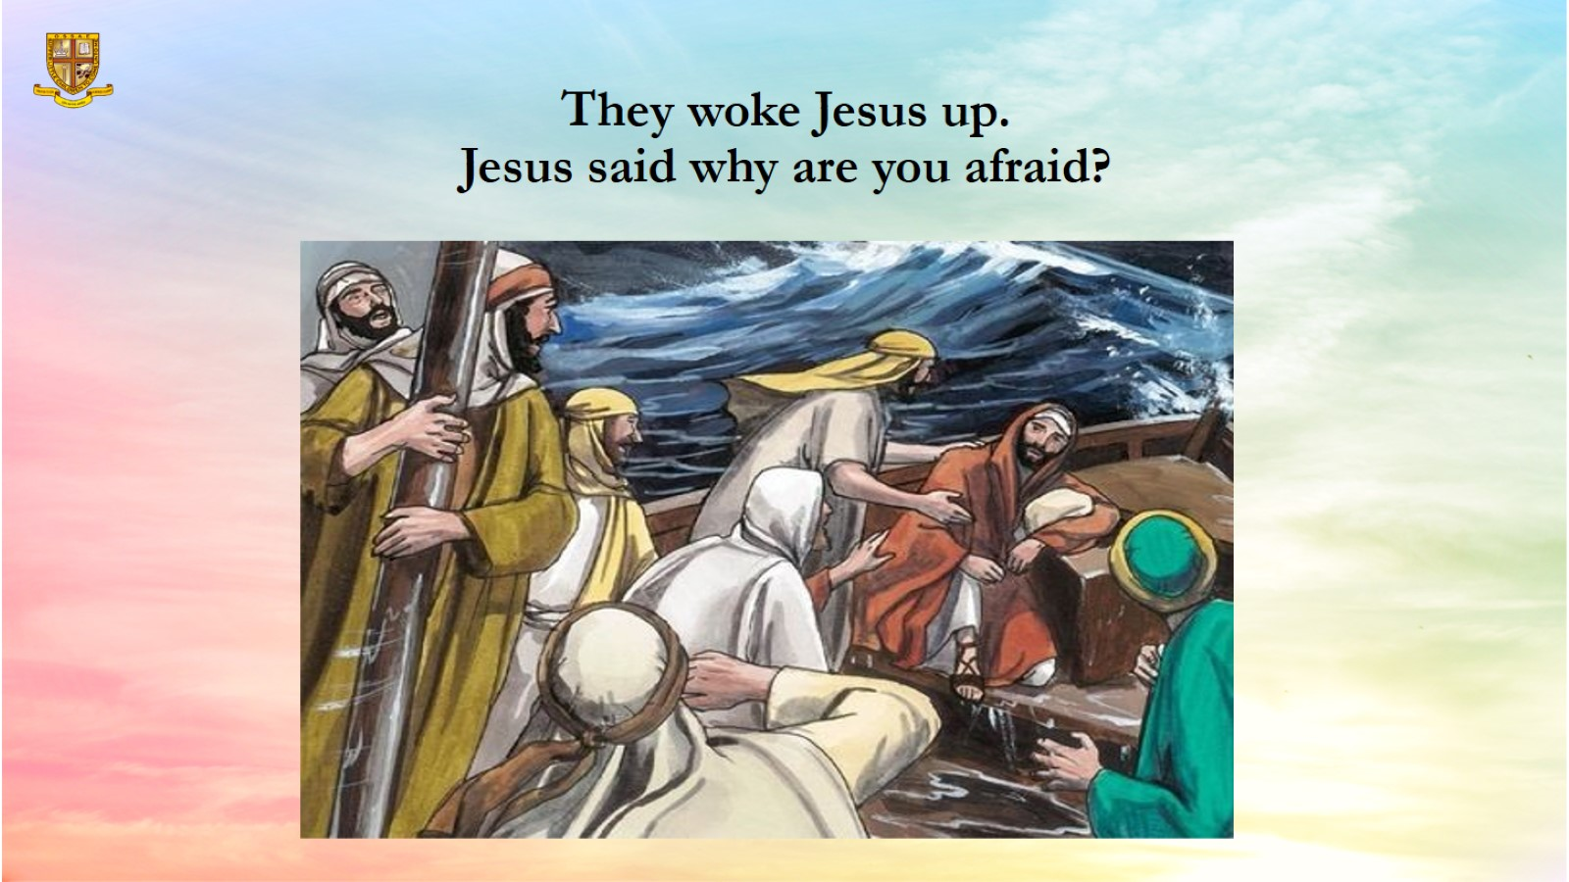
They woke Jesus up.
Jesus said why are you afraid?

Slide 12
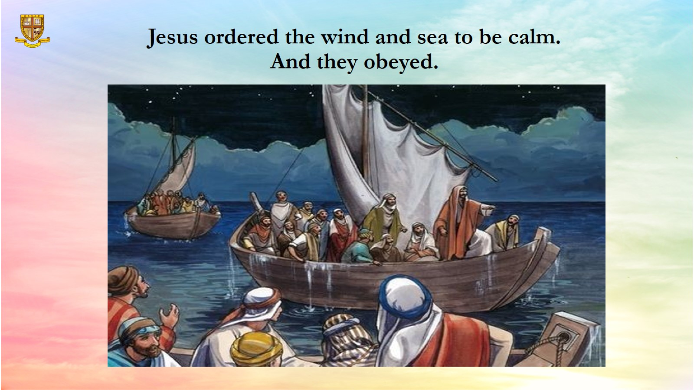
Jesus ordered the wind and sea to be calm.
And they obeyed.

Slide 13
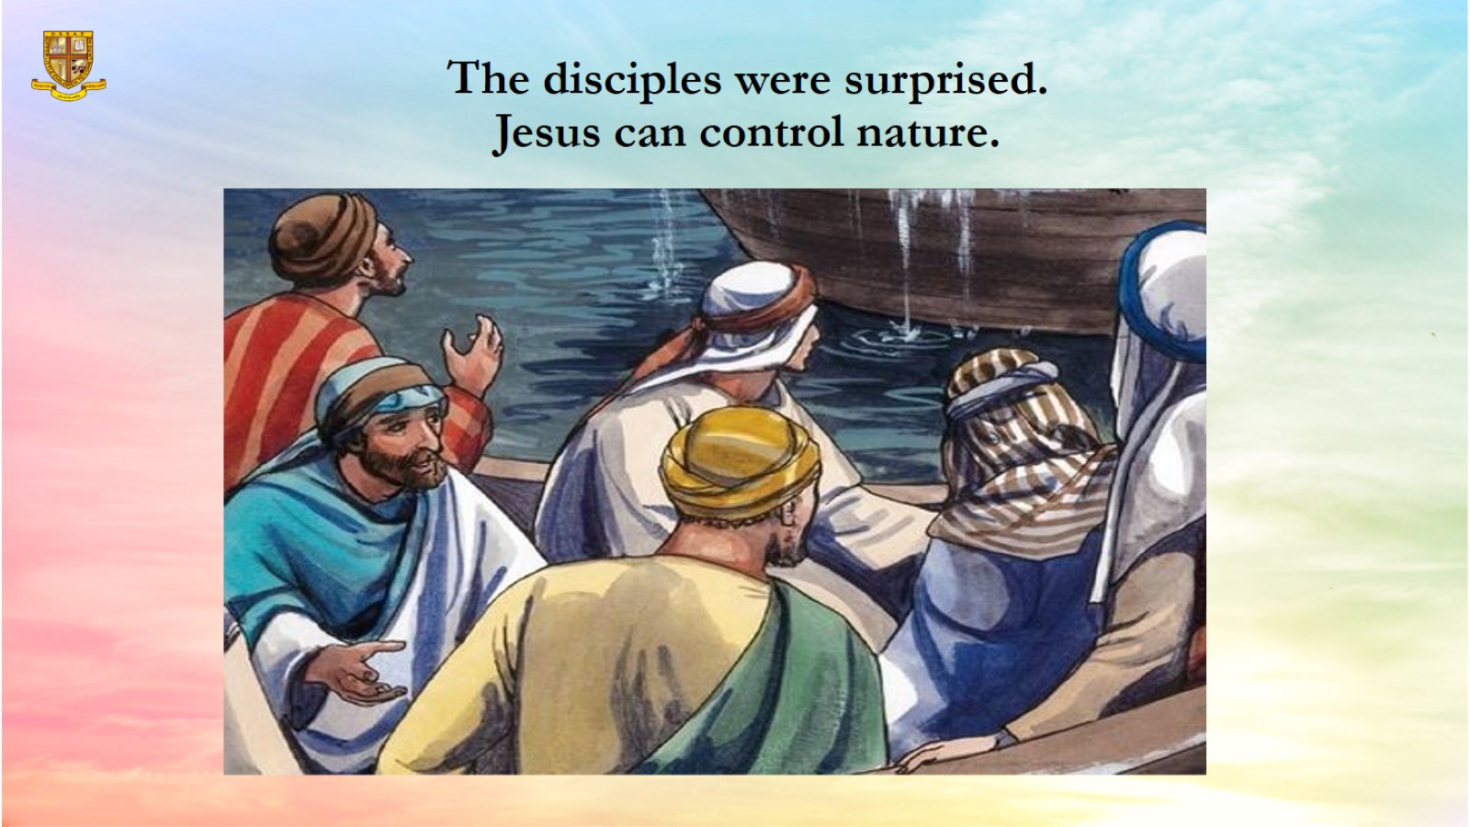
The disciples were surprised.
Jesus can control nature.

Slide 14
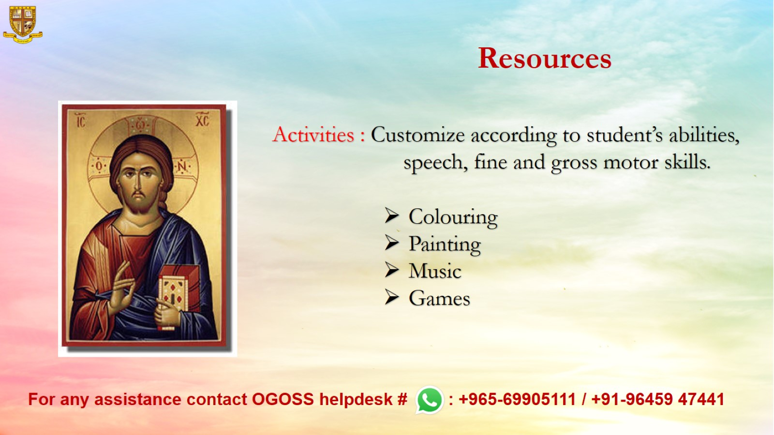
Resources

