Slide 1
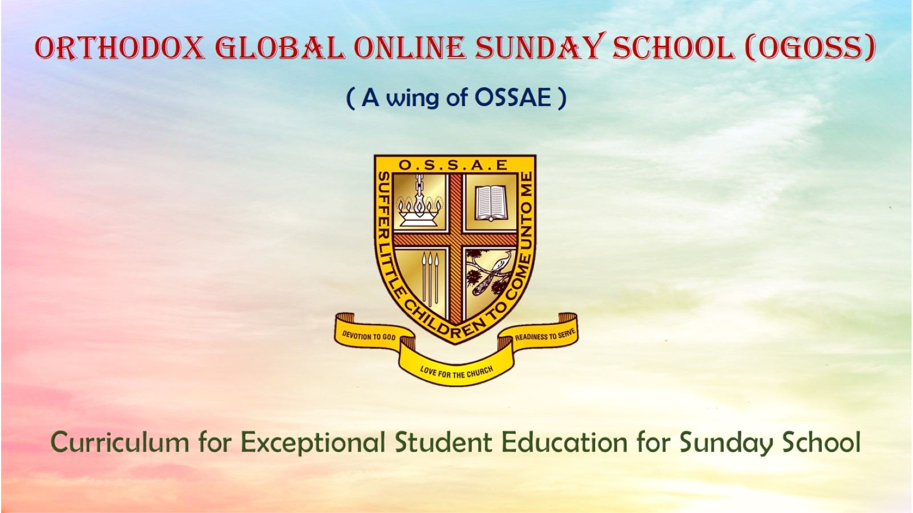
Orthodox Global Online Sunday School (OGOSS)

Slide 2
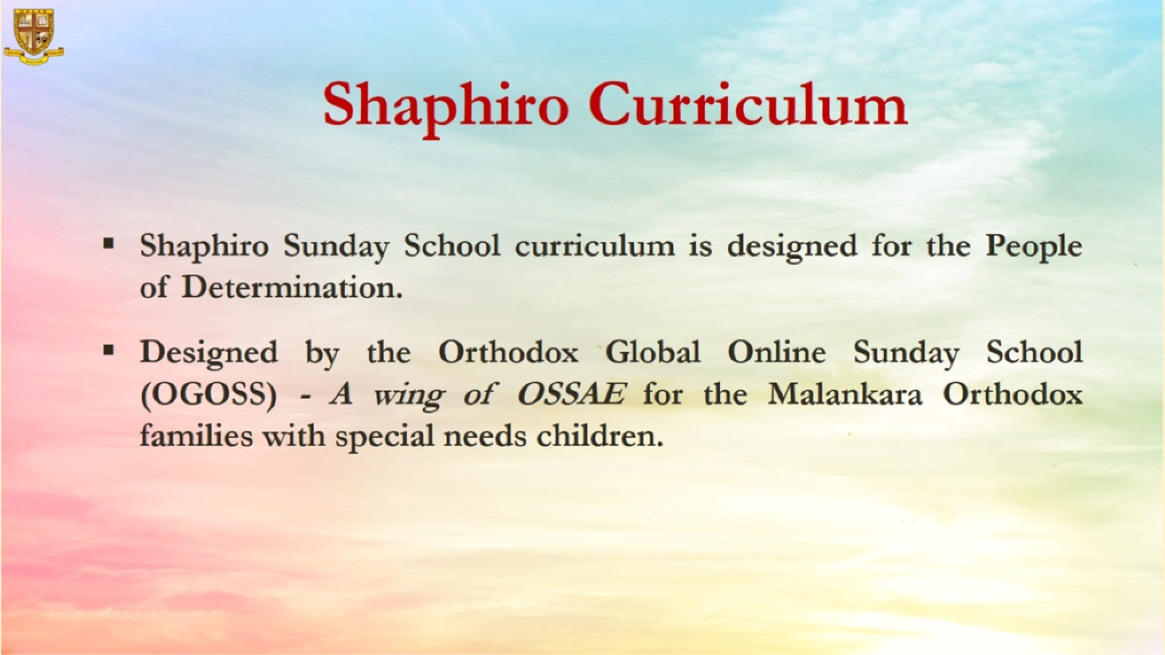

Slide 3


Slide 4
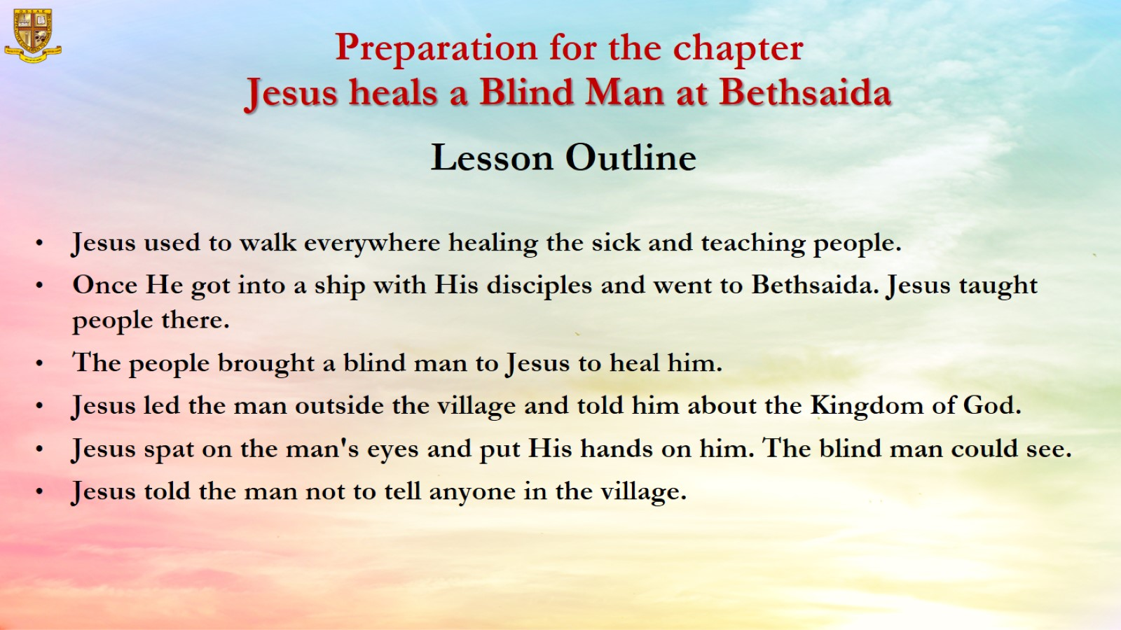

Slide 5
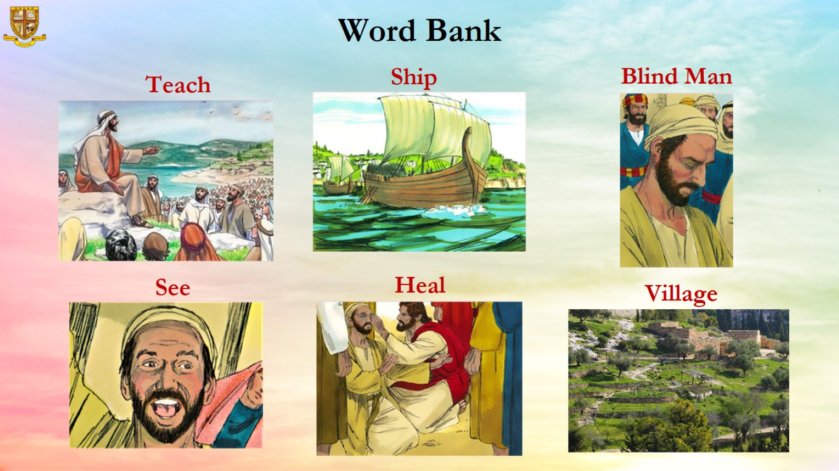

Slide 6
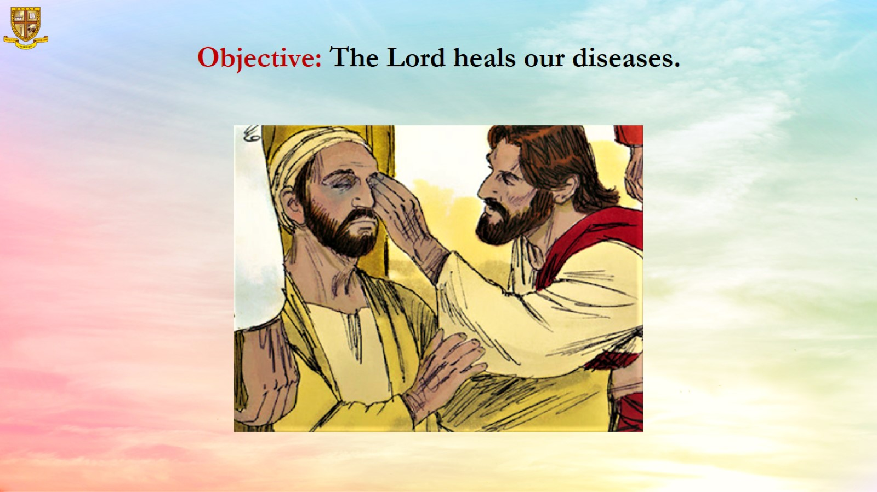
Objective: The Lord heals our diseases.

Slide 7
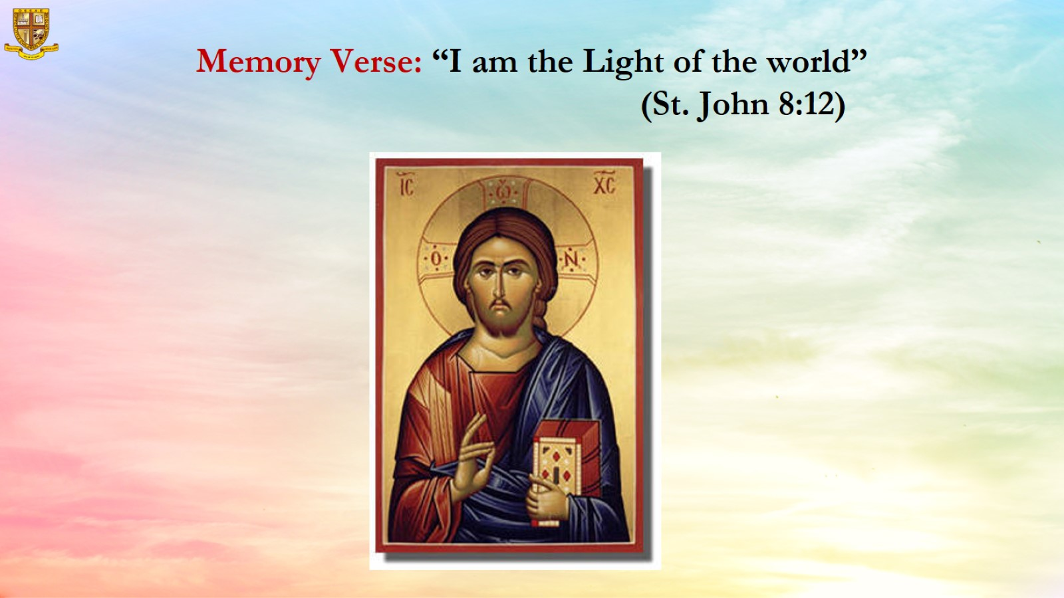

Slide 8
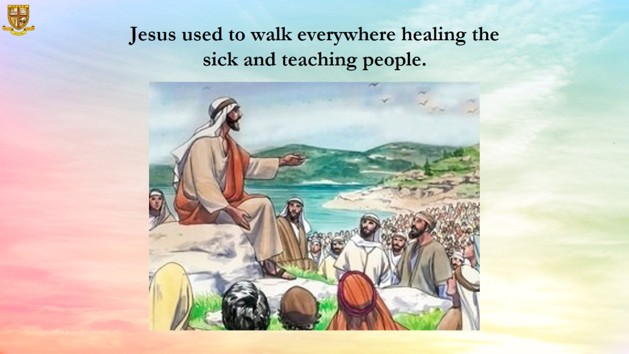
Jesus used to walk everywhere healing the sick and teaching people.

Slide 9
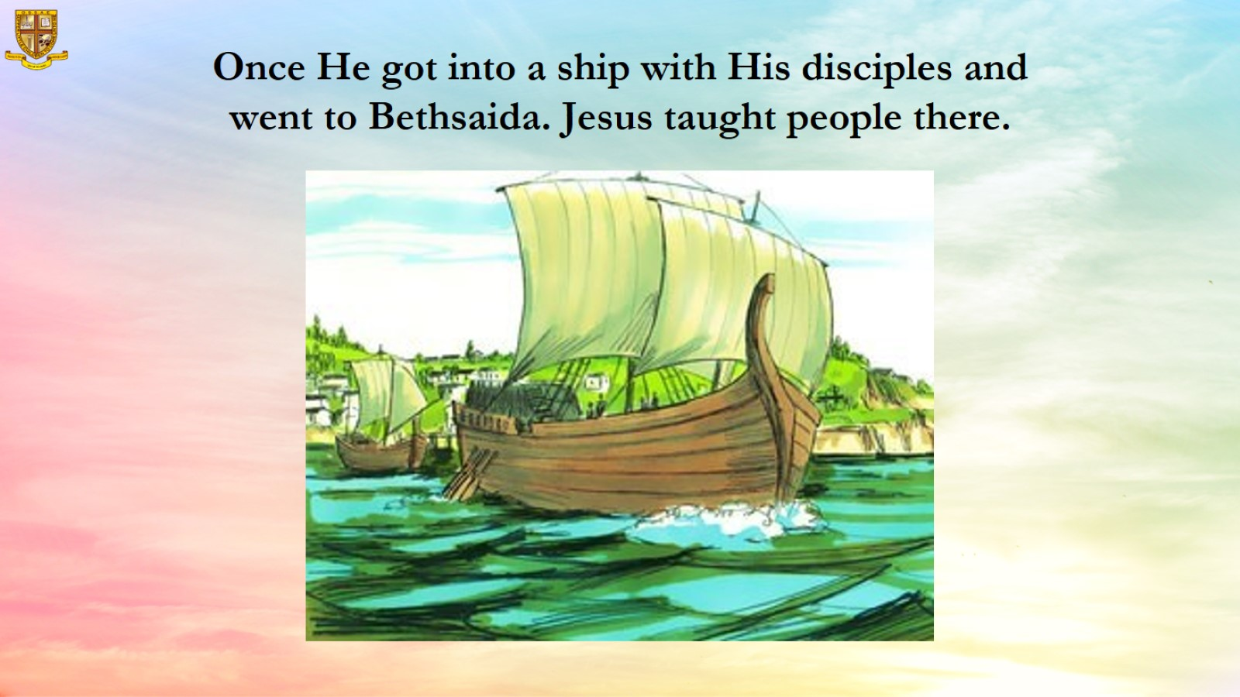
Once He got into a ship with His disciples and went to Bethsaida. Jesus taught people there.

Slide 10
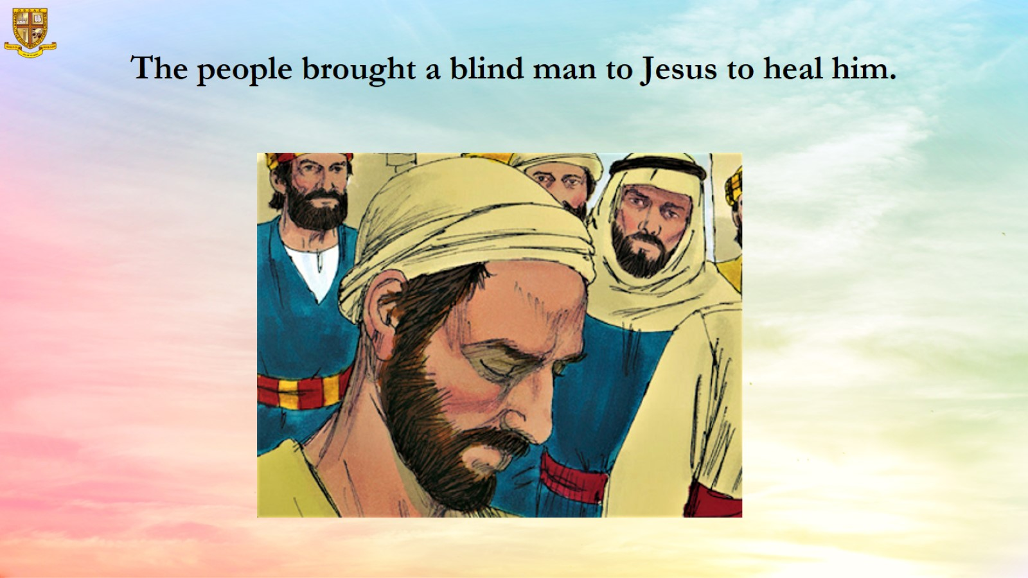

Slide 11
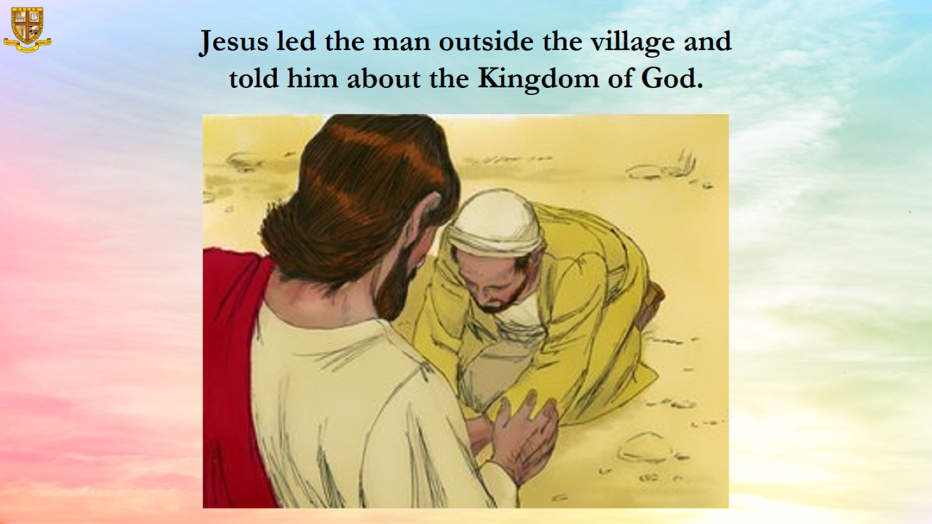
Jesus led the man outside the village and told him about the Kingdom of God.

Slide 12
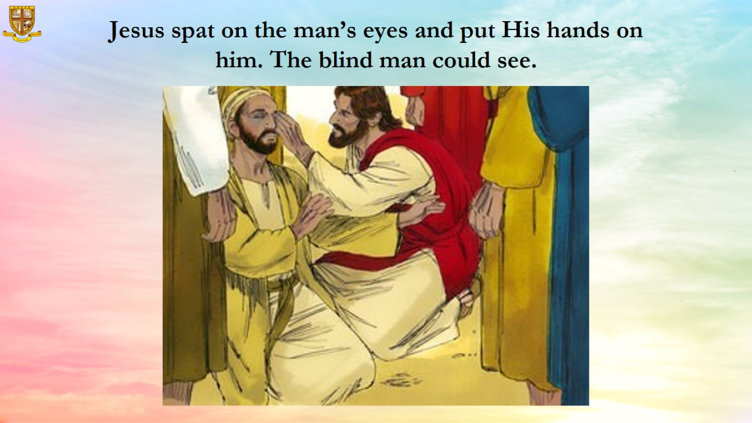
Jesus spat on the man’s eyes and put His hands on him. The blind man could see.

Slide 13
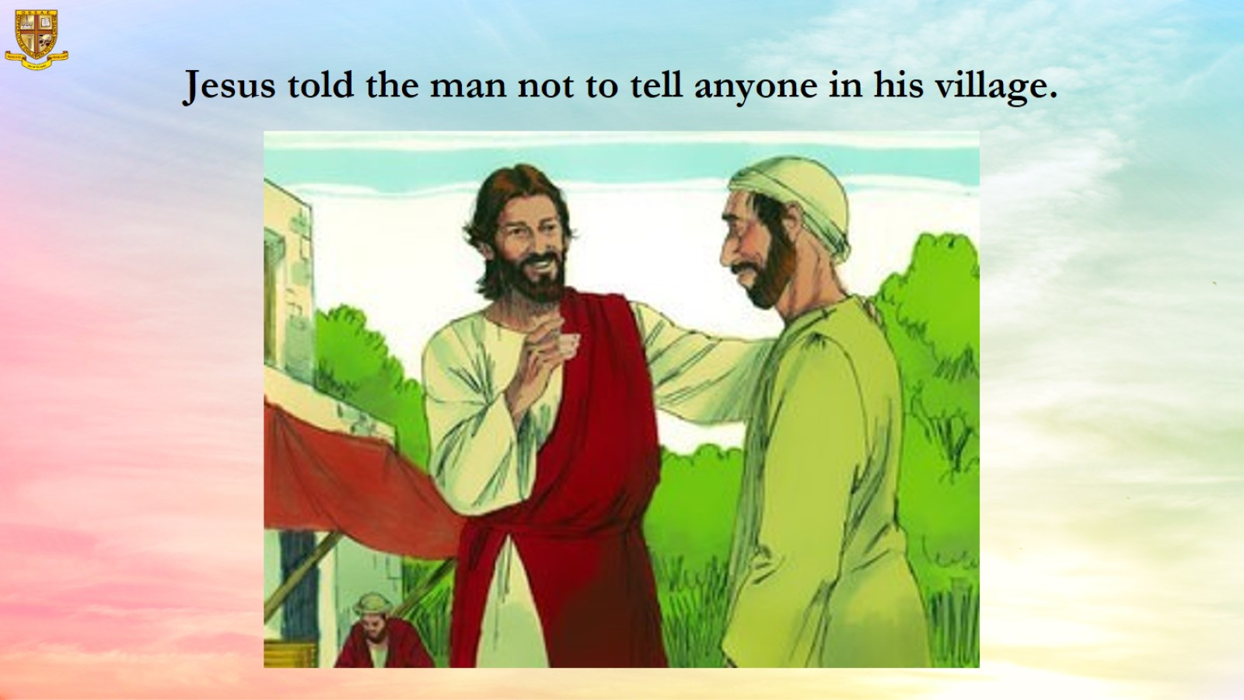

Slide 14
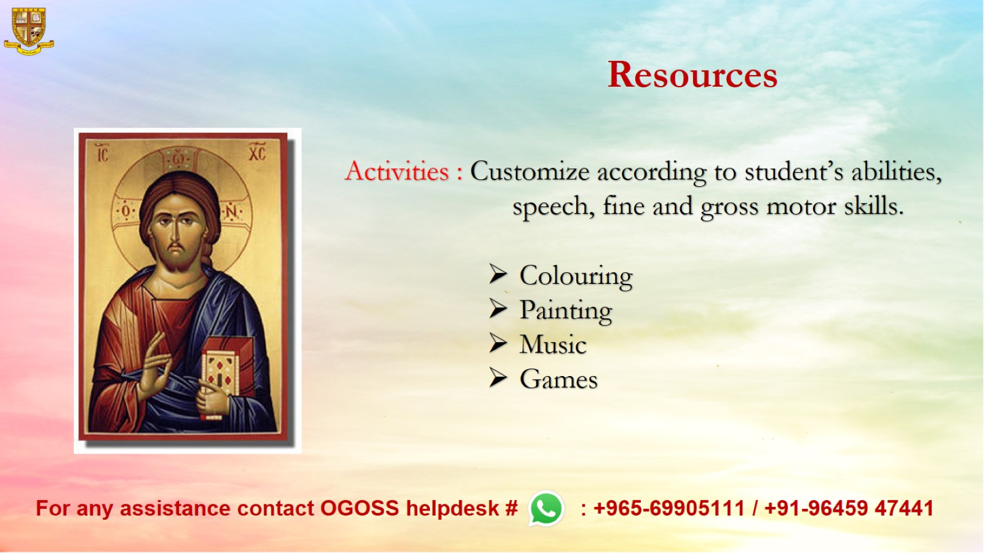
Resources

