Slide 1
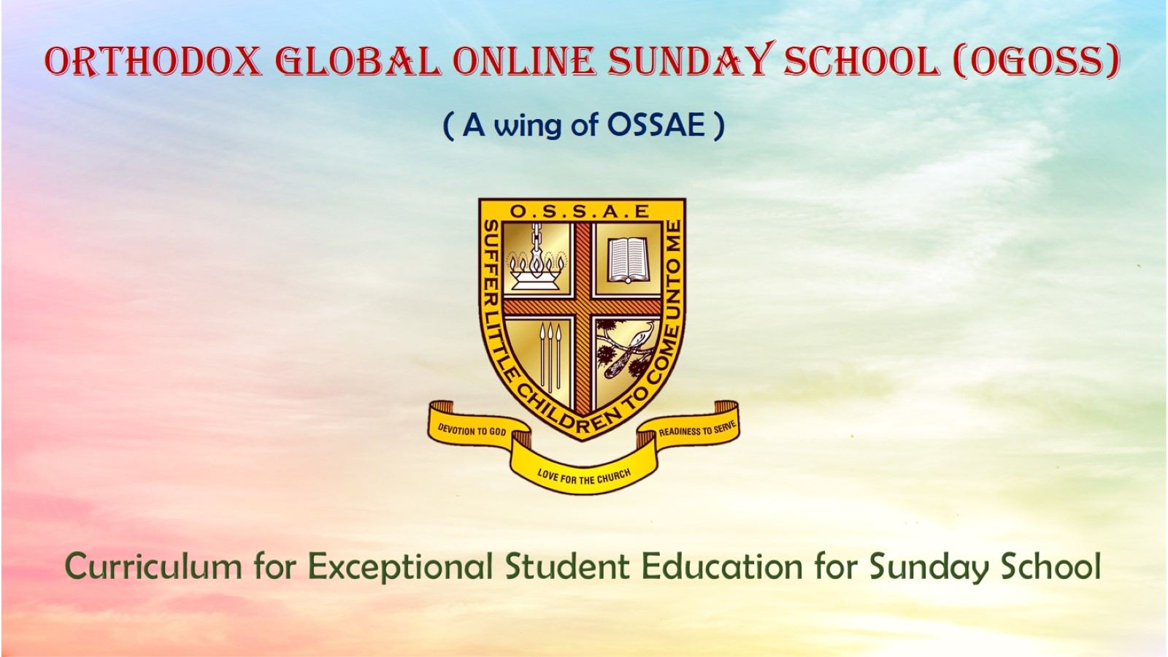
Orthodox Global Online Sunday School (OGOSS)

Slide 2
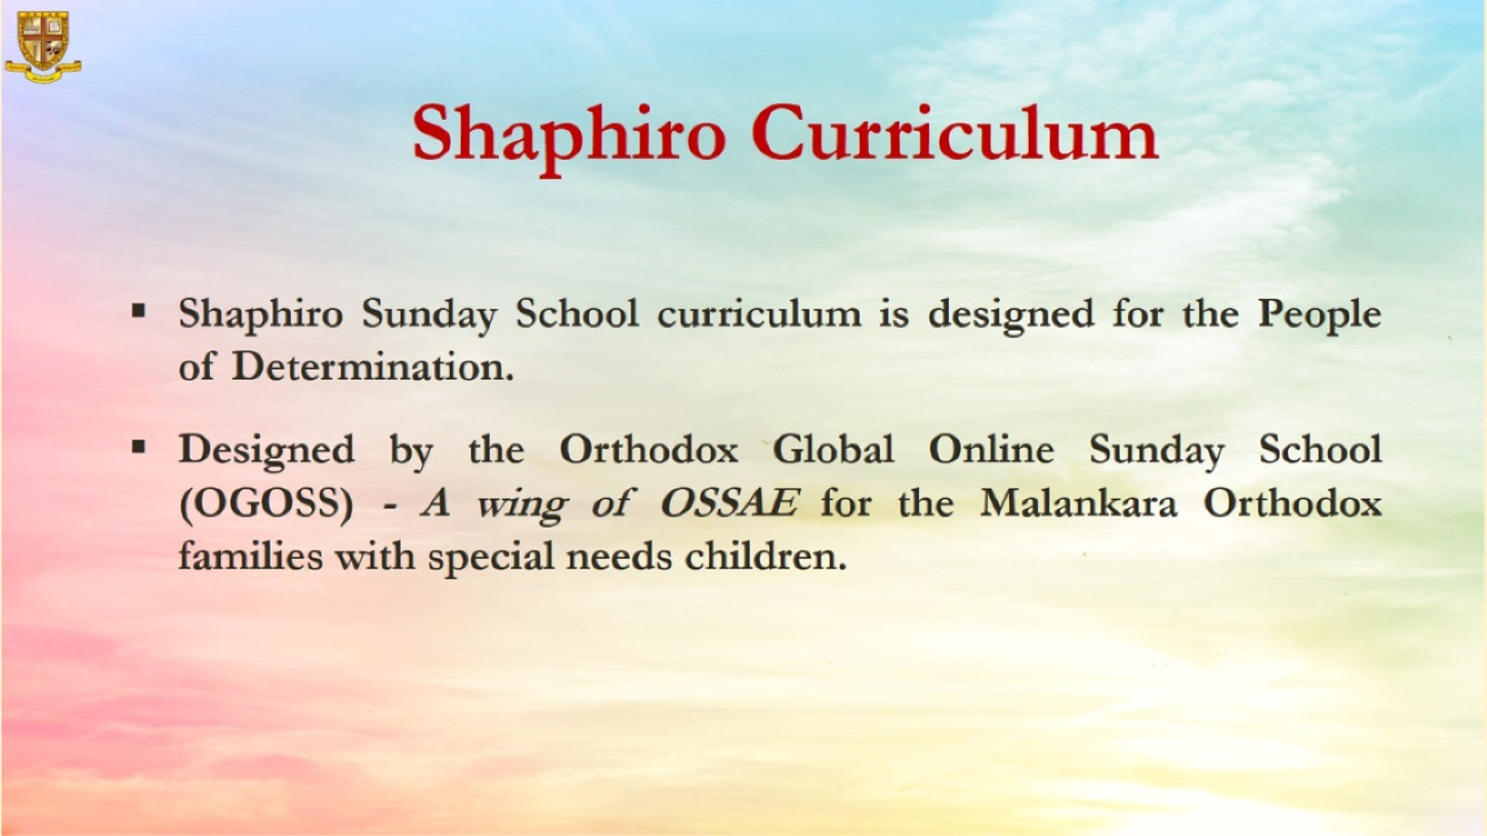

Slide 3
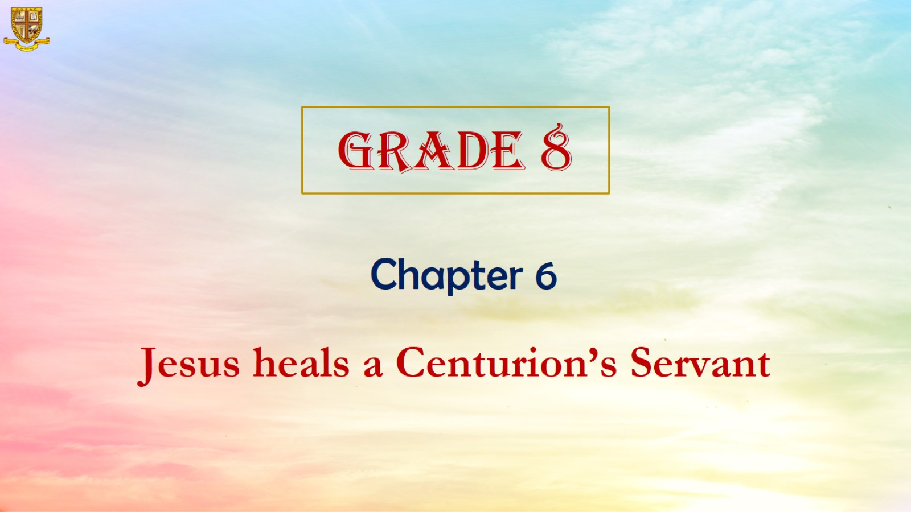

Slide 4
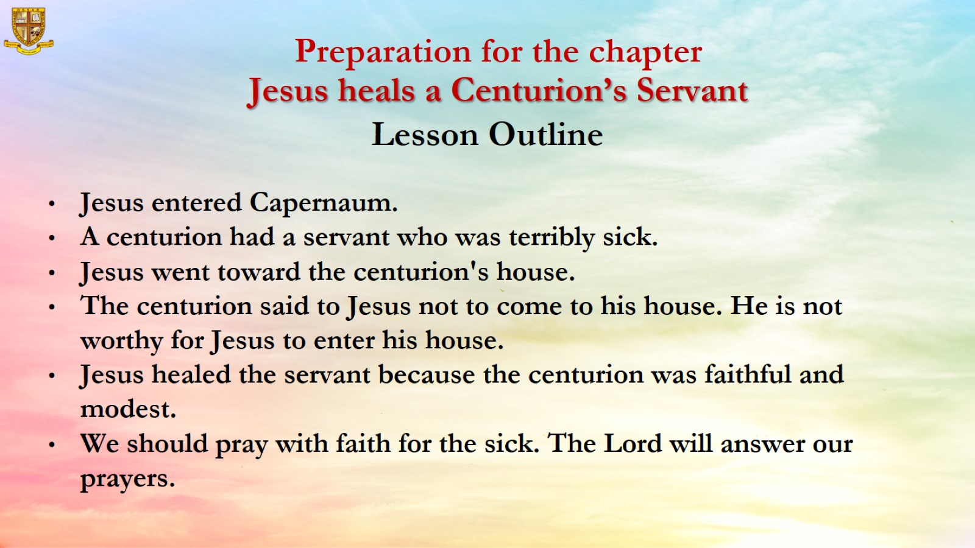

Slide 5
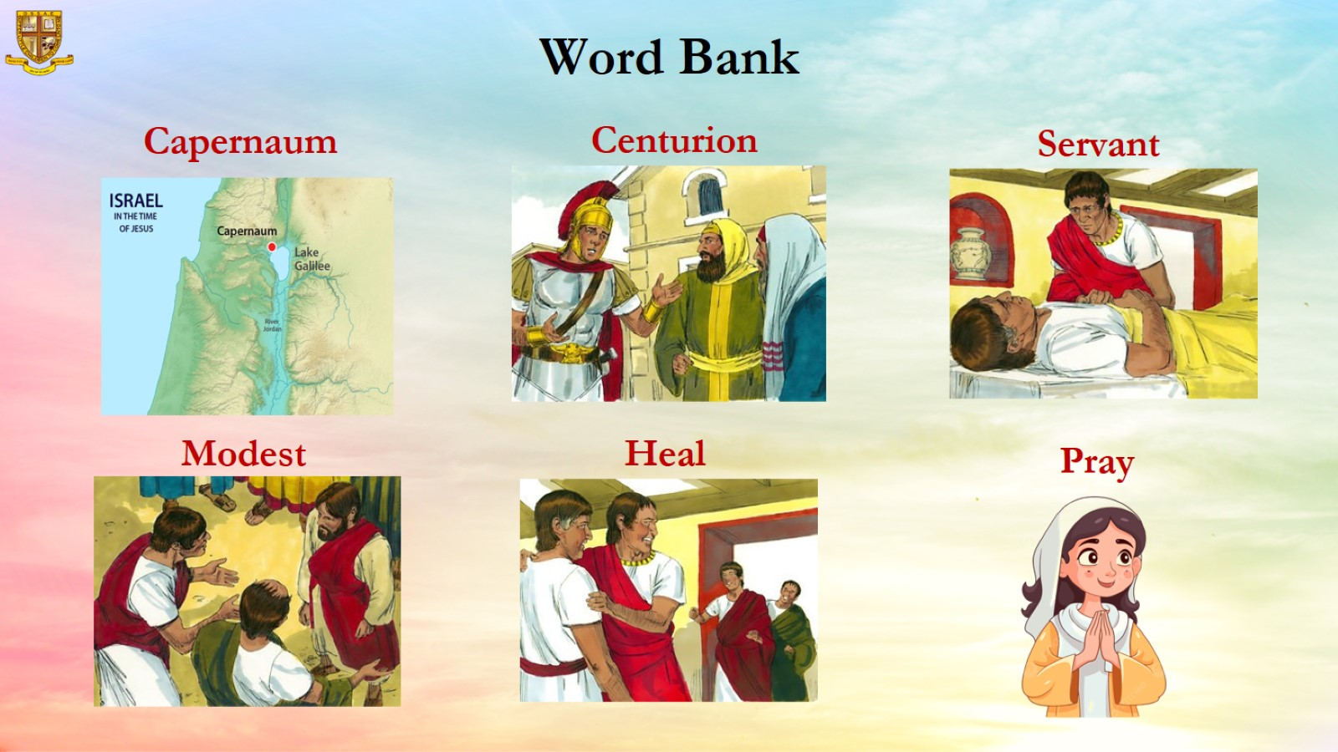

Slide 6
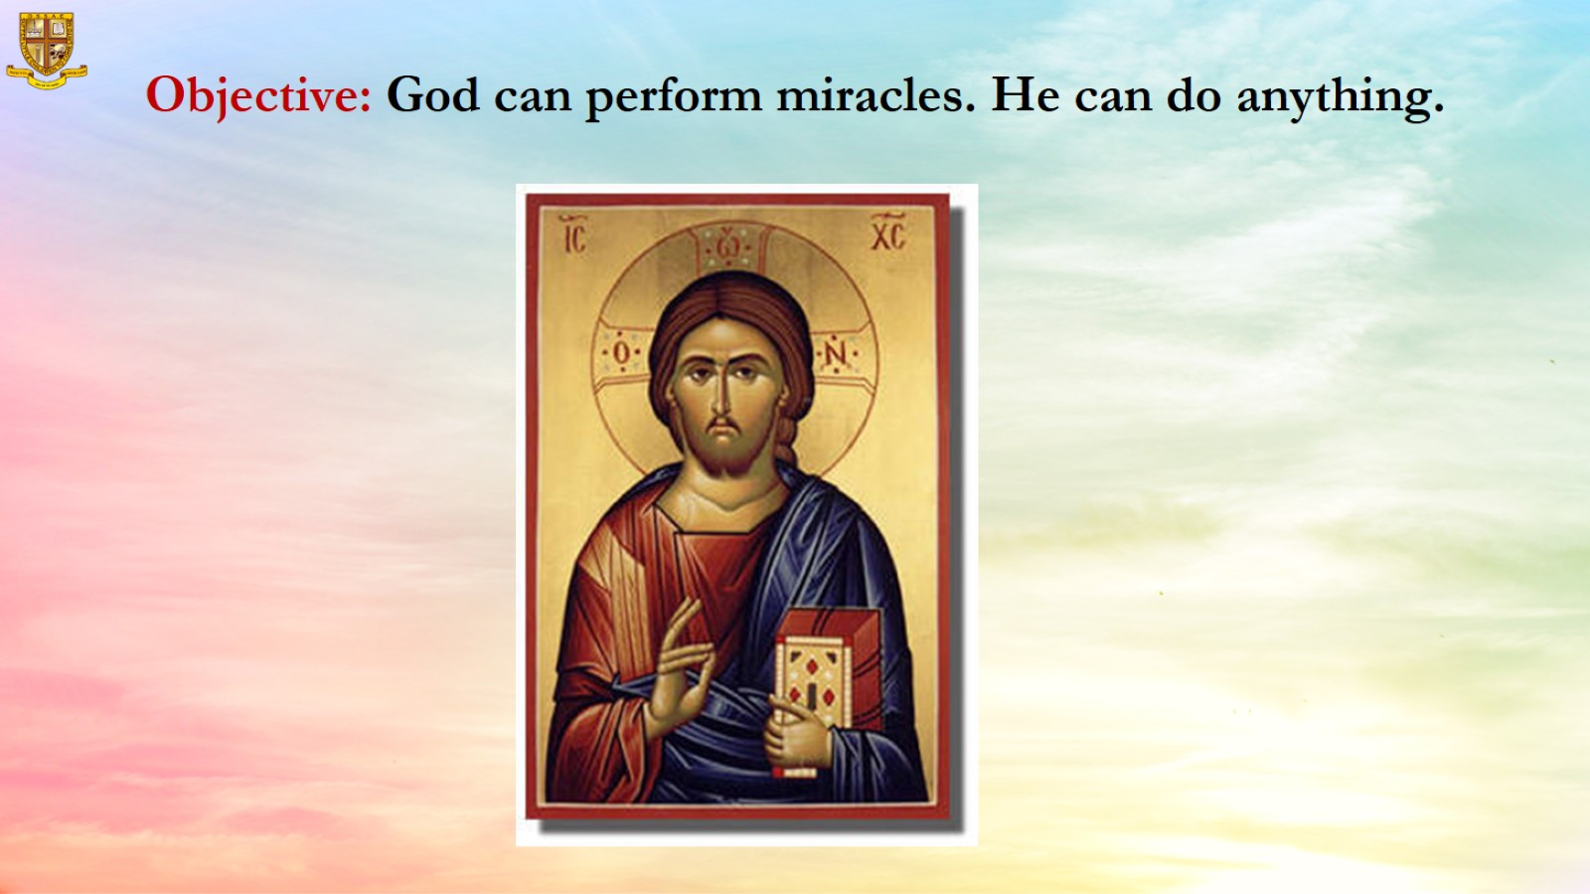
Objective: God can perform miracles. He can do anything.

Slide 7
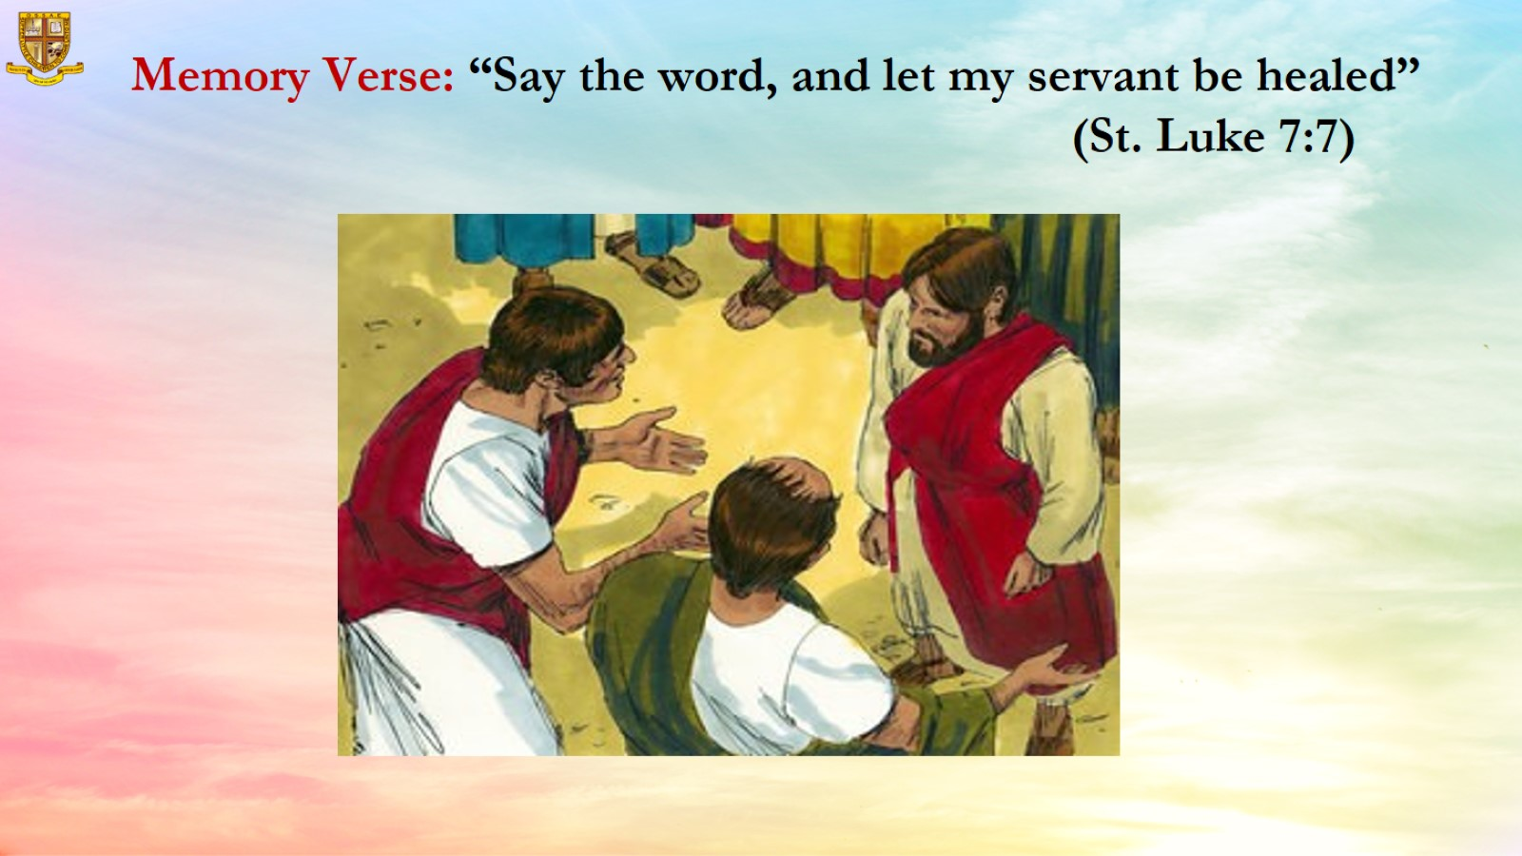
Memory Verse: “Say the word, and let my servant be healed” (St. Luke 7:7)

Slide 8
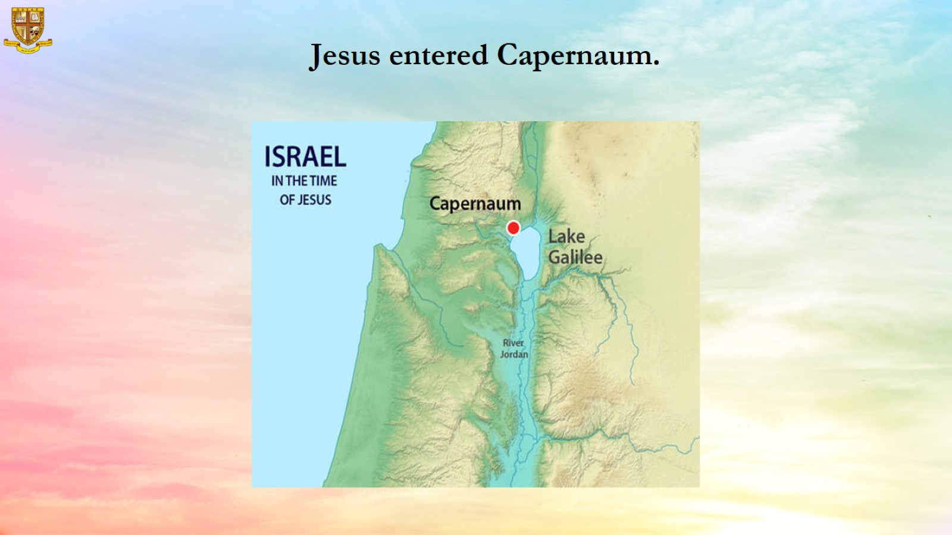
Jesus entered Capernaum.

Slide 9
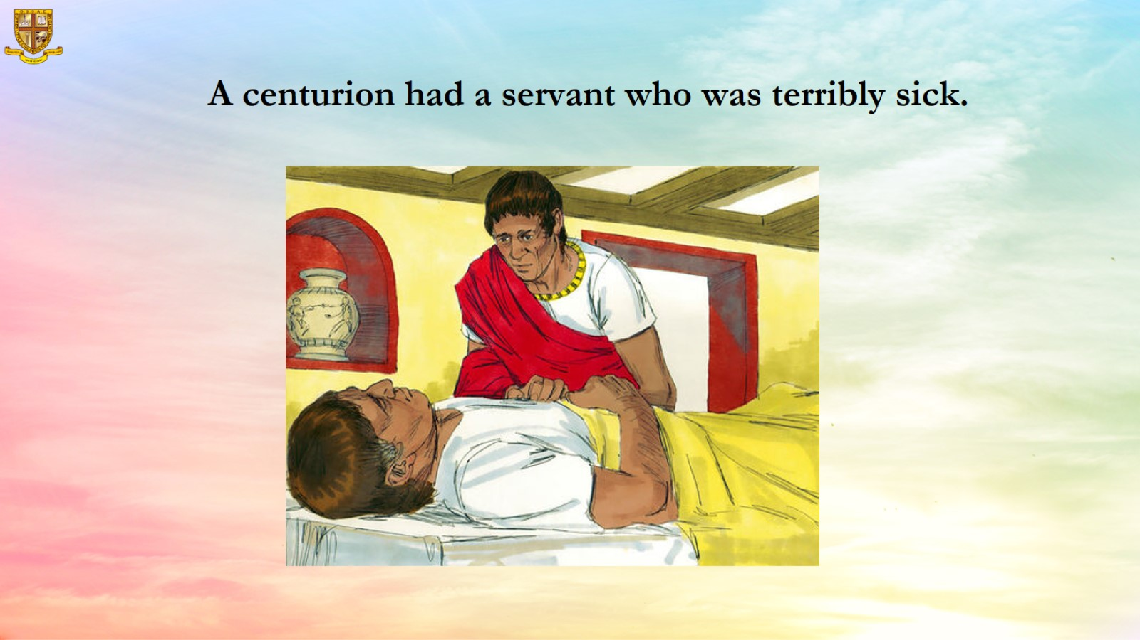

Slide 10
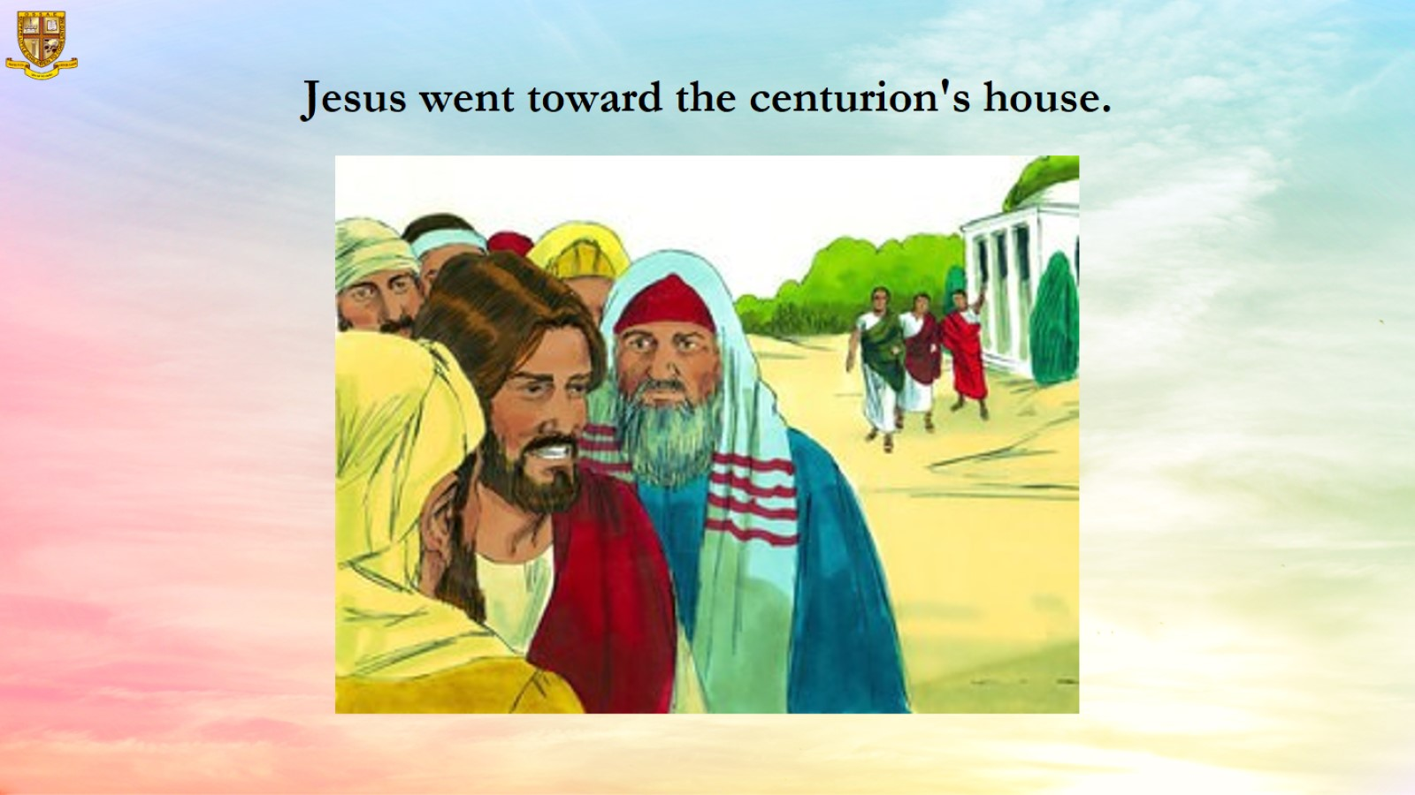
Jesus went toward the centurion's house.

Slide 11
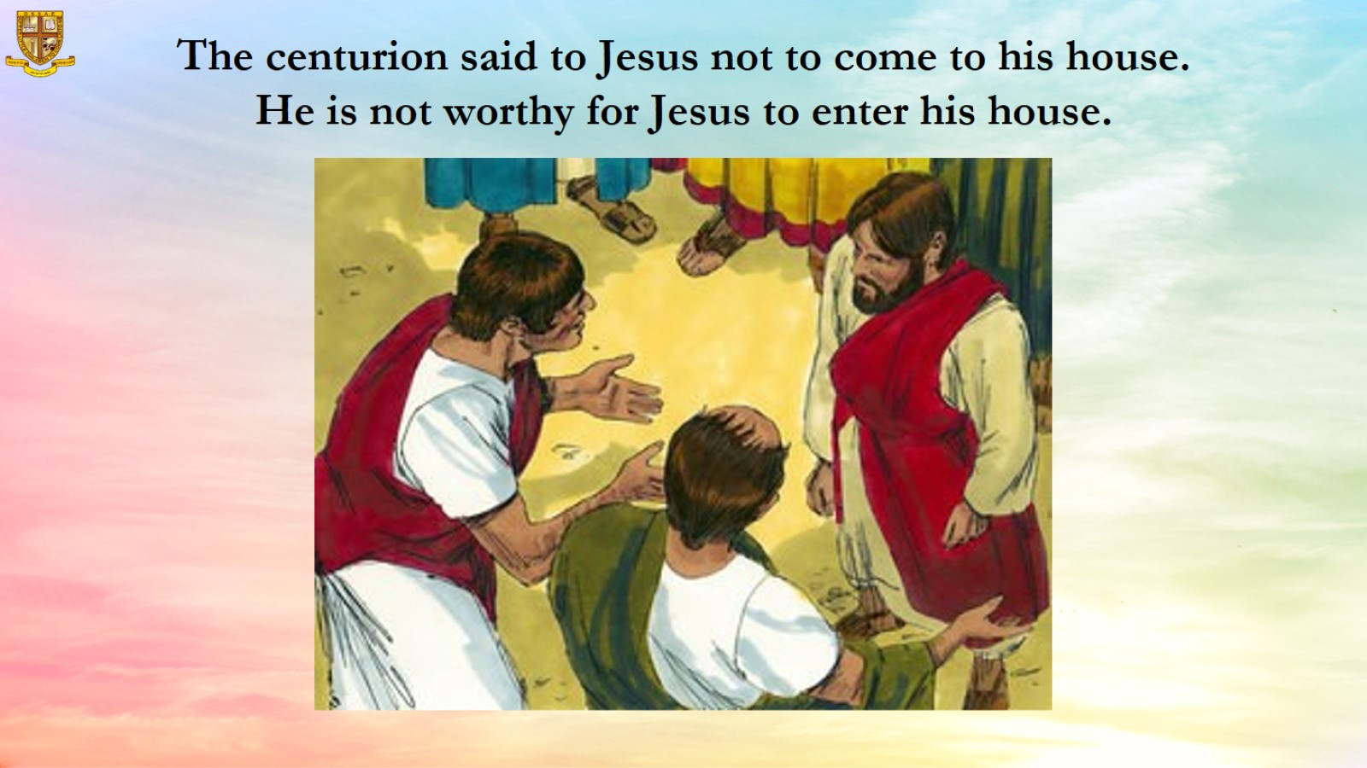
The centurion said to Jesus not to come to his house. He is not worthy for Jesus to enter his house.

Slide 12
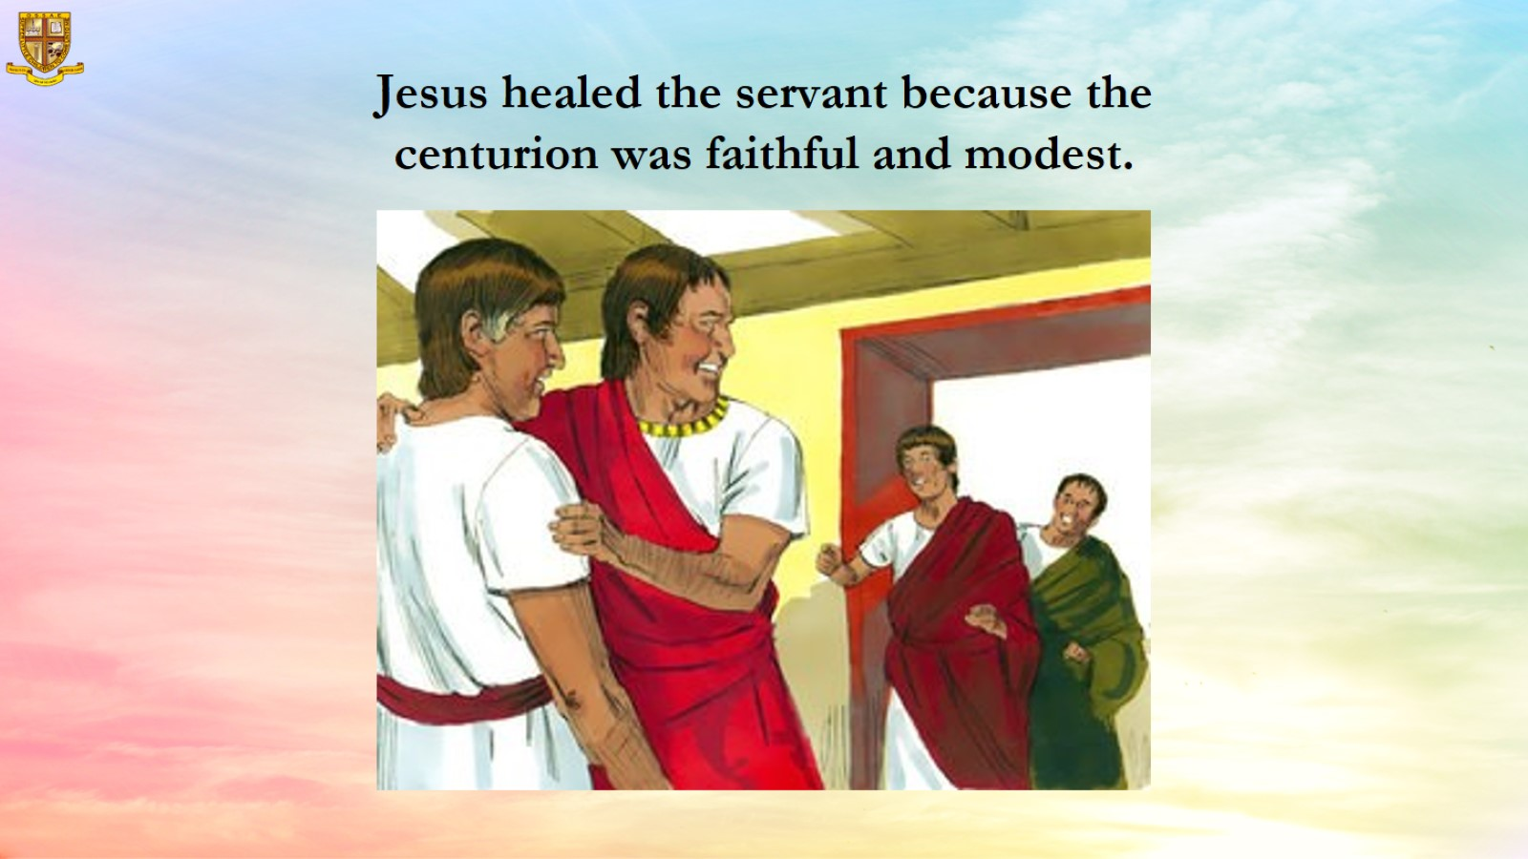

Slide 13
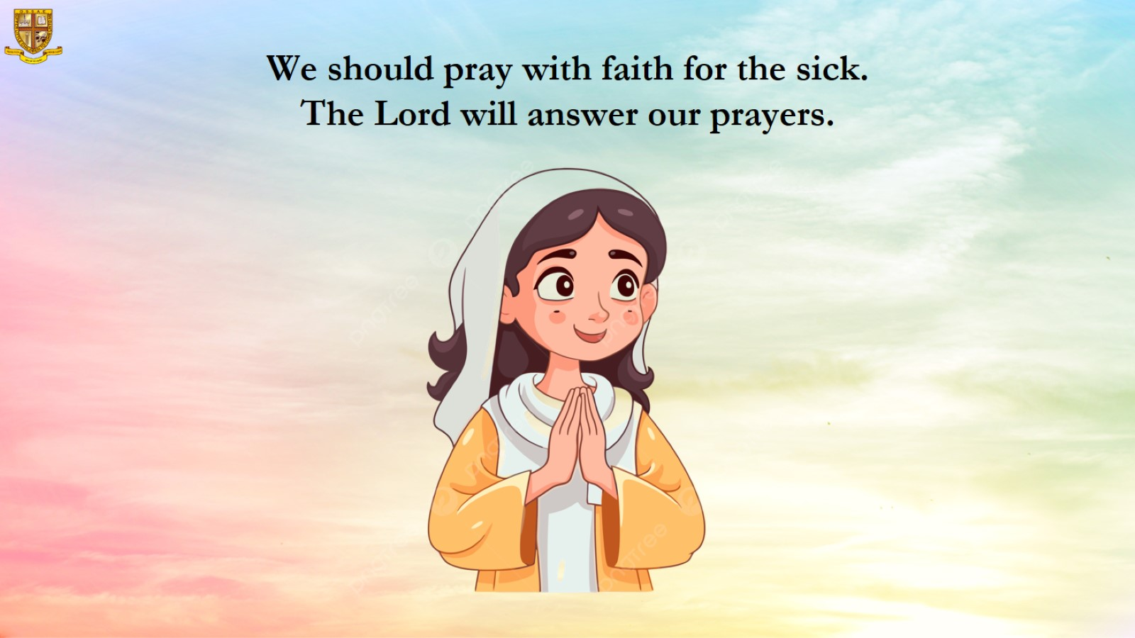

Slide 14
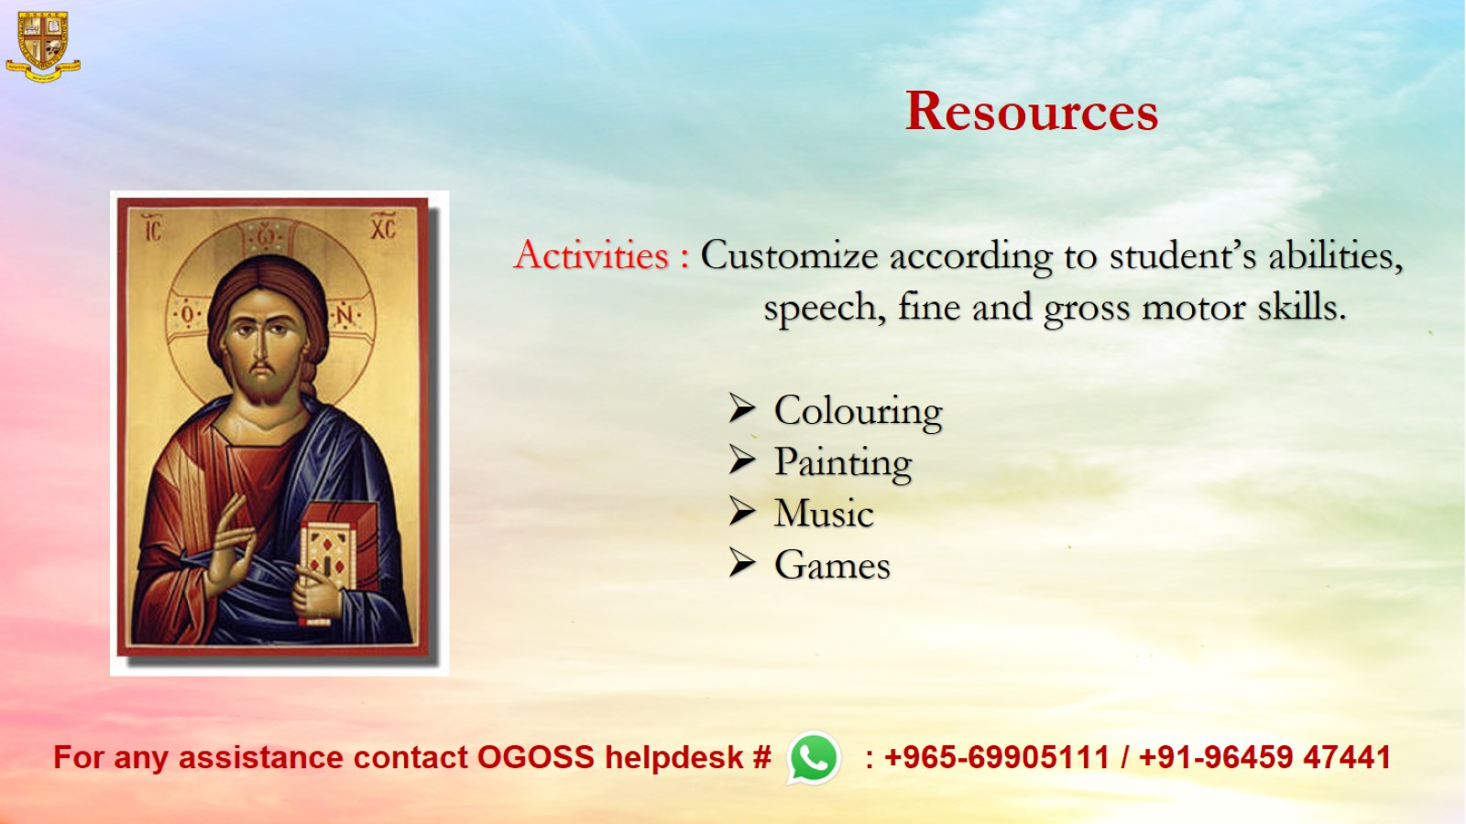
Resources

