Slide 1

Orthodox Global Online Sunday School (OGOSS)

Slide 2
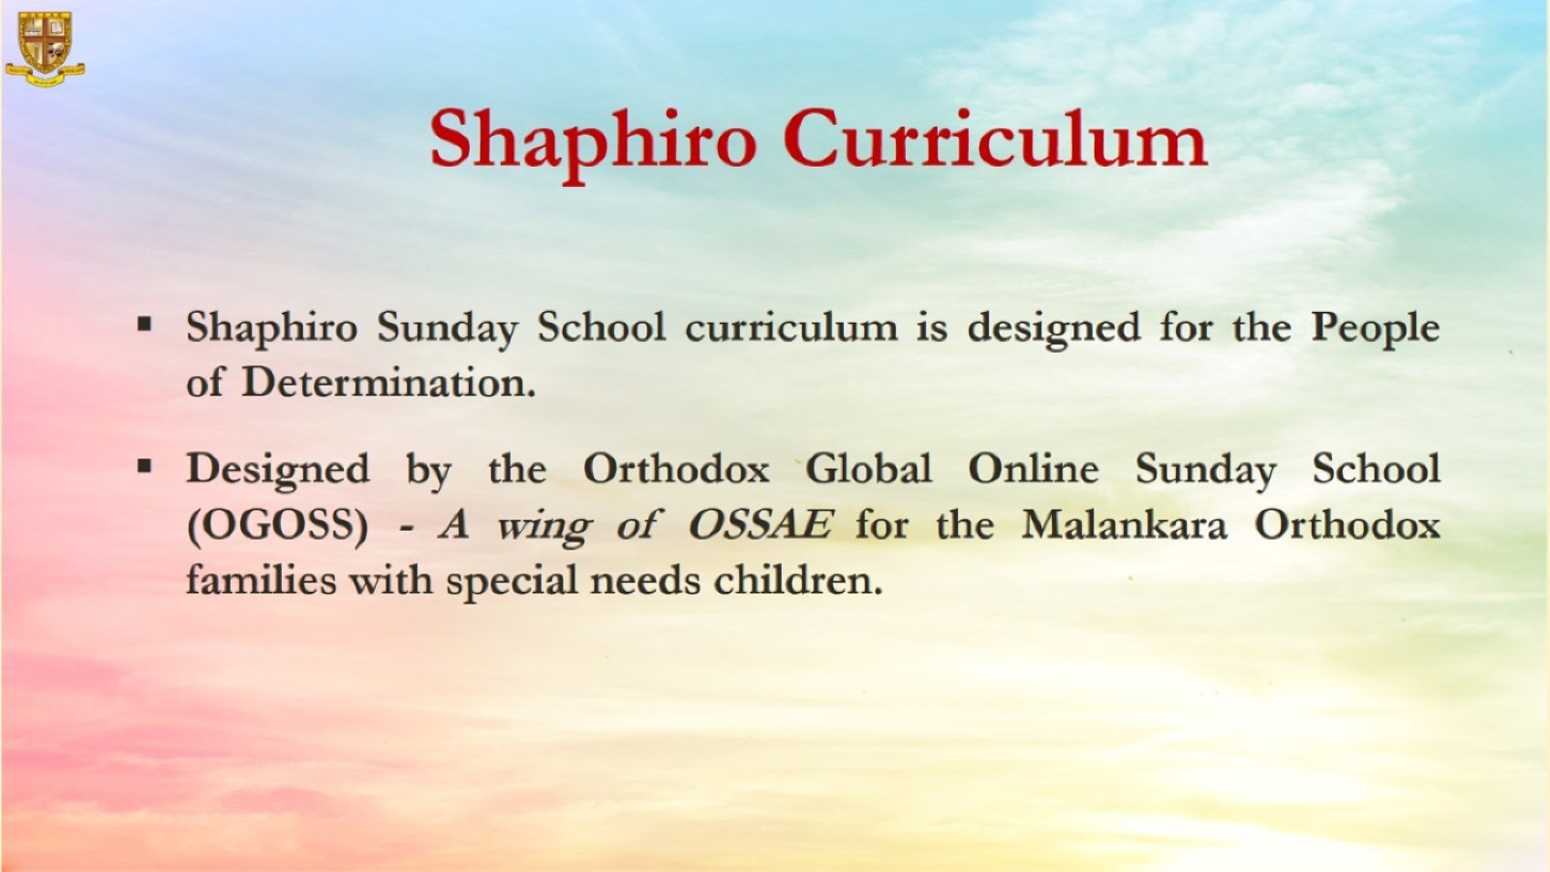

Slide 3


Slide 4
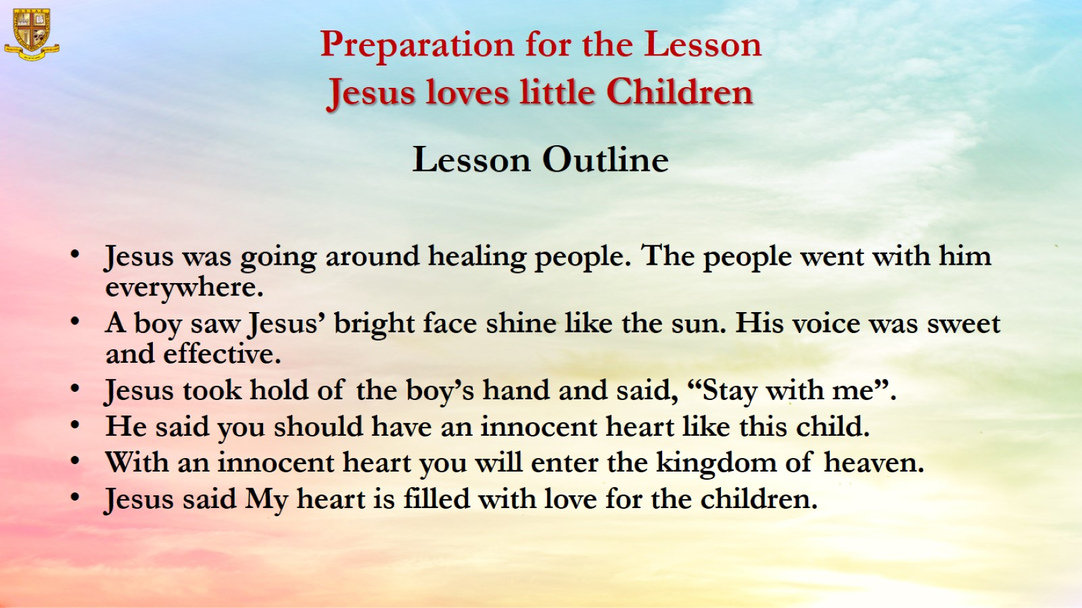
Preparation for the Lesson
Jesus loves little Children

Slide 5
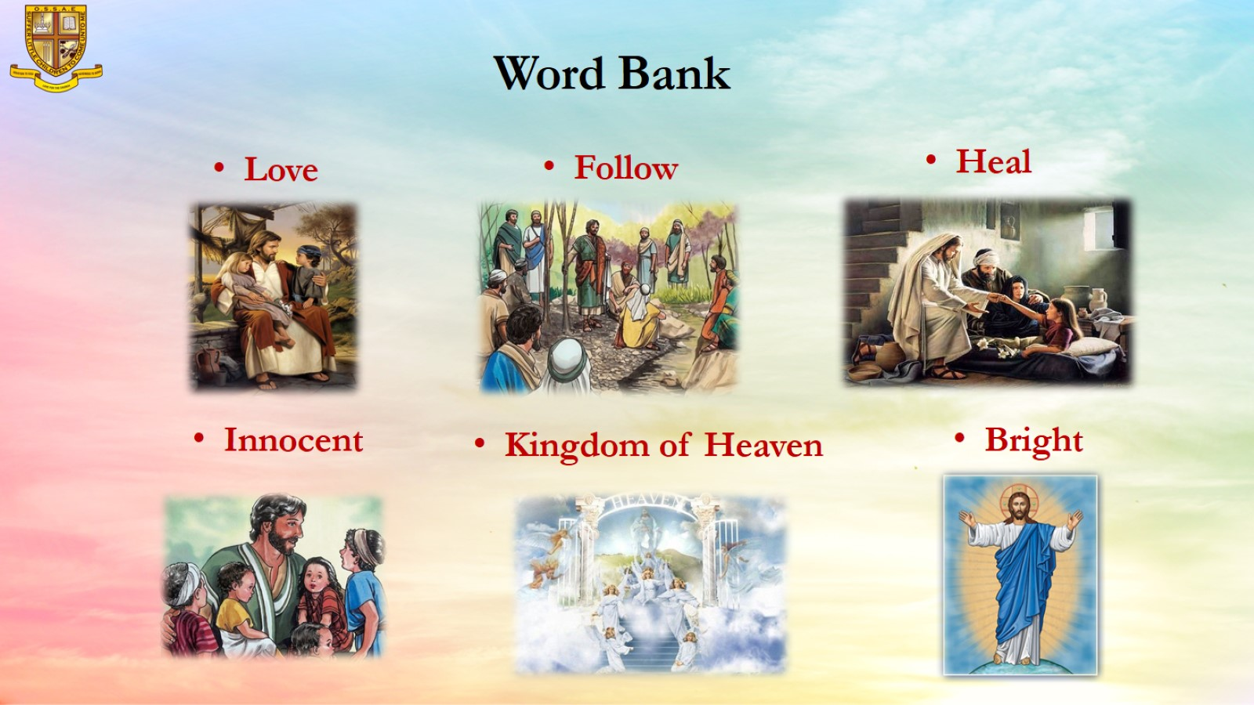
Word Bank

Slide 6
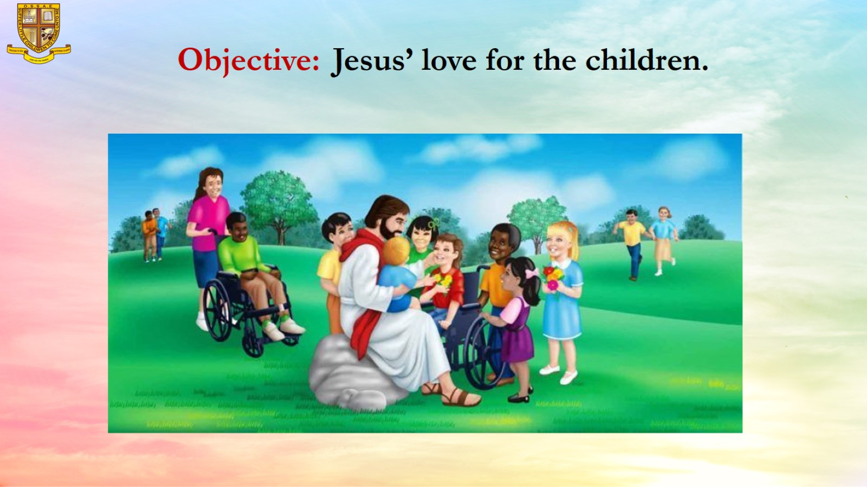
Objective: Jesus’ love for the children.

Slide 7
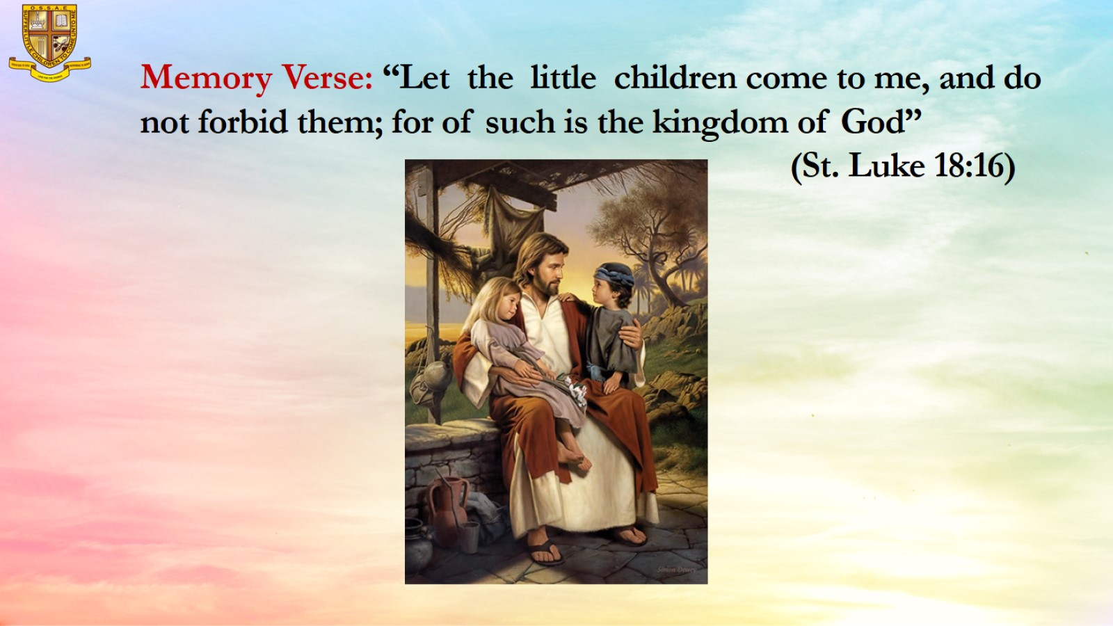
Memory Verse: “Let the little children come to me, and do not forbid them; for of such is the kingdom of God”
(St. Luke 18:16)

Slide 8
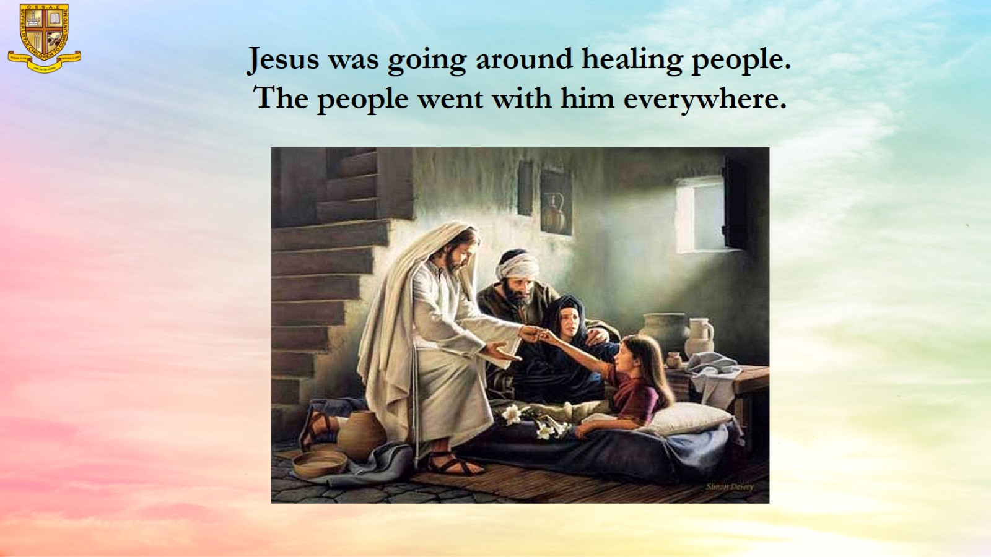
Jesus was going around healing people.
The people went with him everywhere.

Slide 9
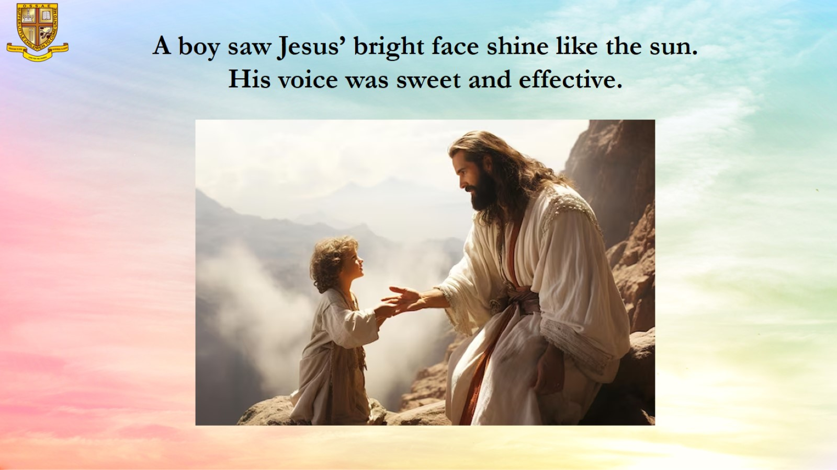
A boy saw Jesus’ bright face shine like the sun.
His voice was sweet and effective.

Slide 10
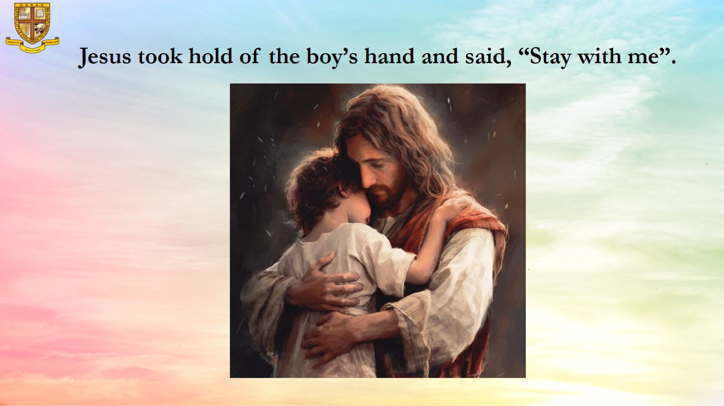
Jesus took hold of the boy’s hand and said, “Stay with me”.

Slide 11
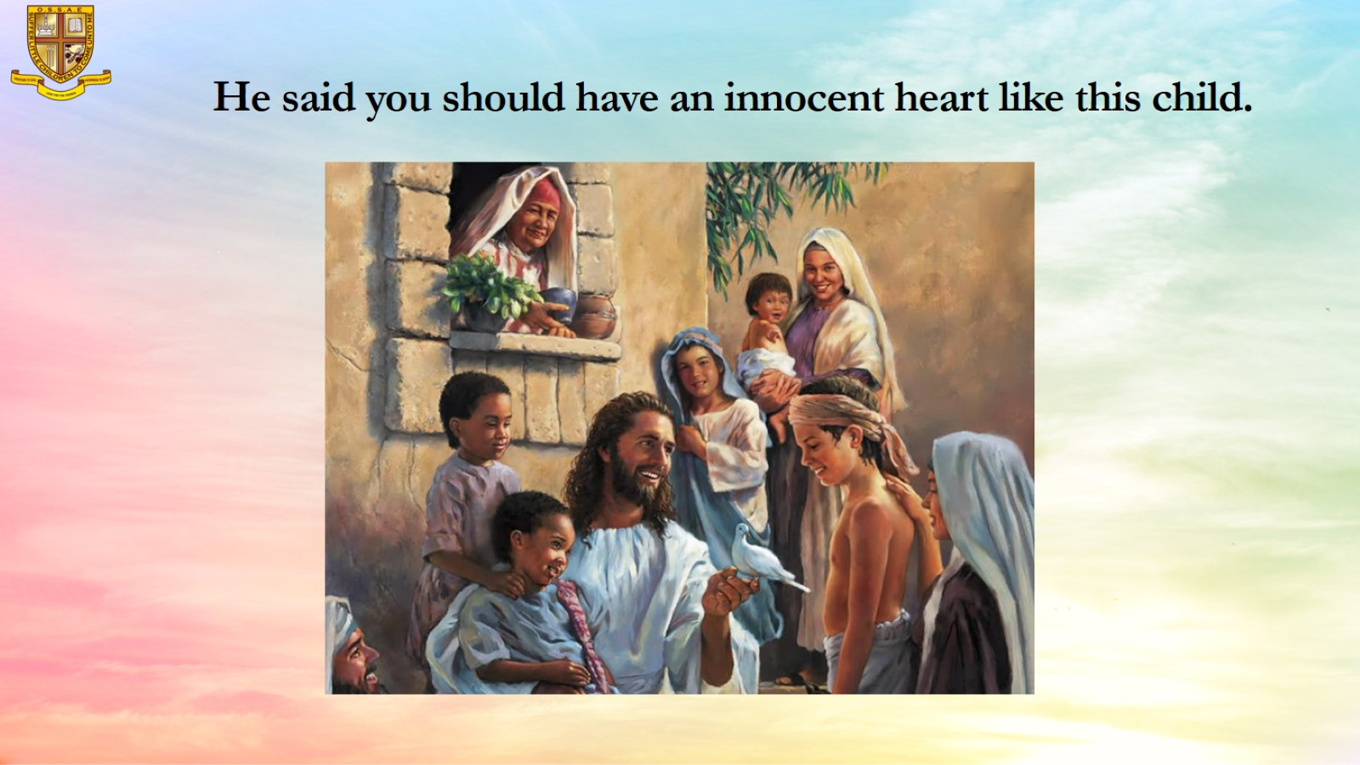
He said you should have an innocent heart like this child.

Slide 12
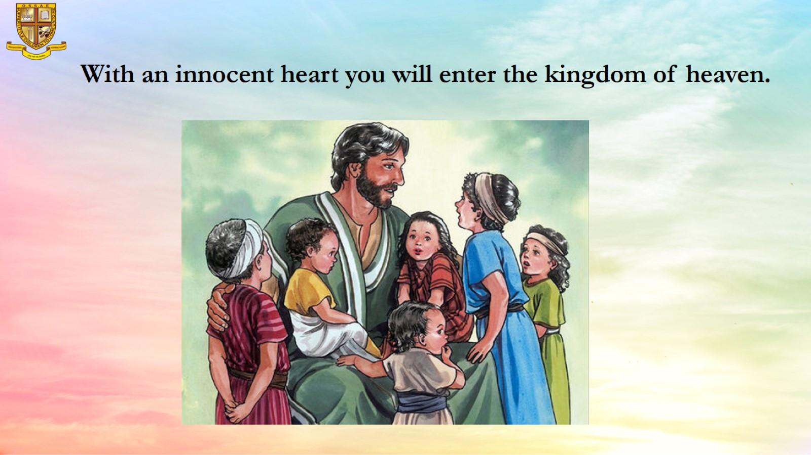
With an innocent heart you will enter the kingdom of heaven.

Slide 13
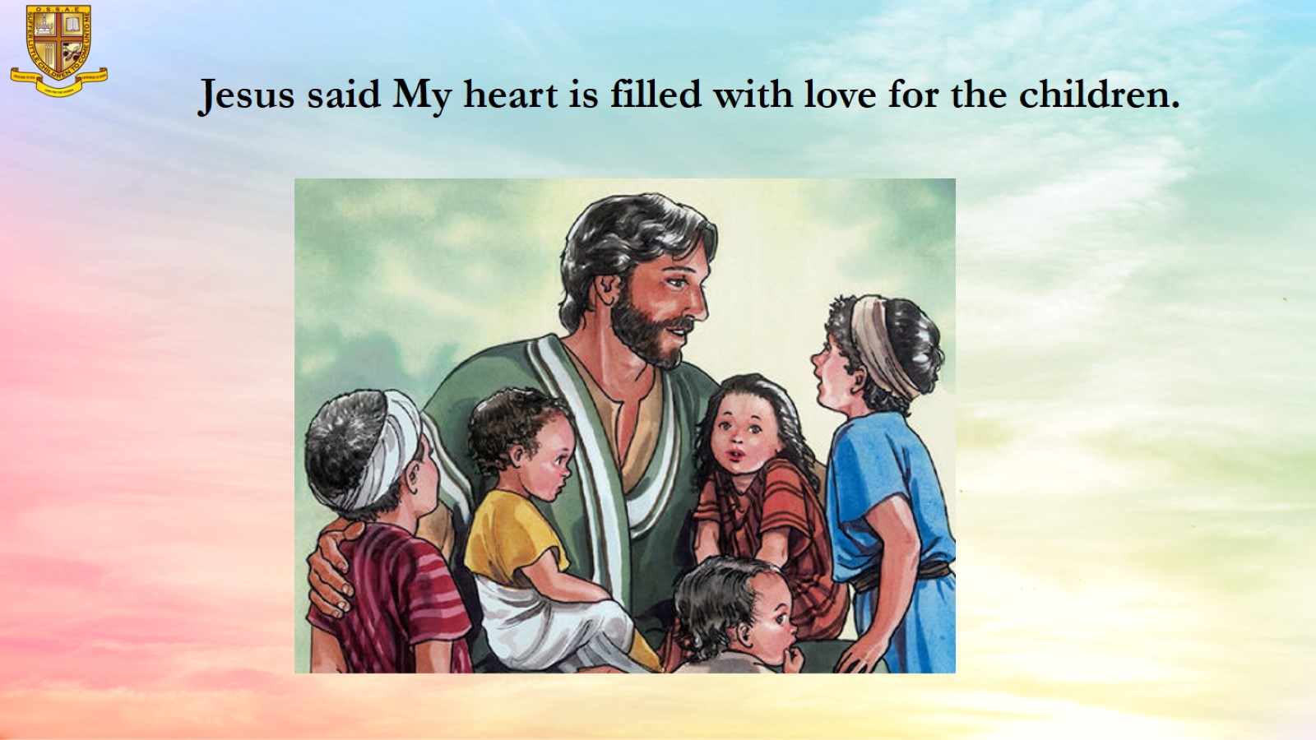
Jesus said My heart is filled with love for the children.

Slide 14
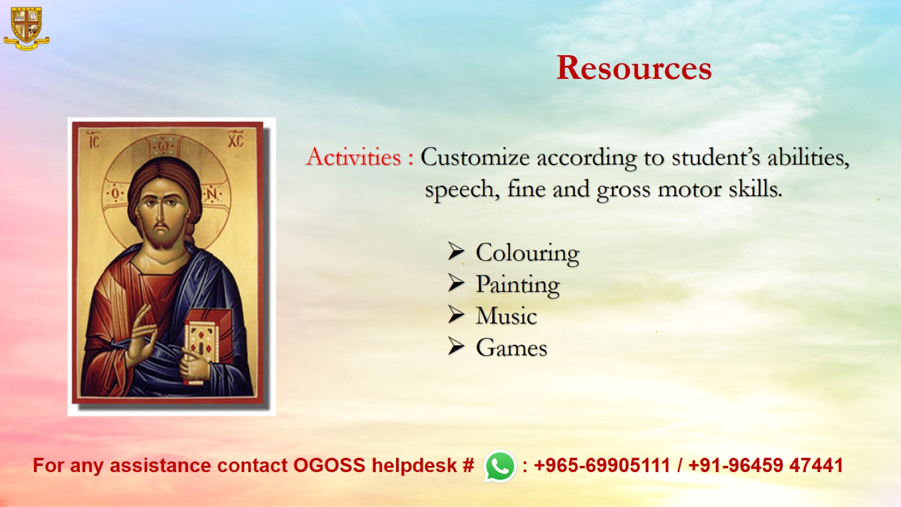
Resources

