Slide 1


Slide 2
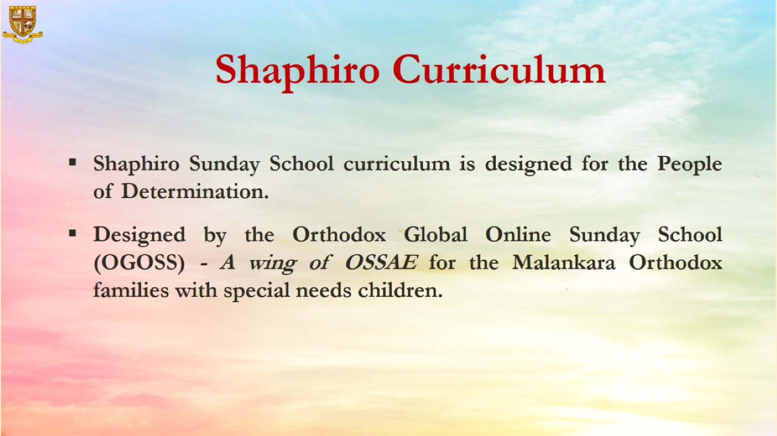

Slide 3


Grade 1
Chapter 7
Jesus’ Dearest Family

Slide 4
Preparation for Friends of Jesus Christ
Preparation for the chapter
Jesus’ Dearest Family
Lesson Outline
Lazarus had two sisters, Mary and Martha. They loved Jesus.
Jesus loved them and He visited them.
Mary sat at the Lord’s feet and listened to him.
Martha was distracted with much serving and preparations. She was busy working.
Martha complained to Jesus. She wanted Mary to help her.
Jesus told Martha not to be worried and upset. He told her that Mary was listening to His words and chosen which is better and needed.

Slide 5
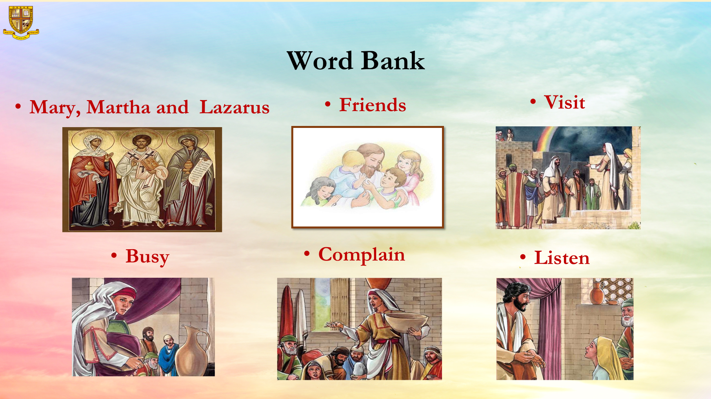
Word Bank

Slide 6
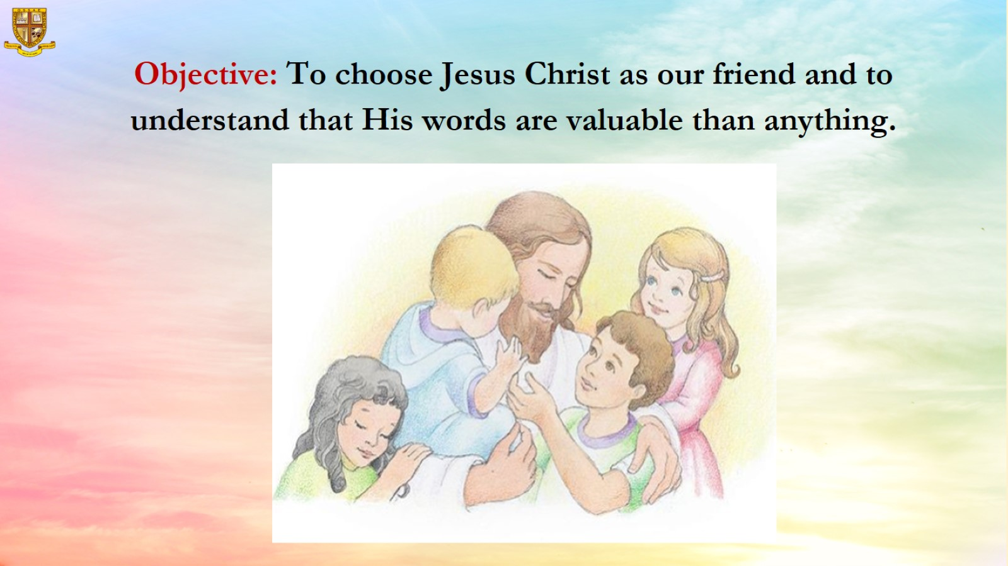

Slide 7
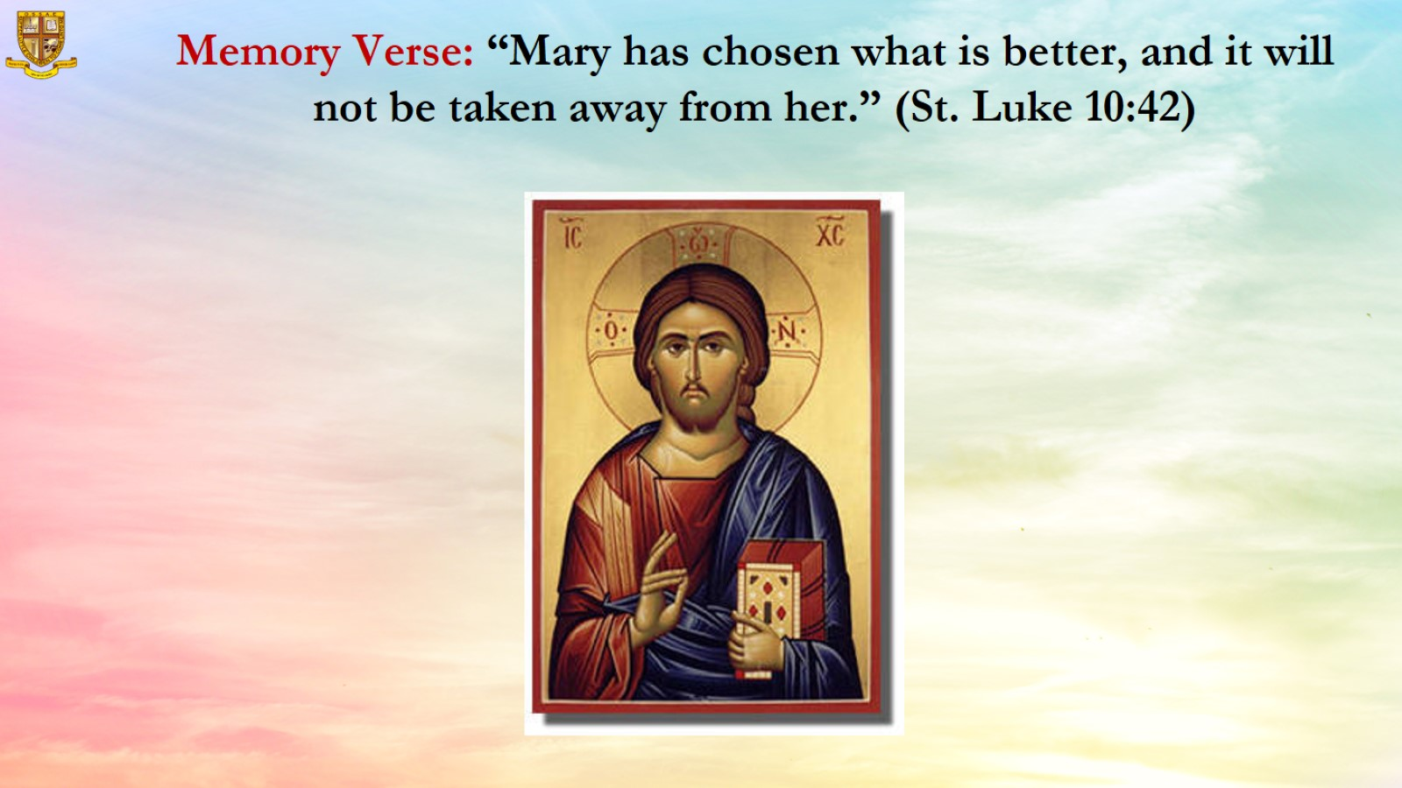

Slide 8
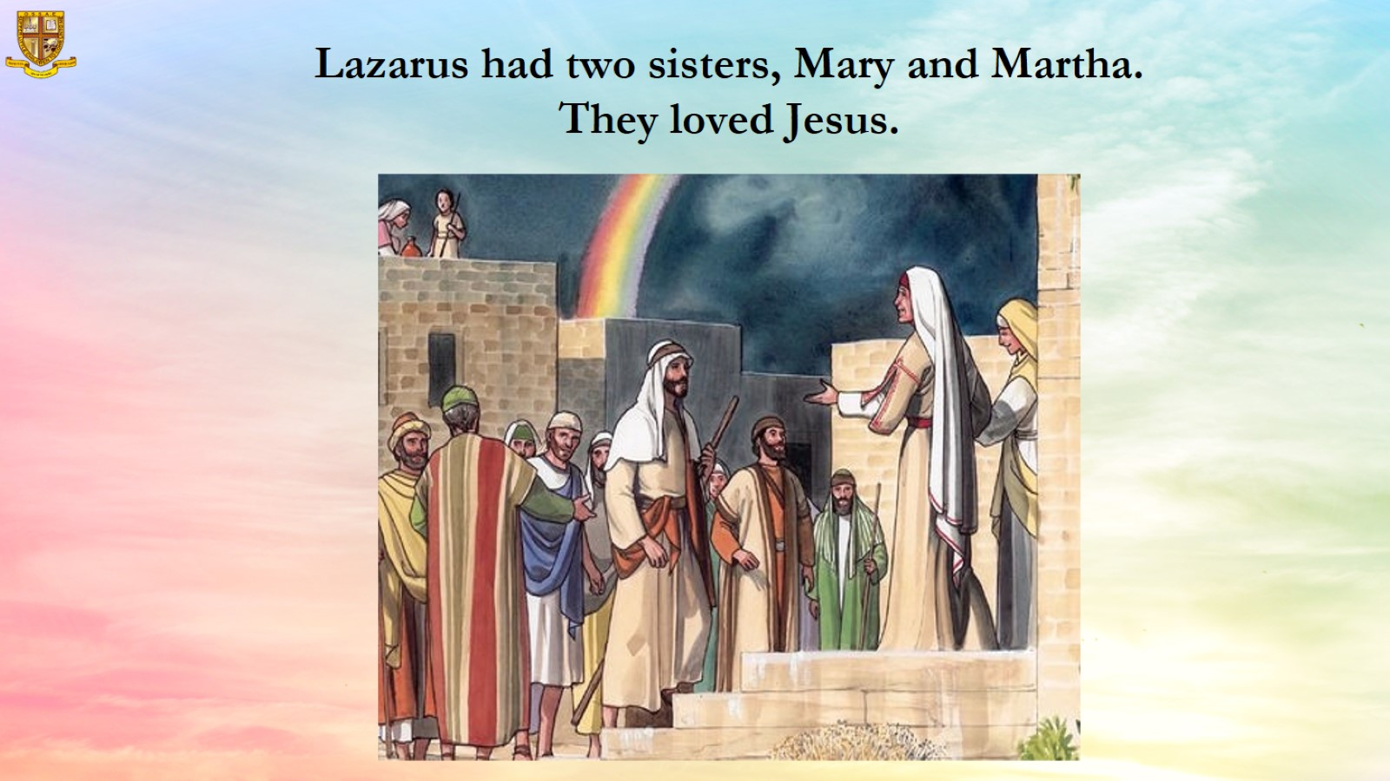

Slide 9
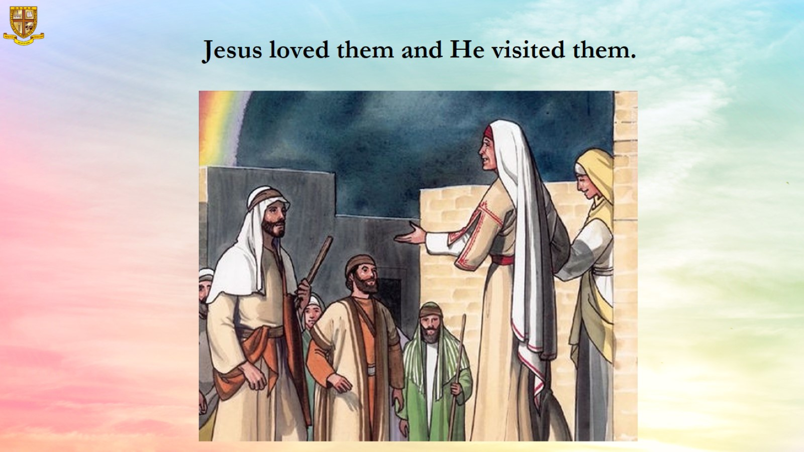
Jesus loved them and He visited them.

Slide 10
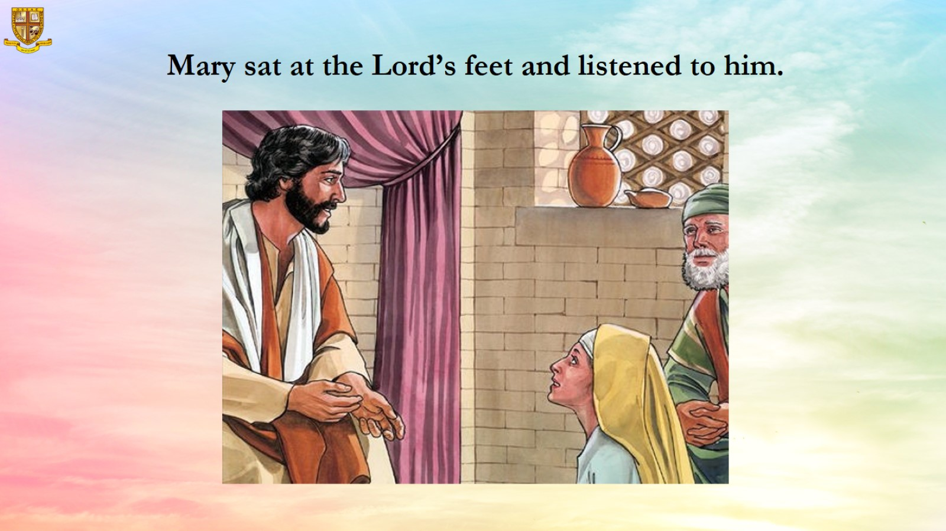

Slide 11
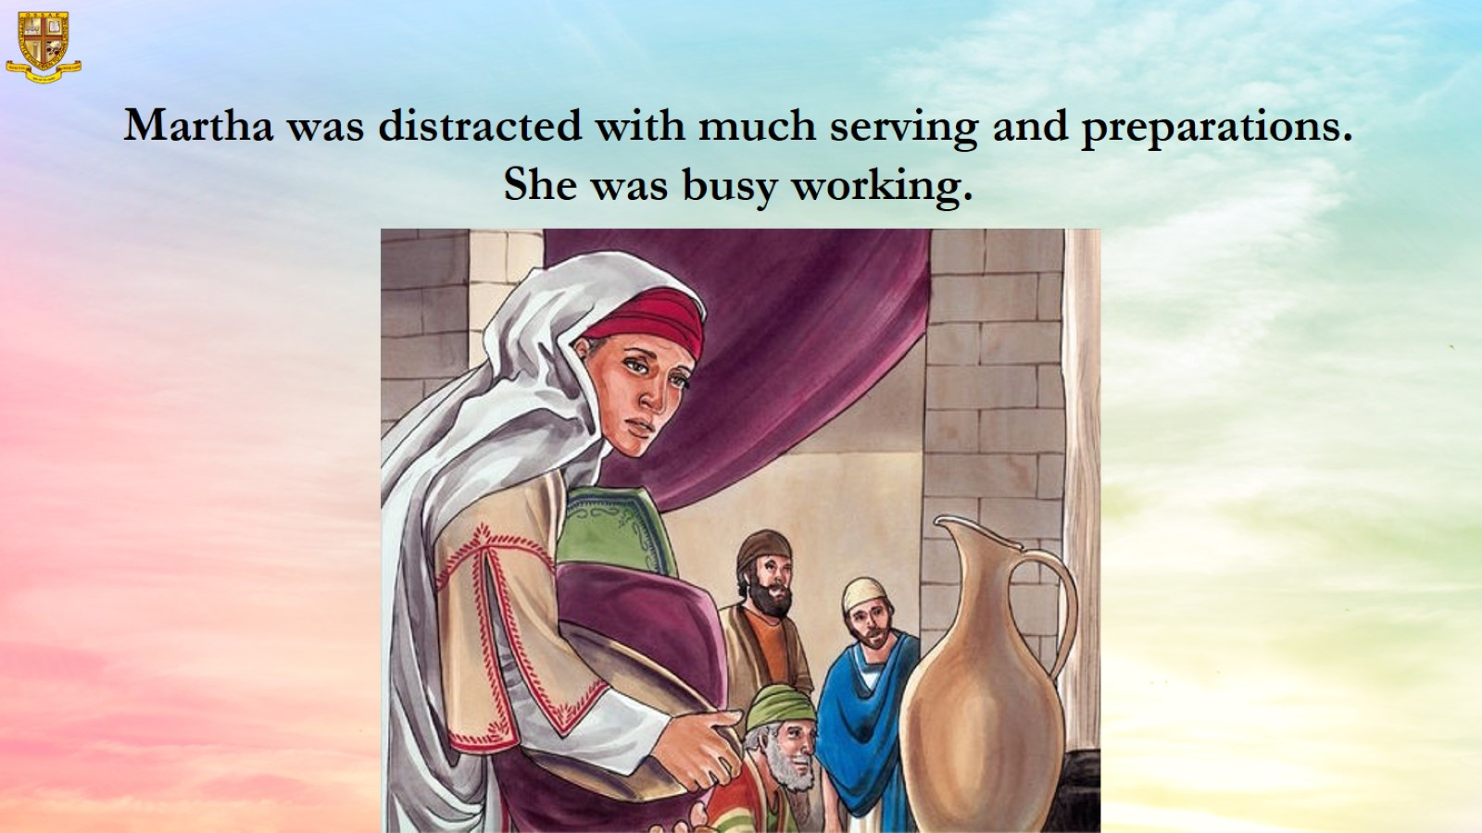
Martha was distracted with much serving and preparations. She was busy working.

Slide 12
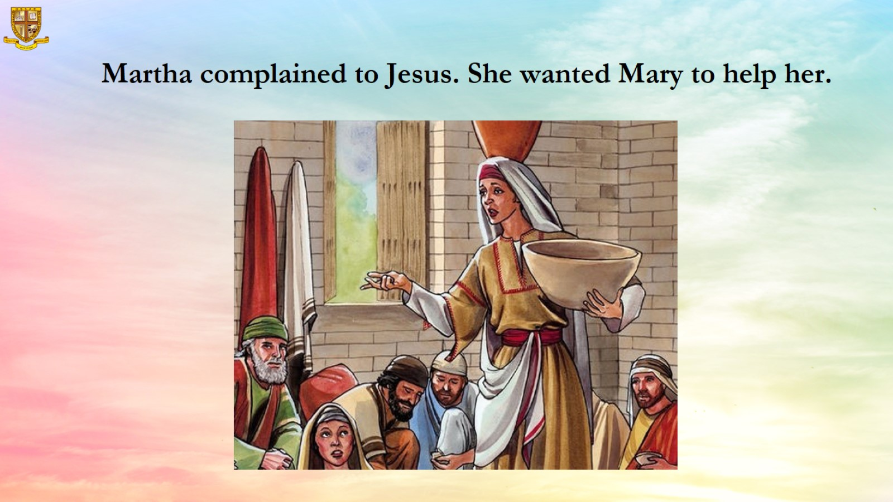

Slide 13
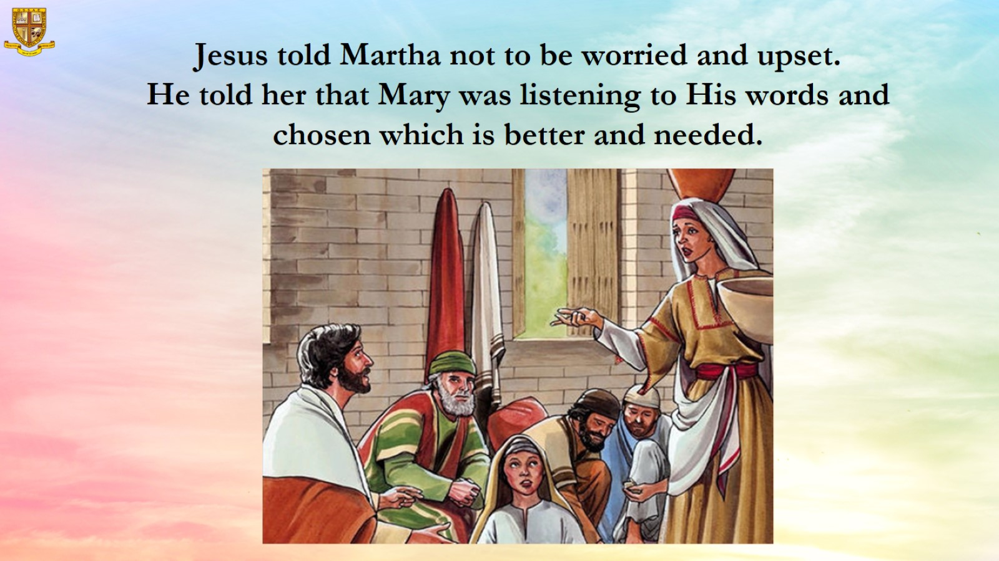

Slide 14
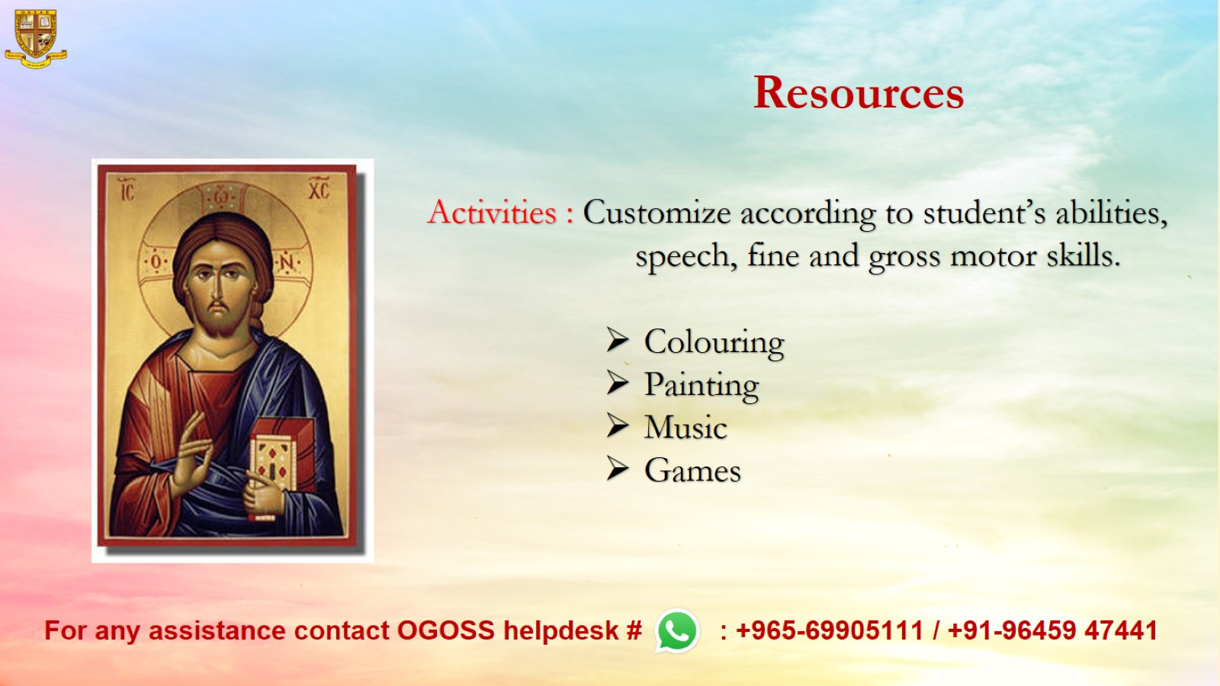
Resources

