Slide 1
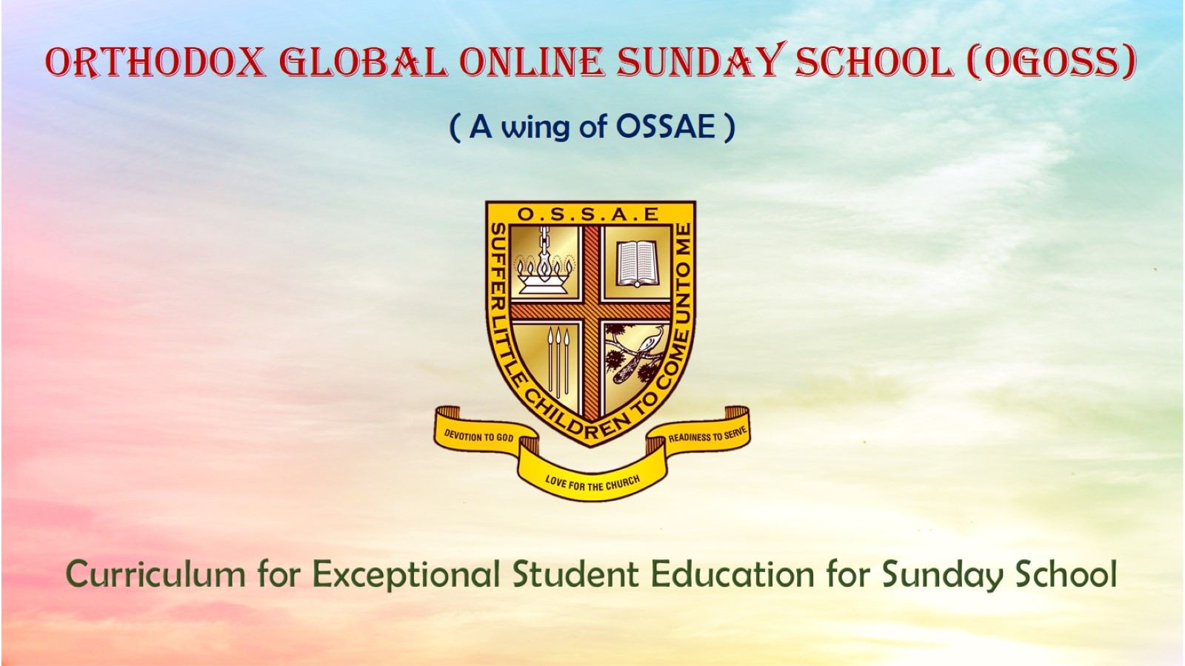
Orthodox Global Online Sunday School (OGOSS)

Slide 2
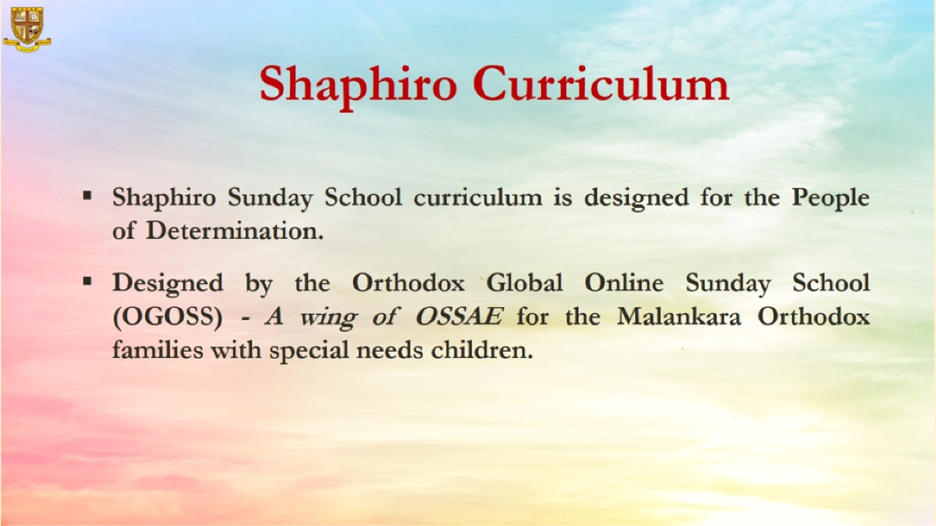

Slide 3
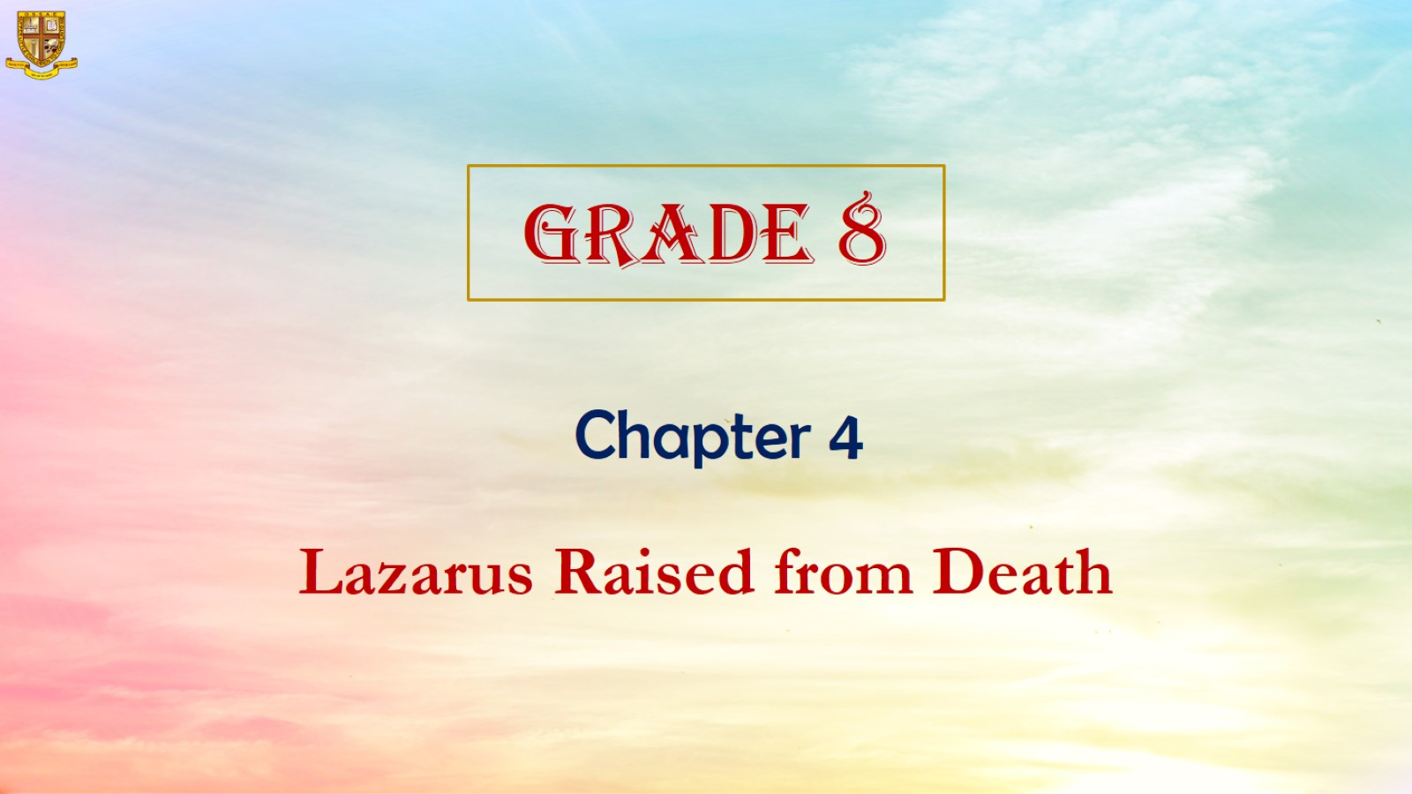

Slide 4
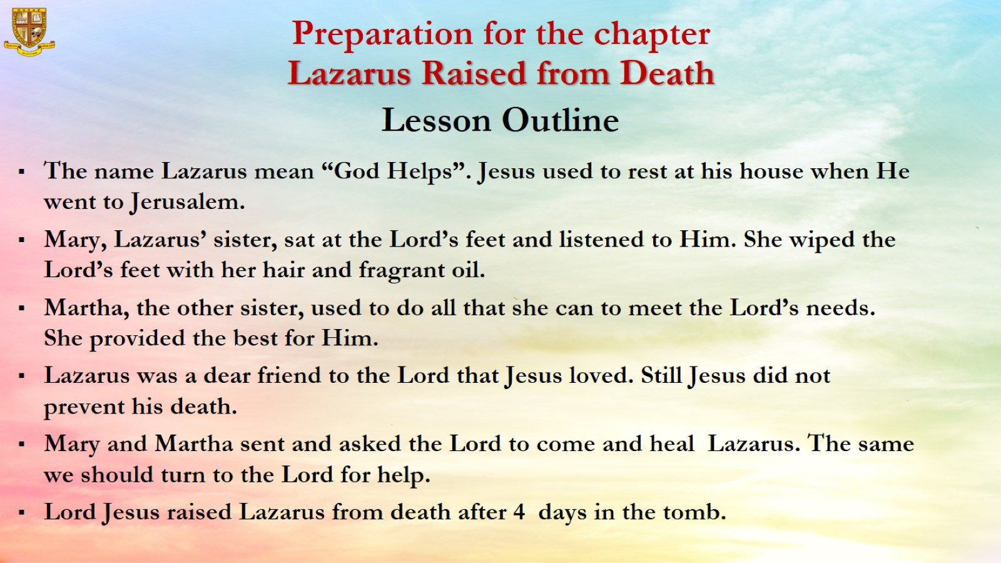

Slide 5
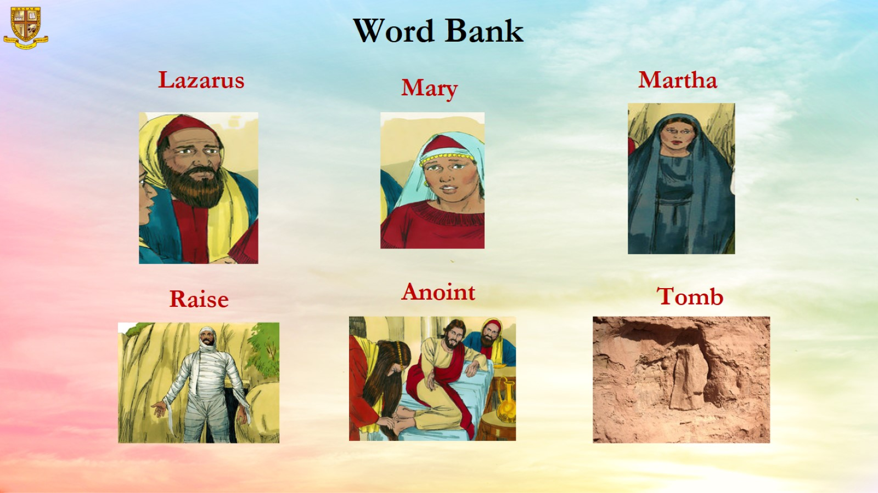

Slide 6
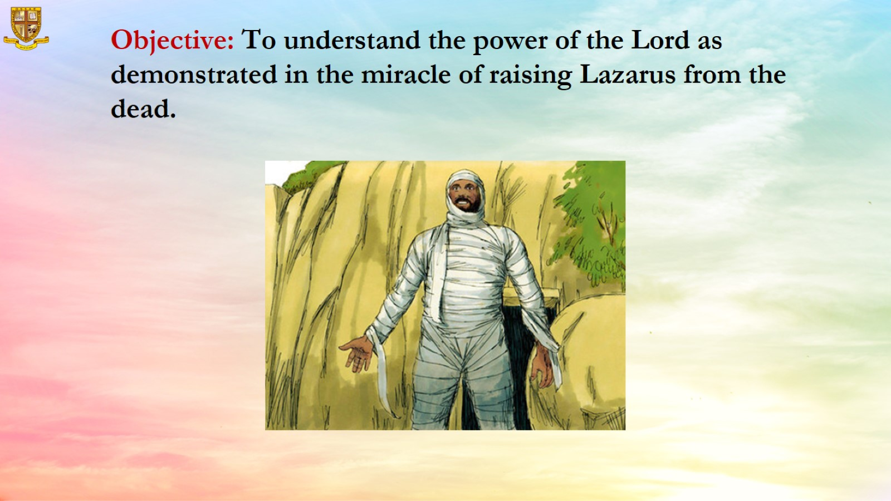
Objective: To understand the power of the Lord as demonstrated in the miracle of raising Lazarus from the dead.

Slide 7
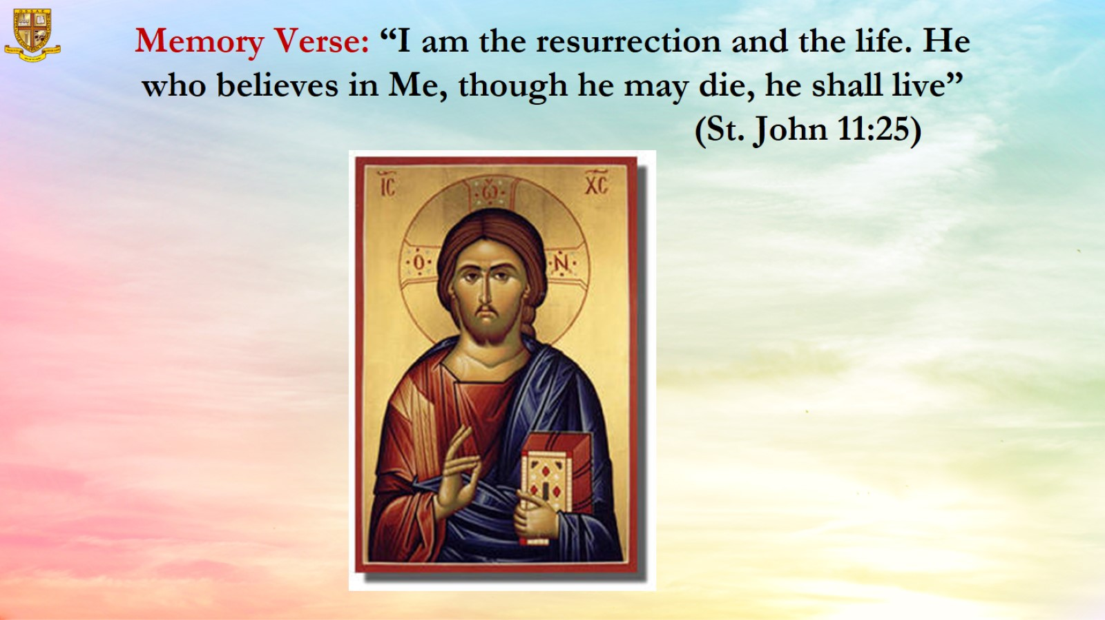
Memory Verse: “I am the resurrection and the life. He who believes in Me, though he may die, he shall live” (St. John 11:25)

Slide 8
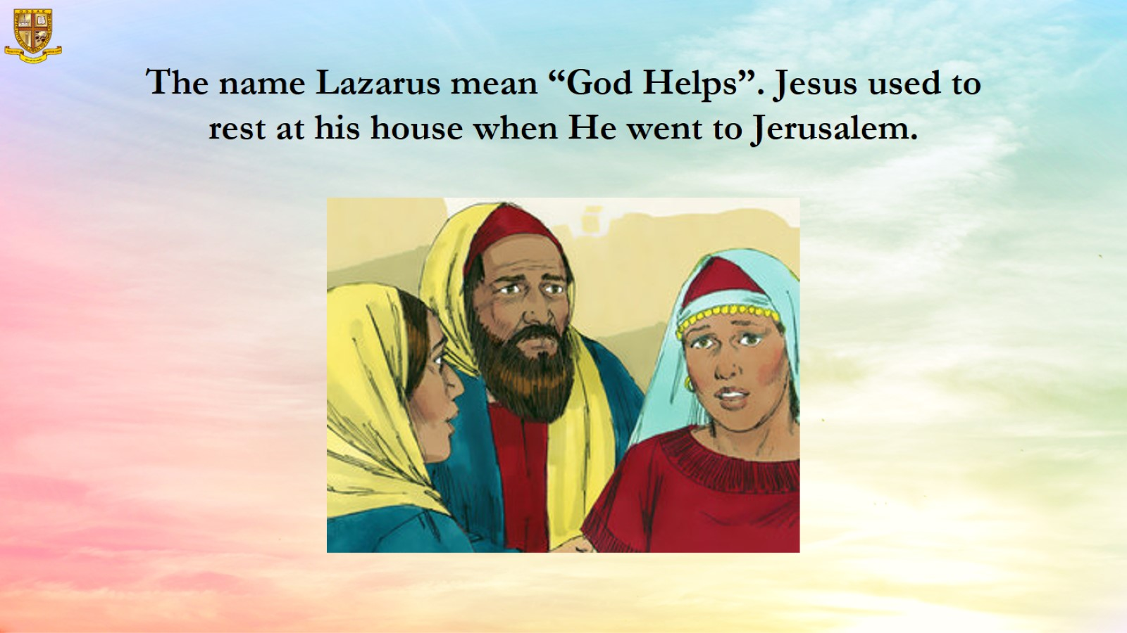
The name Lazarus mean “God Helps”. Jesus used to rest at his house when He went to Jerusalem.

Slide 9
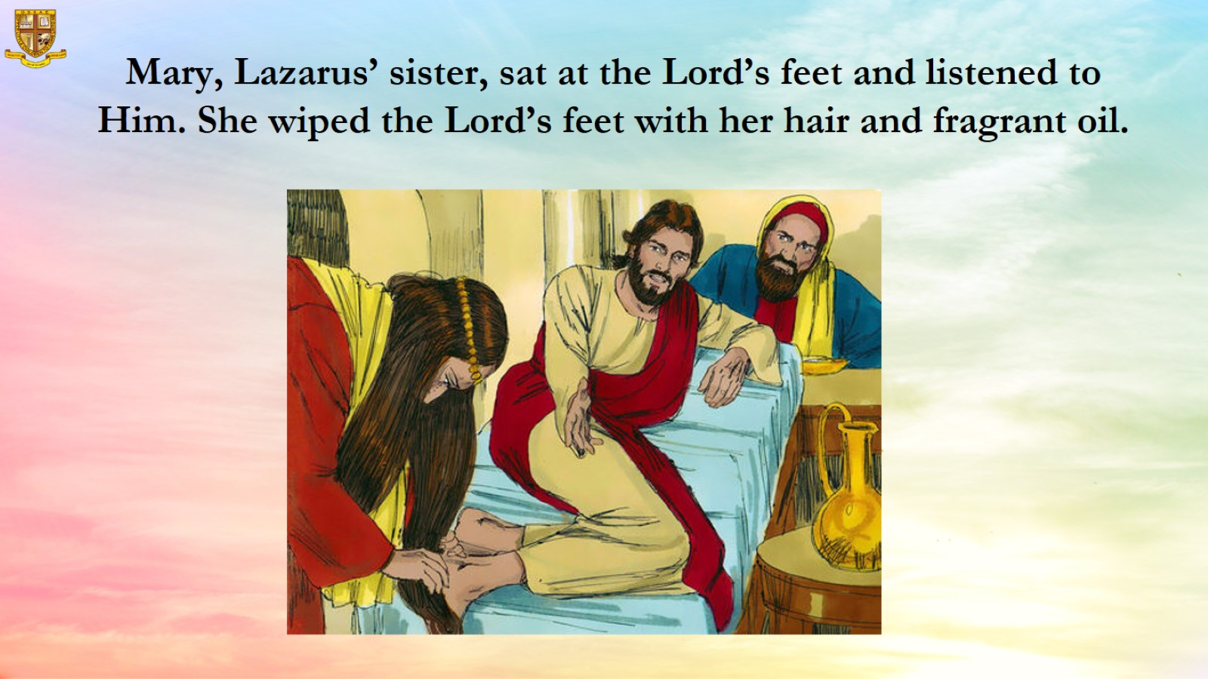
Mary, Lazarus’ sister, sat at the Lord’s feet and listened to Him. She wiped the Lord’s feet with her hair and fragrant oil.

Slide 10
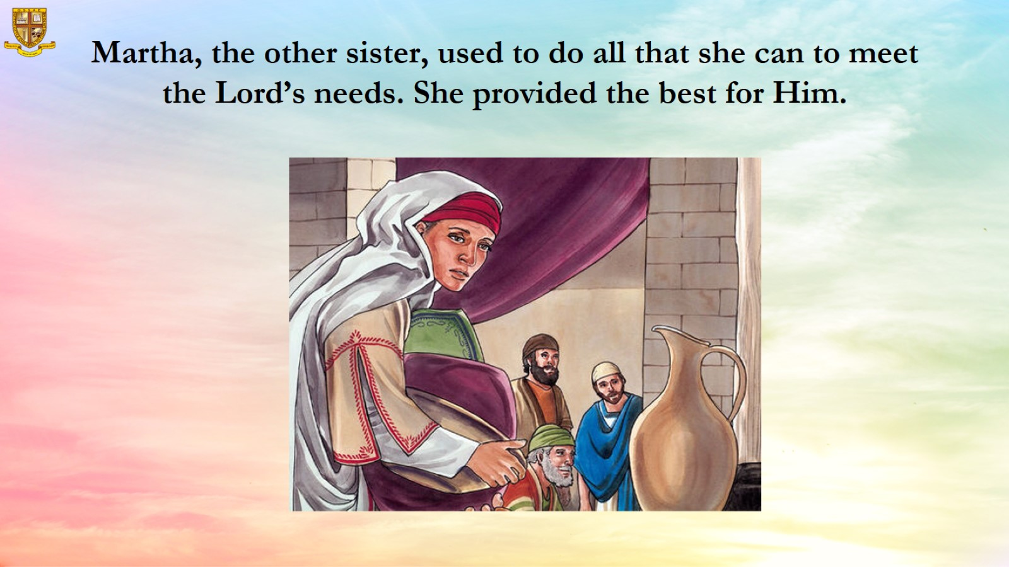
Martha, the other sister, used to do all that she can to meet the Lord’s needs. She provided the best for Him.

Slide 11
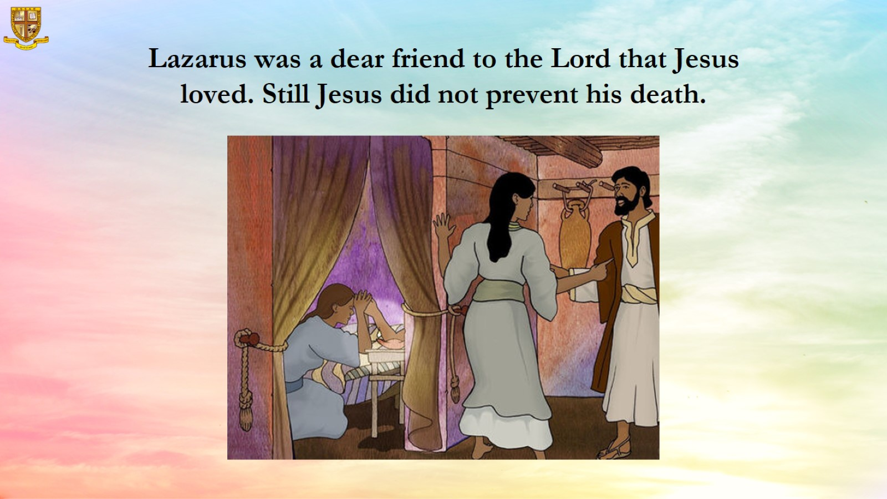
Lazarus was a dear friend to the Lord that Jesus loved. Still Jesus did not prevent his death.

Slide 12
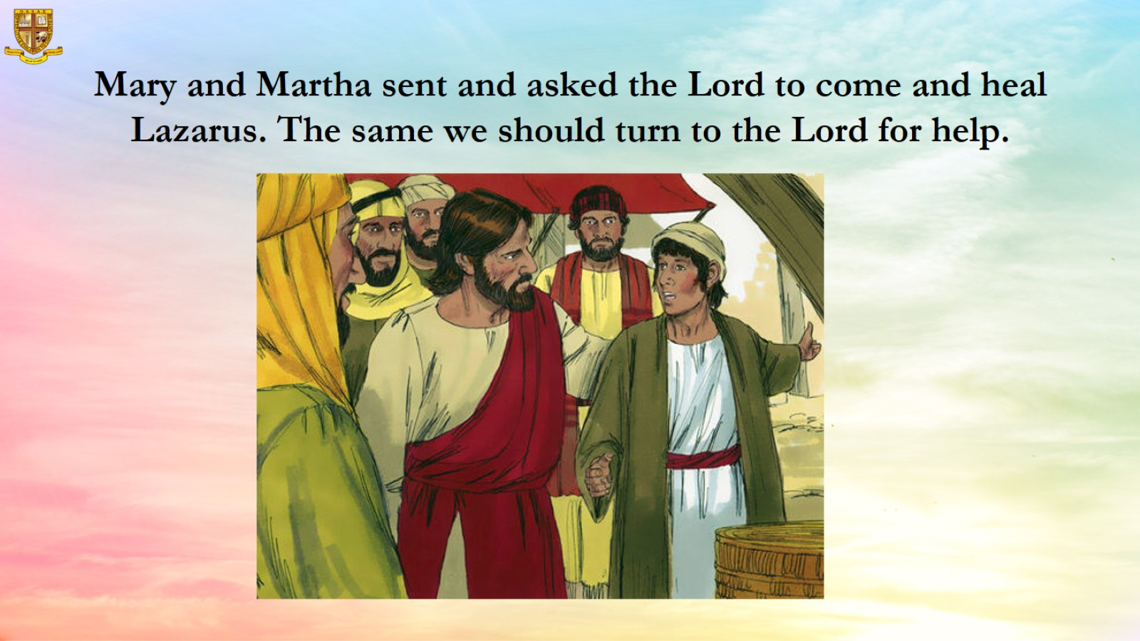
Mary and Martha sent and asked the Lord to come and heal Lazarus. The same we should turn to the Lord for help.

Slide 13
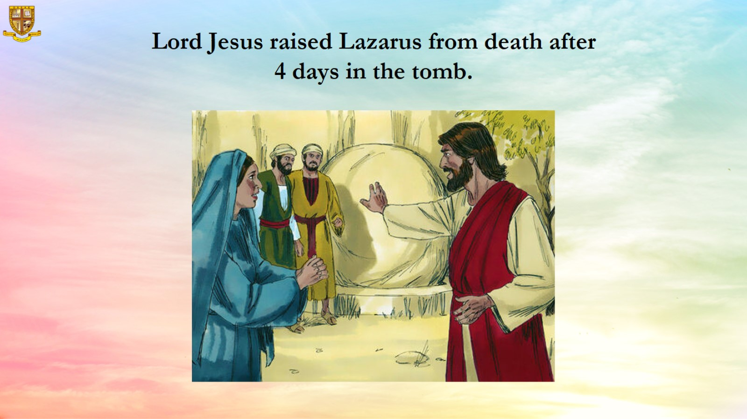
Lord Jesus raised Lazarus from death after 4 days in the tomb.

Slide 14
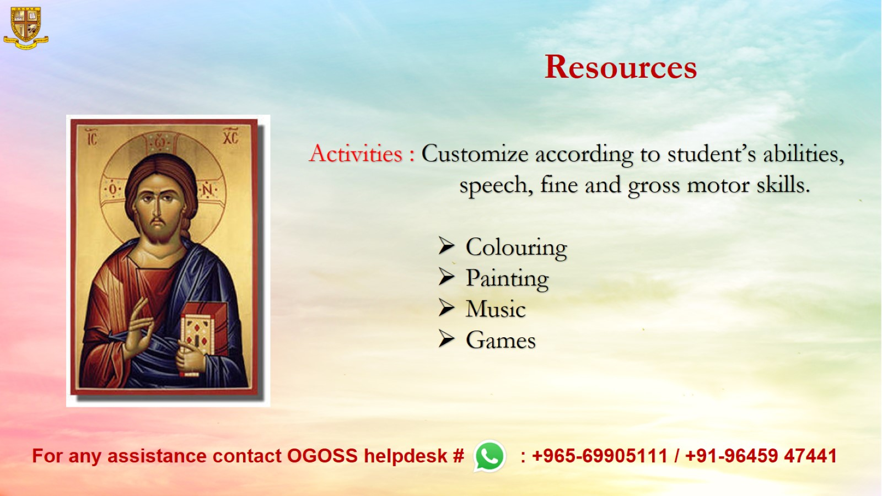
Resources

