Slide 1
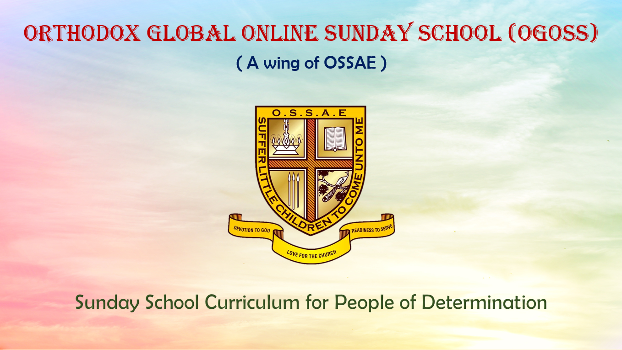

Slide 2
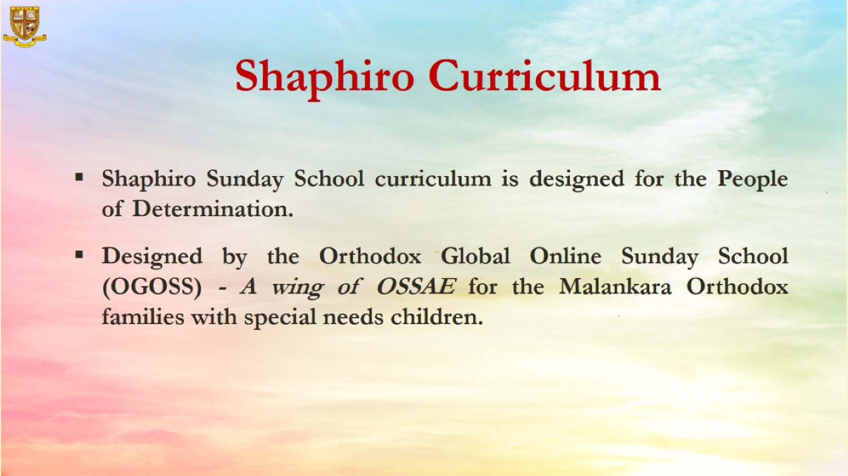

Slide 3


Grade 1
Chapter 12
Love for the Church

Slide 4
Preparation for the chapter
Love for the Church
Lesson Outline
  Jesus saw people selling and buying things in the temple. He drove them out.
  They were not showing respect in God’s house. We should show respect to the Church because it is Holy.
  We should take off our shoes/slippers before entering the Church.
  We should give alms (charity) to the poor and needy.
  We shouldn’t misbehave, make noise, eat or run during the Holy Qurbana.
  When we see a bishop, priest or nun we should greet them.

Slide 5
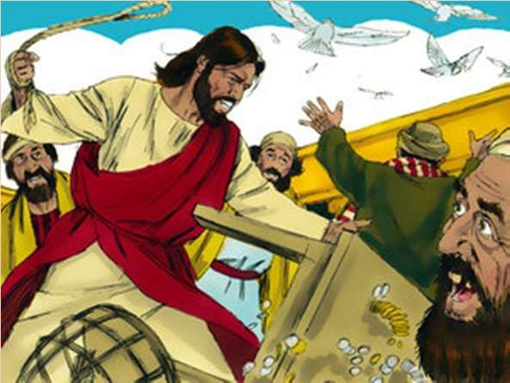

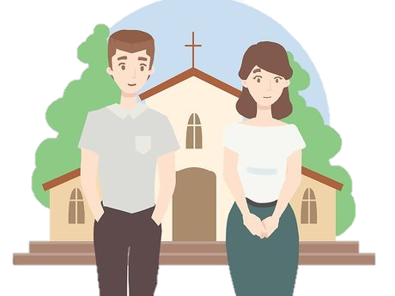
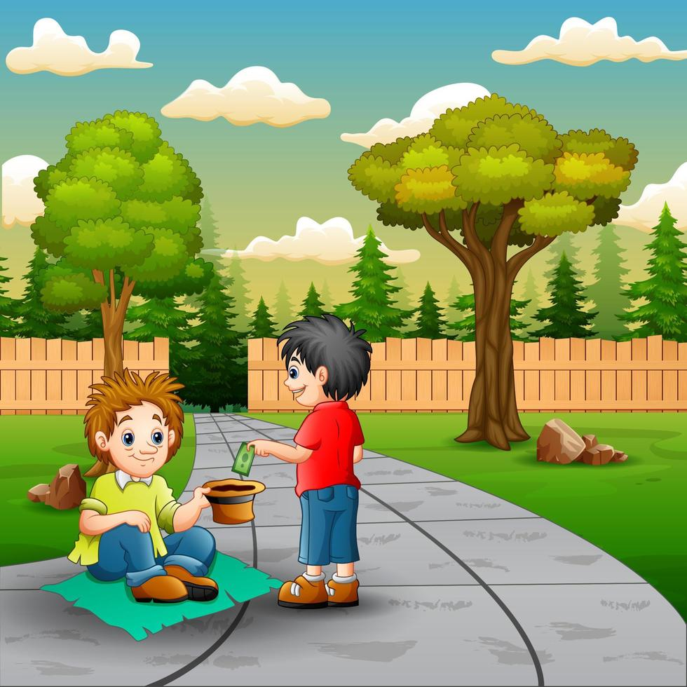
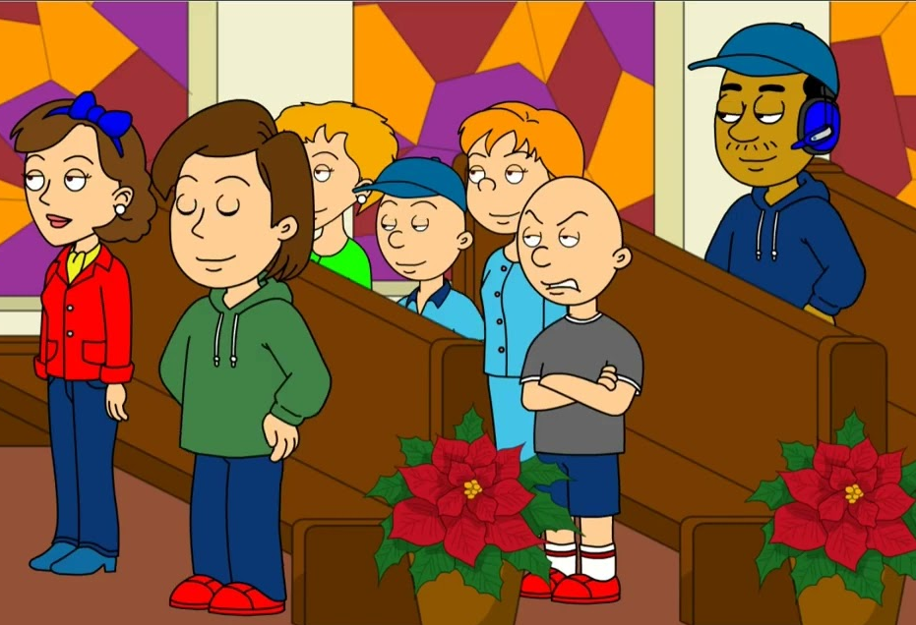
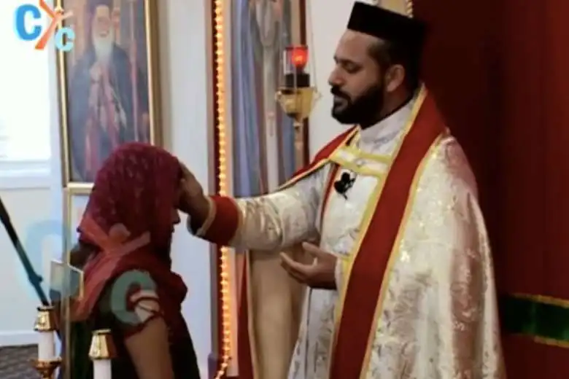
Word Bank
Out
Respect
Shoes
Charity
Misbehave
Greet

Slide 6
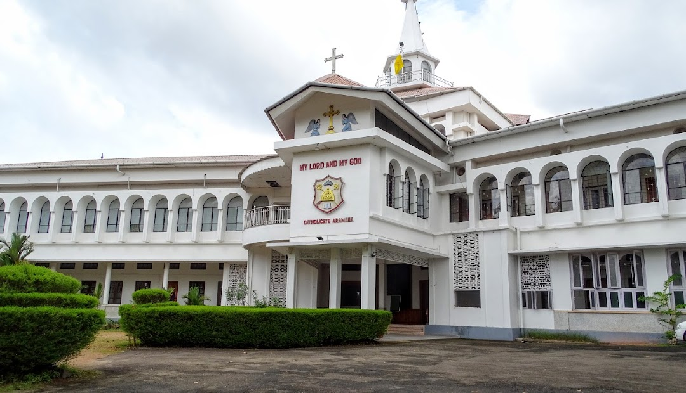
Objective: Encouraging the child to go to Church, attend Holy Qurbana regularly and to respect God’s House.

Slide 7
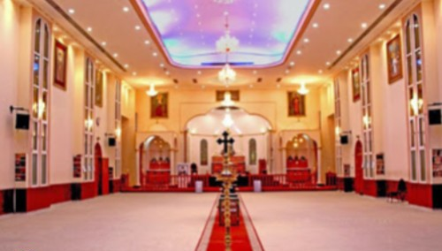
Memory Verse: “I will come into Your house in the multitude of Your mercy.”
(Psalm 5:7)

Slide 8
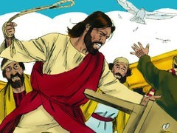
Jesus saw people selling and buying things in the temple. He drove them out.

Slide 9

They were not showing respect in God’s house.
We should show respect to the Church because it is Holy.

Slide 10

We should take off our shoes/slippers before entering the Church.

Slide 11
We should give alms (charity) to the poor and needy.

Slide 12
We shouldn’t misbehave, make a lot of noise, eat or run during the Holy Qurbana.

Slide 13

When we see a bishop, priest or nun we should greet them.

Slide 14
