Slide 1
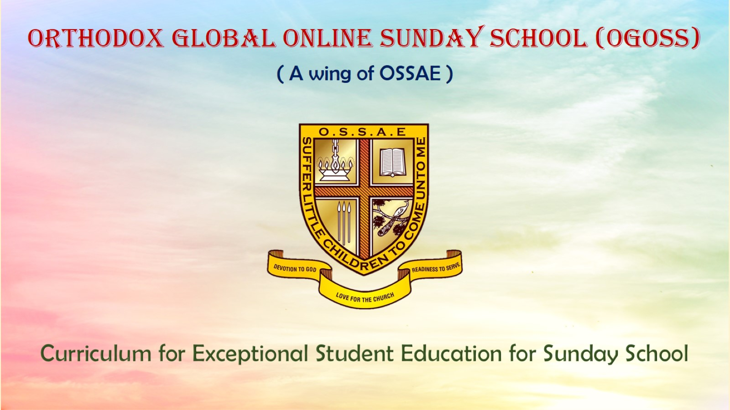
Orthodox Global Online Sunday School (OGOSS)

Slide 2
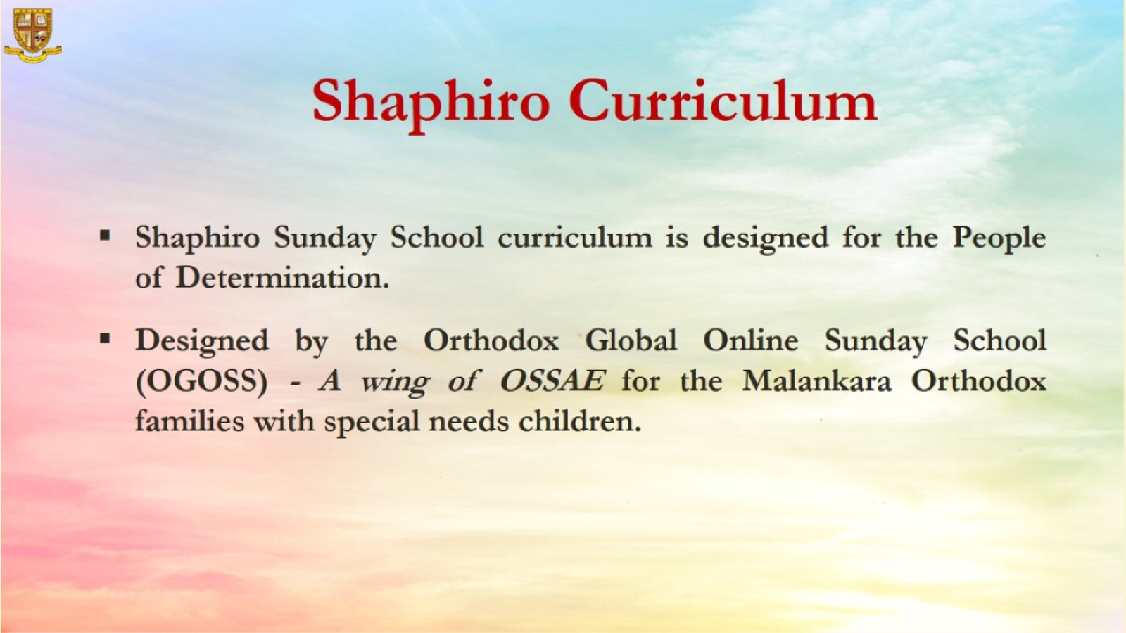

Slide 3
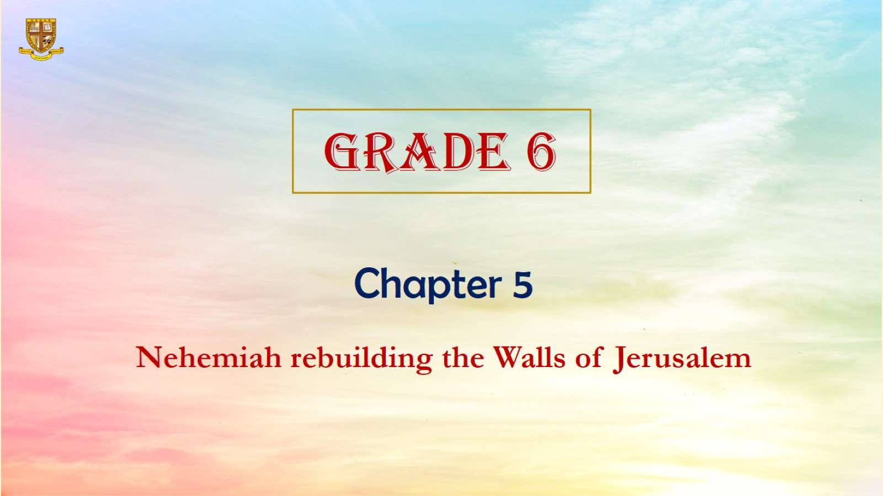

Slide 4
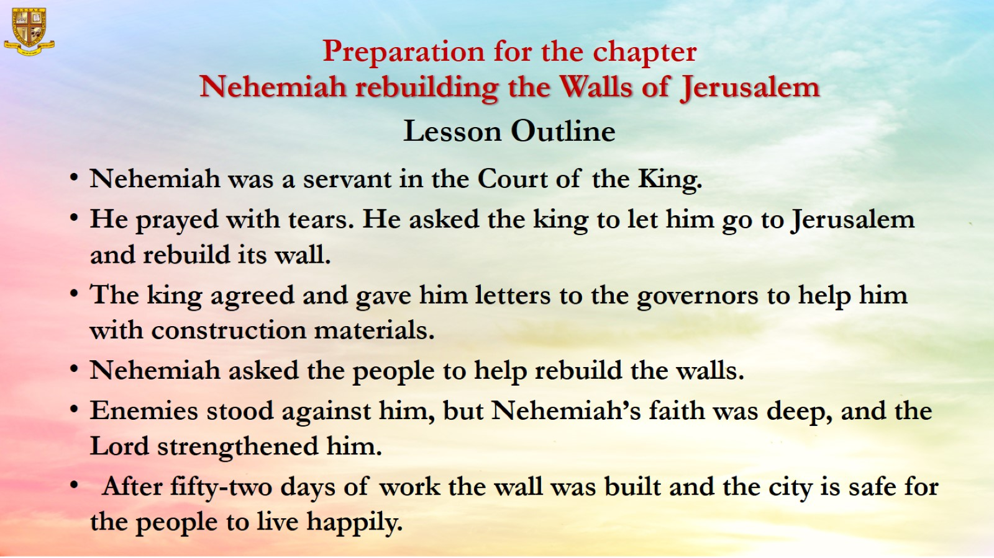
Preparation for the chapter
Nehemiah rebuilding the Walls of Jerusalem
Lesson Outline

Slide 5
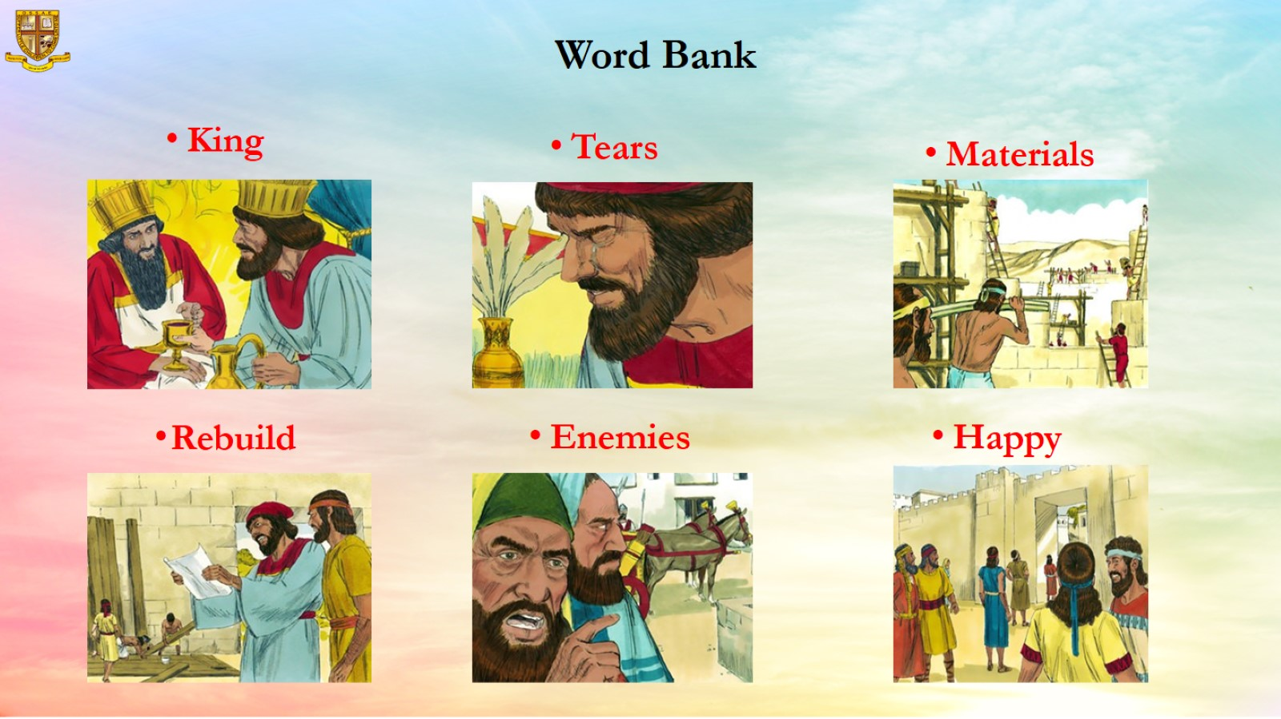
Word Bank

Slide 6
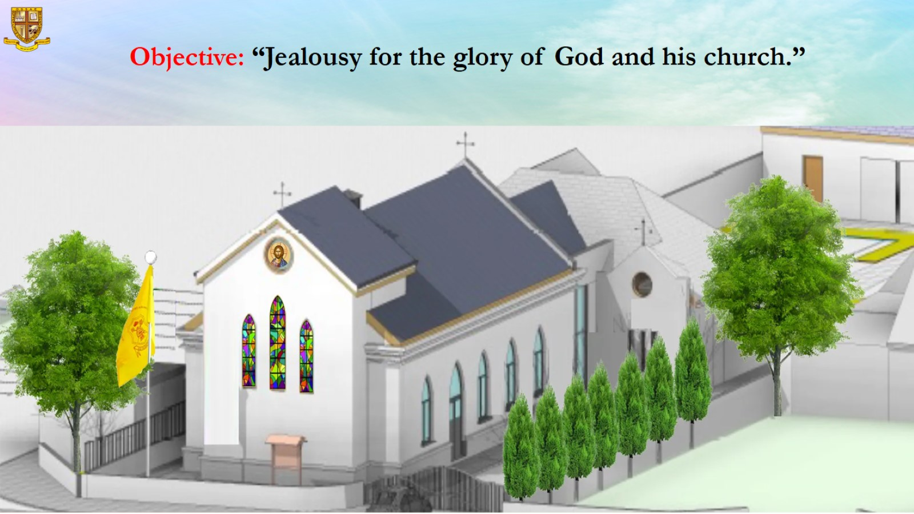
Objective: “Jealousy for the glory of God and his church.”

Slide 7
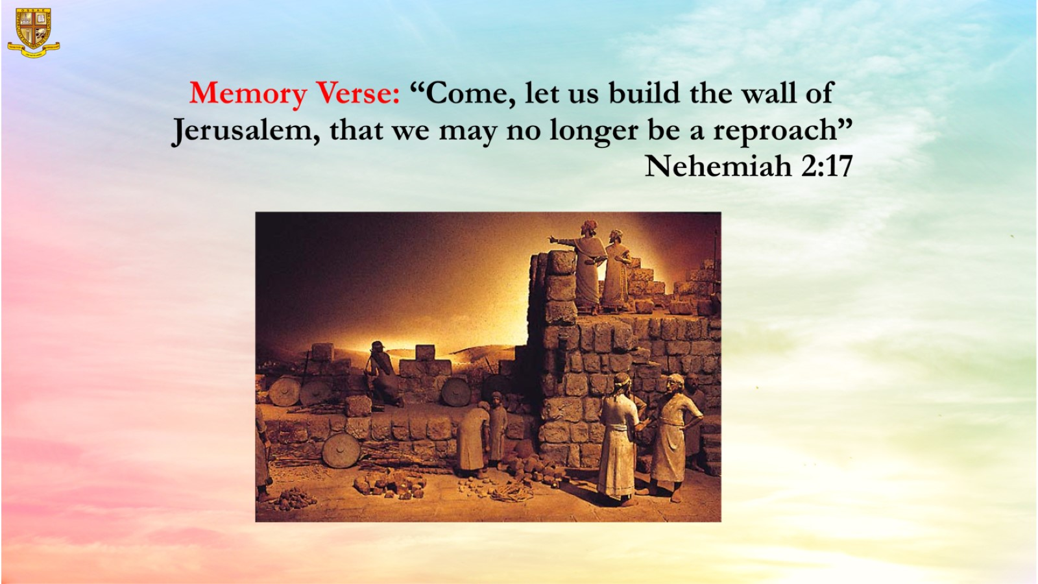

Slide 8
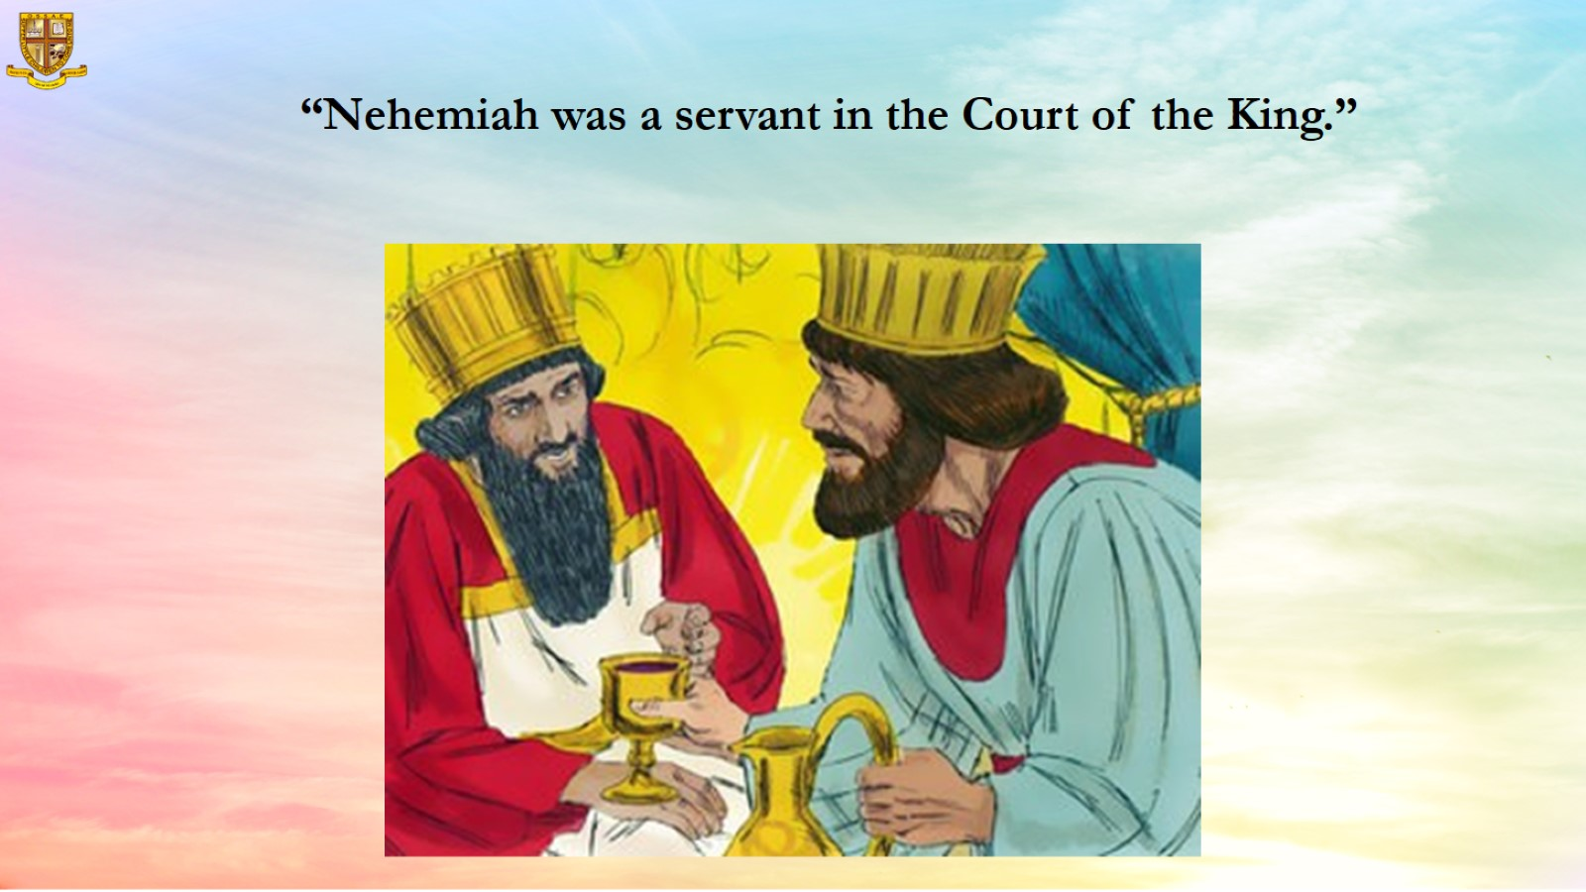
“Nehemiah was a servant in the Court of the King.”

Slide 9
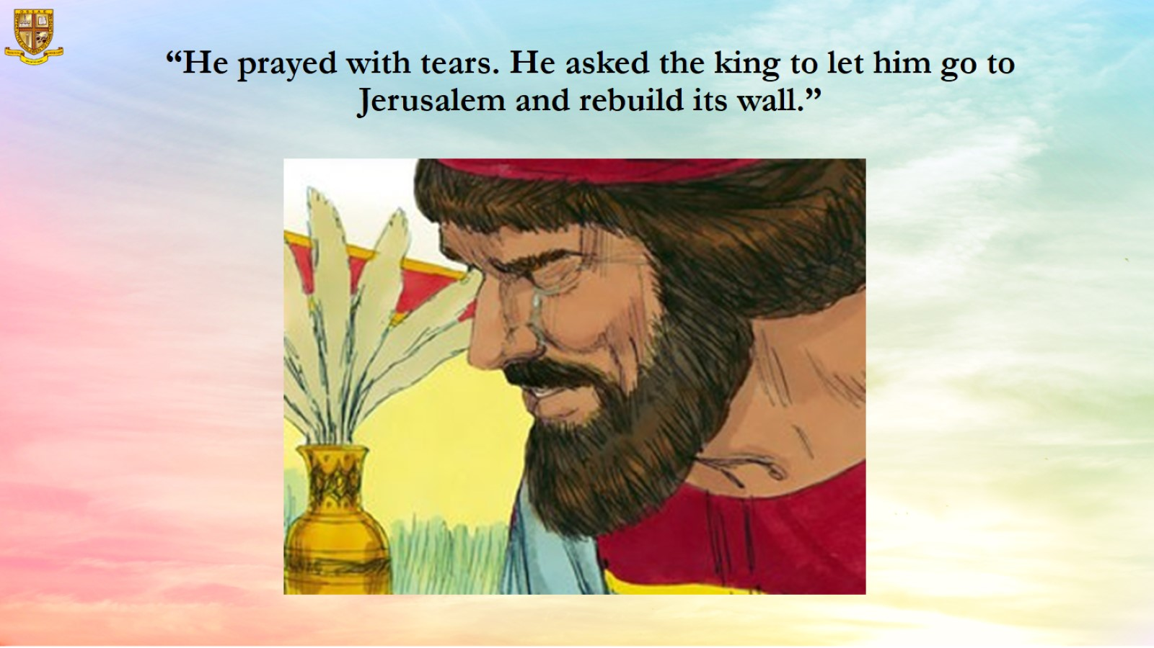
“He prayed with tears. He asked the king to let him go to Jerusalem and rebuild its wall.”

Slide 10
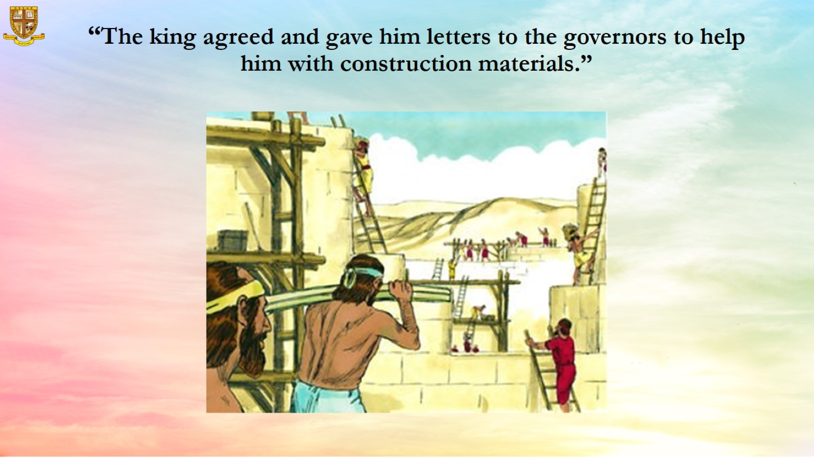
“The king agreed and gave him letters to the governors to help him with construction materials.”

Slide 11
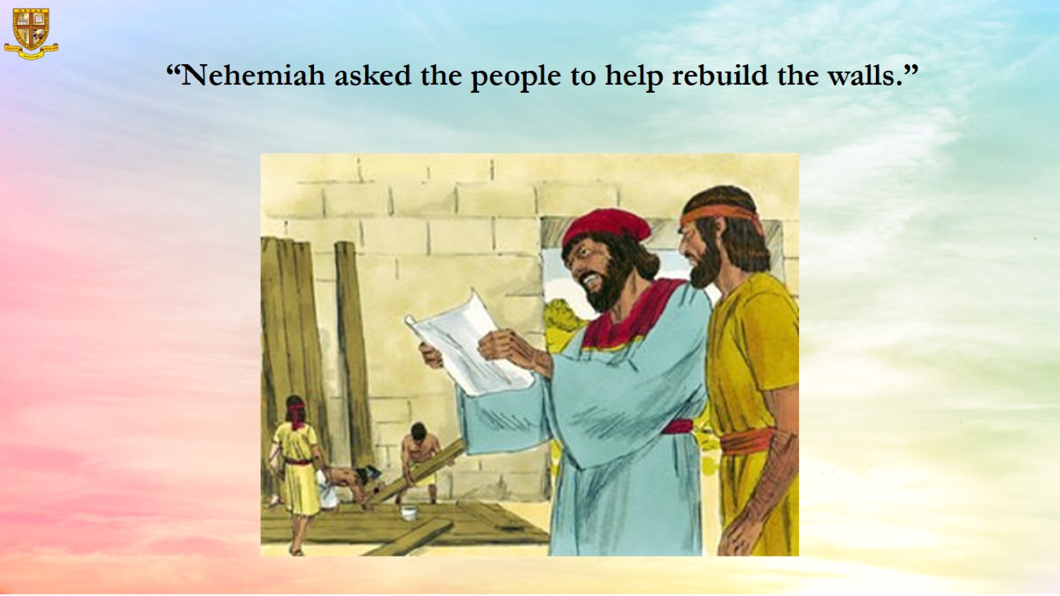
“Nehemiah asked the people to help rebuild the walls.”

Slide 12
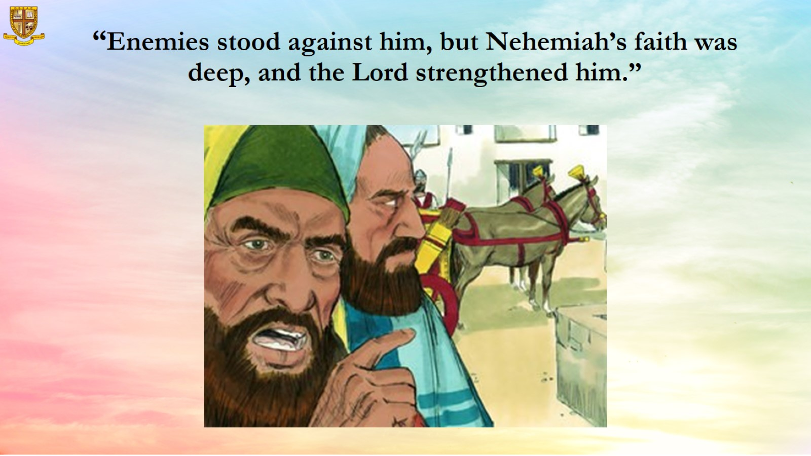
“Enemies stood against him, but Nehemiah’s faith was deep, and the Lord strengthened him.”

Slide 13
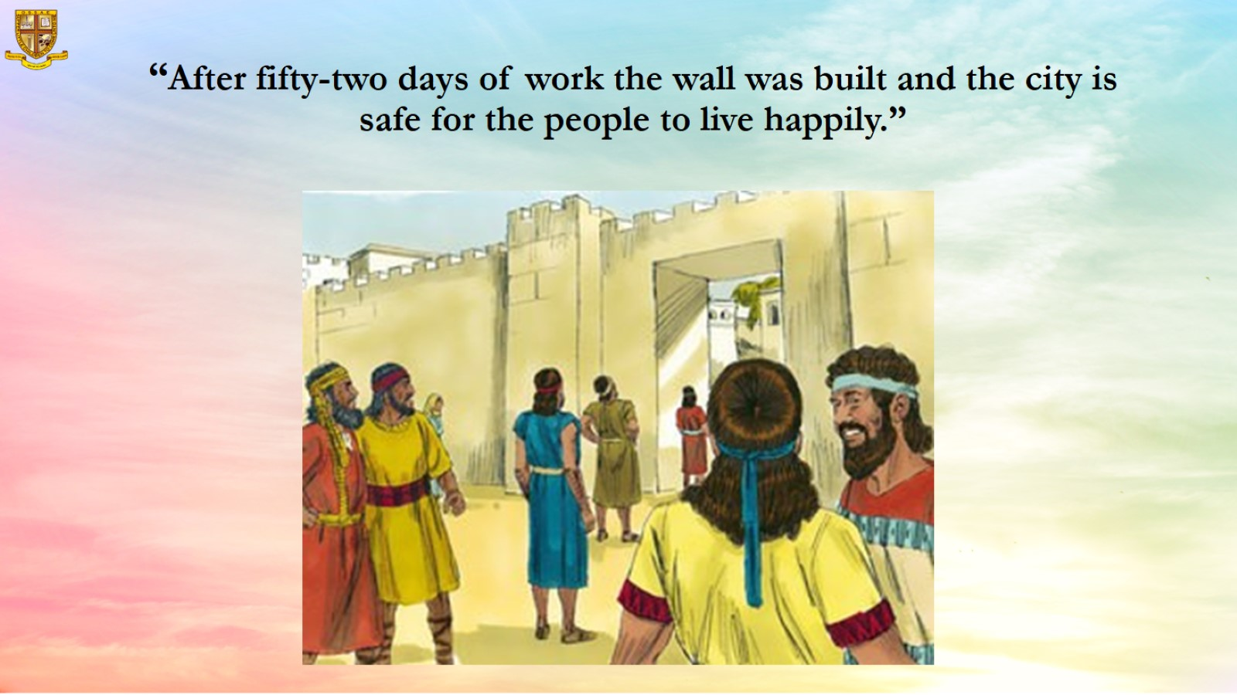
“After fifty-two days of work the wall was built and the city is safe for the people to live happily.”

Slide 14
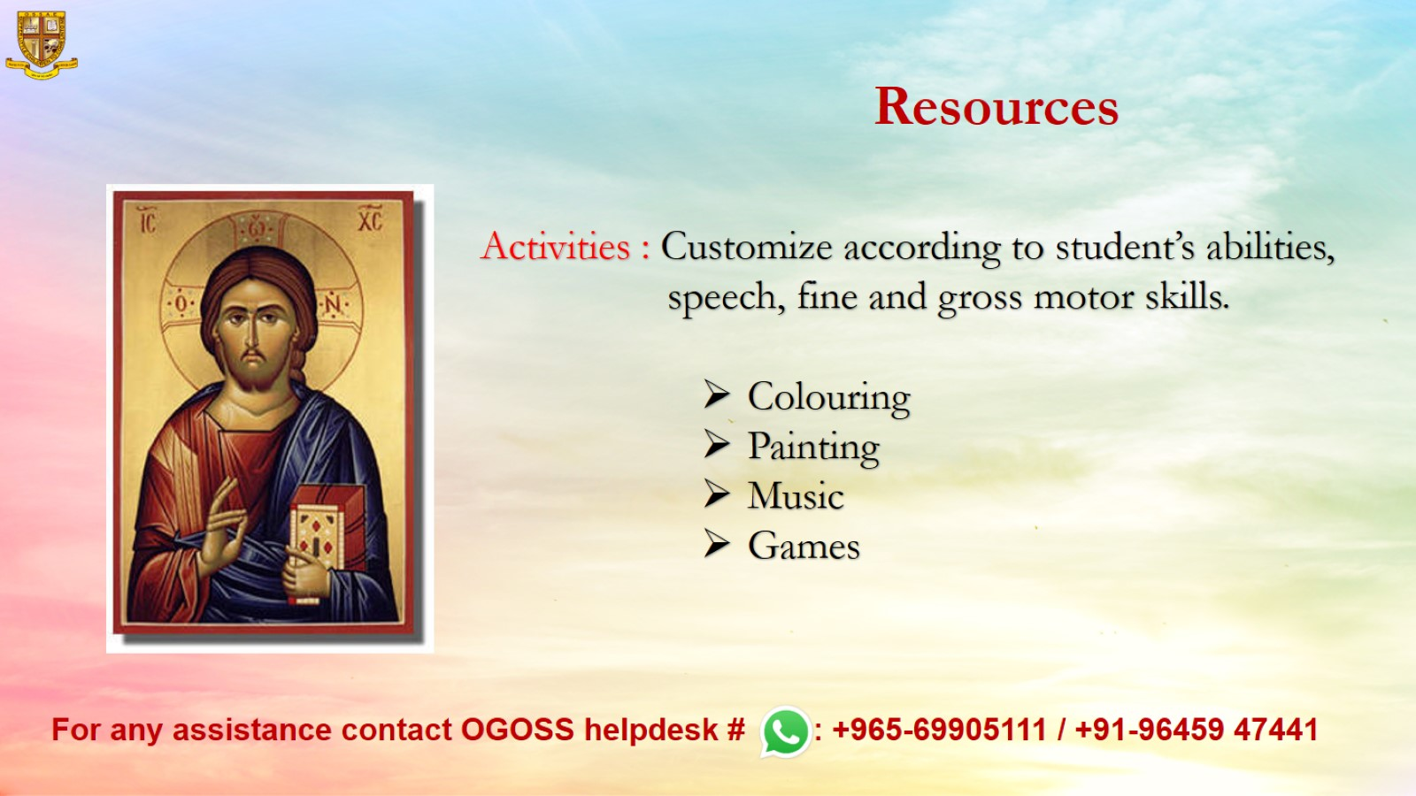
Resources

