Slide 1

Orthodox Global Online Sunday School (OGOSS)

Slide 2
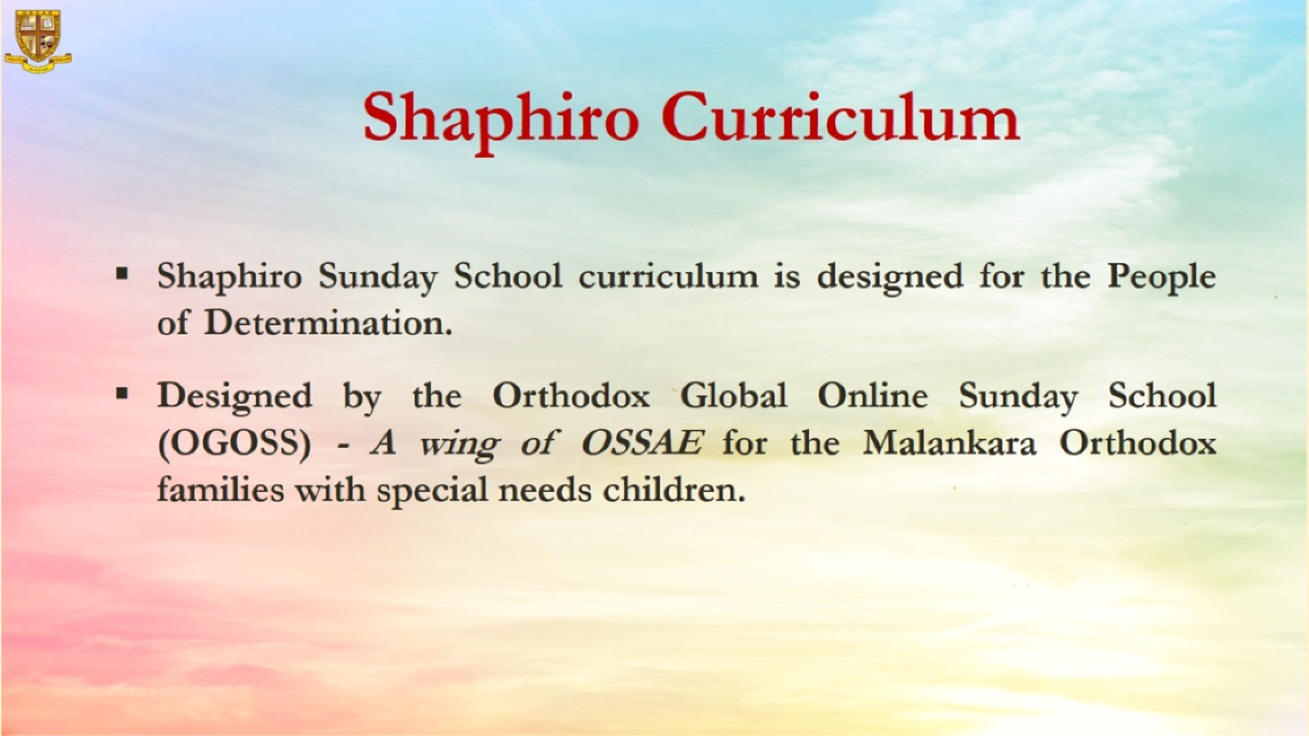

Slide 3
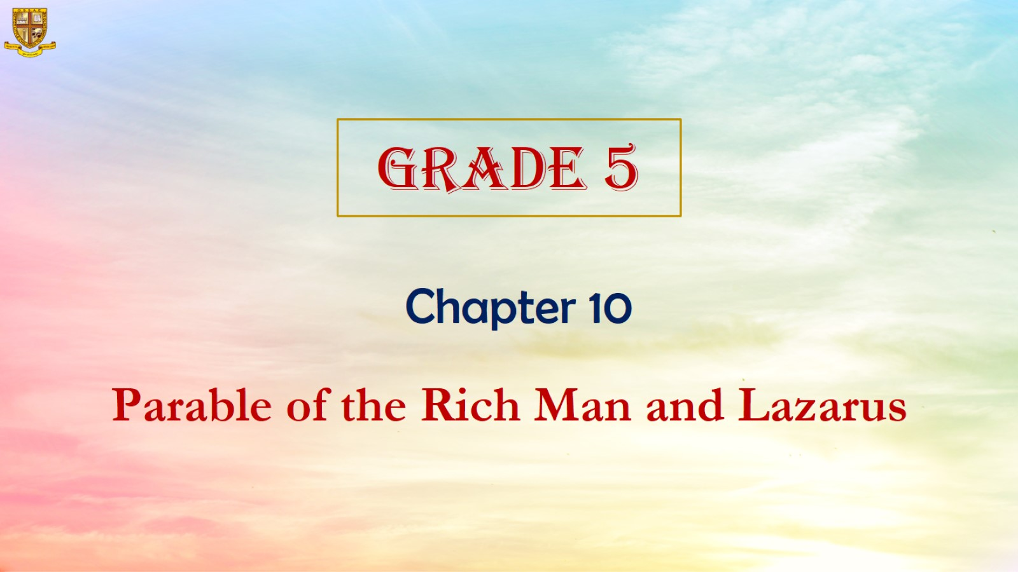

Slide 4
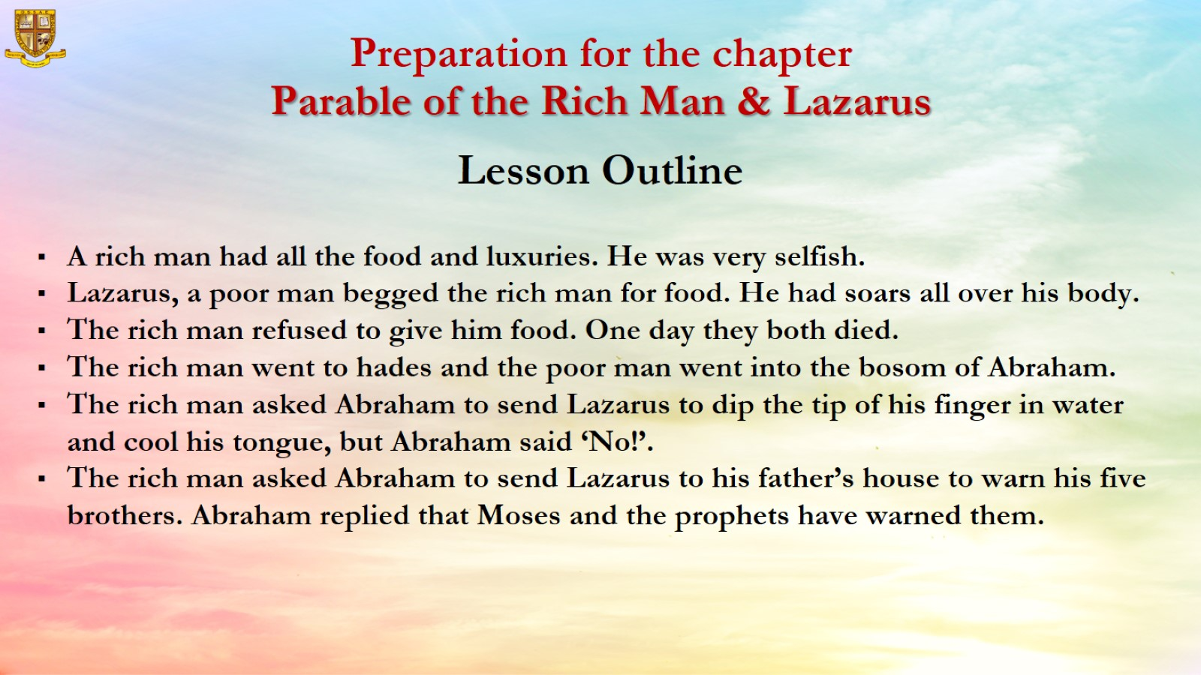
Preparation for the chapter
Parable of the Rich Man & Lazarus

Slide 5
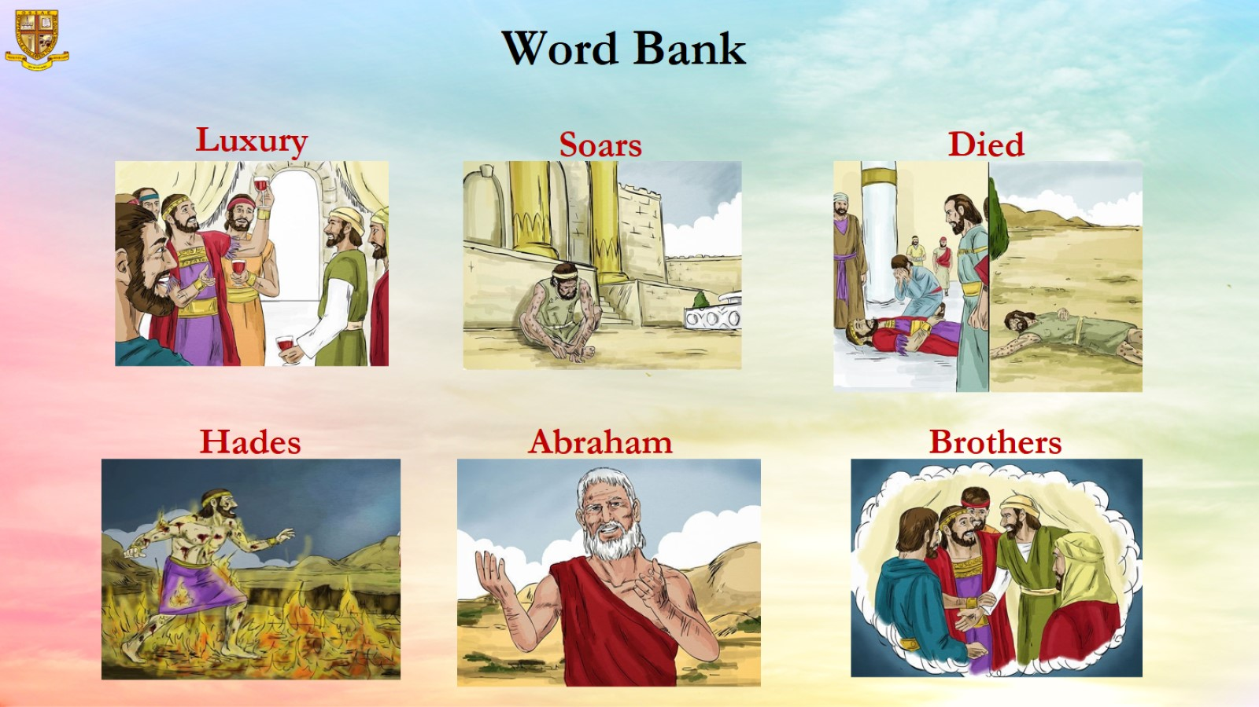
Word Bank

Slide 6
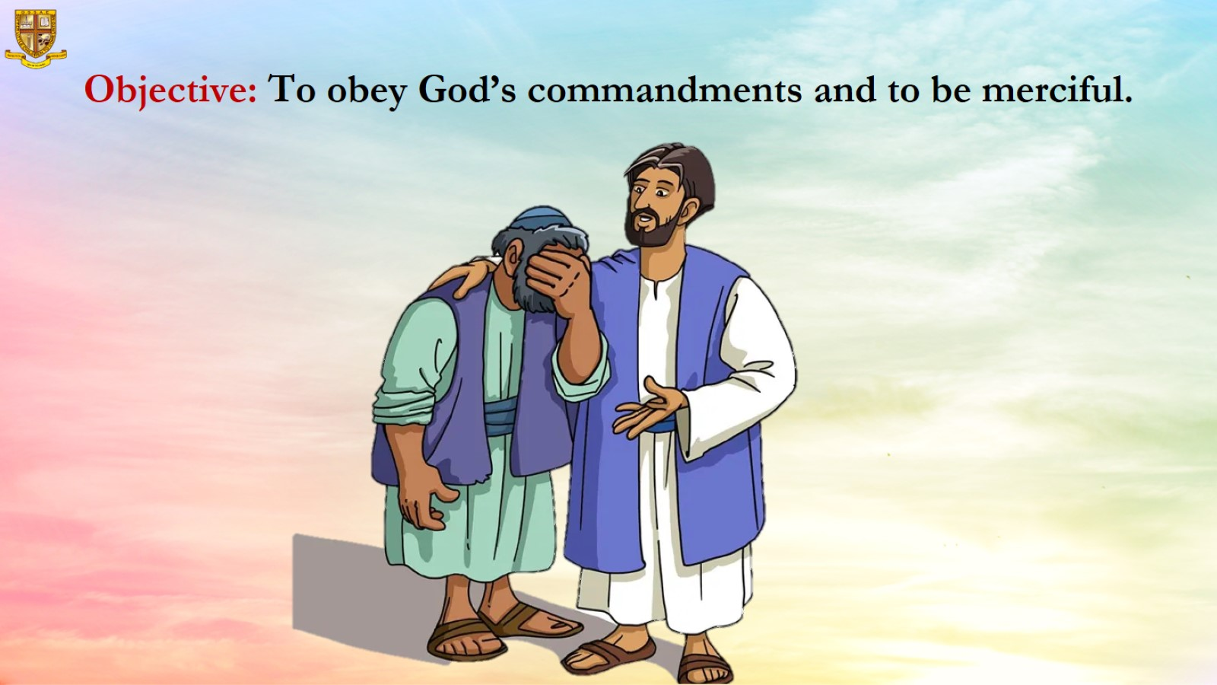
Objective: To obey God’s commandments and to be merciful.

Slide 7
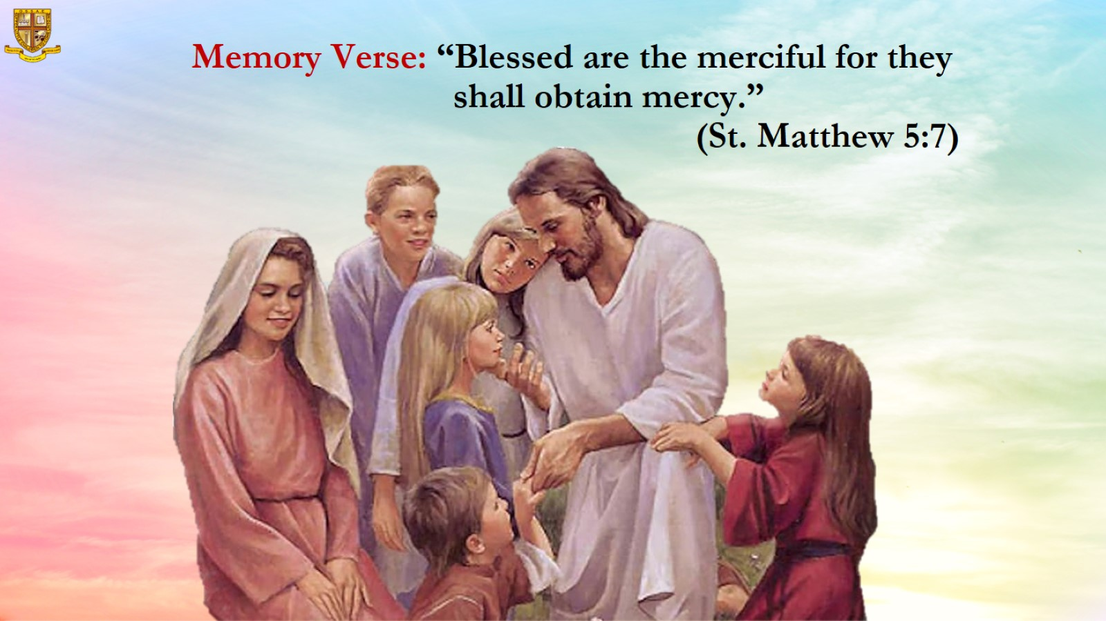
Memory Verse: “Blessed are the merciful for they shall obtain mercy.”
(St. Matthew 5:7)

Slide 8
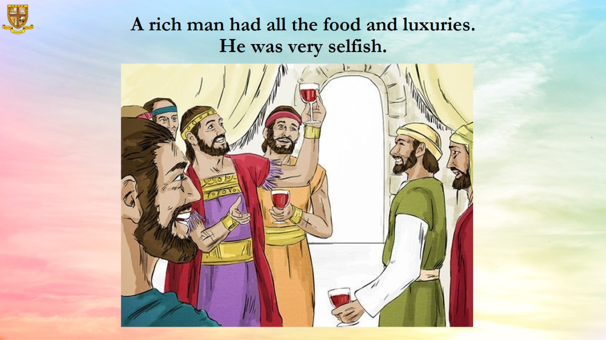
A rich man had all the food and luxuries. He was very selfish.

Slide 9
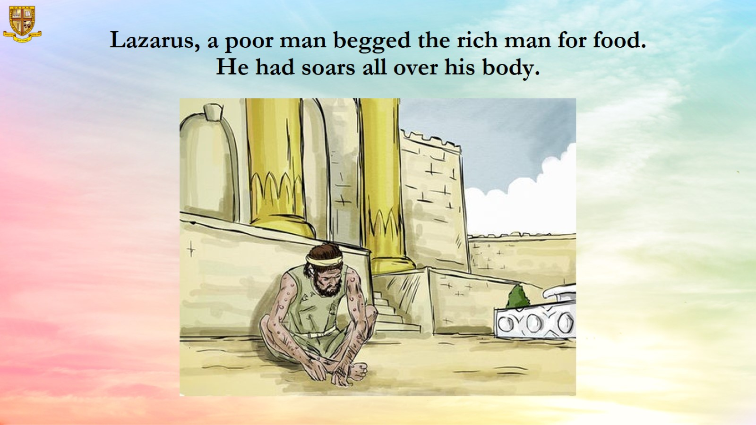
Lazarus, a poor man begged the rich man for food. He had soars all over his body.

Slide 10
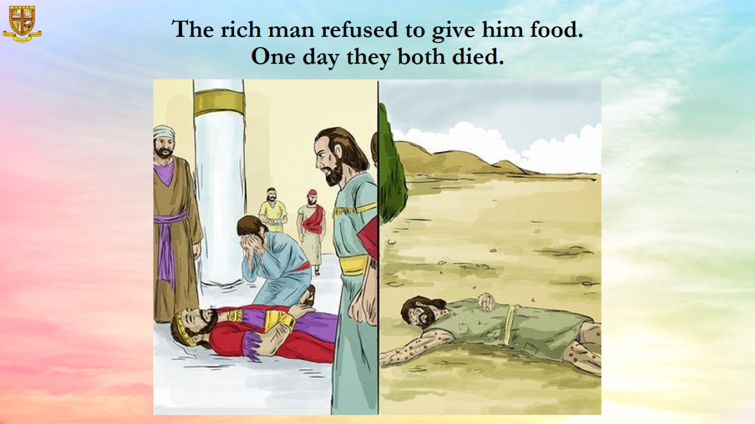
The rich man refused to give him food. One day they both died.

Slide 11
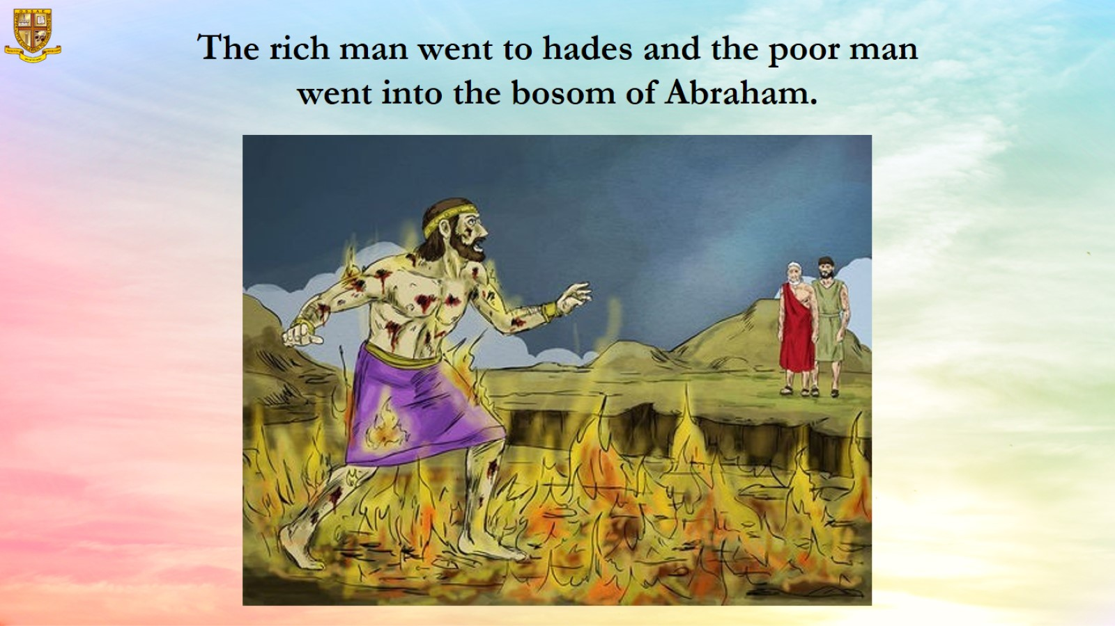
The rich man went to hades and the poor man went into the bosom of Abraham.

Slide 12
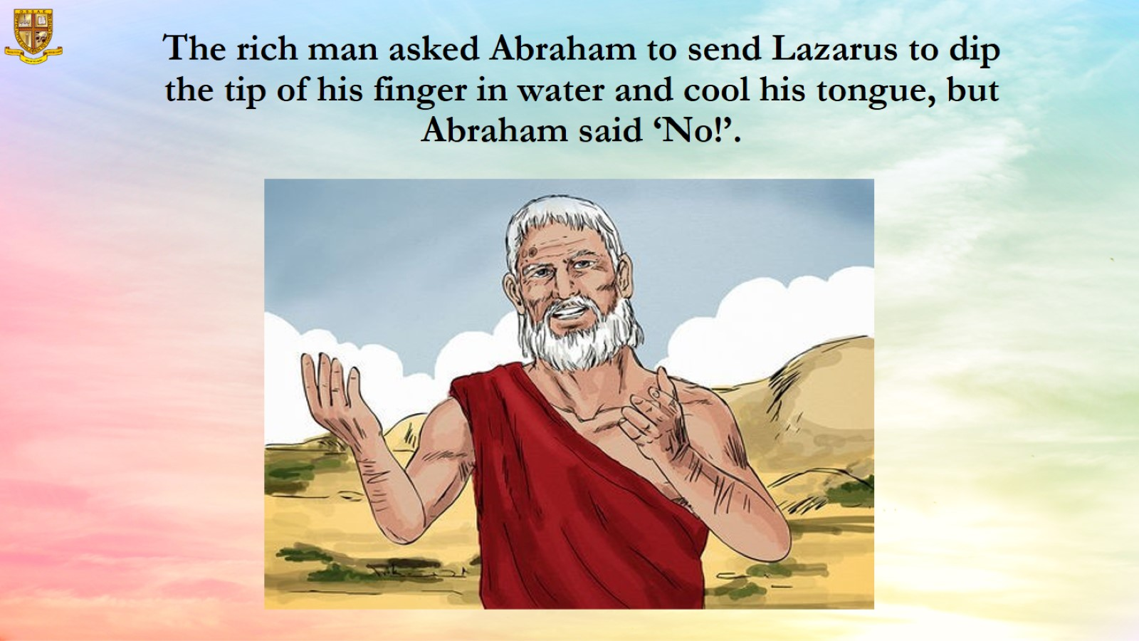
The rich man asked Abraham to send Lazarus to dip the tip of his finger in water and cool his tongue, but Abraham said ‘No!’.

Slide 13
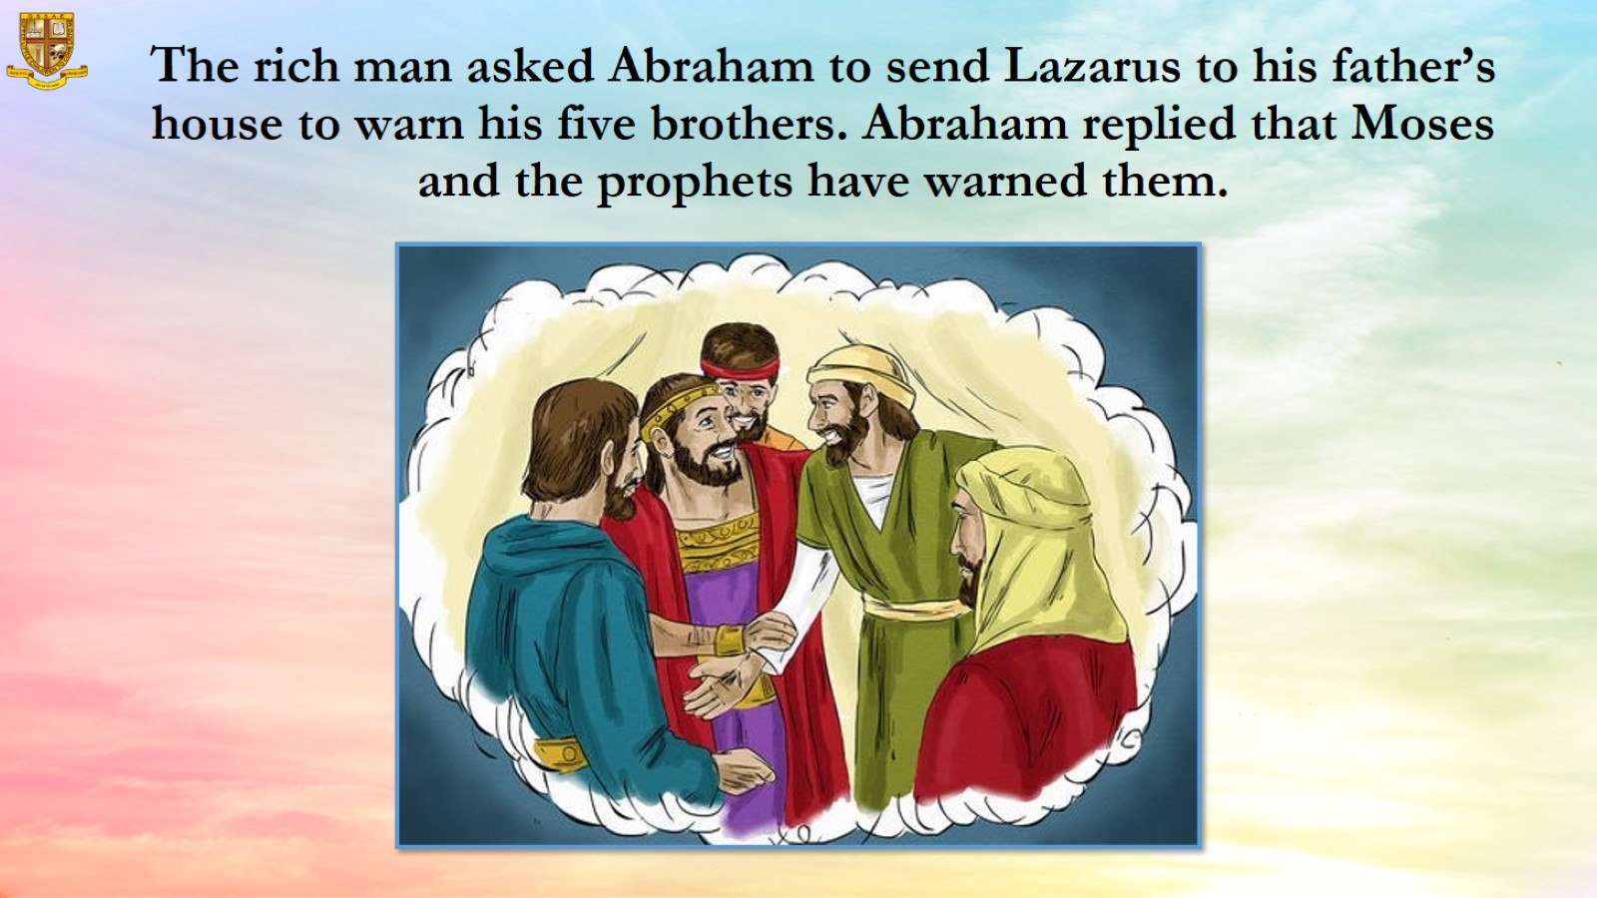
The rich man asked Abraham to send Lazarus to his father’s house to warn his five brothers. Abraham replied that Moses and the prophets have warned them.

Slide 14
