Slide 1

Orthodox Global Online Sunday School (OGOSS)

Slide 2
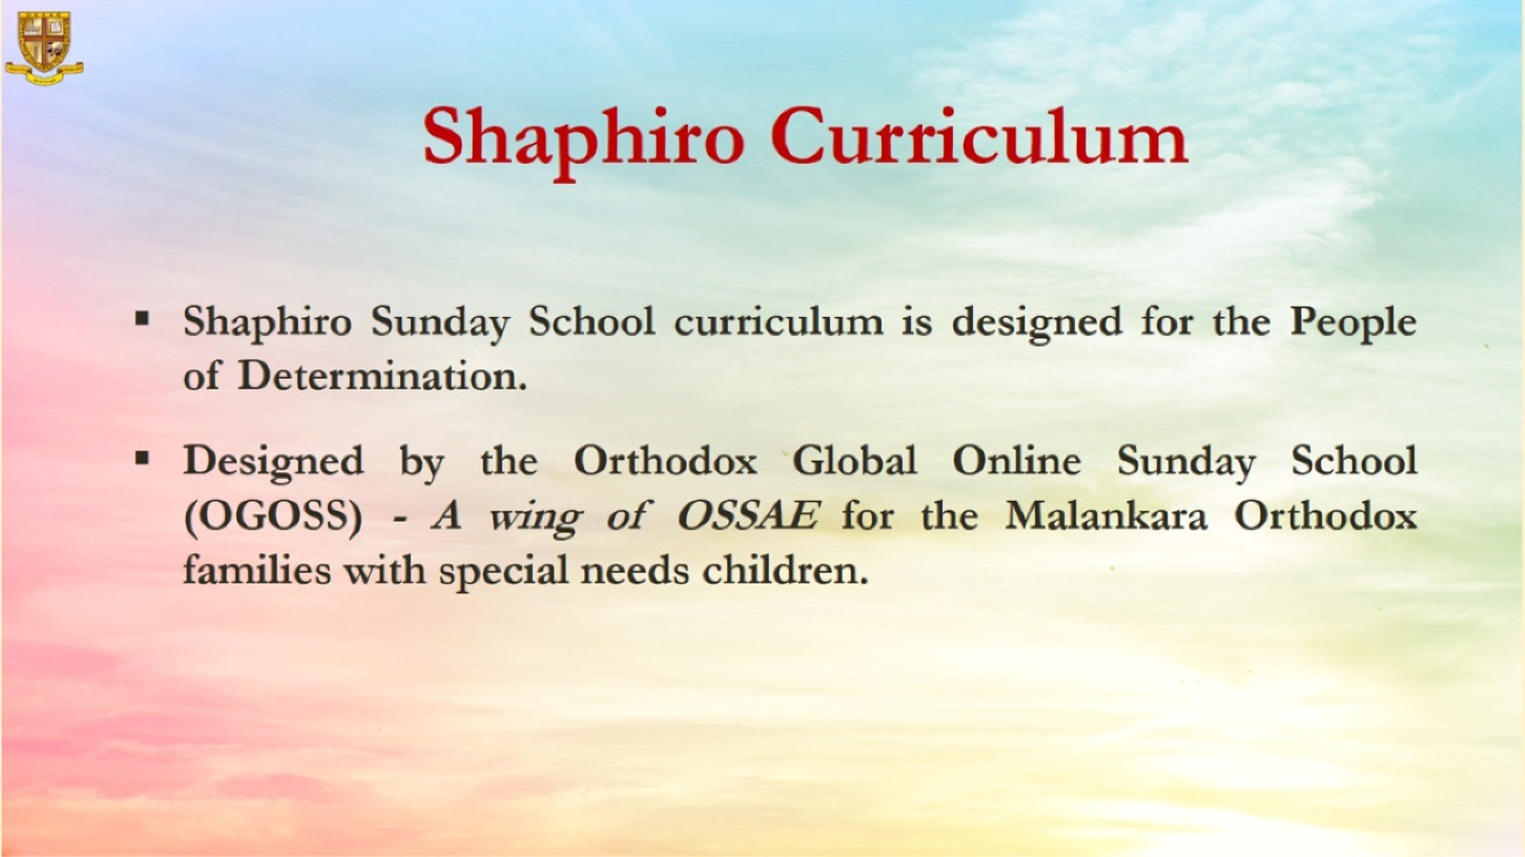

Slide 3


Slide 4
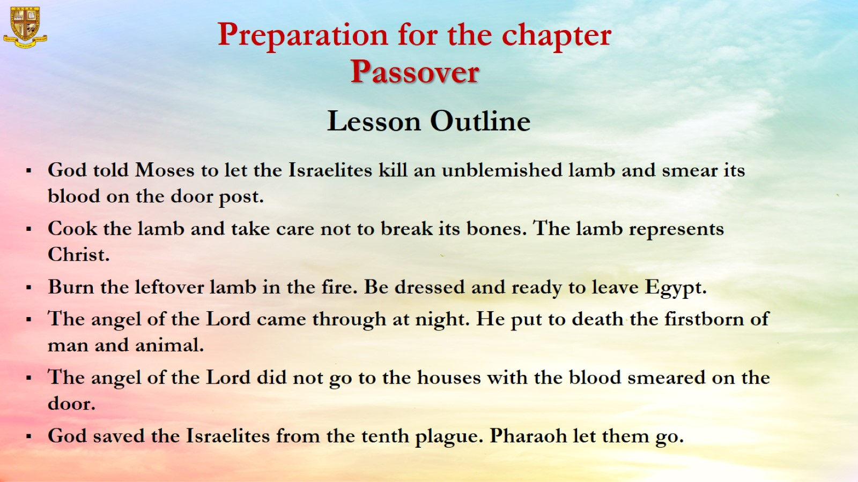

Slide 5
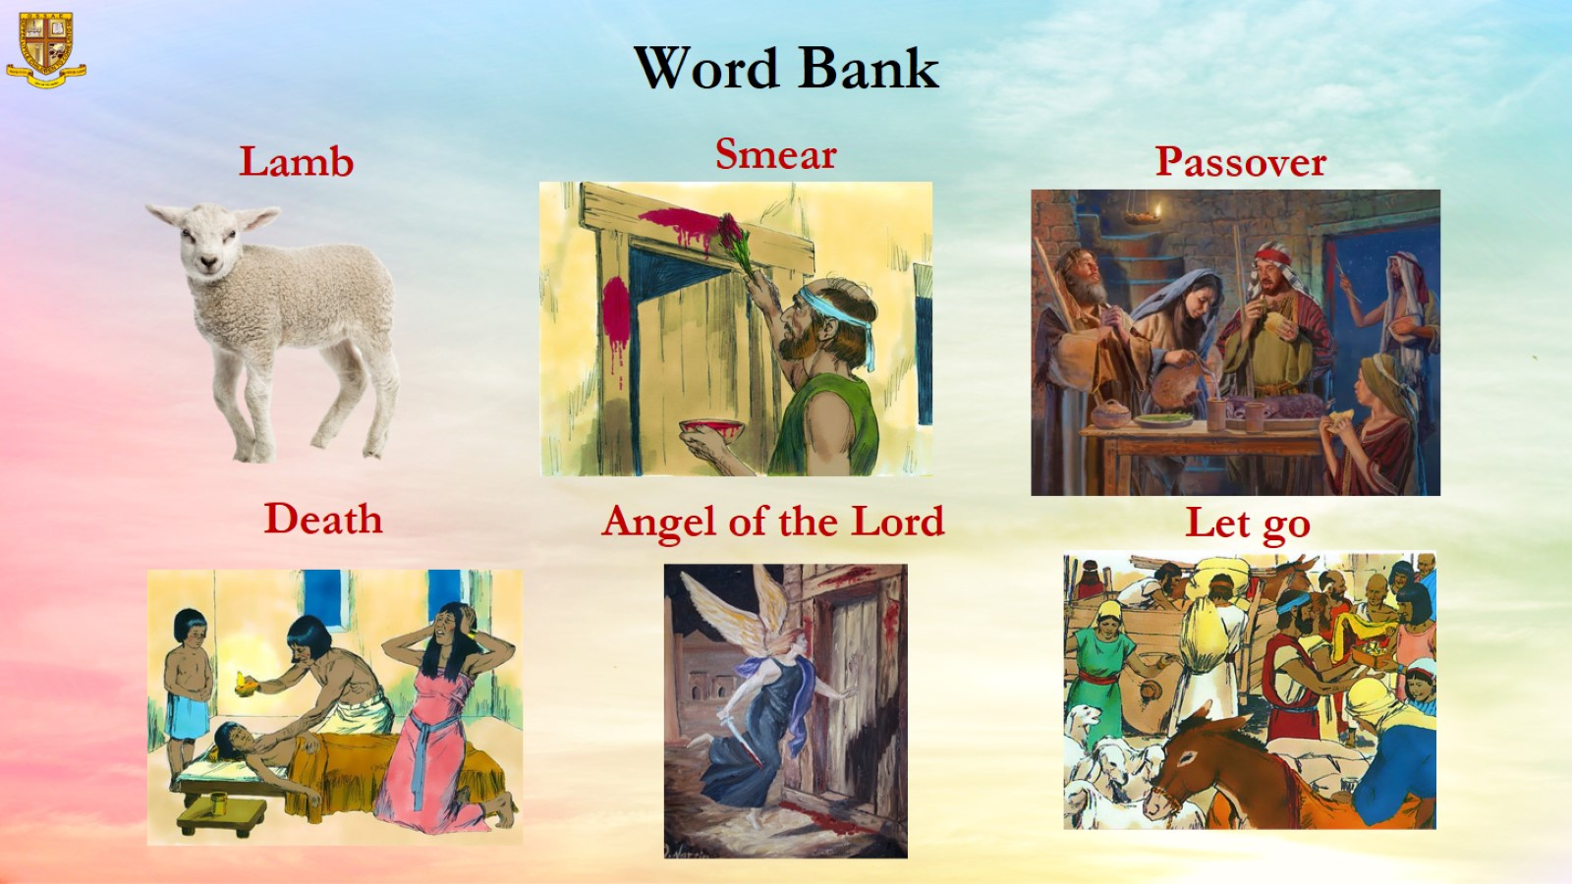

Slide 6
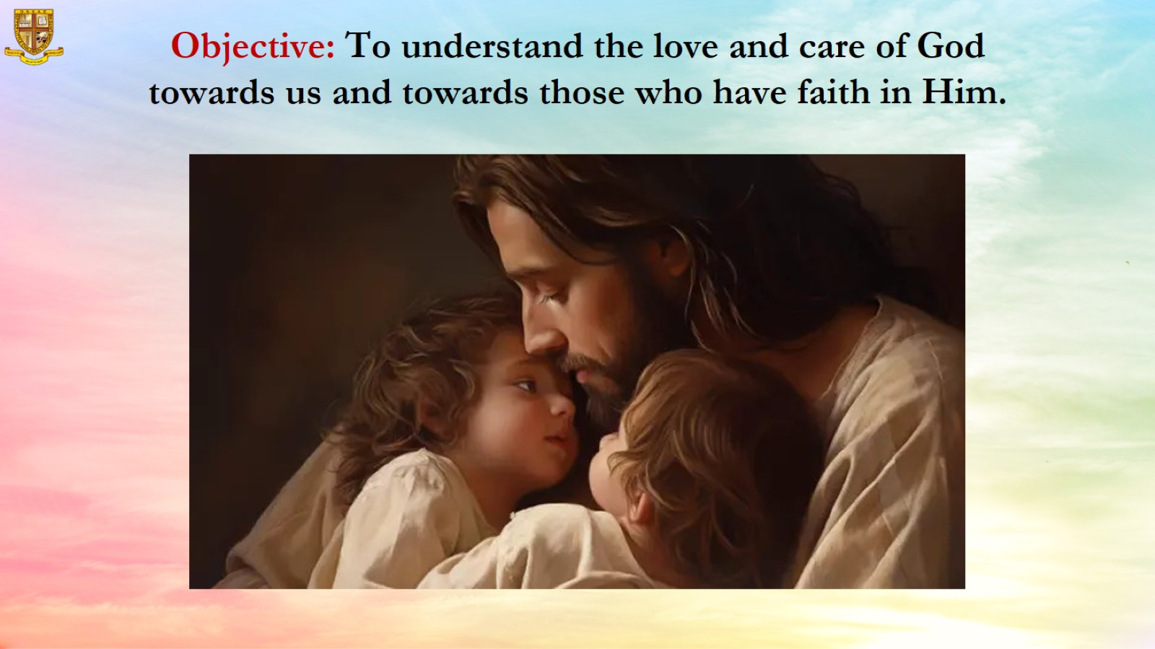
Objective: To understand the love and care of God towards us and towards those who have faith in Him.

Slide 7
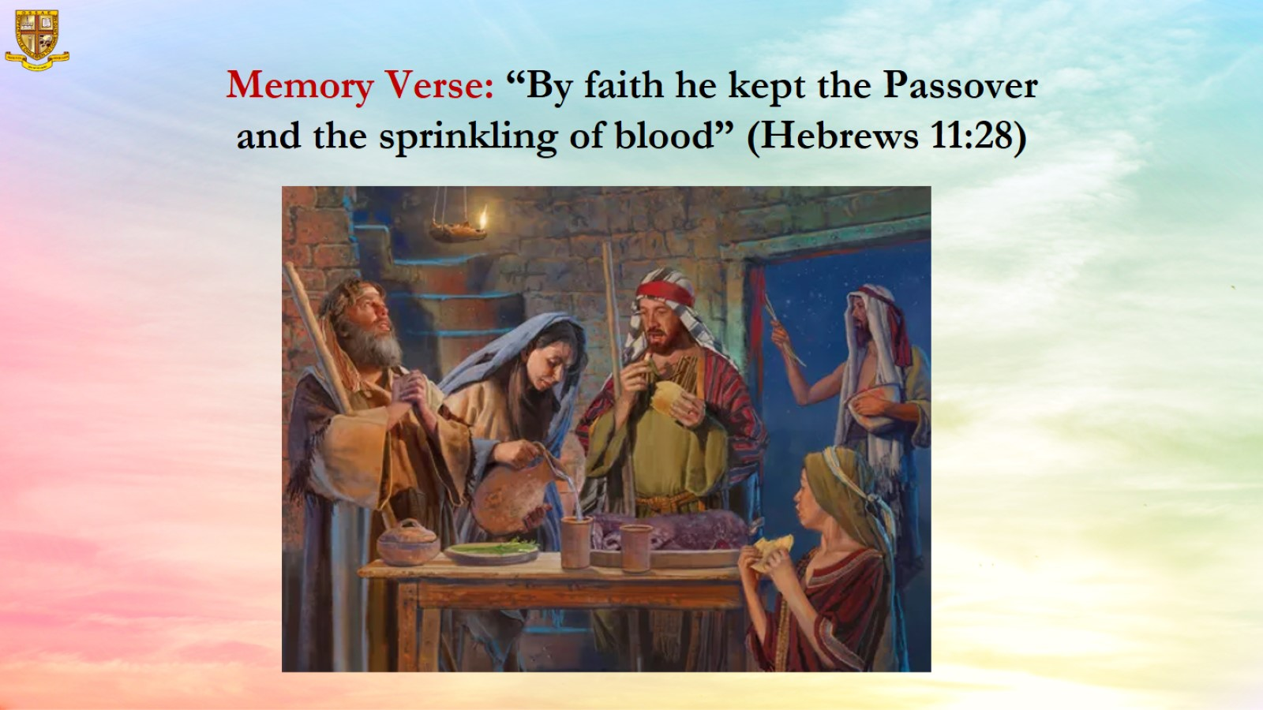
Memory Verse: “By faith he kept the Passover and the sprinkling of blood” (Hebrews 11:28)

Slide 8
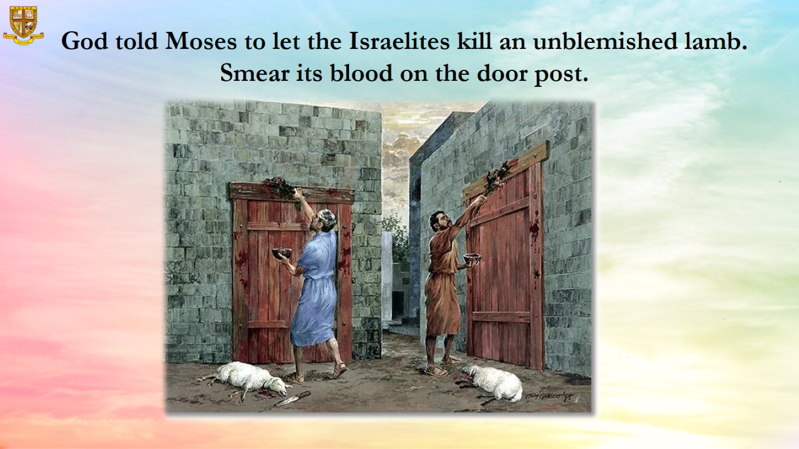
God told Moses to let the Israelites kill an unblemished lamb. Smear its blood on the door post.

Slide 9
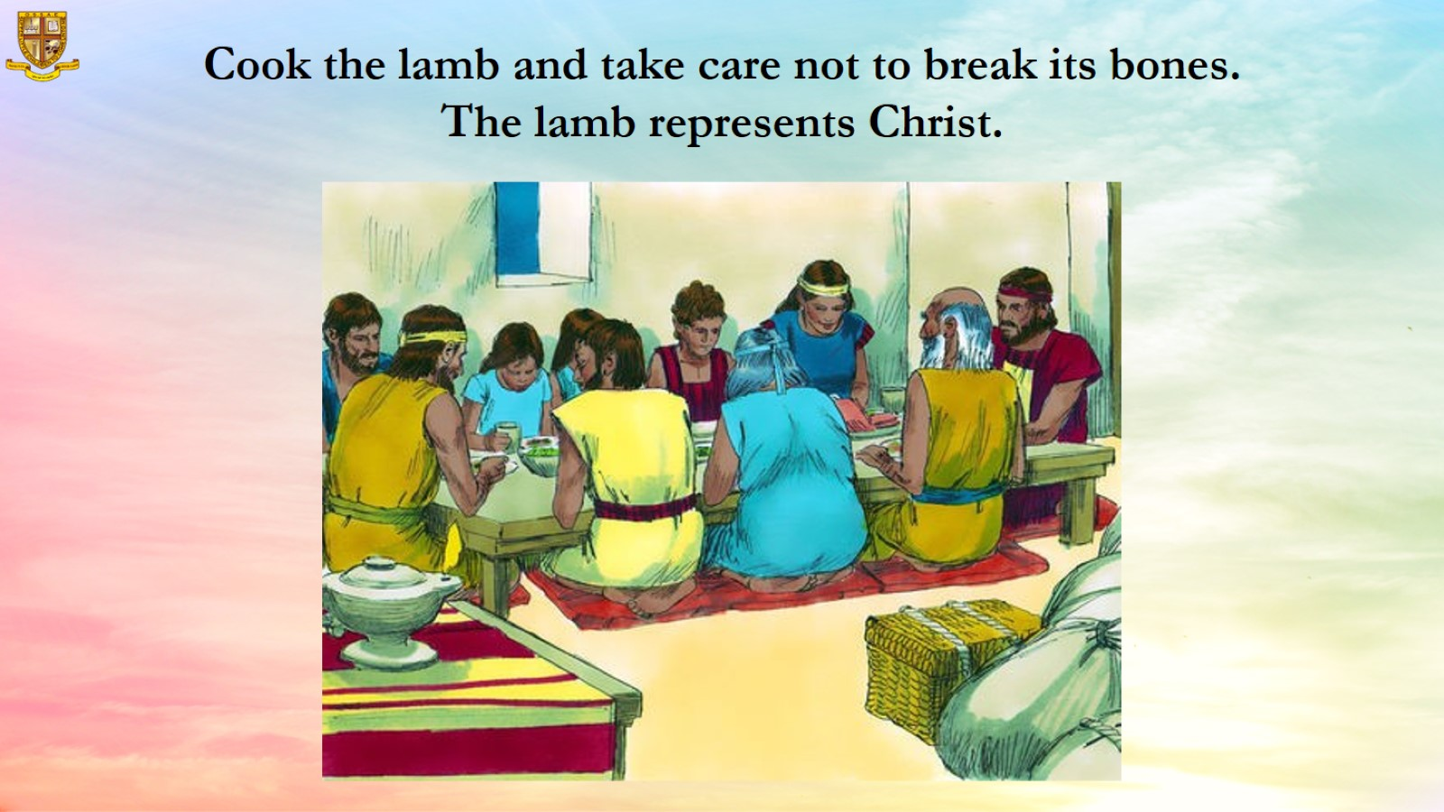

Slide 10
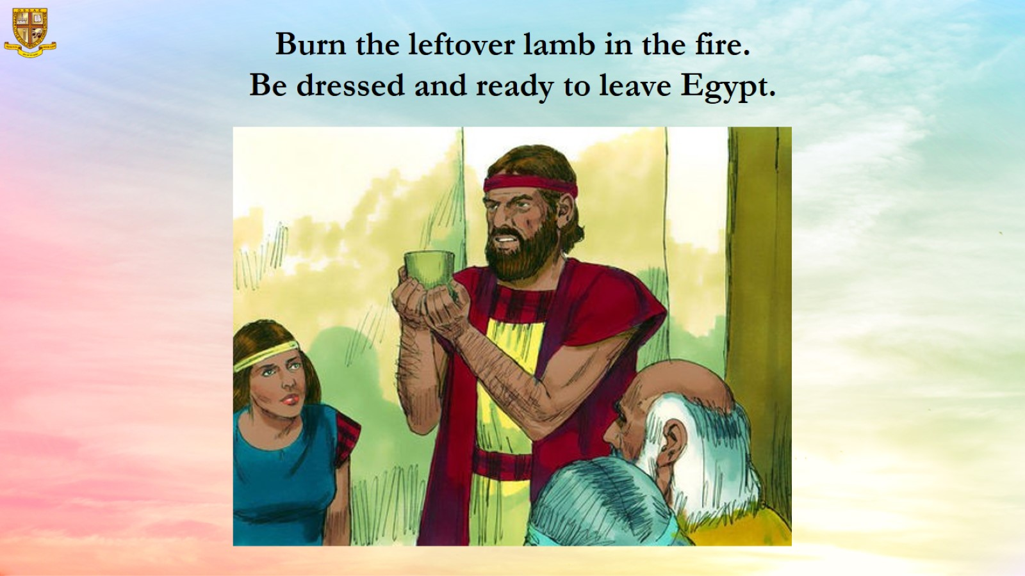

Slide 11
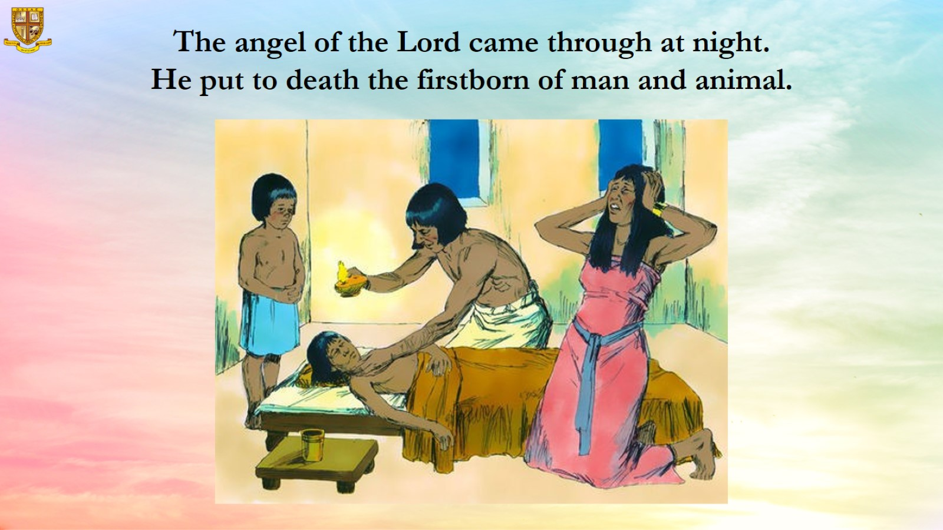

Slide 12
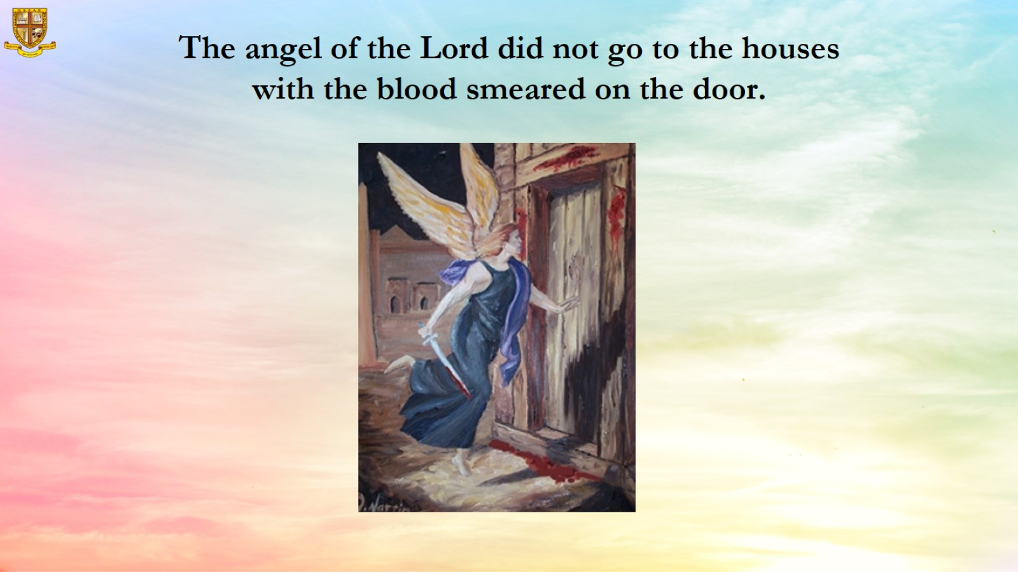

Slide 13
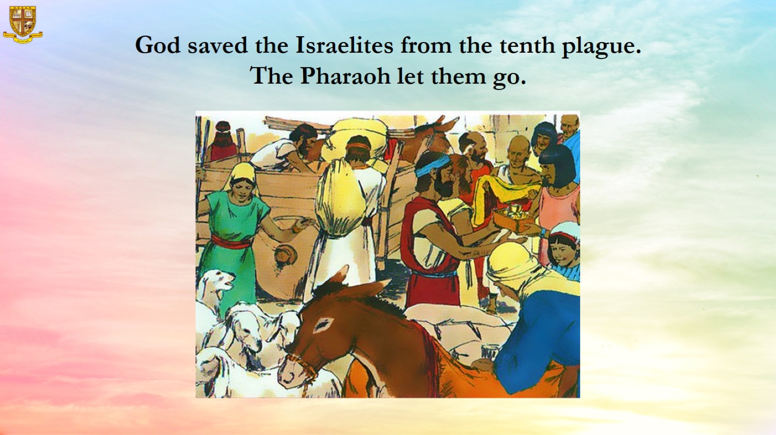

Slide 14
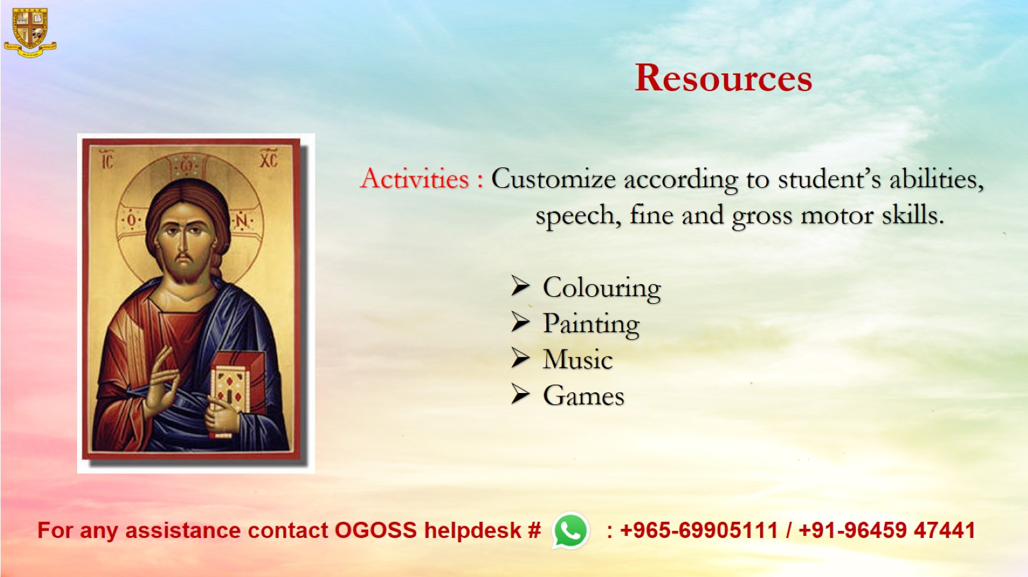
Resources

