Slide 1
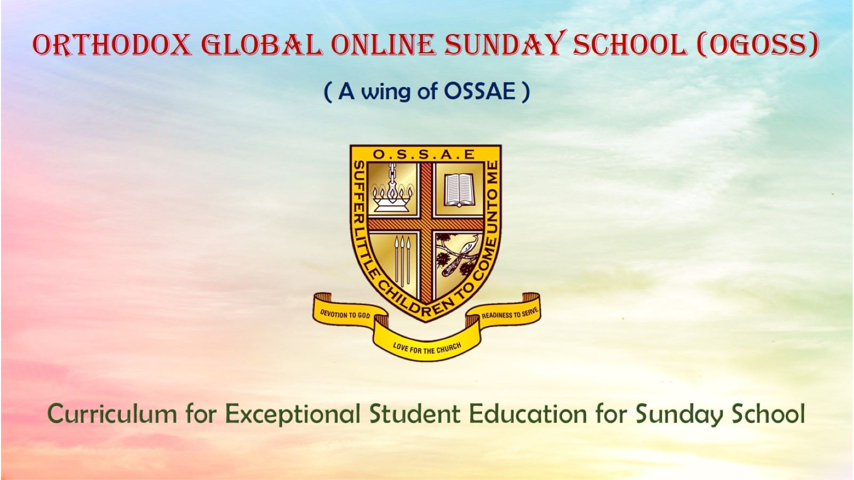
Orthodox Global Online Sunday School (OGOSS)

Slide 2
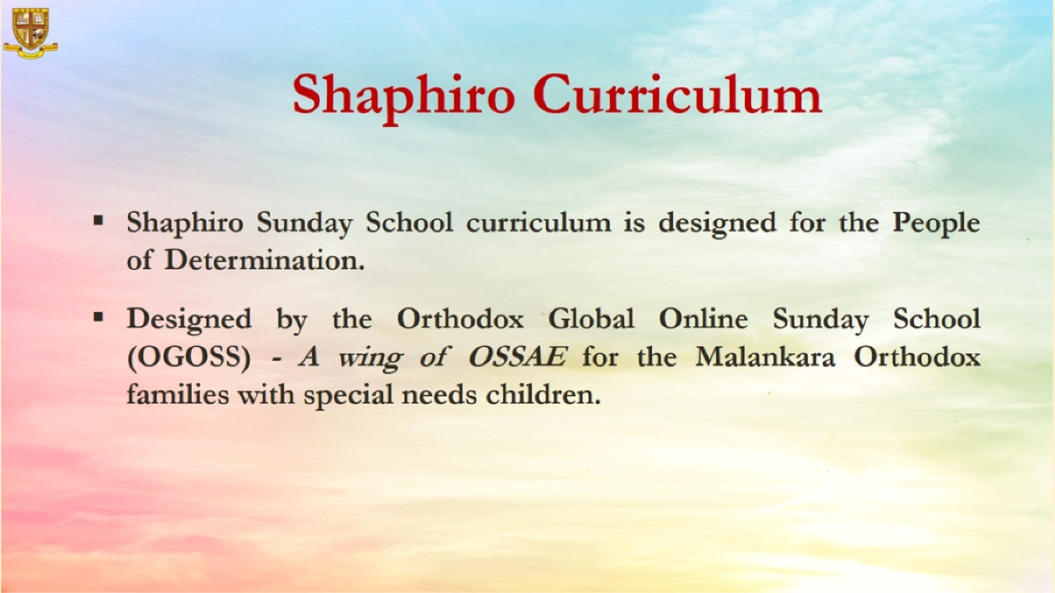

Slide 3
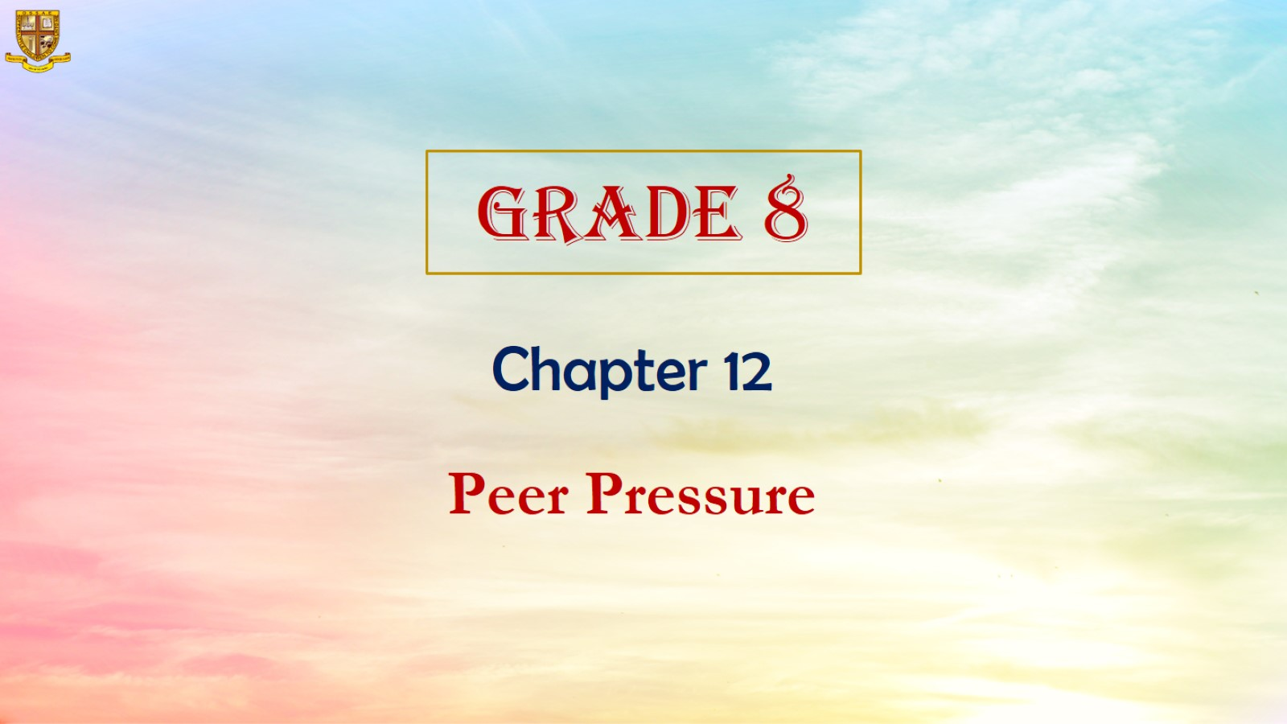

Slide 4
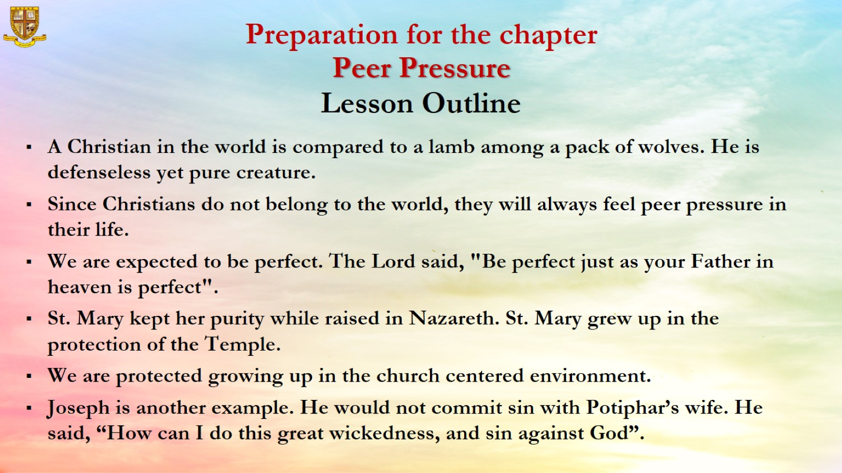

Slide 5
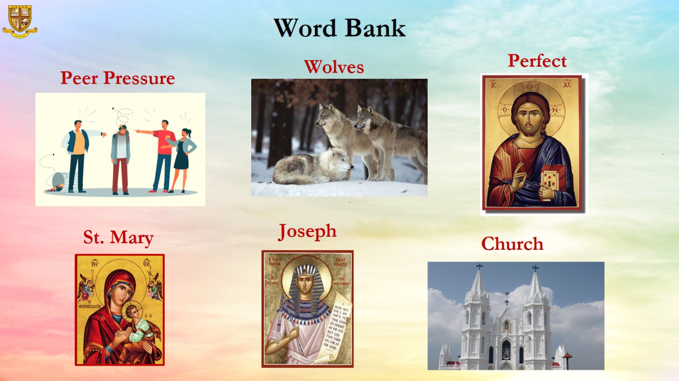

Slide 6
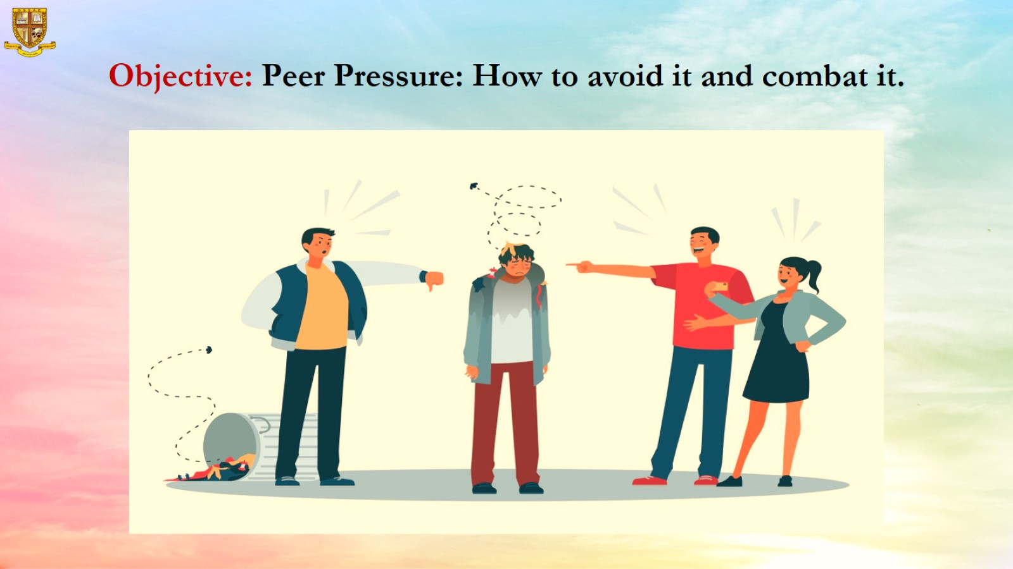
Objective: Peer Pressure: How to avoid it and combat it.

Slide 7
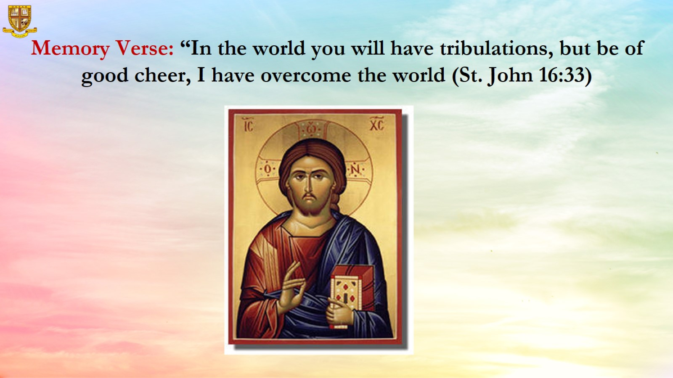

Slide 8
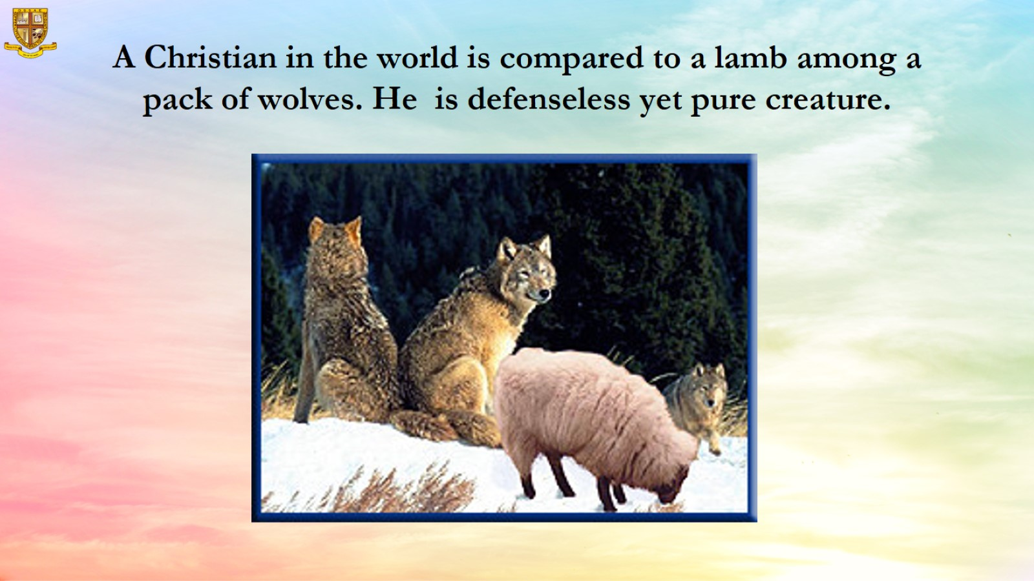
A Christian in the world is compared to a lamb among a pack of wolves. He is defenseless yet pure creature.

Slide 9
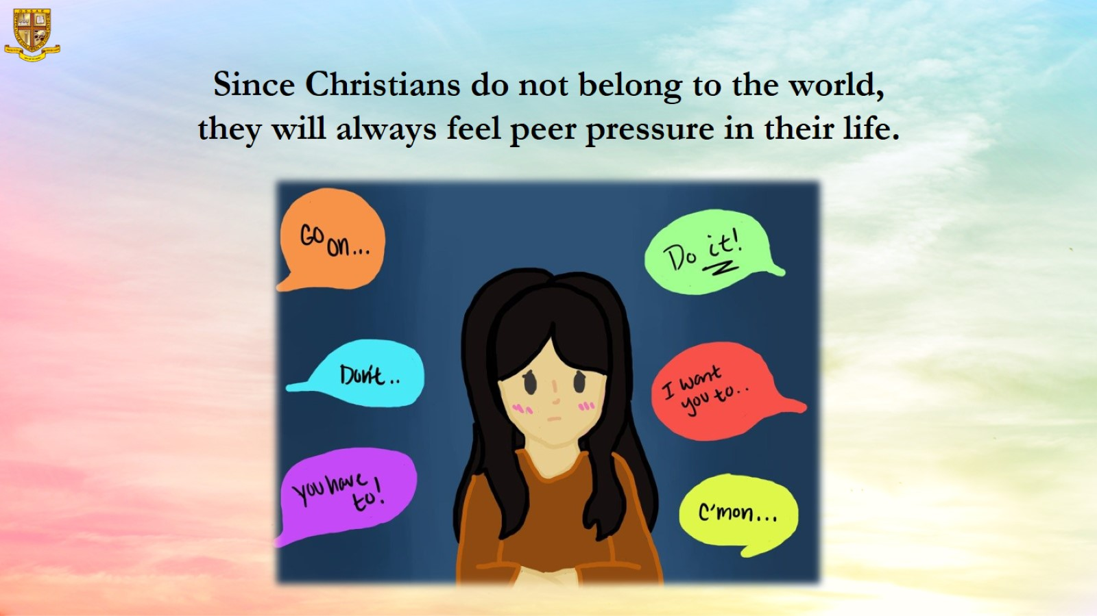
Since Christians do not belong to the world, they will always feel peer pressure in their life.

Slide 10
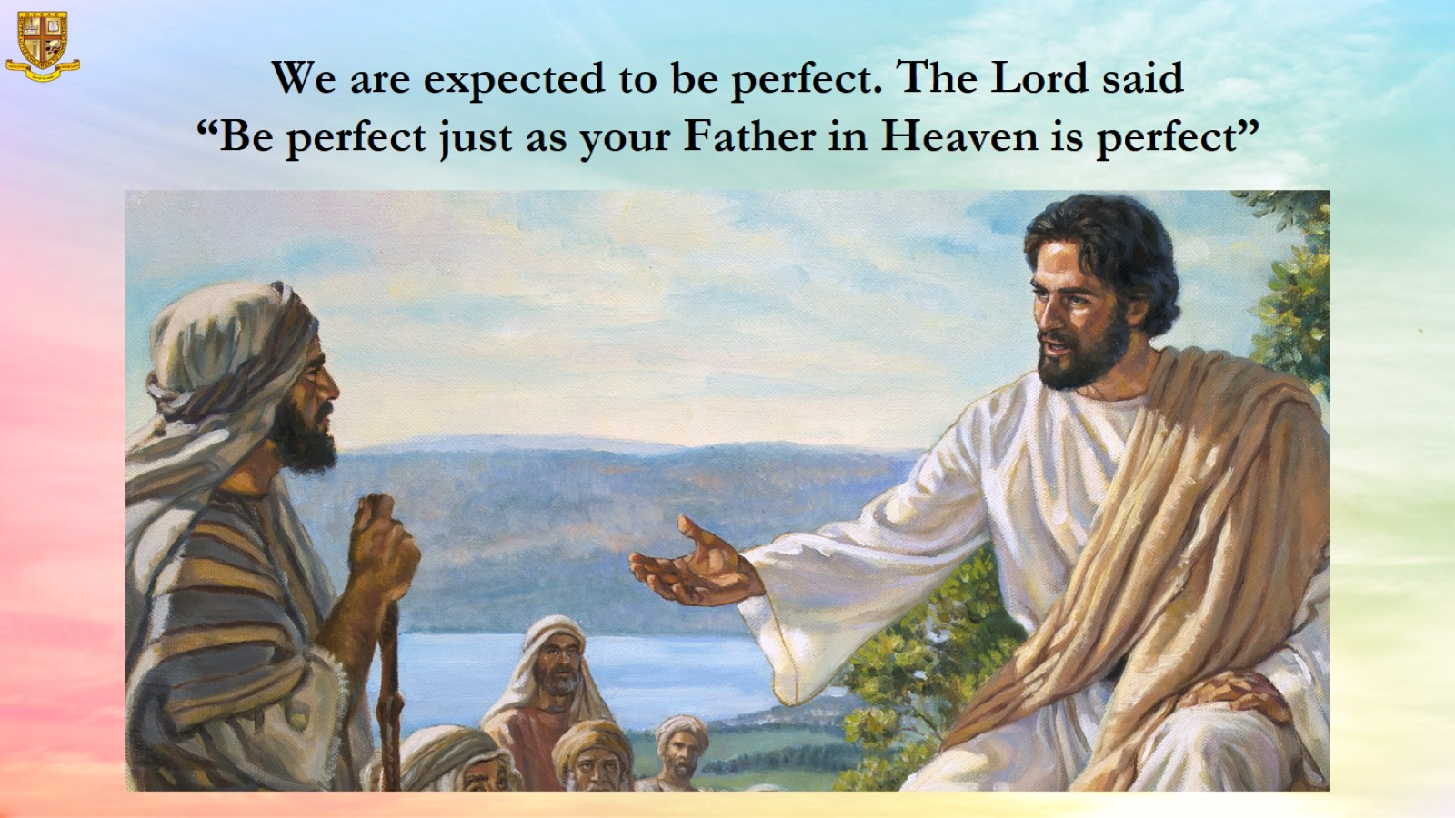
We are expected to be perfect. The Lord said
“Be perfect just as your Father in Heaven is perfect”

Slide 11
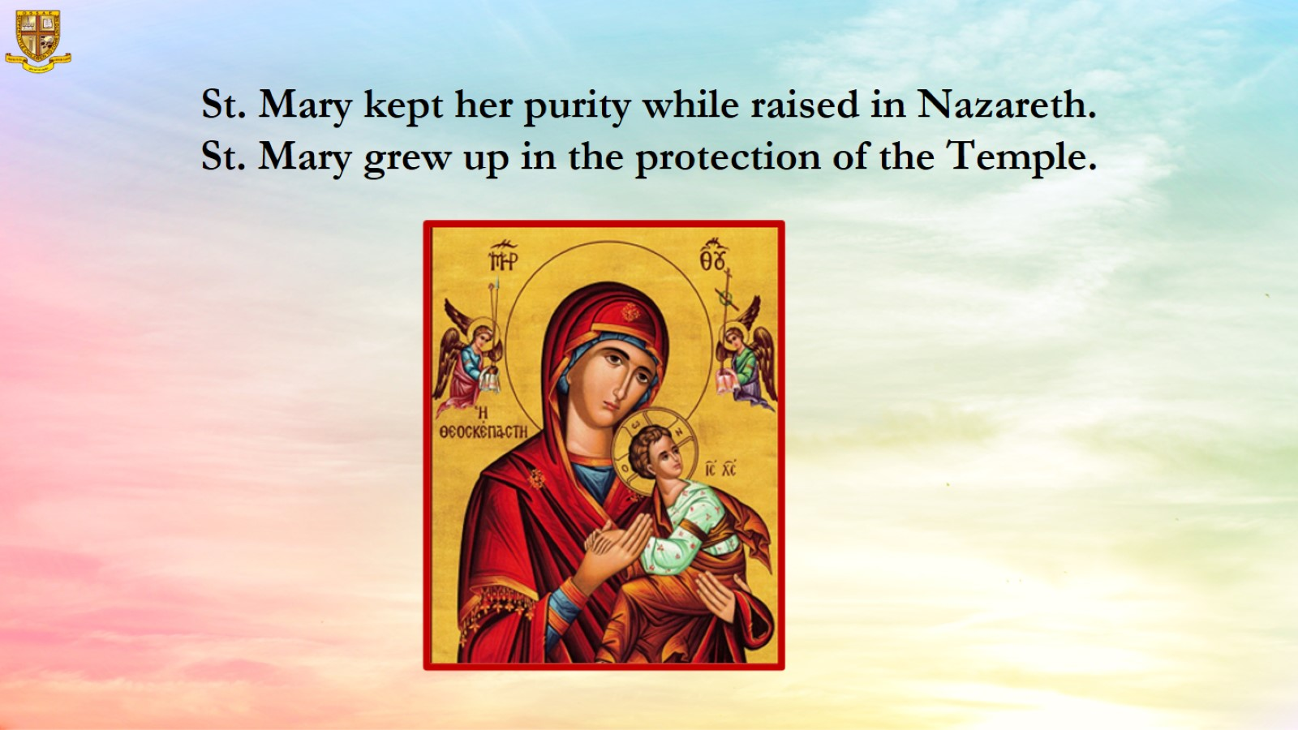
St. Mary kept her purity while raised in Nazareth.
St. Mary grew up in the protection of the Temple.

Slide 12
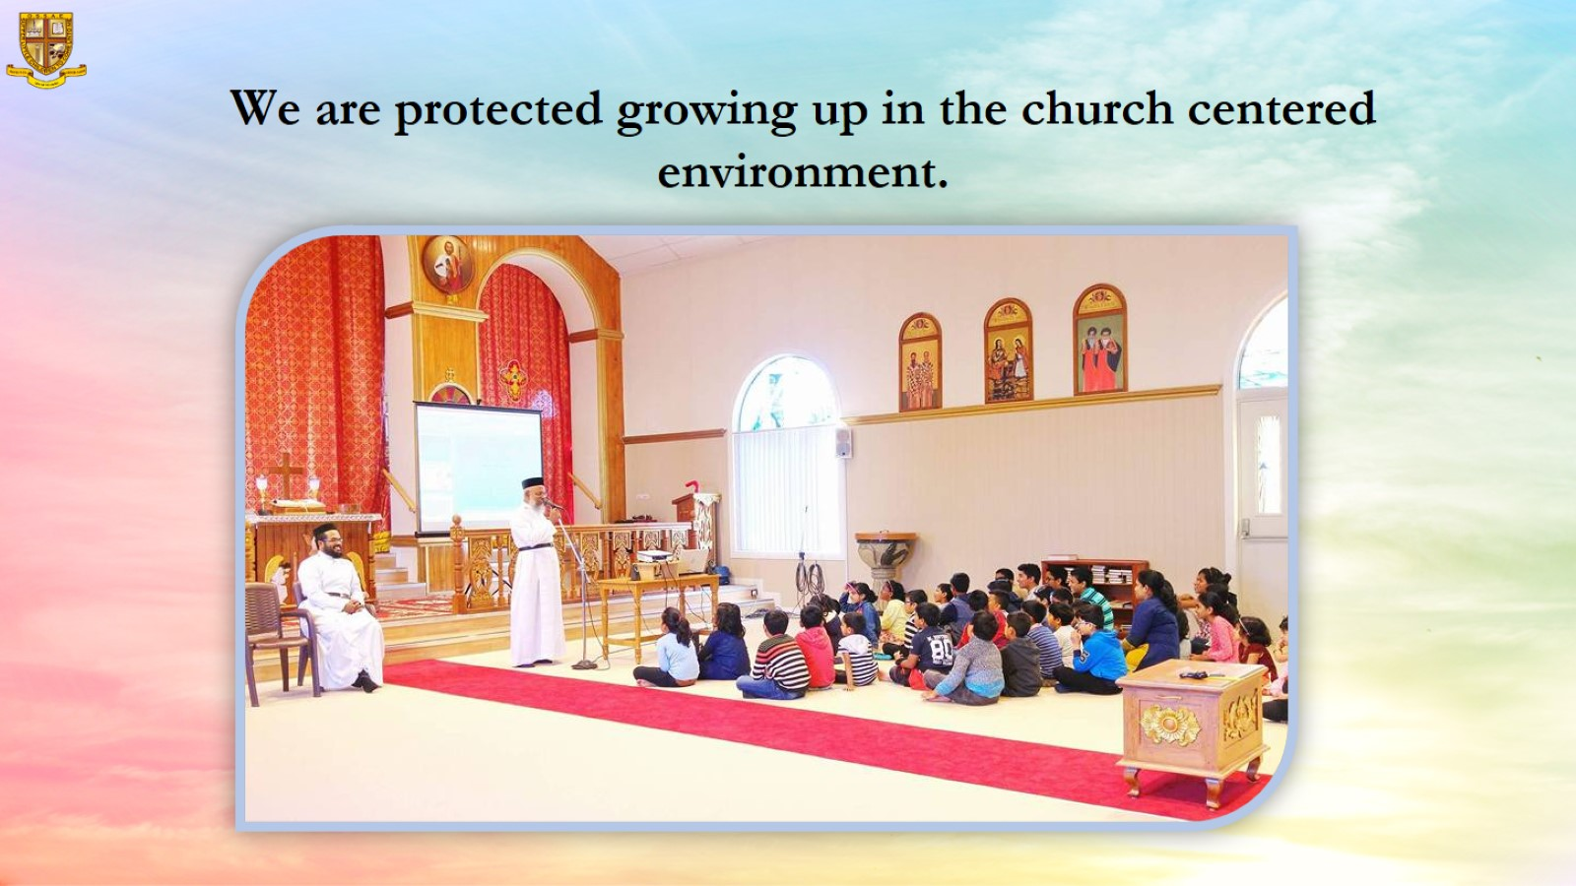
  We are protected growing up in the church centered environment.

Slide 13
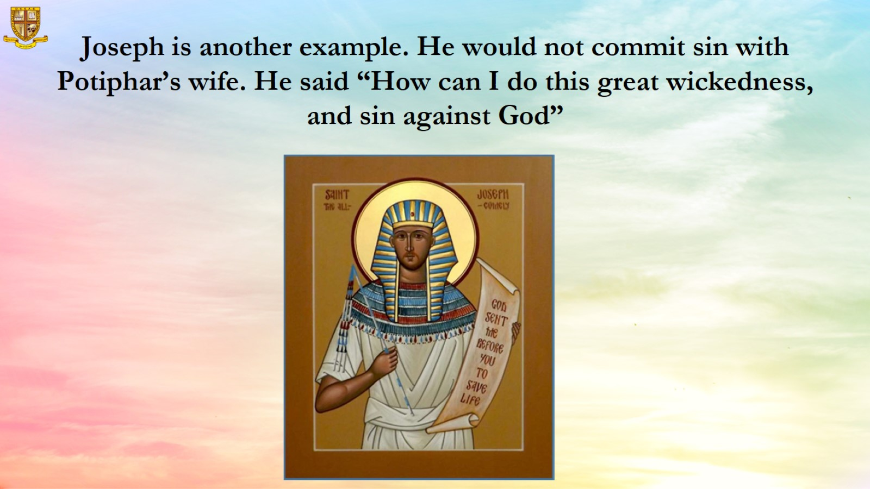
Joseph is another example. He would not commit sin with Potiphar’s wife. He said “How can I do this great wickedness, and sin against God”

Slide 14
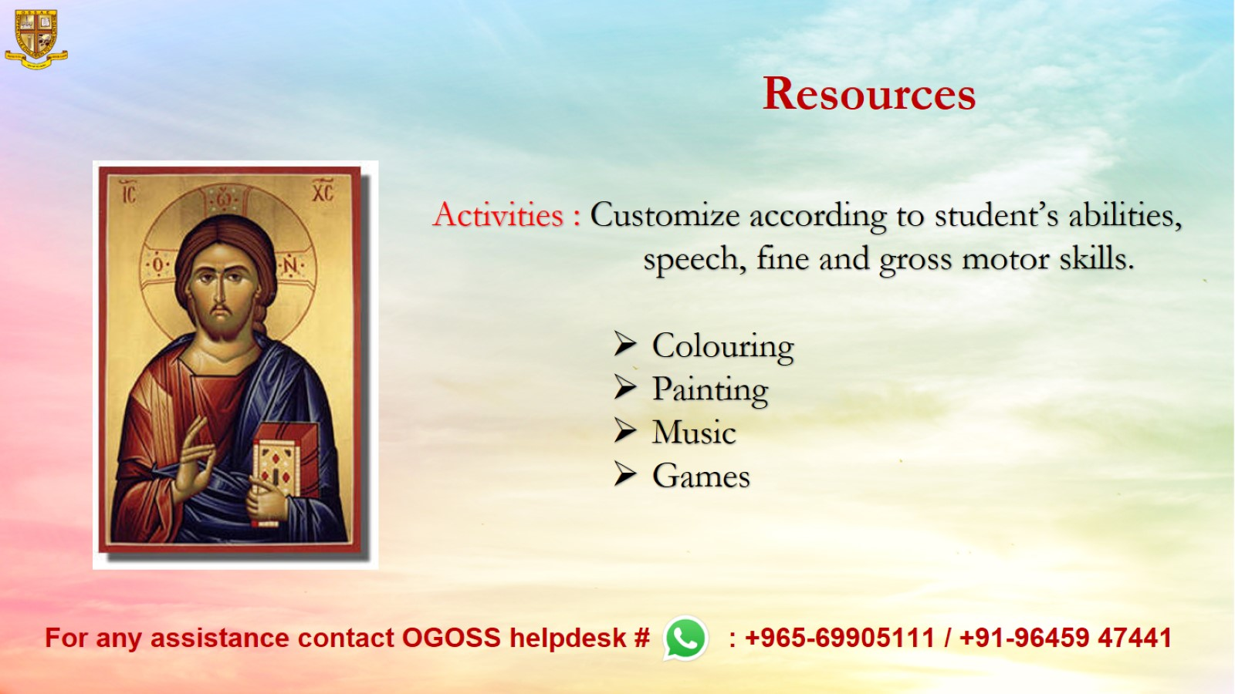
Resources

