Slide 1
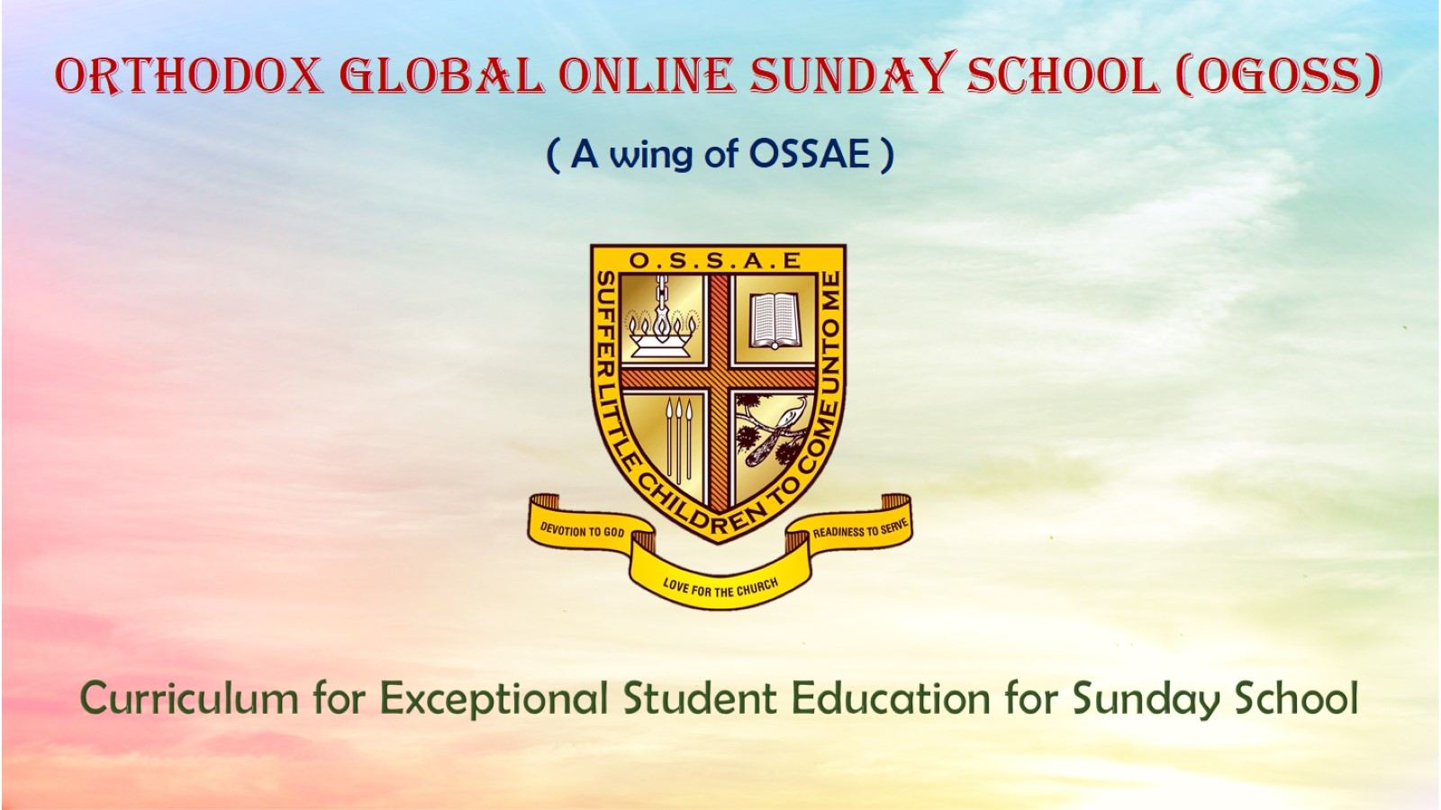
Orthodox Global Online Sunday School (OGOSS)

Slide 2
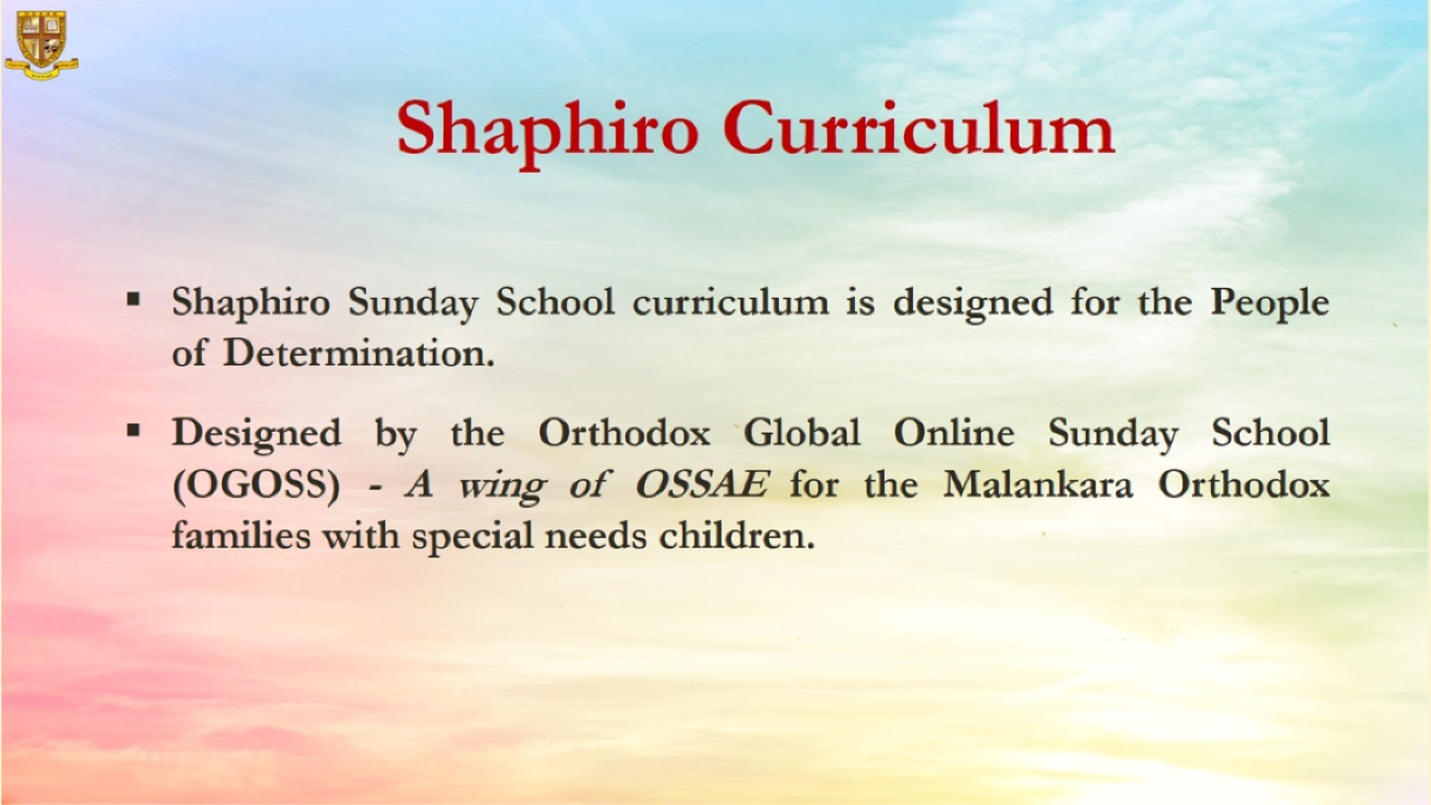

Slide 3
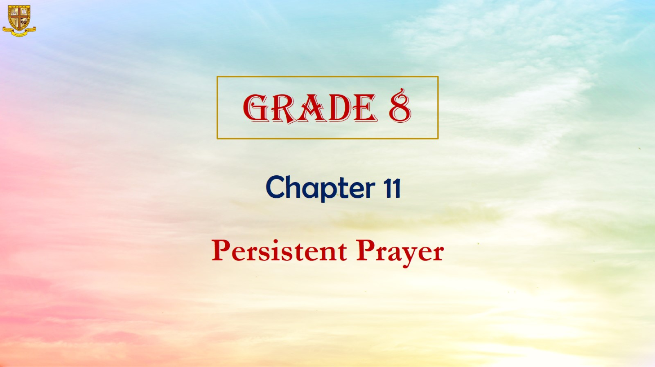

Slide 4
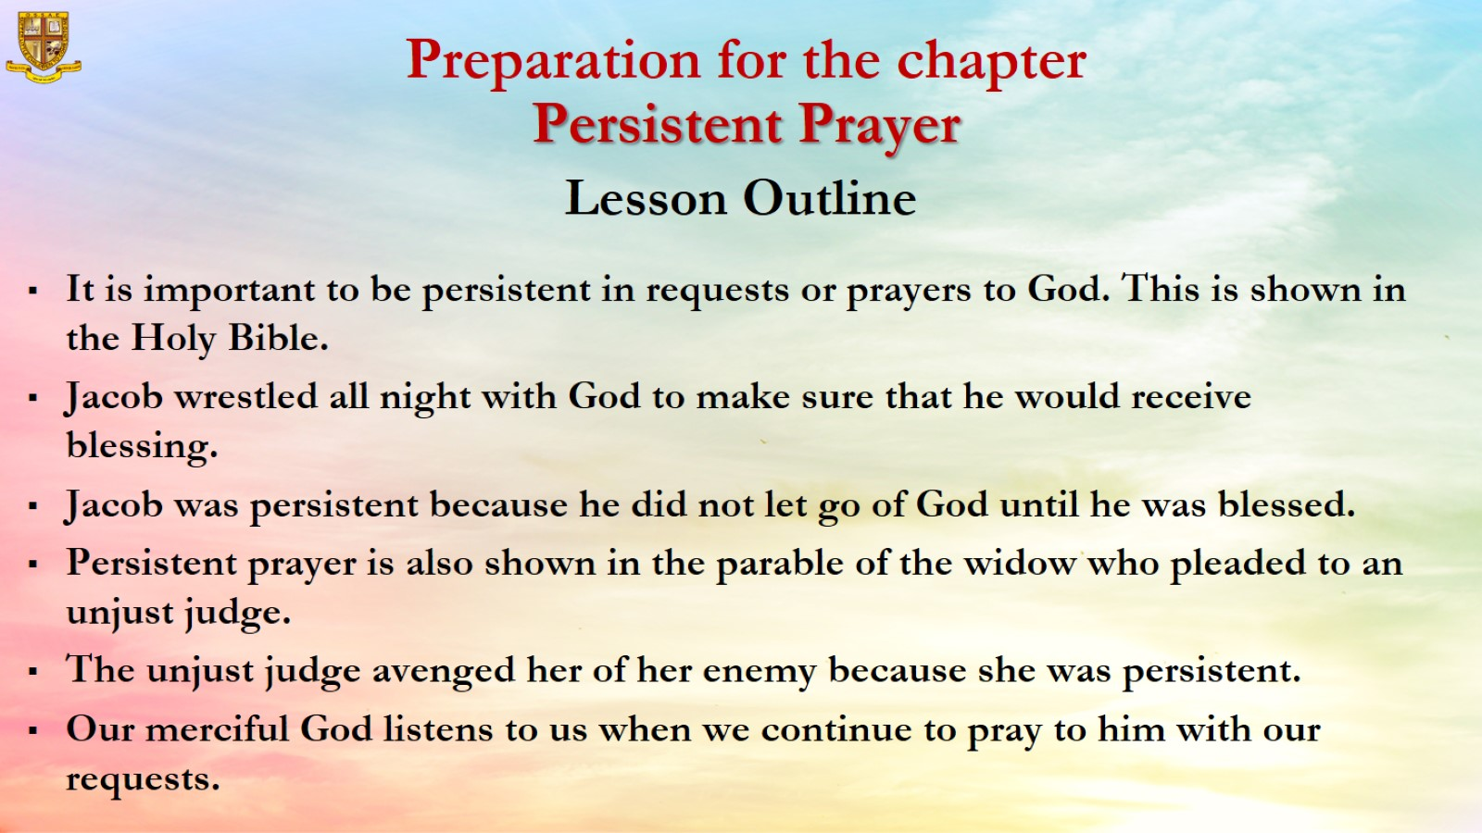

Slide 5
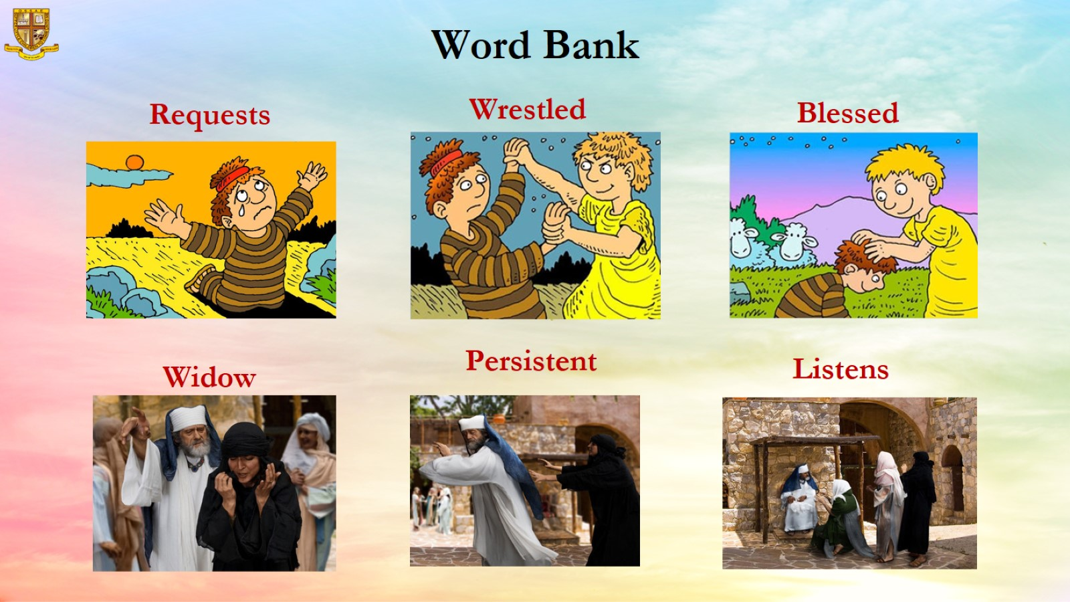

Slide 6
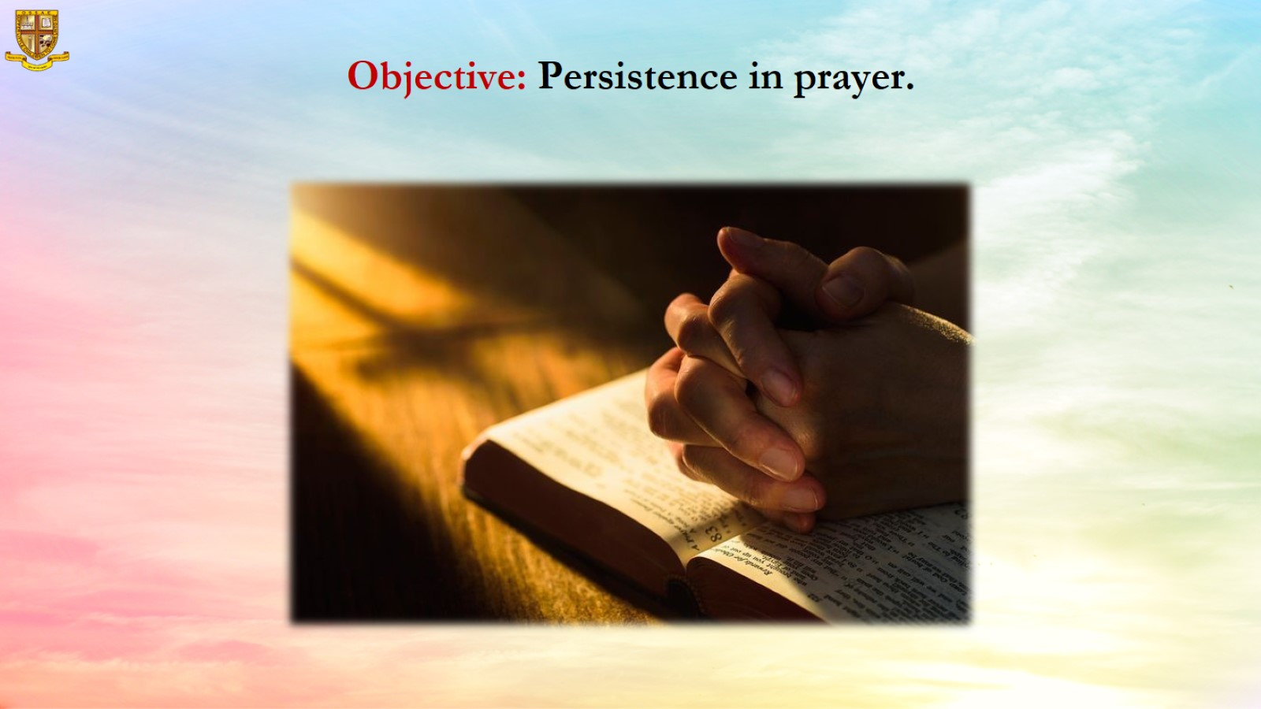
Objective: Persistence in prayer.

Slide 7
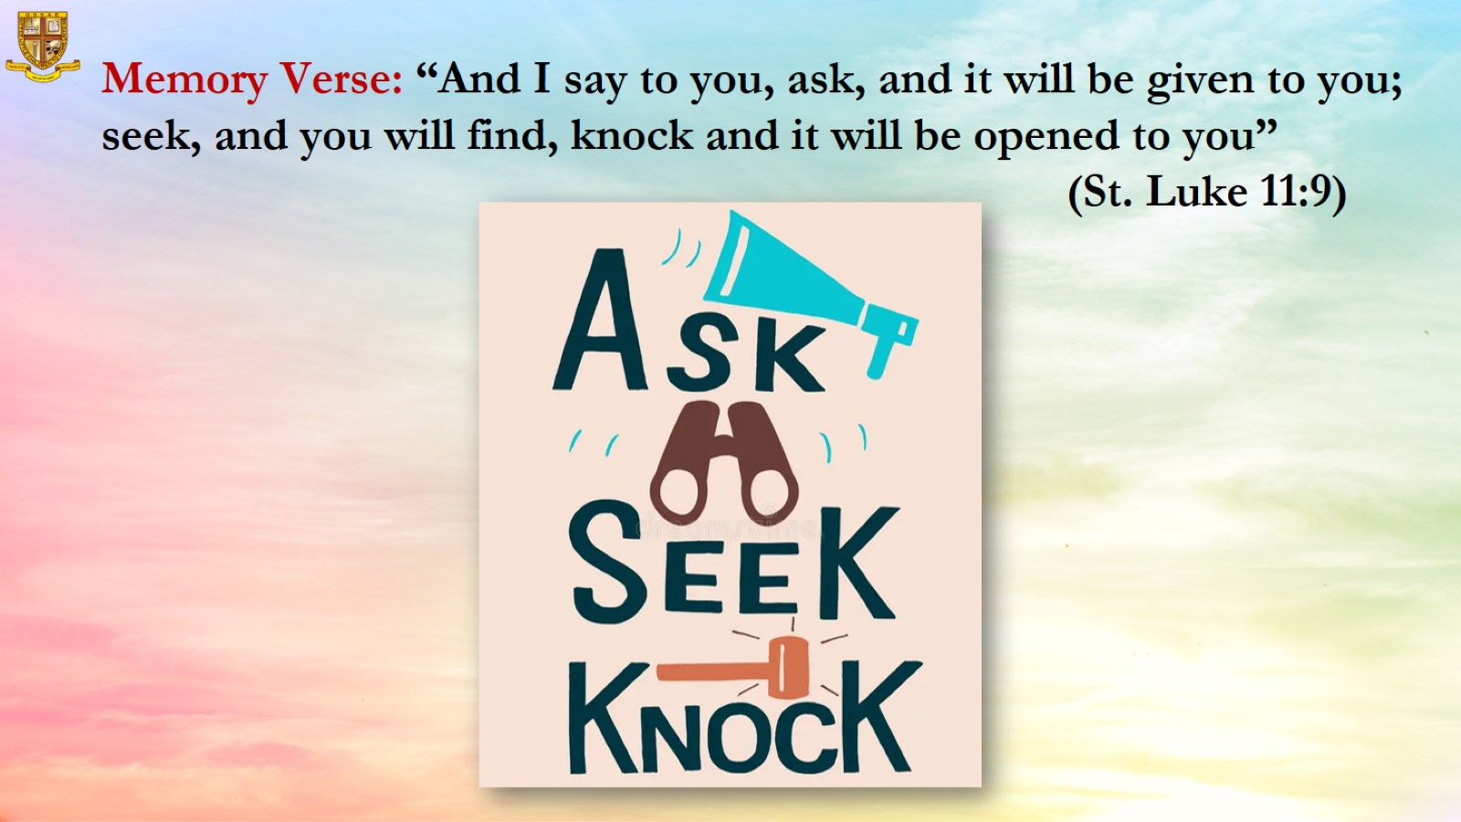
Memory Verse: “And I say to you, ask, and it will be given to you; seek, and you will find, knock and it will be opened to you”
(St. Luke 11:9)

Slide 8
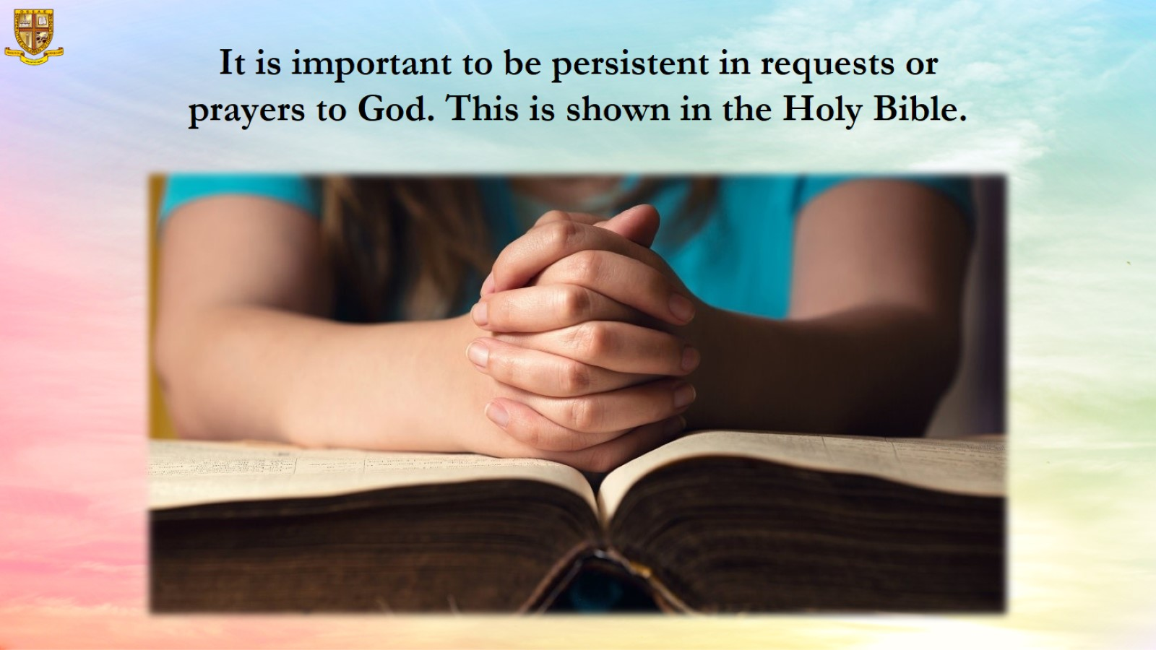
It is important to be persistent in requests or prayers to God. This is shown in the Holy Bible.

Slide 9
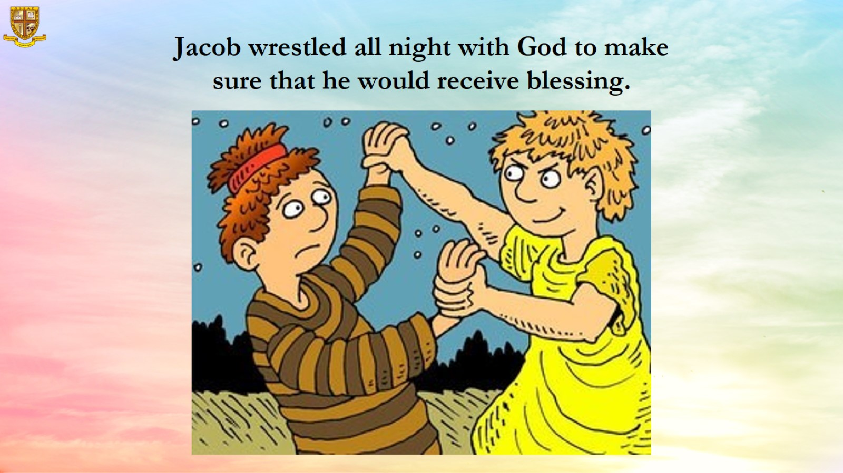
Jacob wrestled all night with God to make sure that he would receive blessing.

Slide 10
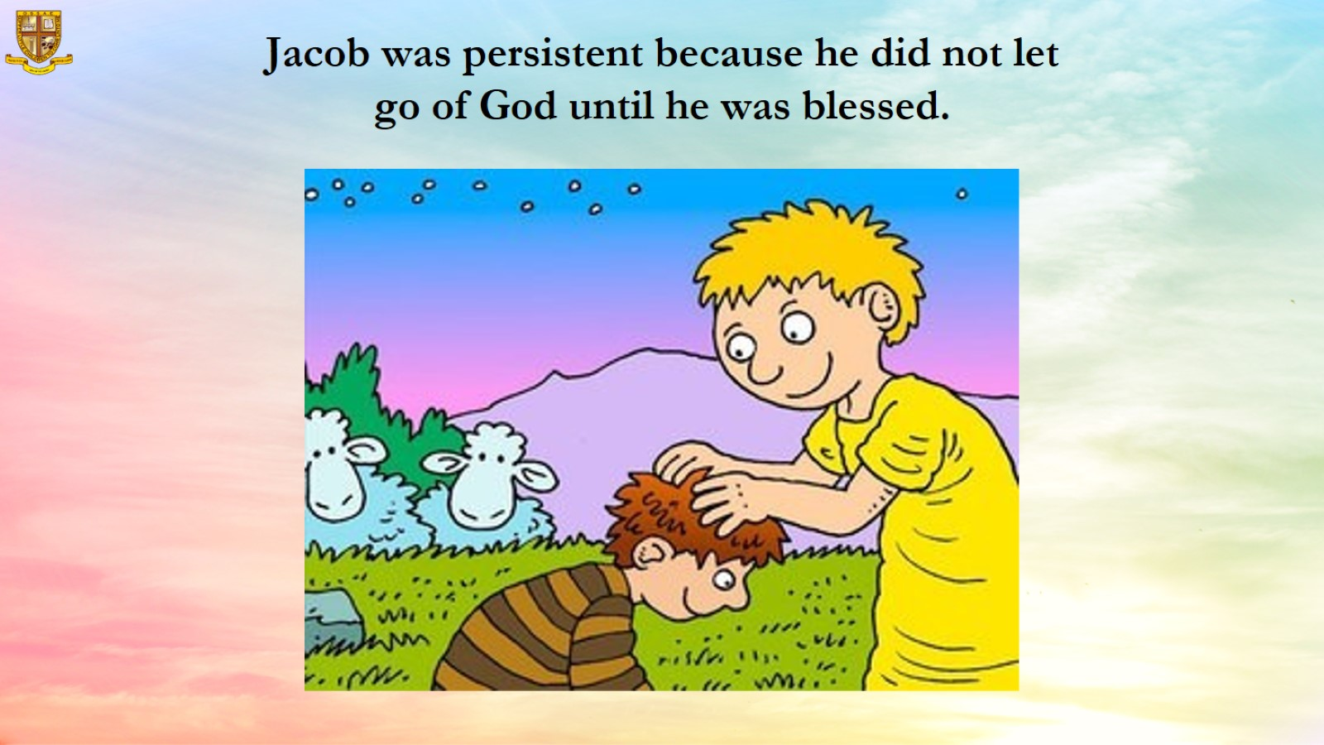
Jacob was persistent because he did not let go of God until he was blessed.

Slide 11
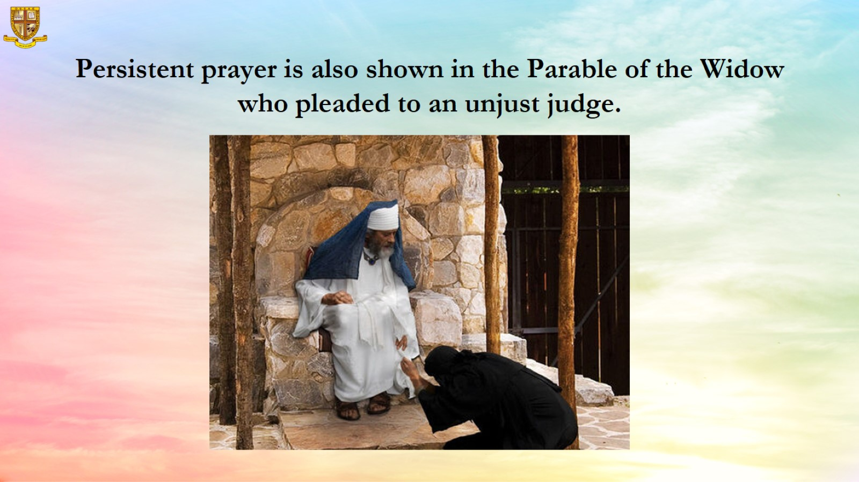
Persistent prayer is also shown in the Parable of the Widow who pleaded to an unjust judge.

Slide 12
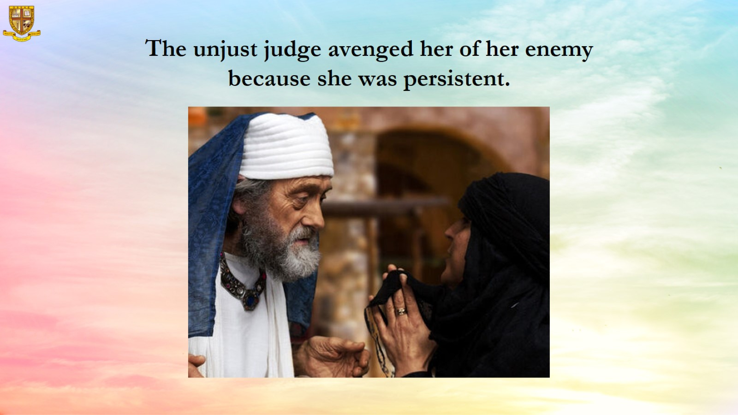
The unjust judge avenged her of her enemy because she was persistent.

Slide 13
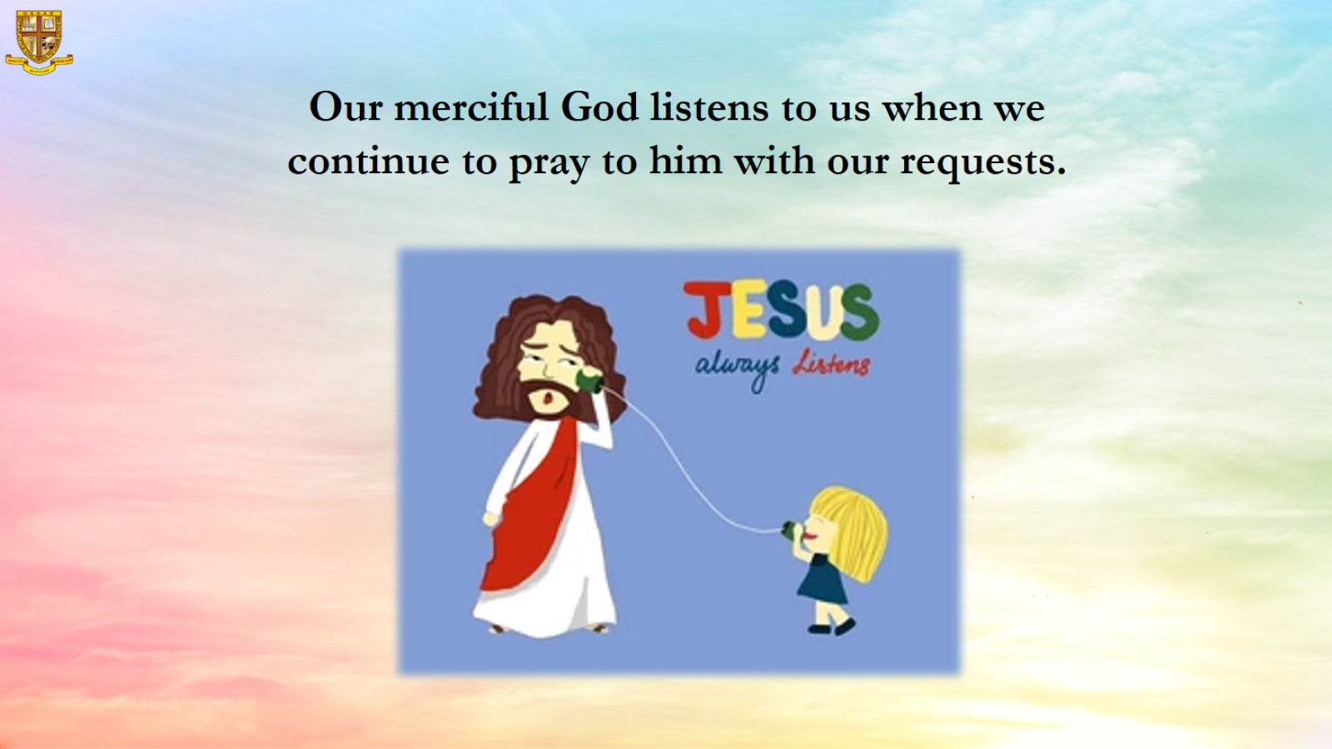
Our merciful God listens to us when we continue to pray to him with our requests.

Slide 14
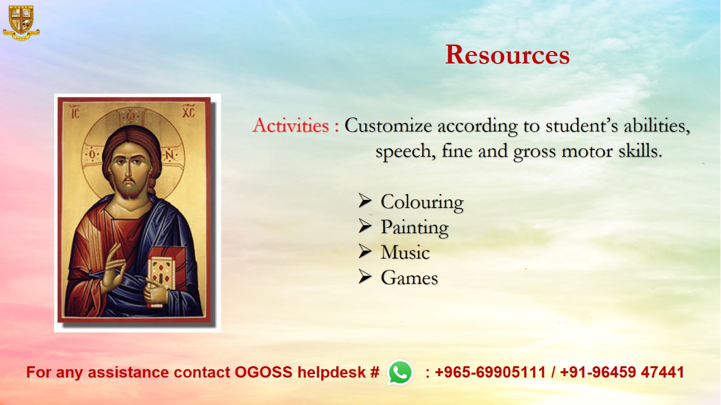
Resources

