Slide 1
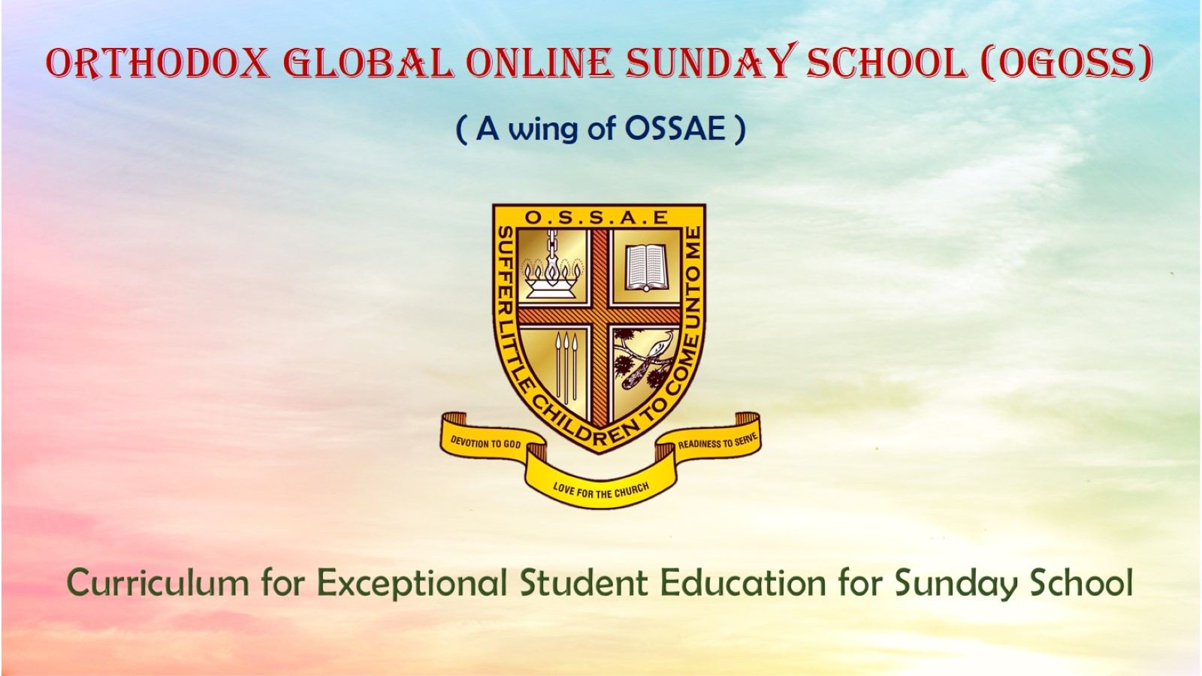
Orthodox Global Online Sunday School (OGOSS)

Slide 2
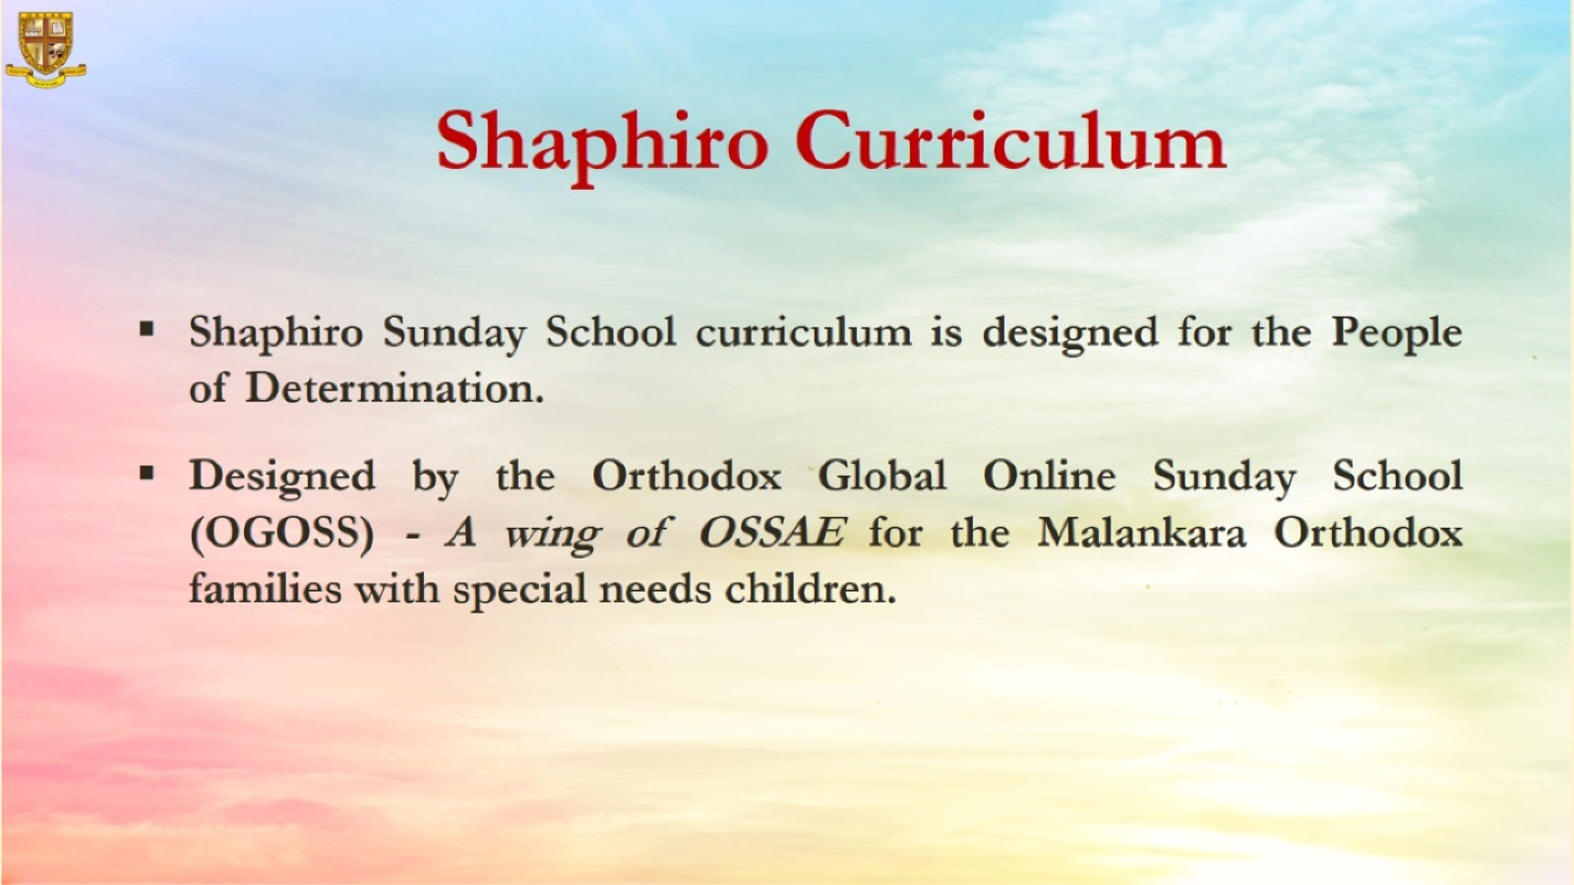

Slide 3
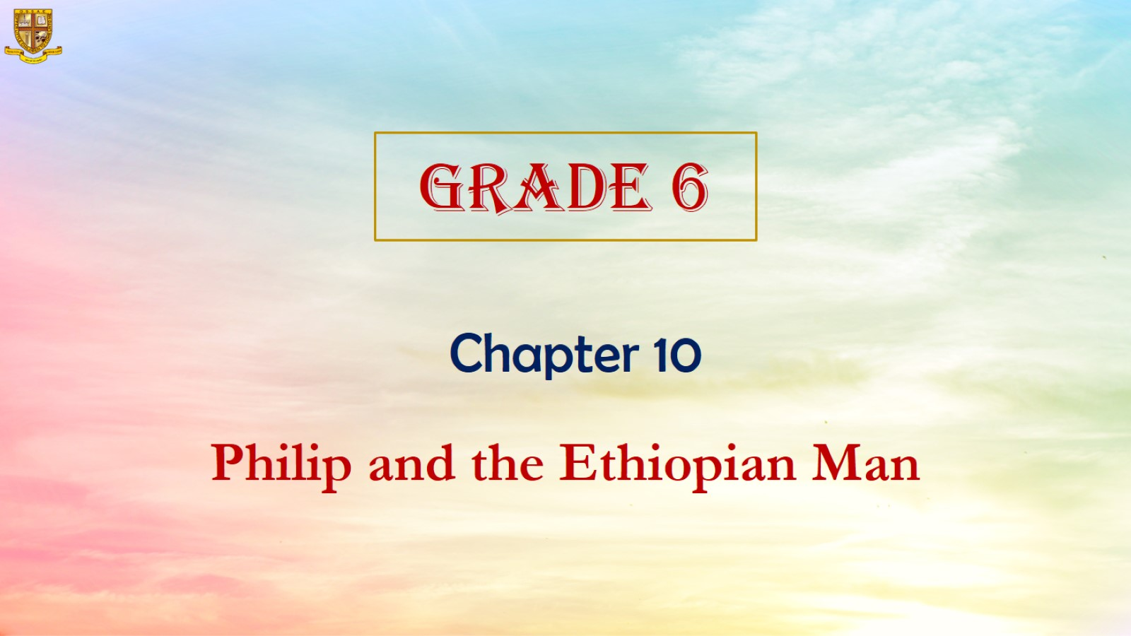

Slide 4
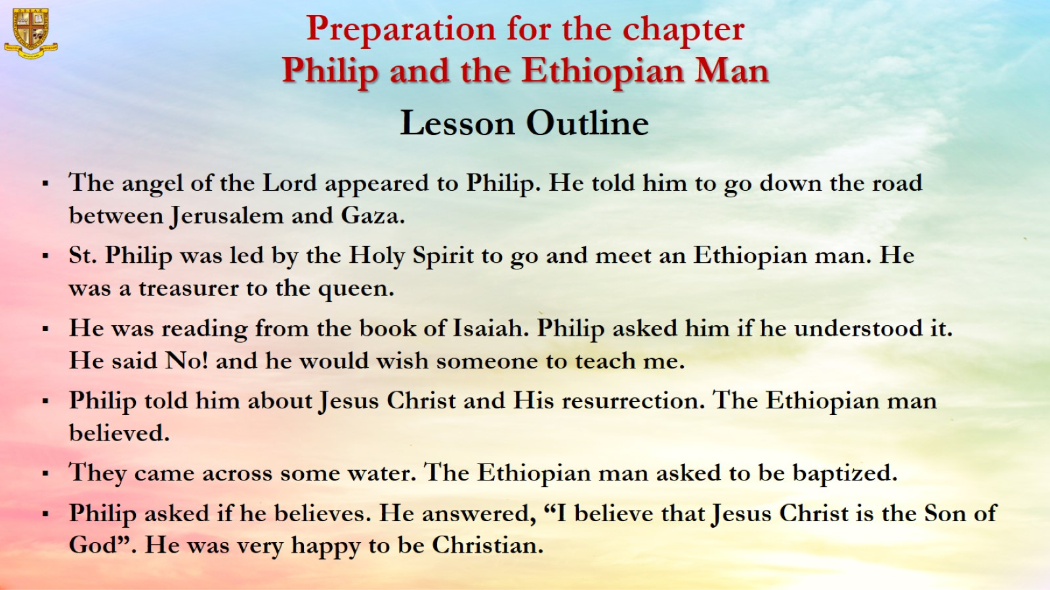

Slide 5
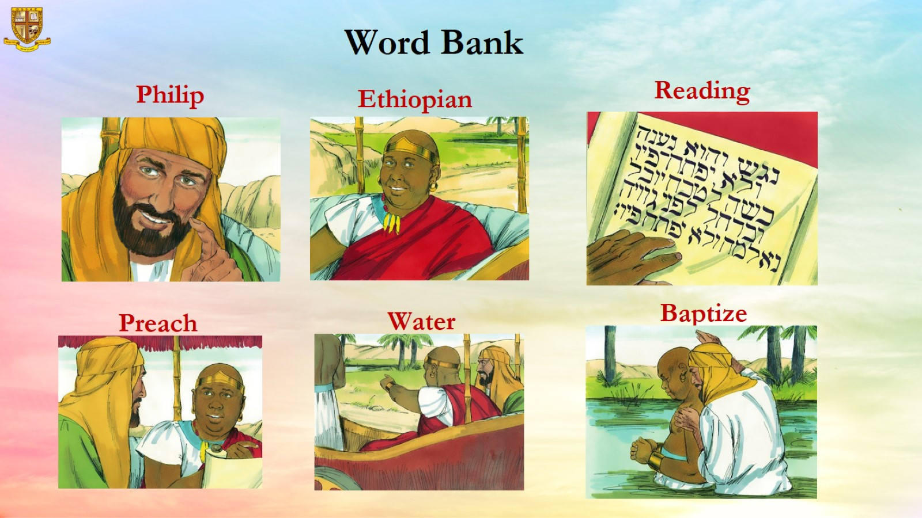
Word Bank

Slide 6
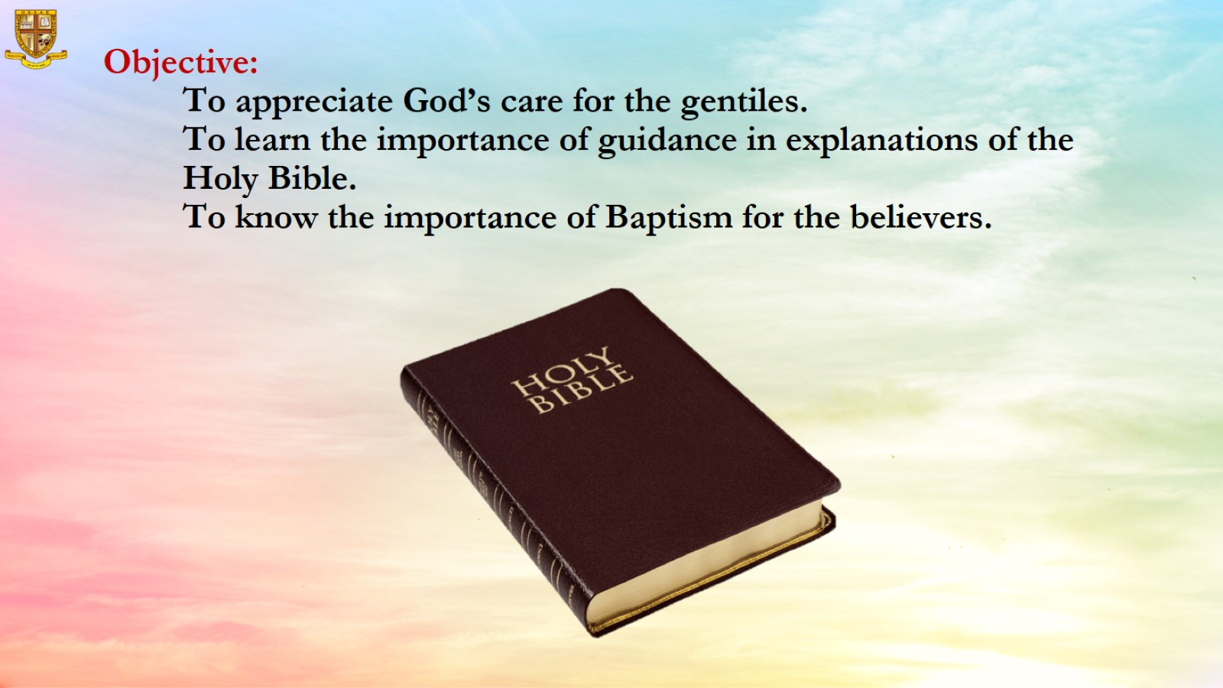
Objective:
To appreciate God’s care for the gentiles.
To learn the importance of guidance in explanations of the Holy Bible.
To know the importance of Baptism for the believers.

Slide 7
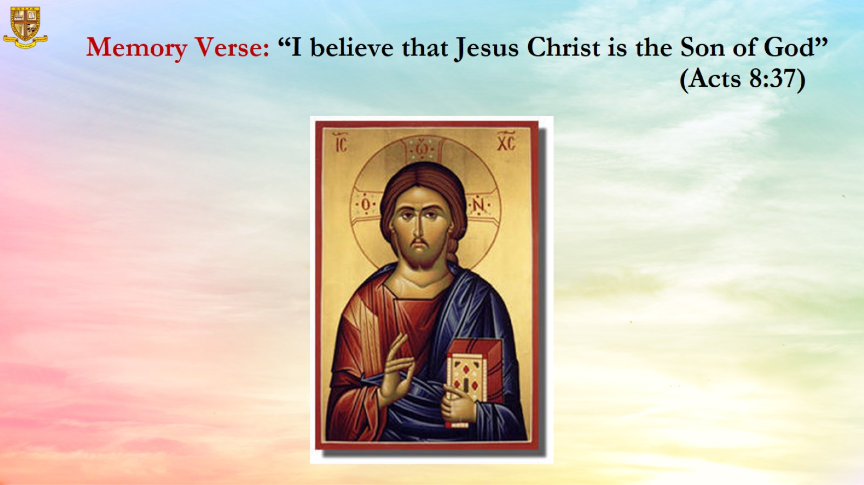
Memory Verse: “I believe that Jesus Christ is the Son of God” (Acts 8:37)

Slide 8
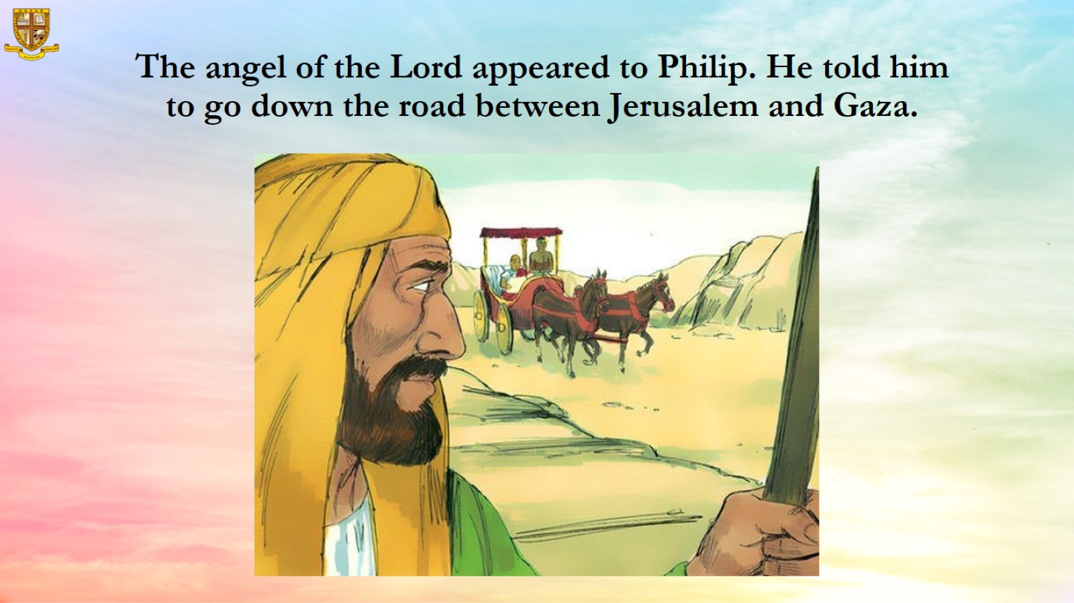
The angel of the Lord appeared to Philip. He told him to go down the road between Jerusalem and Gaza.

Slide 9
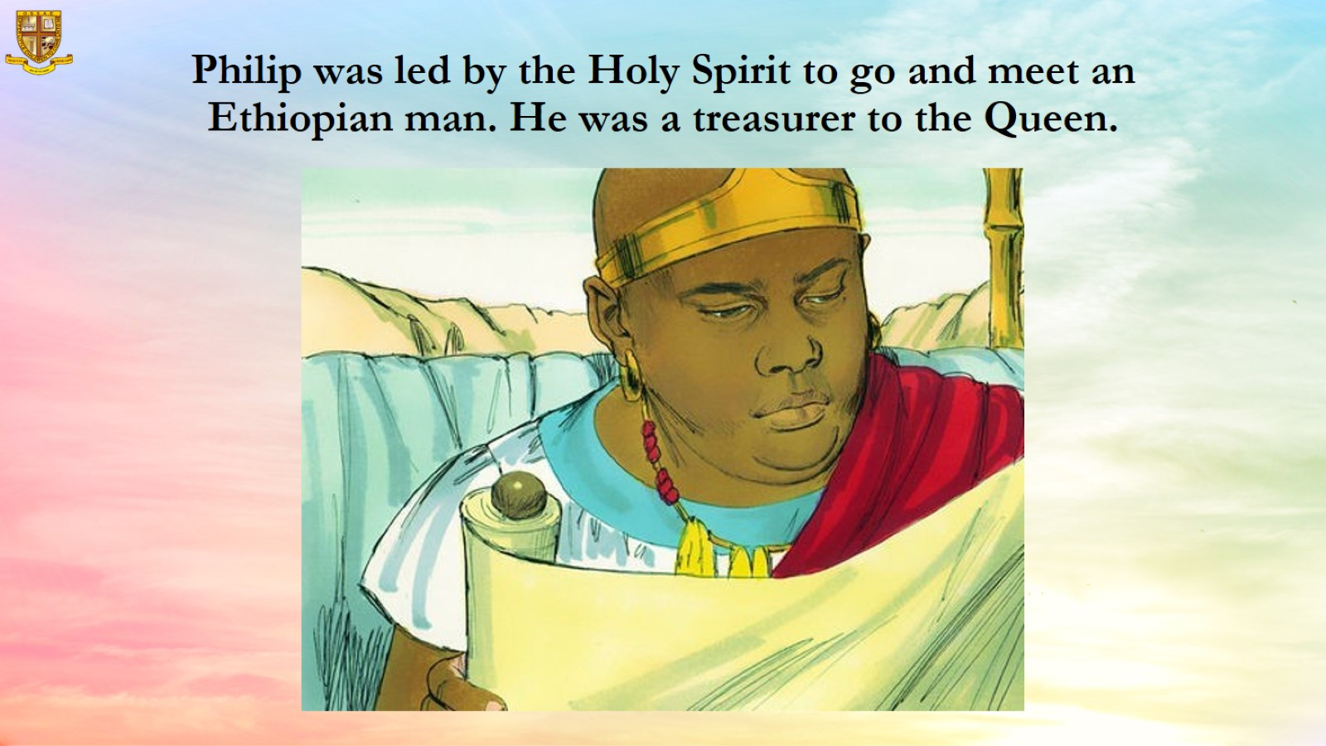
Philip was led by the Holy Spirit to go and meet an Ethiopian man. He was a treasurer to the Queen.

Slide 10
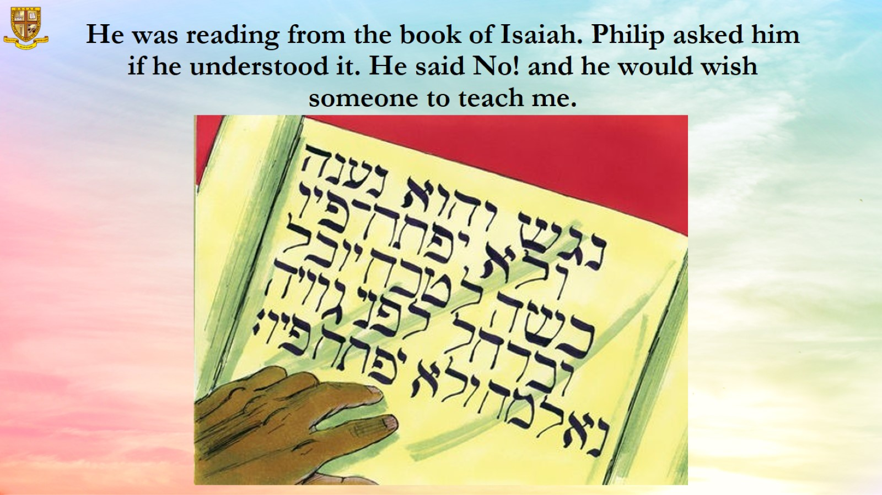
He was reading from the book of Isaiah. Philip asked him if he understood it. He said No! and he would wish someone to teach me.

Slide 11
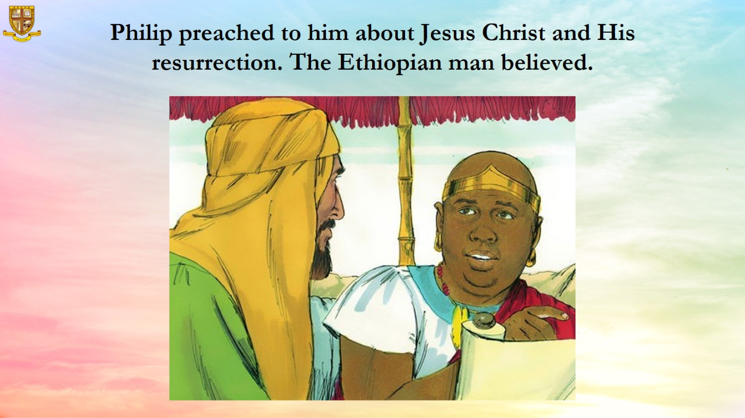

Slide 12
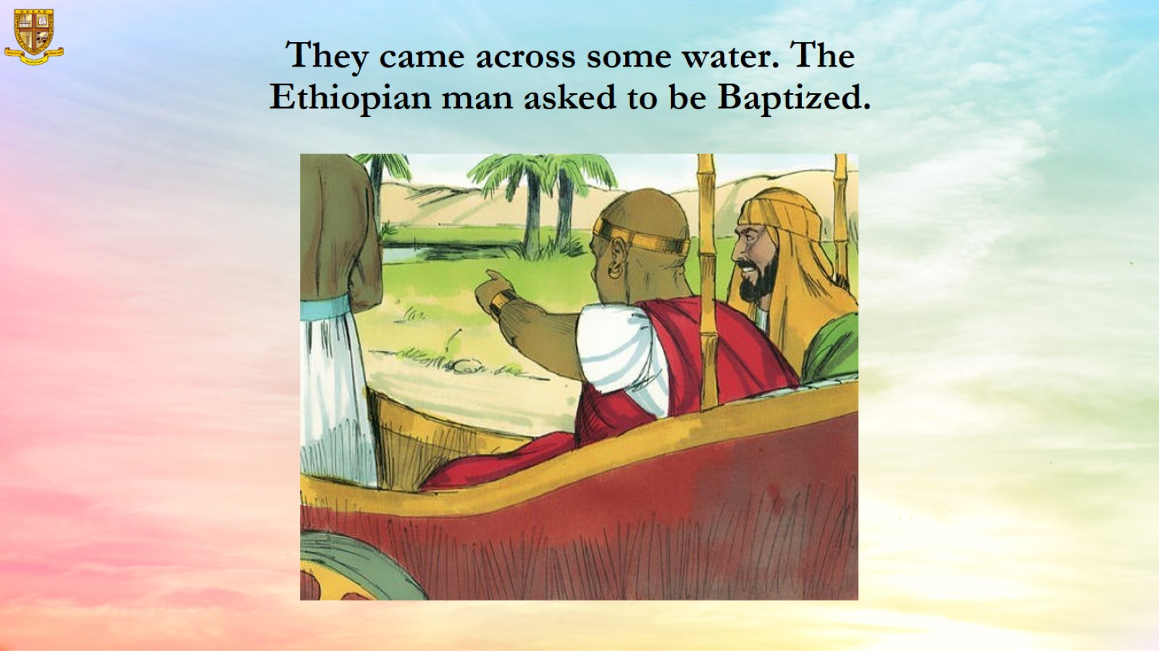
They came across some water. The Ethiopian man asked to be Baptized.

Slide 13
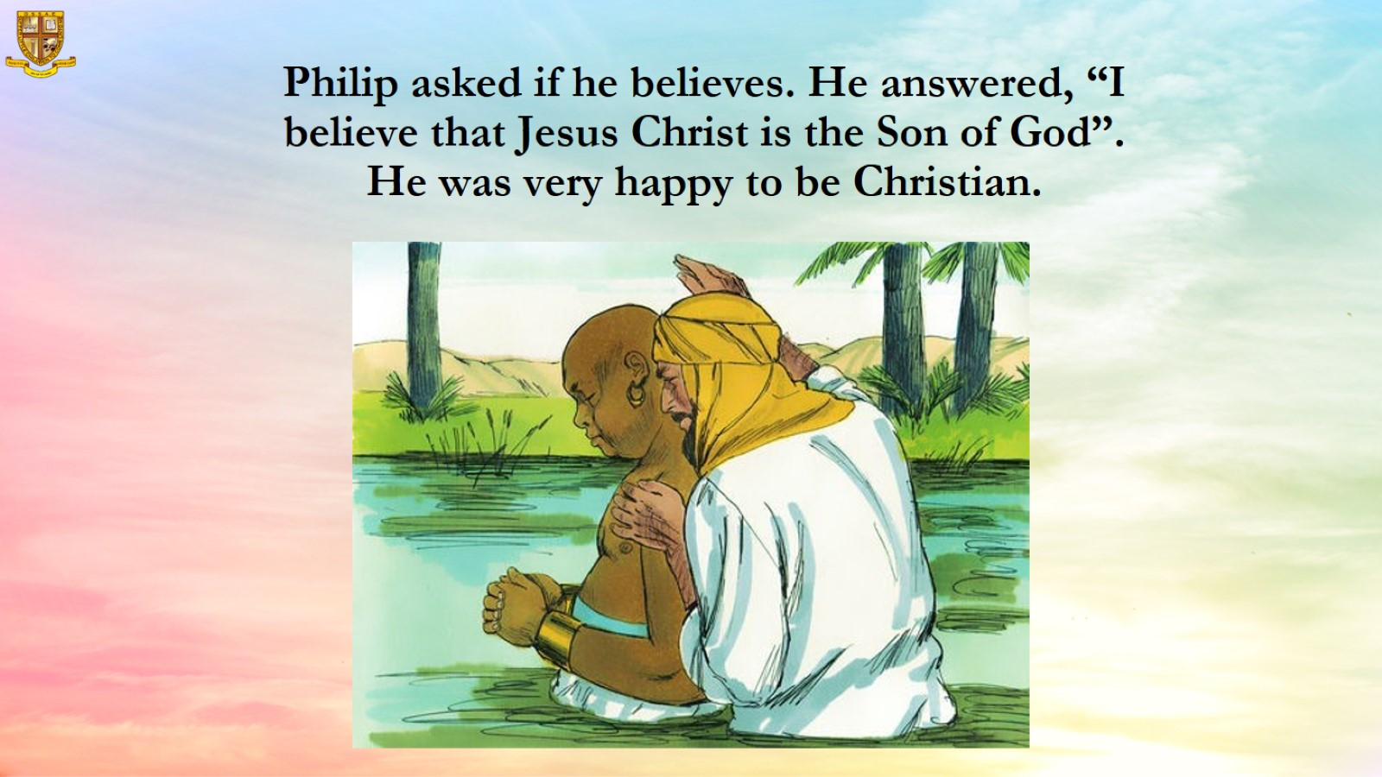
Philip asked if he believes. He answered, “I believe that Jesus Christ is the Son of God”. He was very happy to be Christian.

Slide 14
