Slide 1
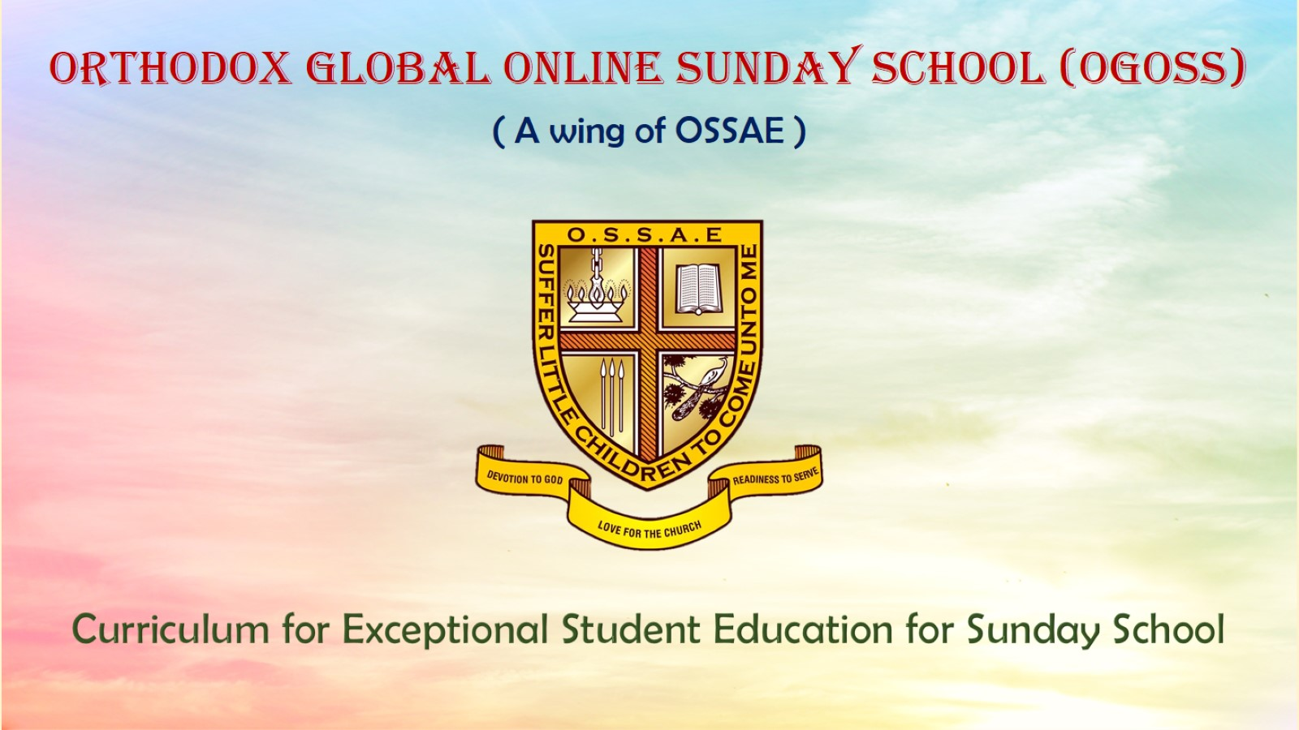
Orthodox Global Online Sunday School (OGOSS)

Slide 2
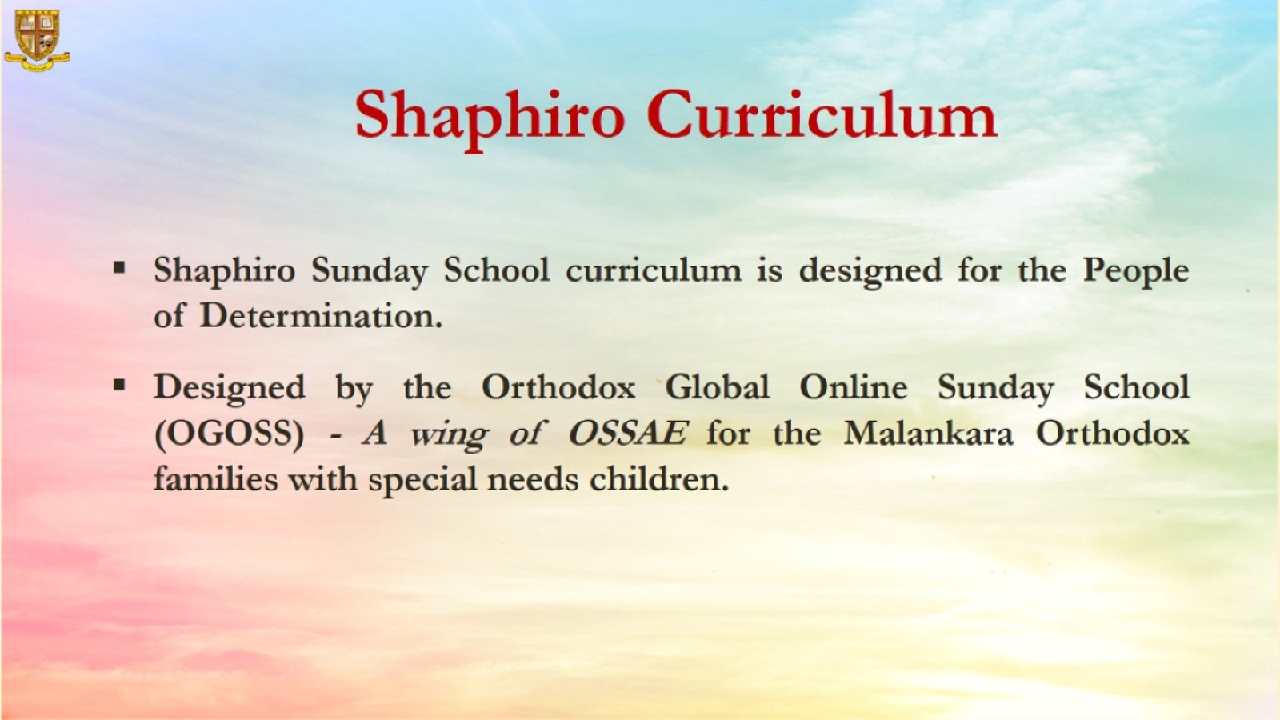

Slide 3
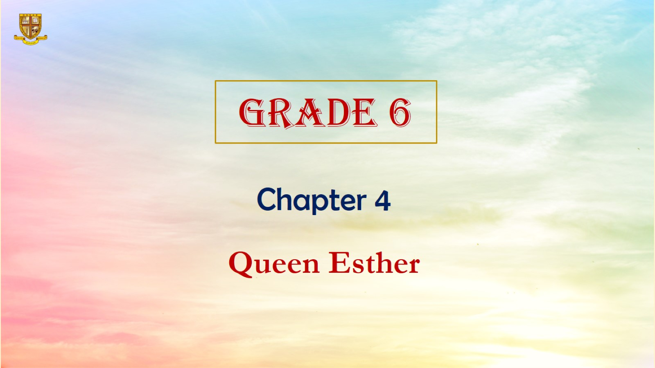

Slide 4
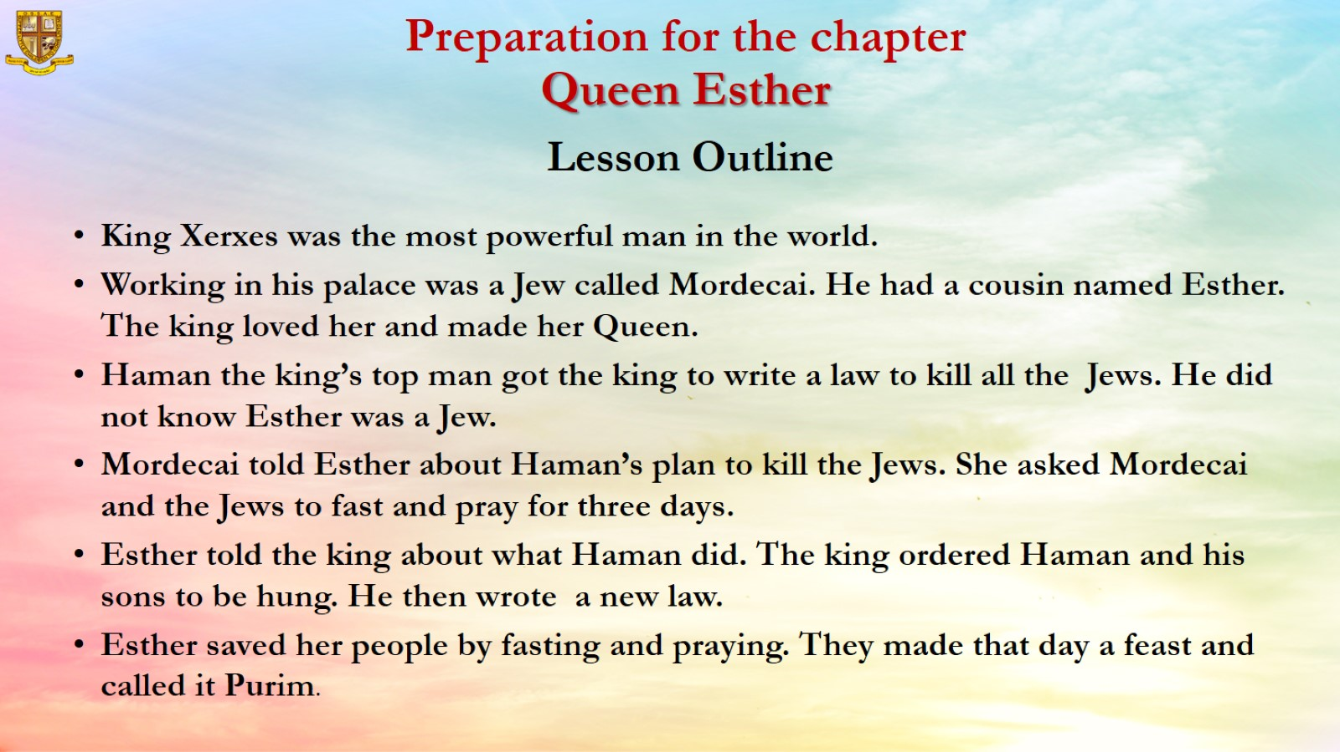
Preparation for the chapter
Queen Esther
Lesson Outline

Slide 5
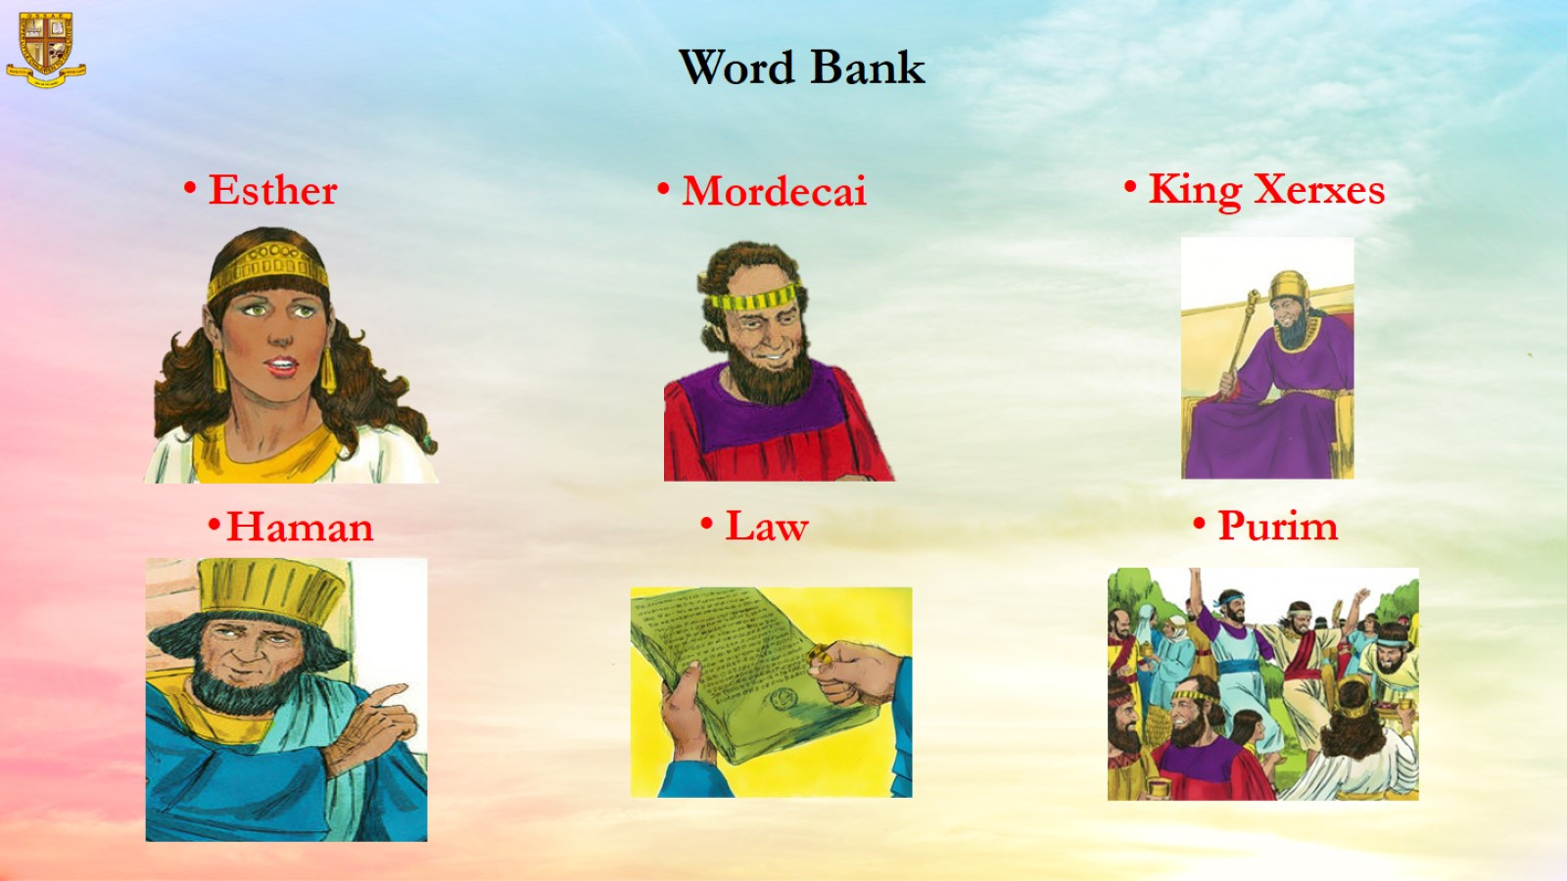
Word Bank

Slide 6
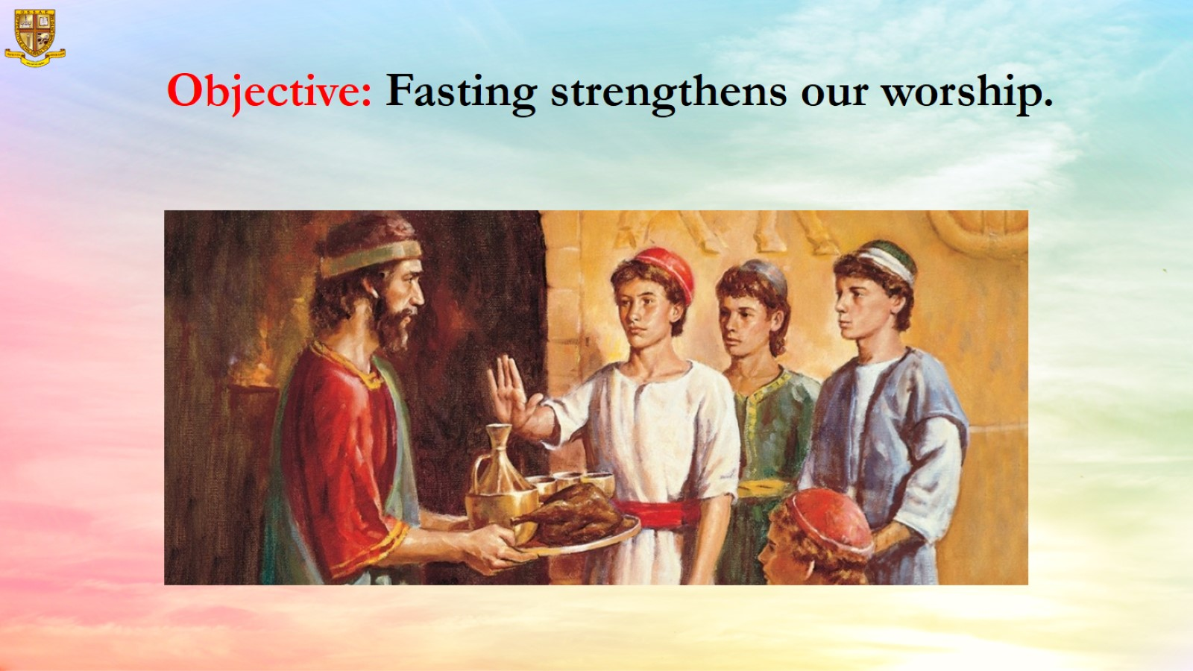
Objective: Fasting strengthens our worship.

Slide 7
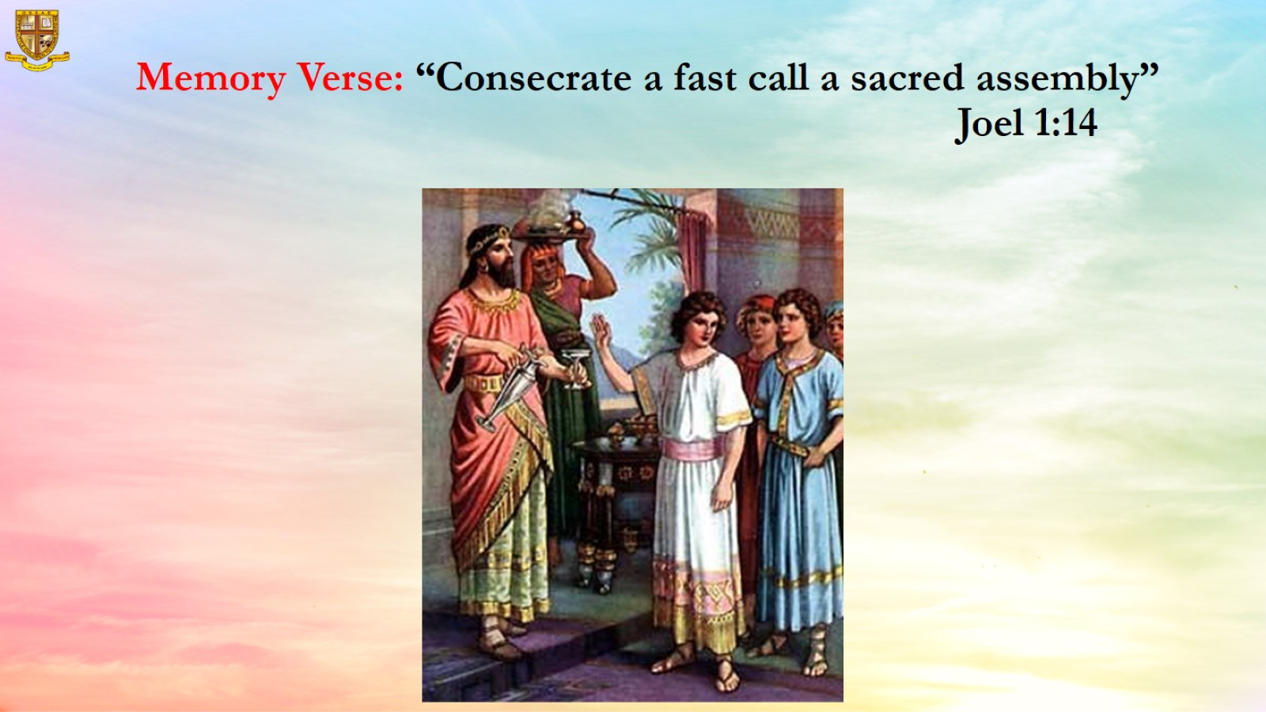
Memory Verse: “Consecrate a fast call a sacred assembly” Joel 1:14

Slide 8
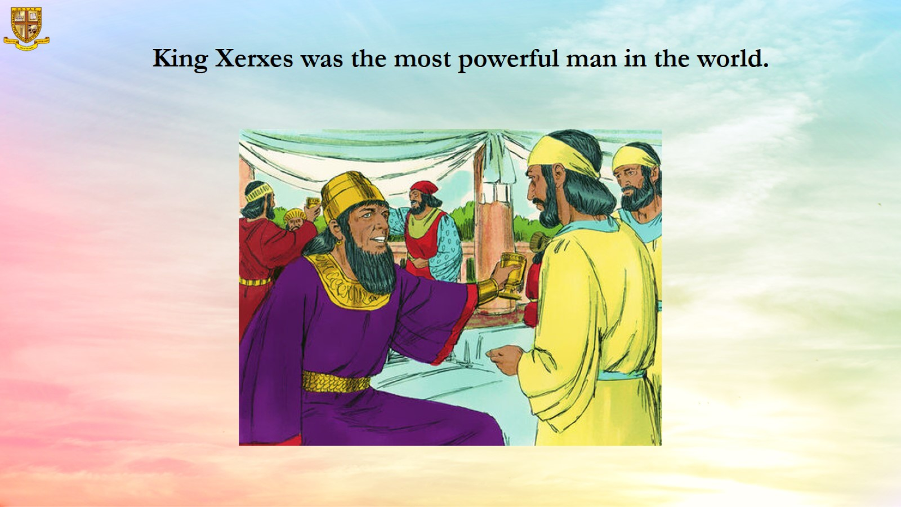
King Xerxes was the most powerful man in the world.

Slide 9
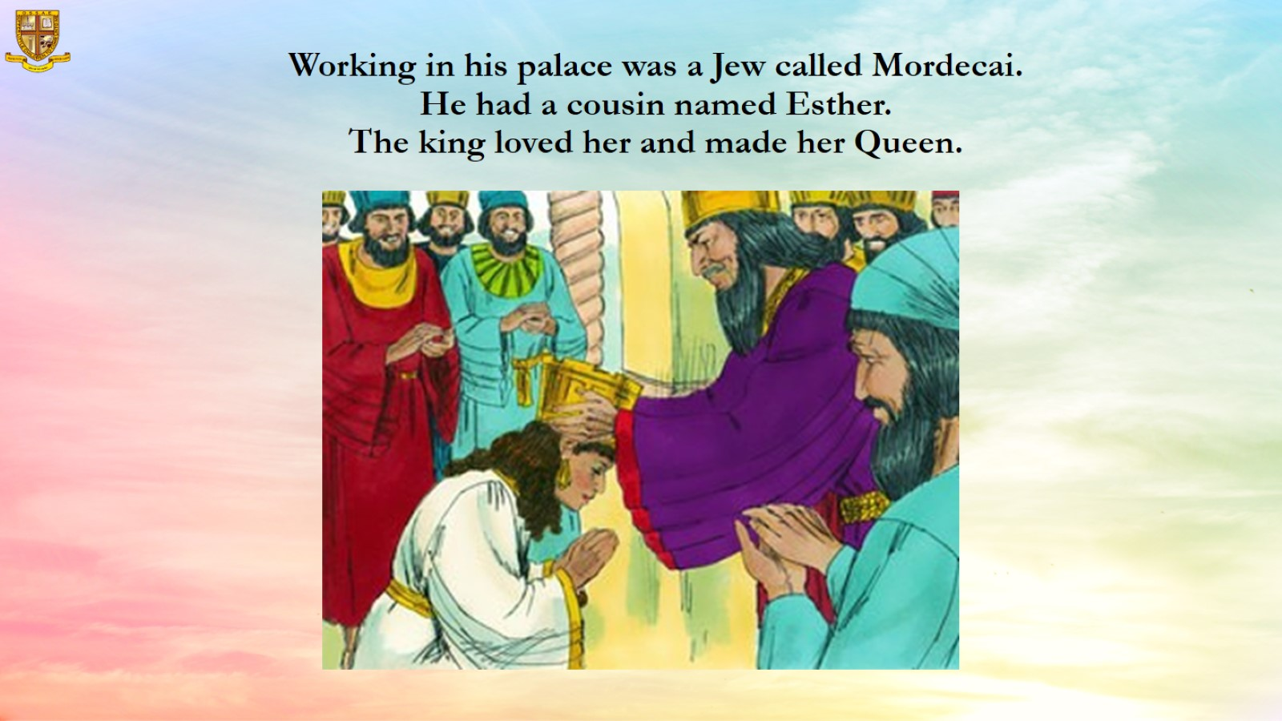
Working in his palace was a Jew called Mordecai.
He had a cousin named Esther.
The king loved her and made her Queen.

Slide 10
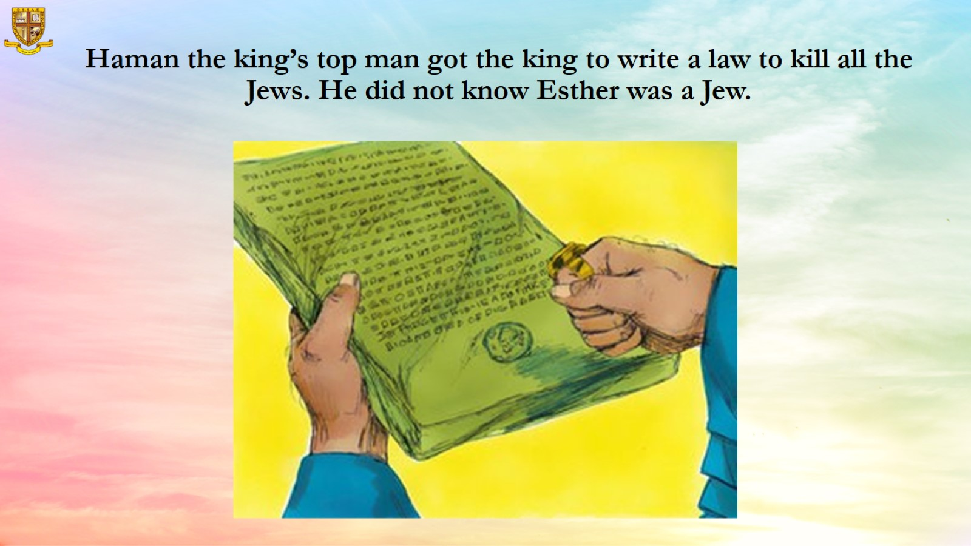
Haman the king’s top man got the king to write a law to kill all the Jews. He did not know Esther was a Jew.

Slide 11
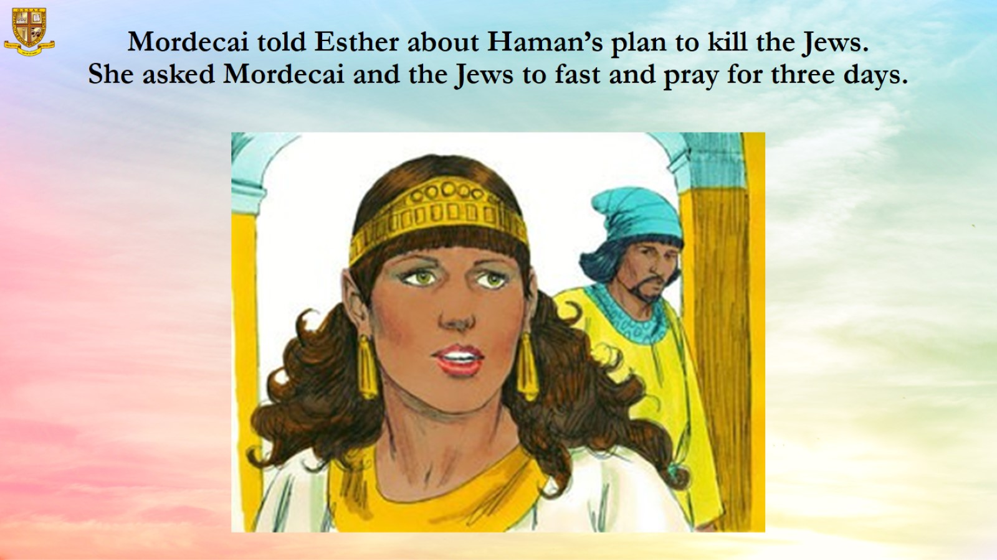
Mordecai told Esther about Haman’s plan to kill the Jews.
She asked Mordecai and the Jews to fast and pray for three days.

Slide 12
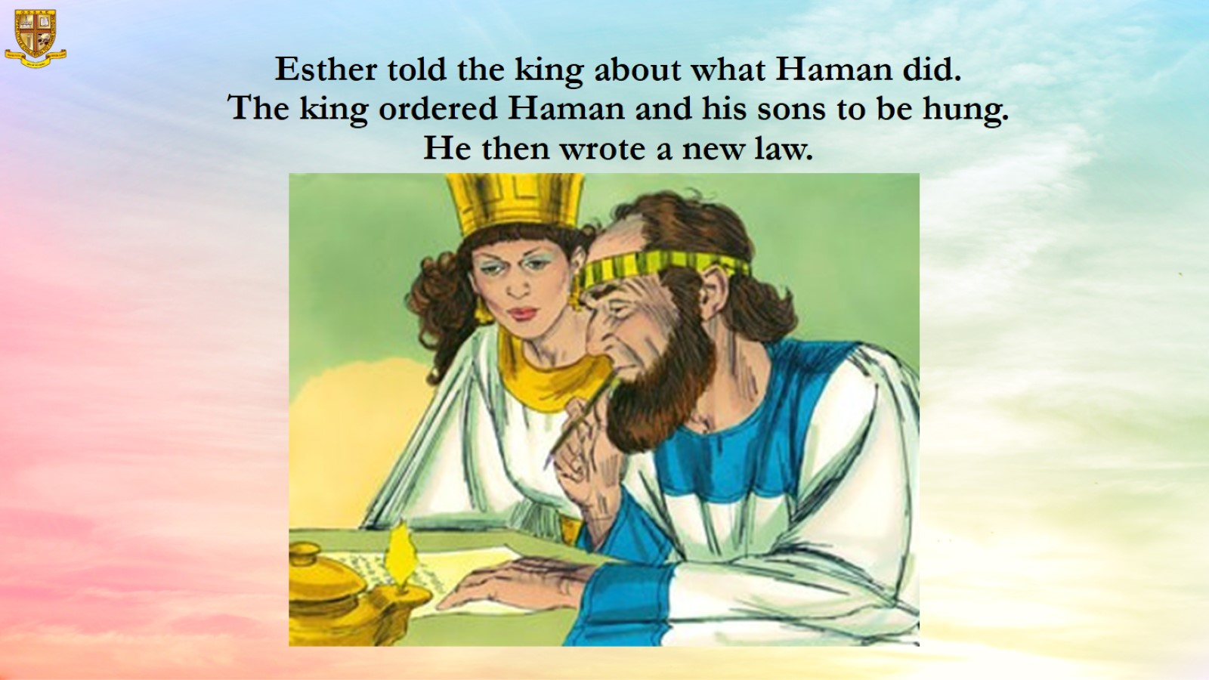
Esther told the king about what Haman did.
The king ordered Haman and his sons to be hung.
He then wrote a new law.

Slide 13
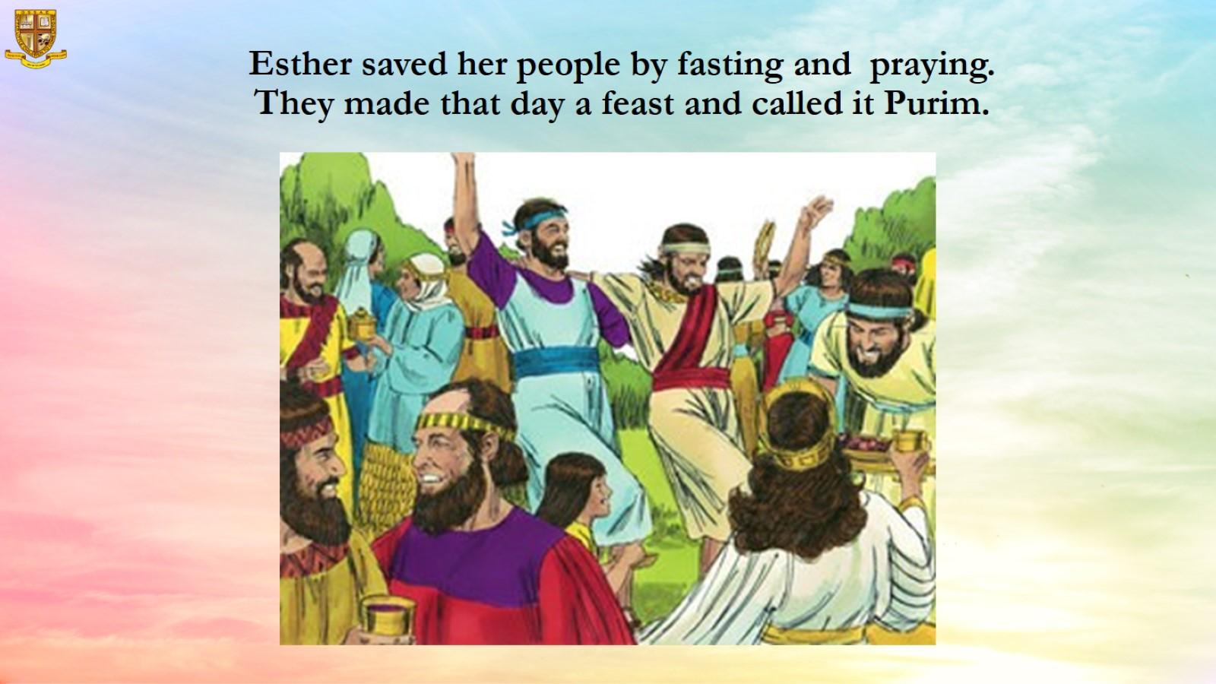
Esther saved her people by fasting and praying.
They made that day a feast and called it Purim.

Slide 14
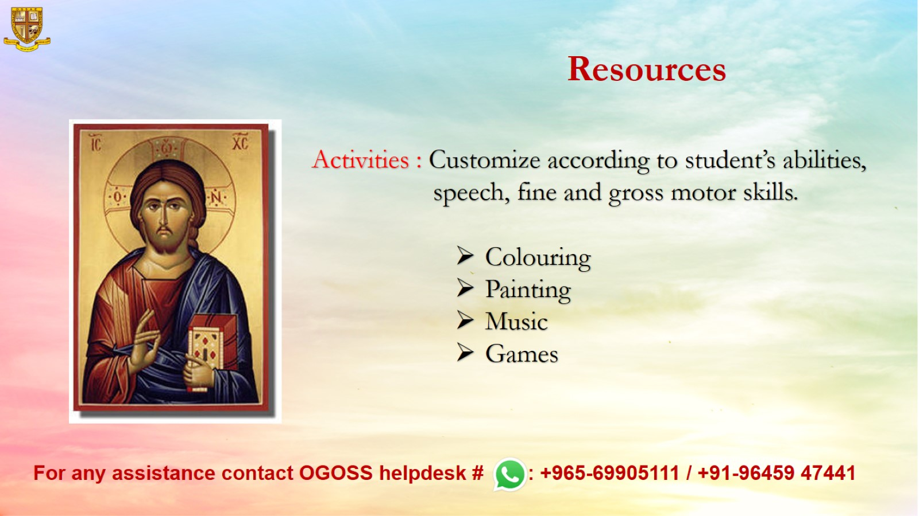
Resources

