Slide 1
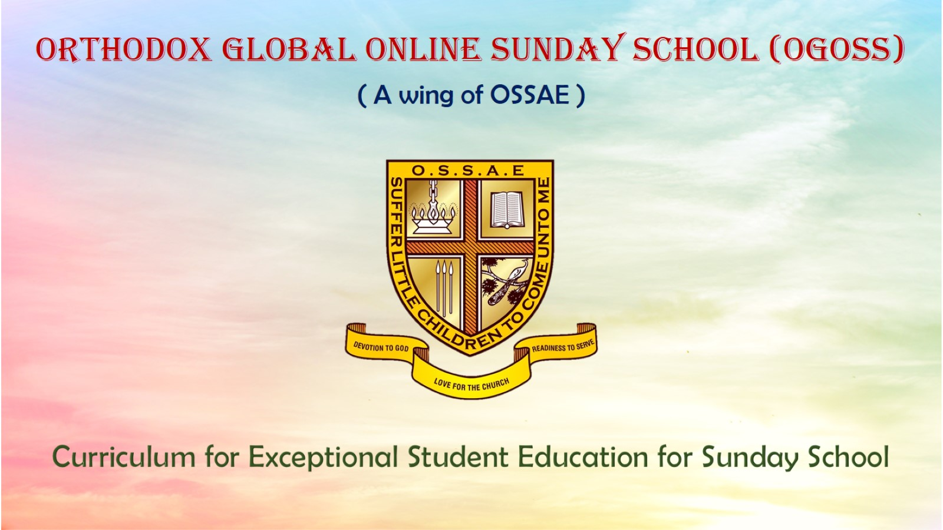
Orthodox Global Online Sunday School (OGOSS)

Slide 2
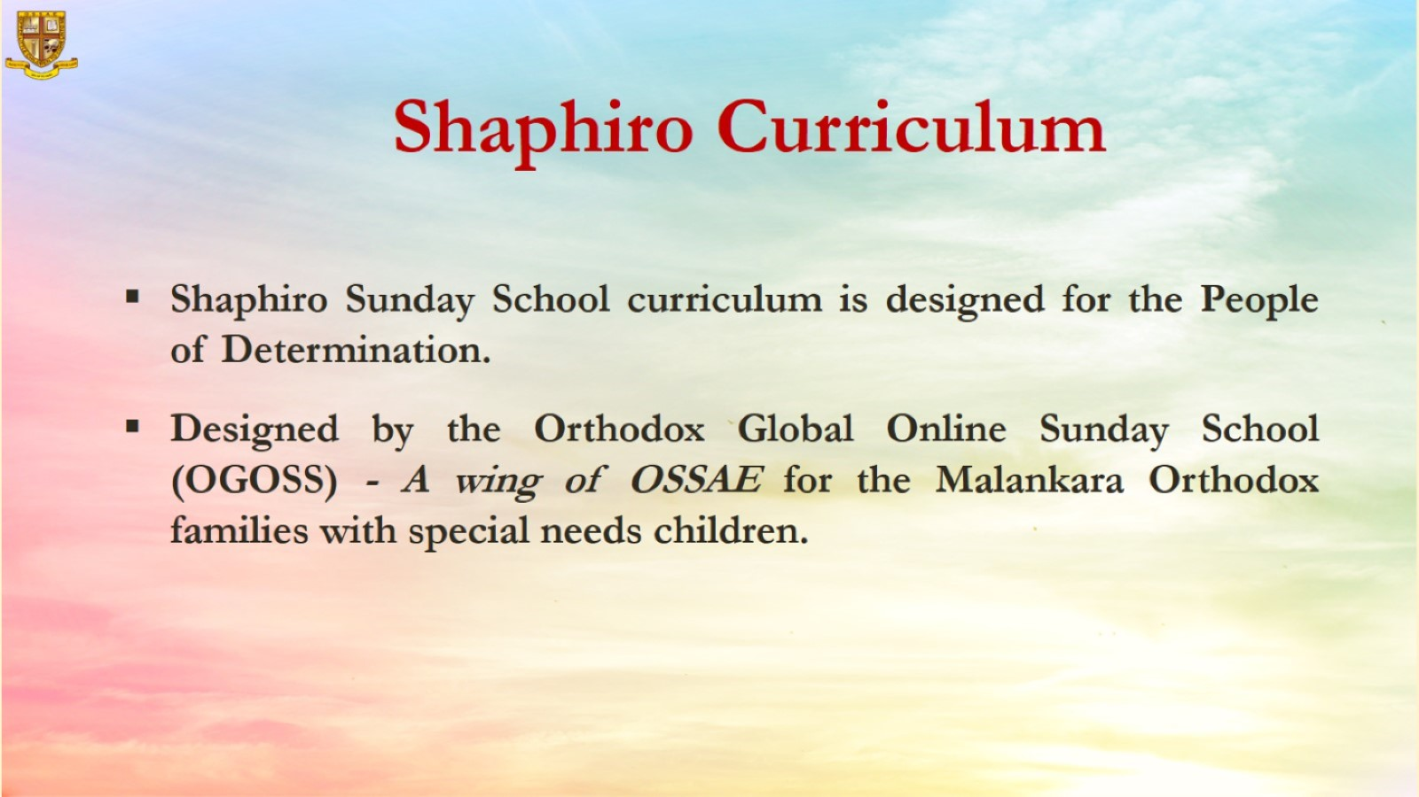

Slide 3
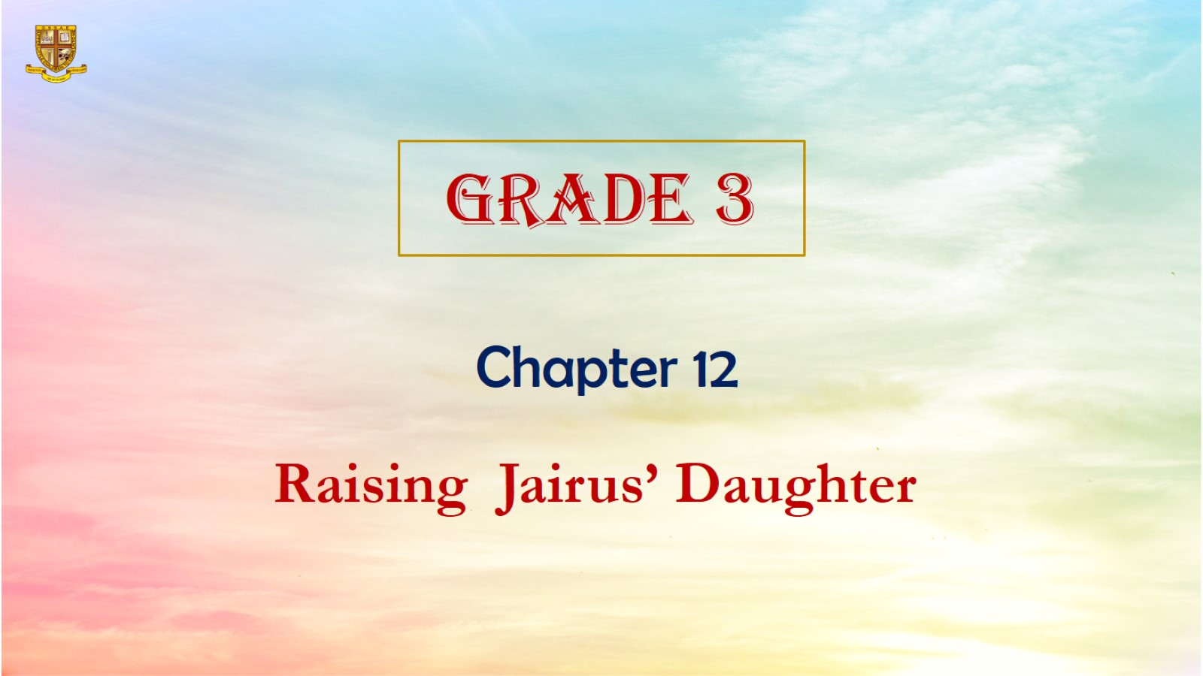

Slide 4
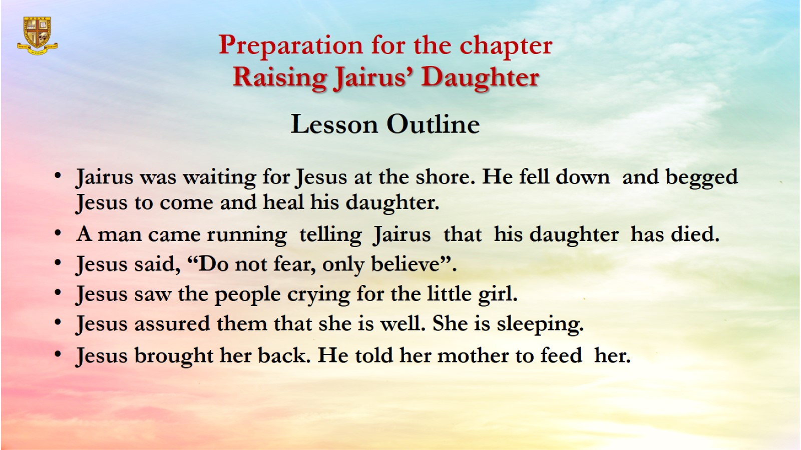
Preparation for the chapter
Raising Jairus’ Daughter
Lesson Outline

Slide 5
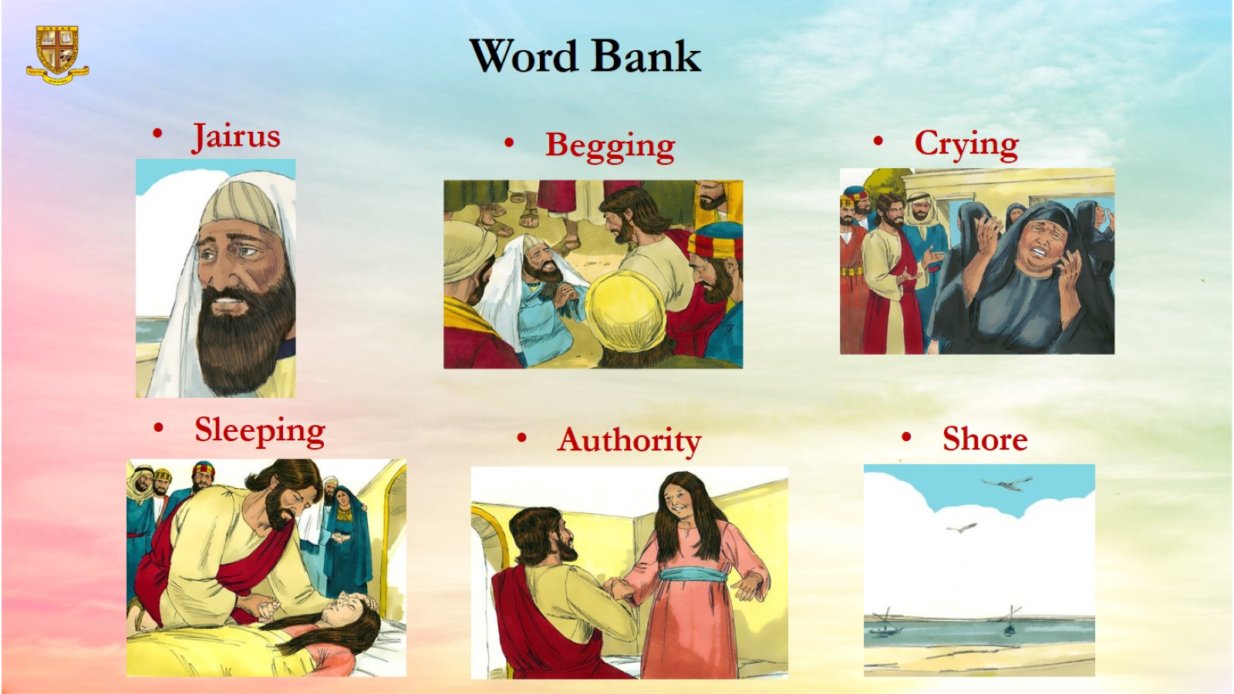
Word Bank

Slide 6
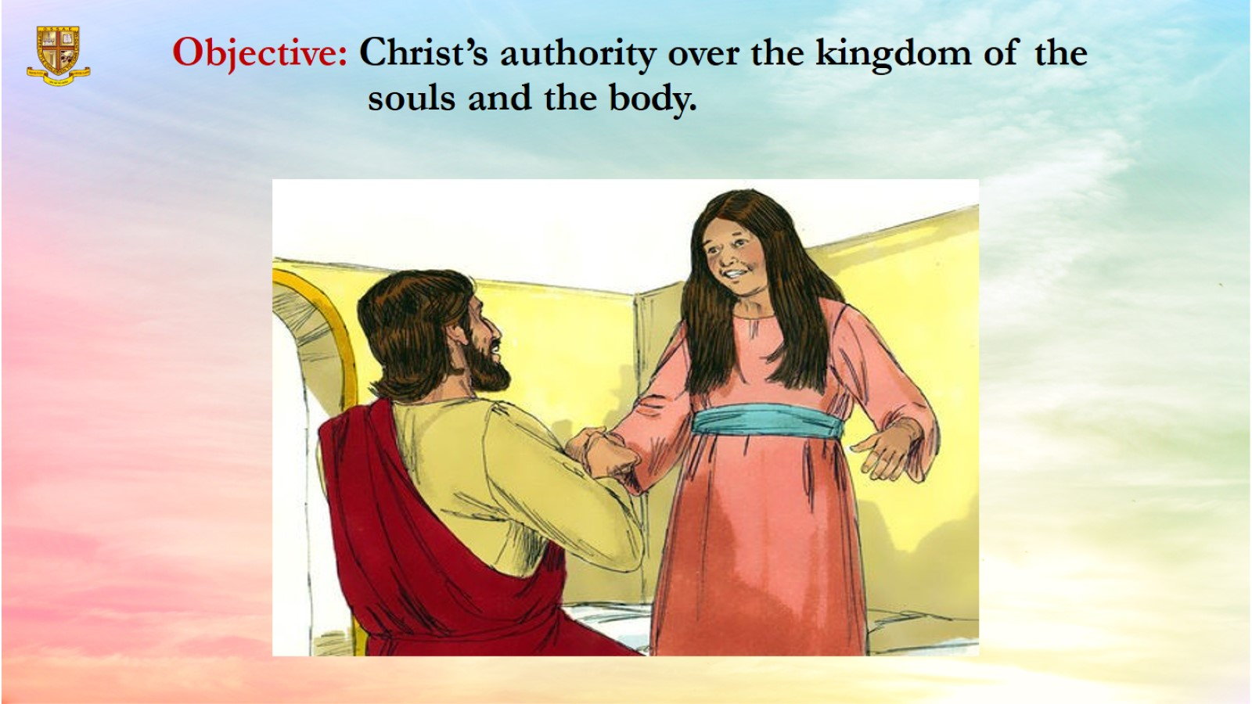
Objective: Christ’s authority over the kingdom of the souls and the body.

Slide 7
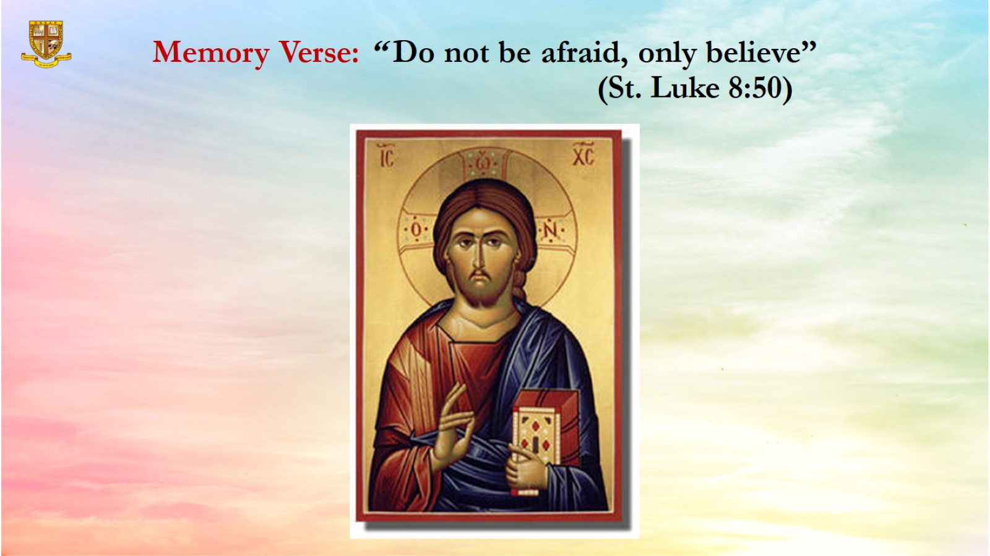
Memory Verse: “ Do not be afraid, only believe”
(St. Luke 8:50)

Slide 8
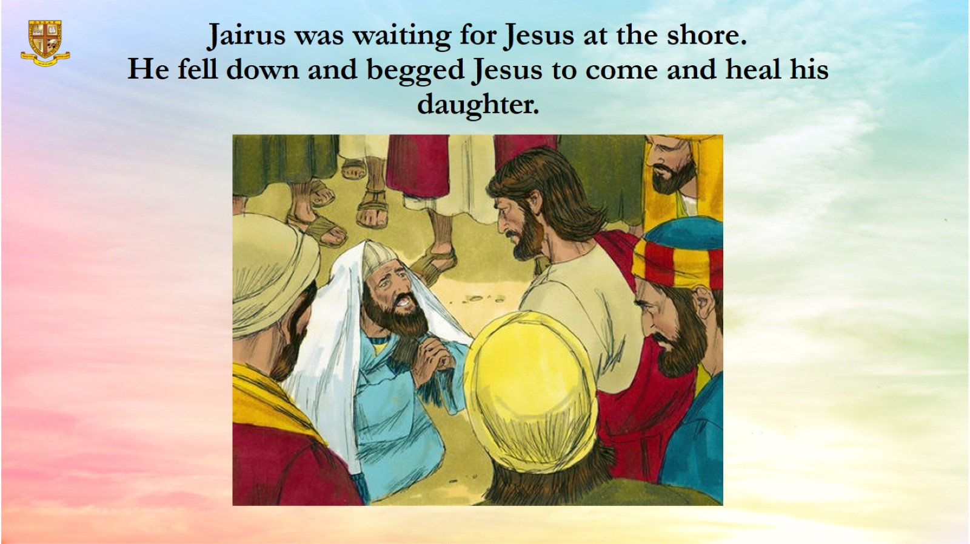
Jairus was waiting for Jesus at the shore.
He fell down and begged Jesus to come and heal his daughter.

Slide 9
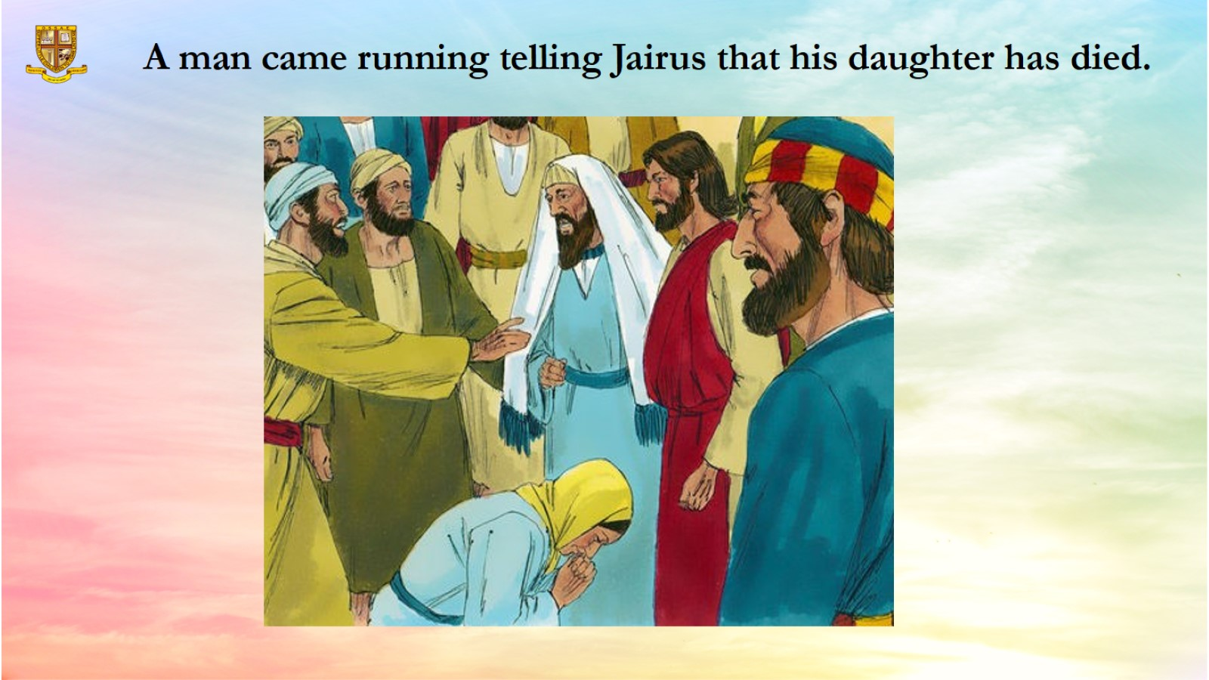
A man came running telling Jairus that his daughter has died.

Slide 10
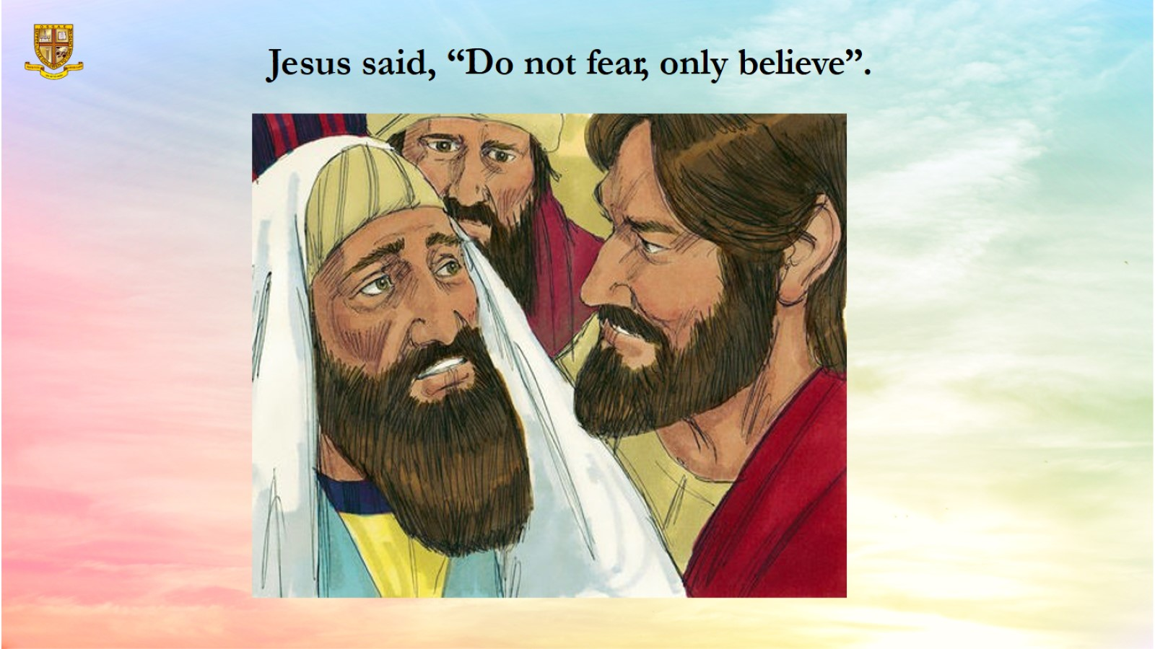
Jesus said, “Do not fear, only believe”.

Slide 11
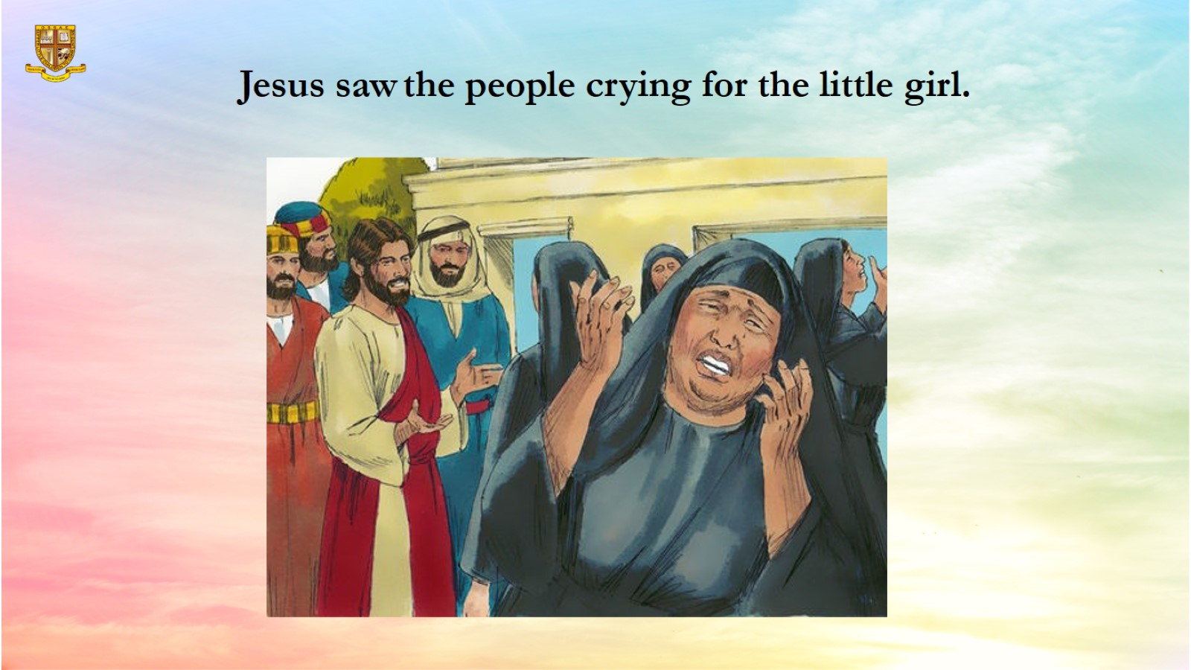
Jesus saw the people crying for the little girl.

Slide 12
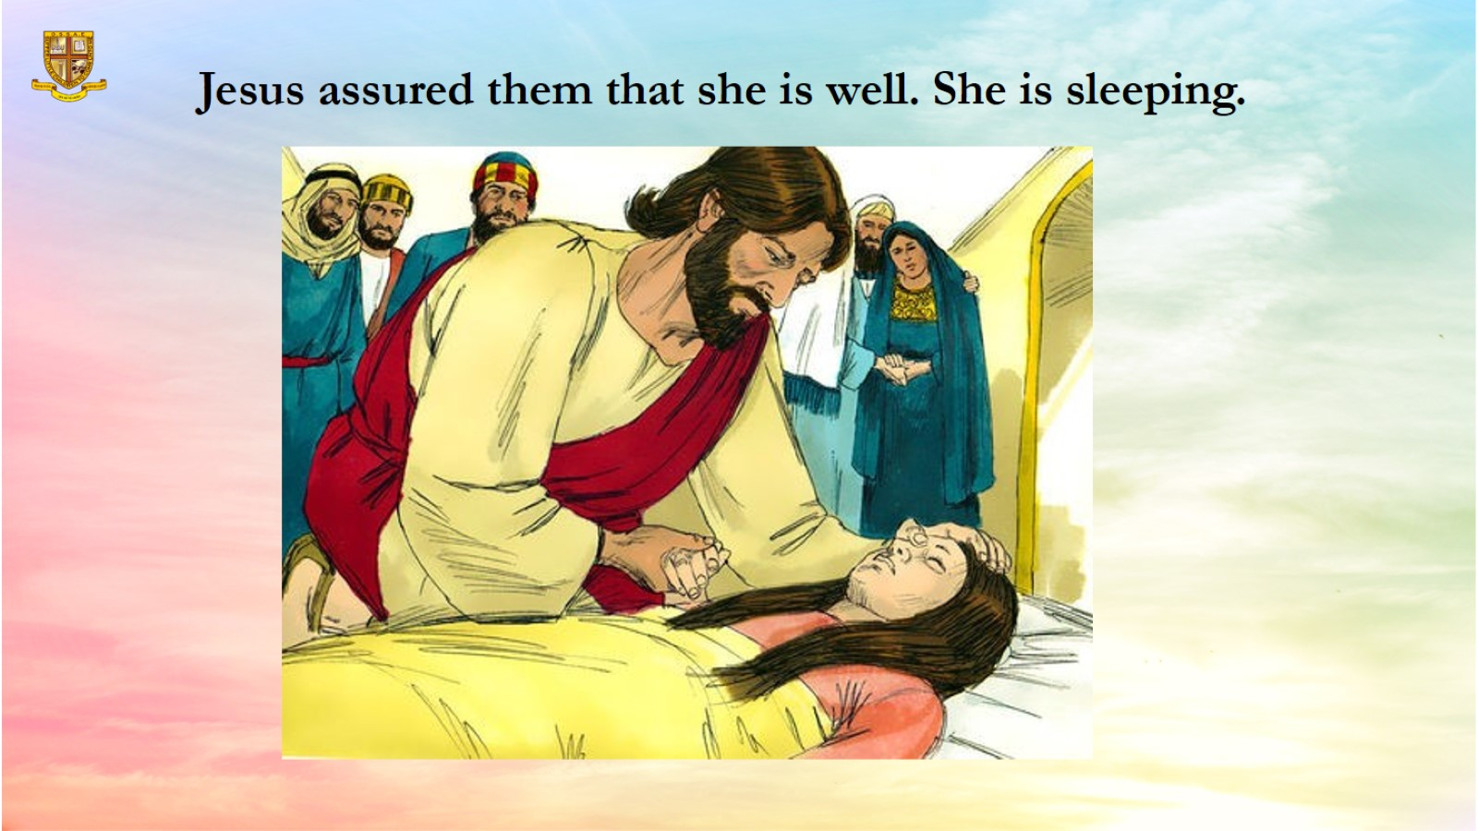
Jesus assured them that she is well. She is sleeping.

Slide 13
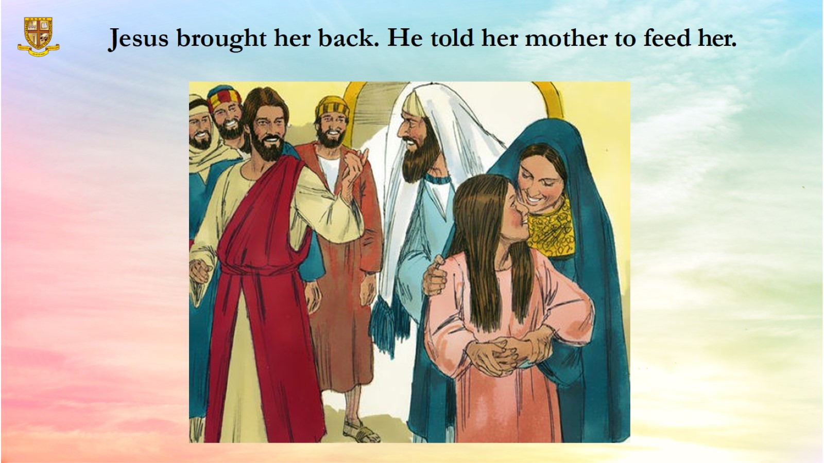

Slide 14
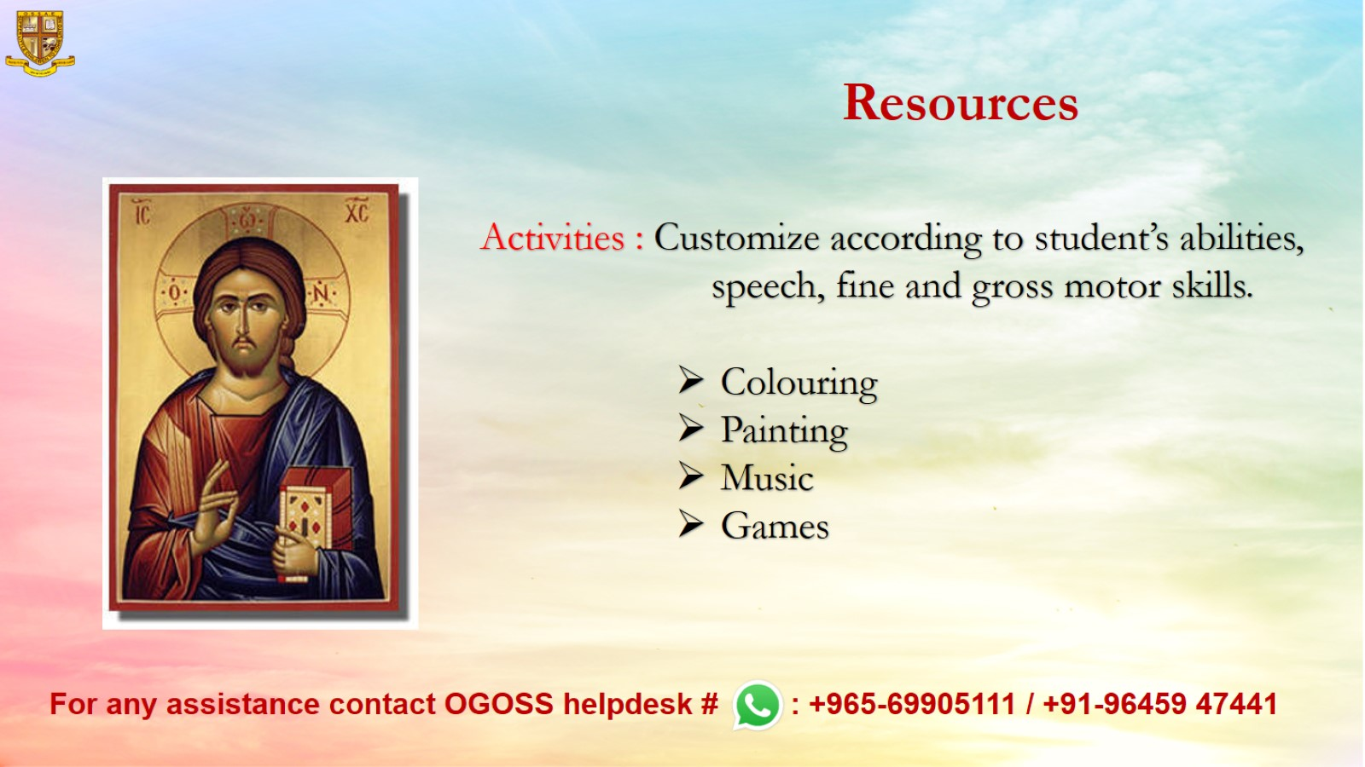
Resources

