Slide 1
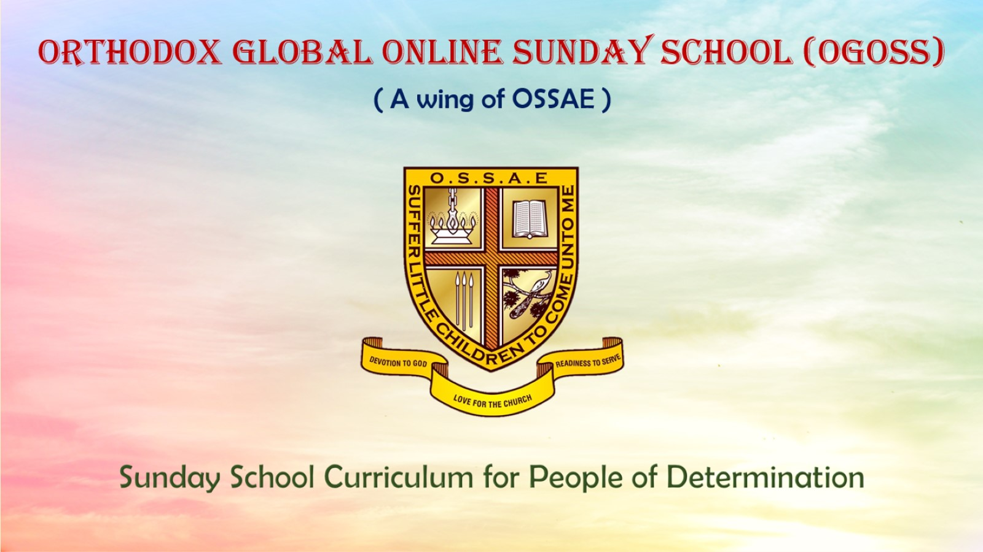

Slide 2
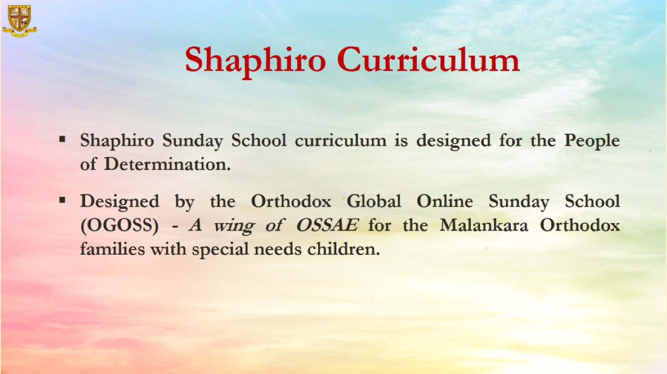

Slide 3


Grade 1
Chapter 2
Samson and the lion

Slide 4
Preparation for Samson and the Lion
Lesson Outline
Preparation for the chapter
Samson and the lion
Lesson Outline
An angel told a woman she would have a son named Samson. God made him special.
He got his strength from his hair. He never cut his hair.
One day Samson was walking to another town.
A lion attacked him. He killed it with his bare hands.
On the way home, he passed the dead lion. He found honey in its belly.
He ate the honey. He also took some home to his parents.

Slide 5
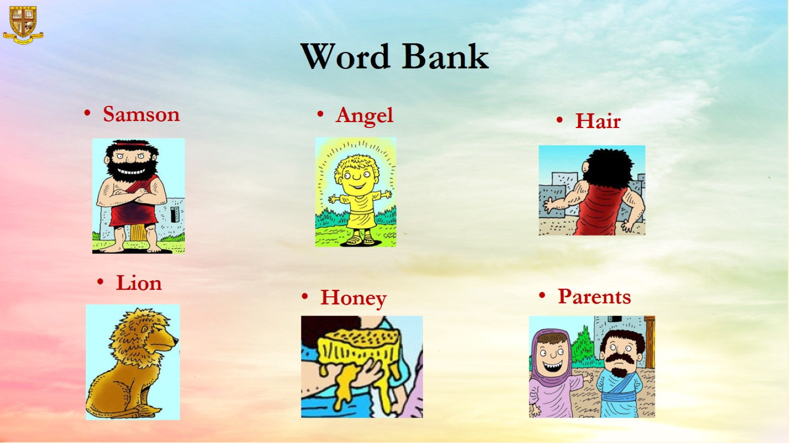
Word Bank

Slide 6
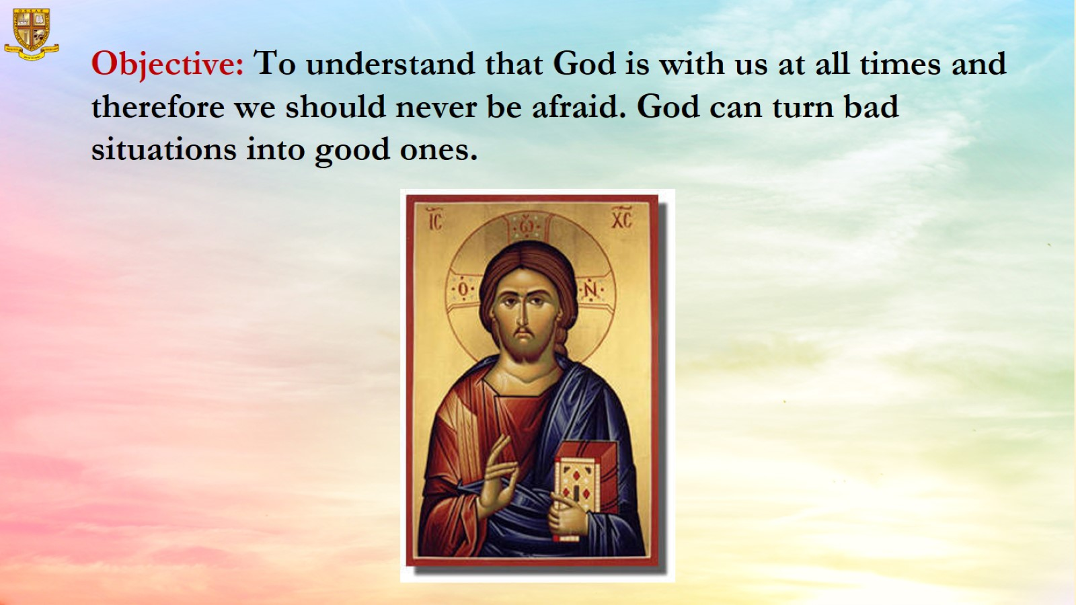

Slide 7
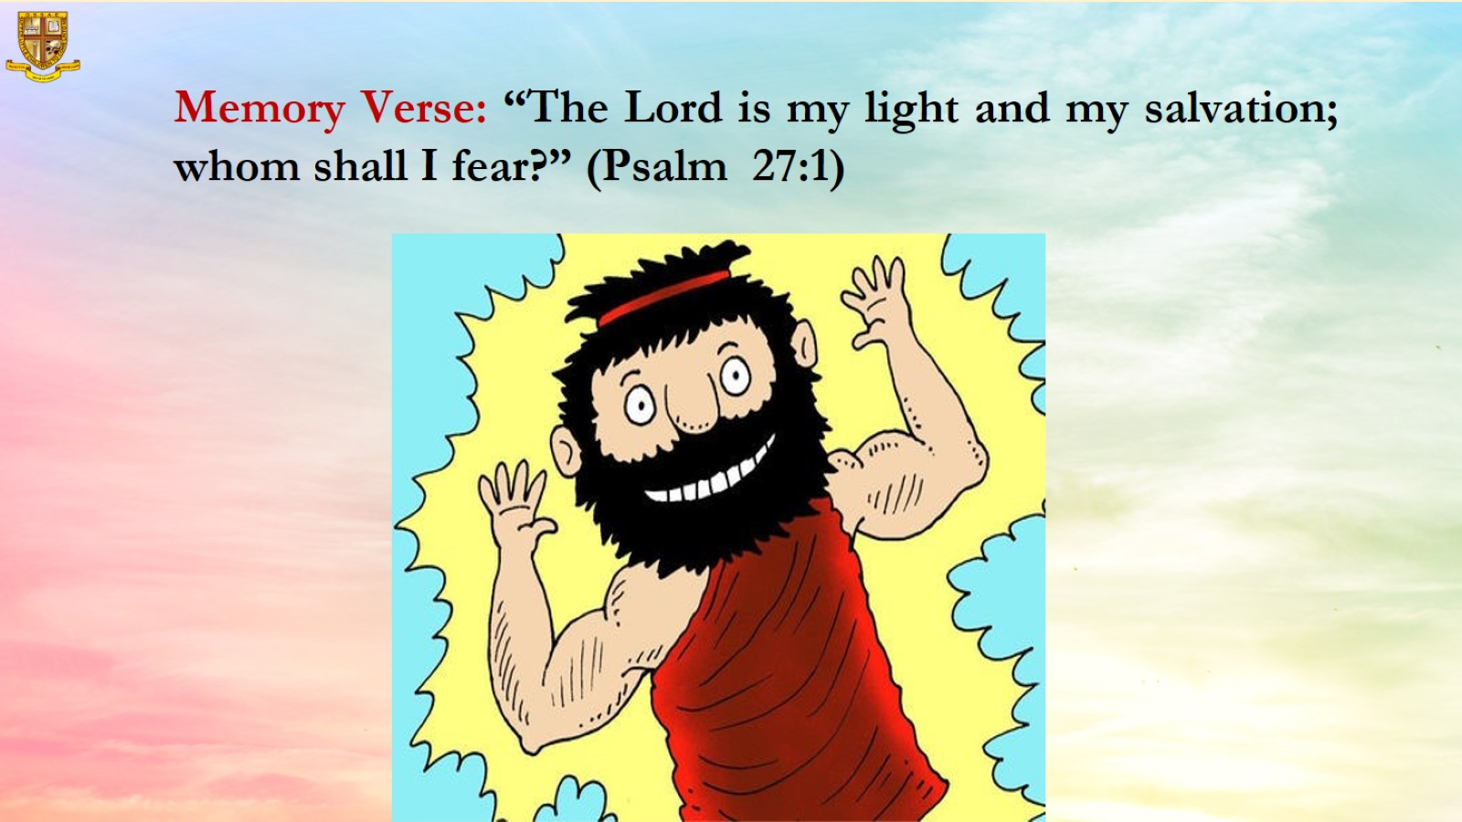

Slide 8
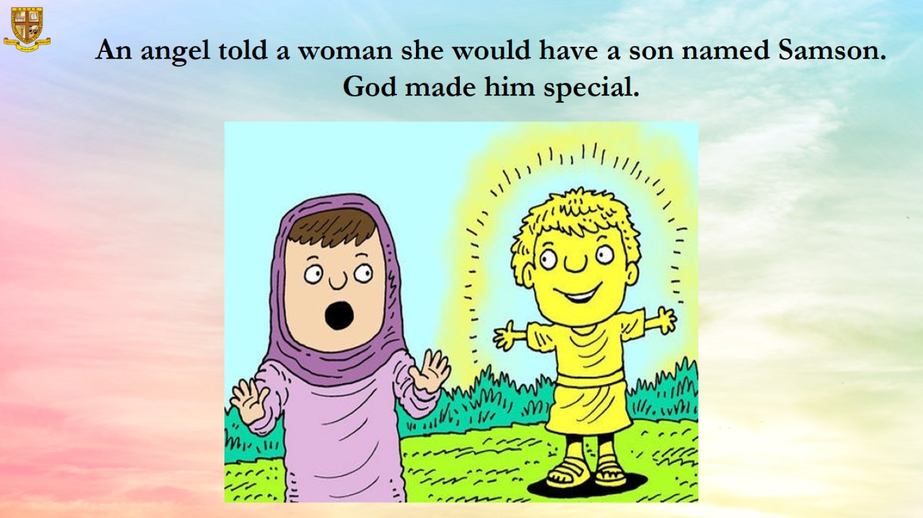

Slide 9
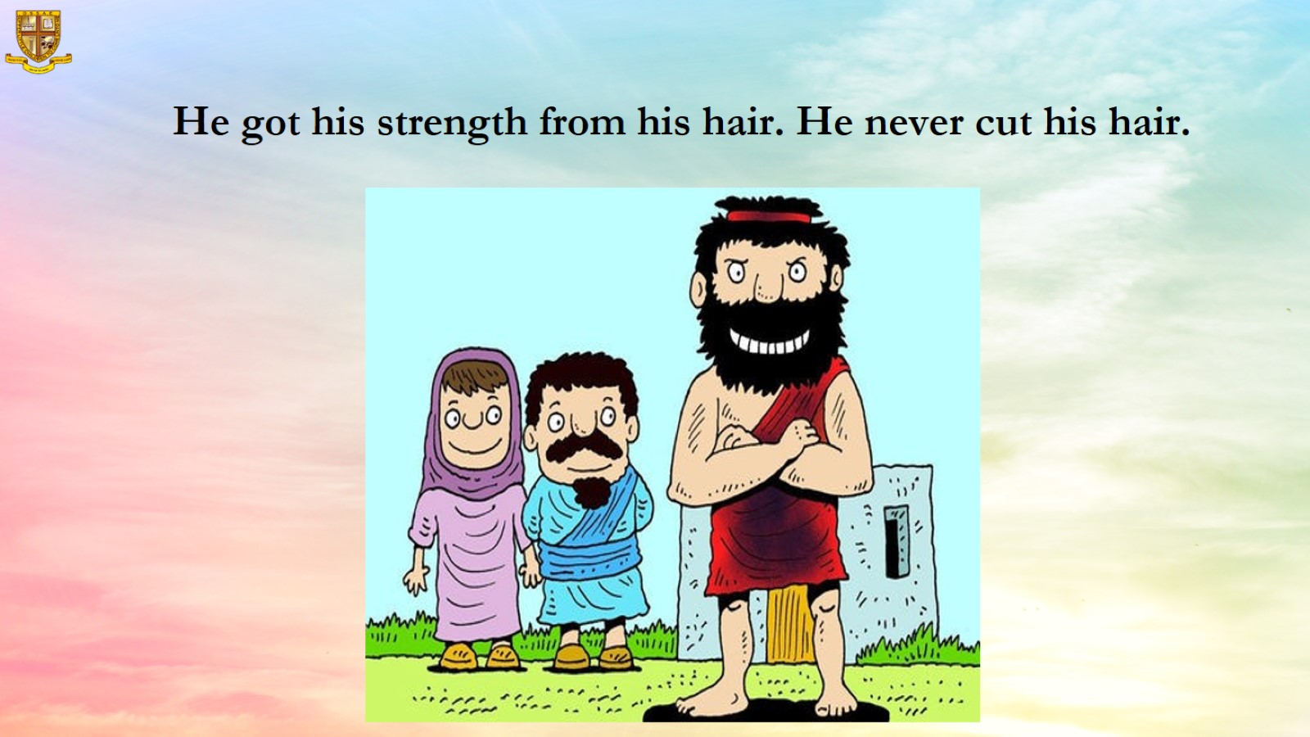
He got his strength from his hair. He never cut his hair.

Slide 10
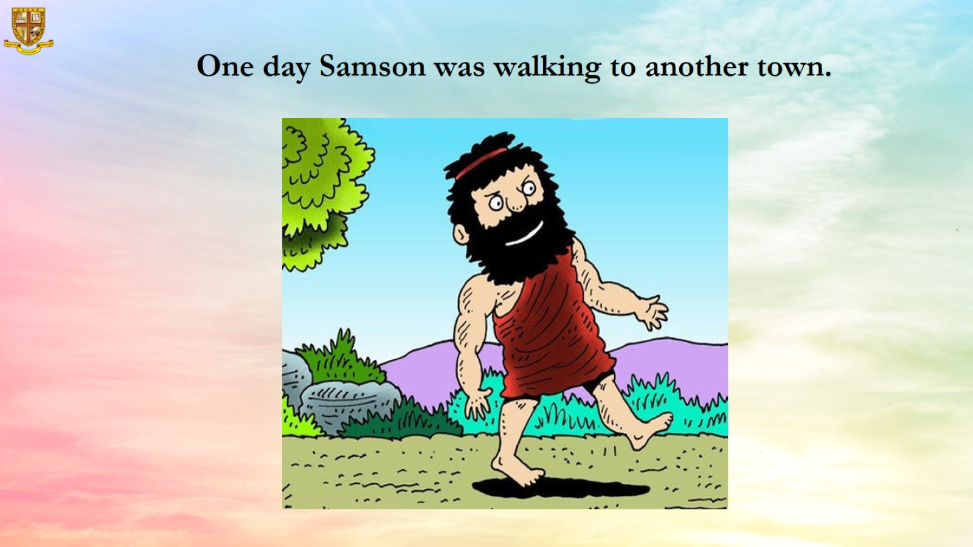
One day Samson was walking to another town.

Slide 11
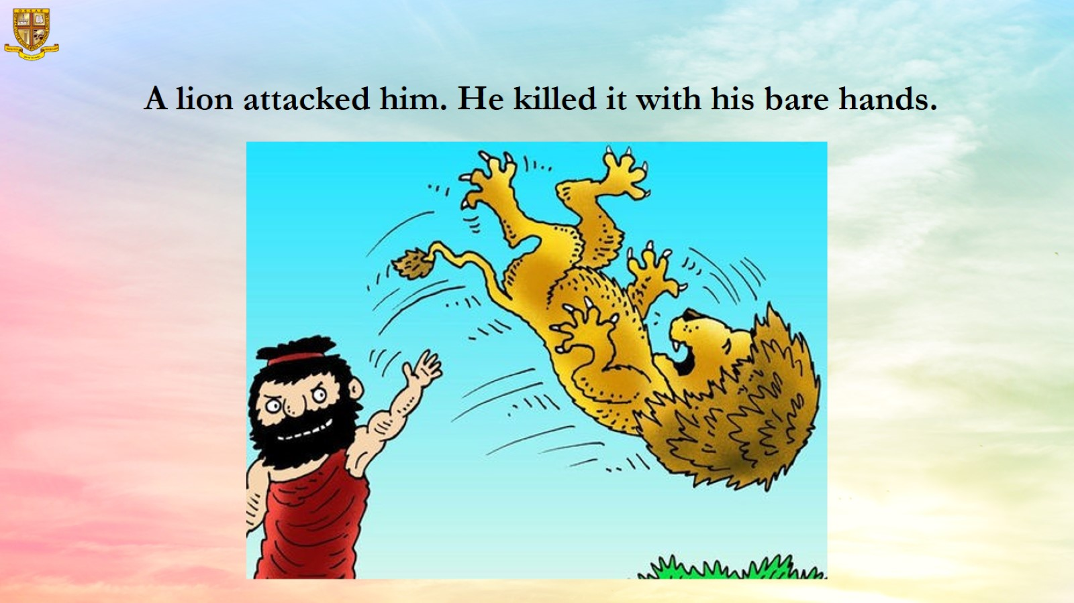
A lion attacked him. He killed it with his bare hands.

Slide 12
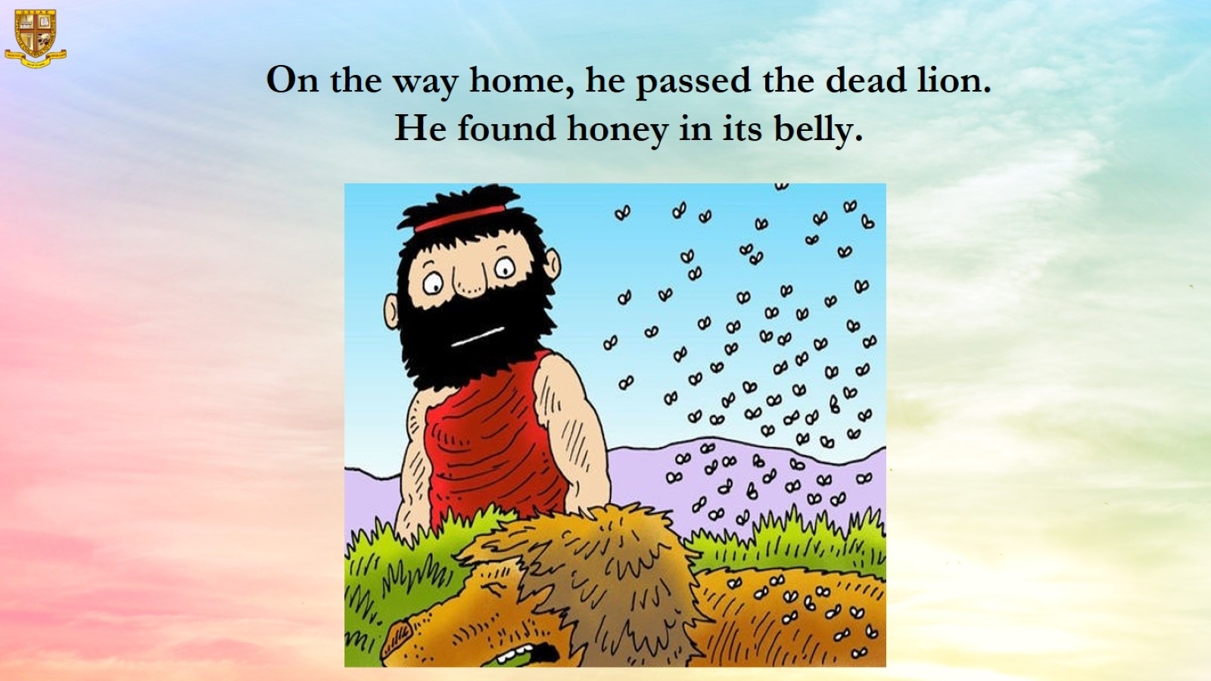
On the way home, he passed the dead lion.
He found honey in its belly.

Slide 13
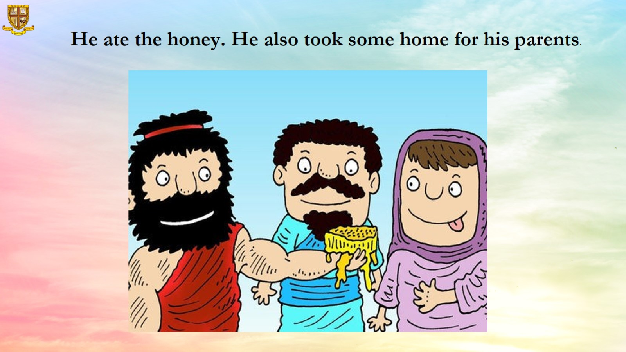

Slide 14

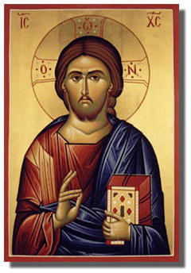

Resources
Activities : Customize according to student’s abilities, speech, fine and gross motor skills.
          Colouring
          Painting
          Music
          Games
For any assistance contact OGOSS helpdesk # : +965-69905111 / +91-96459 47441

