Slide 1

Orthodox Global Online Sunday School (OGOSS)

Slide 2
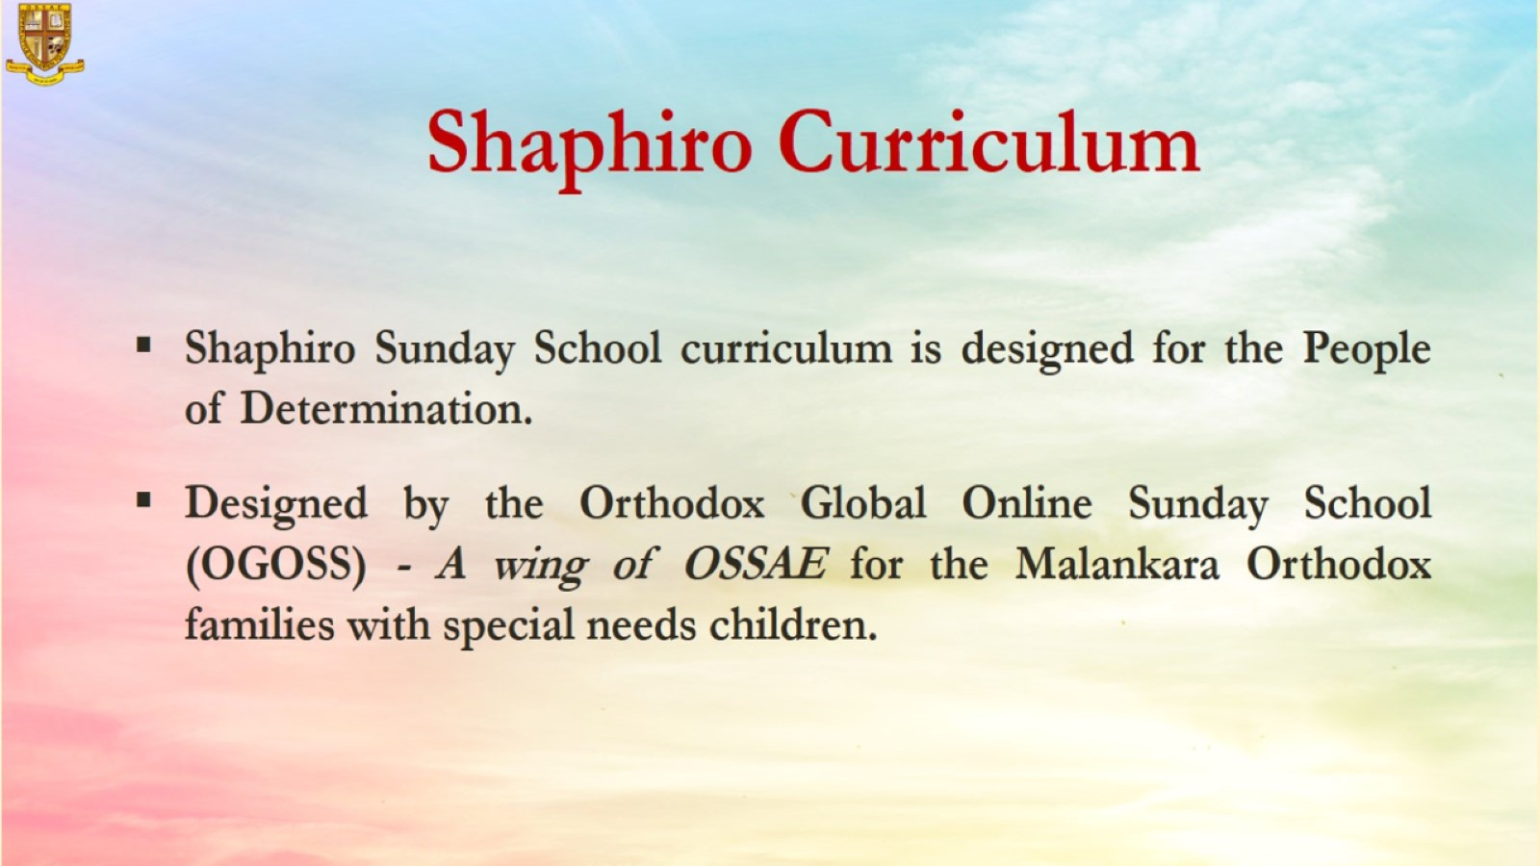

Slide 3
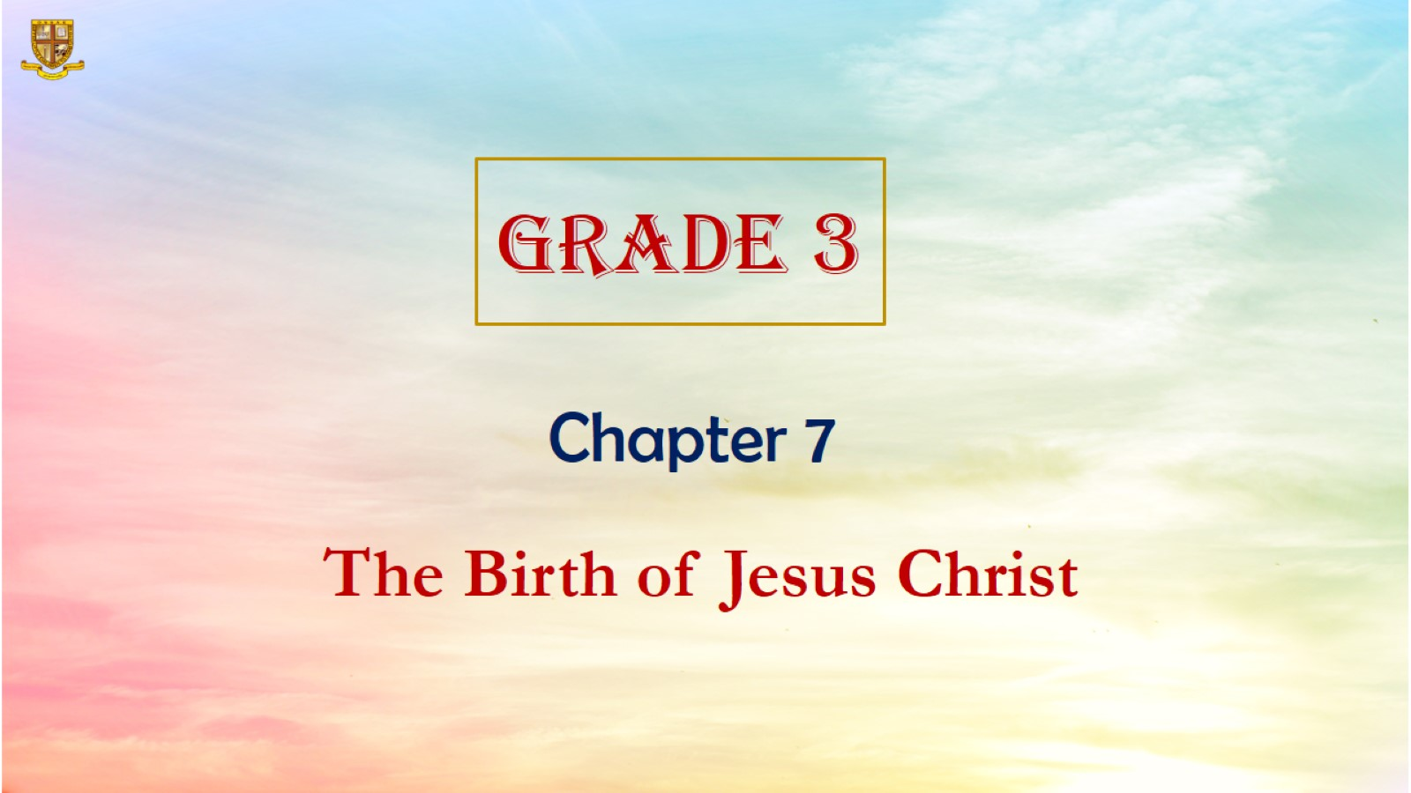

Slide 4
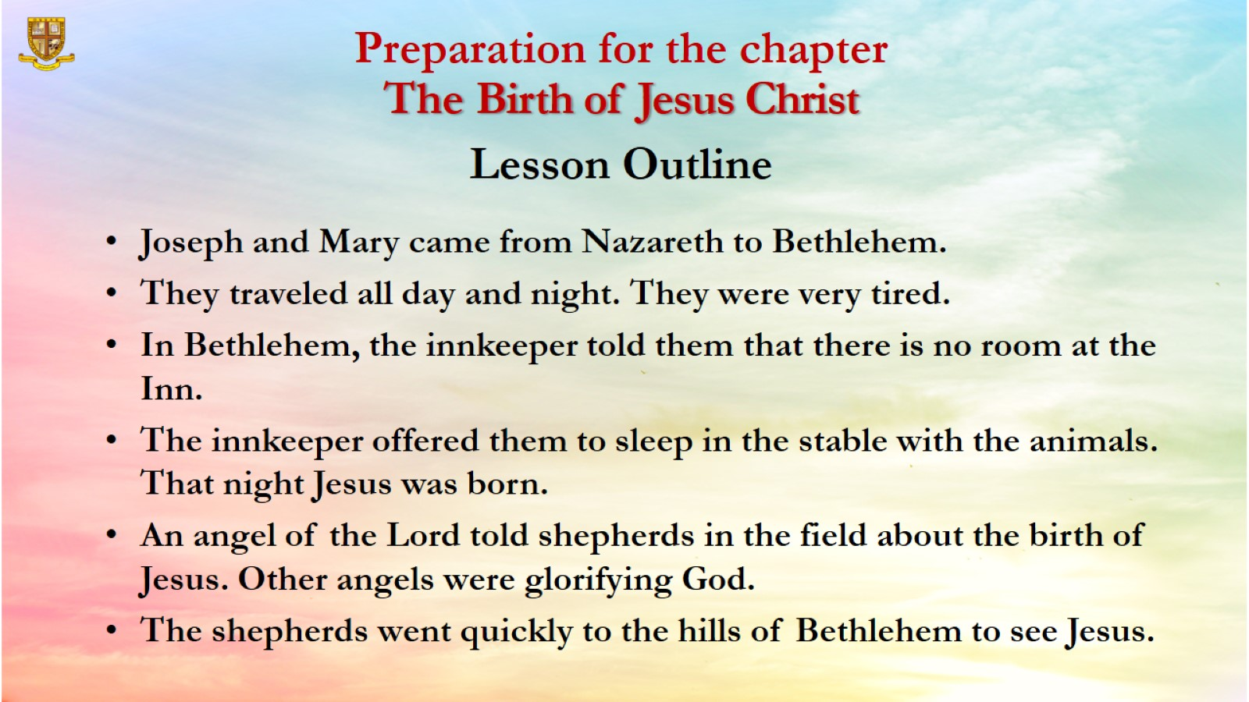
Preparation for the chapter
The Birth of Jesus Christ
Lesson Outline

Slide 5
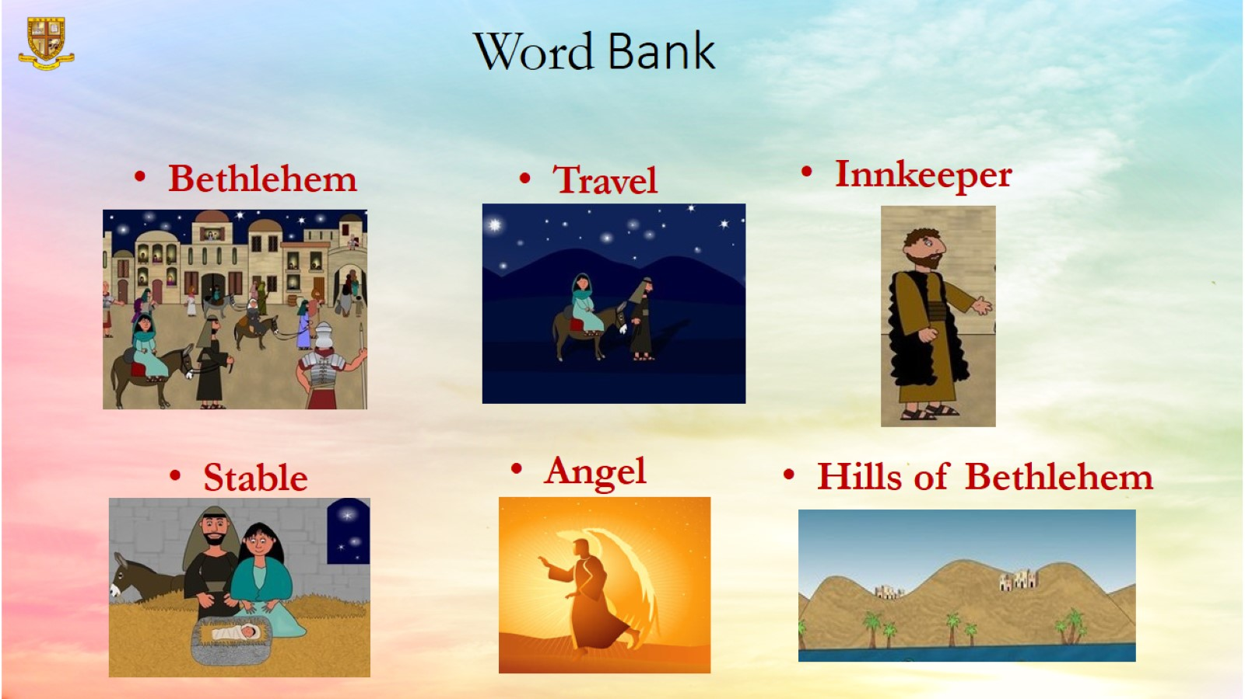
Word Bank

Slide 6
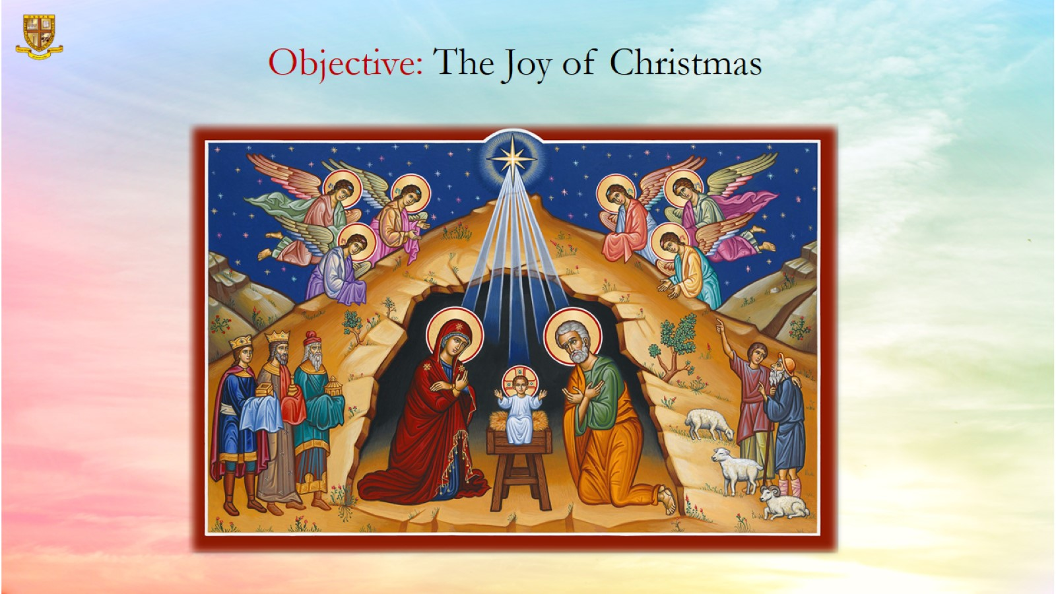
Objective: The Joy of Christmas

Slide 7
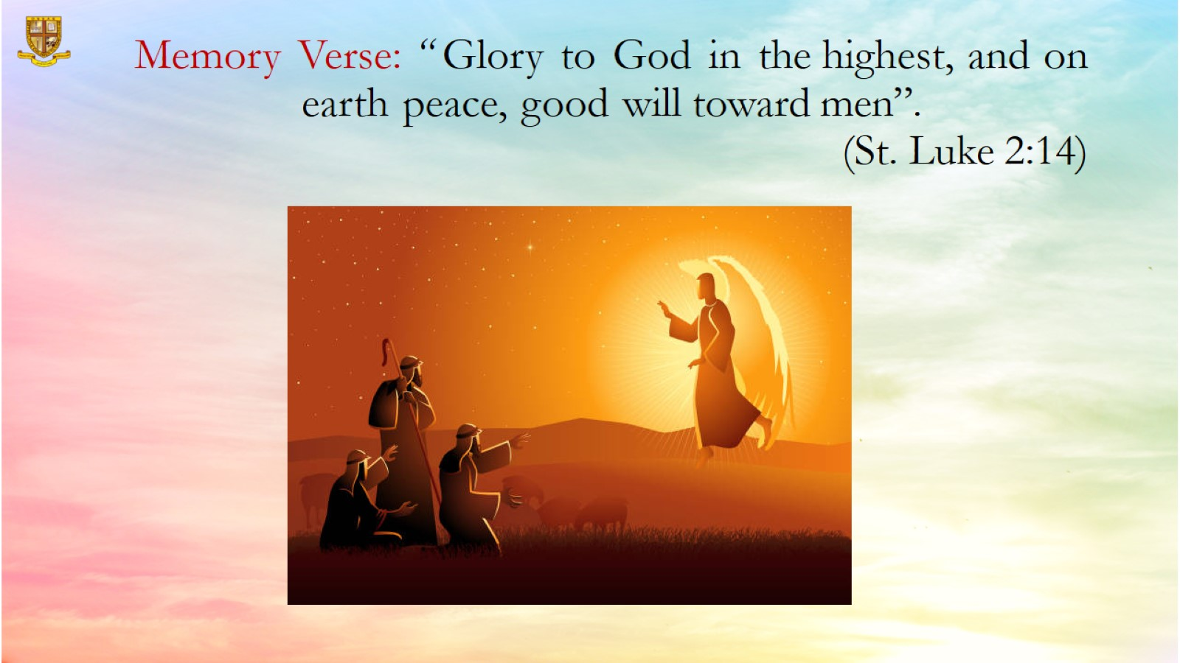
Memory Verse: “ Glory to God in the highest, and on earth peace, good will toward men”.
(St. Luke 2:14)

Slide 8
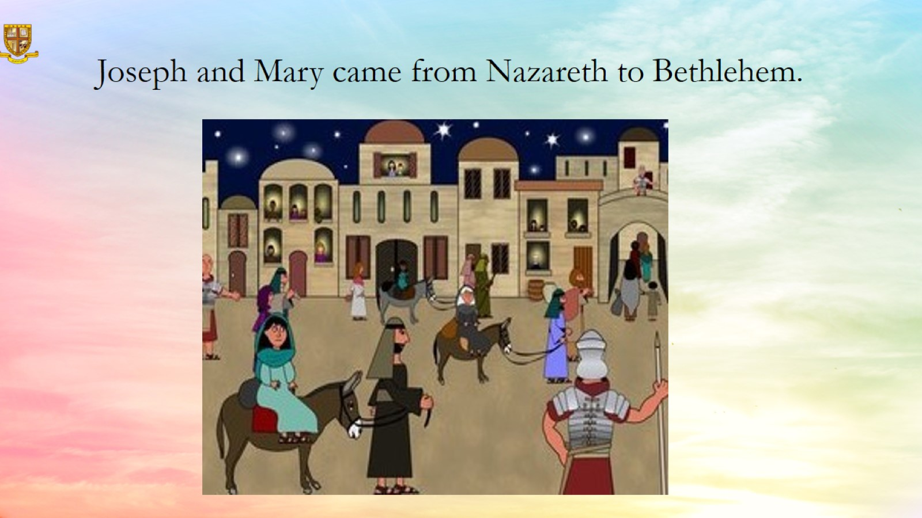
Joseph and Mary came from Nazareth to Bethlehem.

Slide 9
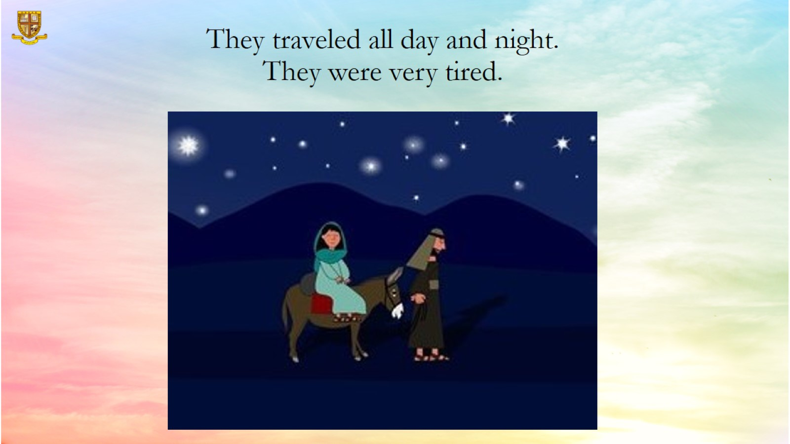
They traveled all day and night. They were very tired.

Slide 10
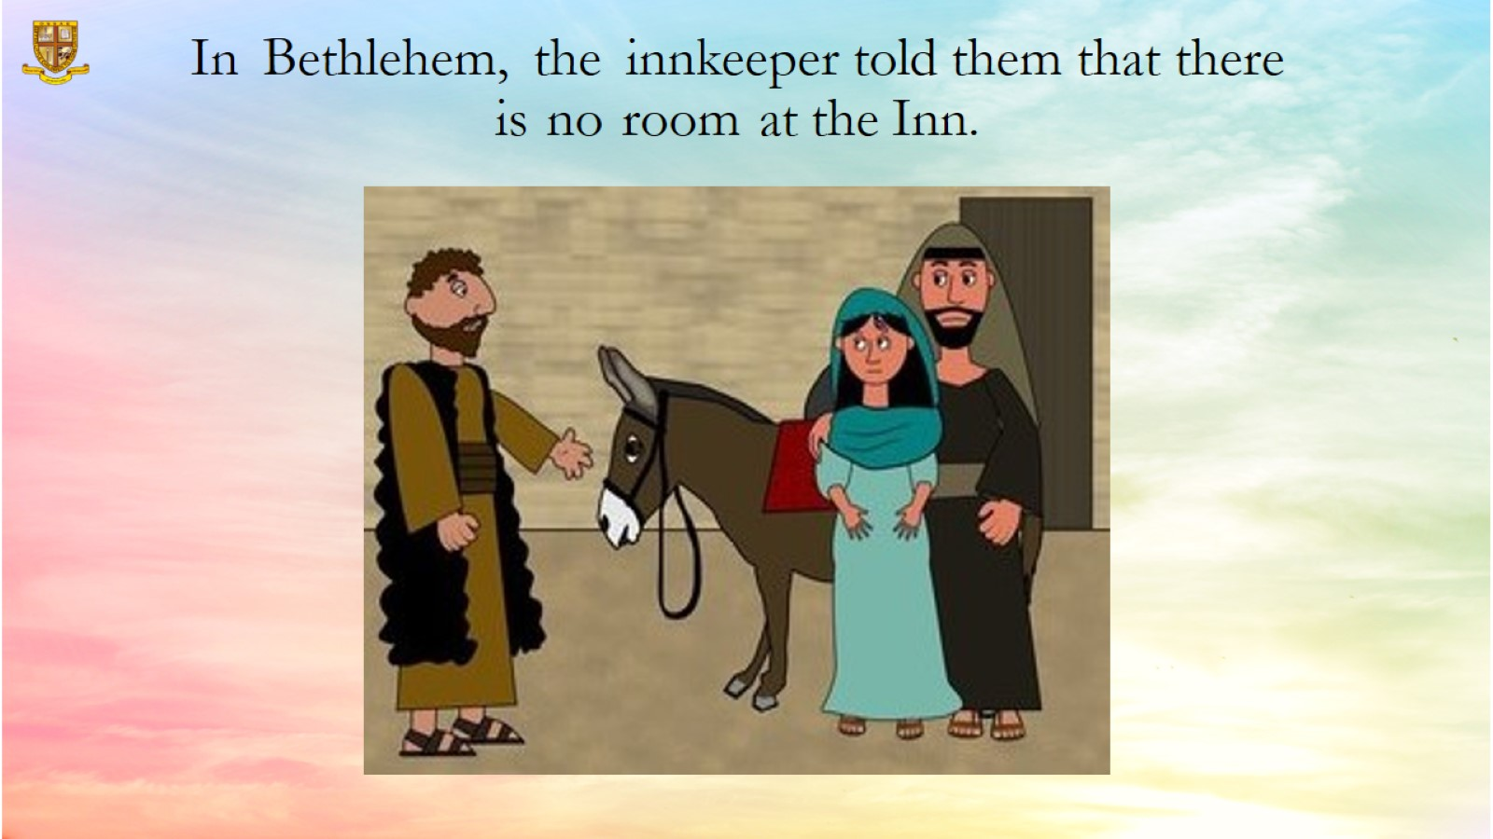
In Bethlehem, the innkeeper told them that there is no room at the Inn.

Slide 11
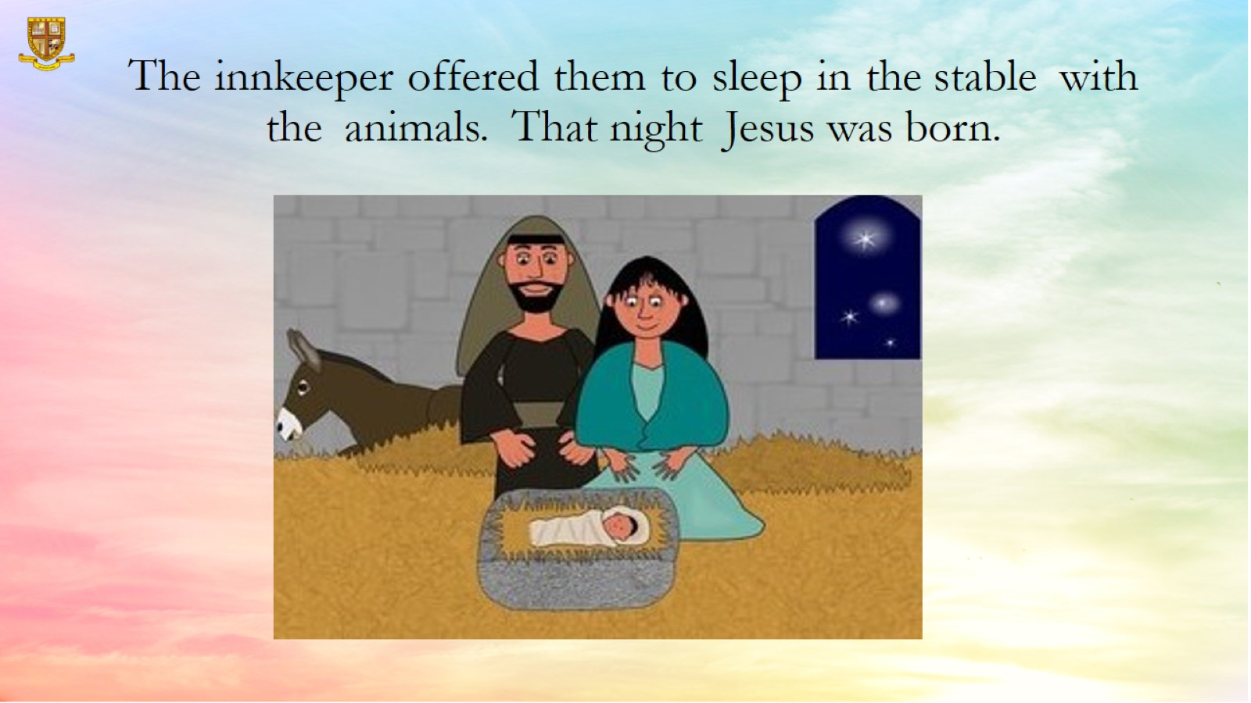
The innkeeper offered them to sleep in the stable with the animals. That night Jesus was born.

Slide 12
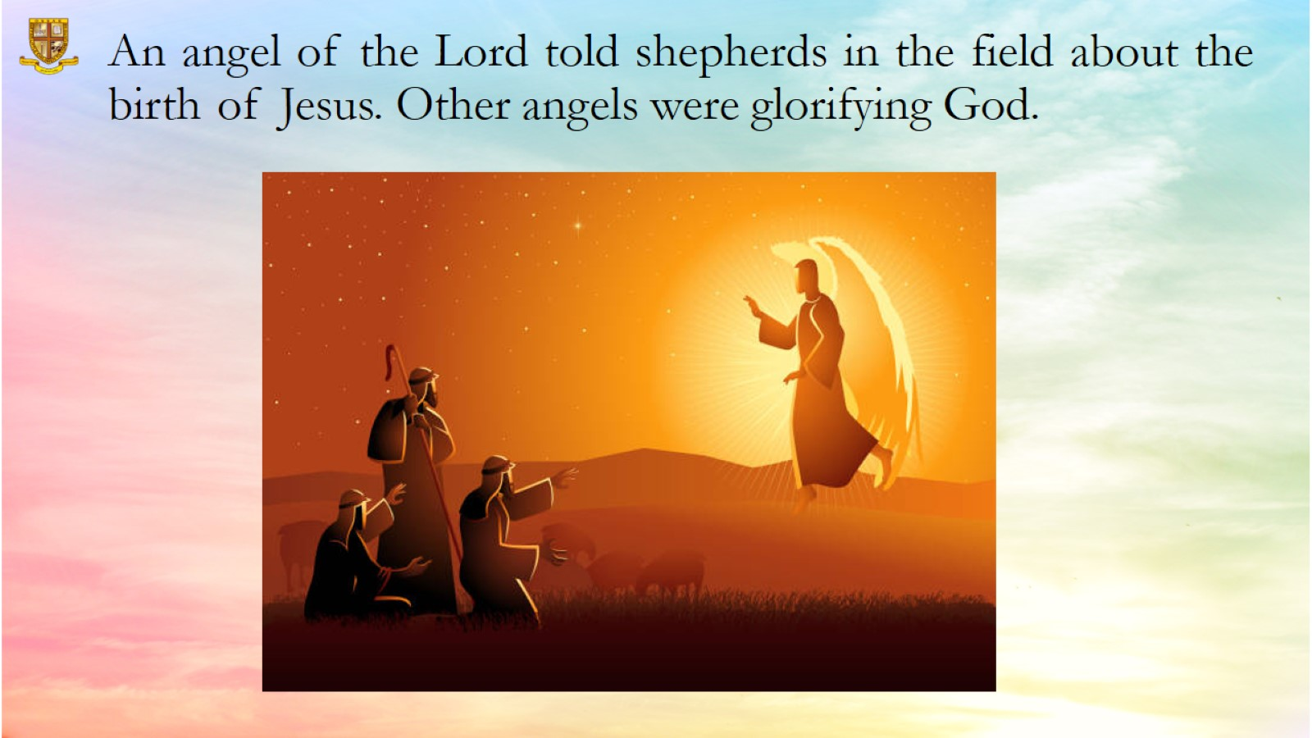
An angel of the Lord told shepherds in the field about the birth of Jesus. Other angels were glorifying God.

Slide 13
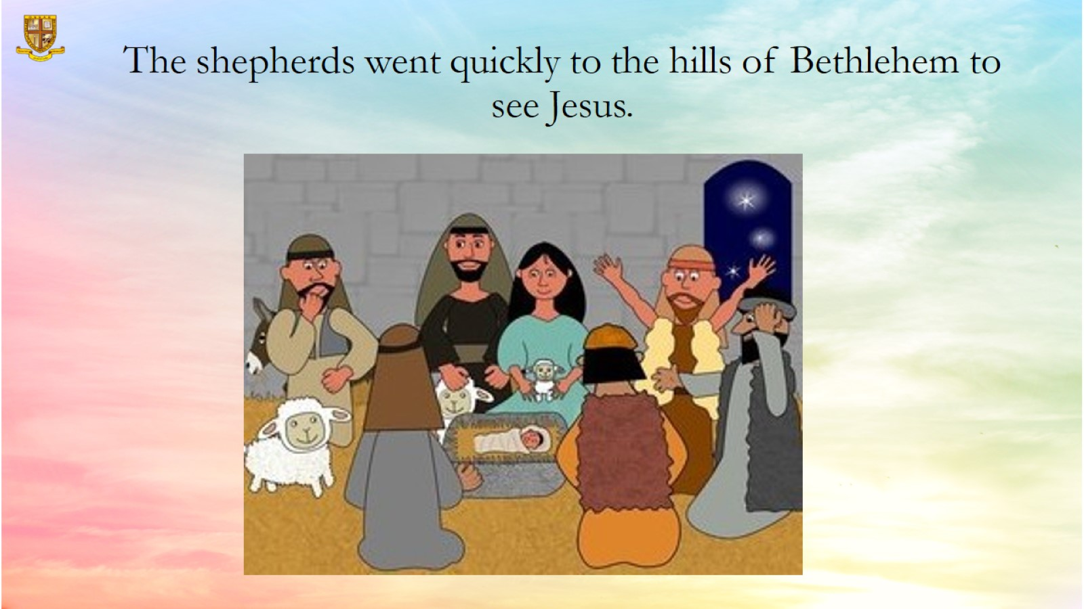
The shepherds went quickly to the hills of Bethlehem to see Jesus.

Slide 14
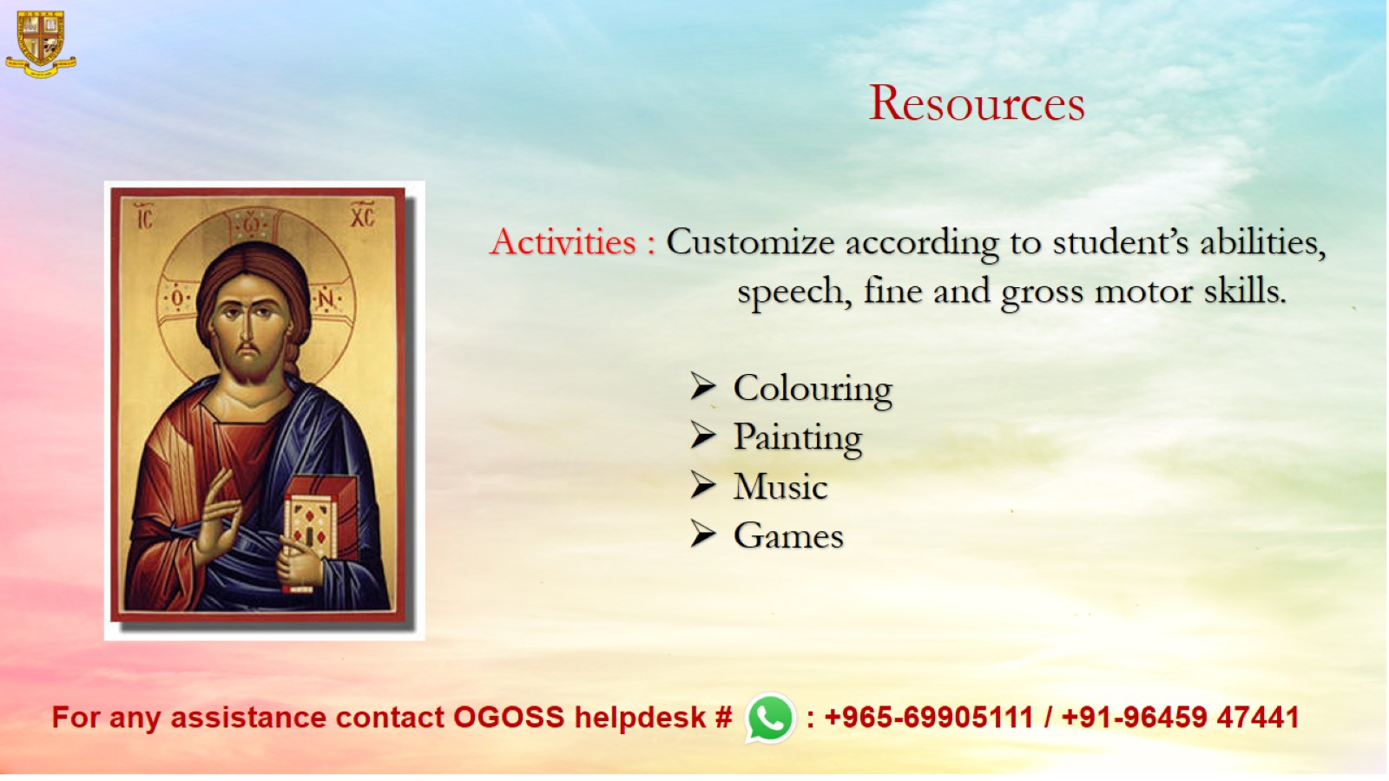
Resources

