Slide 1
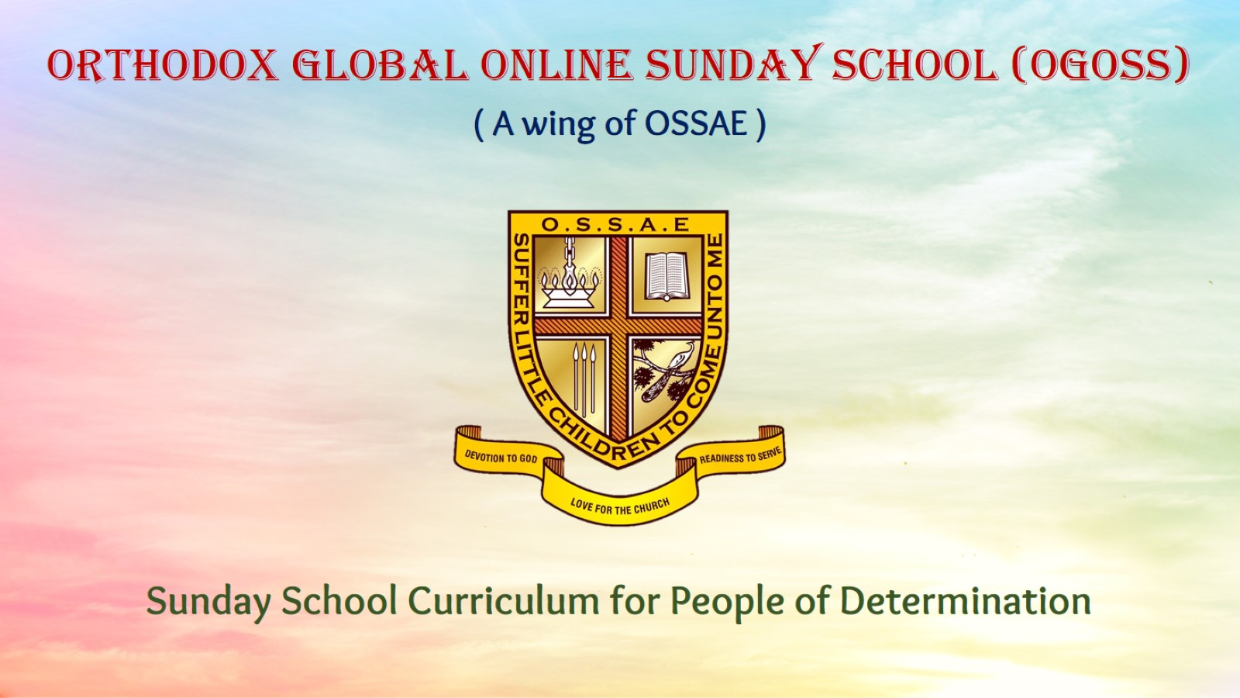
Orthodox Global Online Sunday School (OGOSS)

Slide 2
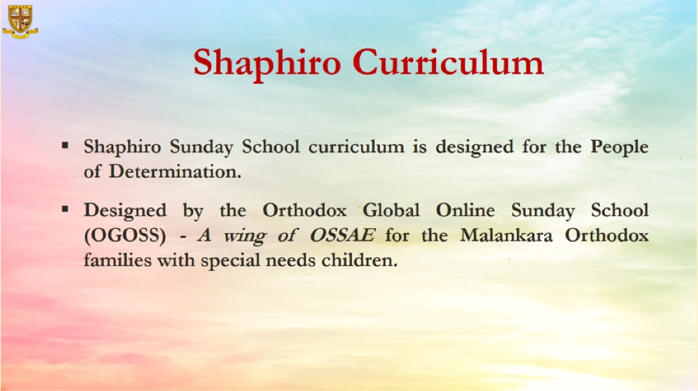

Slide 3
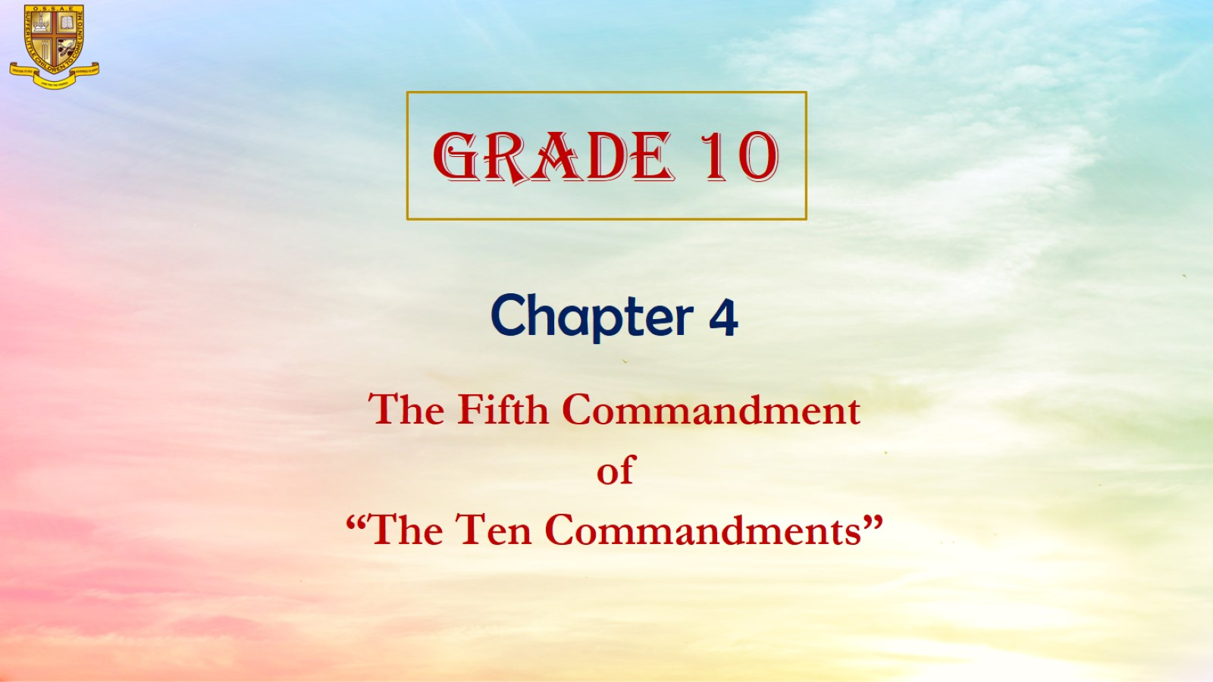

Slide 4
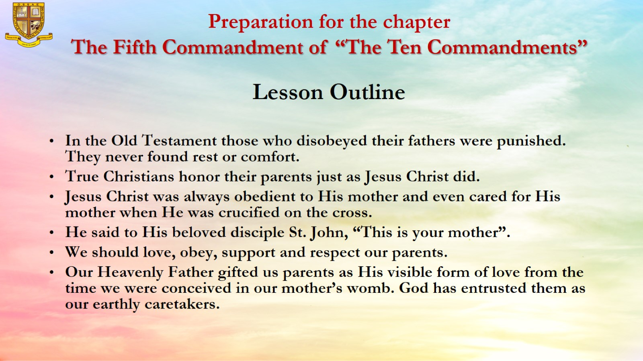
Preparation for the chapter
The Fifth Commandment of “The Ten Commandments”

Slide 5
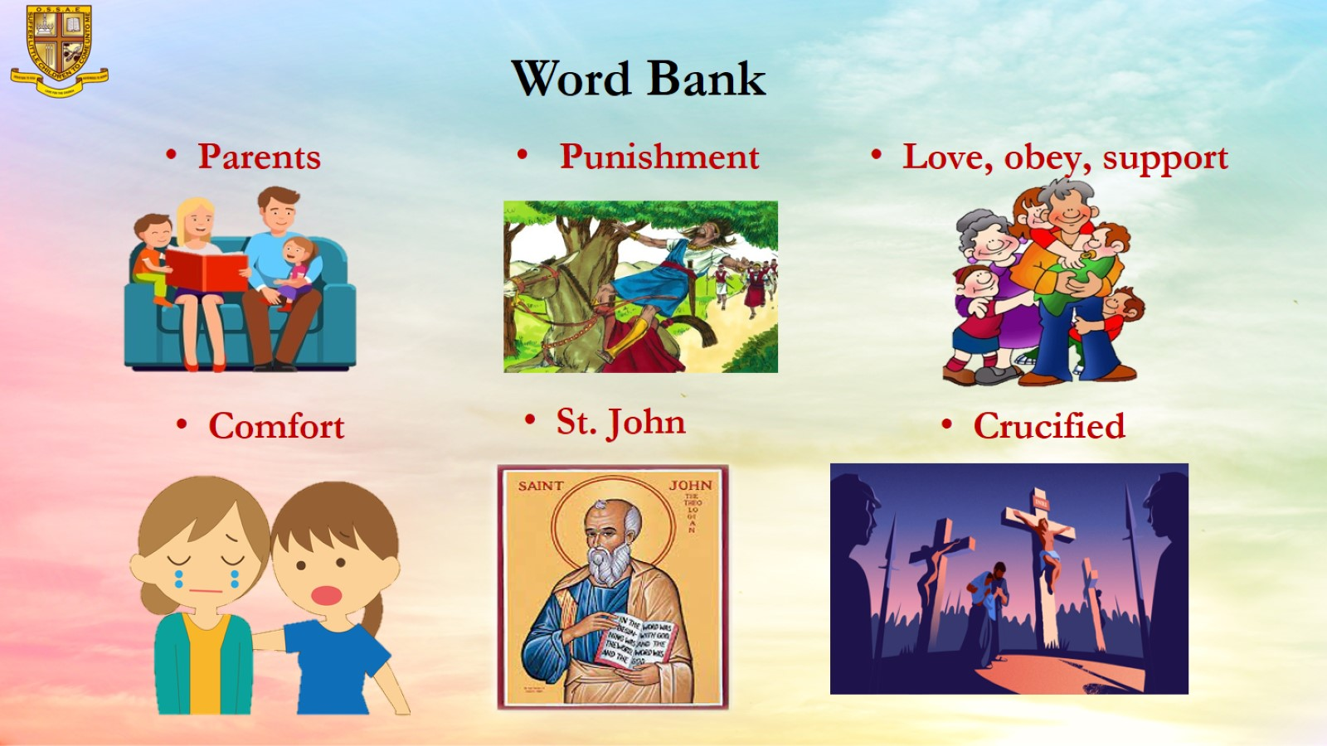
Word Bank

Slide 6

Objective: Honoring our parents and showing respect to them. Rewarding them for their love to us.

Slide 7
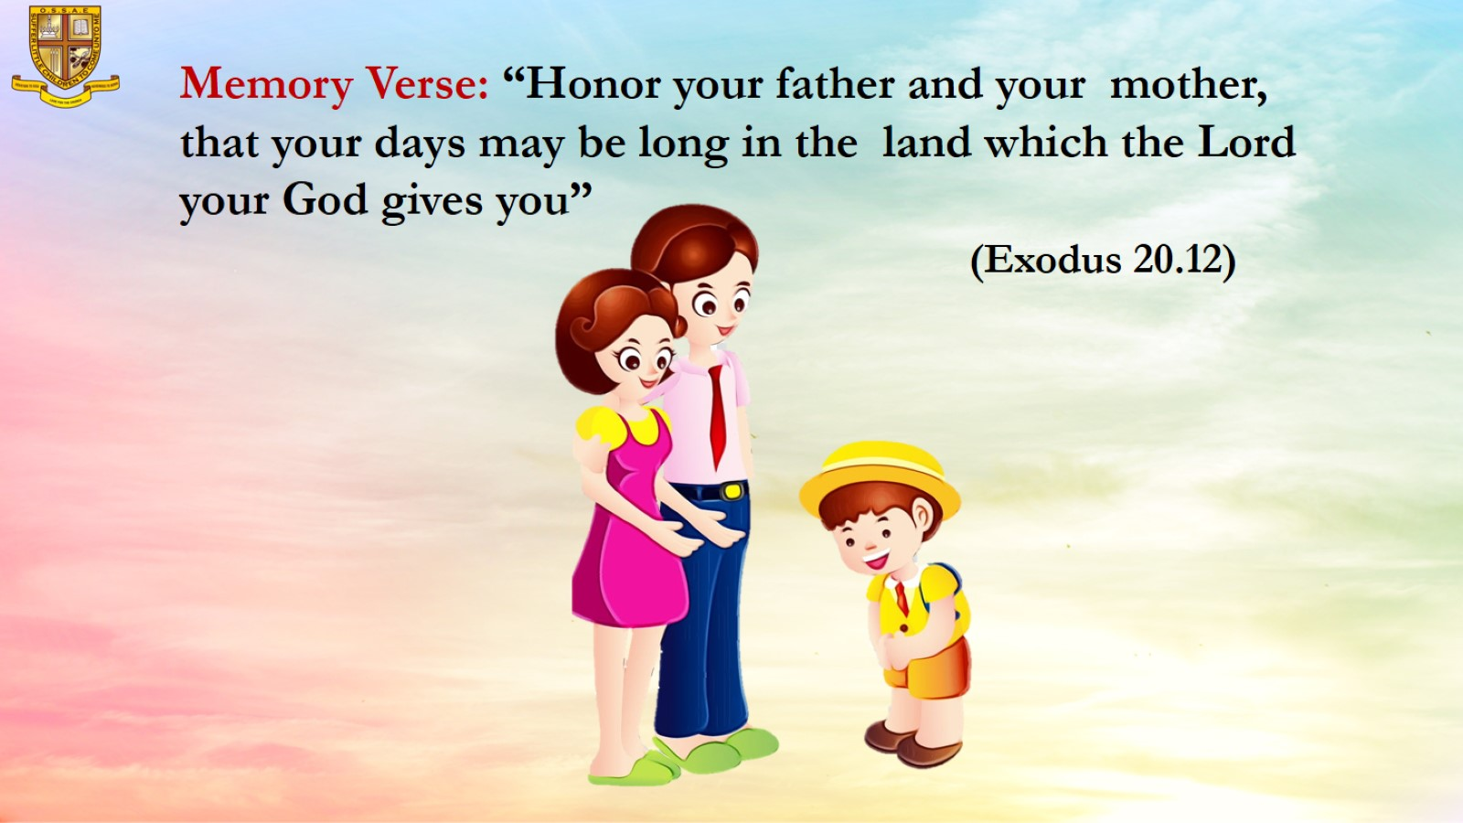
Memory Verse: “Honor your father and your mother, that your days may be long in the land which the Lord your God gives you” (Exodus 20.12)

Slide 8
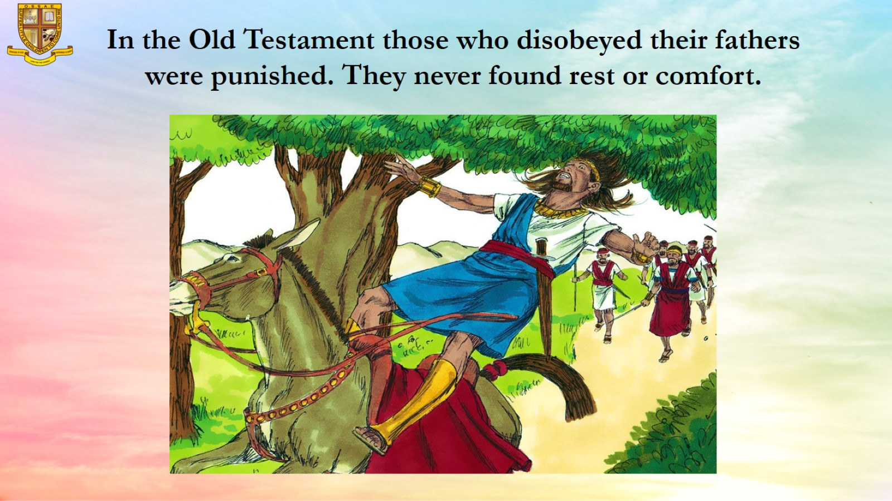
In the Old Testament those who disobeyed their fathers were punished. They never found rest or comfort.

Slide 9
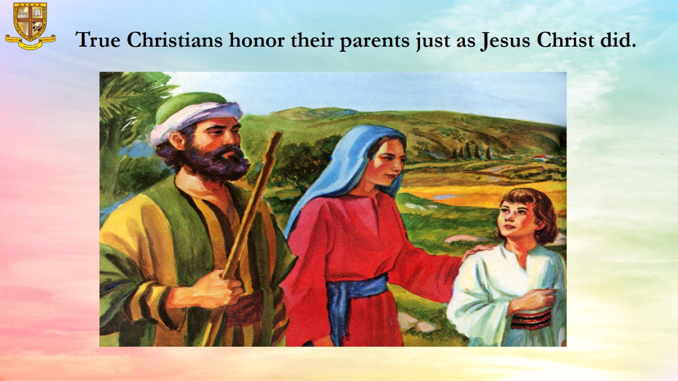
True Christians honor their parents just as Jesus Christ did.

Slide 10
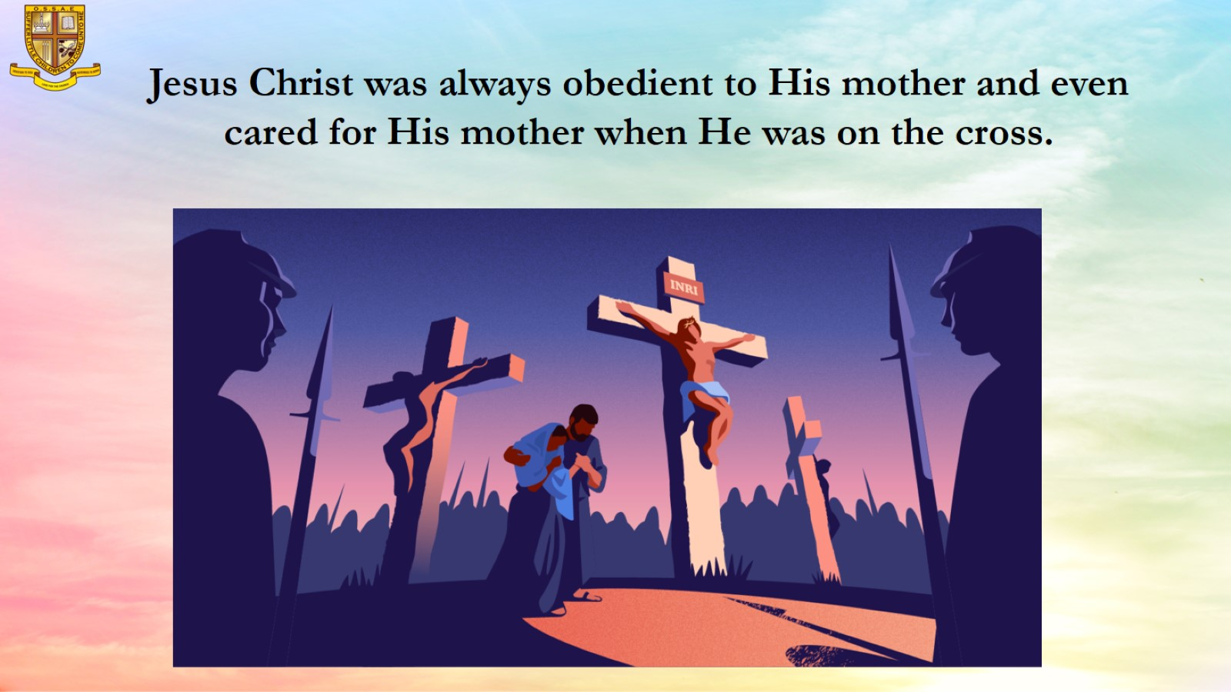
Jesus Christ was always obedient to His mother and even cared for His mother when He was on the cross.

Slide 11
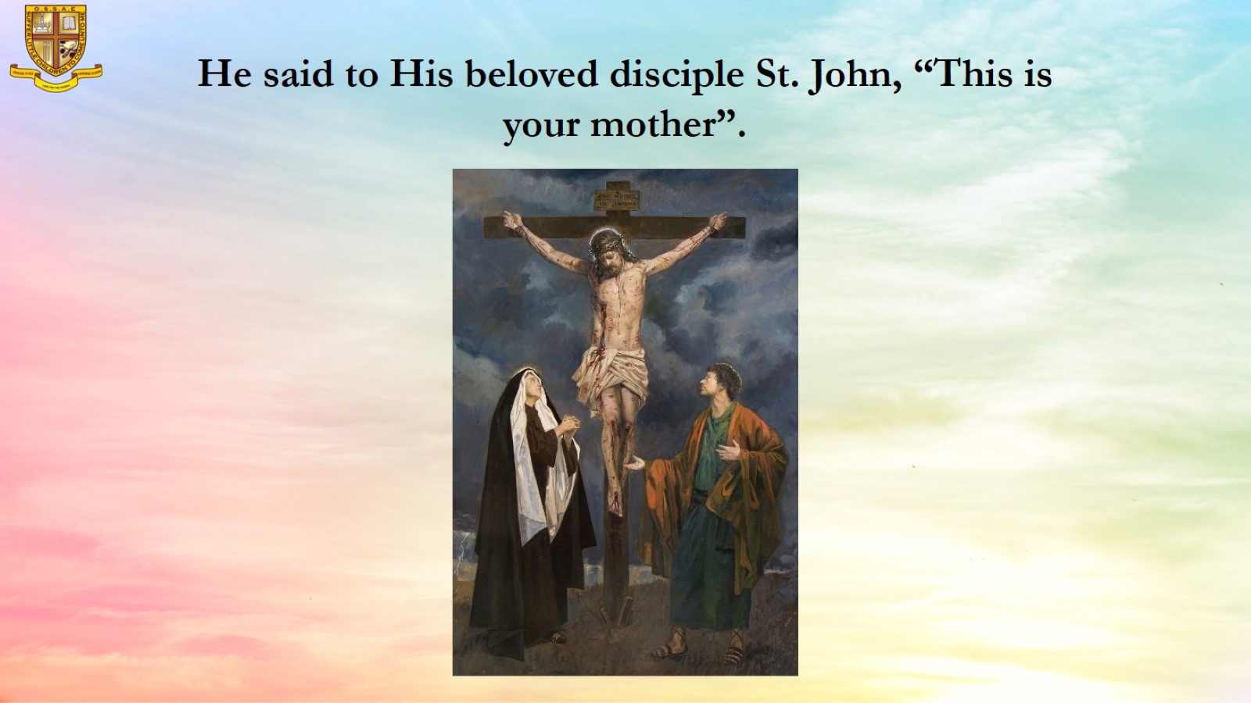
He said to His beloved disciple St. John, “This is your mother”.

Slide 12

We should love, obey, support and respect our parents.

Slide 13
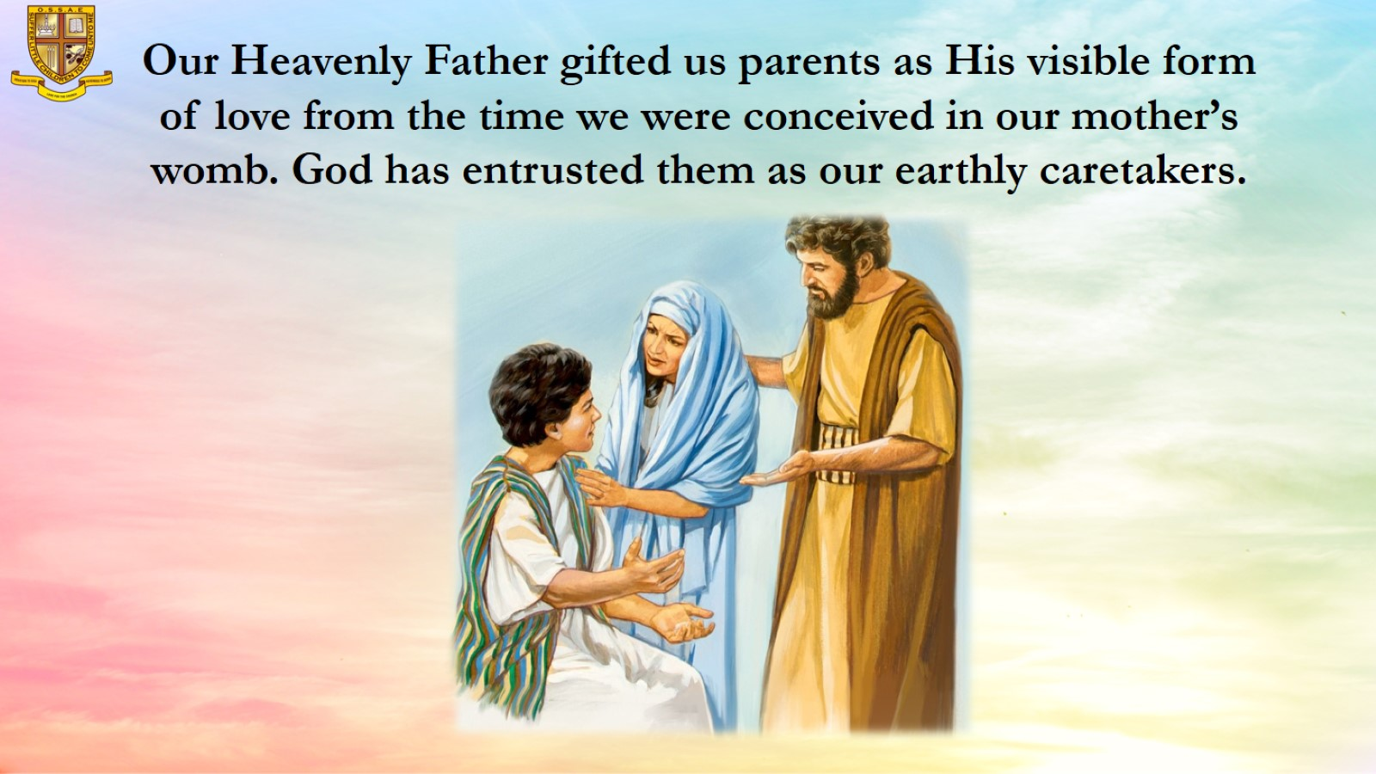
Our Heavenly Father gifted us parents as His visible form of love from the time we were conceived in our mother’s womb. God has entrusted them as our earthly caretakers.

Slide 14
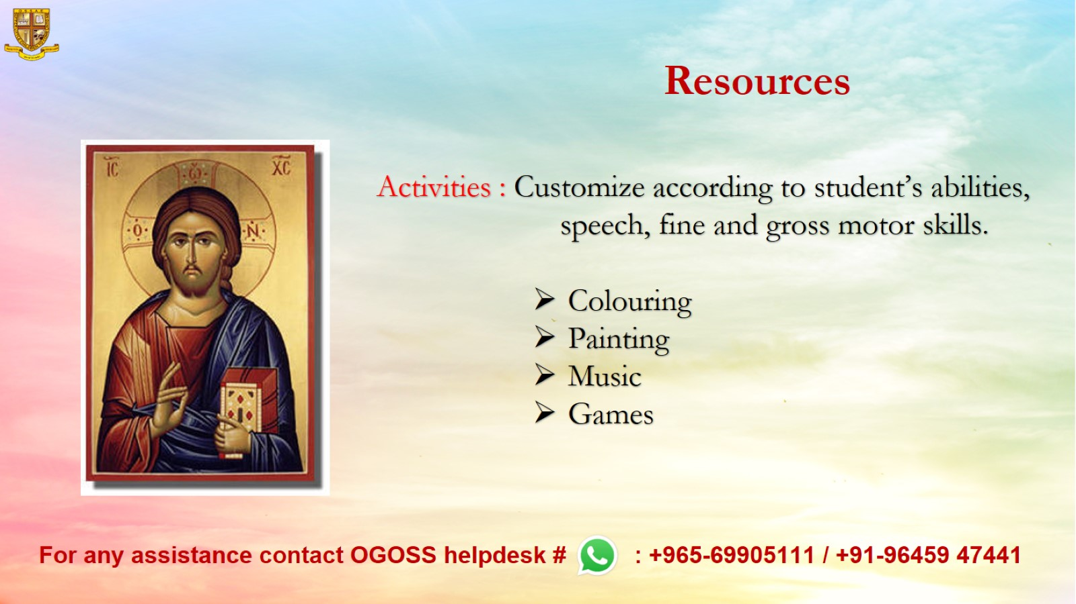
Resources

