Slide 1


Slide 2


Slide 3


Slide 4
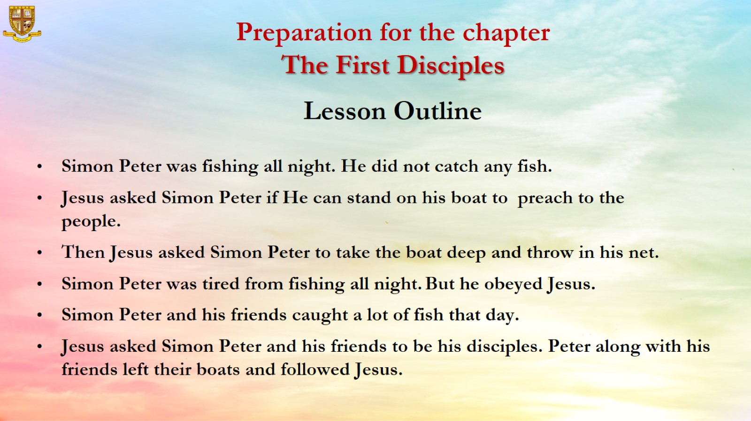
Preparation for the chapter
The First Disciples

Slide 5
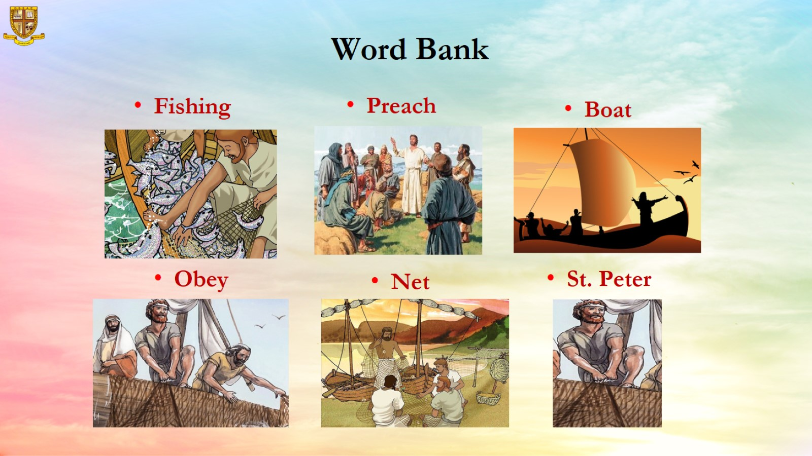
Word Bank

Slide 6
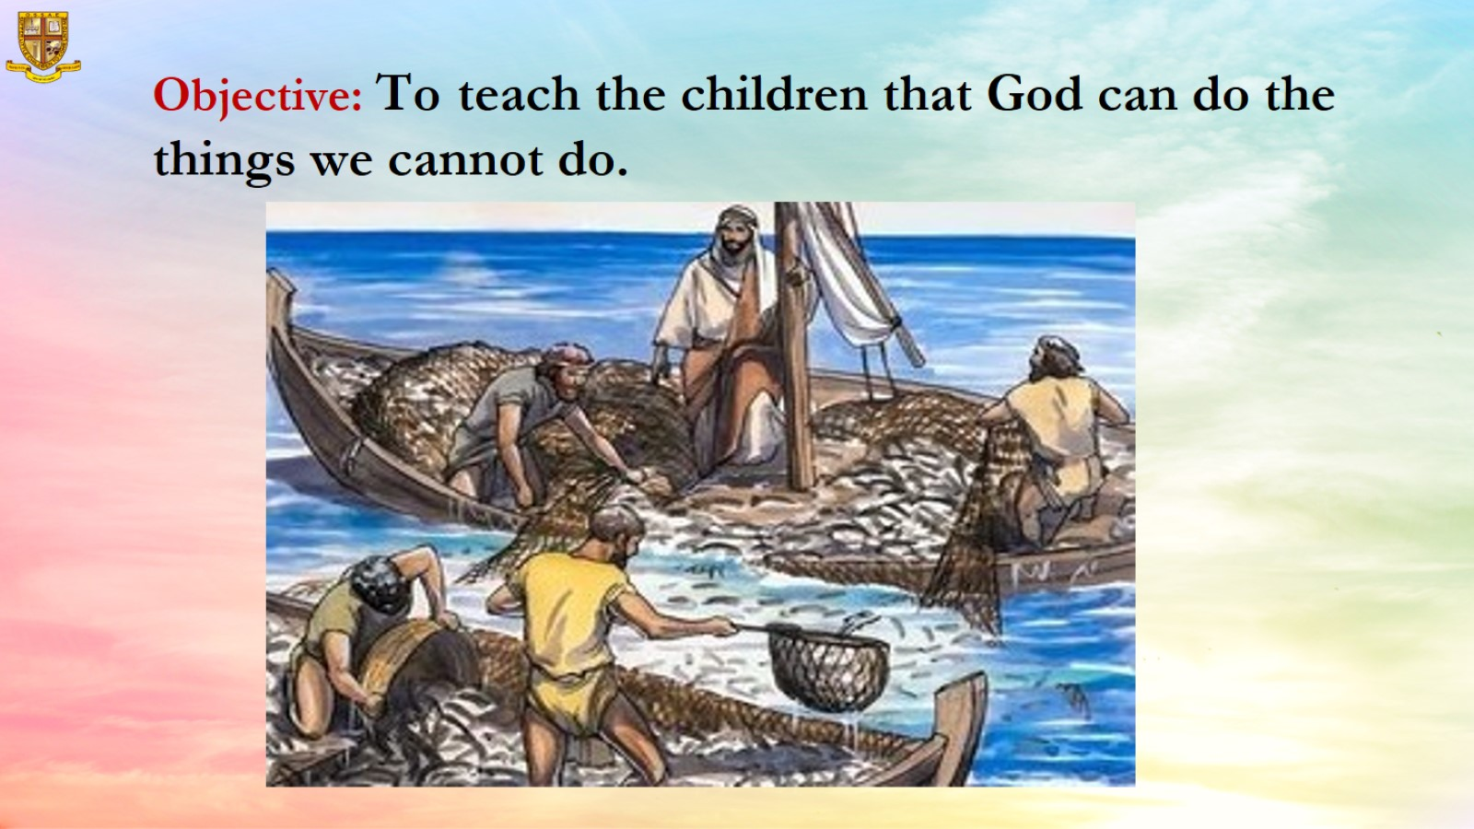
Objective: To teach the children that God can do the things we cannot do.

Slide 7
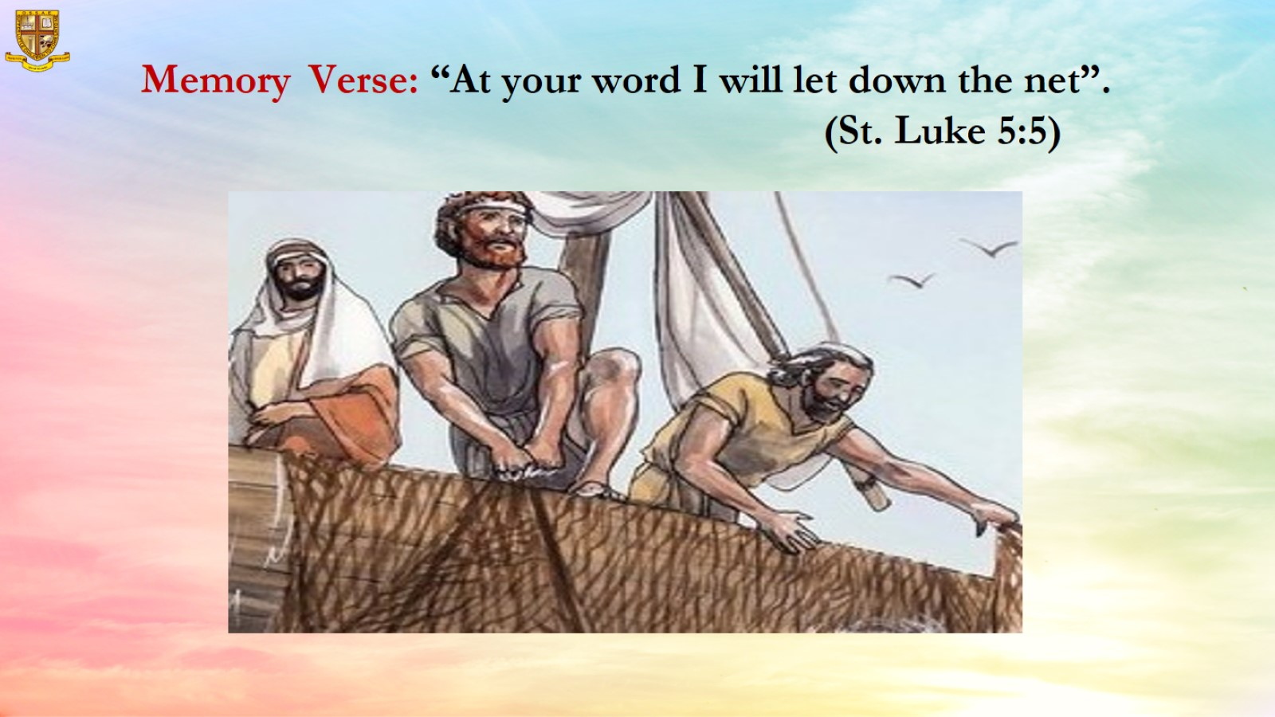
Memory Verse: “At your word I will let down the net”.
(St. Luke 5:5)

Slide 8
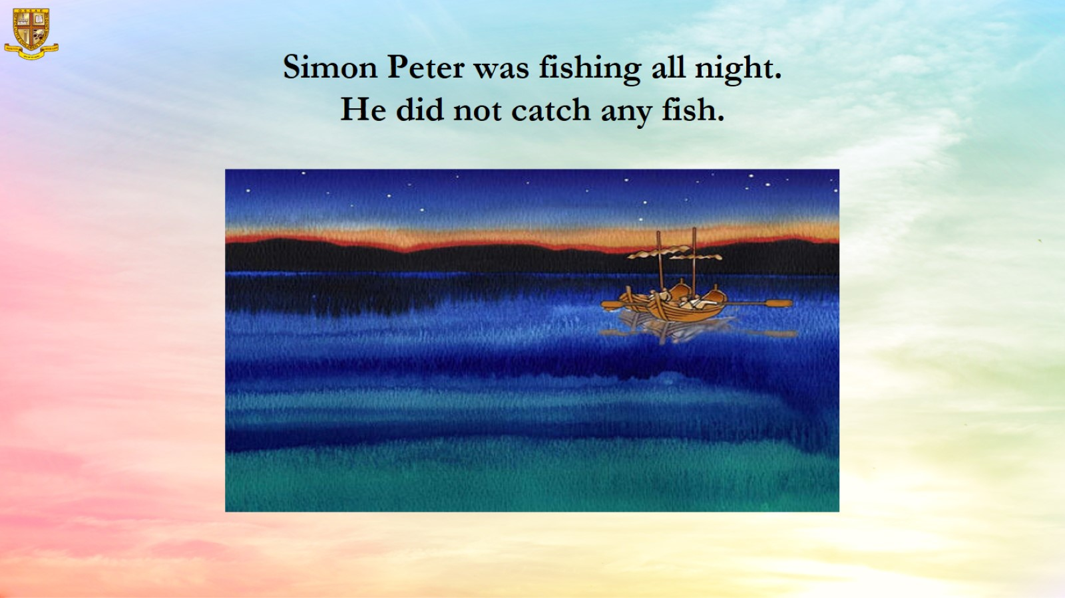
Simon Peter was fishing all night.
He did not catch any fish.

Slide 9
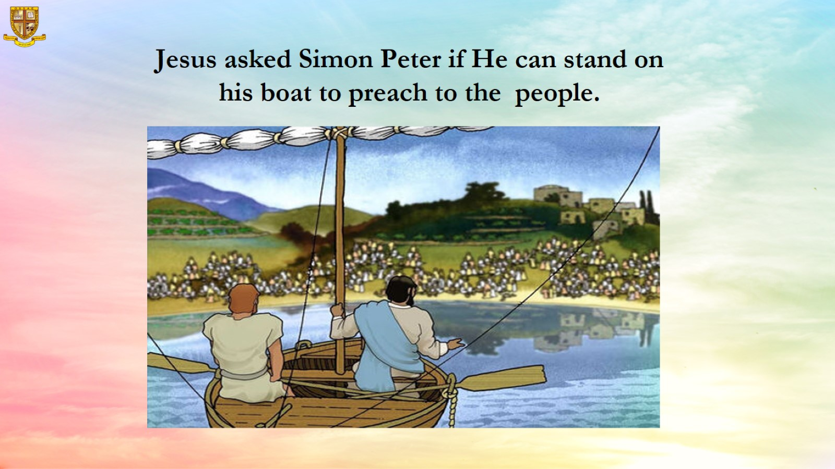
Jesus asked Simon Peter if He can stand on his boat to preach to the people.

Slide 10
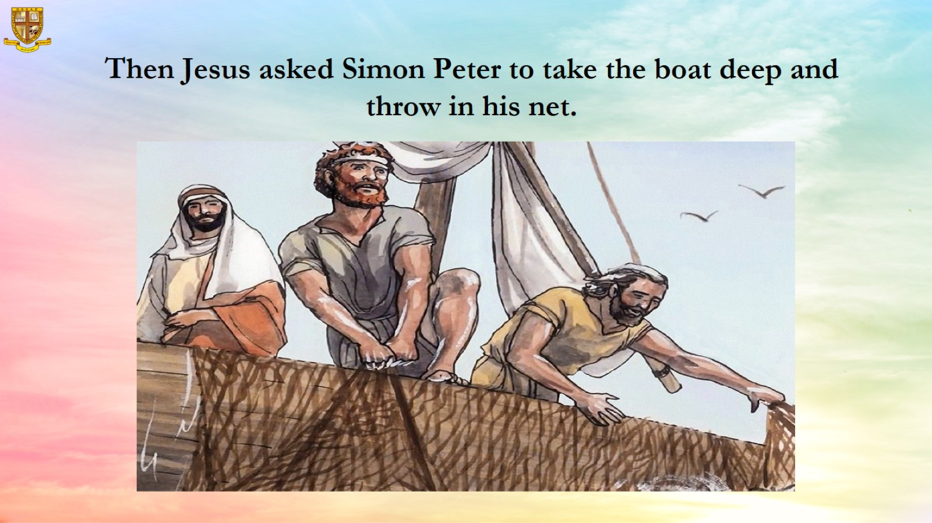
Then Jesus asked Simon Peter to take the boat deep and throw in his net.

Slide 11
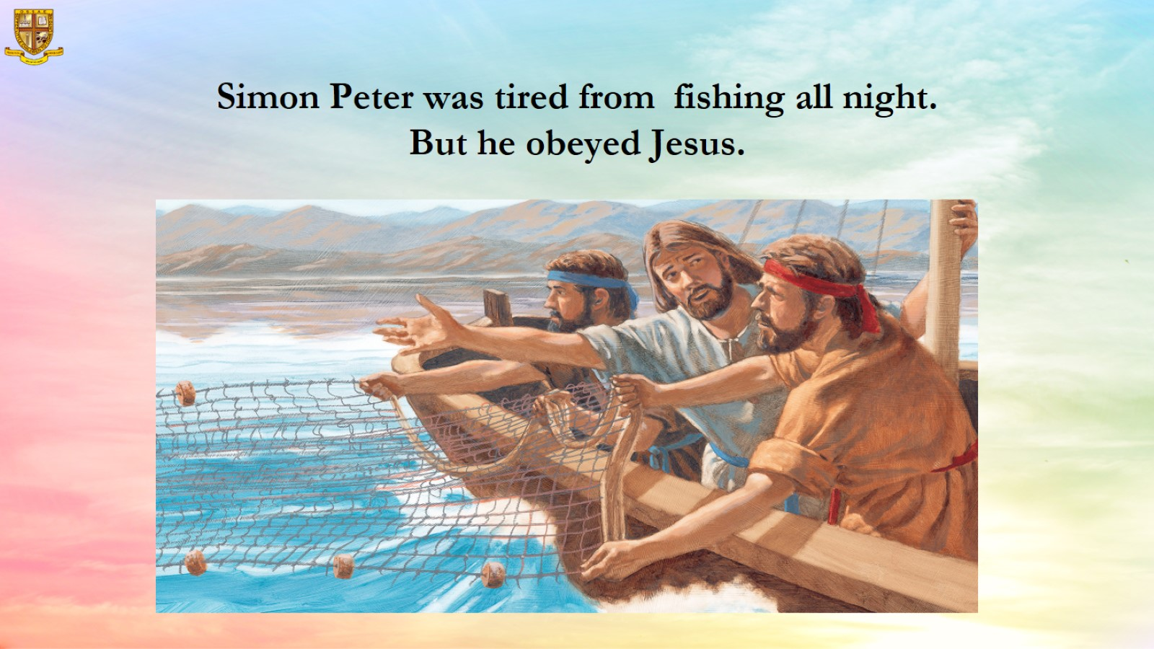
Simon Peter was tired from fishing all night.
But he obeyed Jesus.

Slide 12
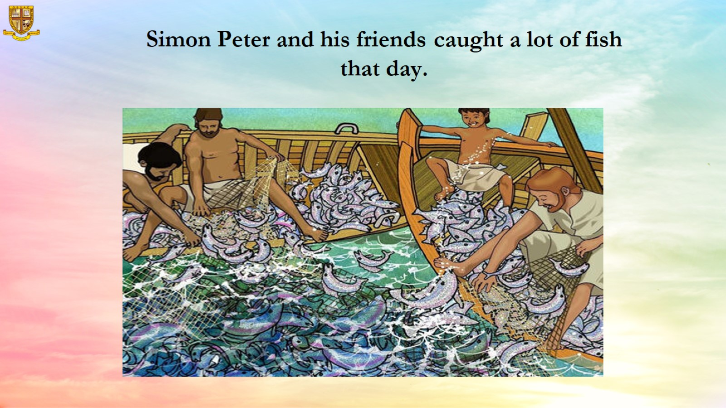
Simon Peter and his friends caught a lot of fish that day.

Slide 13
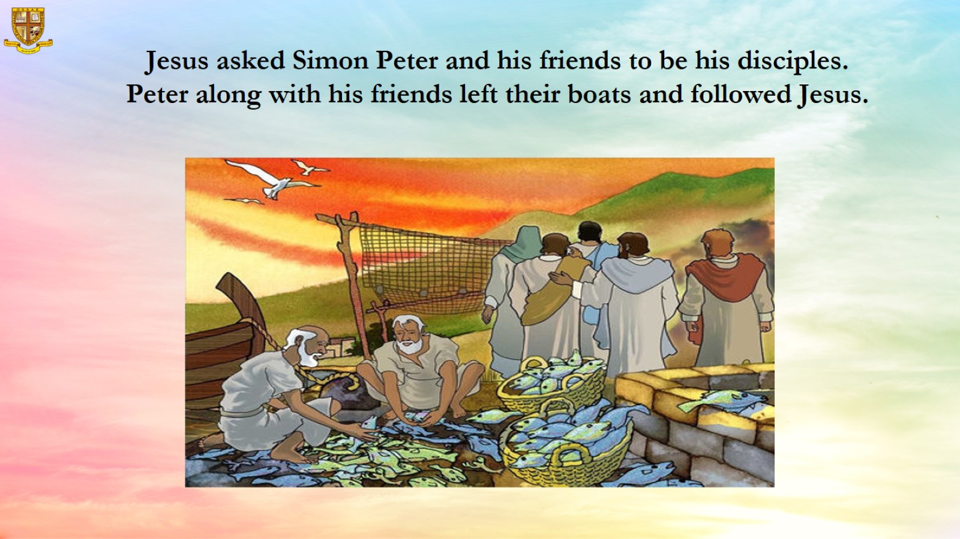

Slide 14
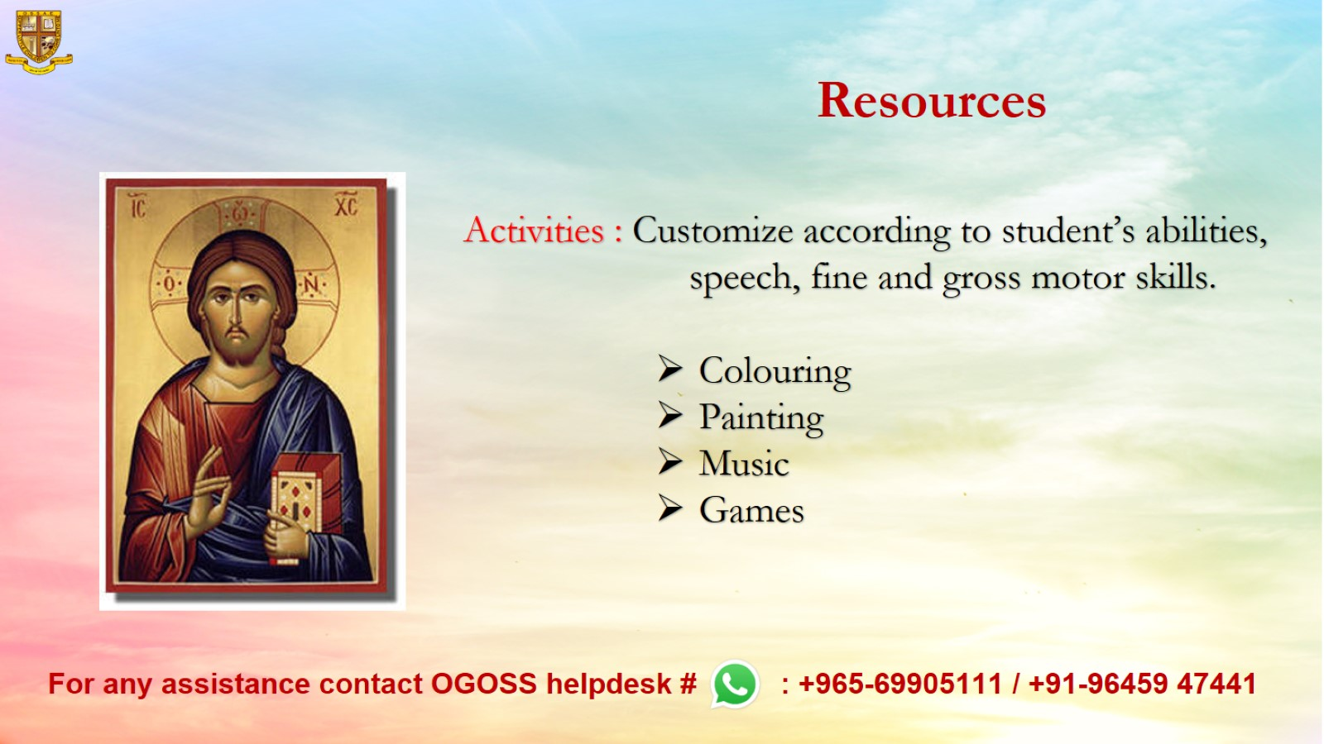
Resources

