Slide 1

Orthodox Global Online Sunday School (OGOSS)

Slide 2


Slide 3


Slide 4
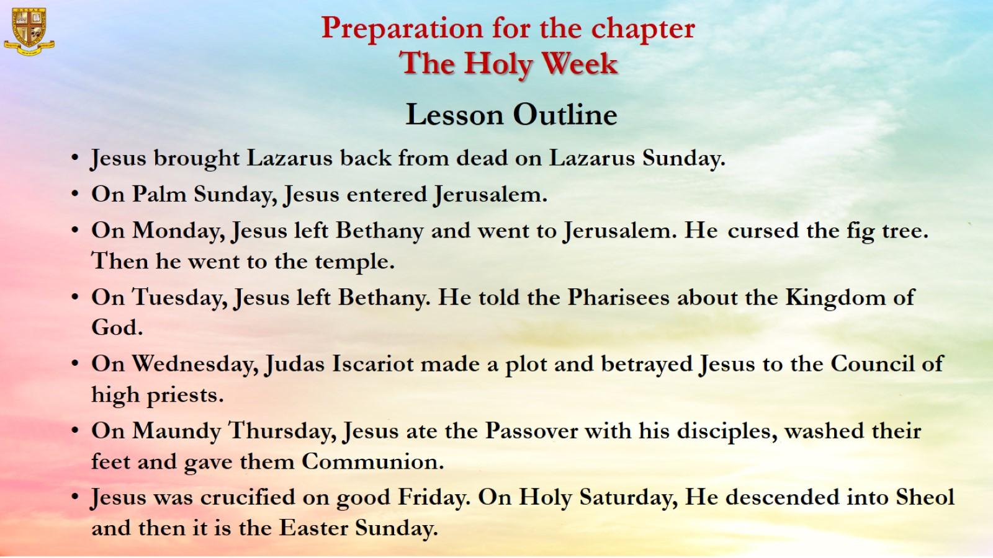
Preparation for the chapter
The Holy Week
Lesson Outline

Slide 5
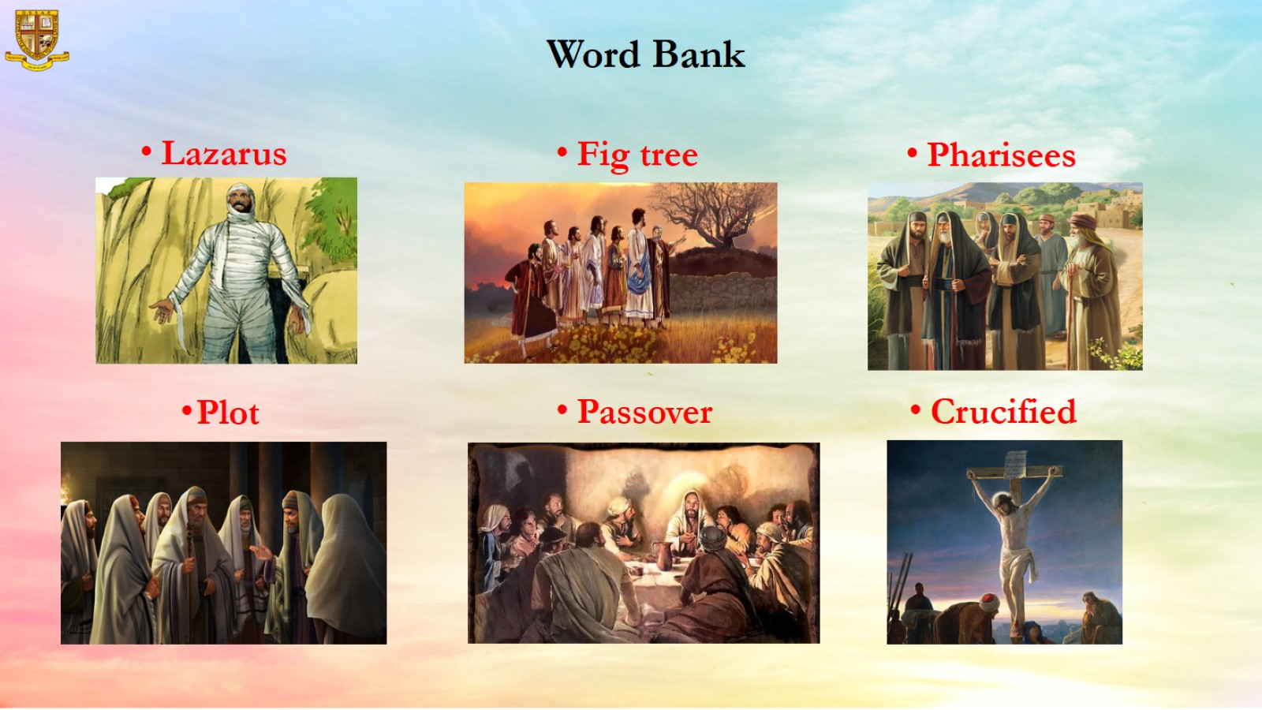
Word Bank

Slide 6
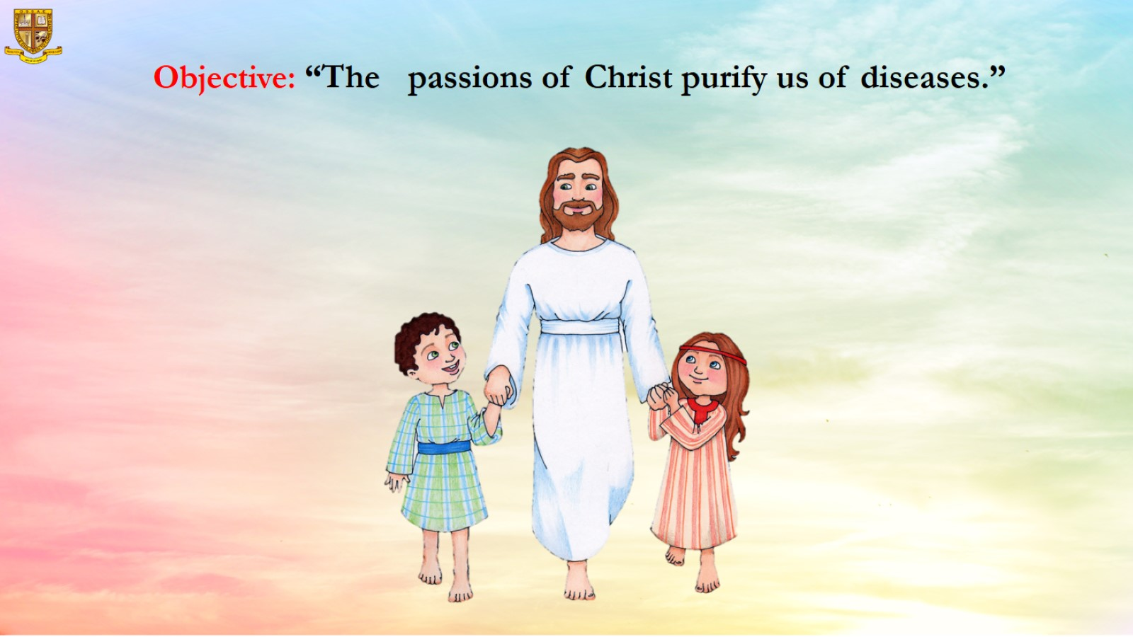
Objective: “The passions of Christ purify us of diseases.”

Slide 7
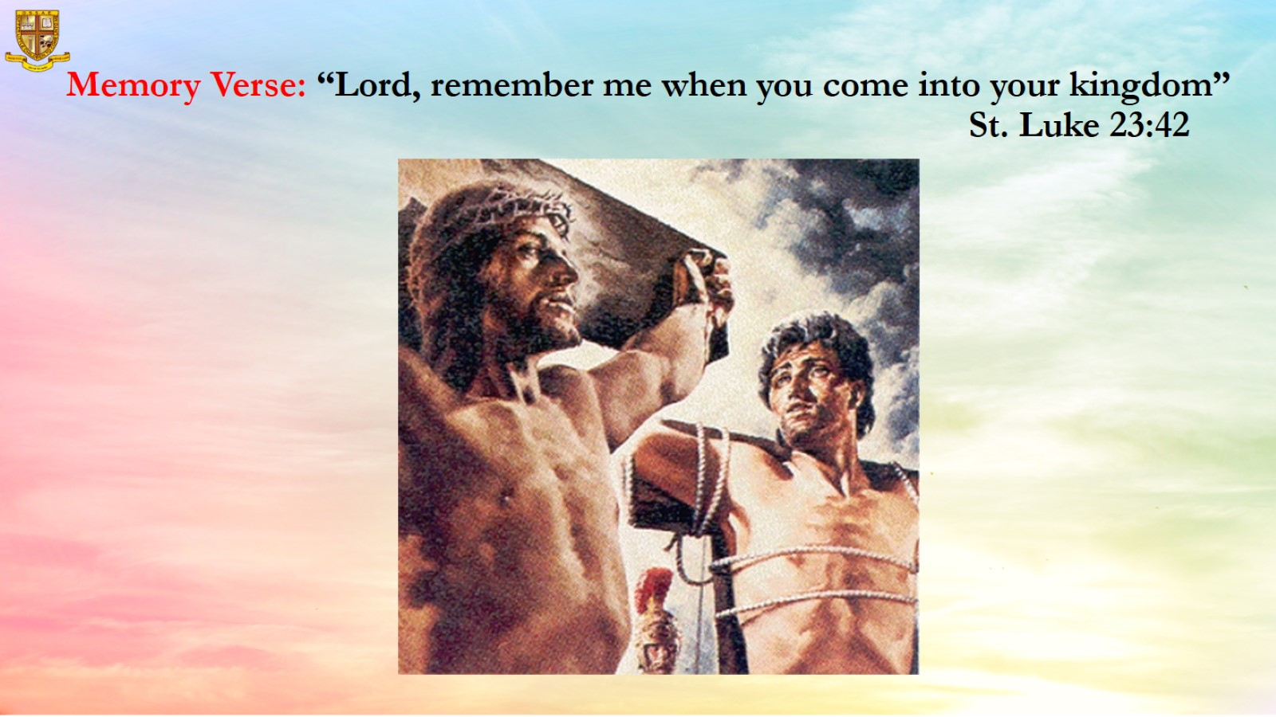
Memory Verse: “Lord, remember me when you come into your kingdom”
St. Luke 23:42

Slide 8
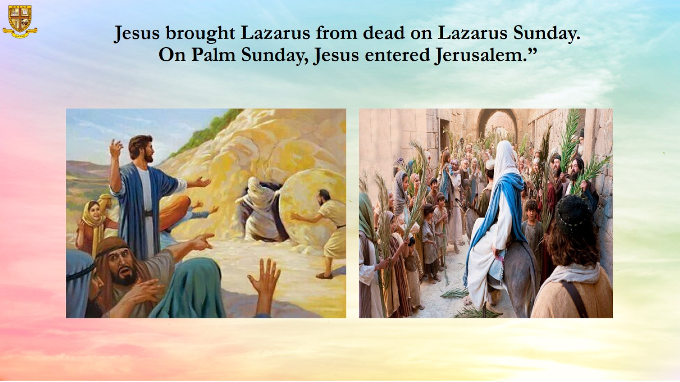
Jesus brought Lazarus from dead on Lazarus Sunday.
On Palm Sunday, Jesus entered Jerusalem.”

Slide 9
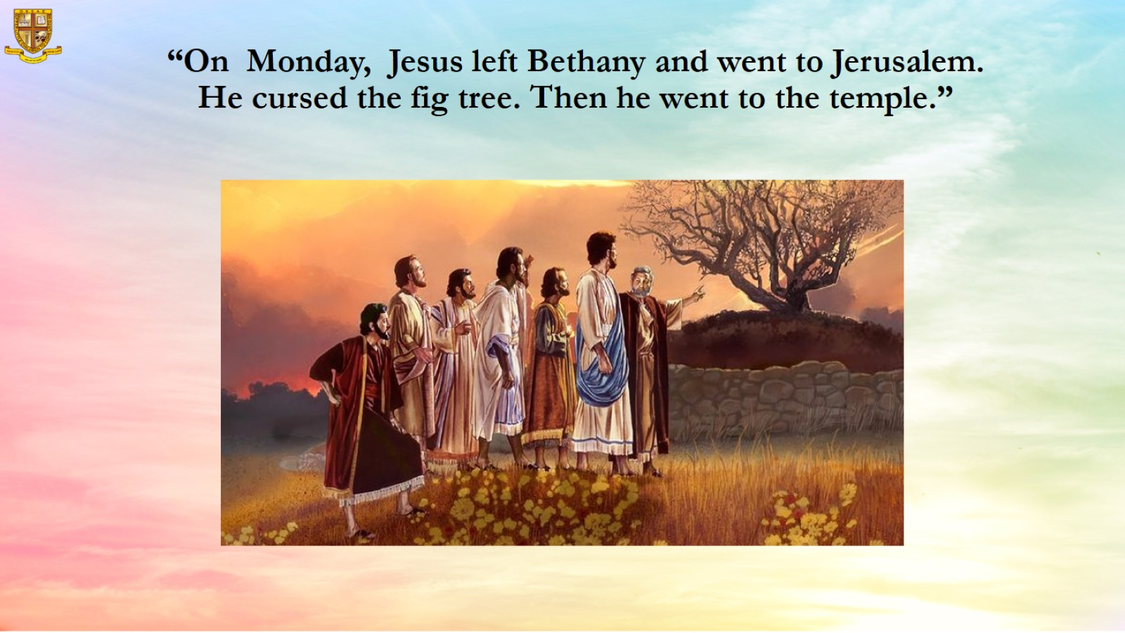
“On Monday, Jesus left Bethany and went to Jerusalem.
He cursed the fig tree. Then he went to the temple.”

Slide 10
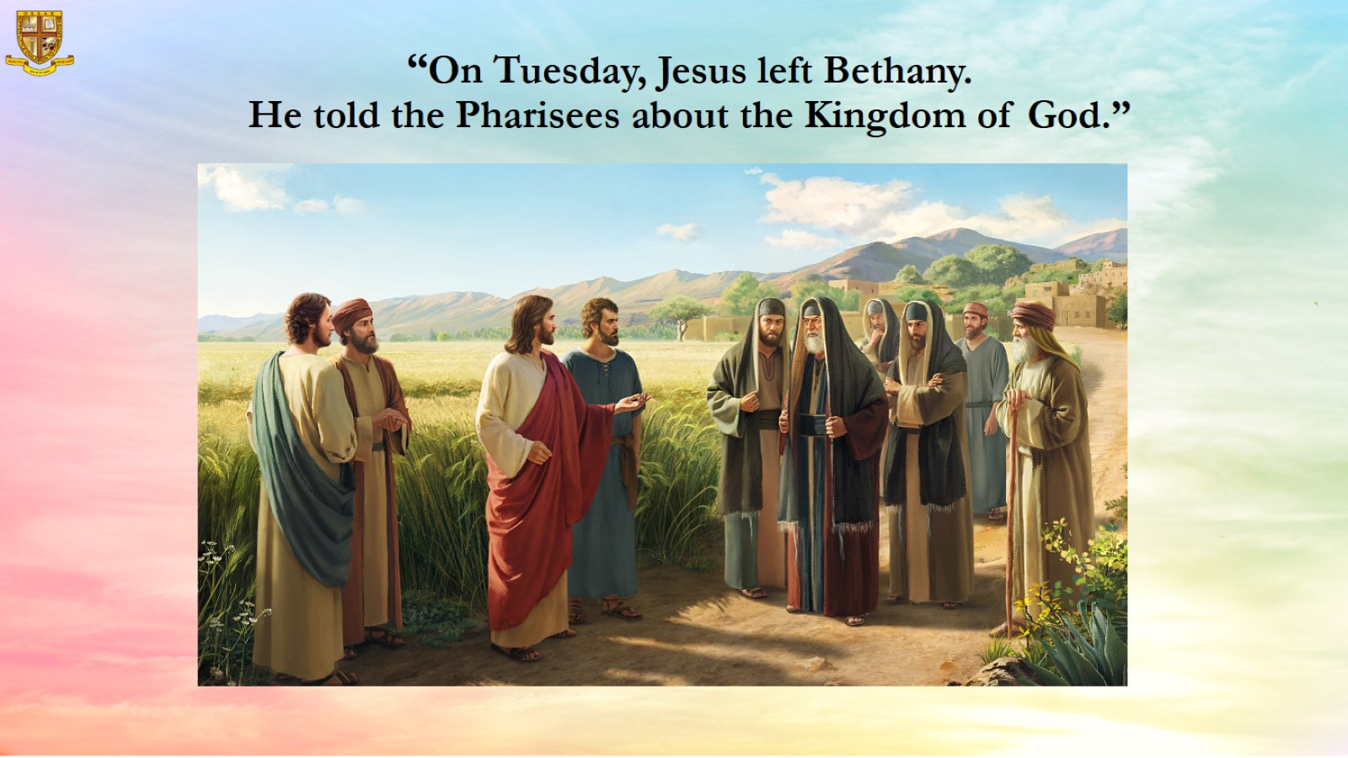
“On Tuesday, Jesus left Bethany.
He told the Pharisees about the Kingdom of God.”

Slide 11
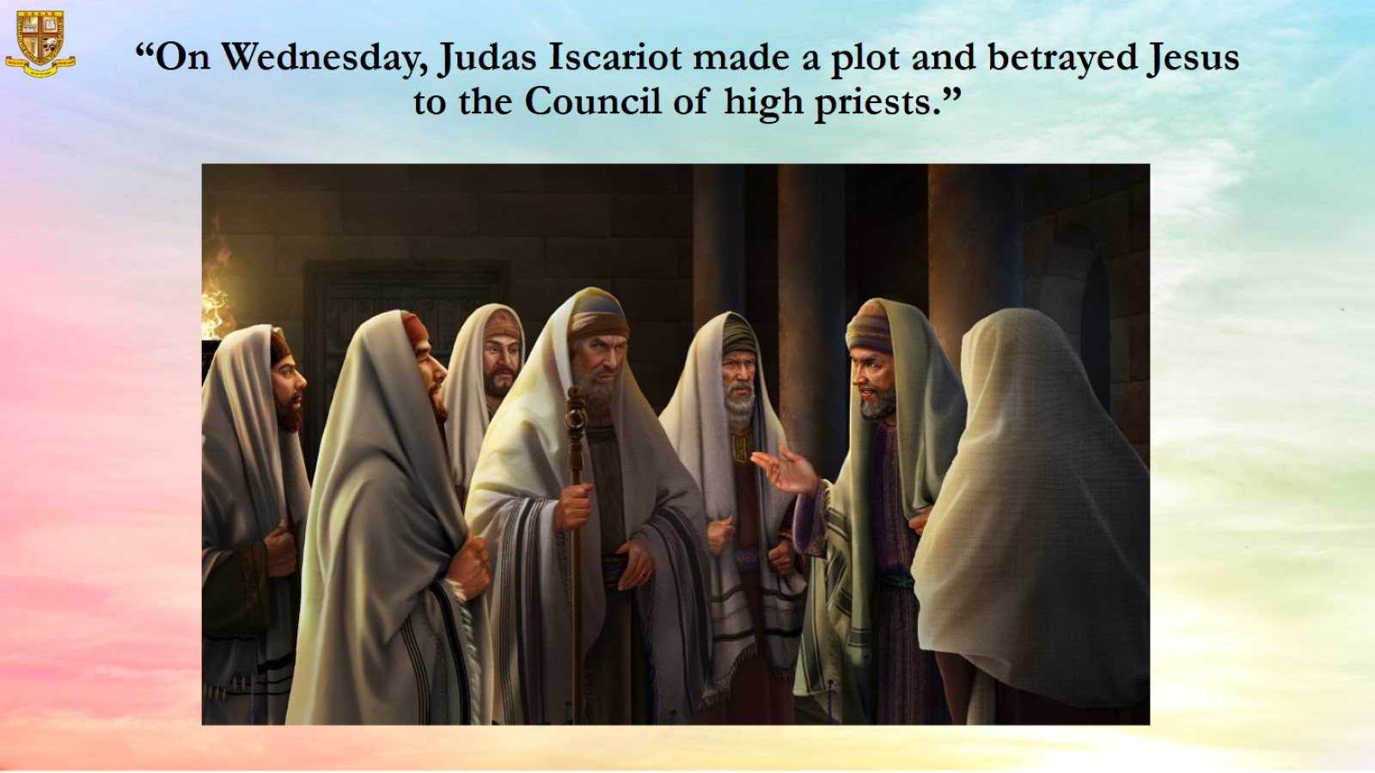
“On Wednesday, Judas Iscariot made a plot and betrayed Jesus to the Council of high priests.”

Slide 12
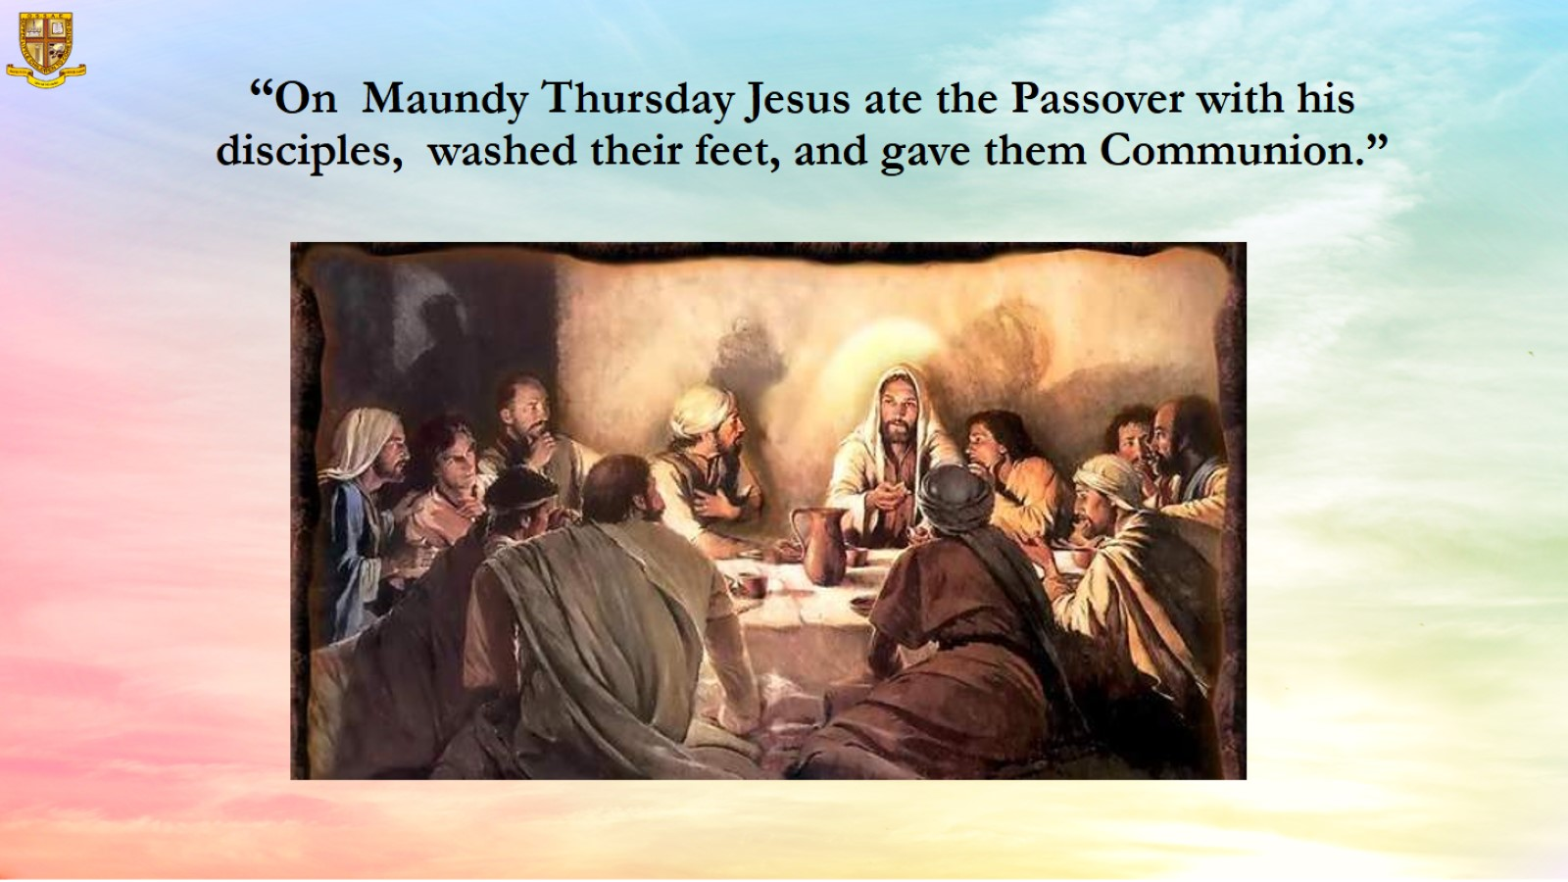
“On Maundy Thursday Jesus ate the Passover with his disciples, washed their feet, and gave them Communion.”

Slide 13
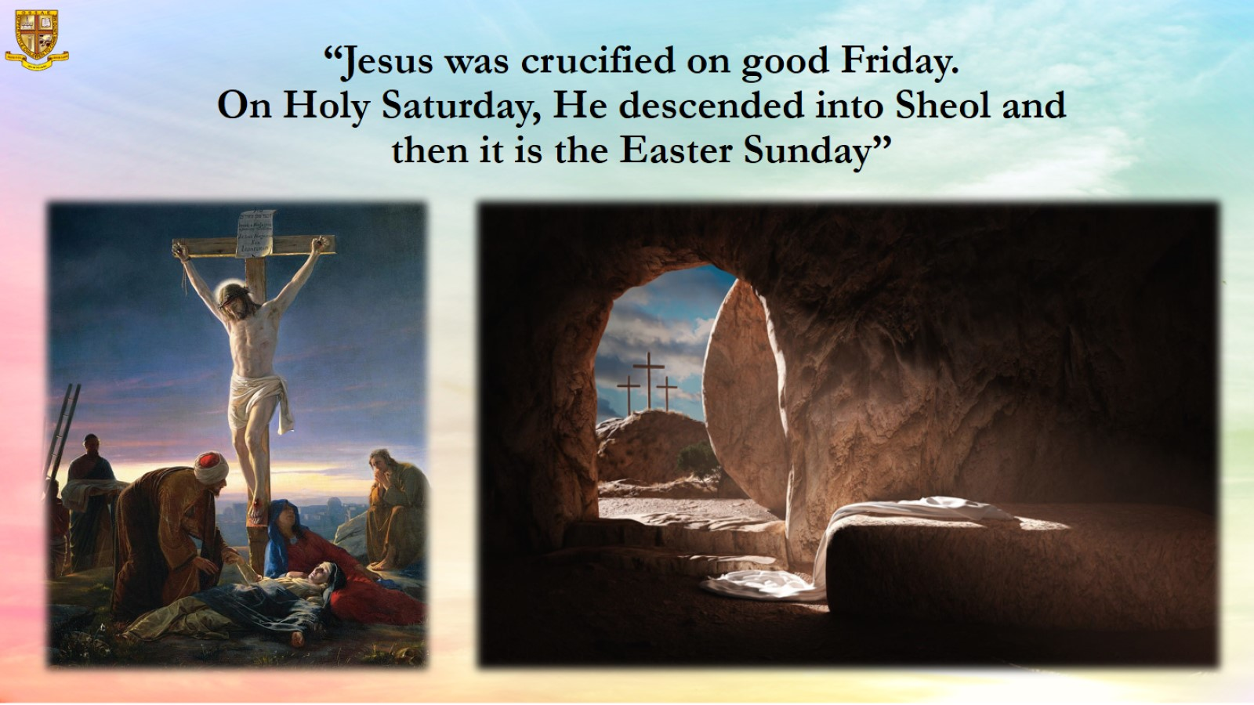
“Jesus was crucified on good Friday.
On Holy Saturday, He descended into Sheol and then it is the Easter Sunday”

Slide 14
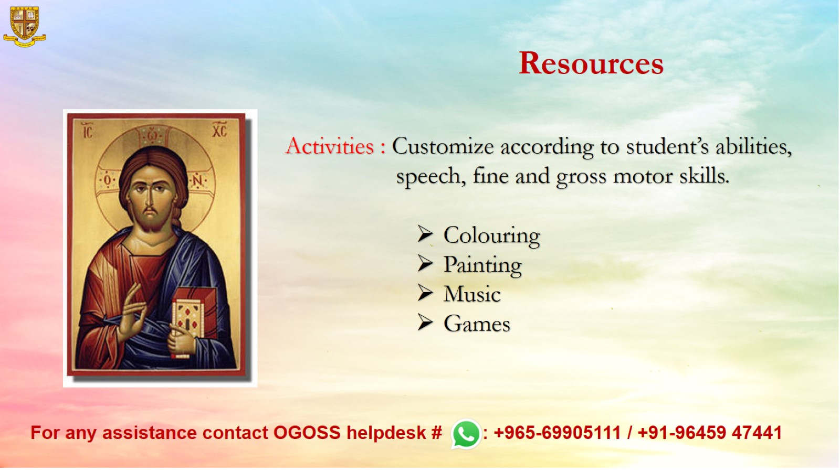
Resources

