Slide 1

Orthodox Global Online Sunday School (OGOSS)

Slide 2


Slide 3


Slide 4
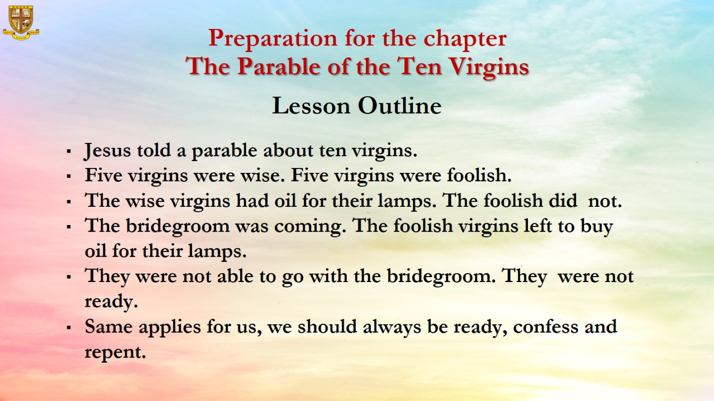

Slide 5
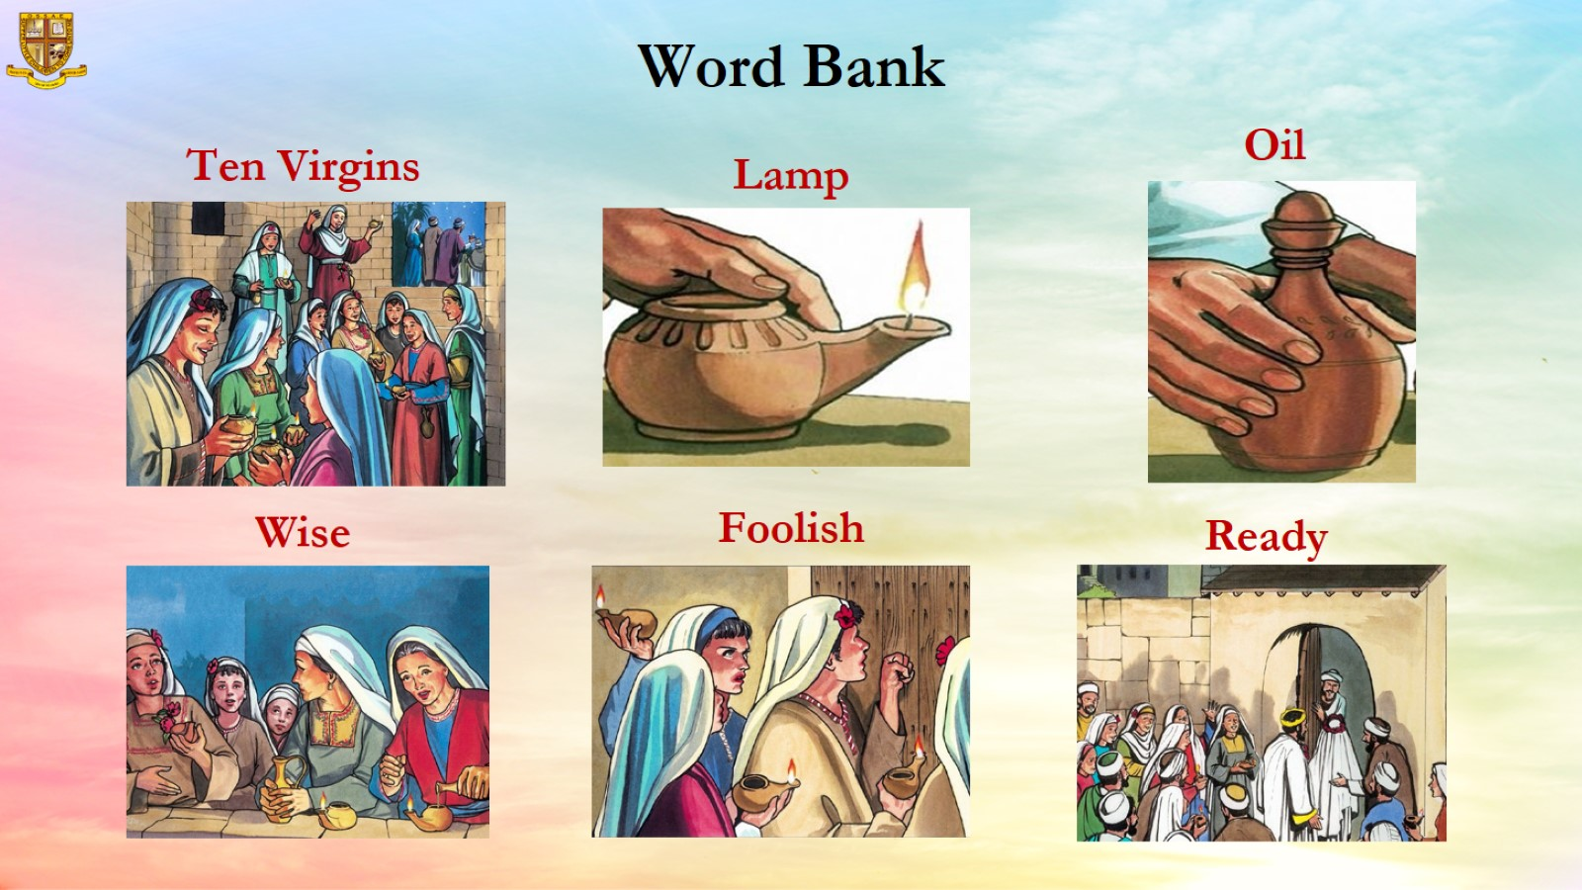

Slide 6
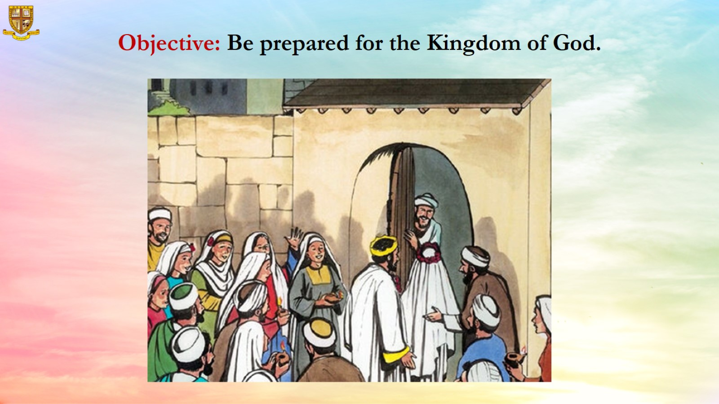
Objective: Be prepared for the Kingdom of God.

Slide 7
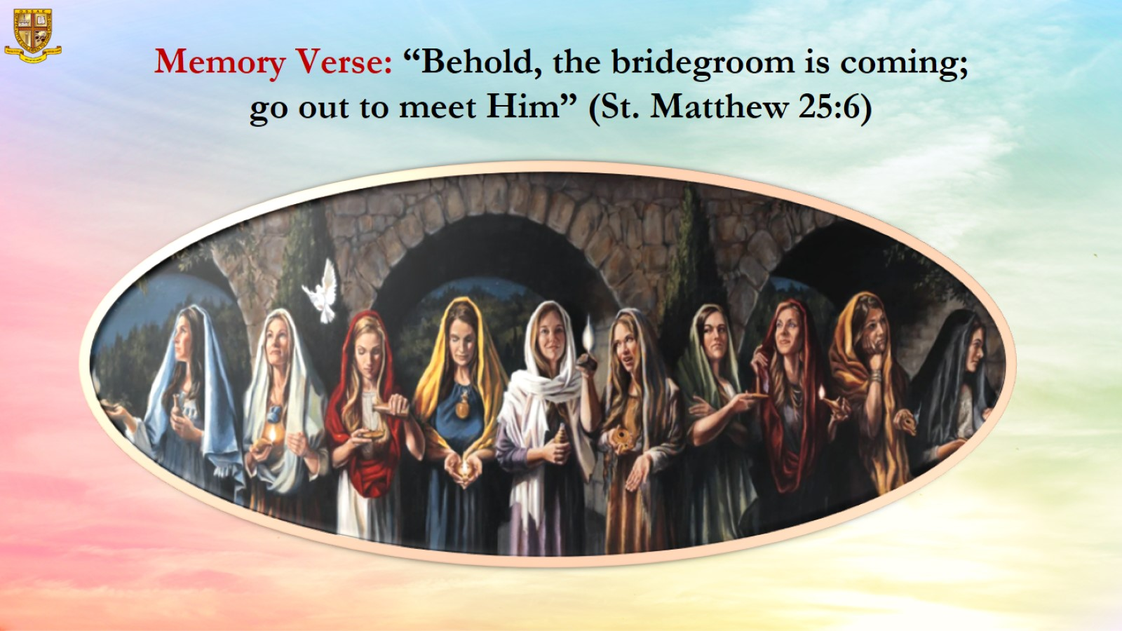
Memory Verse: “Behold, the bridegroom is coming; go out to meet Him” (St. Matthew 25:6)

Slide 8
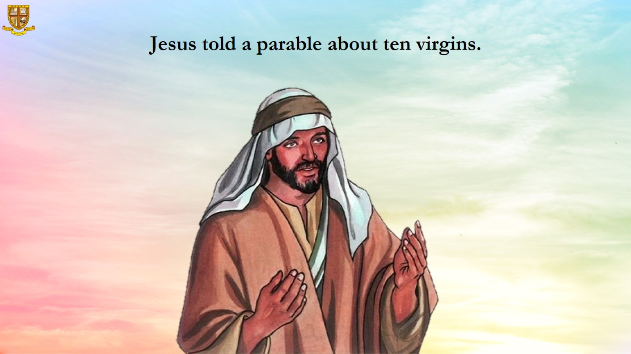
Jesus told a parable about ten virgins.

Slide 9
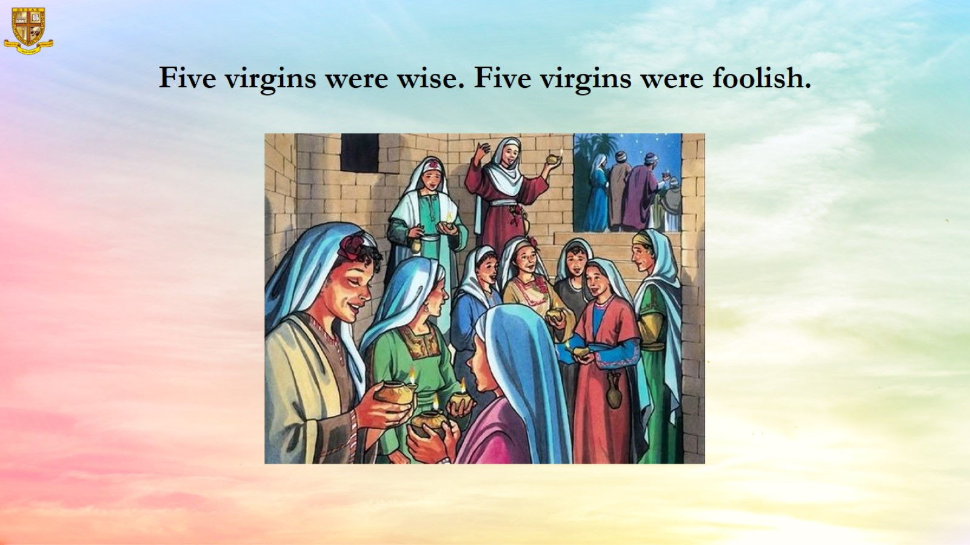

Slide 10
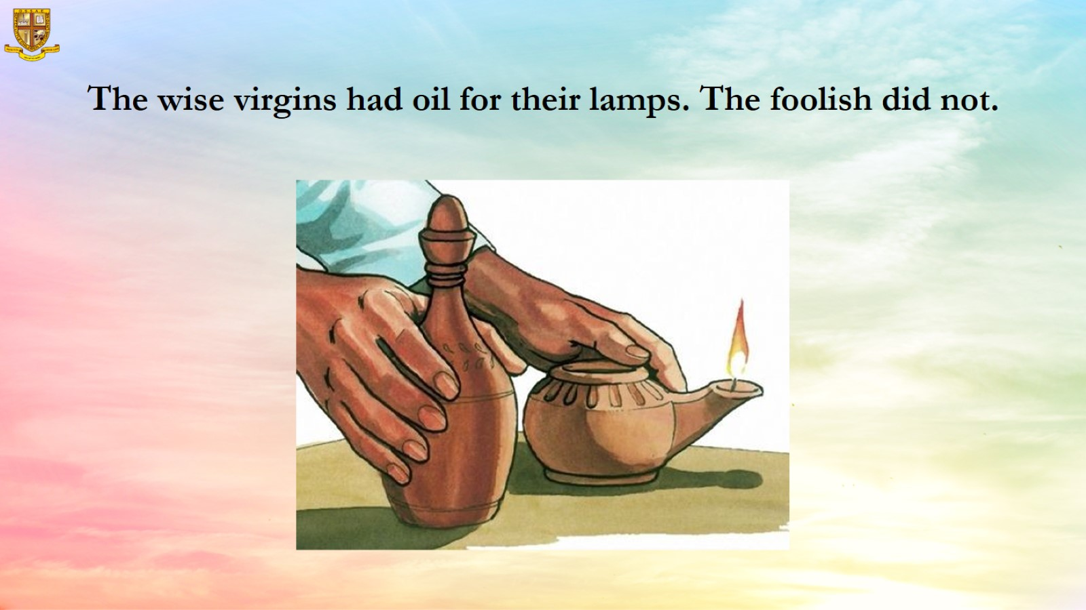
The wise virgins had oil for their lamps. The foolish did not.

Slide 11
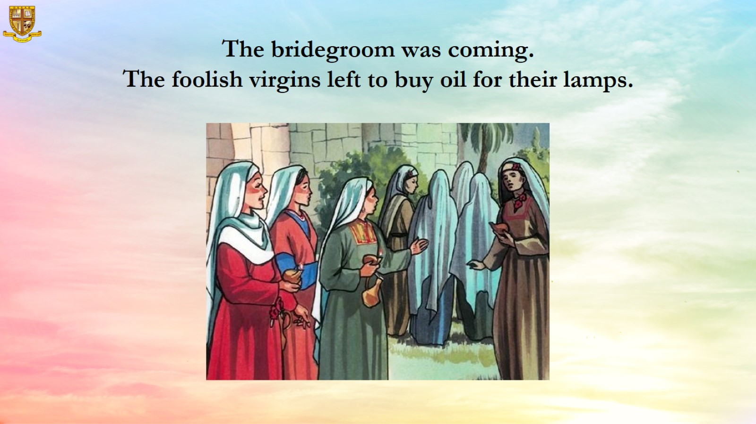
The bridegroom was coming.
The foolish virgins left to buy oil for their lamps.

Slide 12
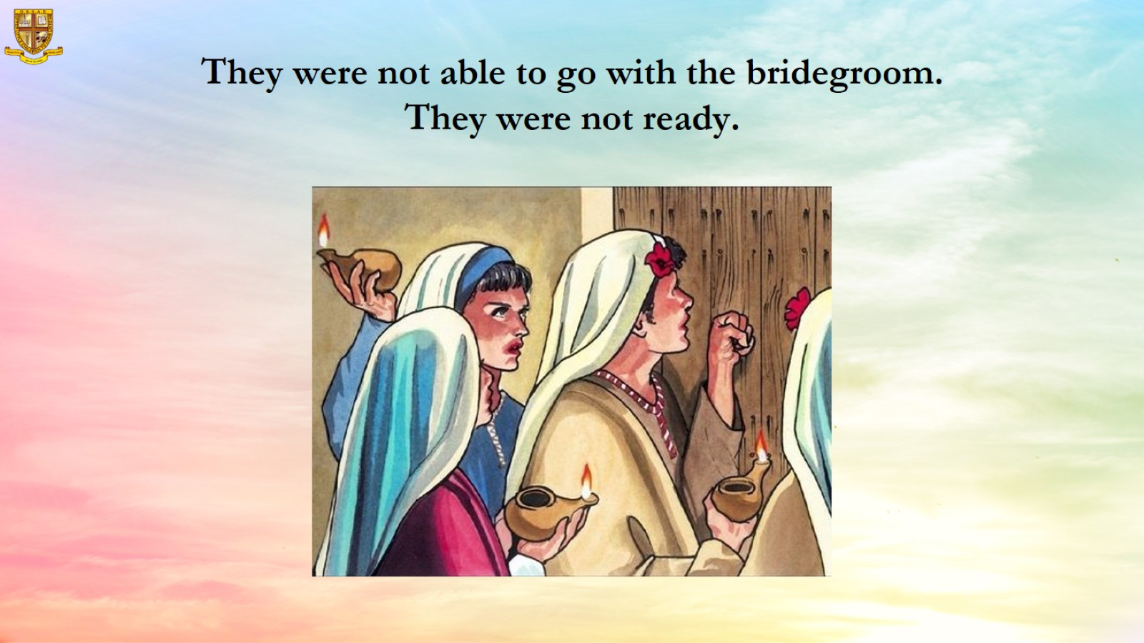
They were not able to go with the bridegroom. They were not ready.

Slide 13
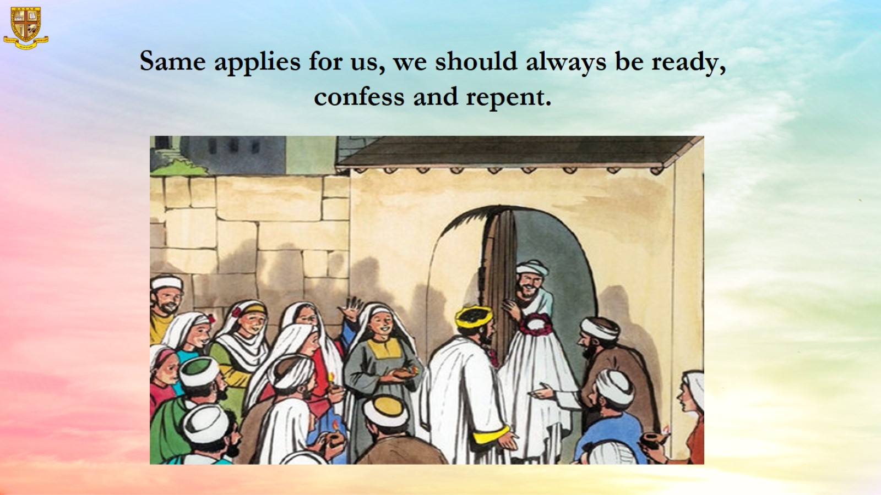
Same applies for us, we should always be ready, confess and repent.

Slide 14
