Slide 1
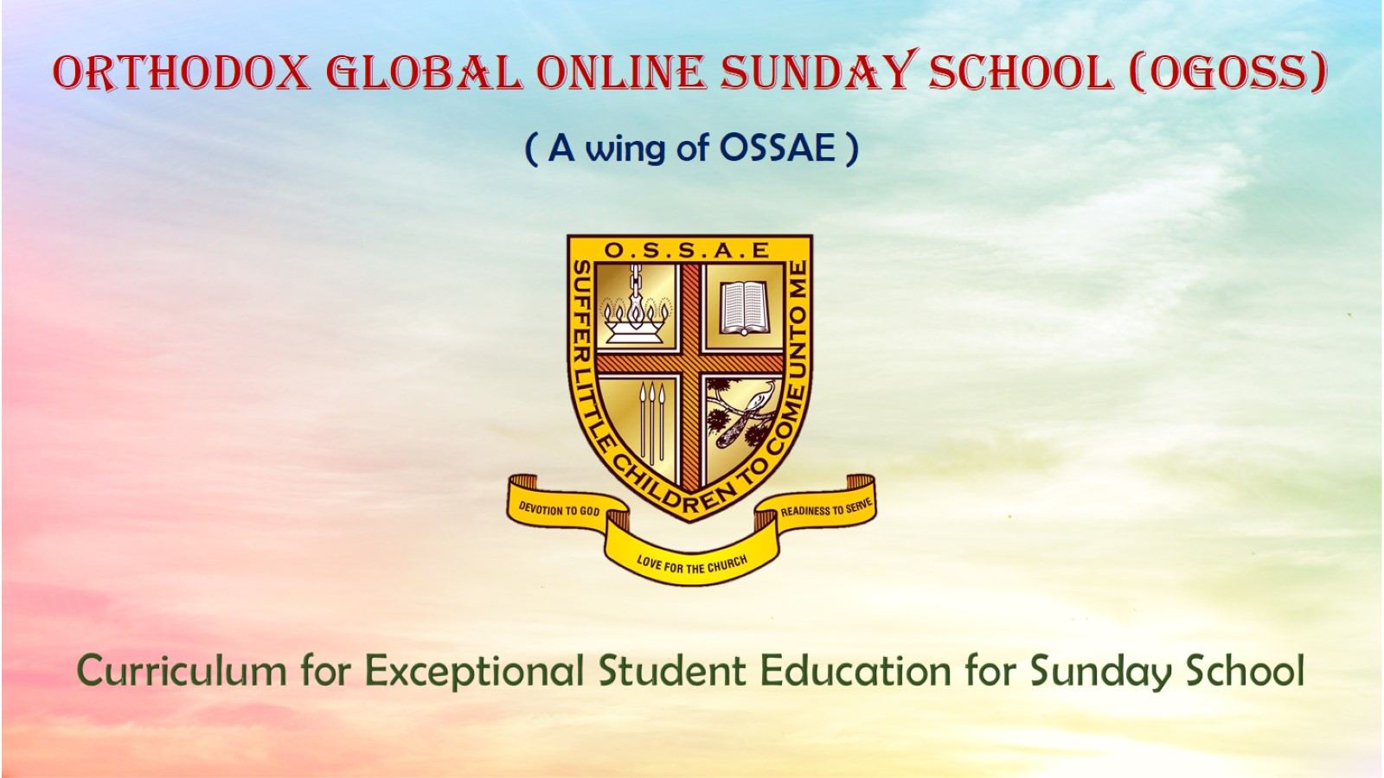
Orthodox Global Online Sunday School (OGOSS)

Slide 2
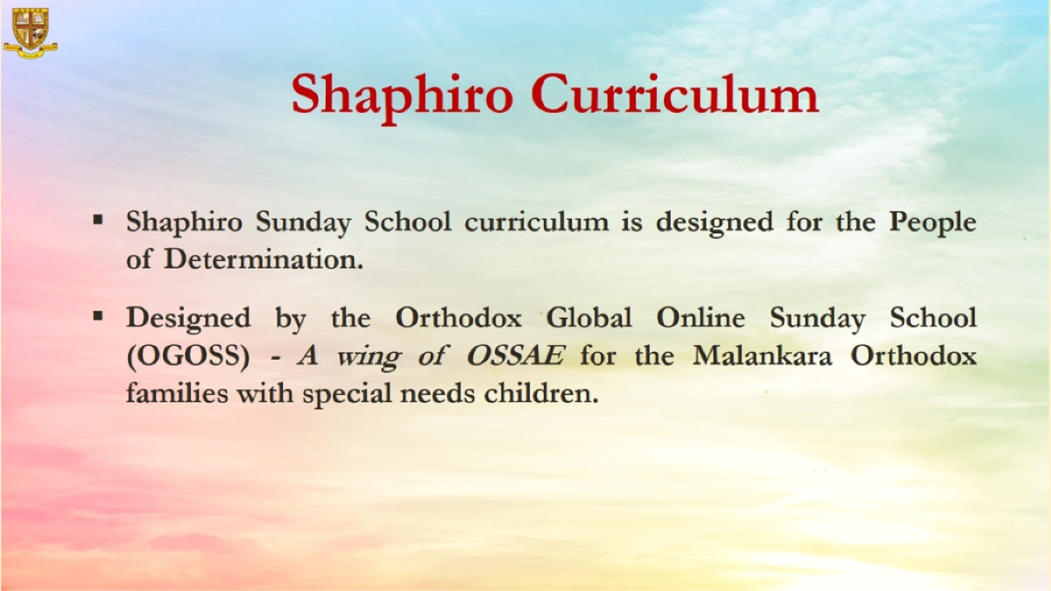

Slide 3
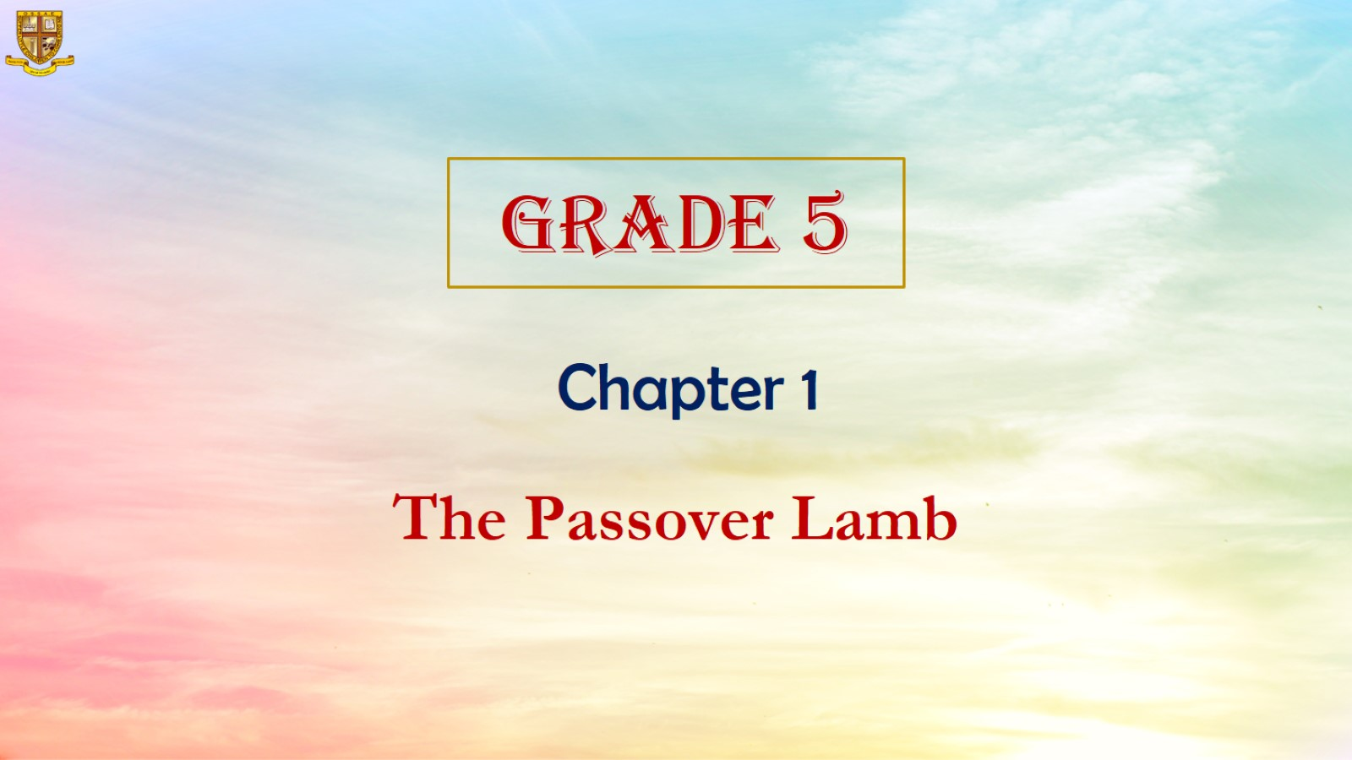

Slide 4
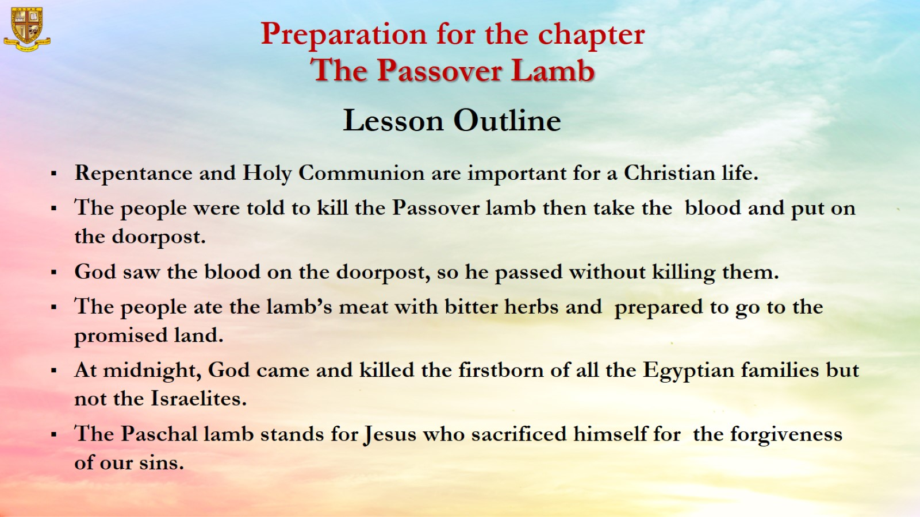

Slide 5
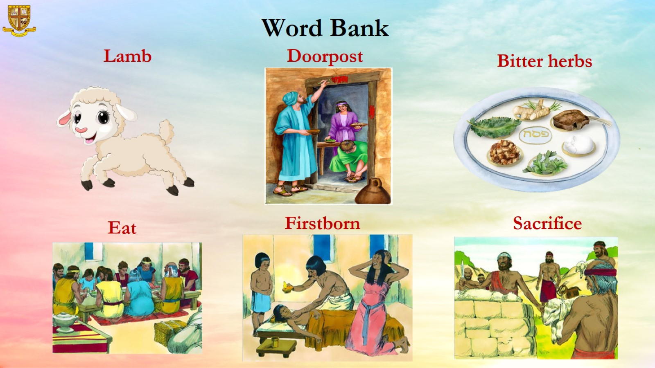

Slide 6
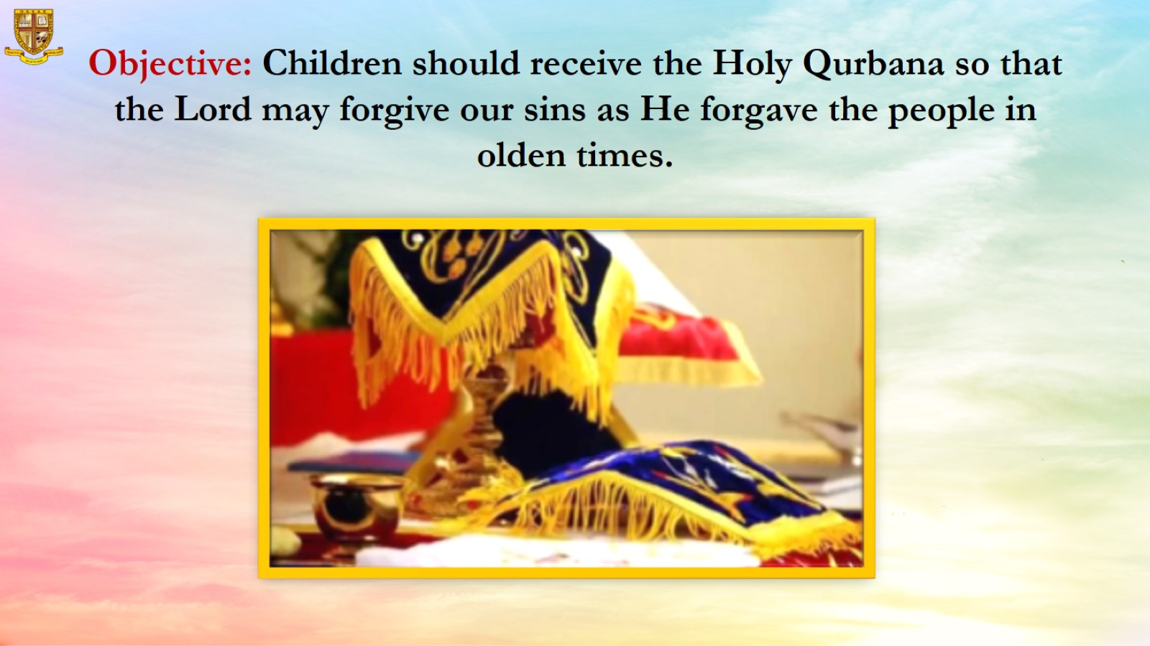
Objective: Children should receive the Holy Qurbana so that the Lord may forgive our sins as He forgave the people in olden times.

Slide 7
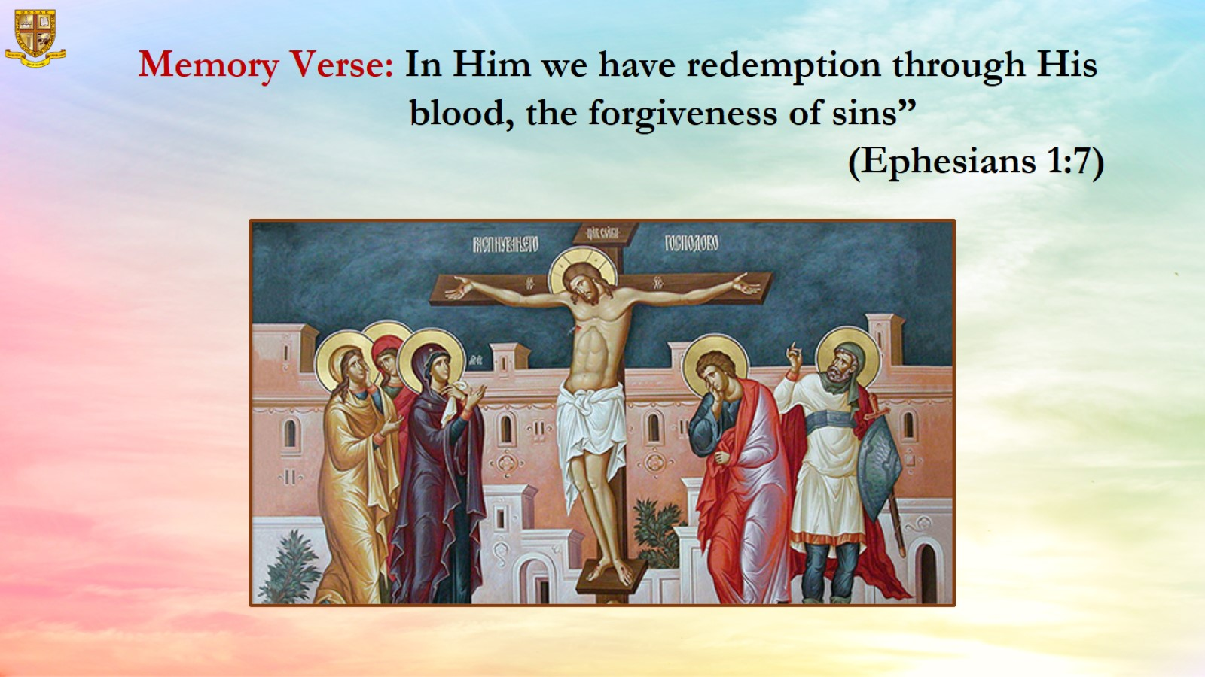
Memory Verse: In Him we have redemption through His blood, the forgiveness of sins”
(Ephesians 1:7)

Slide 8
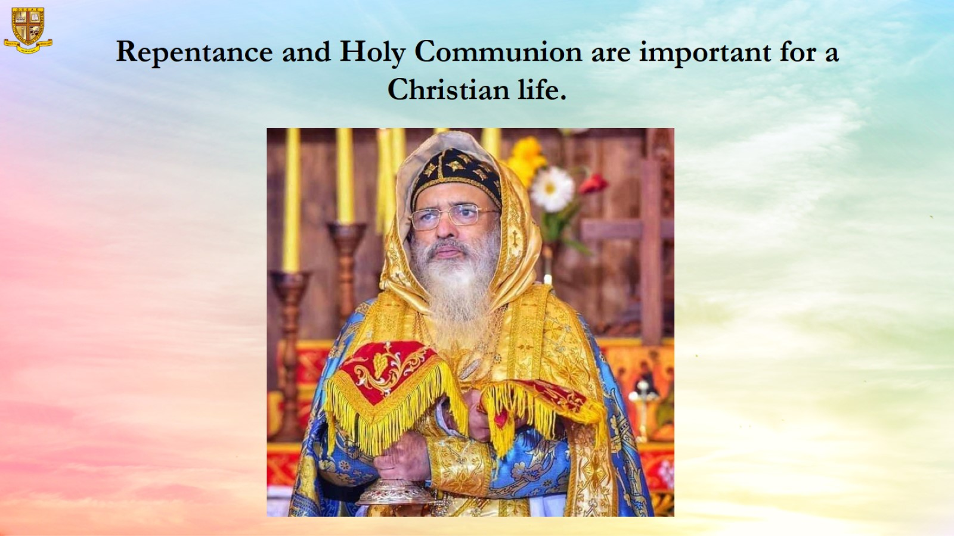
Repentance and Holy Communion are important for a Christian life.

Slide 9
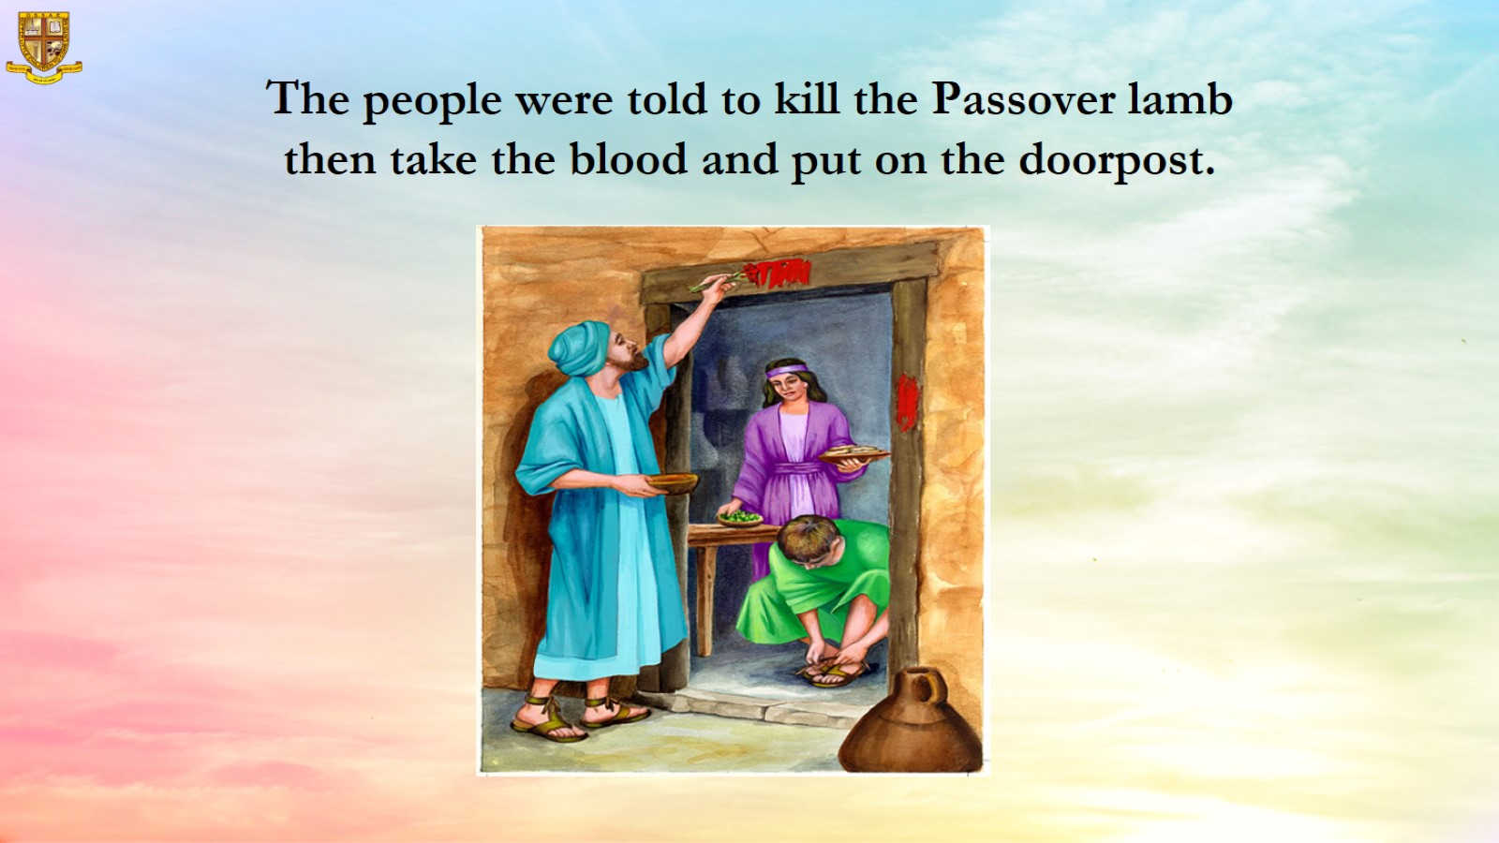
The people were told to kill the Passover lamb then take the blood and put on the doorpost.

Slide 10
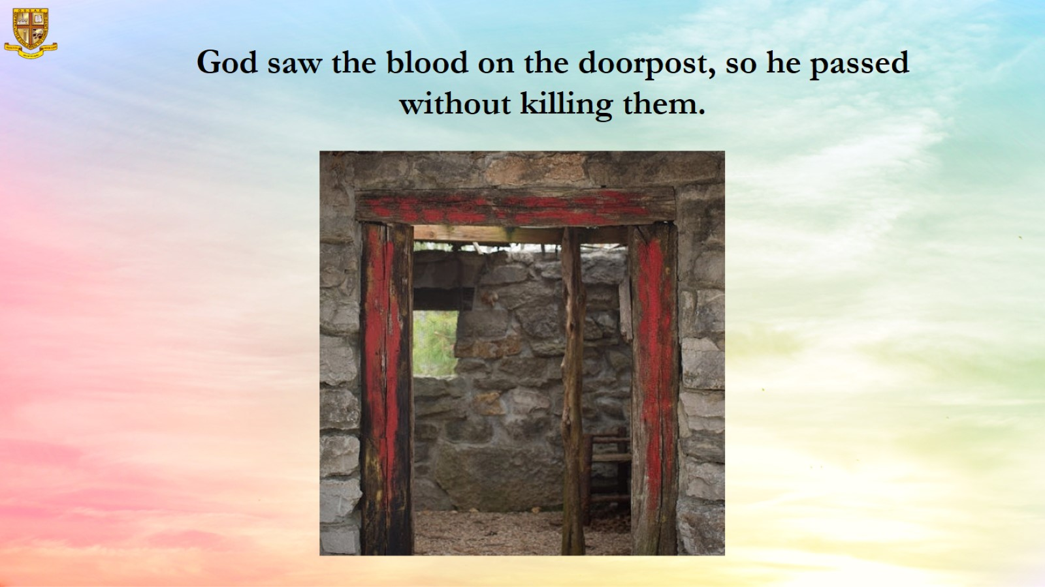
  God saw the blood on the doorpost, so he passed without killing them.

Slide 11
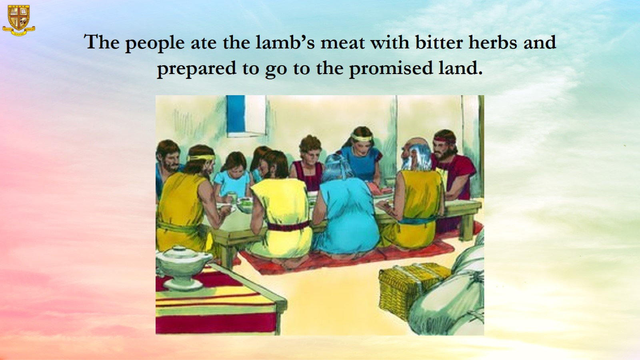
The people ate the lamb’s meat with bitter herbs and prepared to go to the promised land.

Slide 12
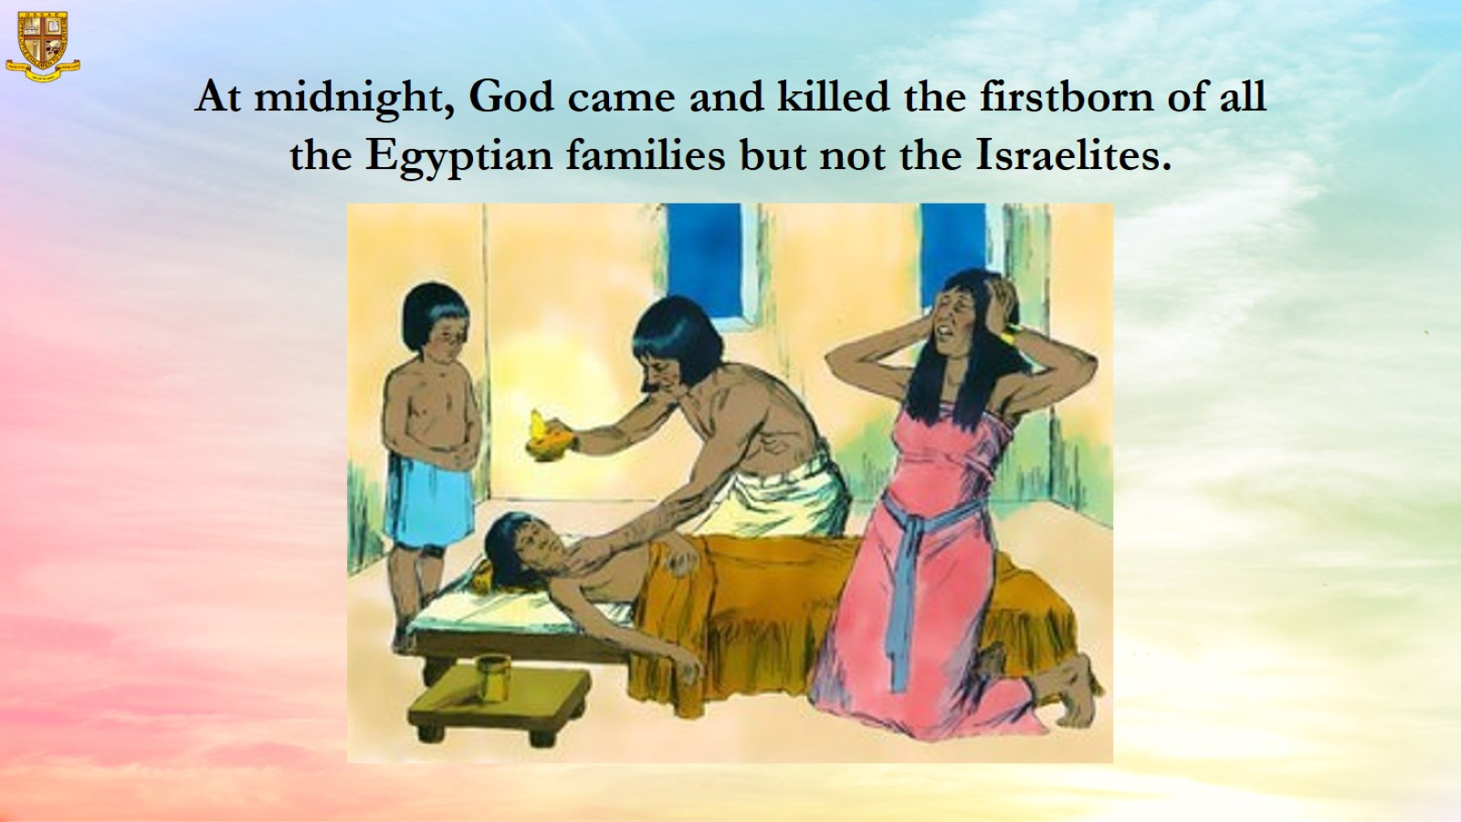
At midnight, God came and killed the firstborn of all the Egyptian families but not the Israelites.

Slide 13
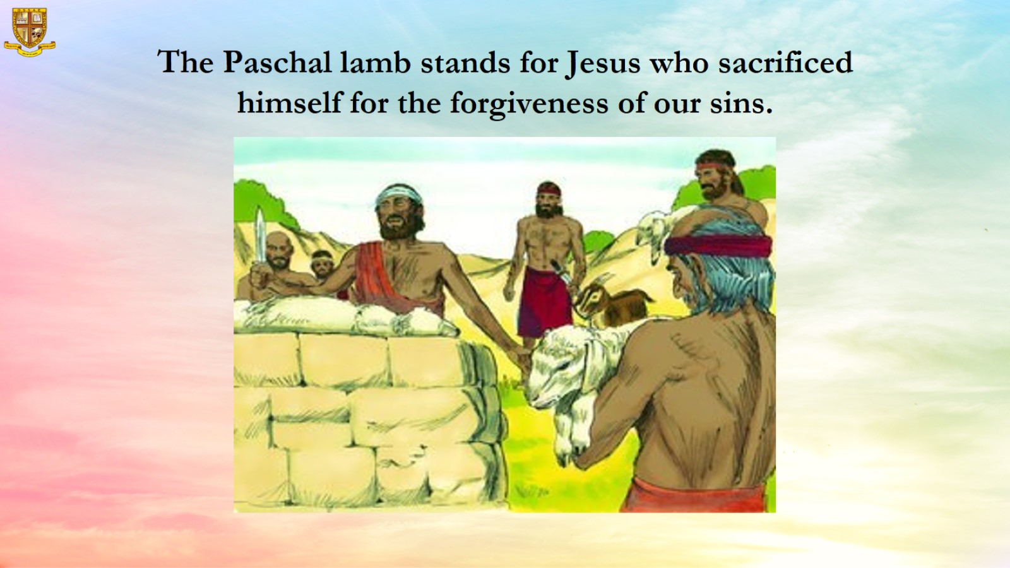
The Paschal lamb stands for Jesus who sacrificed himself for the forgiveness of our sins.

Slide 14
