Slide 1
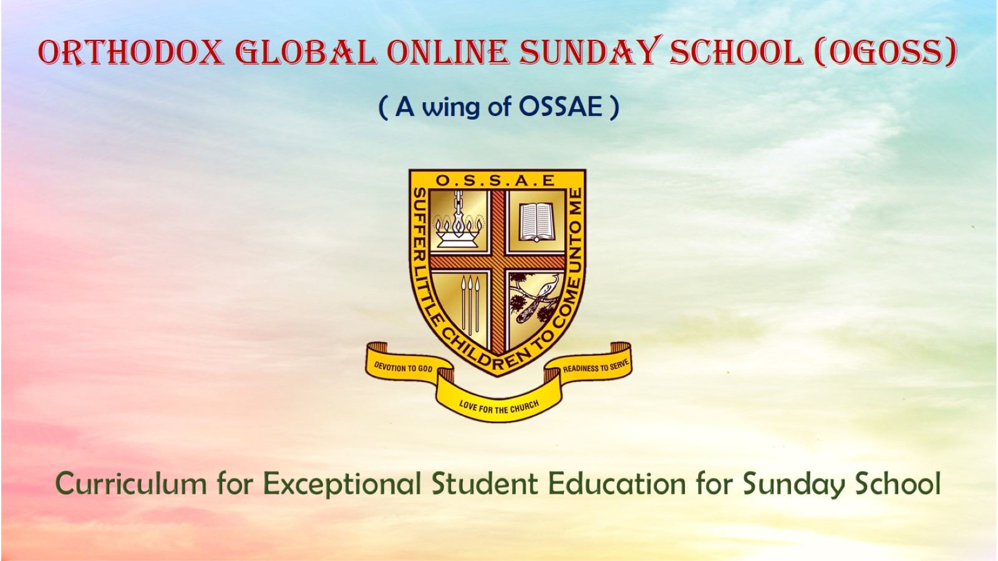
Orthodox Global Online Sunday School (OGOSS)

Slide 2
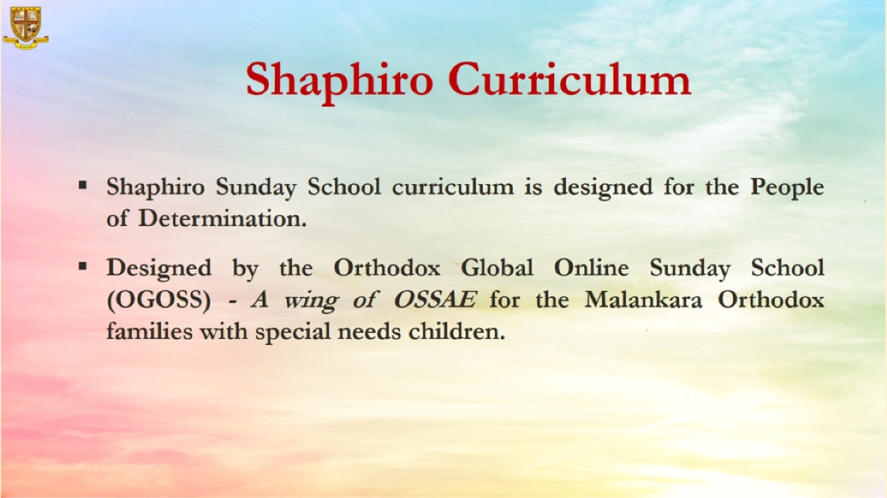

Slide 3
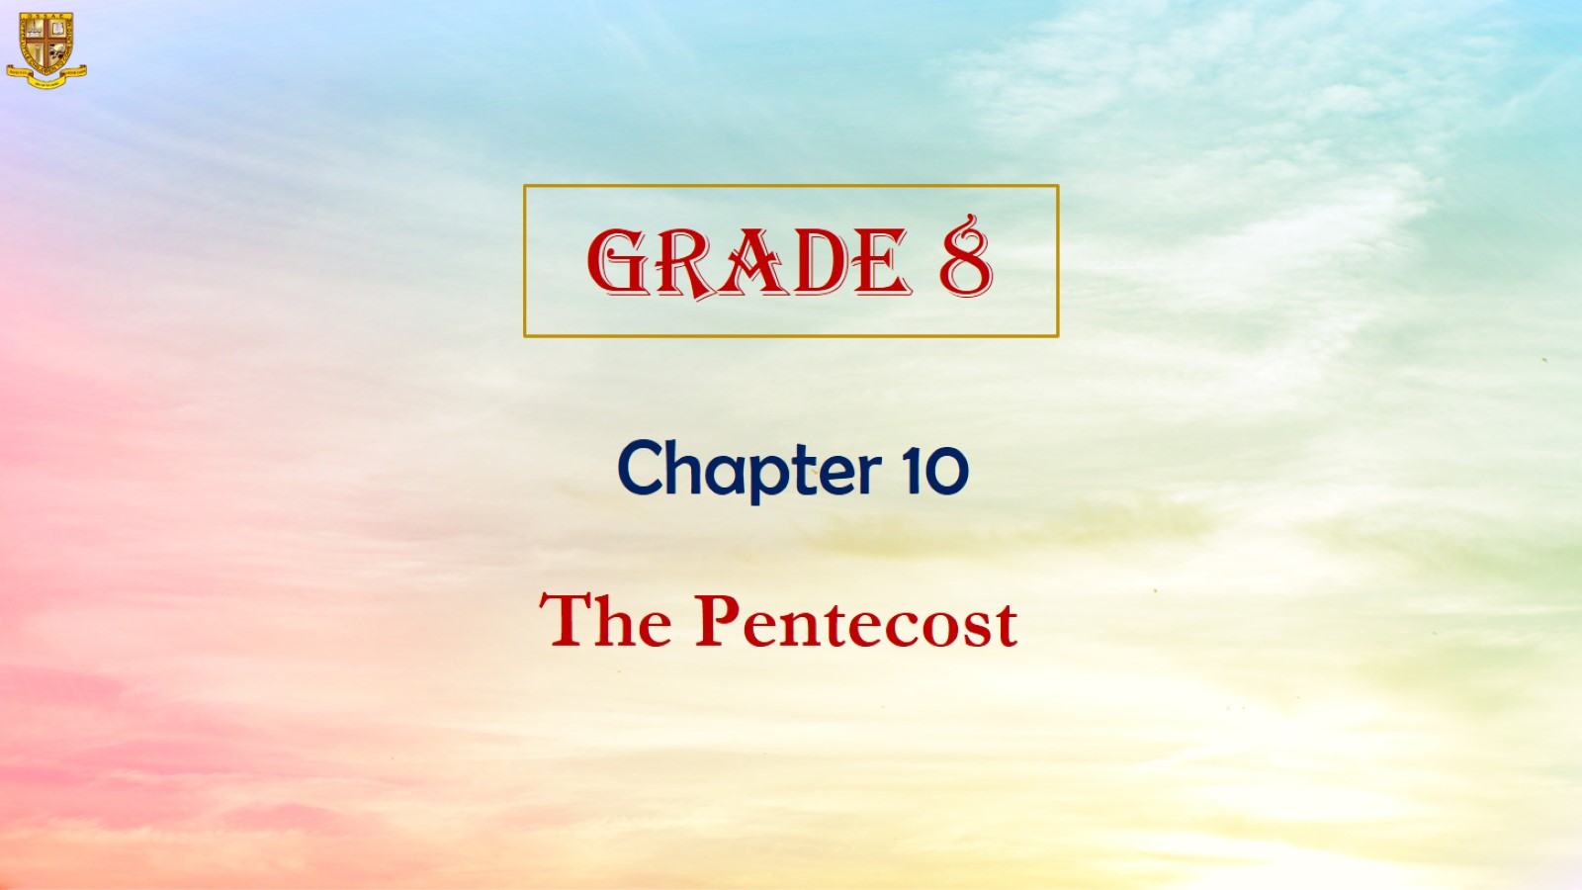

Slide 4
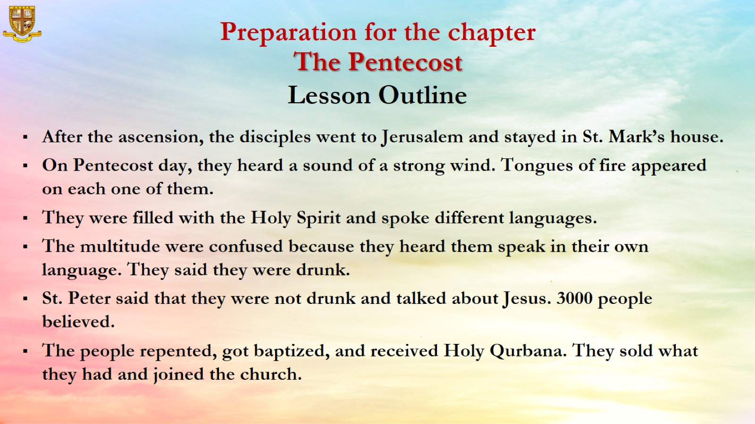

Slide 5
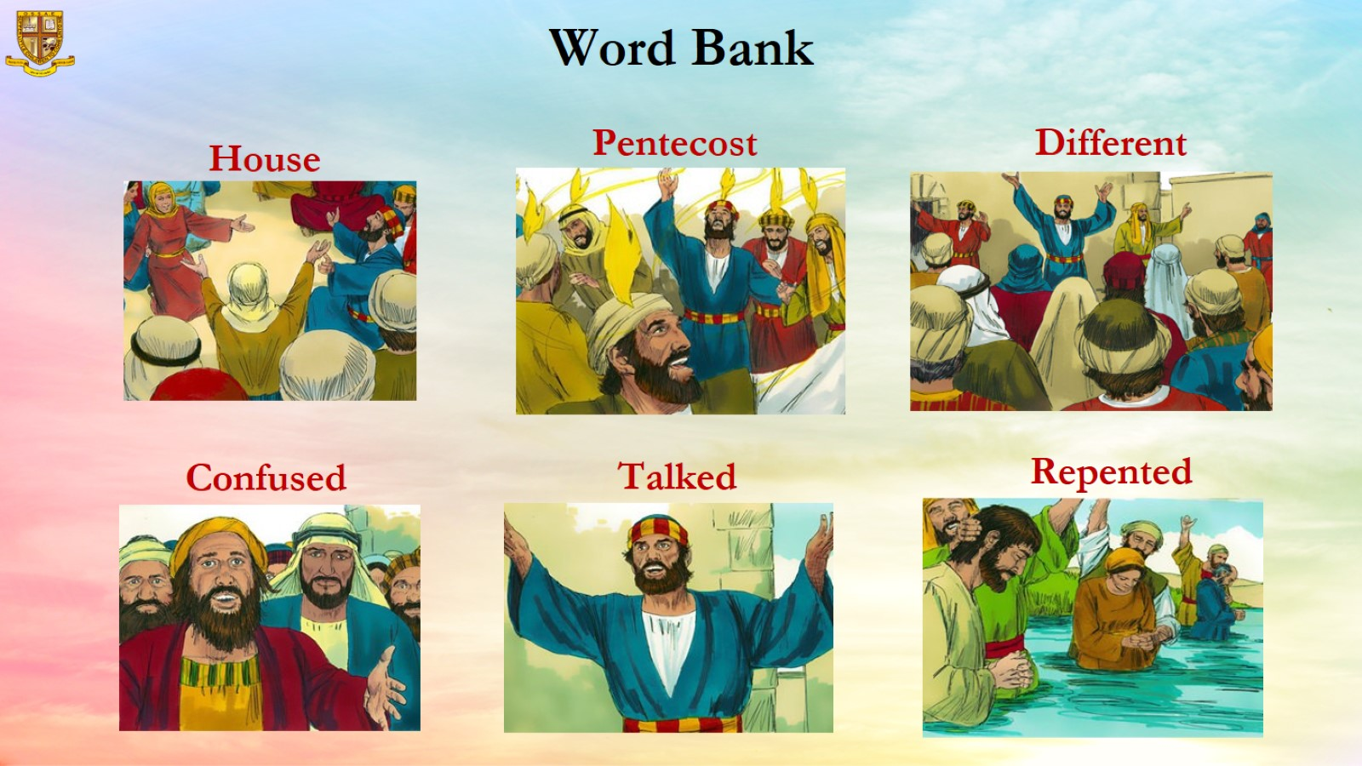

Slide 6
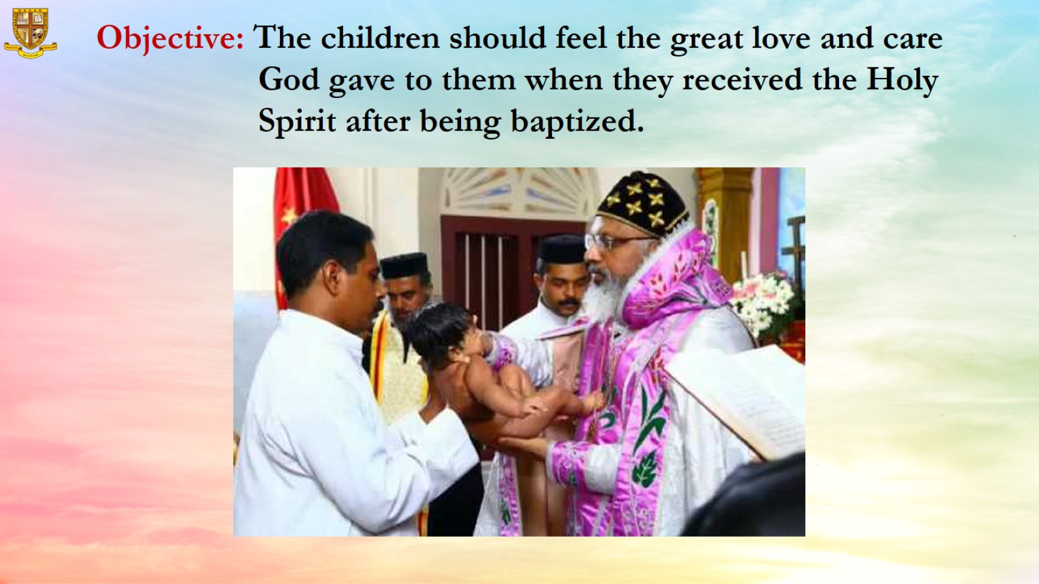
Objective: The children should feel the great love and care
God gave to them when they received the Holy Spirit after being baptized.

Slide 7
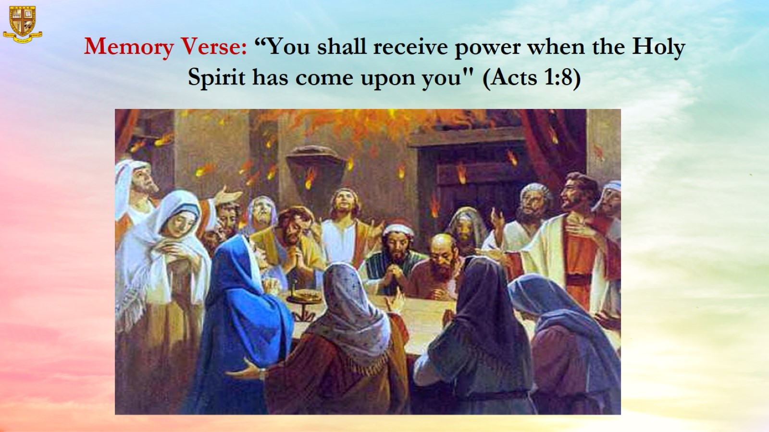
Memory Verse: “You shall receive power when the Holy Spirit has come upon you" (Acts 1:8)

Slide 8
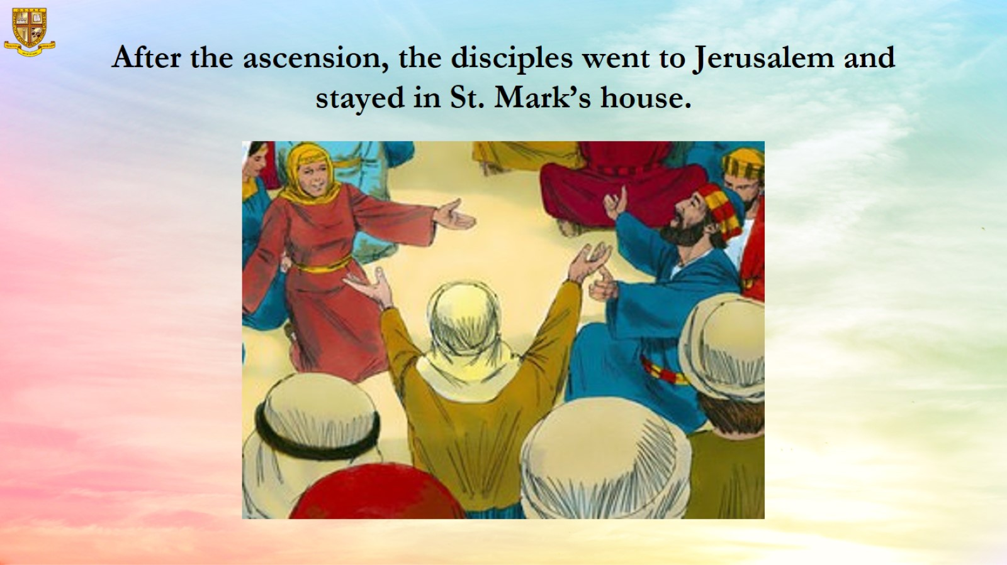
After the ascension, the disciples went to Jerusalem and stayed in St. Mark’s house.

Slide 9
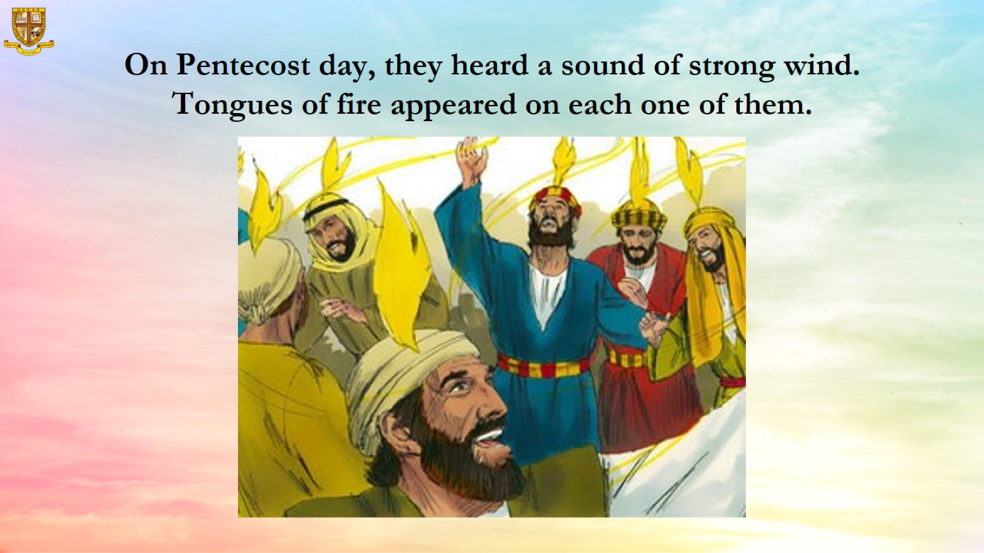
On Pentecost day, they heard a sound of strong wind. Tongues of fire appeared on each one of them.

Slide 10
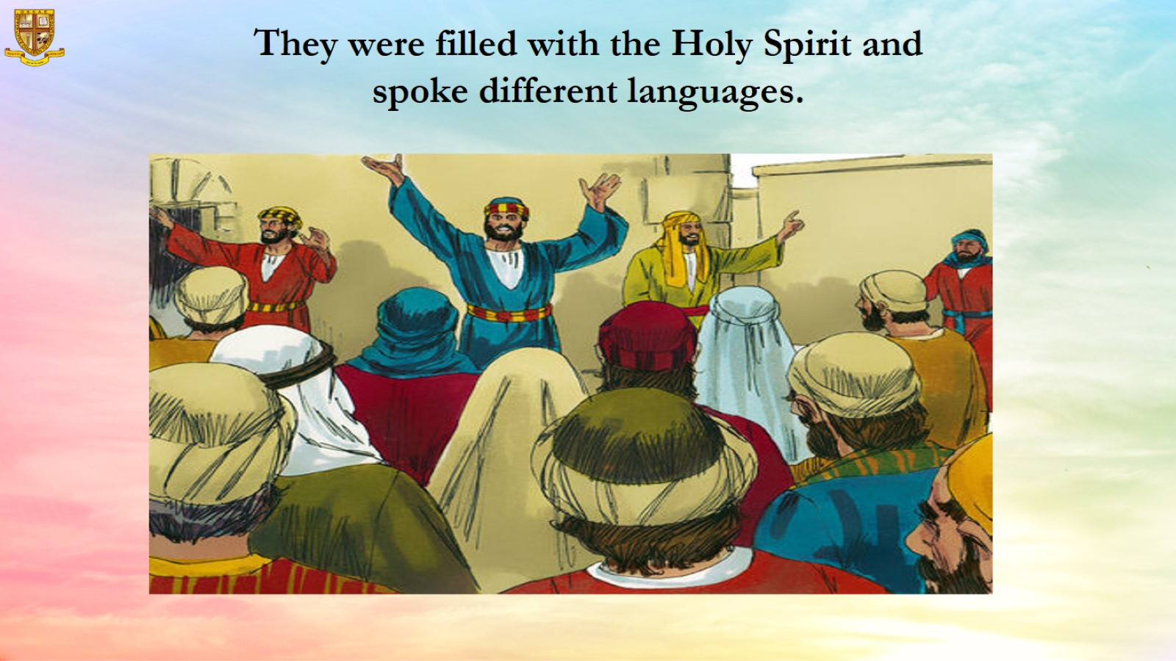
They were filled with the Holy Spirit and spoke different languages.

Slide 11
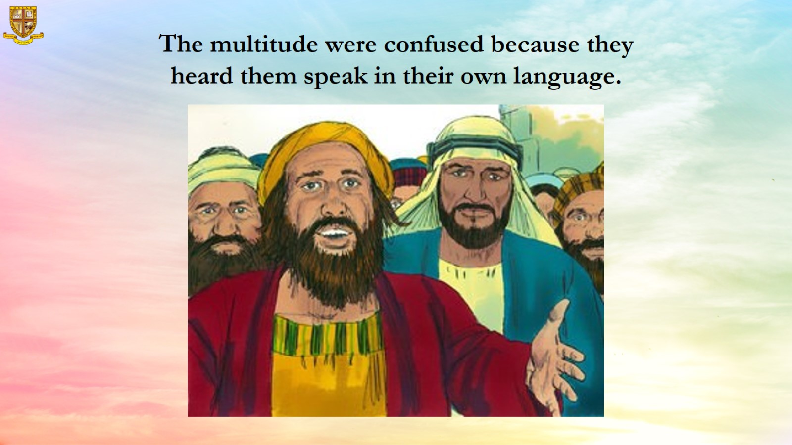
The multitude were confused because they heard them speak in their own language.

Slide 12
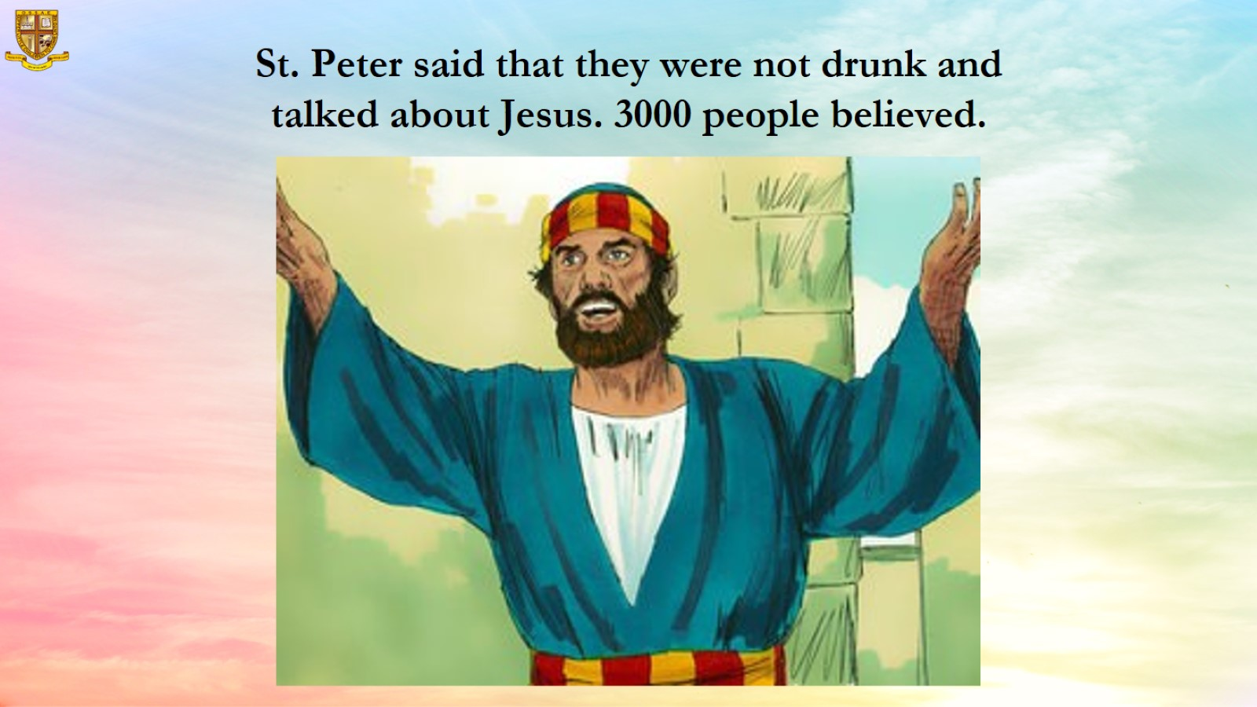
St. Peter said that they were not drunk and talked about Jesus. 3000 people believed.

Slide 13
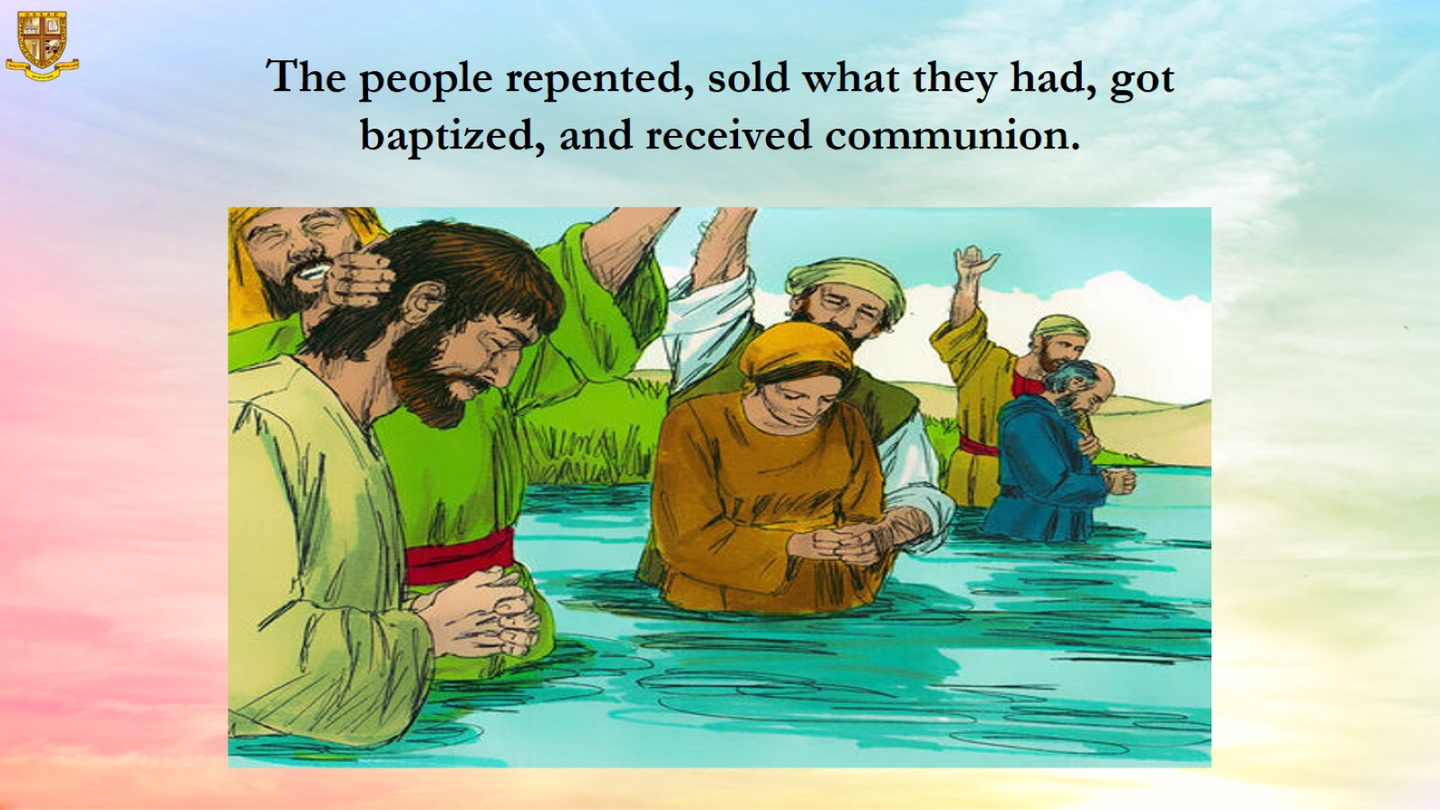
The people repented, sold what they had, got baptized, and received communion.

Slide 14
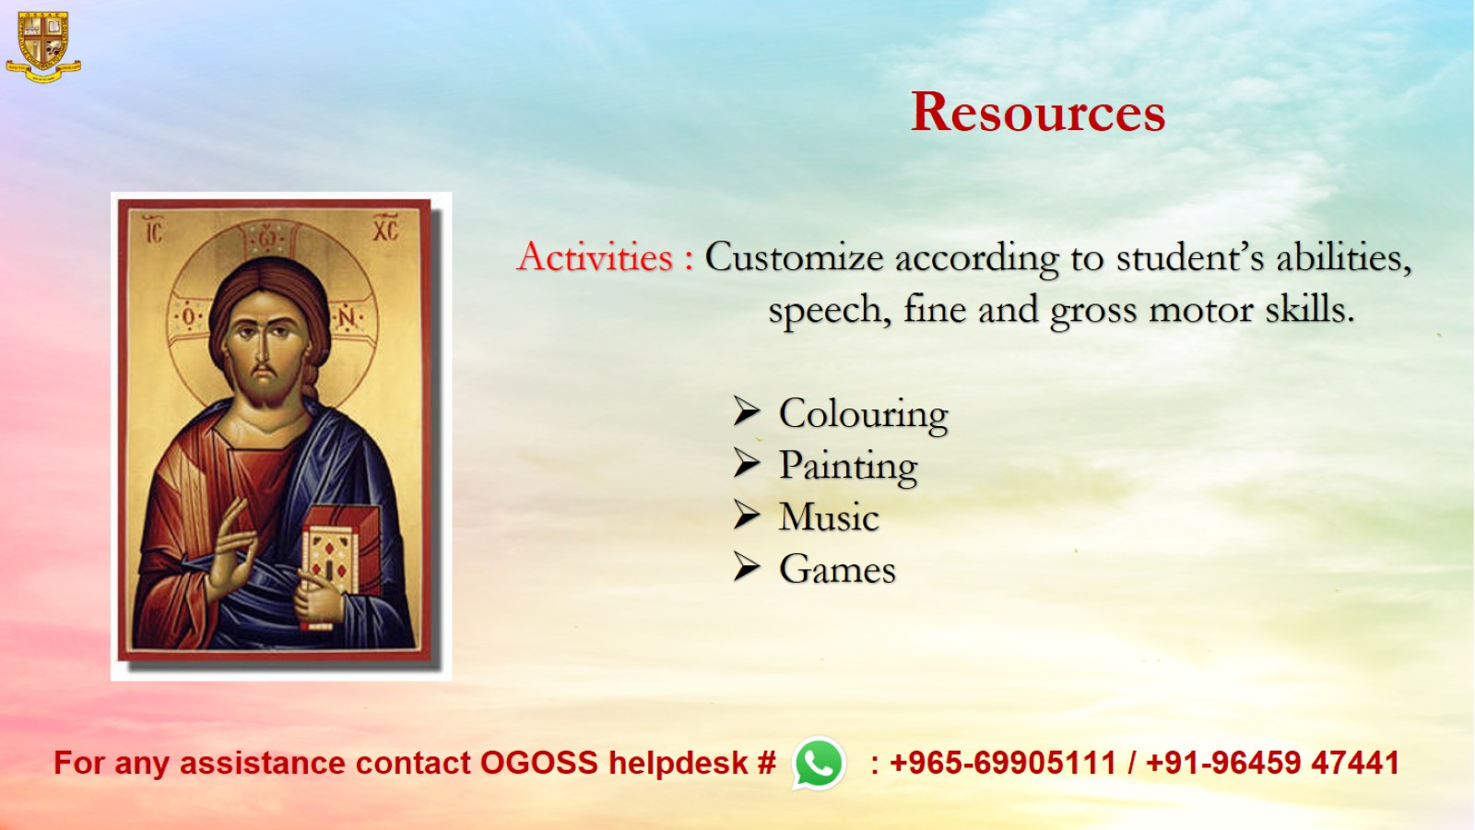
Resources

