Slide 1
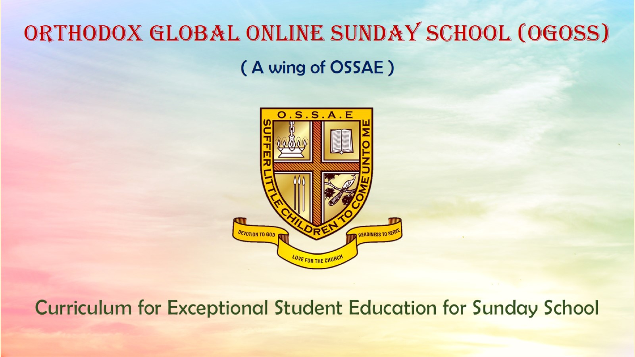
Orthodox Global Online Sunday School (OGOSS)

Slide 2
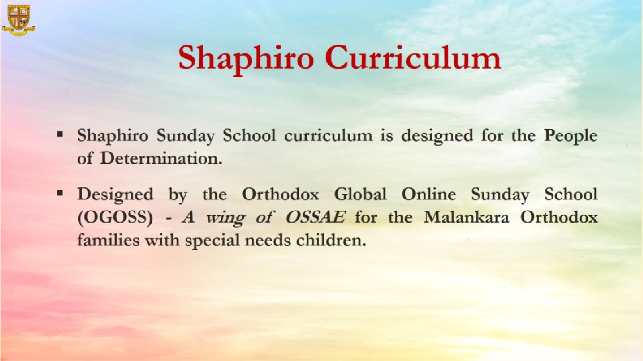

Slide 3
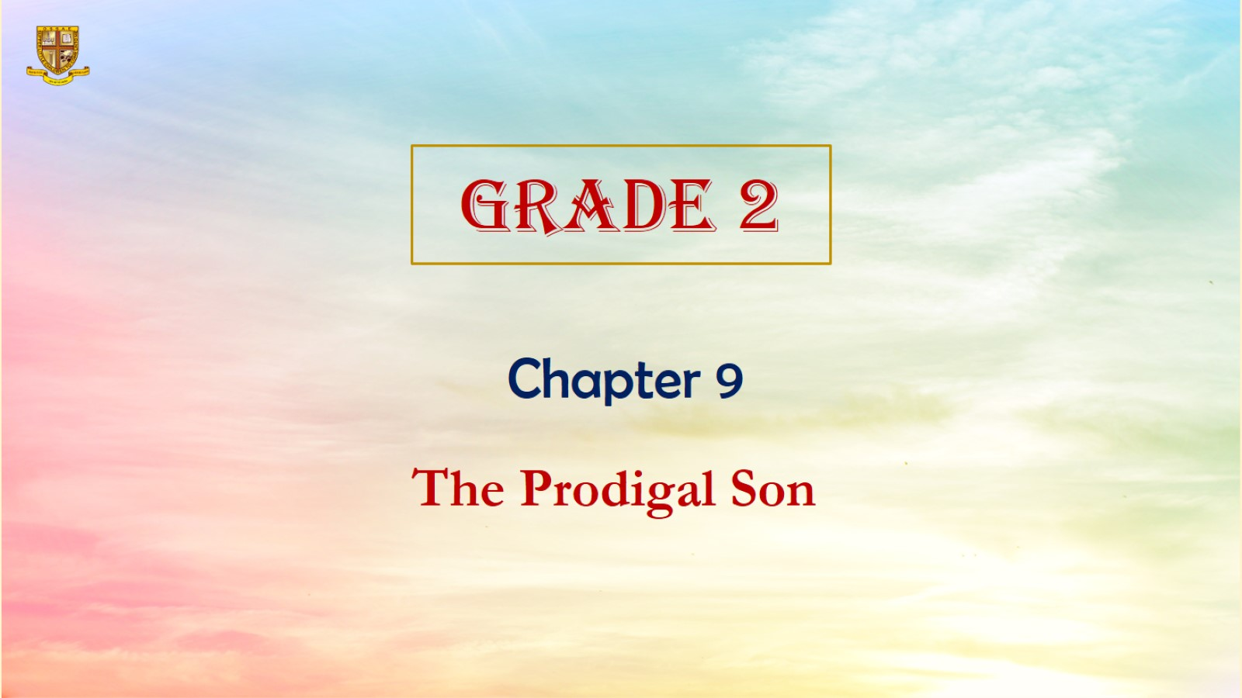

Slide 4
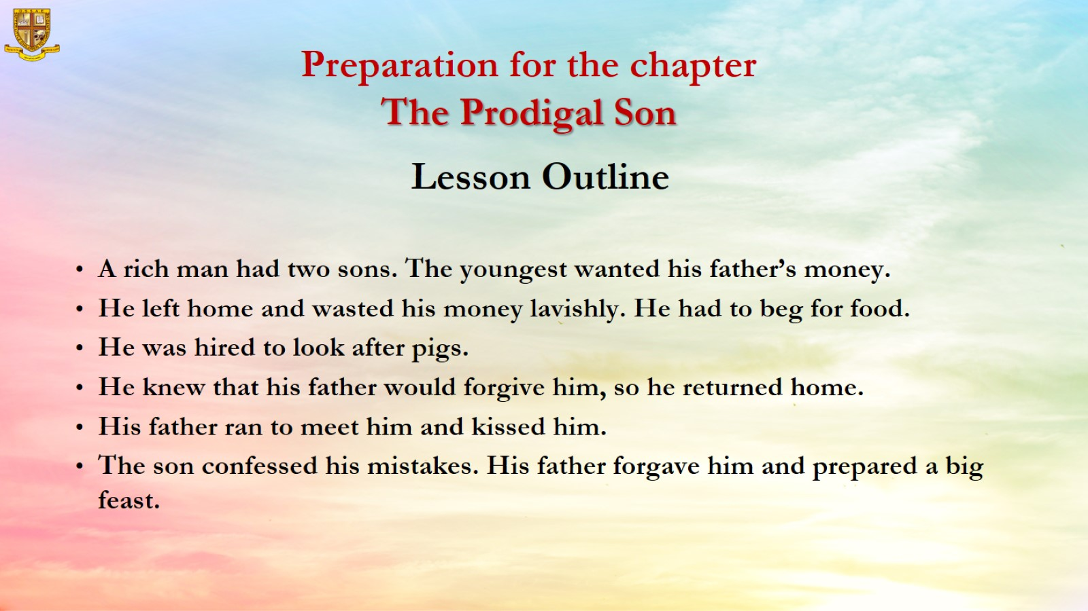
Preparation for the chapter
The Prodigal Son

Slide 5
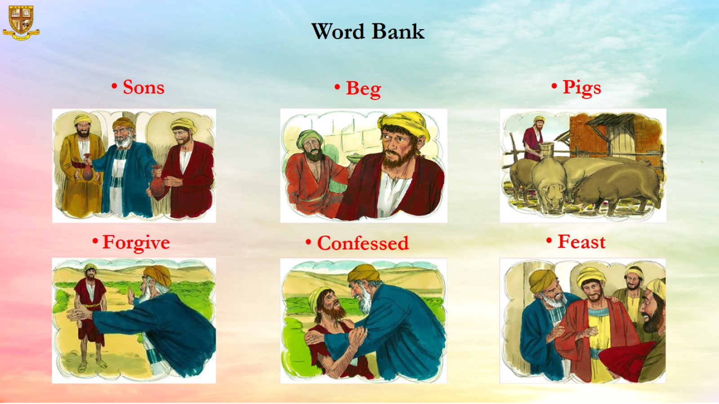
Word Bank

Slide 6
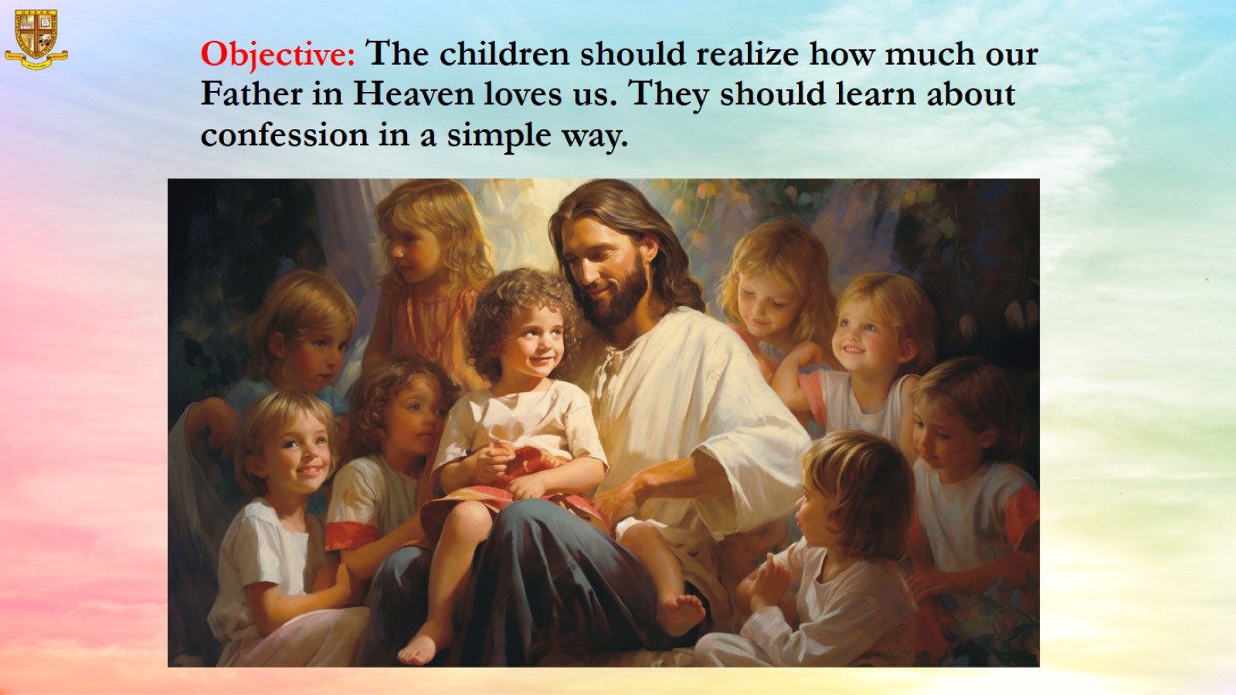
Objective: The children should realize how much our Father in Heaven loves us. They should learn about confession in a simple way.

Slide 7
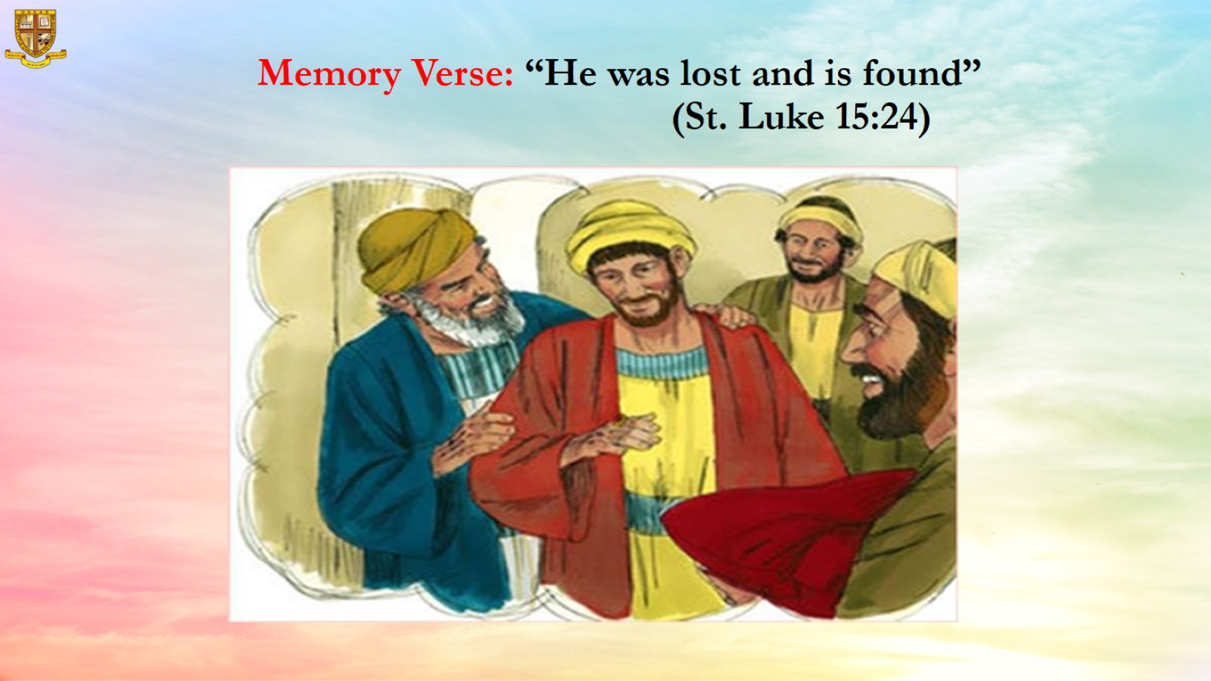
Memory Verse: “He was lost and is found” (St. Luke 15:24)

Slide 8
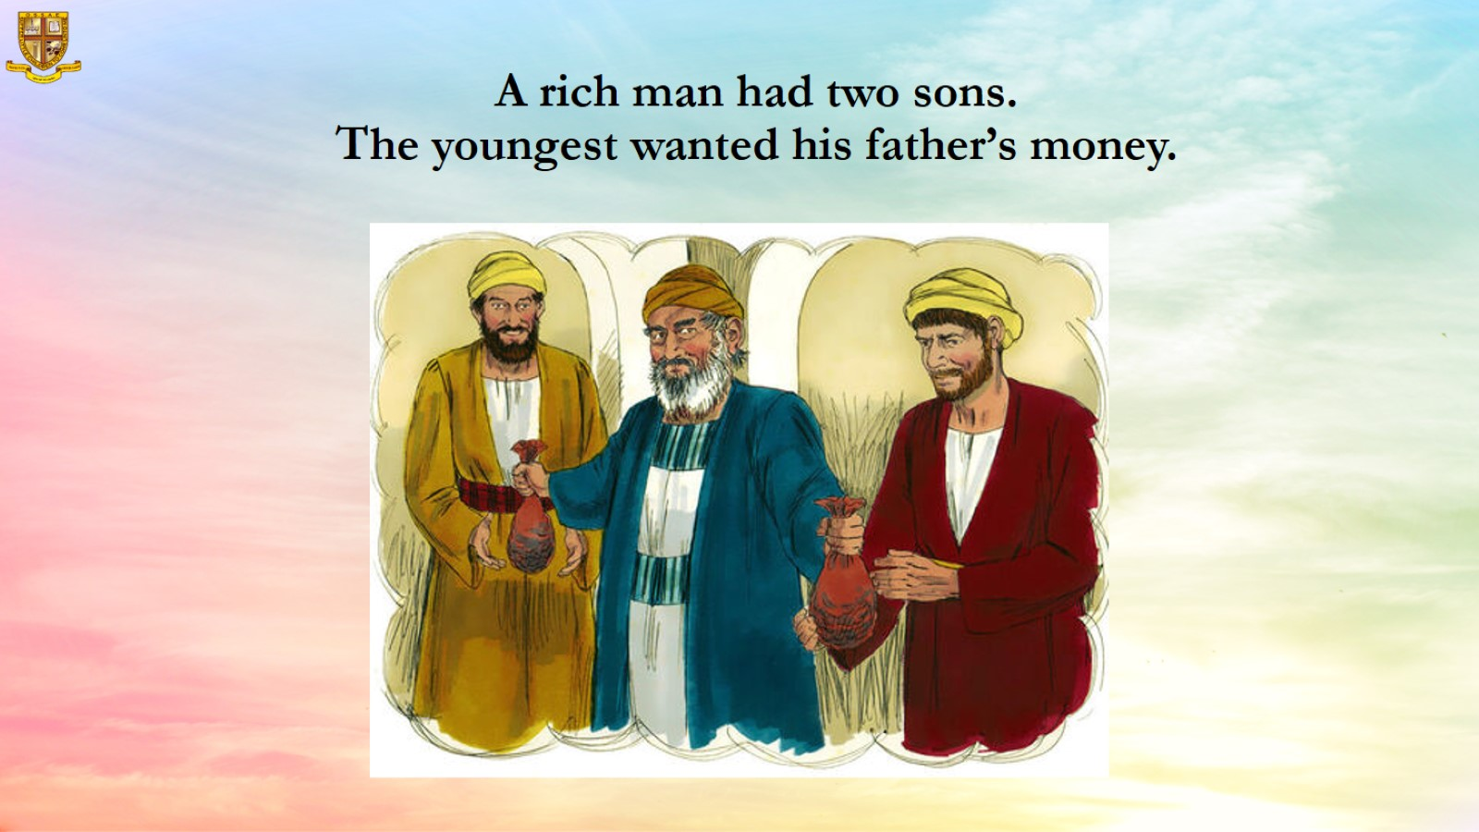
A rich man had two sons.
The youngest wanted his father’s money.

Slide 9
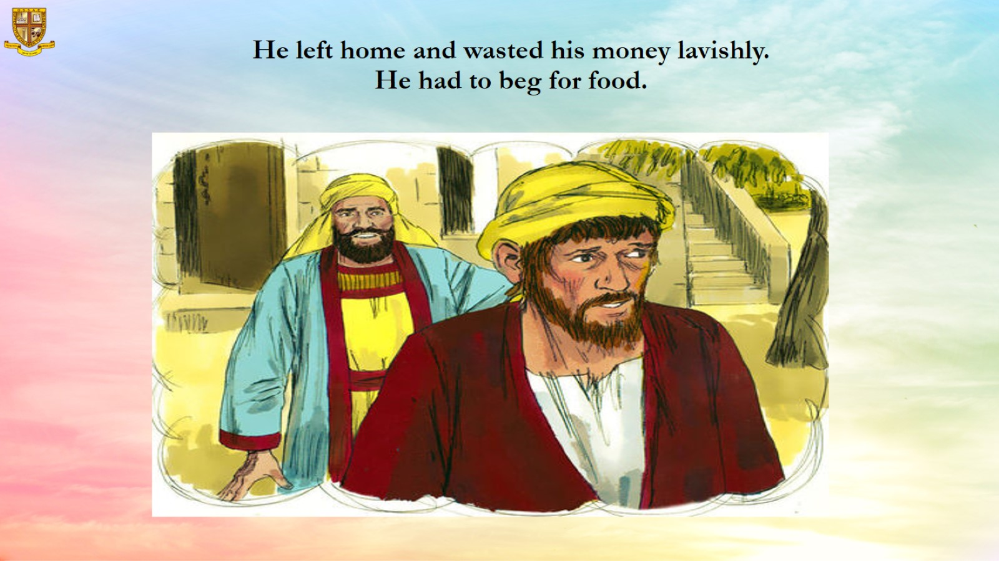
He left home and wasted his money lavishly.
He had to beg for food.

Slide 10
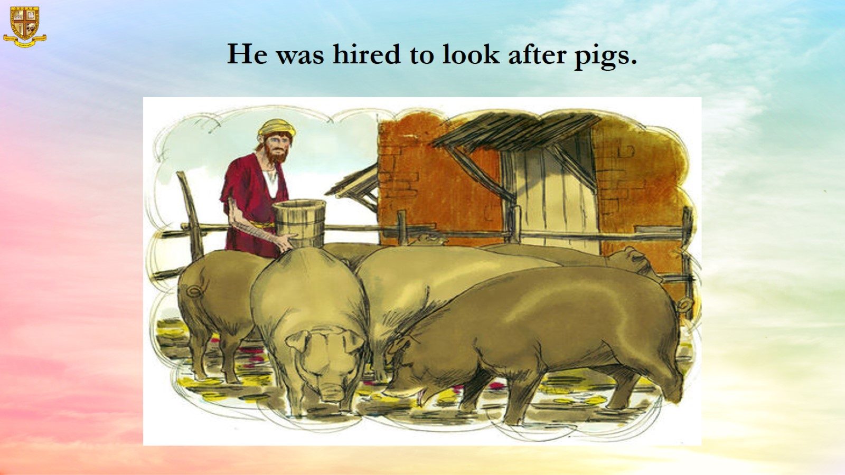
He was hired to look after pigs.

Slide 11
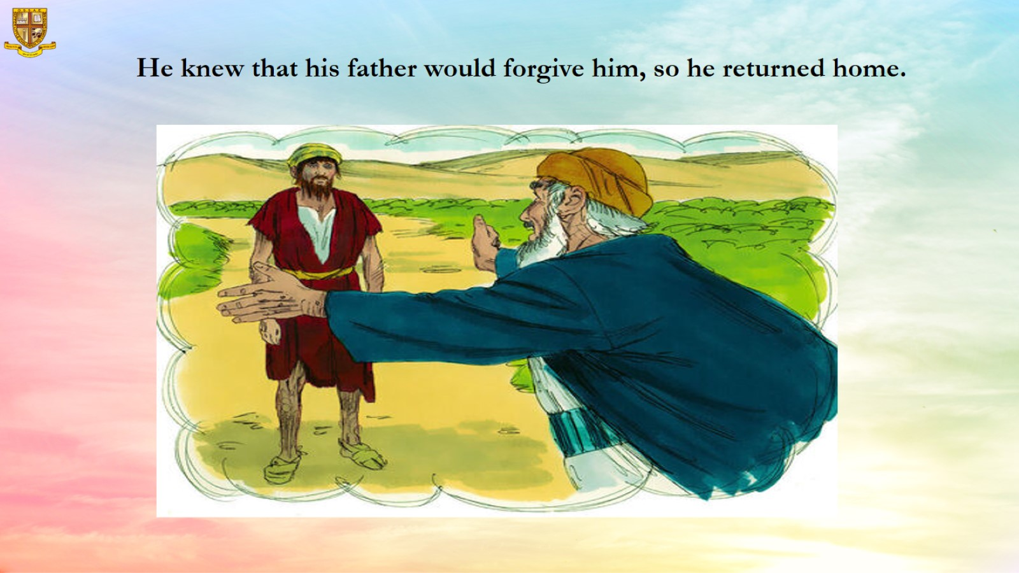
He knew that his father would forgive him, so he returned home.

Slide 12
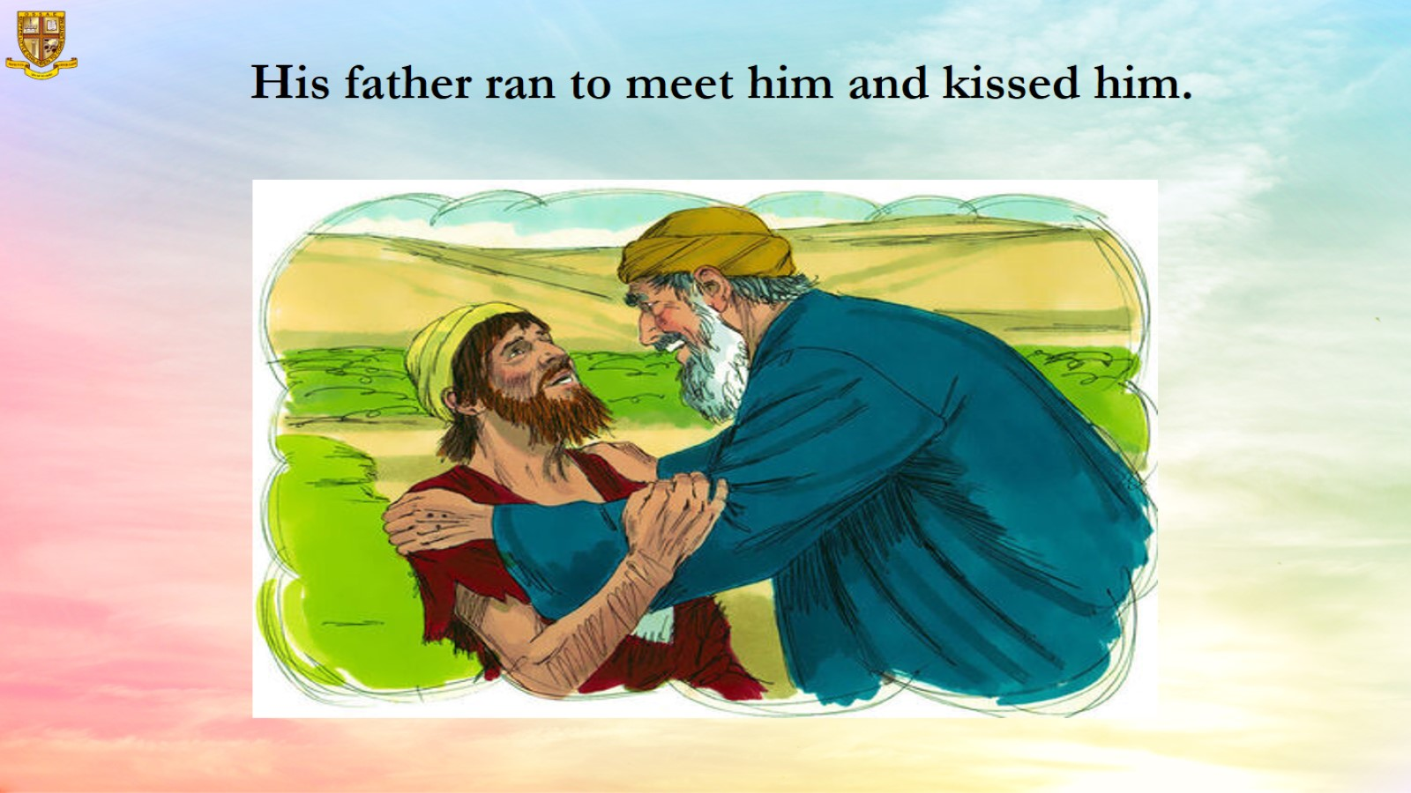
His father ran to meet him and kissed him.

Slide 13
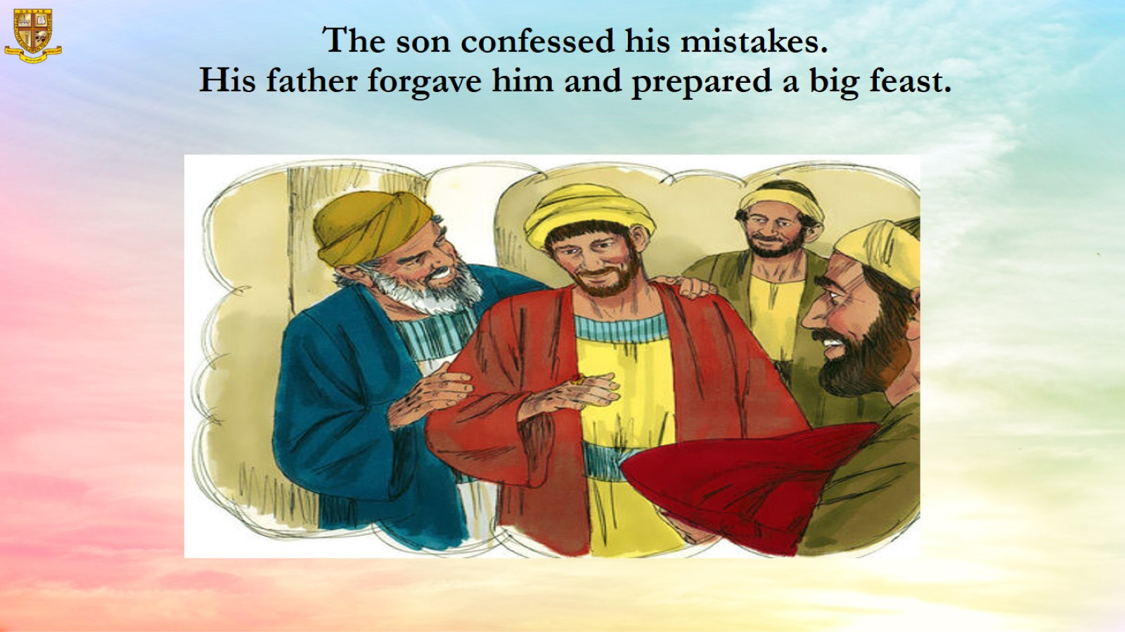
The son confessed his mistakes.
His father forgave him and prepared a big feast.

Slide 14
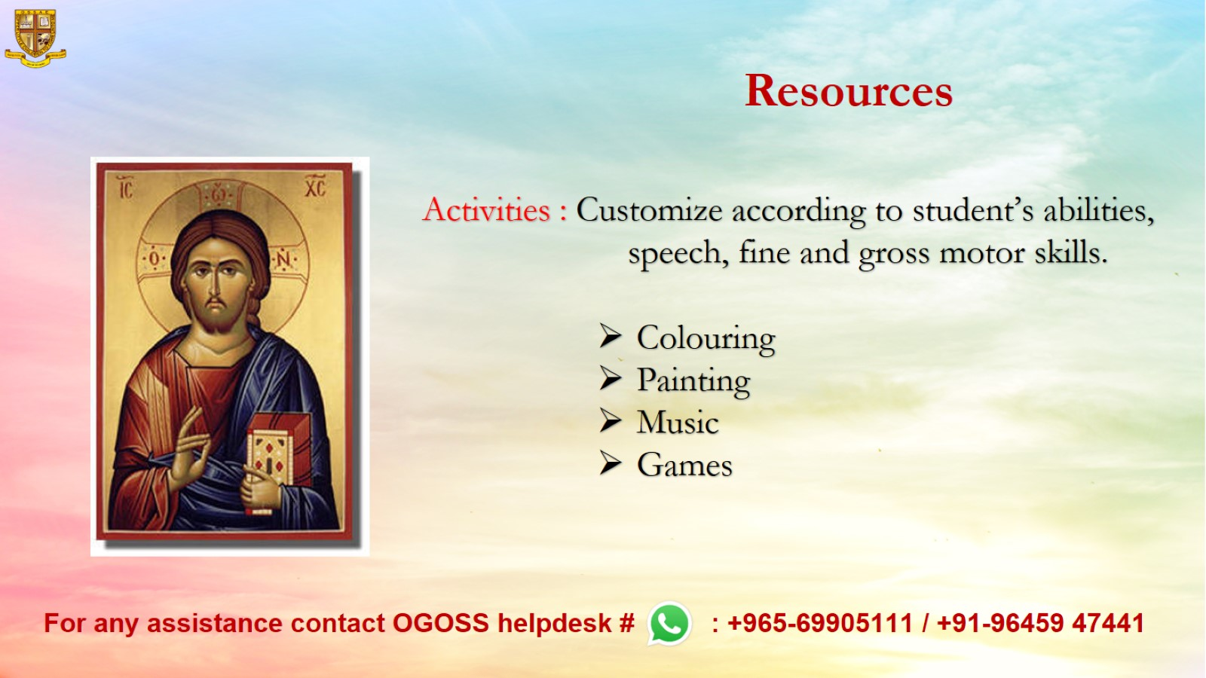
Resources

