Slide 1
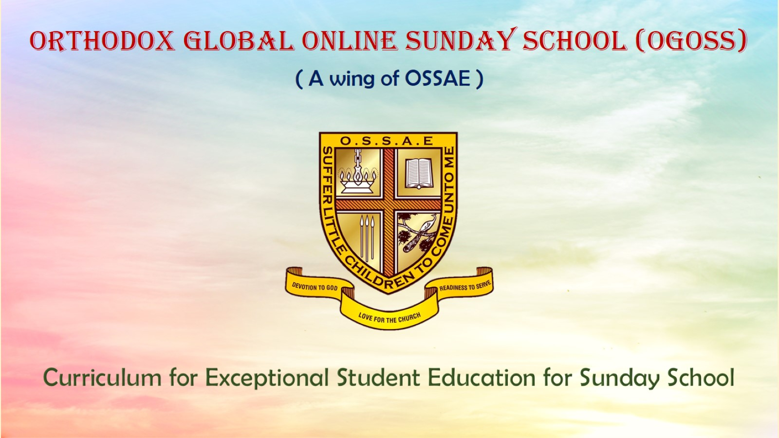
Orthodox Global Online Sunday School (OGOSS)

Slide 2
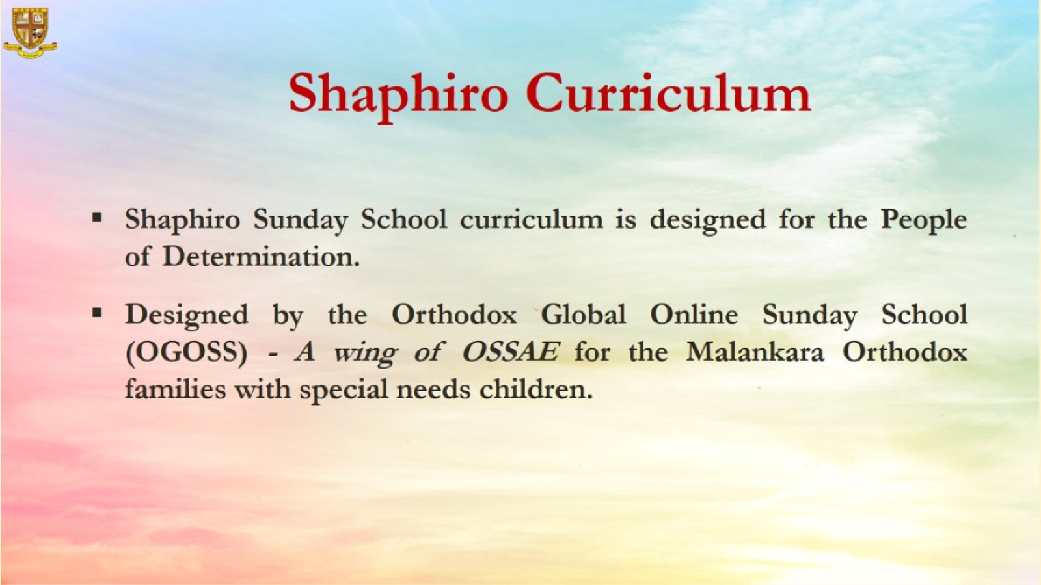

Slide 3
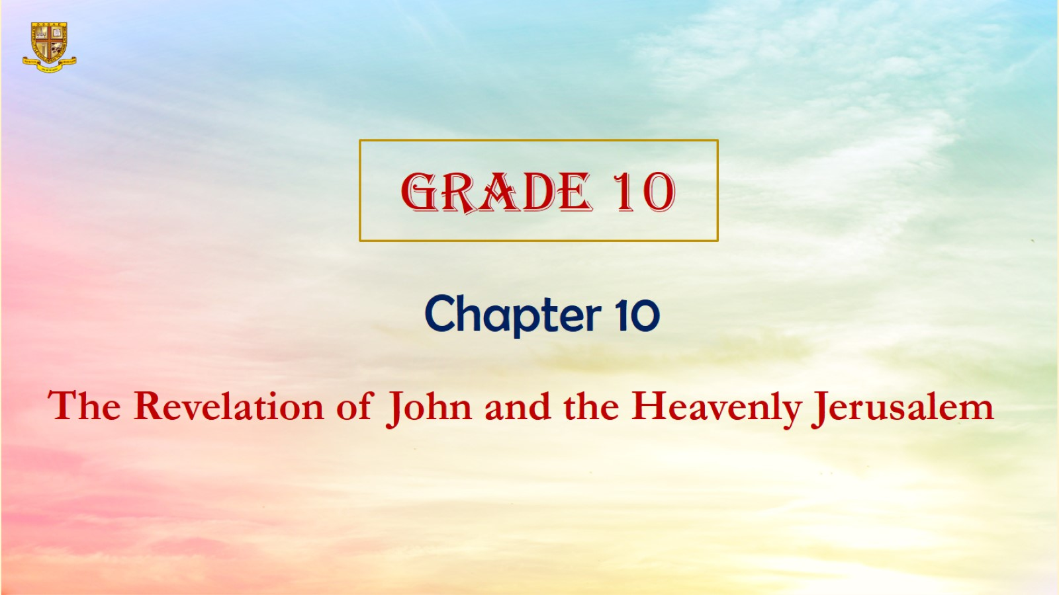

Slide 4
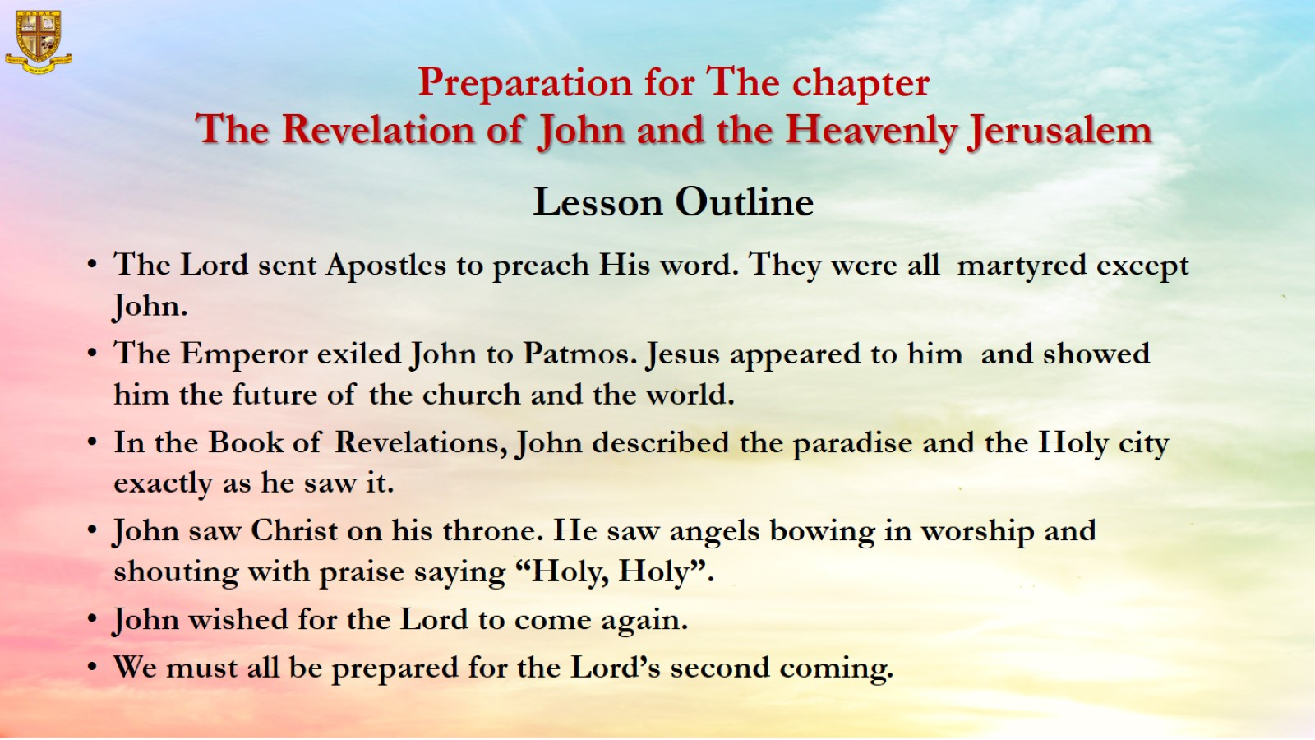
Preparation for The chapter
The Revelation of John and the Heavenly Jerusalem
Lesson Outline

Slide 5
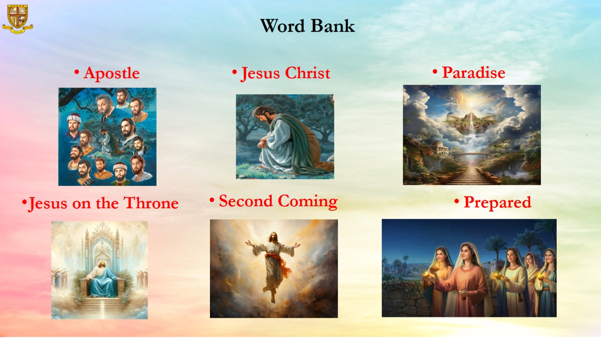
Word Bank

Slide 6
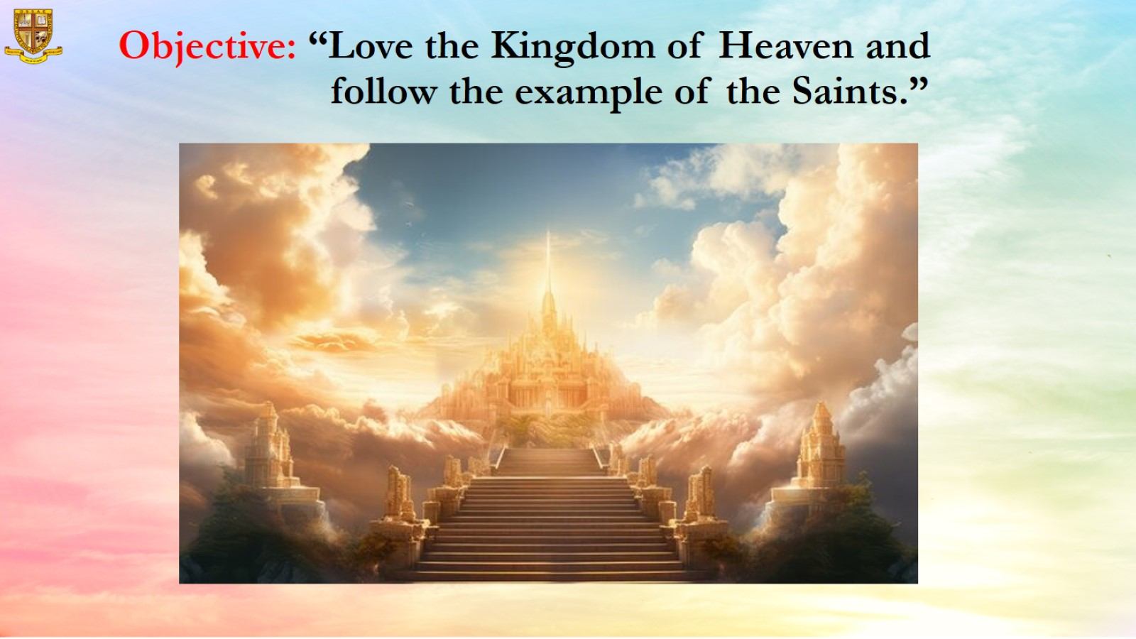
Objective: “Love the Kingdom of Heaven and follow the example of the Saints.”

Slide 7

Memory Verse: “Praise the Lord! Praise God in His Sanctuary”
Psalm 150:1

Slide 8
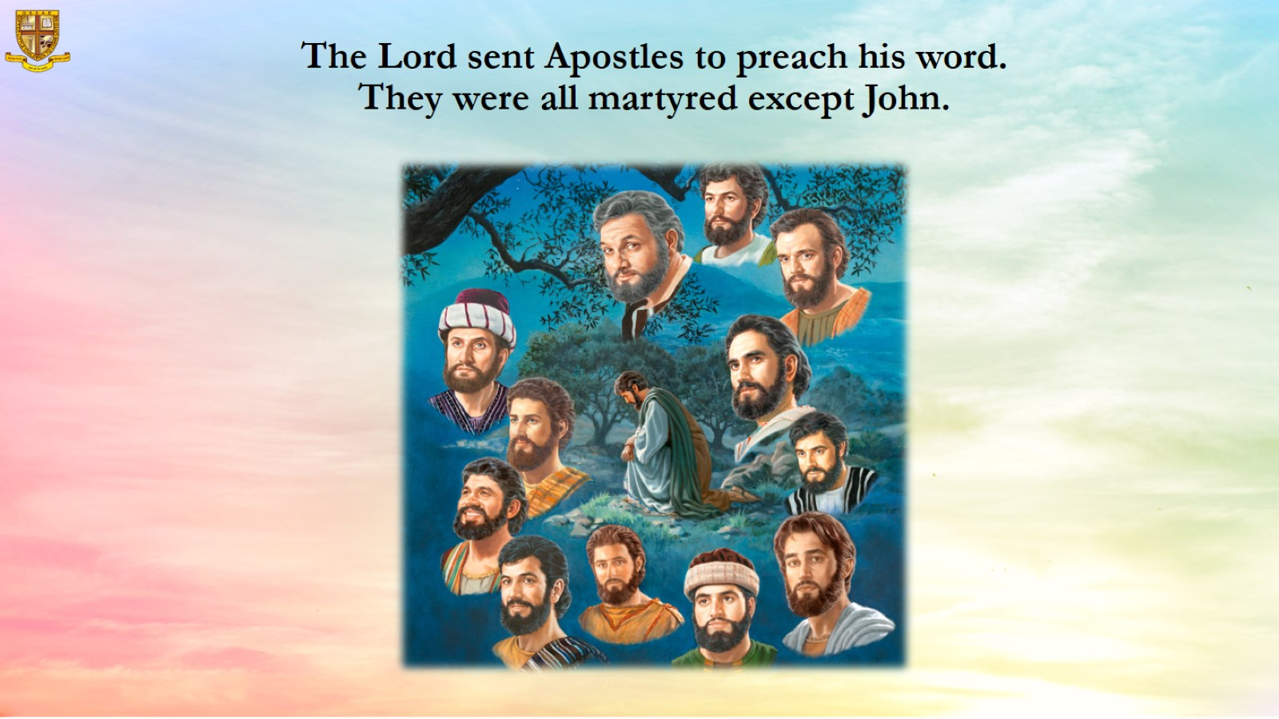
The Lord sent Apostles to preach his word.
They were all martyred except John.

Slide 9
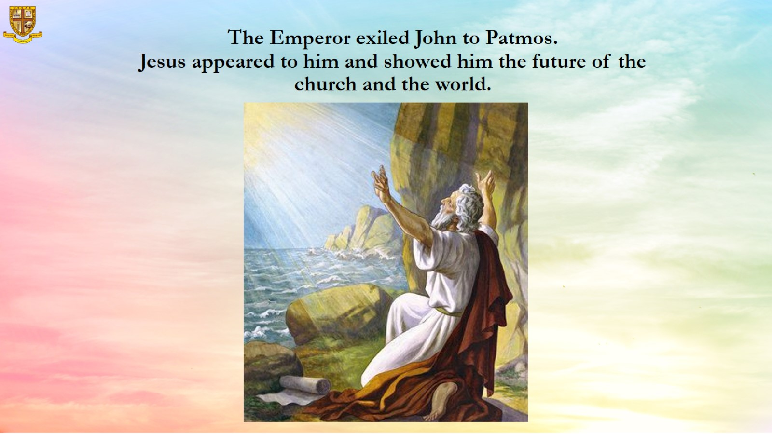
The Emperor exiled John to Patmos.
Jesus appeared to him and showed him the future of the church and the world.

Slide 10
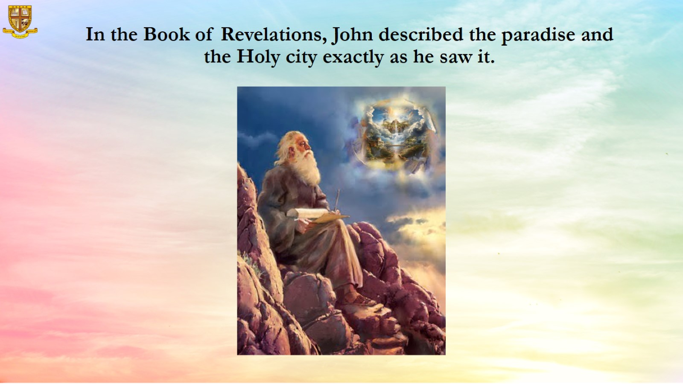
In the Book of Revelations, John described the paradise and the Holy city exactly as he saw it.

Slide 11
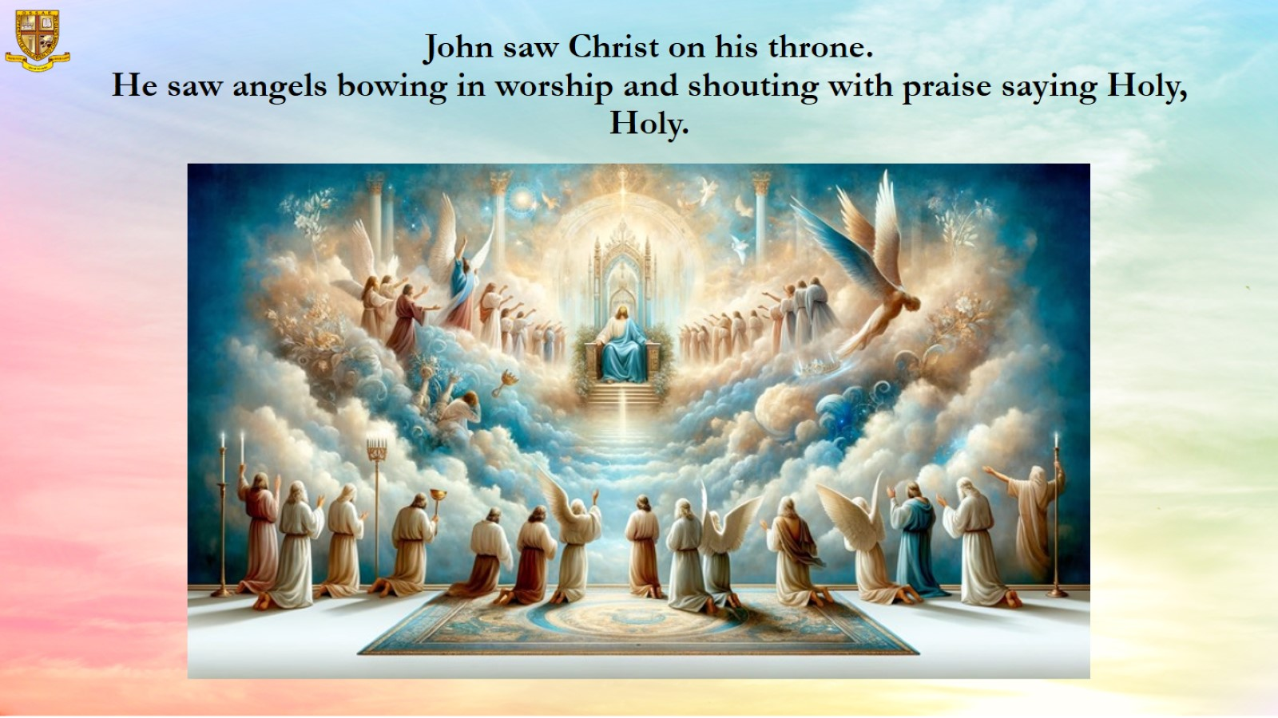
John saw Christ on his throne.
He saw angels bowing in worship and shouting with praise saying Holy, Holy.

Slide 12
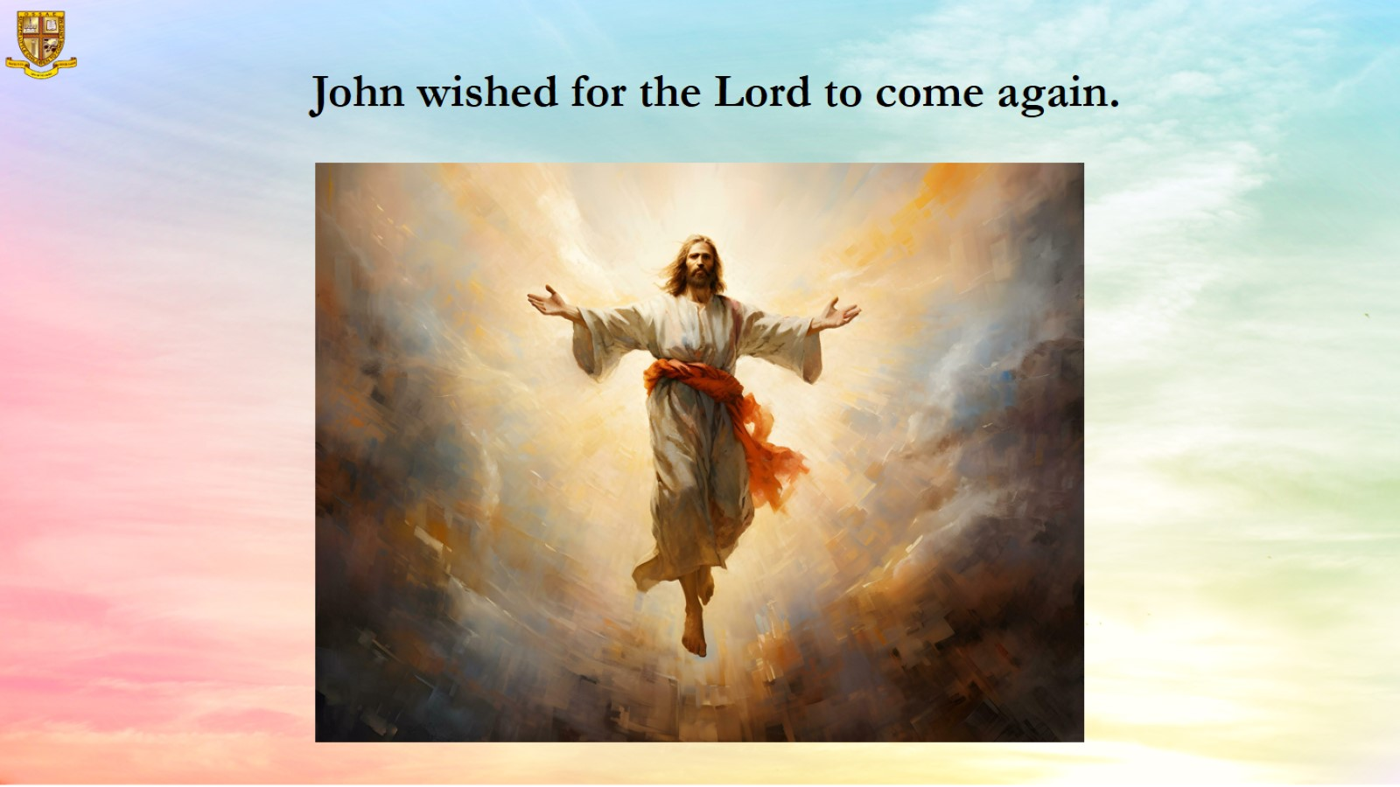
John wished for the Lord to come again.

Slide 13
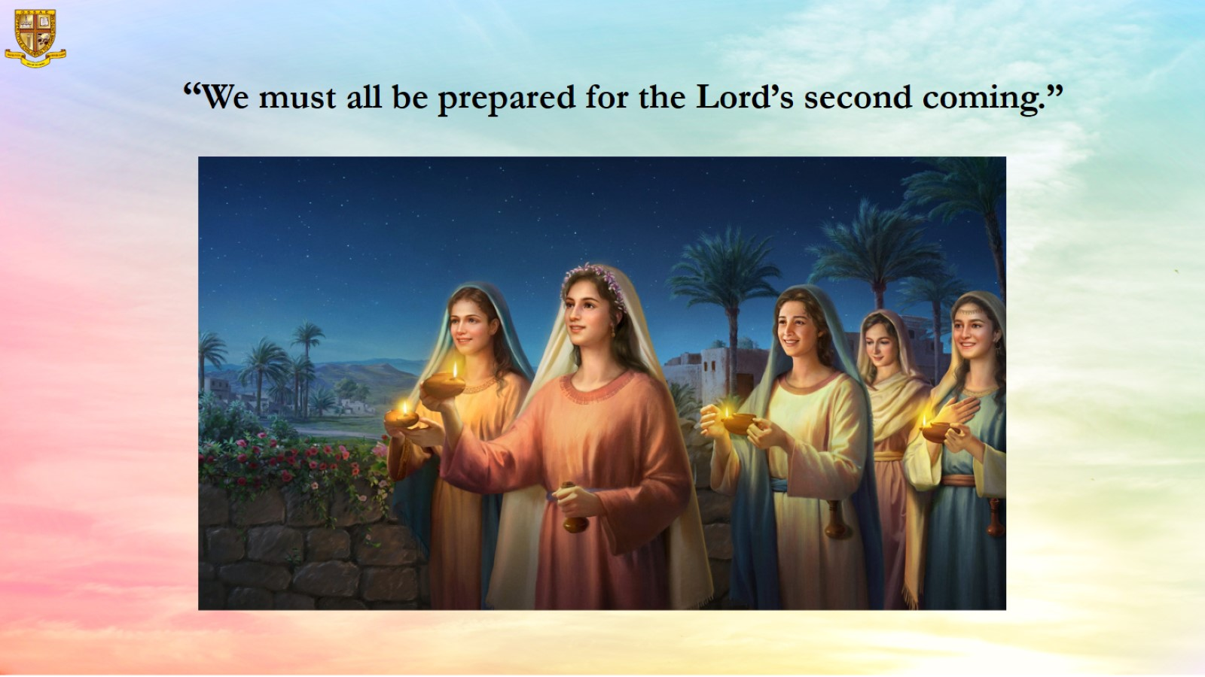
“We must all be prepared for the Lord’s second coming.”

Slide 14
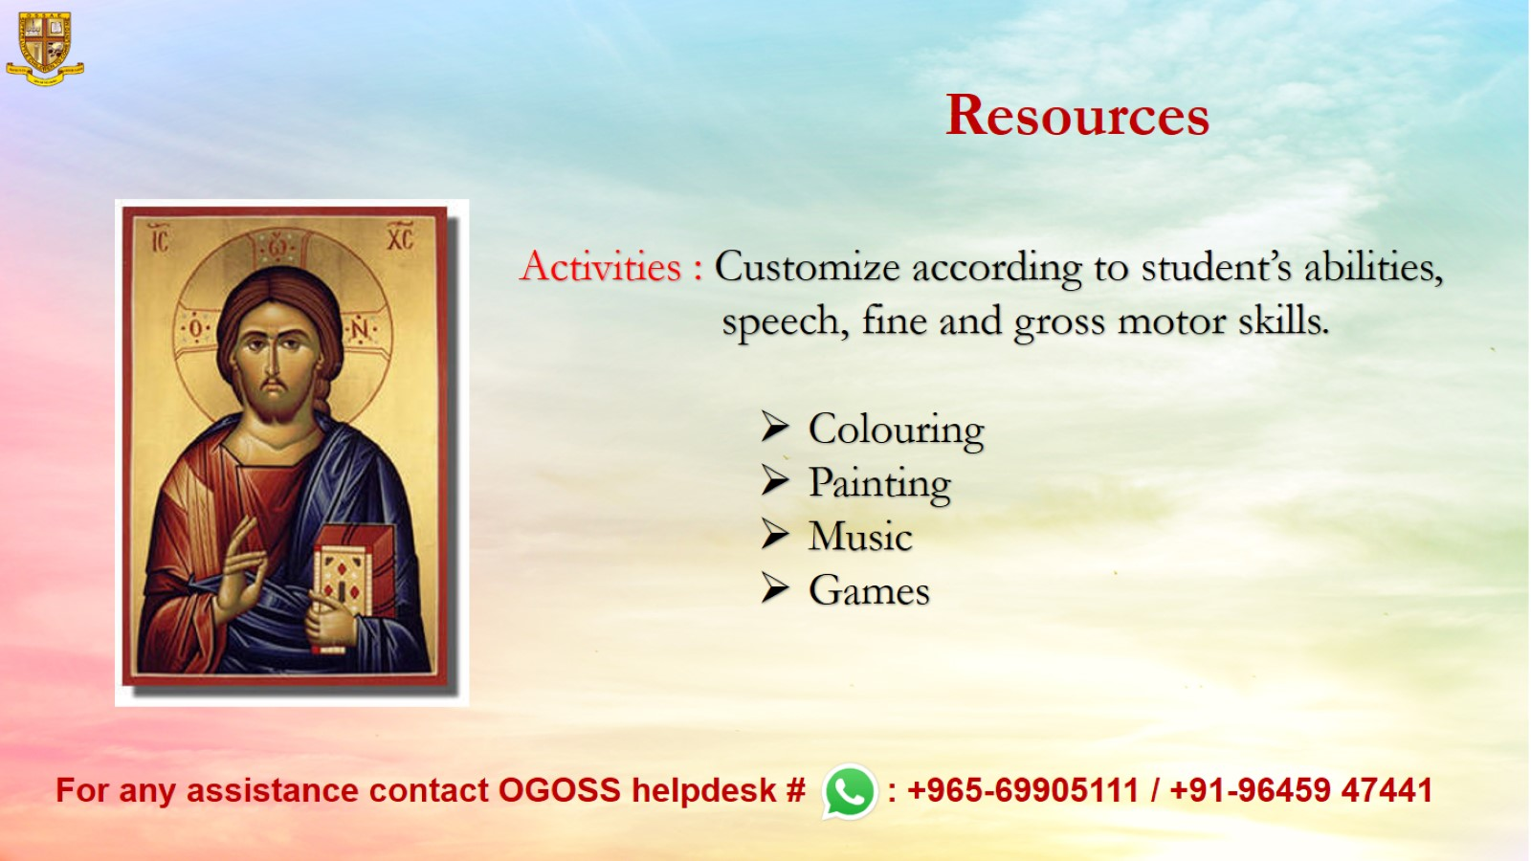
Resources

