Slide 1


Slide 2


Slide 3


Slide 4
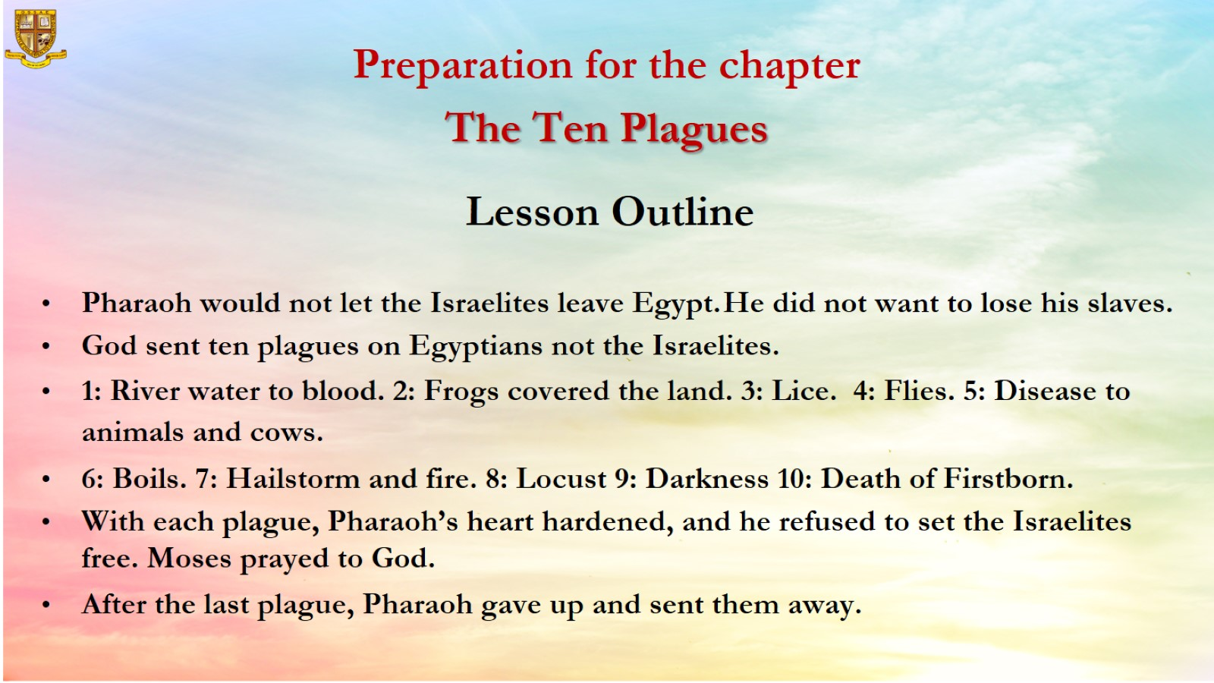

Slide 5
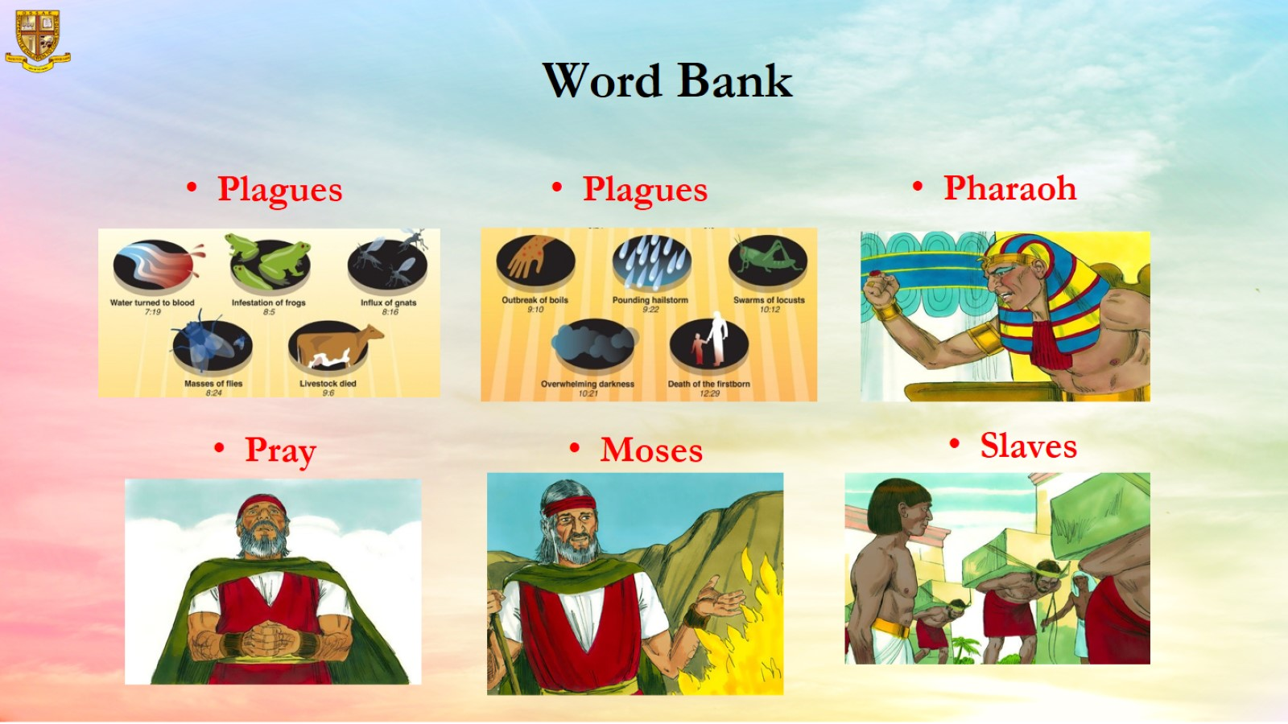
Word Bank

Slide 6
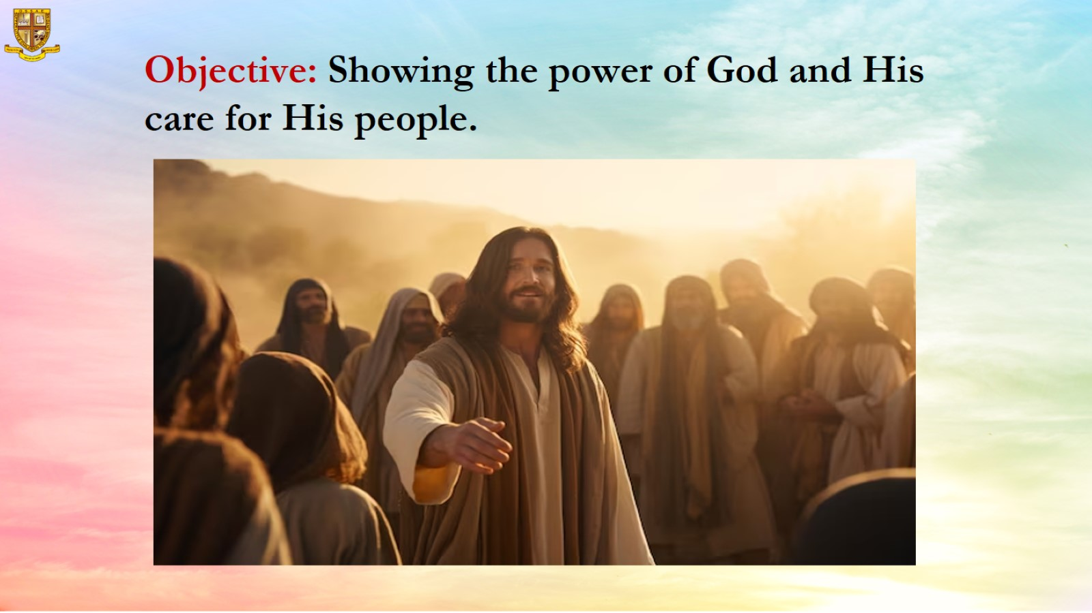
Objective: Showing the power of God and His care for His people.

Slide 7
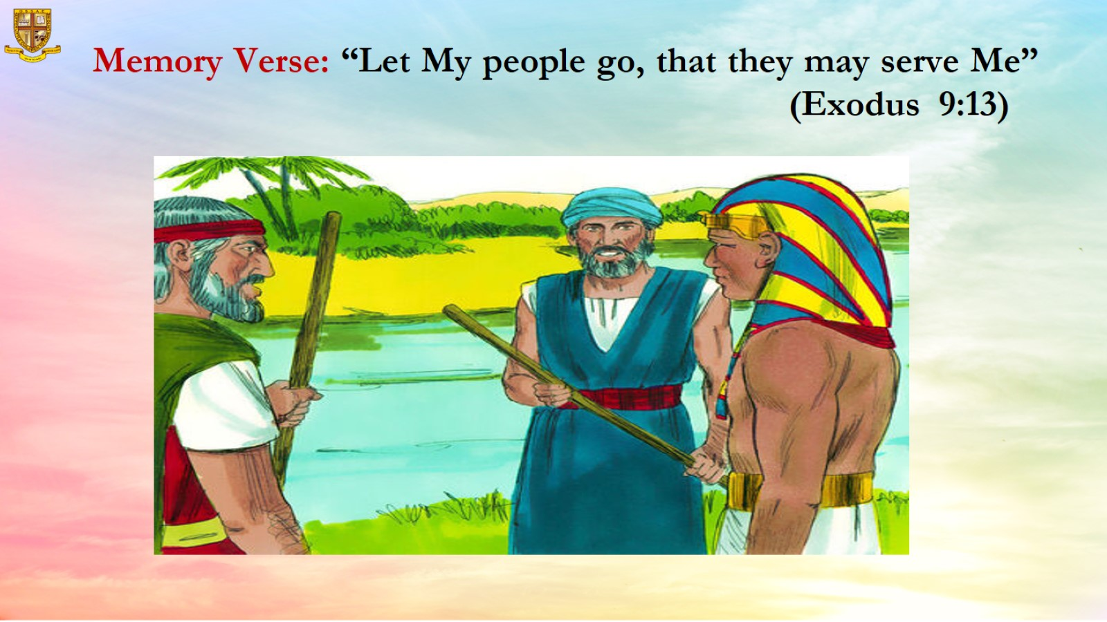
Memory Verse: “Let My people go, that they may serve Me”
(Exodus 9:13)

Slide 8
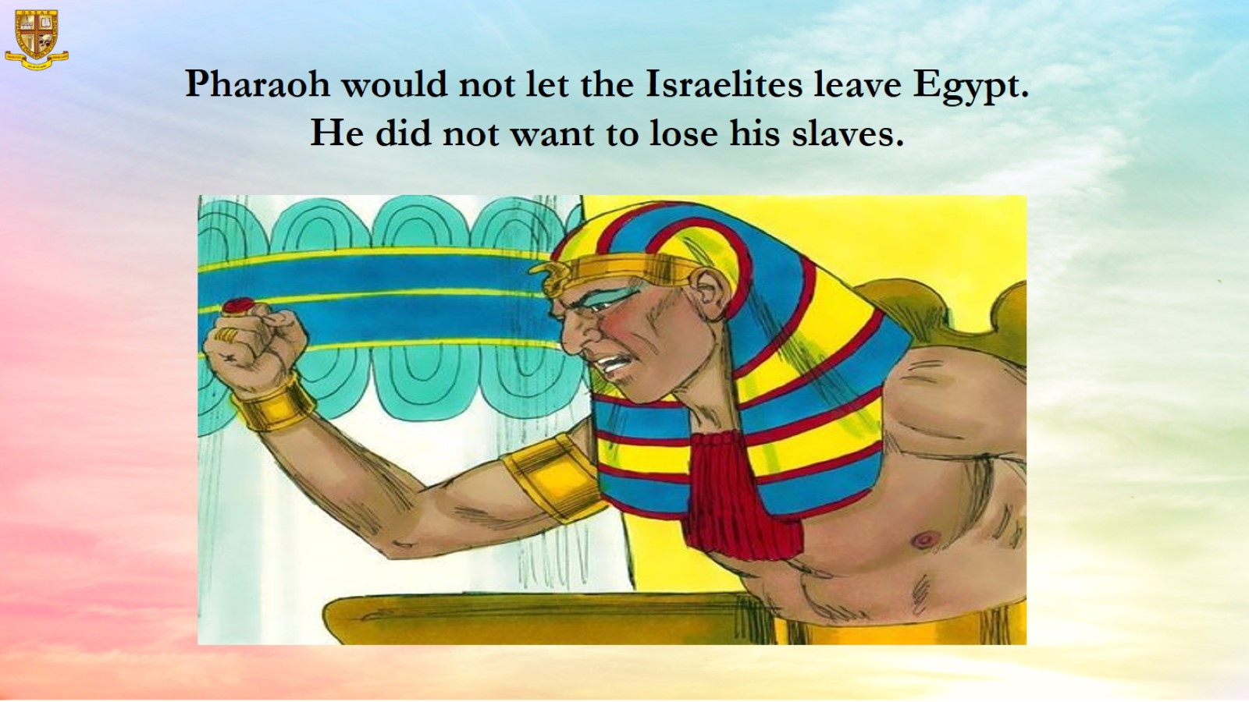

Slide 9
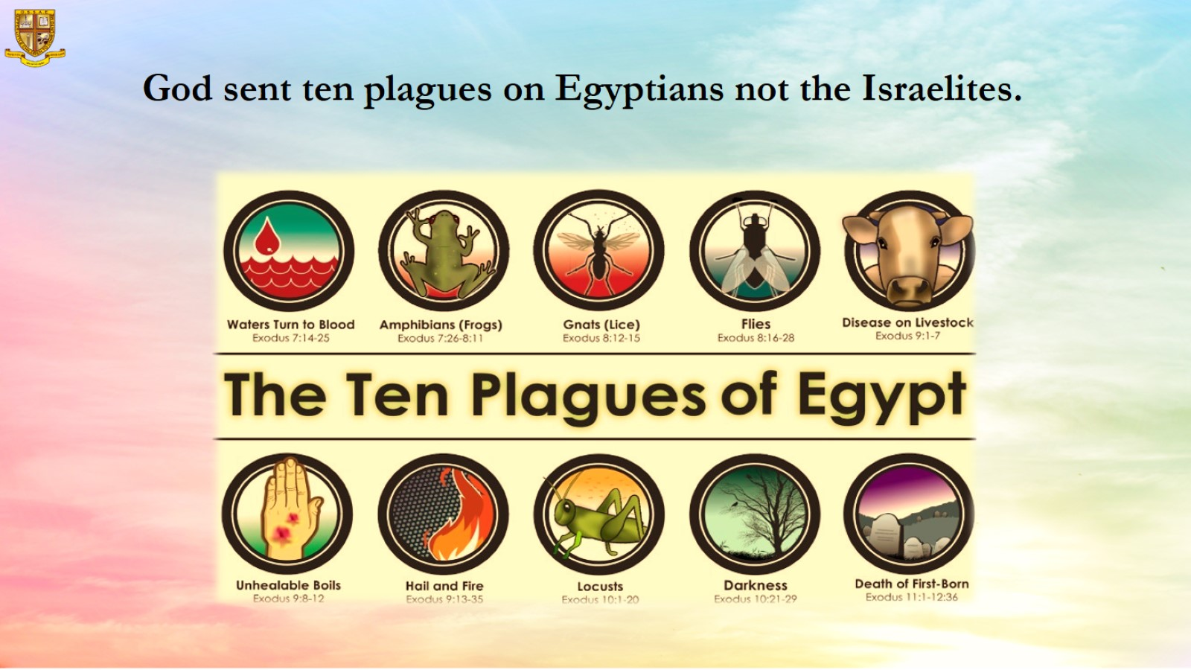
God sent ten plagues on Egyptians not the Israelites.

Slide 10
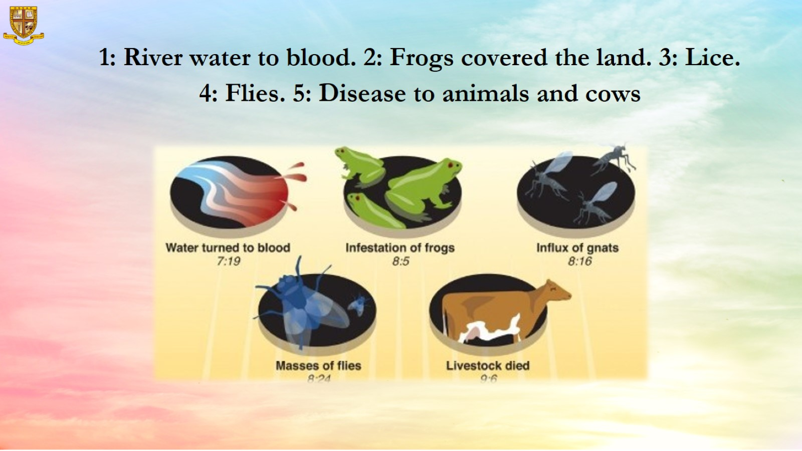

Slide 11
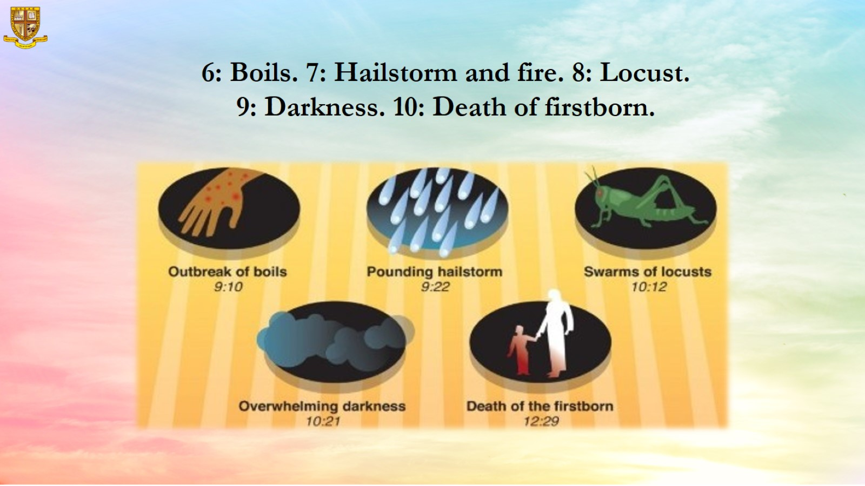
6: Boils. 7: Hailstorm and fire. 8: Locust.
9: Darkness. 10: Death of firstborn.

Slide 12
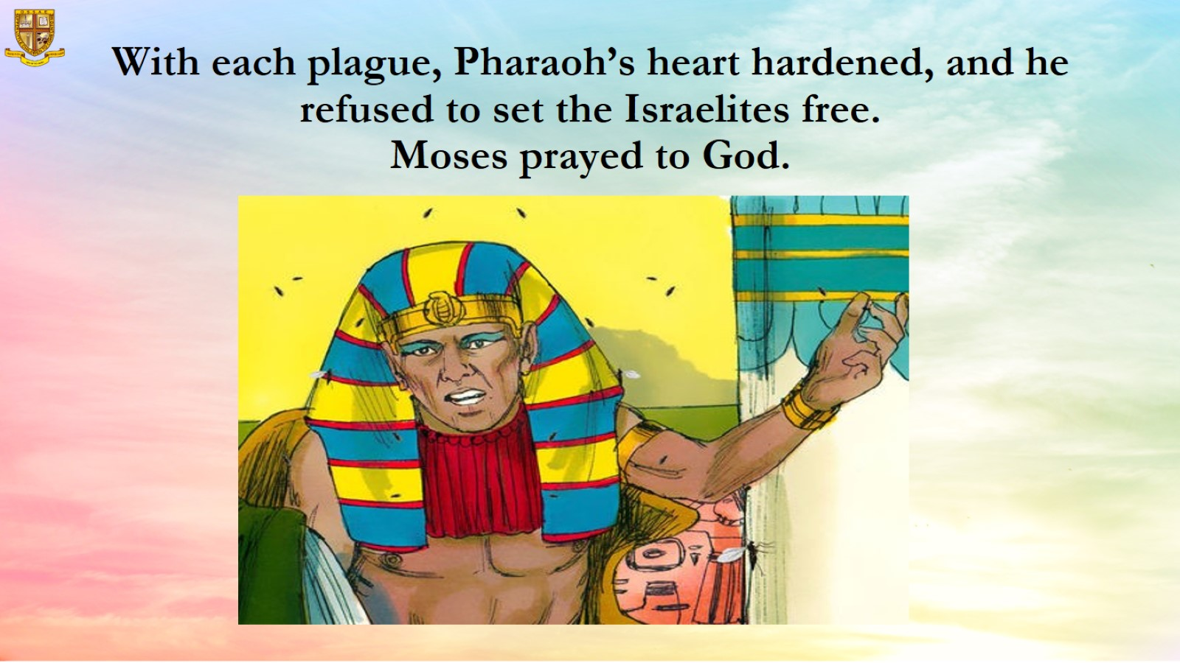
With each plague, Pharaoh’s heart hardened, and he refused to set the Israelites free.
Moses prayed to God.

Slide 13
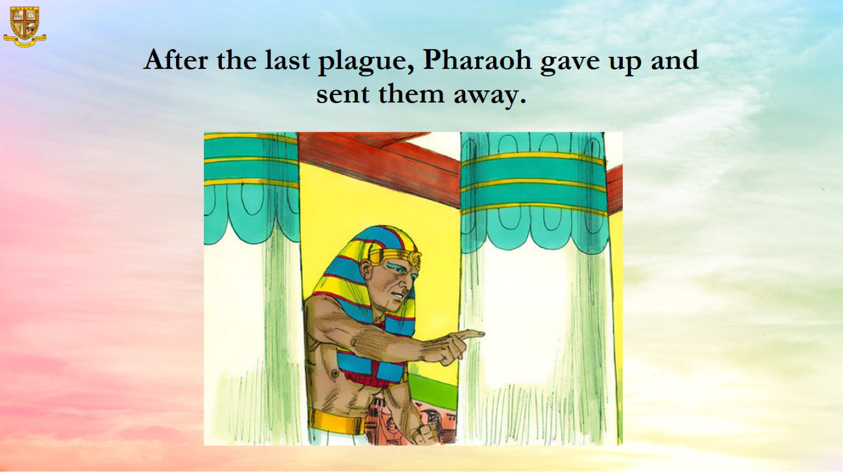
After the last plague, Pharaoh gave up and sent them away.

Slide 14
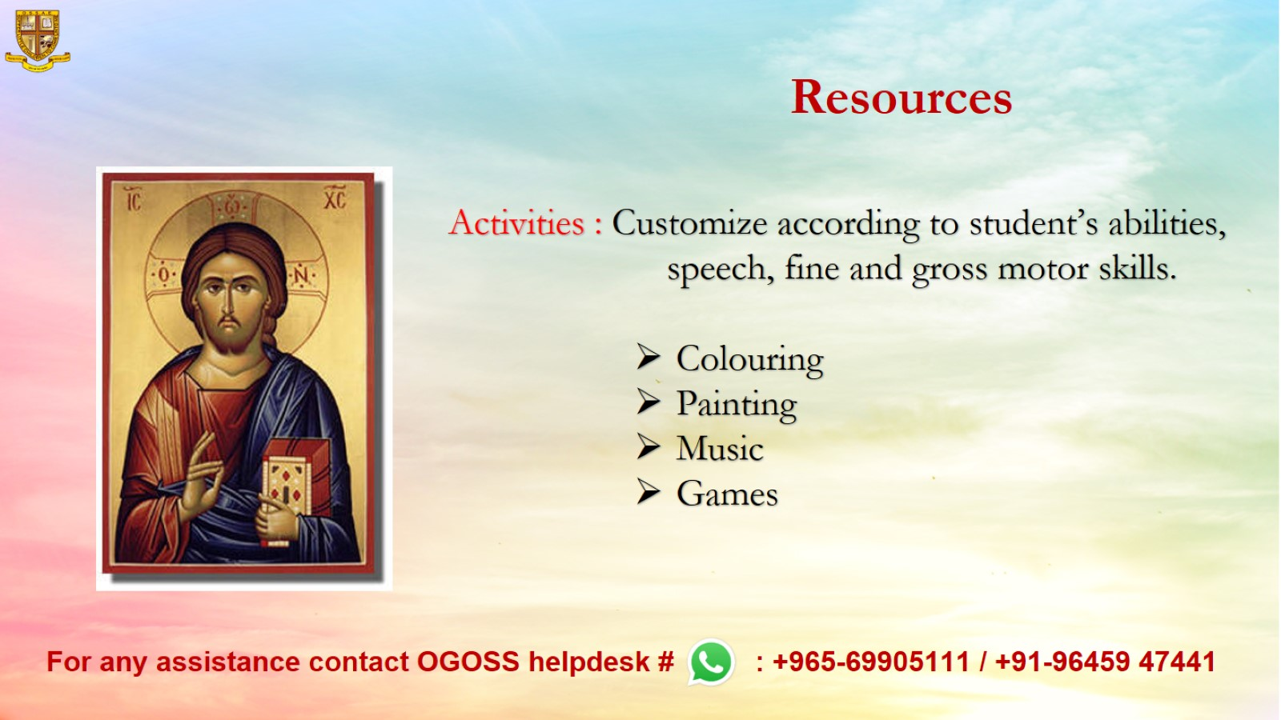
Resources

