Slide 1
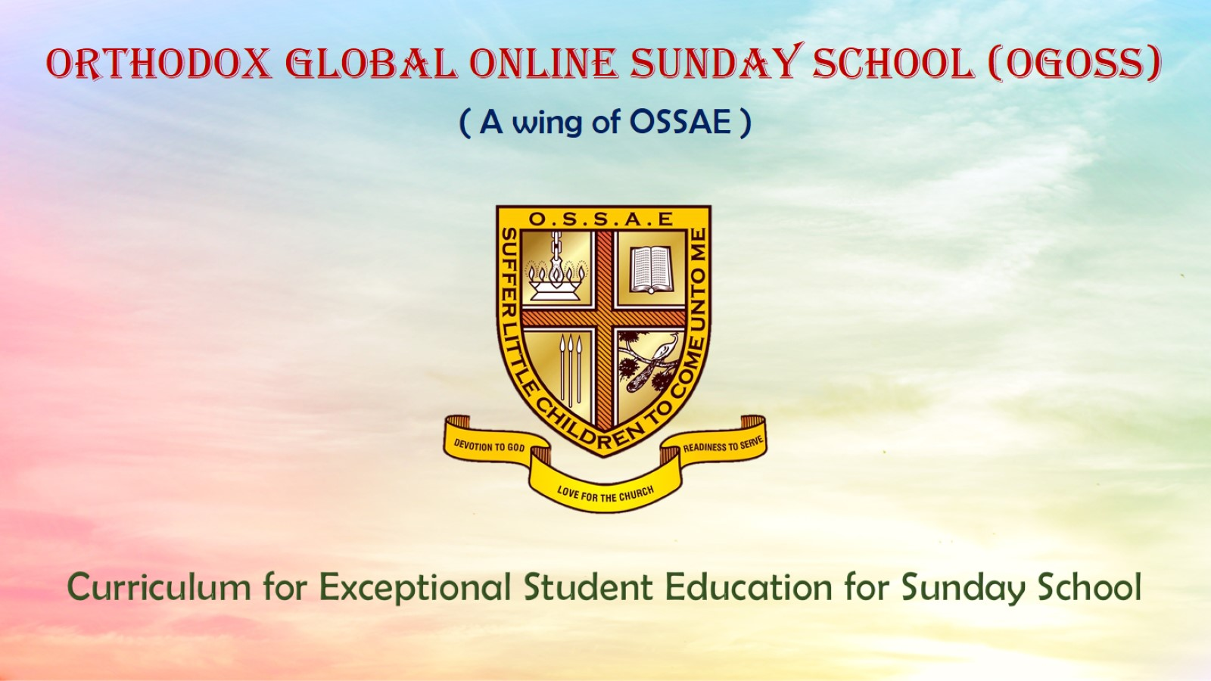
Orthodox Global Online Sunday School (OGOSS)

Slide 2
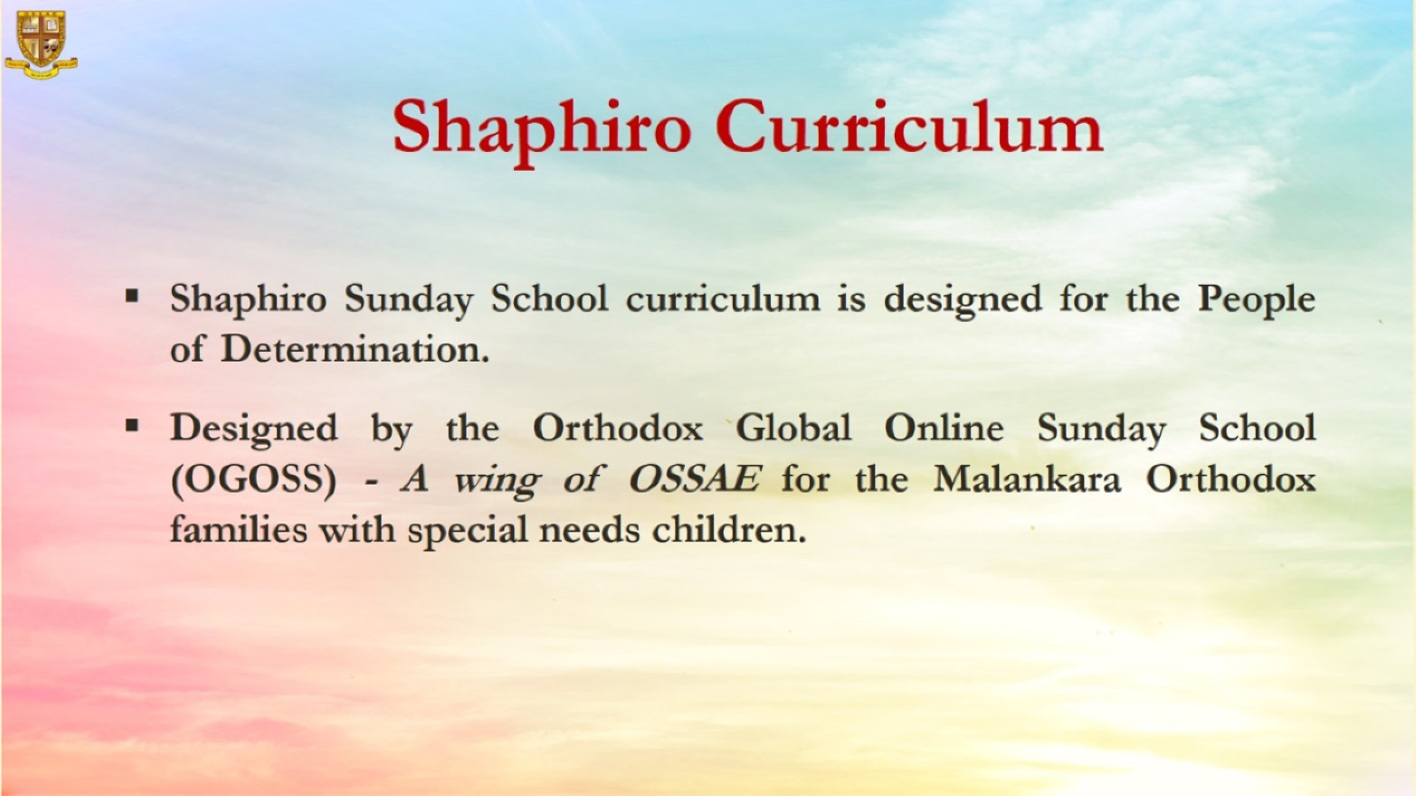

Slide 3
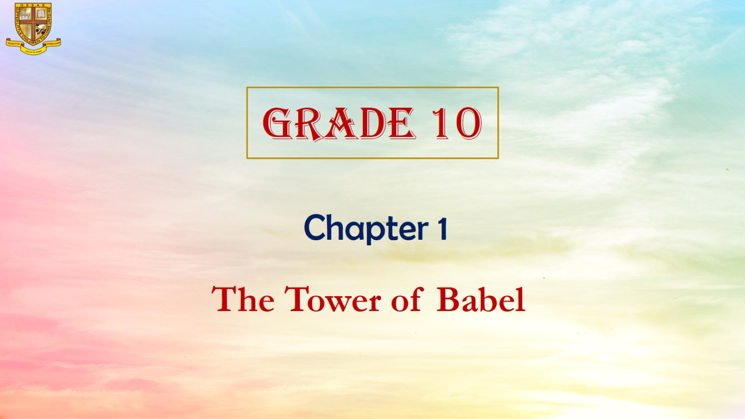

Slide 4
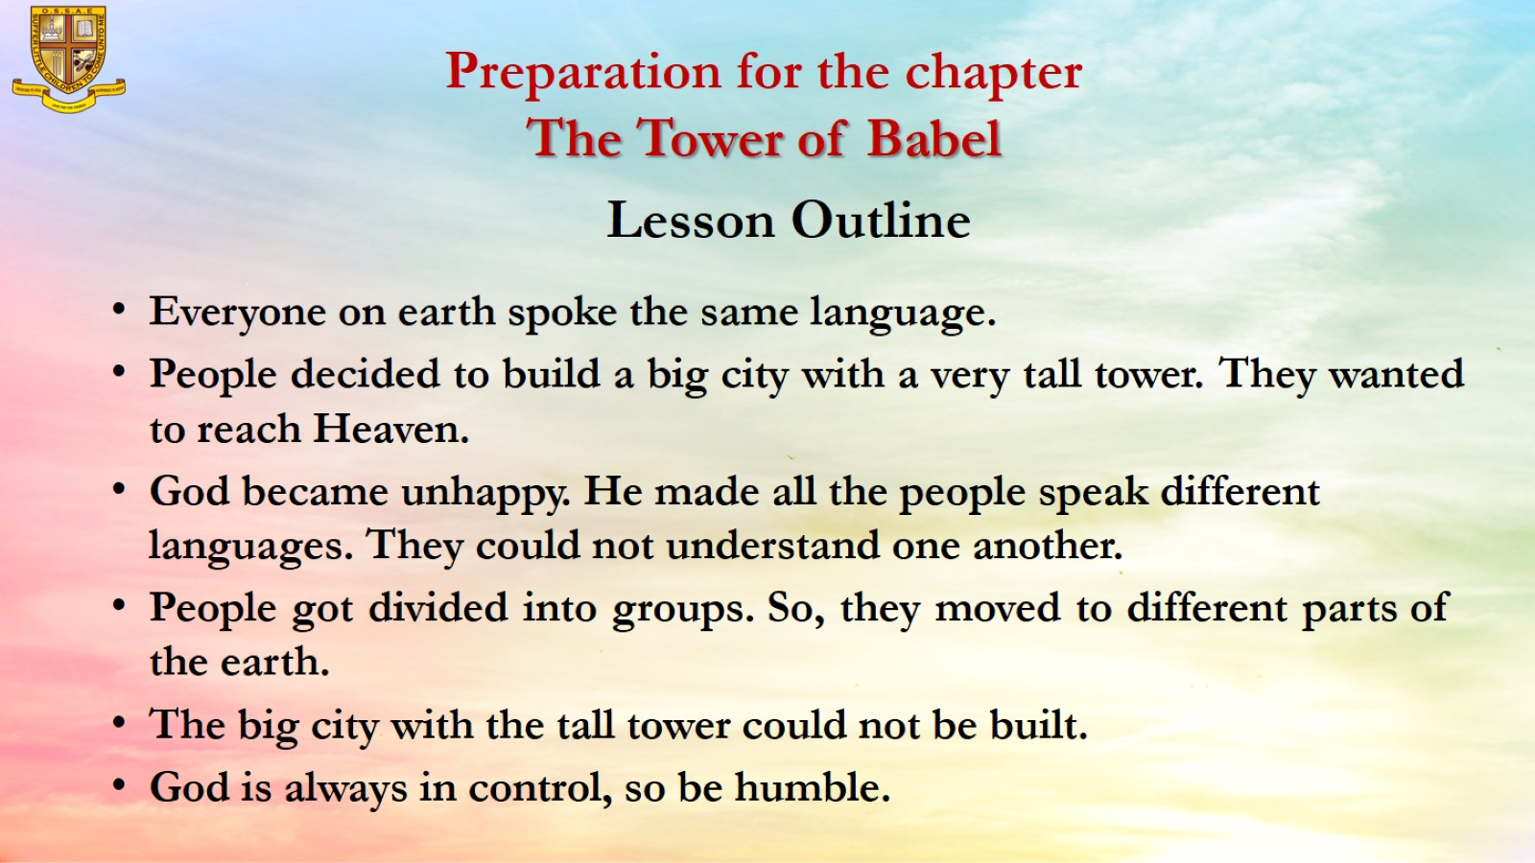
Preparation for the chapter
The Tower of Babel

Slide 5
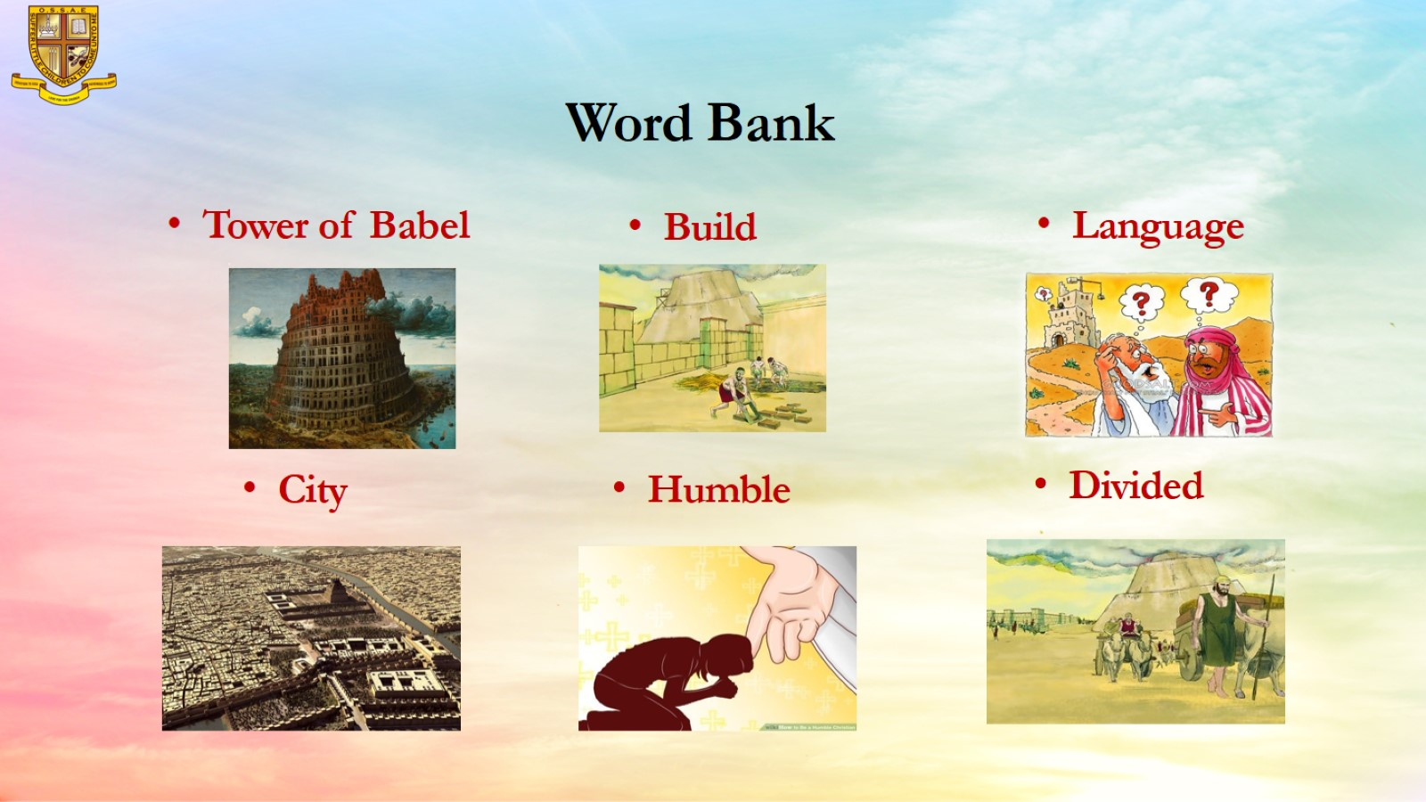
Word Bank

Slide 6
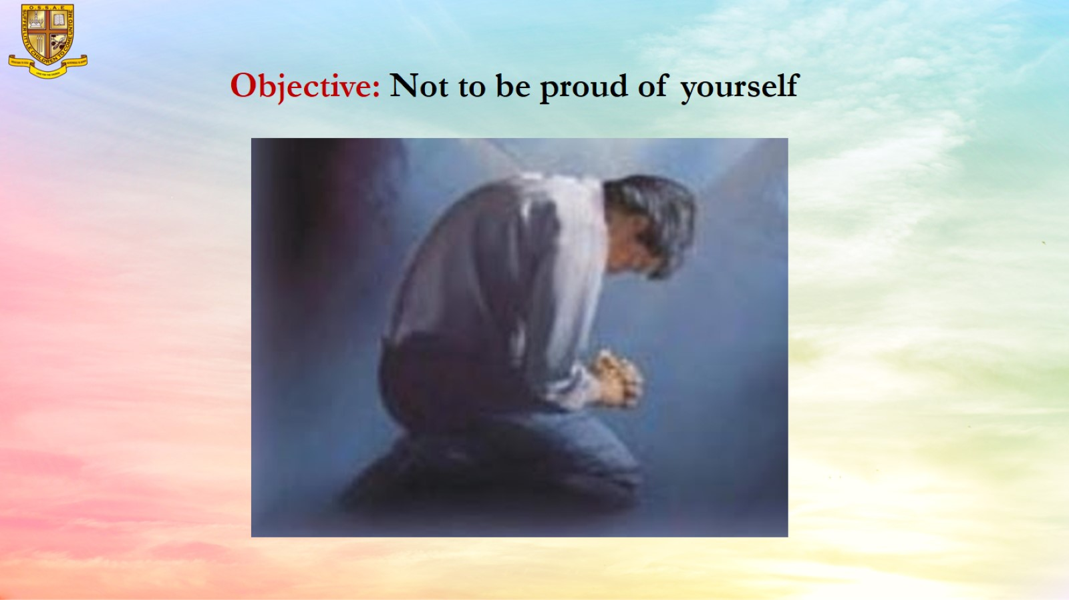
Objective: Not to be proud of yourself

Slide 7
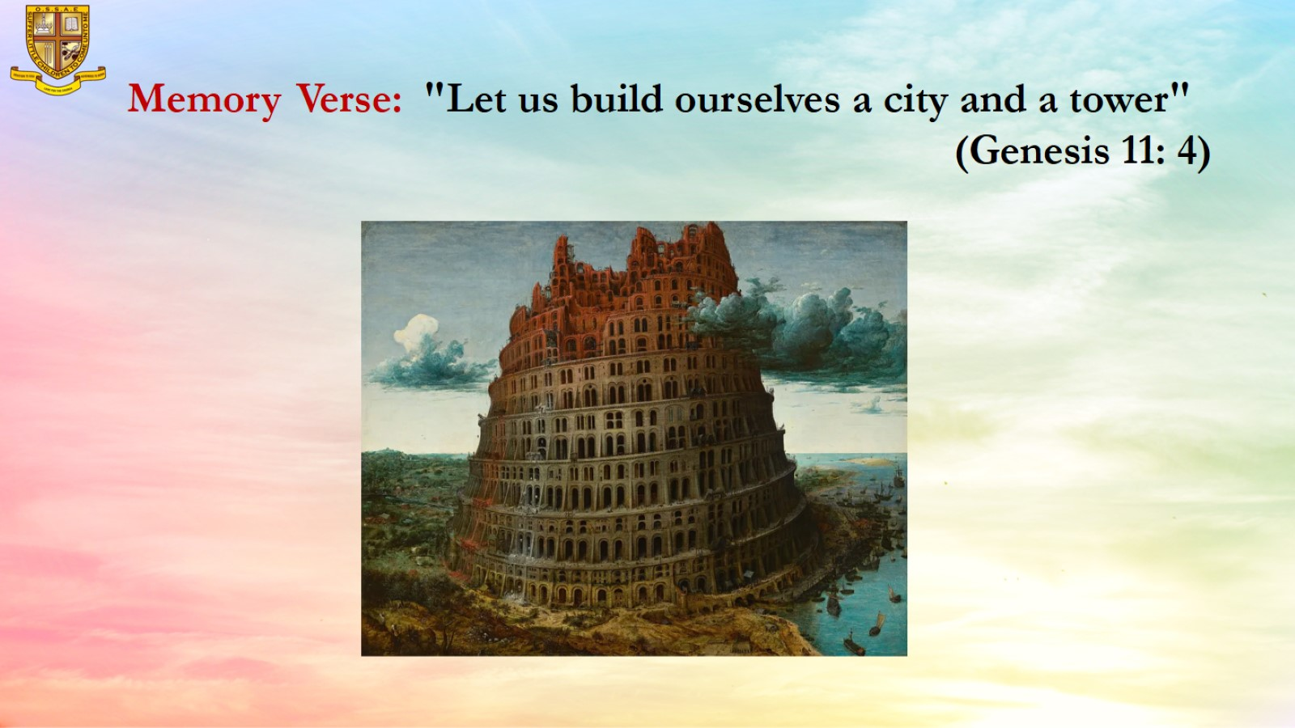
Memory Verse: "Let us build ourselves a city and a tower"
(Genesis 11: 4)

Slide 8
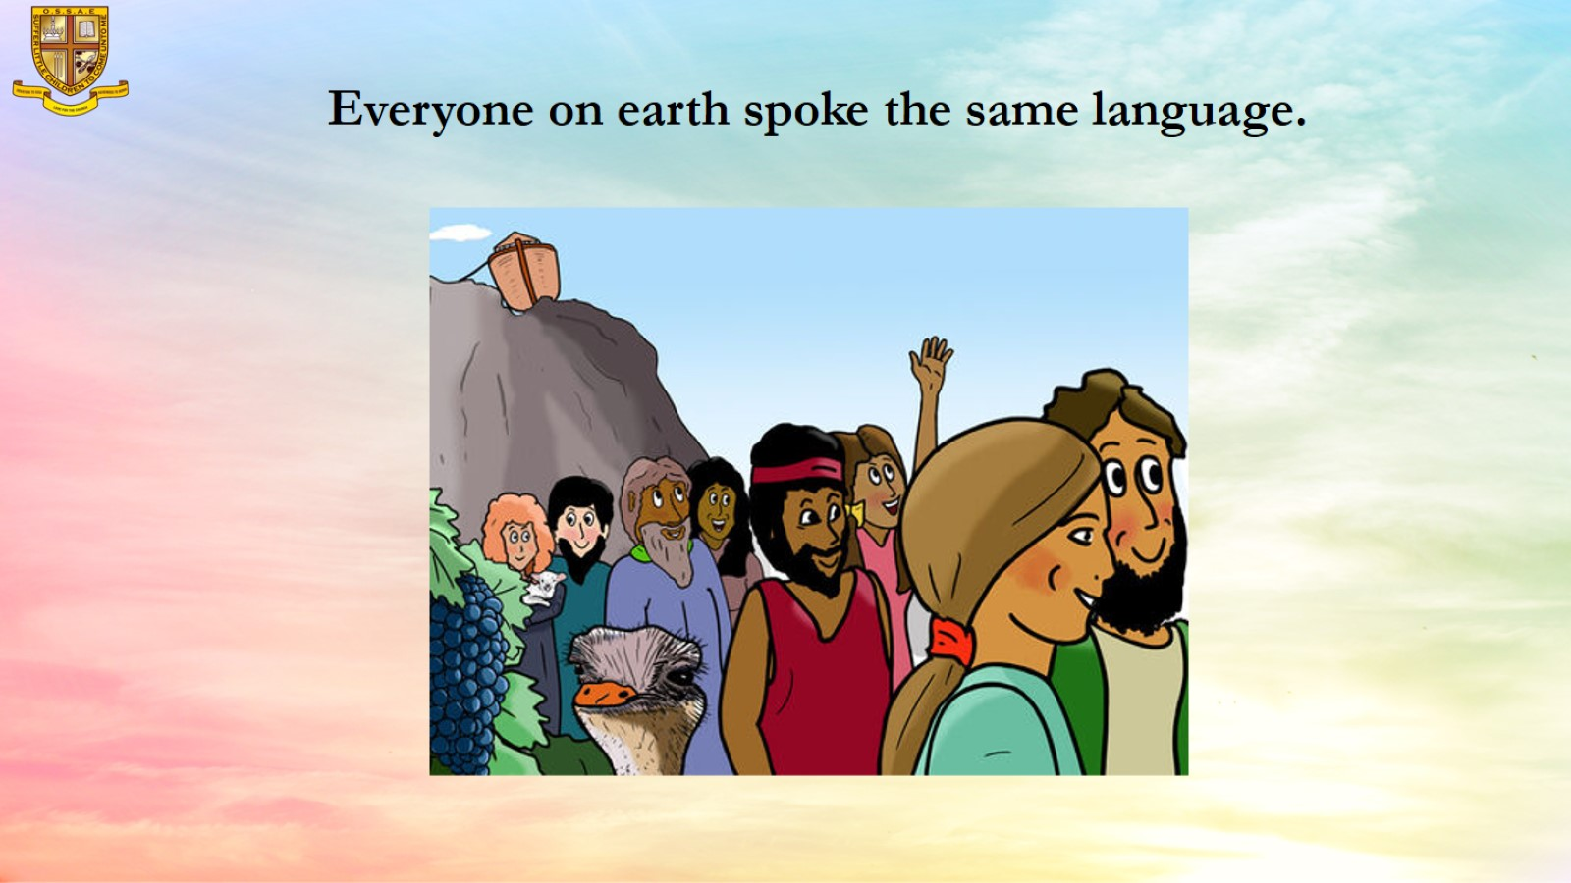
Everyone on earth spoke the same language.

Slide 9
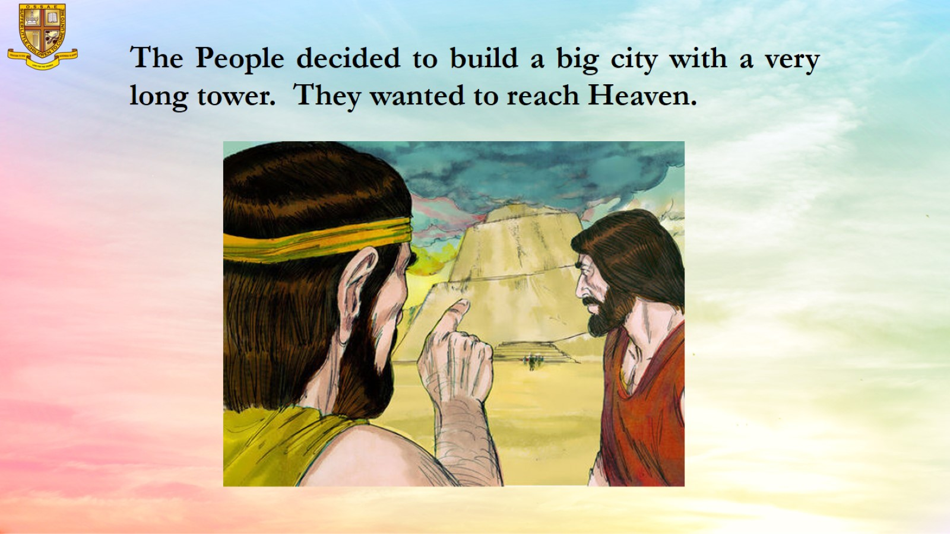
The People decided to build a big city with a very long tower. They wanted to reach Heaven.

Slide 10
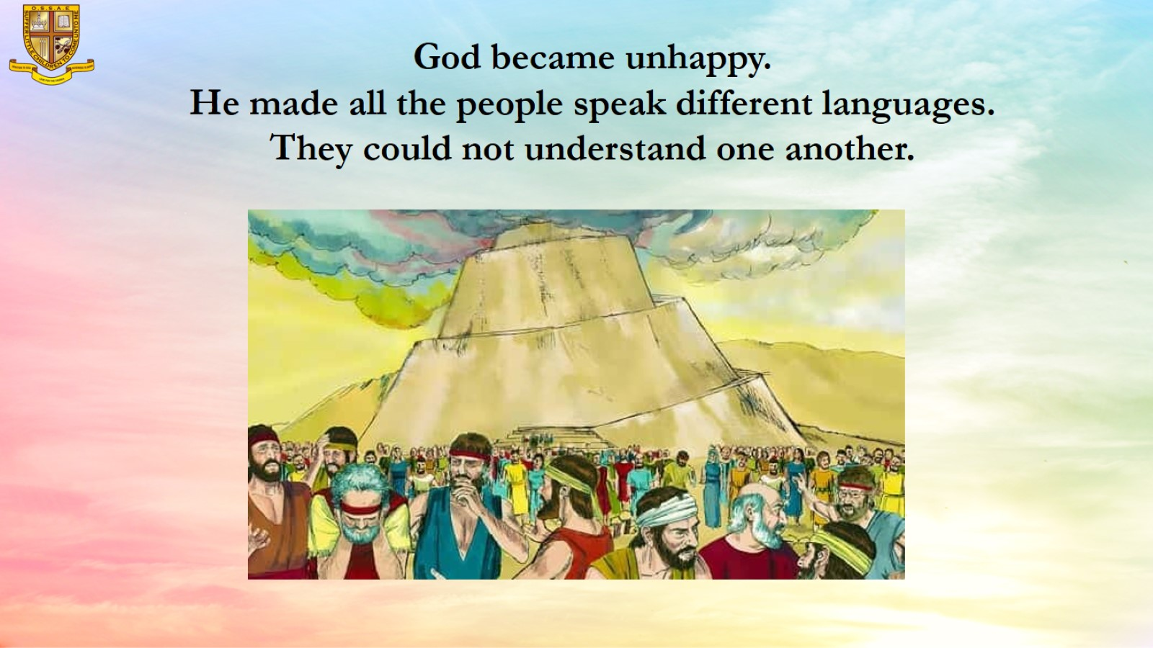
God became unhappy.
He made all the people speak different languages. They could not understand one another.

Slide 11
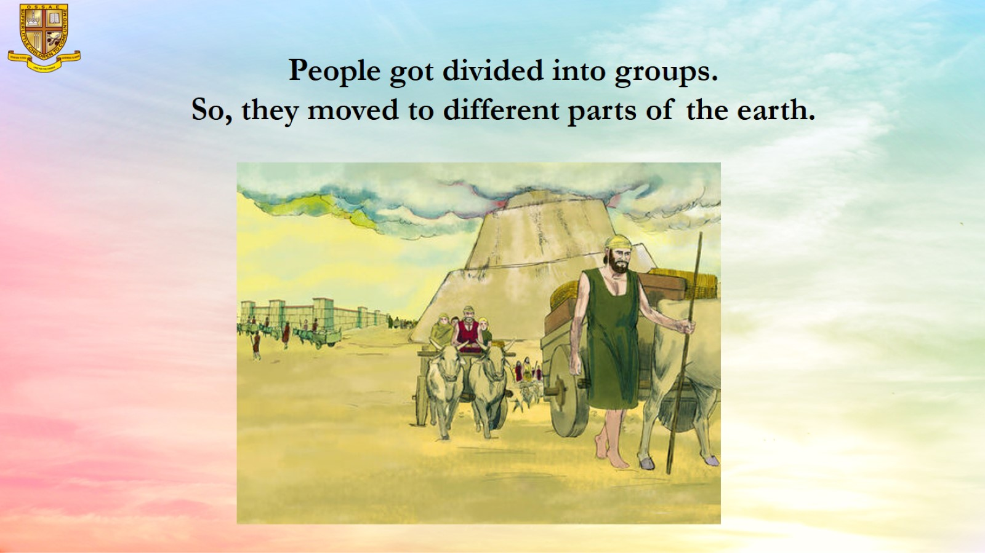
People got divided into groups.
So, they moved to different parts of the earth.

Slide 12
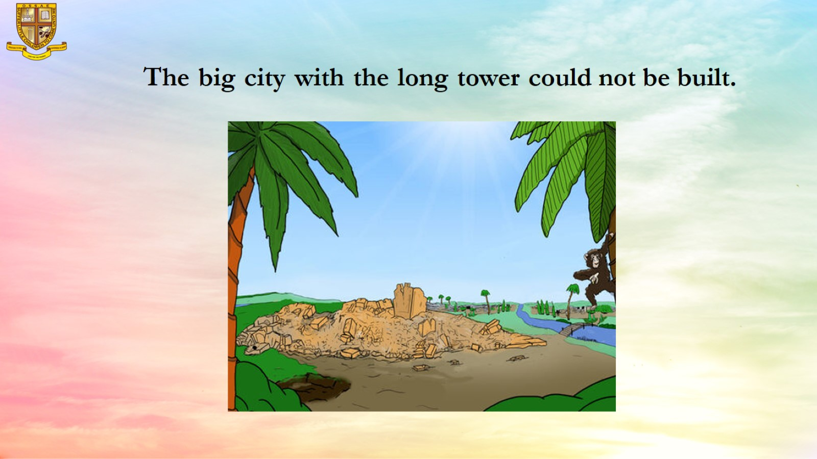
The big city with the long tower could not be built.

Slide 13
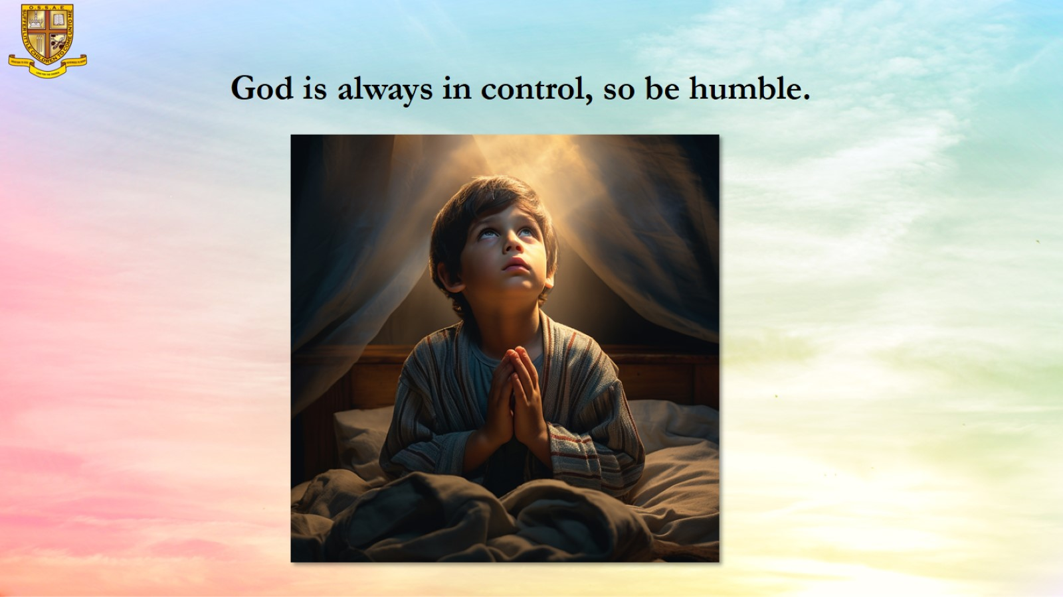
God is always in control, so be humble.

Slide 14
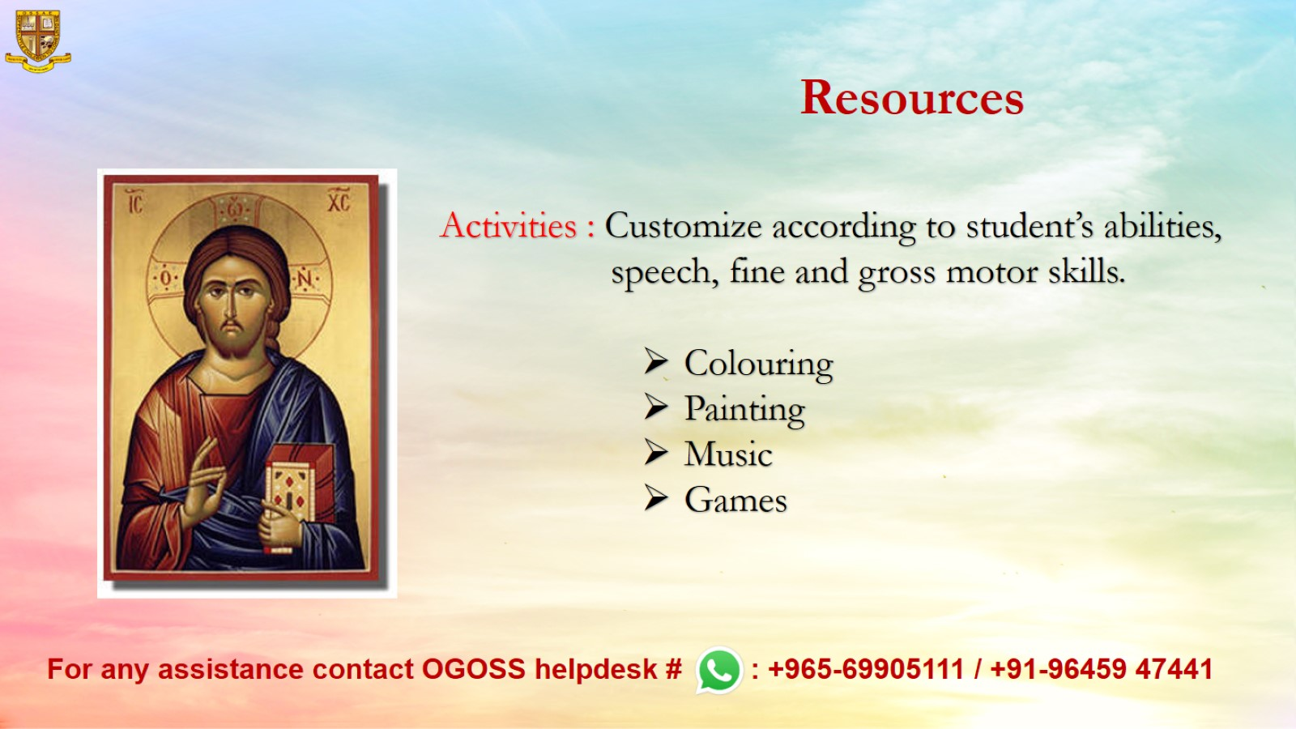
Resources

