Slide 1

Orthodox Global Online Sunday School (OGOSS)

Slide 2
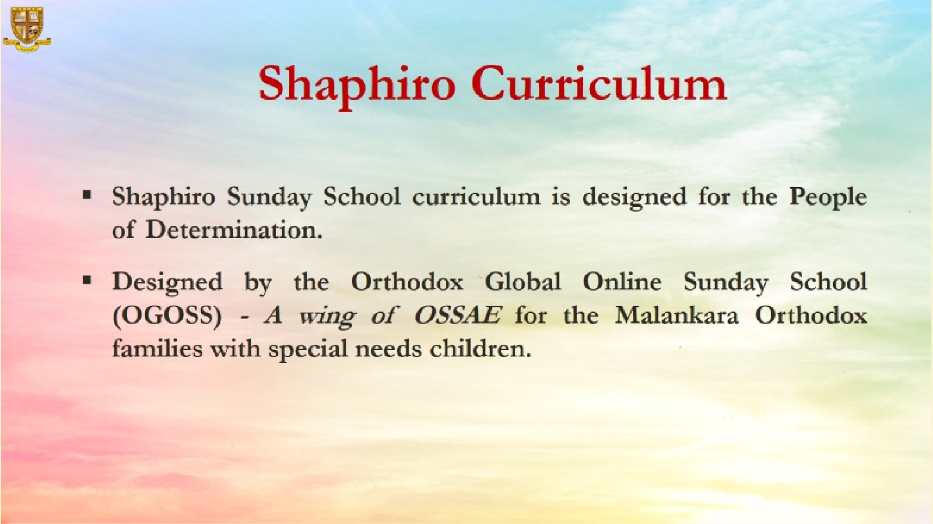

Slide 3


Slide 4
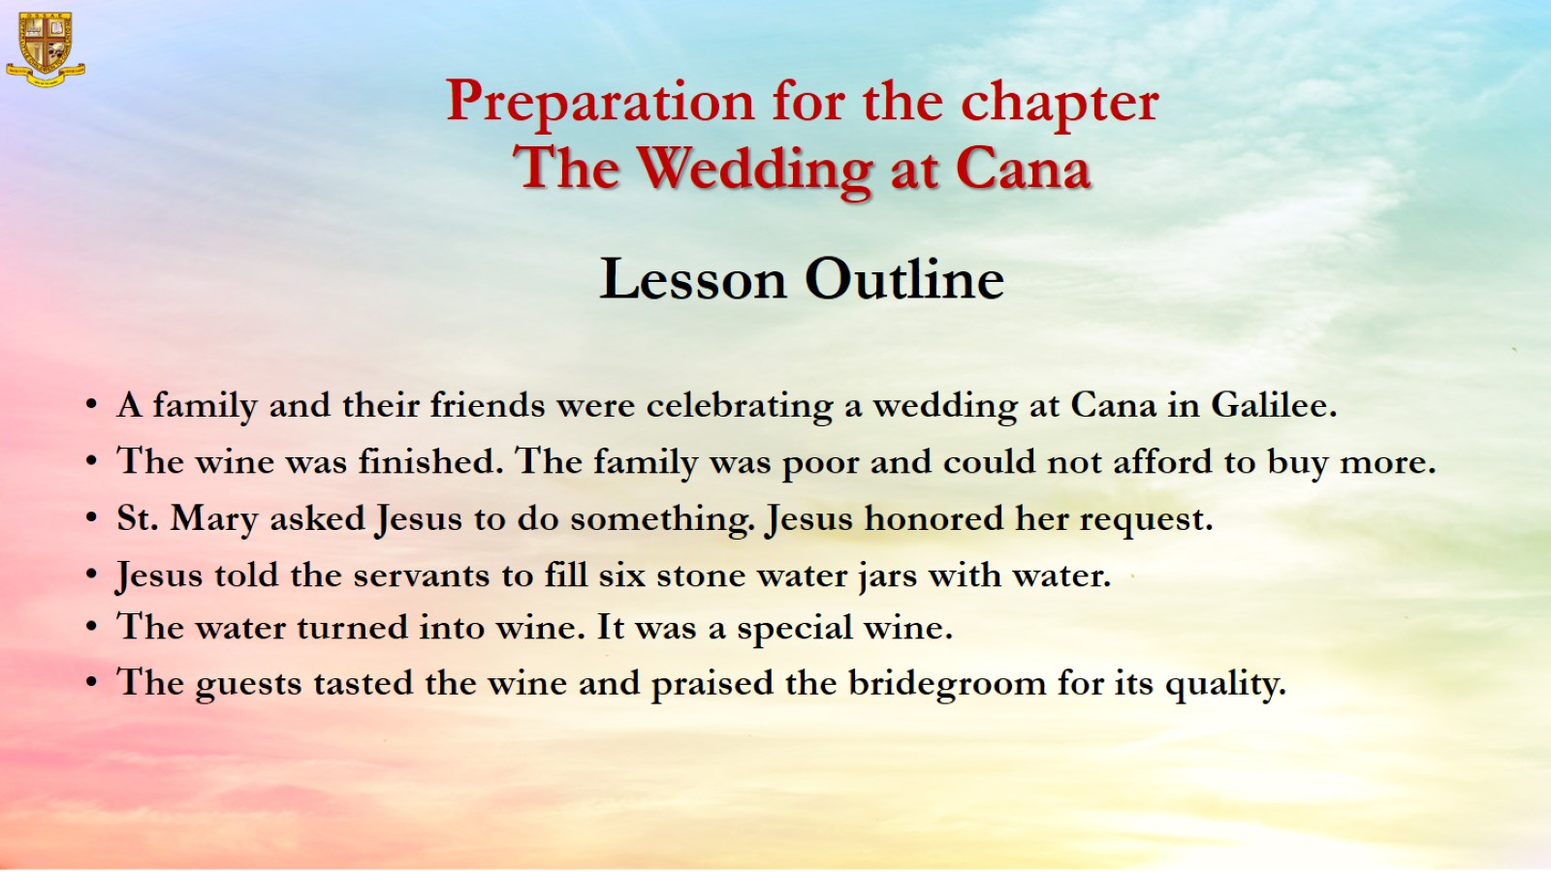
Preparation for the chapter
The Wedding at Cana
Lesson Outline

Slide 5
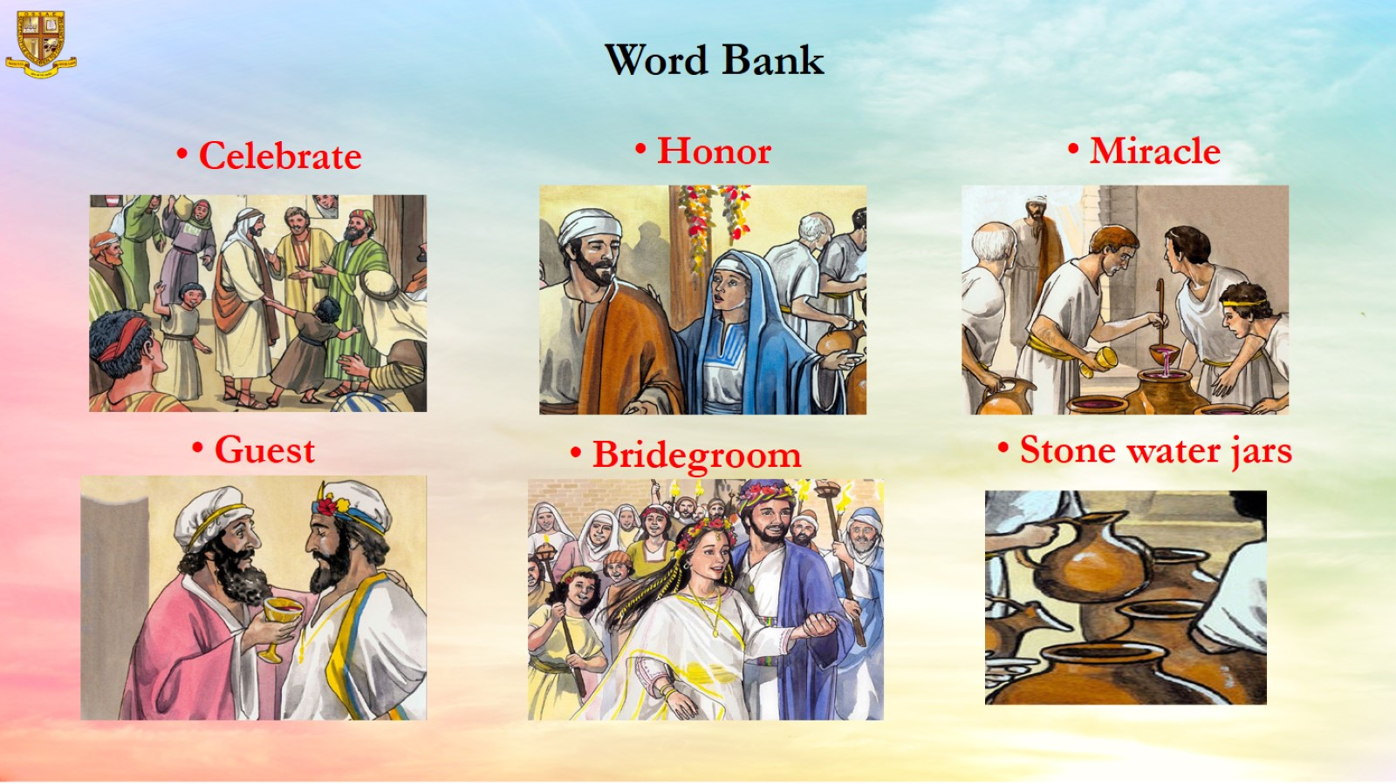
Word Bank

Slide 6
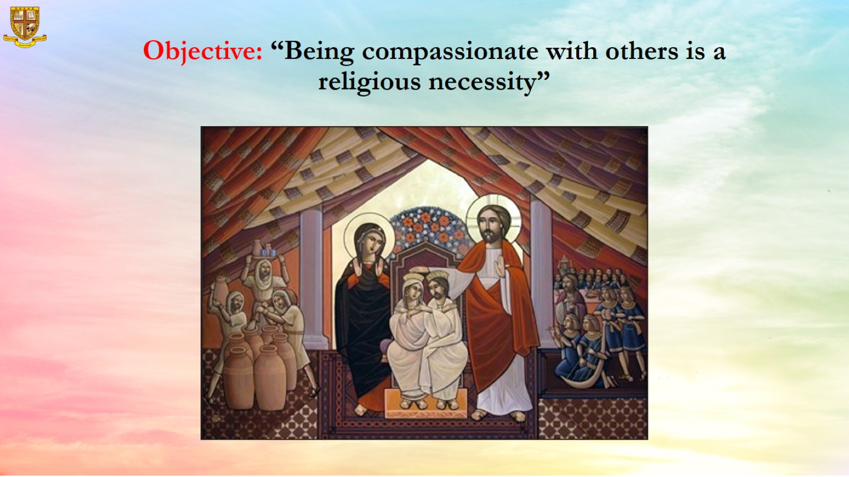
Objective: “Being compassionate with others is a religious necessity”

Slide 7
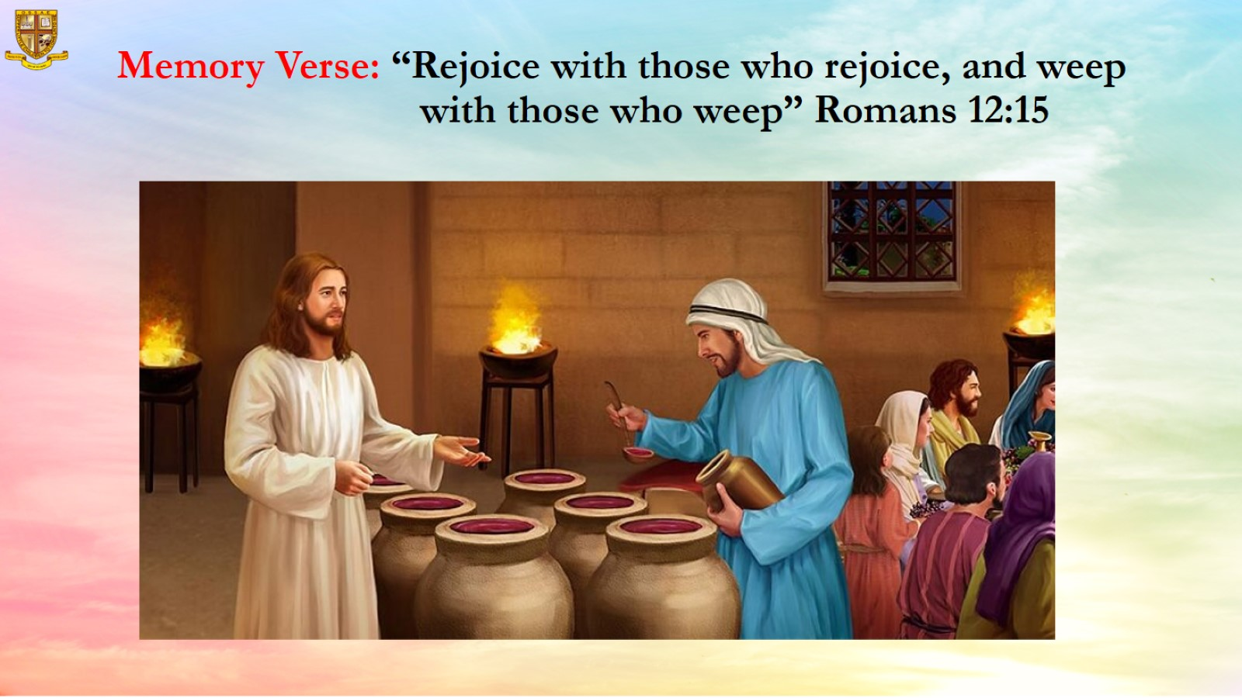
Memory Verse: “Rejoice with those who rejoice, and weep with those who weep” Romans 12:15

Slide 8
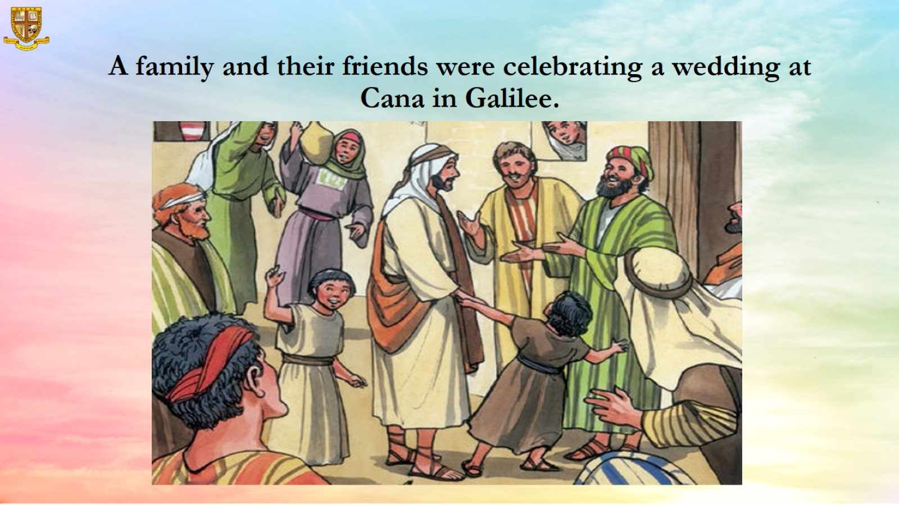
A family and their friends were celebrating a wedding at Cana in Galilee.

Slide 9
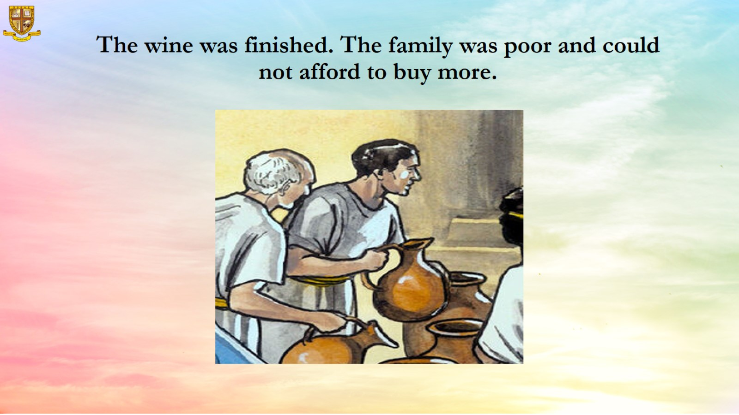
The wine was finished. The family was poor and could not afford to buy more.

Slide 10
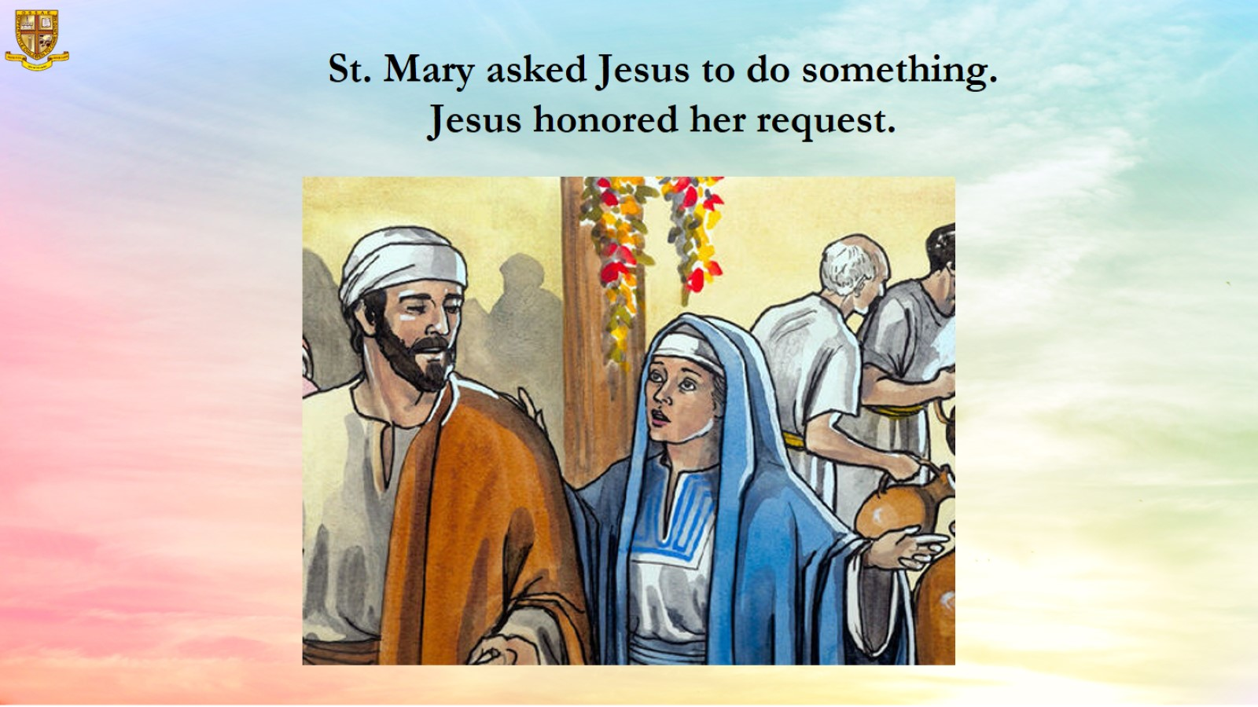
  St. Mary asked Jesus to do something.
  Jesus honored her request.

Slide 11
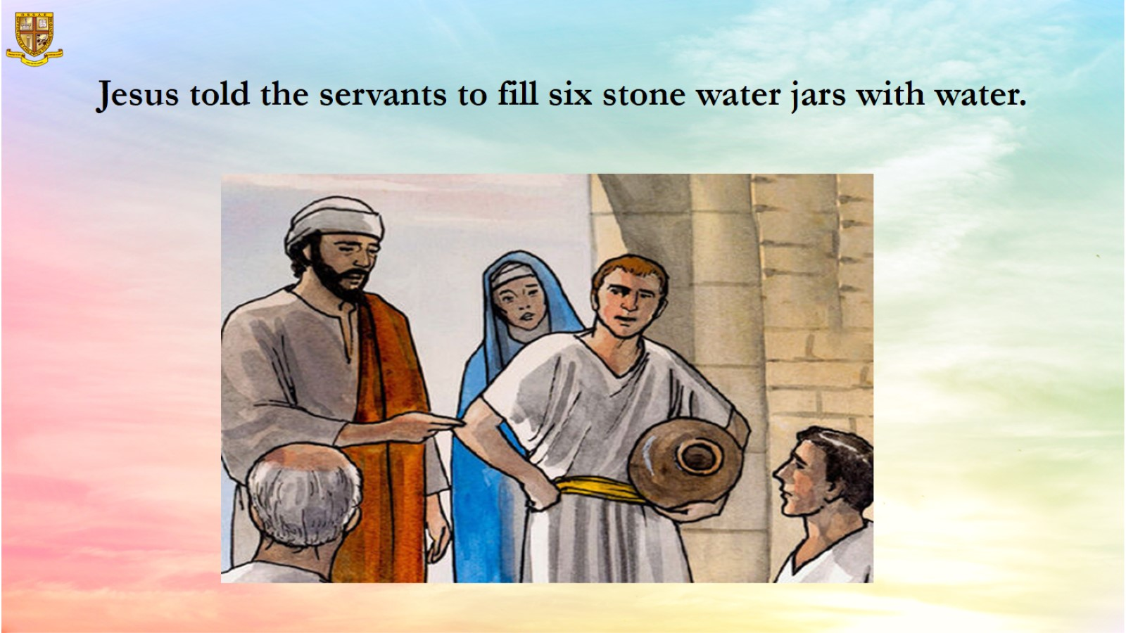
Jesus told the servants to fill six stone water jars with water.

Slide 12
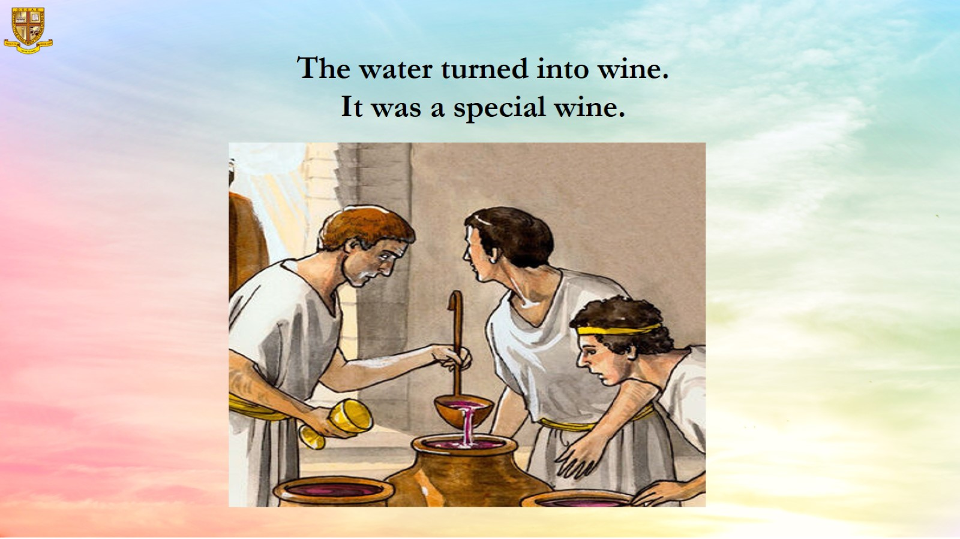
  The water turned into wine.
  It was a special wine.

Slide 13
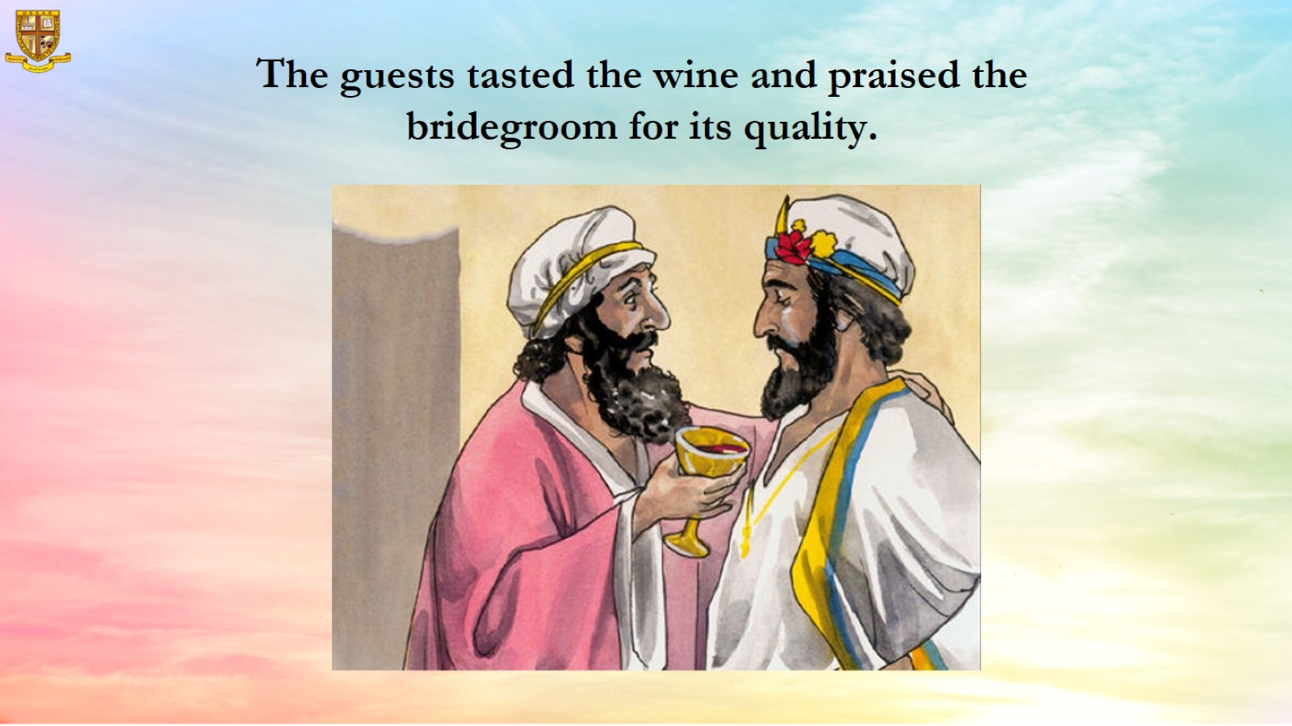
  The guests tasted the wine and praised the bridegroom for its quality.

Slide 14
