Slide 1

Orthodox Global Online Sunday School (OGOSS)

Slide 2
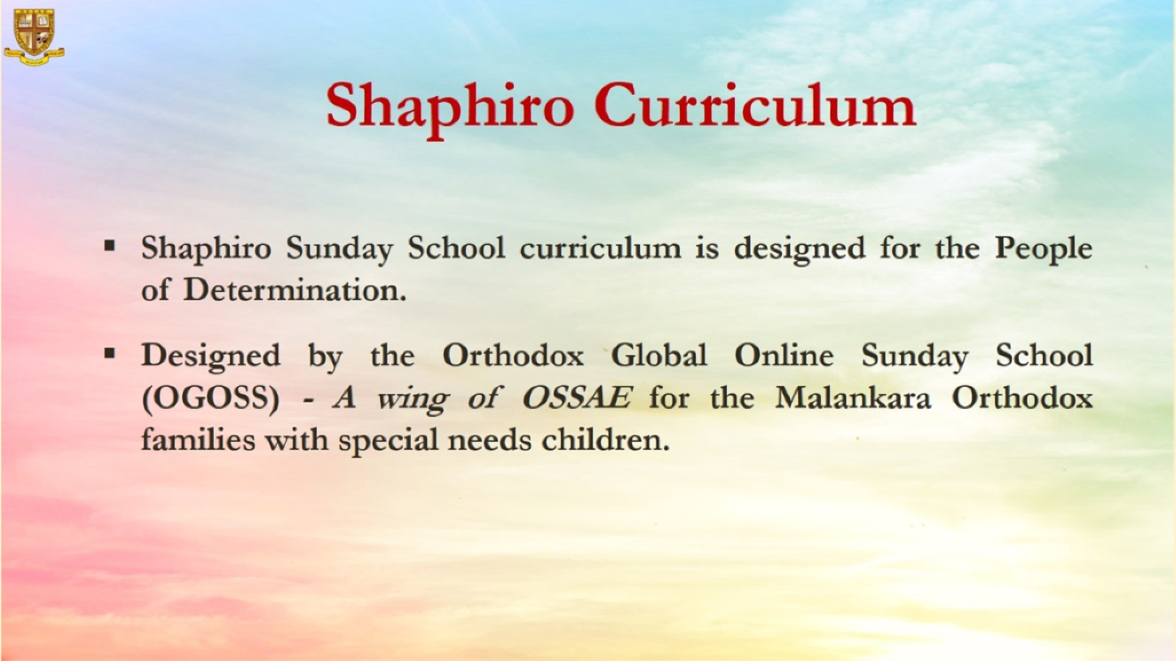

Slide 3


Slide 4
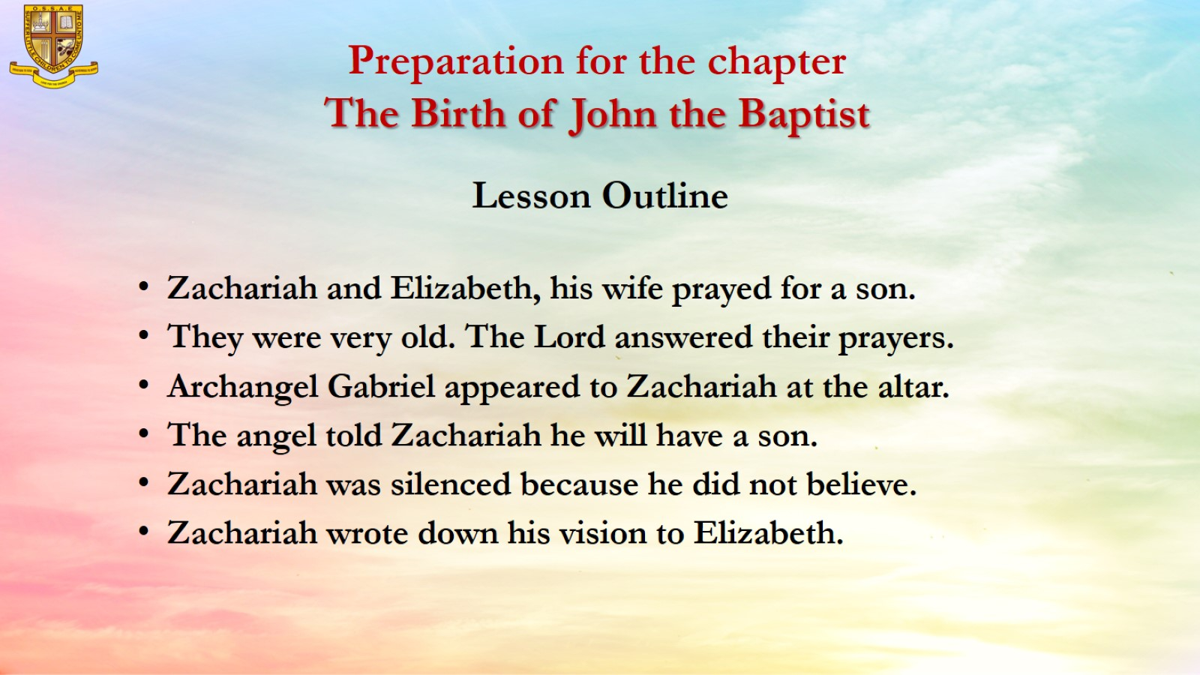
Preparation for the chapter
The Birth of John the Baptist

Slide 5
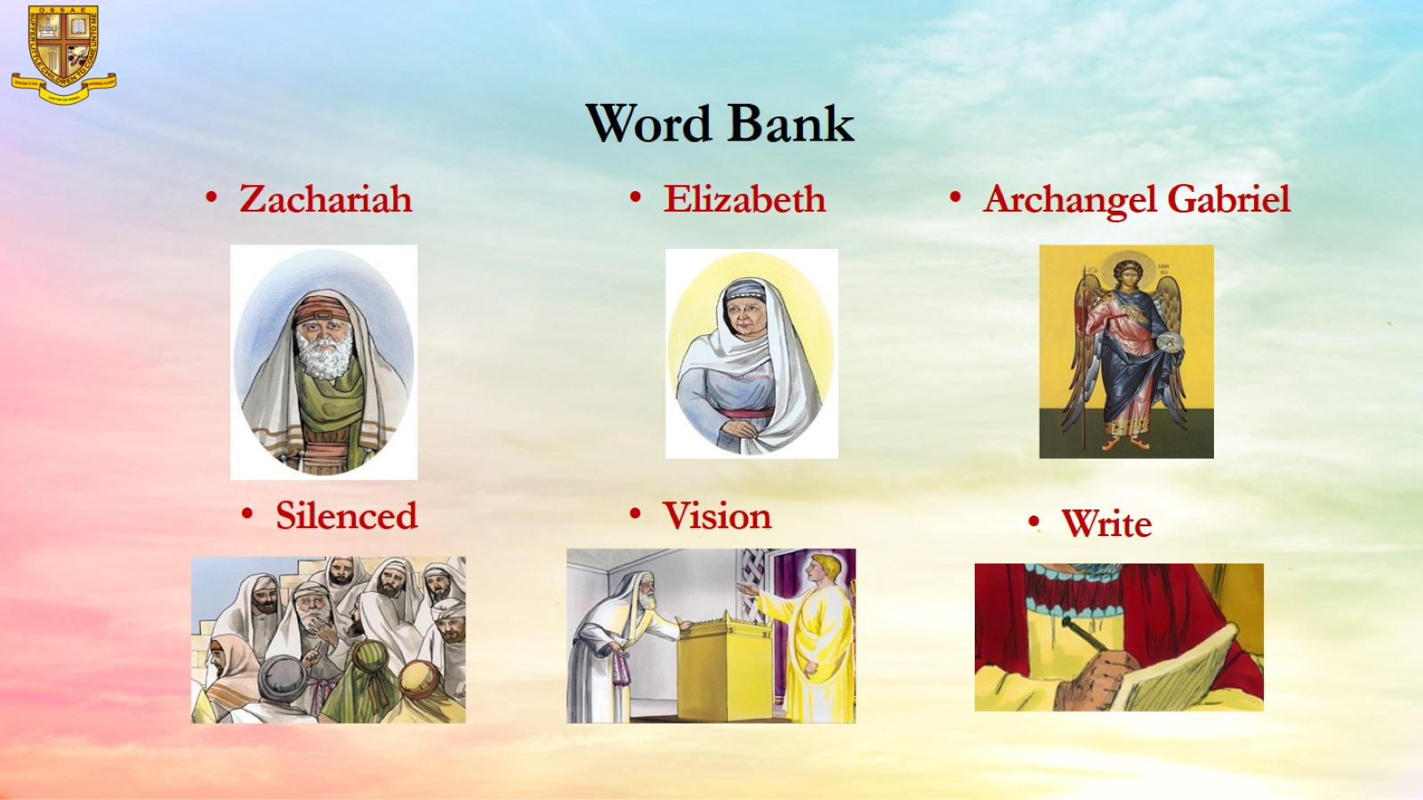
Word Bank

Slide 6
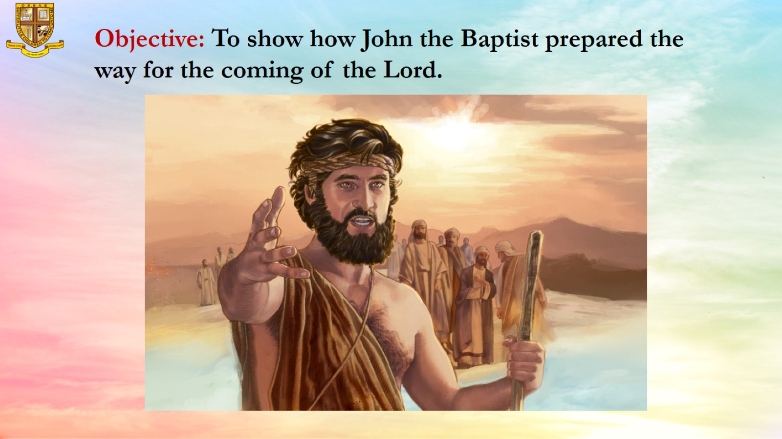
Objective: To show how John the Baptist prepared the way for the coming of the Lord.

Slide 7
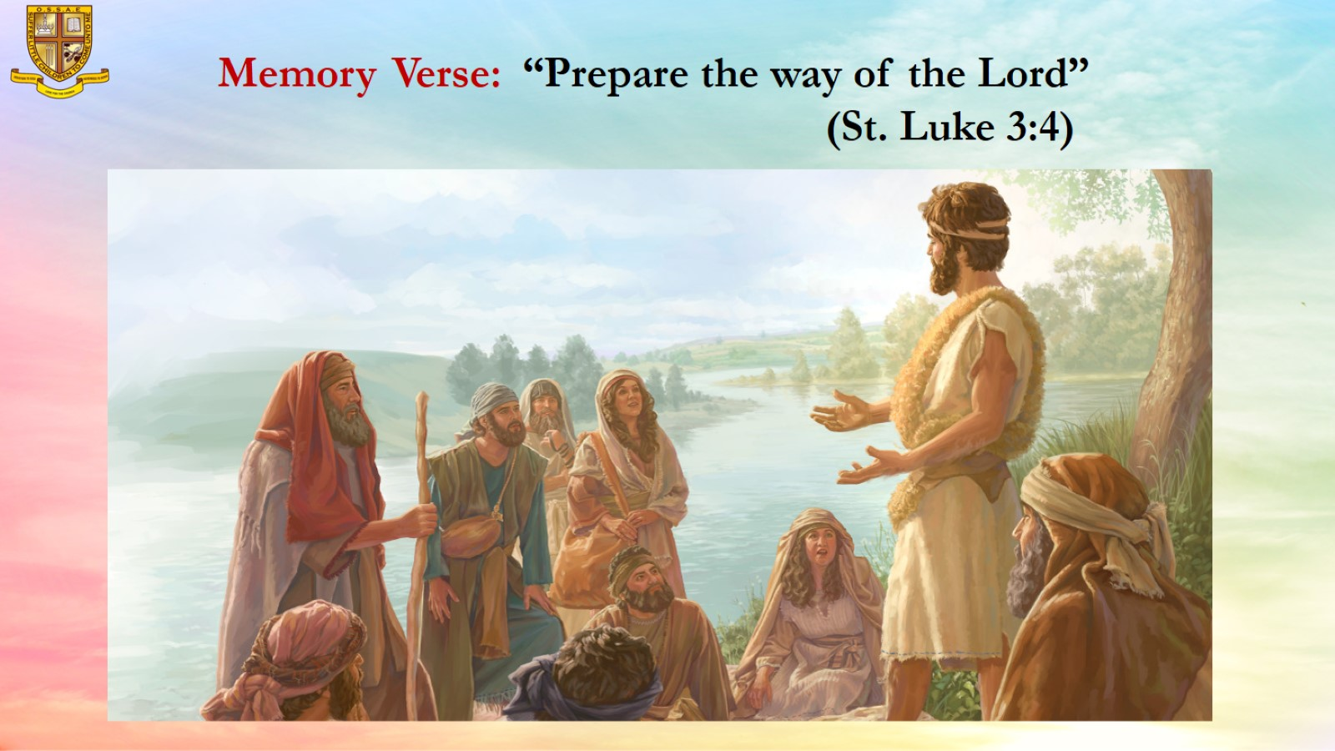
Memory Verse: “Prepare the way of the Lord”
(St. Luke 3:4)

Slide 8
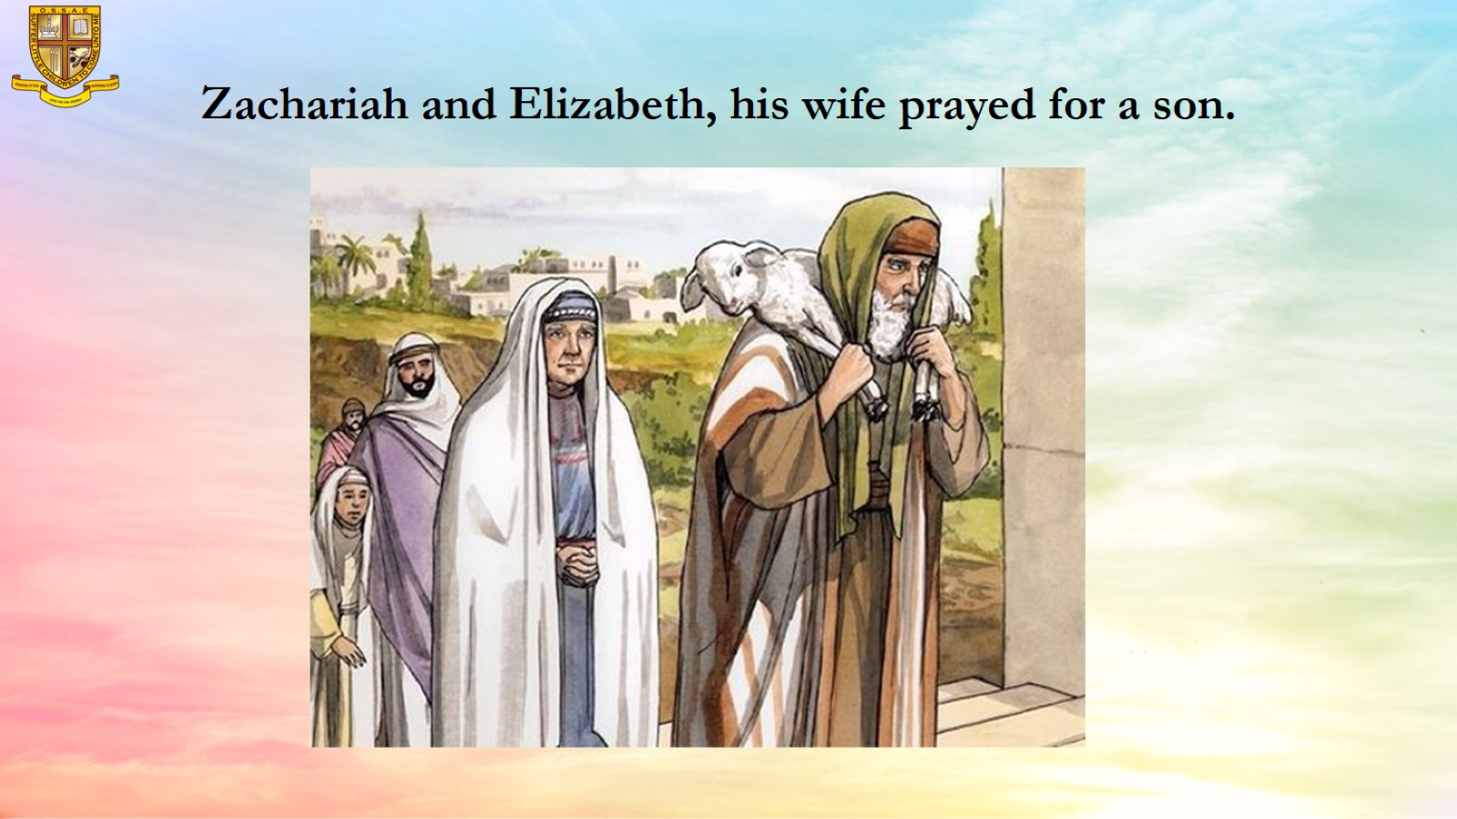
Zachariah and Elizabeth, his wife prayed for a son.

Slide 9
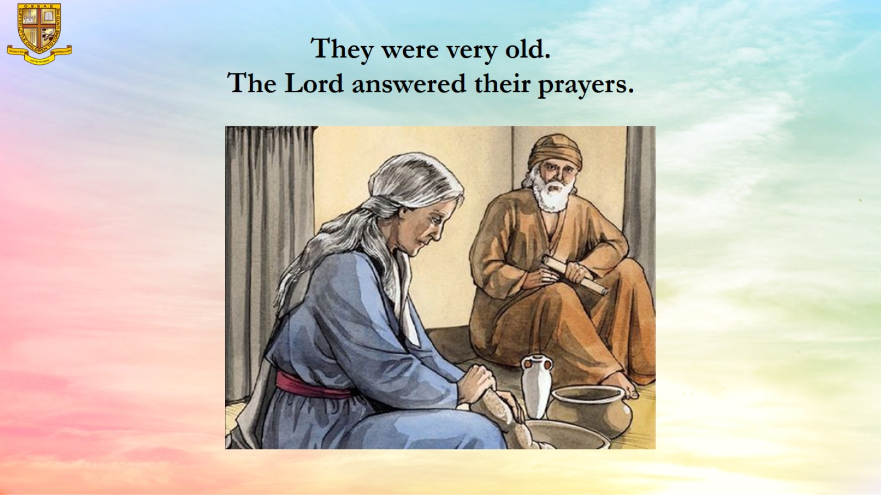
They were very old.
The Lord answered their prayers.

Slide 10
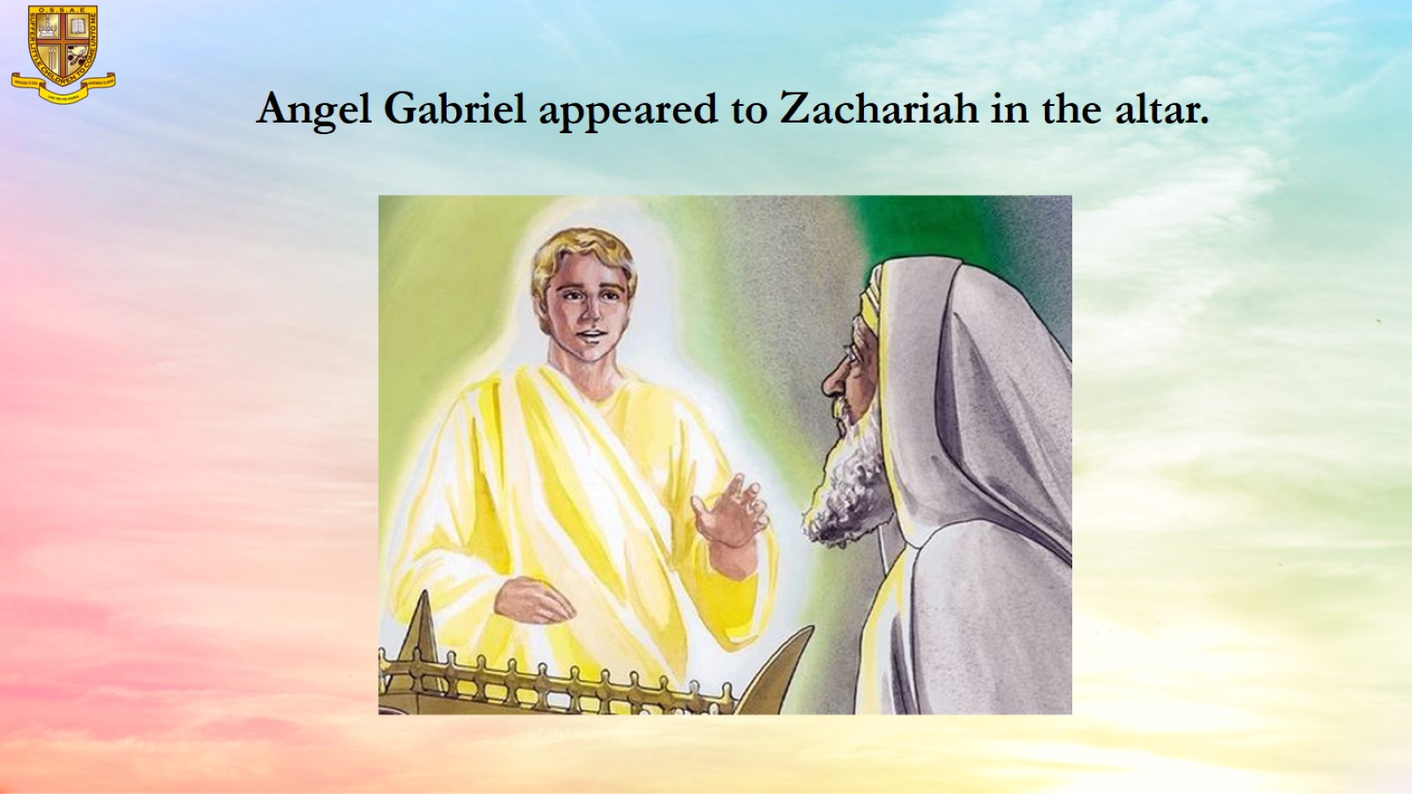
Angel Gabriel appeared to Zachariah in the altar.

Slide 11
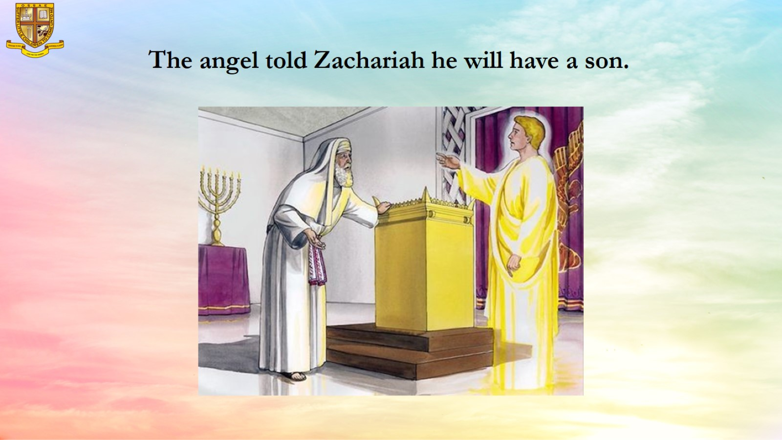
The angel told Zachariah he will have a son.

Slide 12
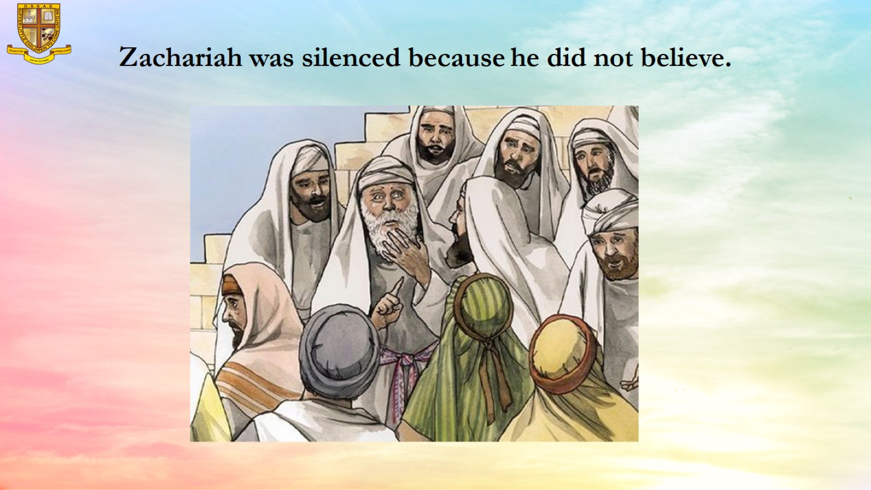
Zachariah was silenced because he did not believe.

Slide 13
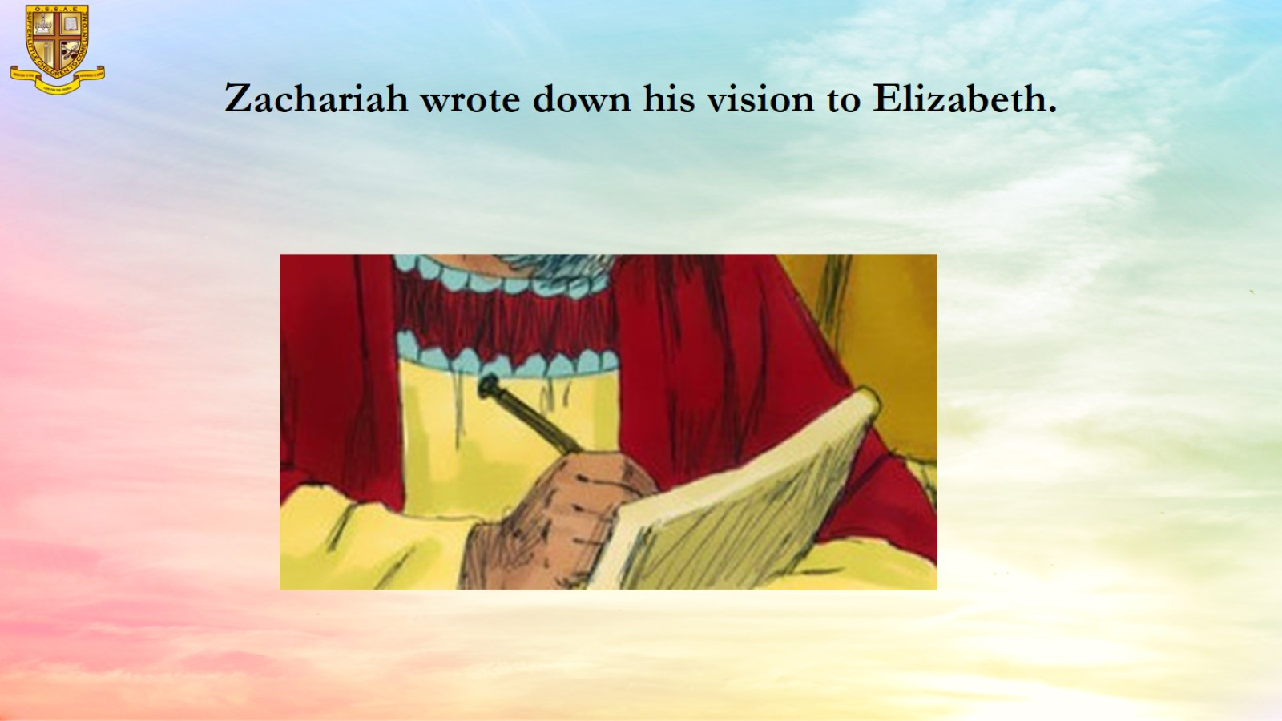
Zachariah wrote down his vision to Elizabeth.

Slide 14
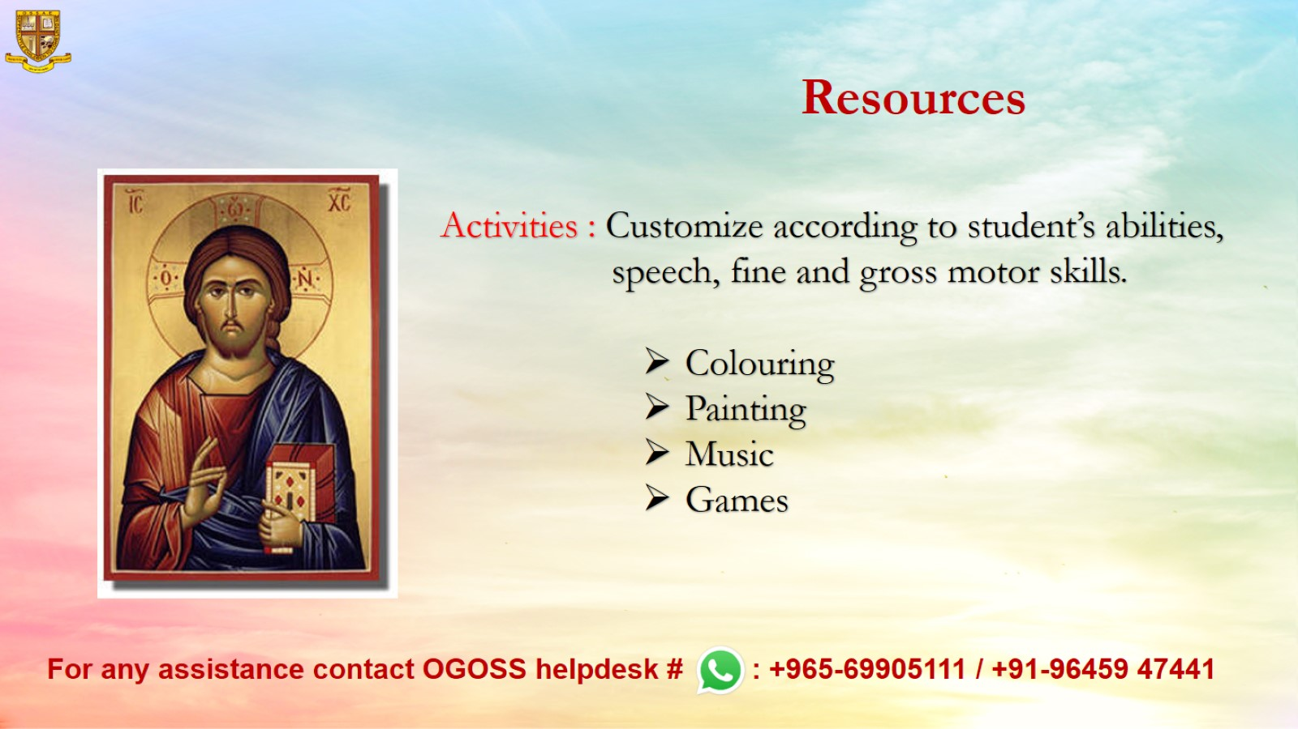
Resources

