Slide 1
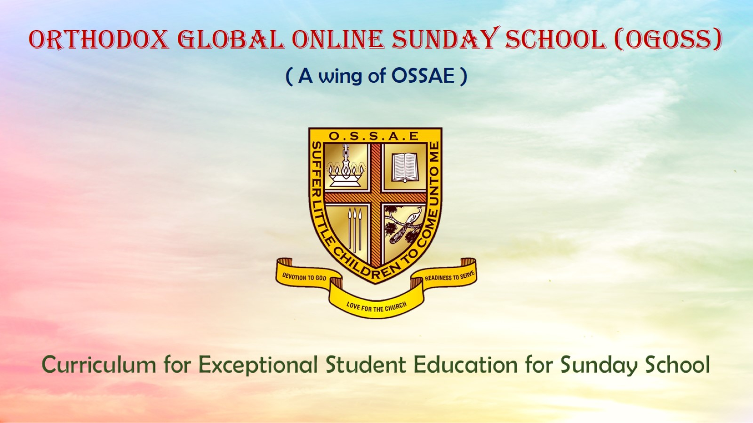
Orthodox Global Online Sunday School (OGOSS)

Slide 2
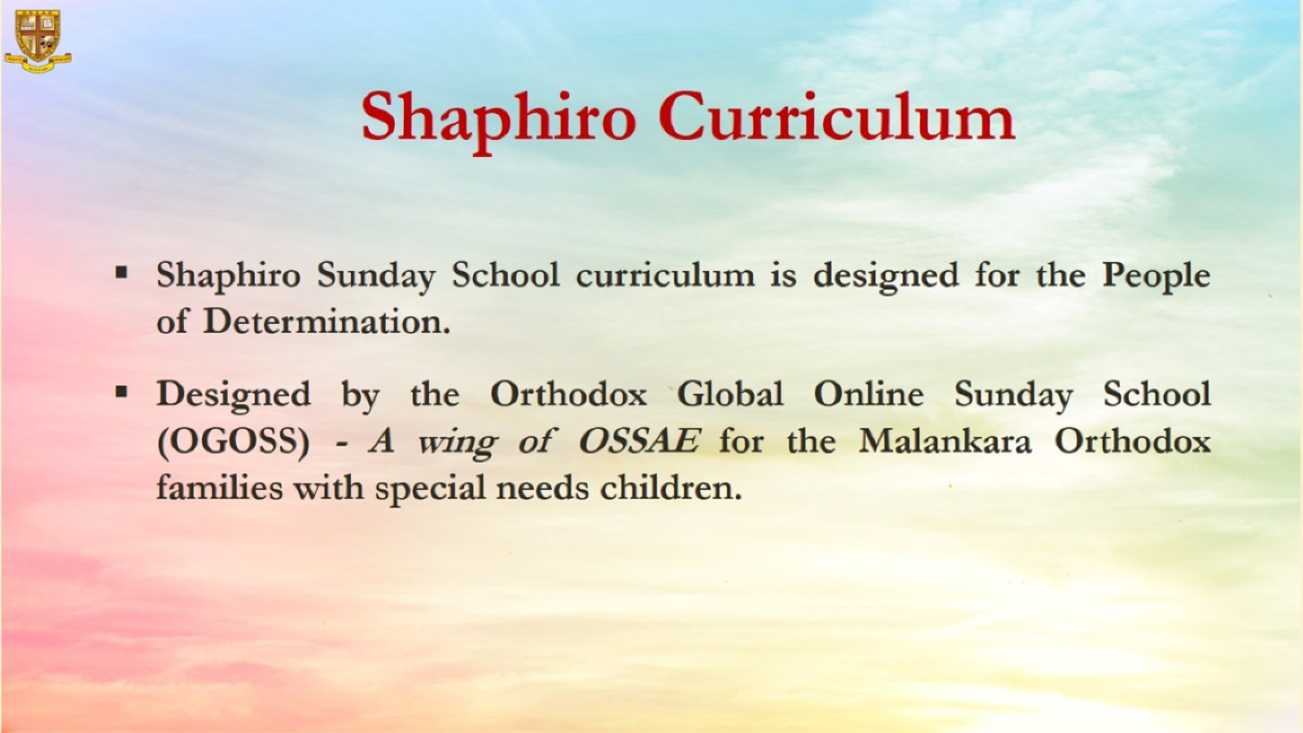

Slide 3
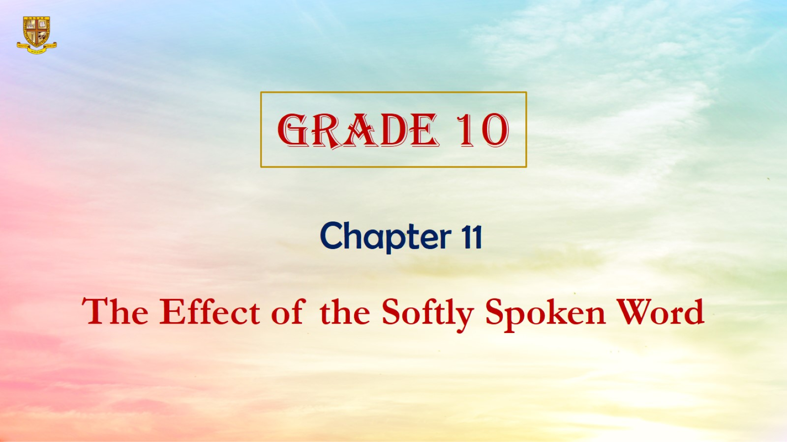

Slide 4
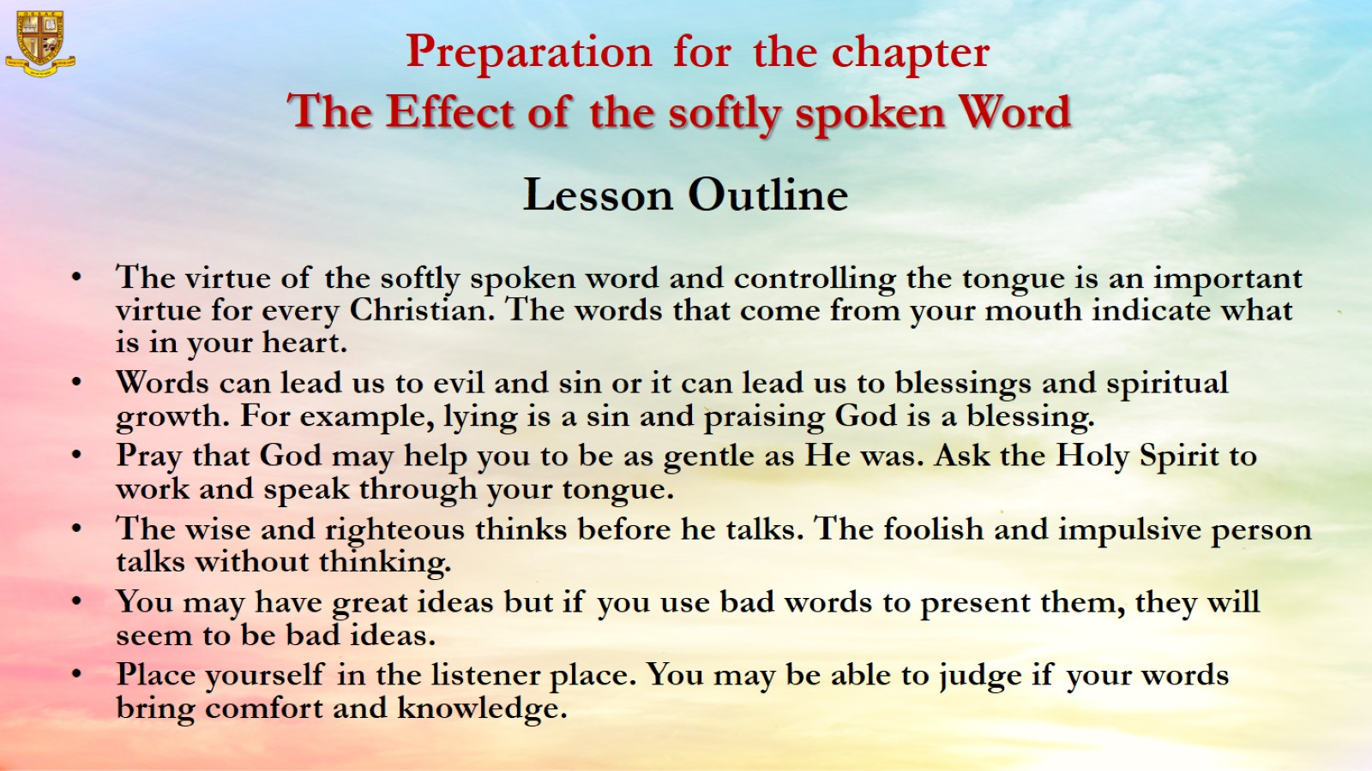
Preparation for the chapter
The Effect of the softly spoken Word

Slide 5
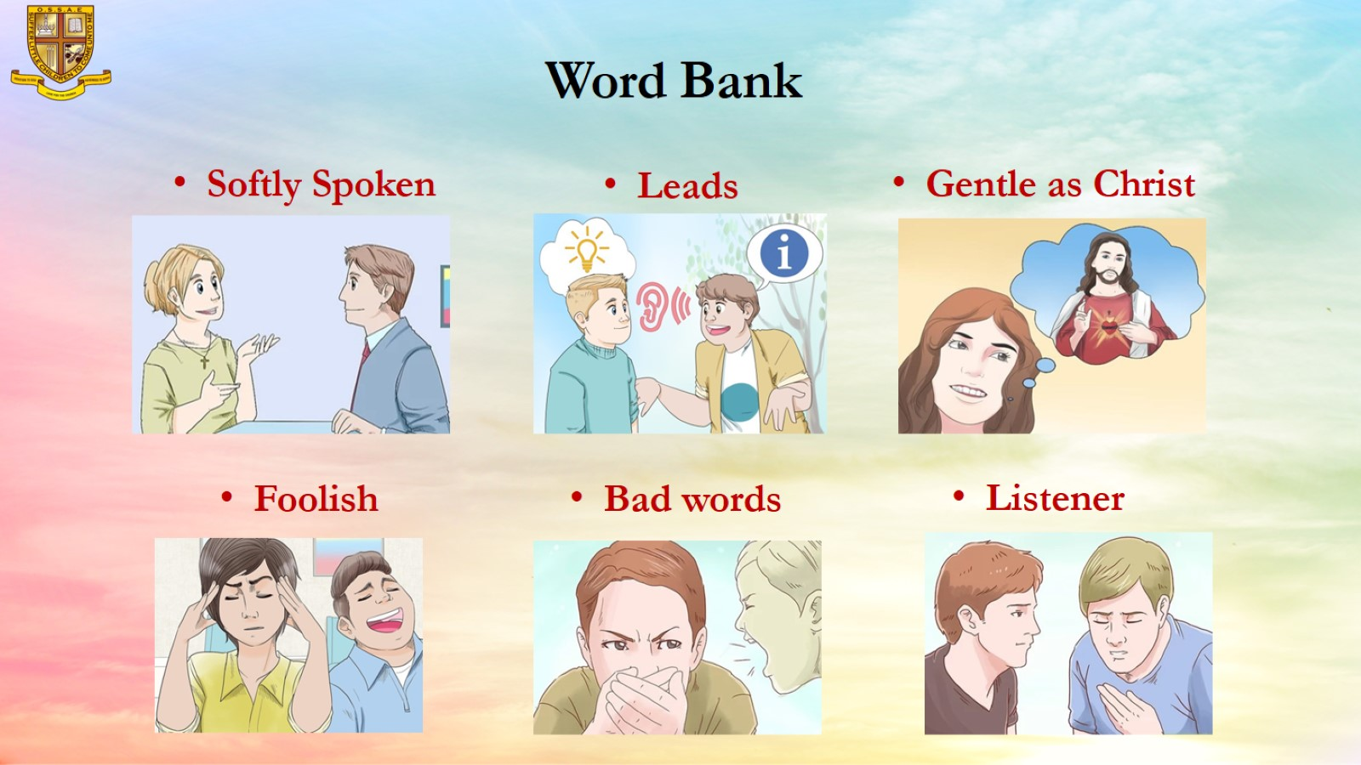
Word Bank

Slide 6
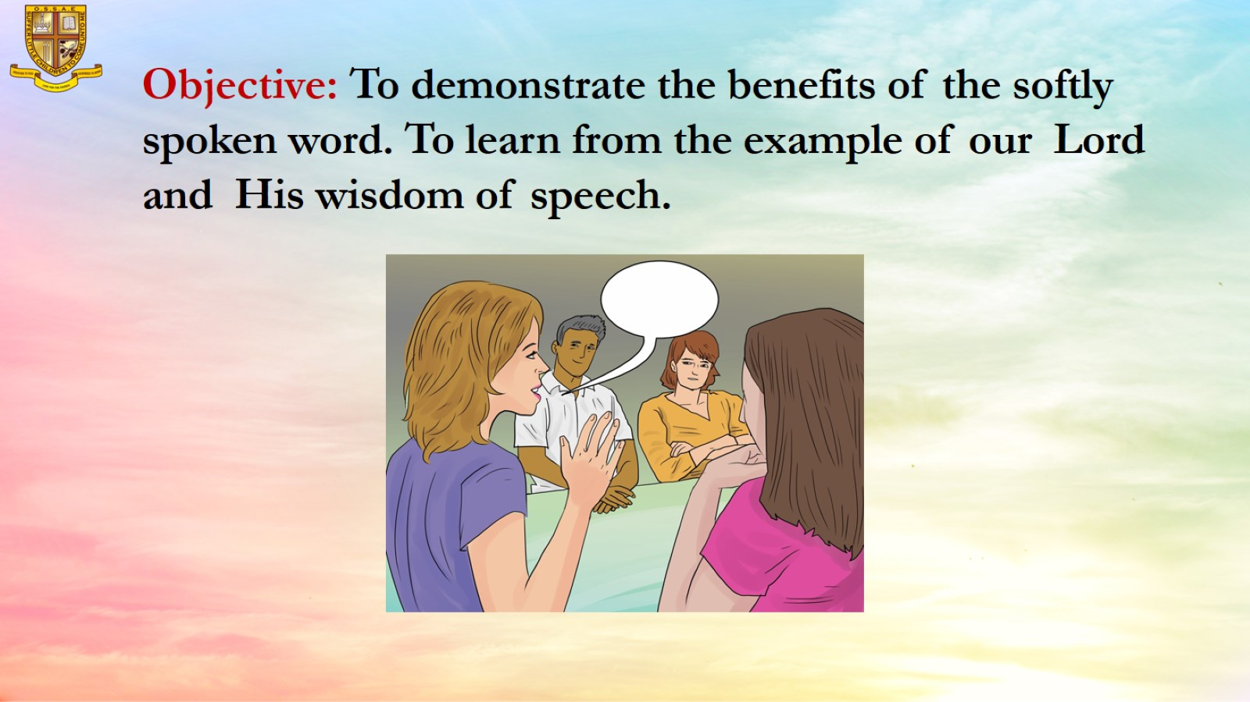
Objective: To demonstrate the benefits of the softly spoken word. To learn from the example of our Lord and His wisdom of speech.

Slide 7
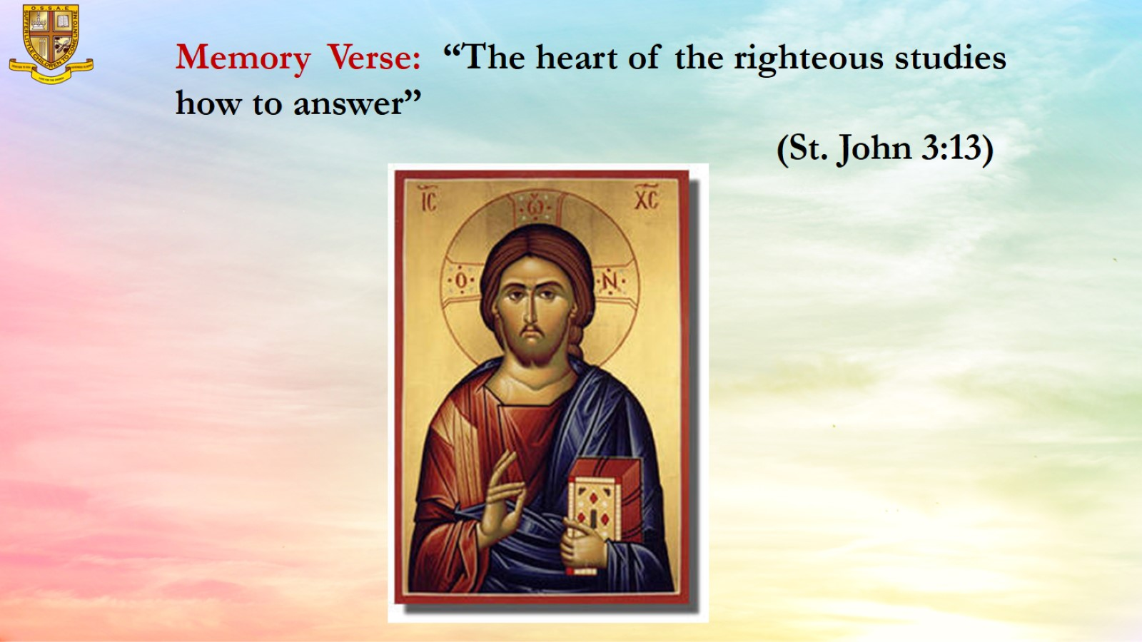
Memory Verse: “The heart of the righteous studies how to answer”
(St. John 3:13)

Slide 8
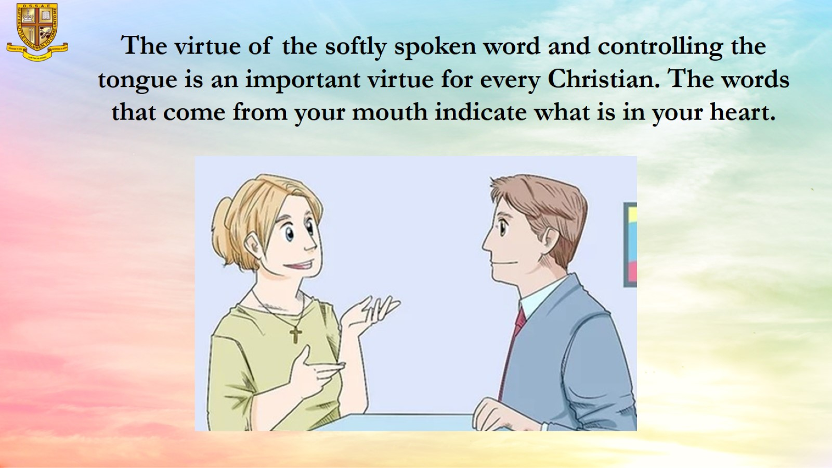
The virtue of the softly spoken word and controlling the tongue is an important virtue for every Christian. The words that come from your mouth indicate what is in your heart.

Slide 9
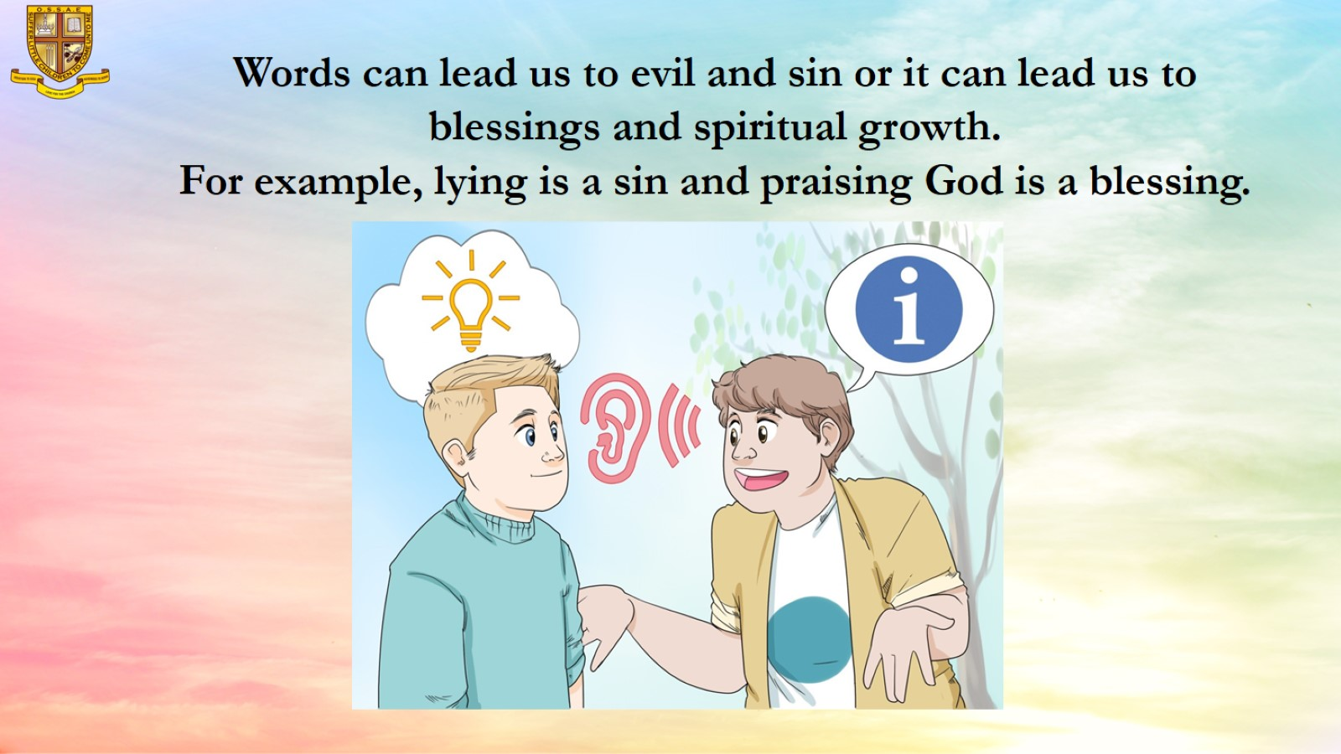

Slide 10
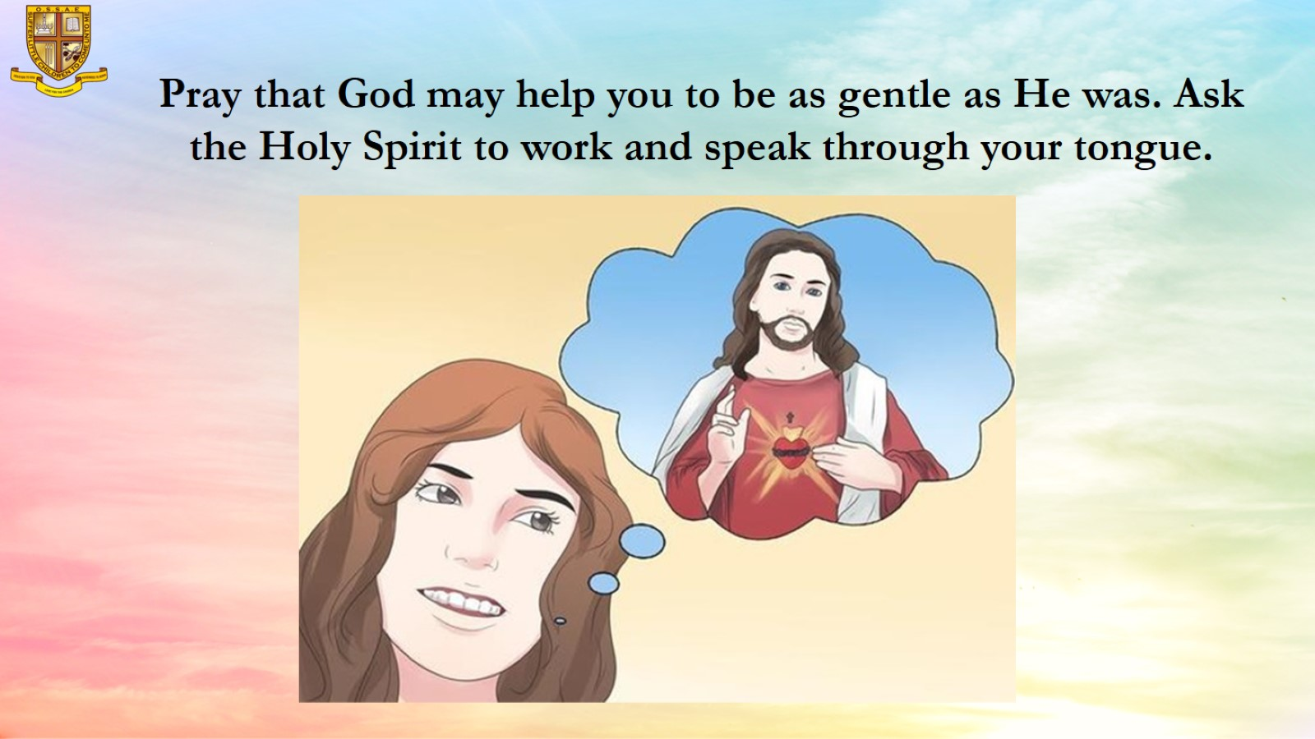
Pray that God may help you to be as gentle as He was. Ask the Holy Spirit to work and speak through your tongue.

Slide 11
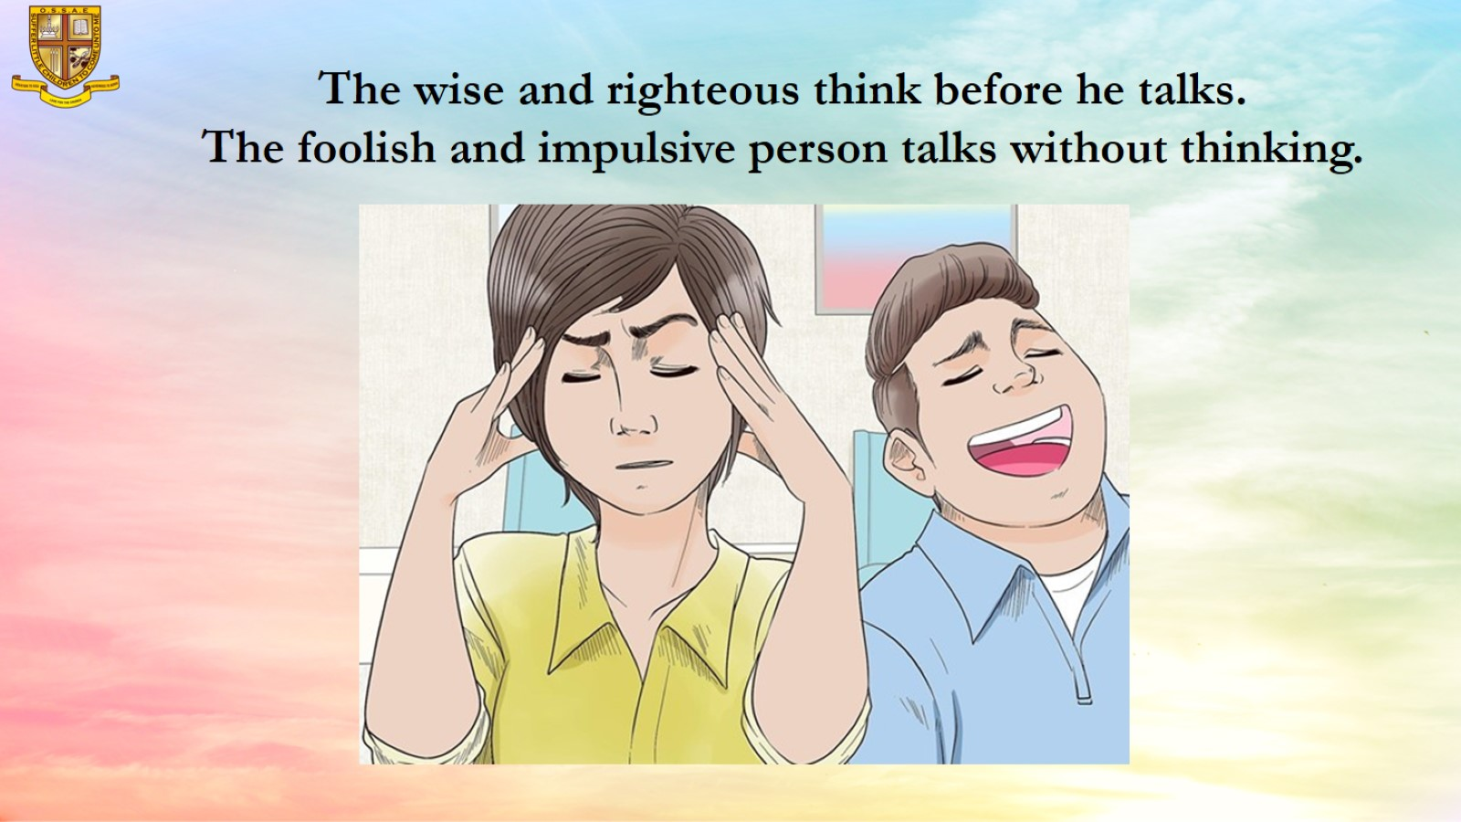
The wise and righteous think before he talks.
The foolish and impulsive person talks without thinking.

Slide 12
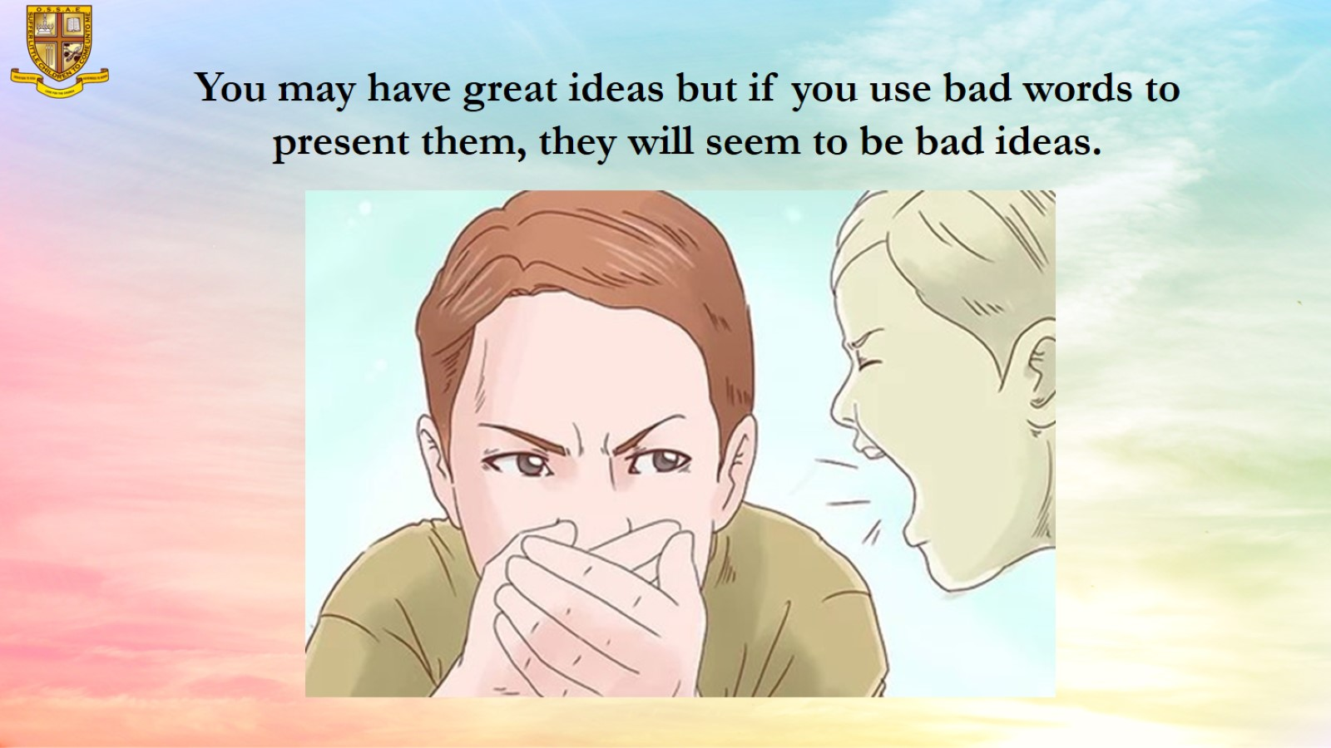
You may have great ideas but if you use bad words to present them, they will seem to be bad ideas.

Slide 13
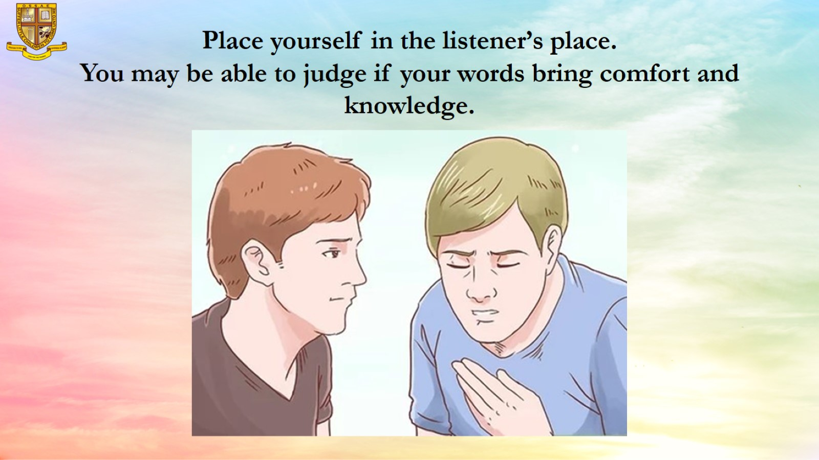
Place yourself in the listener’s place.
You may be able to judge if your words bring comfort and knowledge.

Slide 14
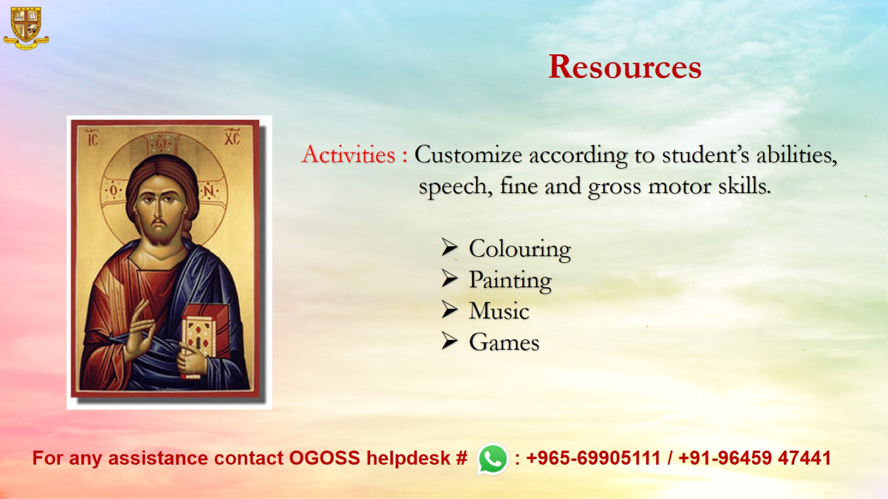
Resources

