Slide 1


Slide 2
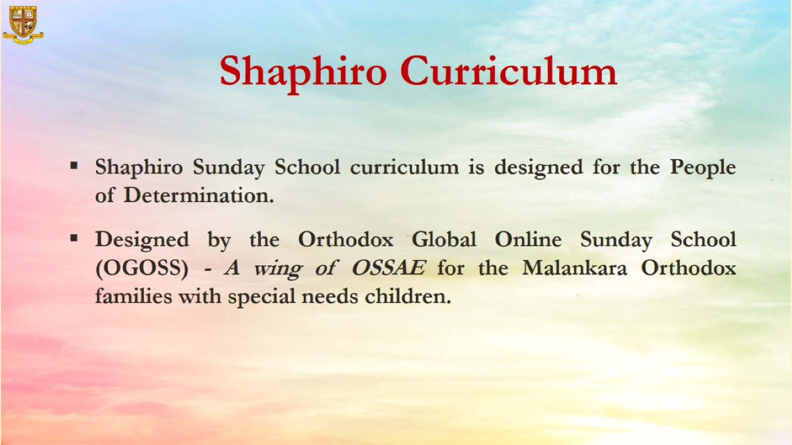

Slide 3


Grade 1
Chapter 5
The miracle of catching huge number of fish

Slide 4
Preparation for
The Miracle of Catching Huge Number of Fish
Preparation for the chapter
The miracle of catching huge number of fish
Lesson Outline
St. Peter and the other disciples fished all night.
They were sad. They did not catch any fish.
They found Jesus on the shore. He was teaching the people.
Later, Jesus got inside the boat. Jesus told them to go deep.
Then He told them to cast the net. They did as Jesus said.
They caught a lot of fish. Their net was very heavy.

Slide 5
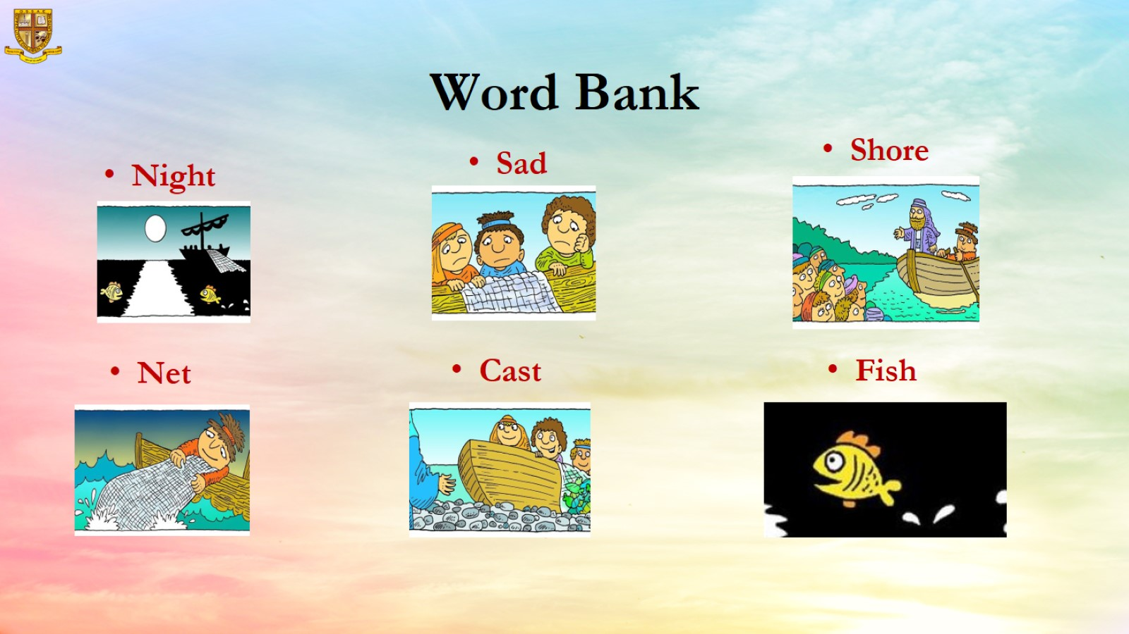
Word Bank

Slide 6
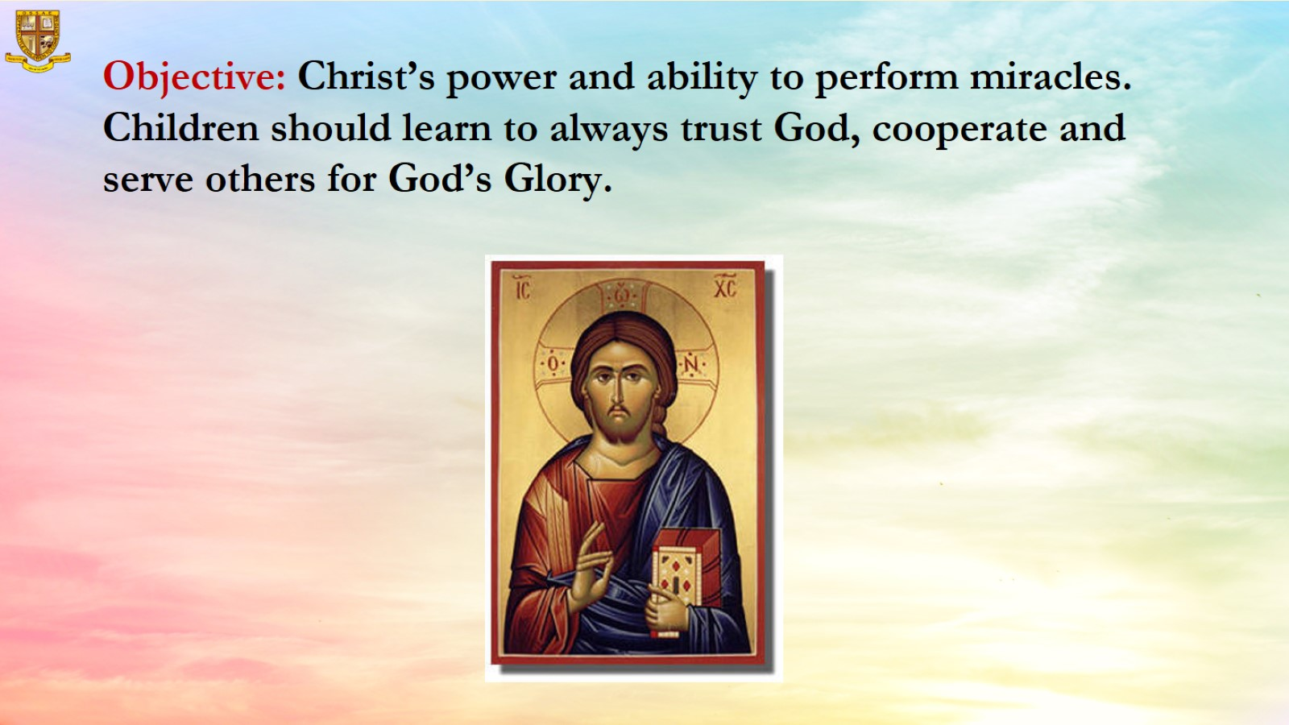

Slide 7
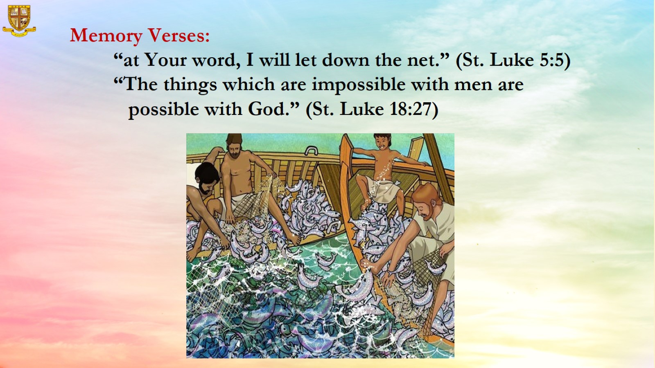

Slide 8
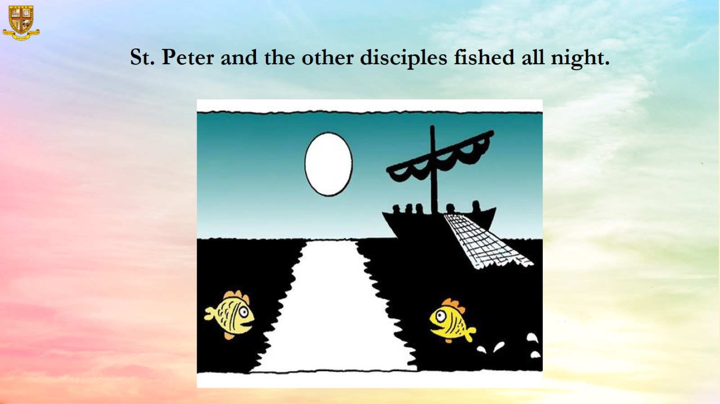
St. Peter and the other disciples fished all night.

Slide 9
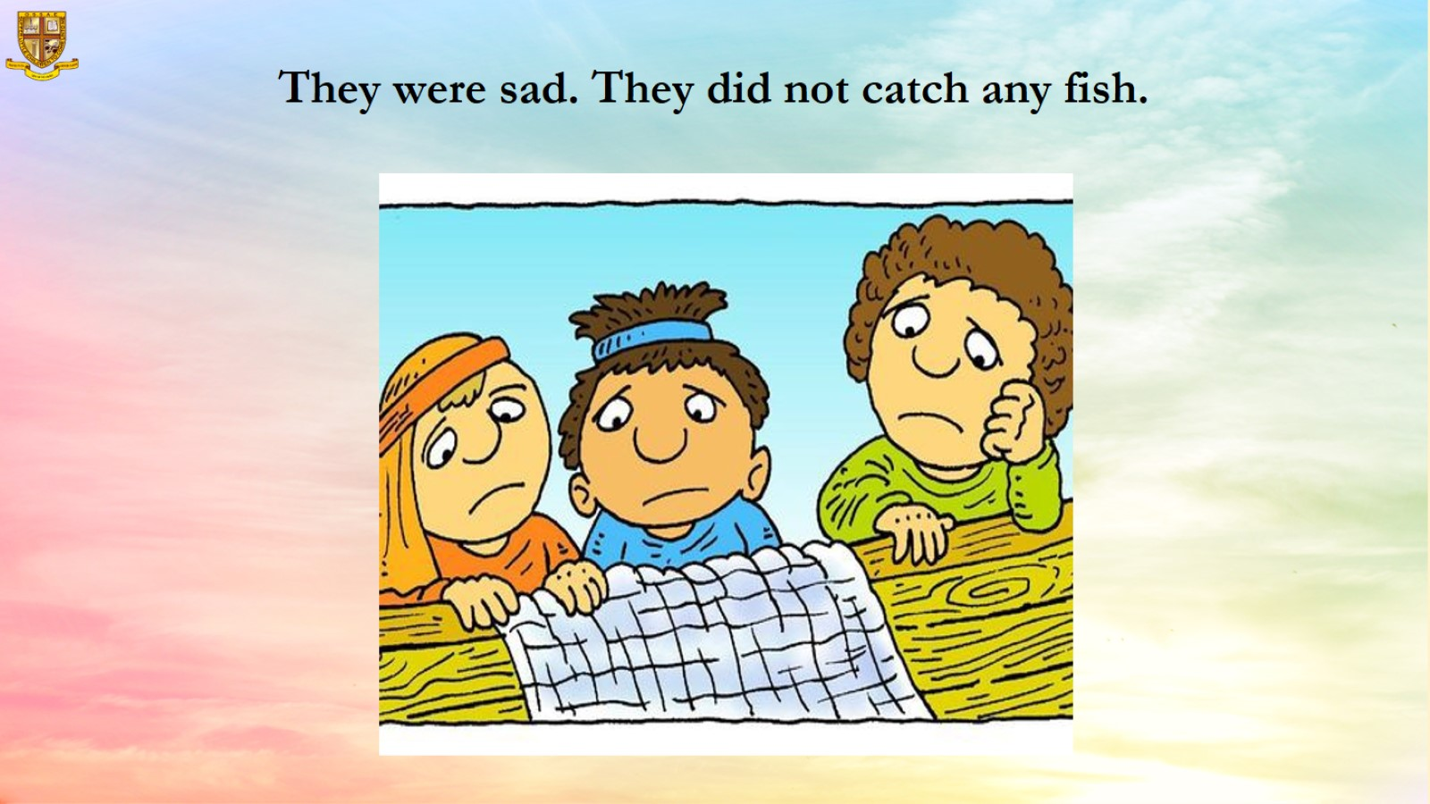

Slide 10
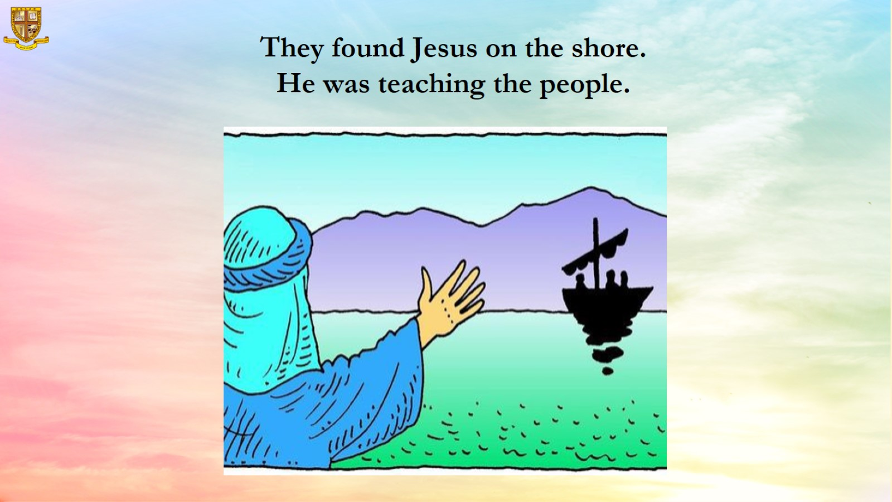

Slide 11
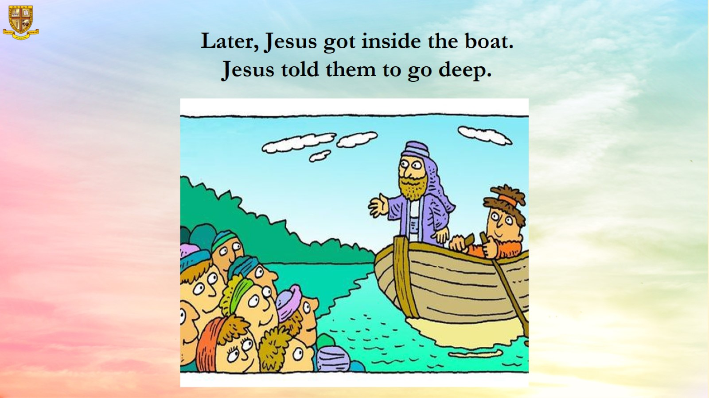

Slide 12
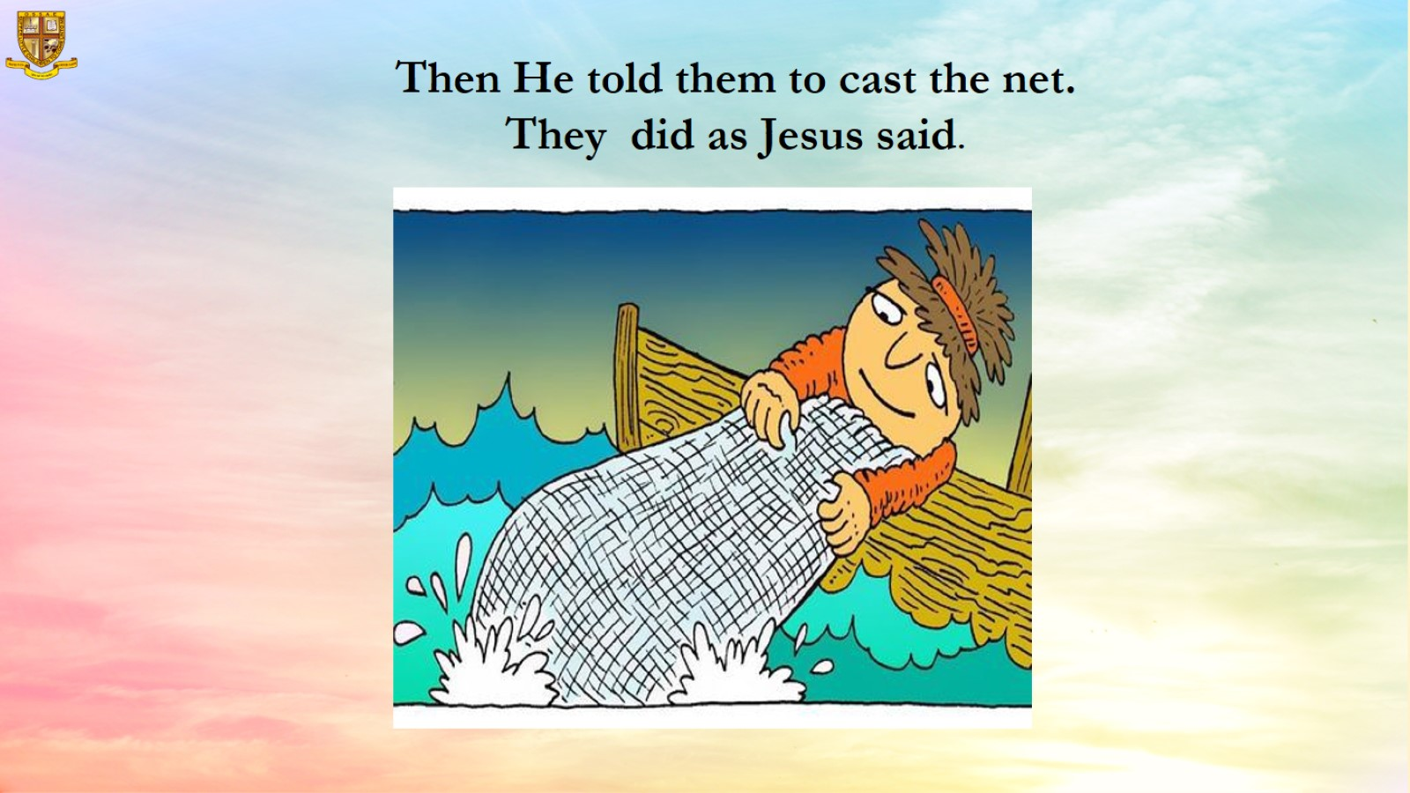

Slide 13
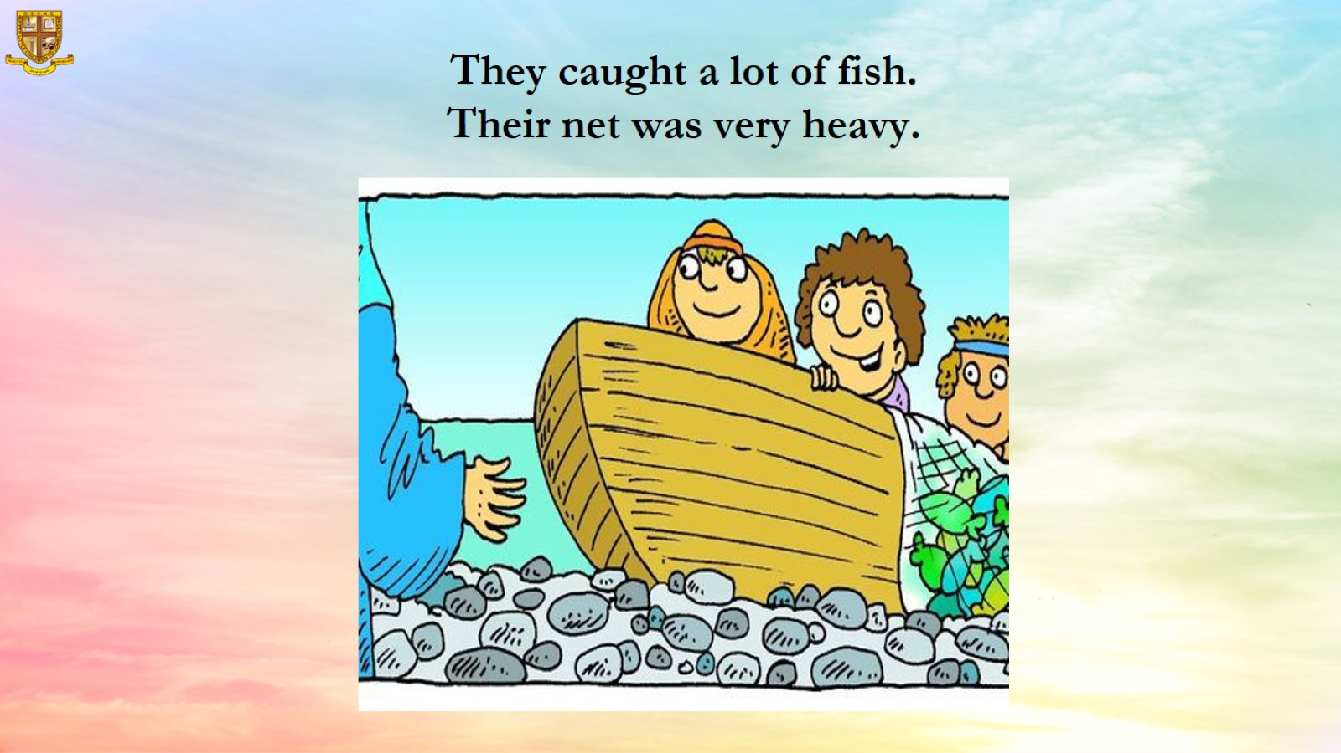
They caught a lot of fish.
Their net was very heavy.

Slide 14
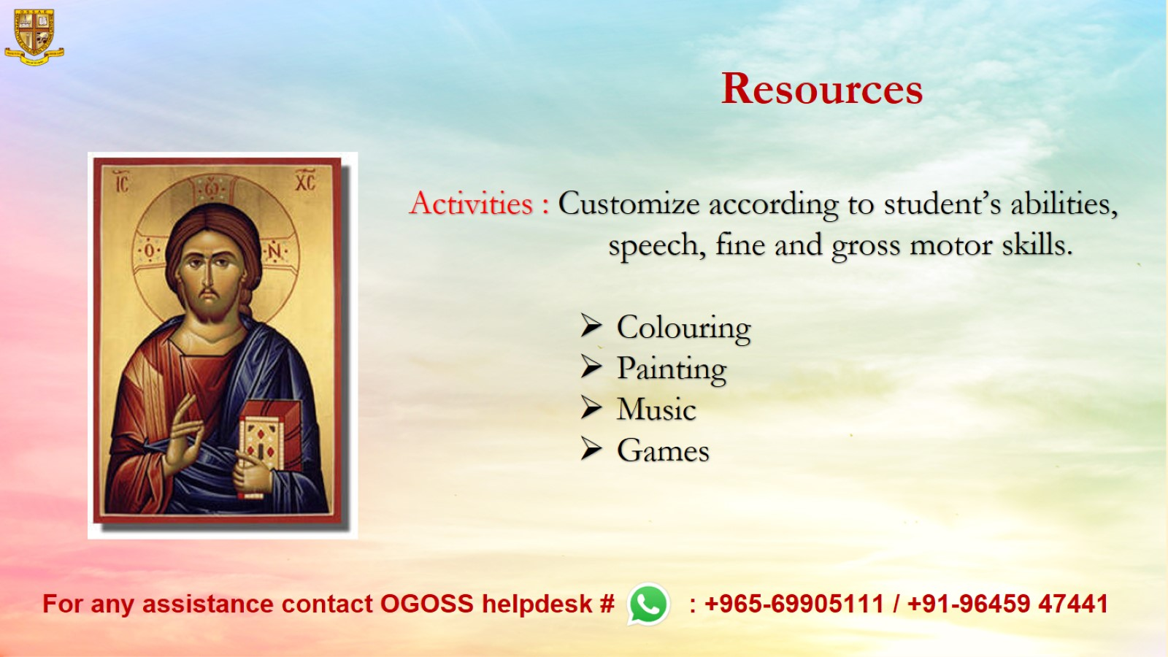
Resources

