Slide 1
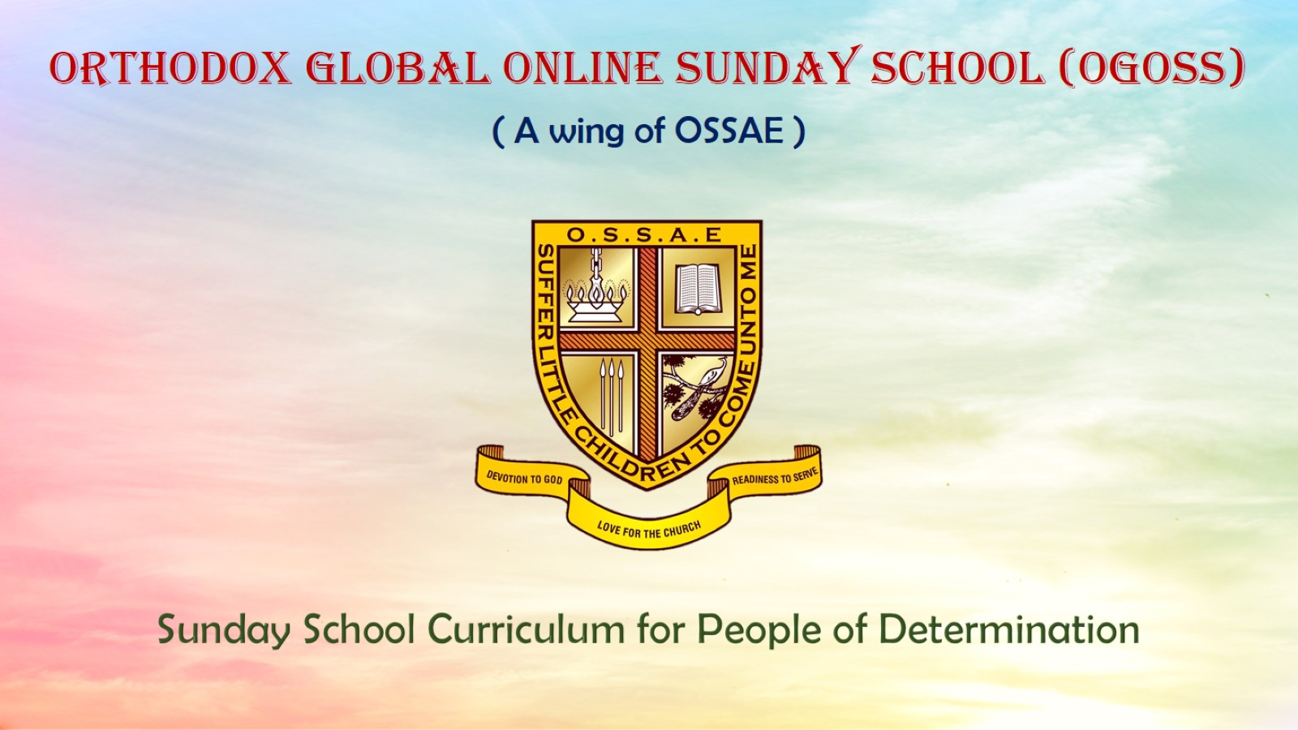
Orthodox Global Online Sunday School (OGOSS)

Slide 2
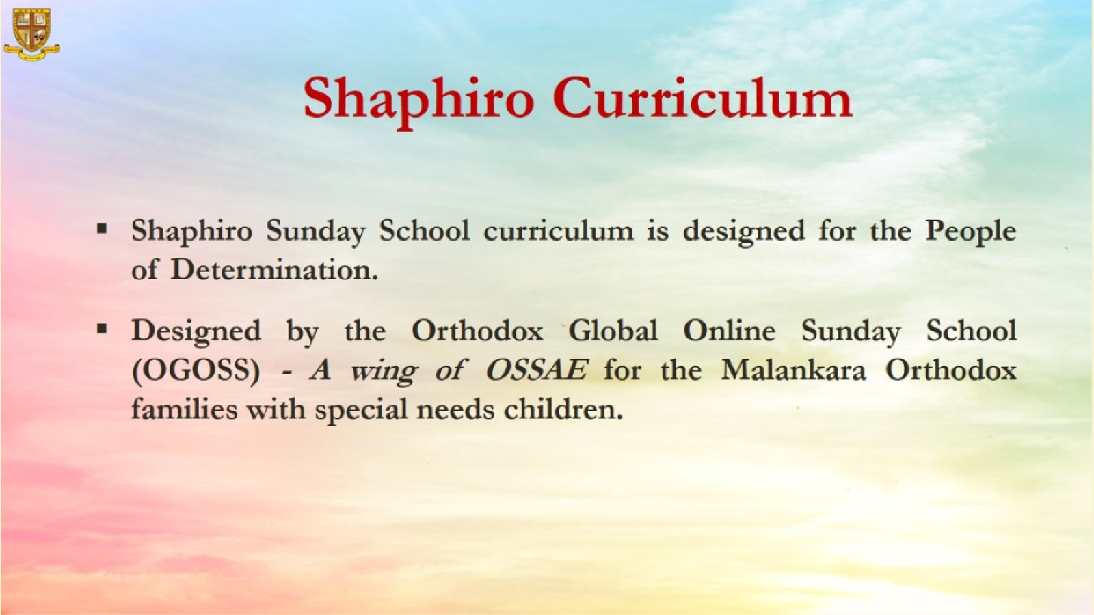

Slide 3
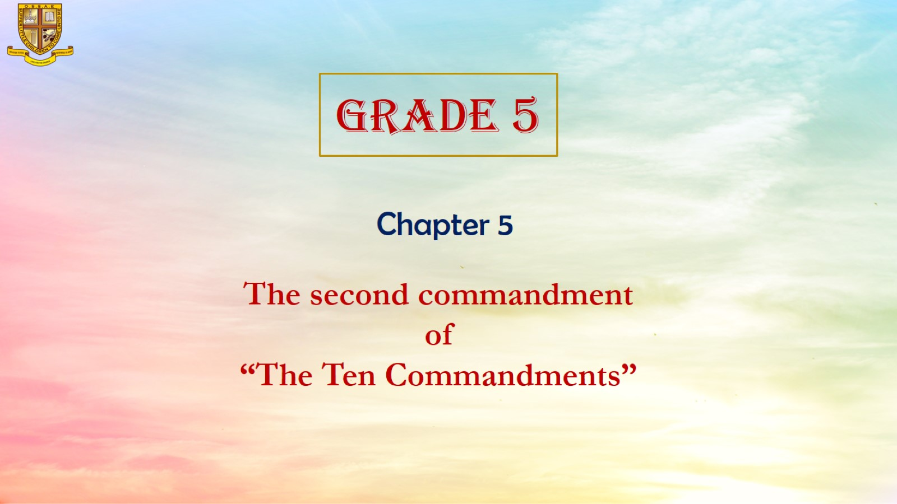

Slide 4
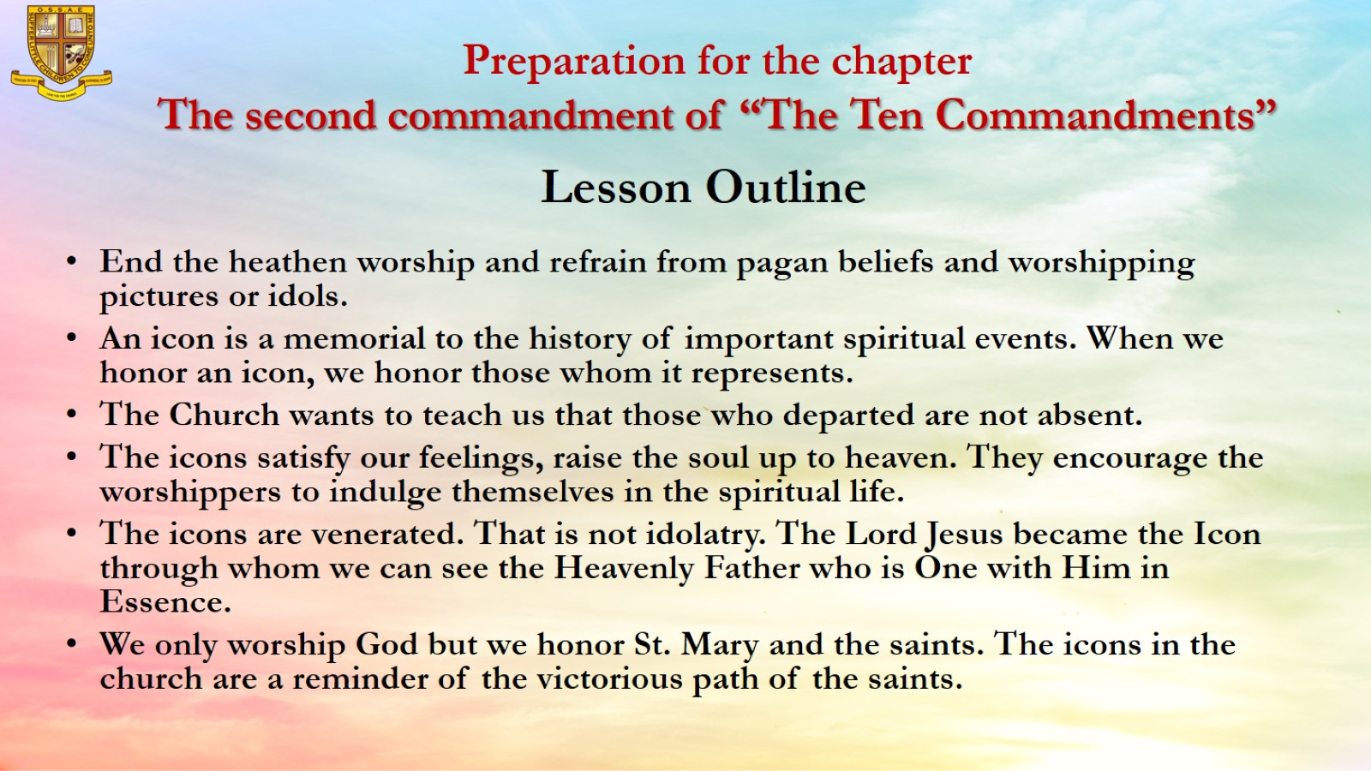
Preparation for the chapter
The second commandment of “The Ten Commandments”

Slide 5
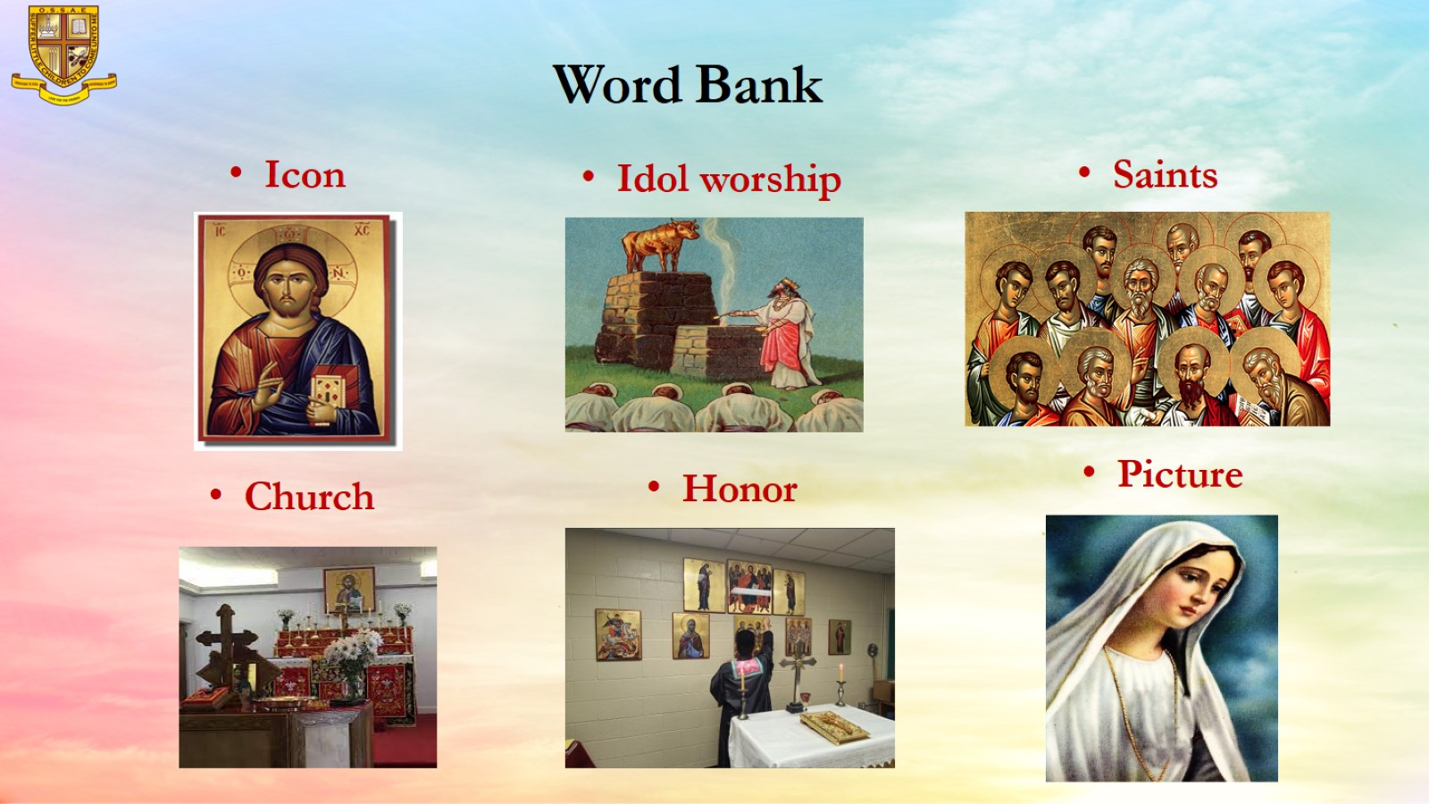
Word Bank

Slide 6
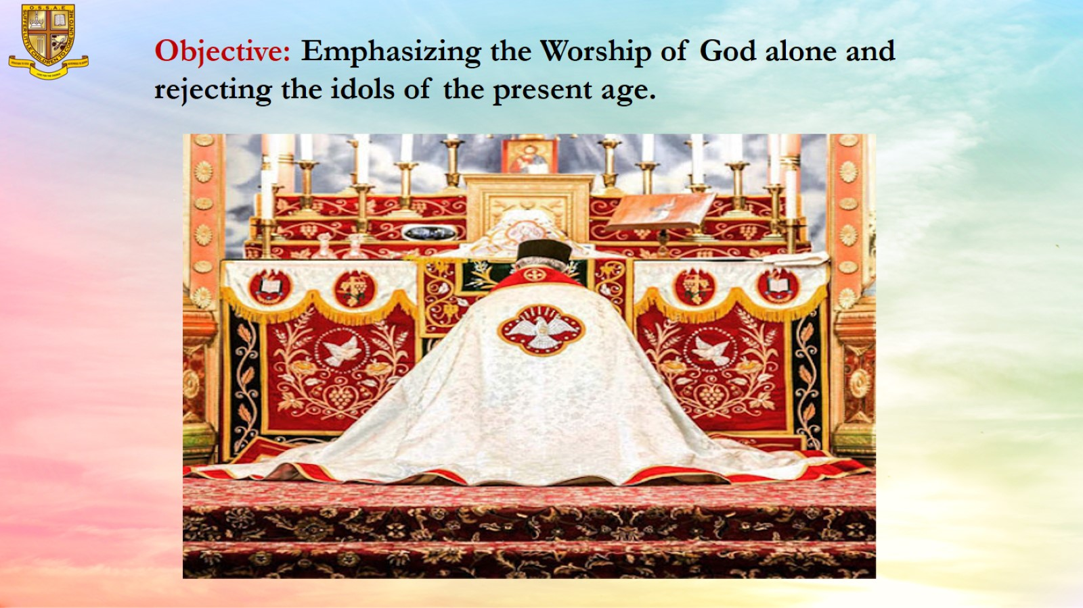
Objective: Emphasizing the Worship of God alone and rejecting the idols of the present age.

Slide 7
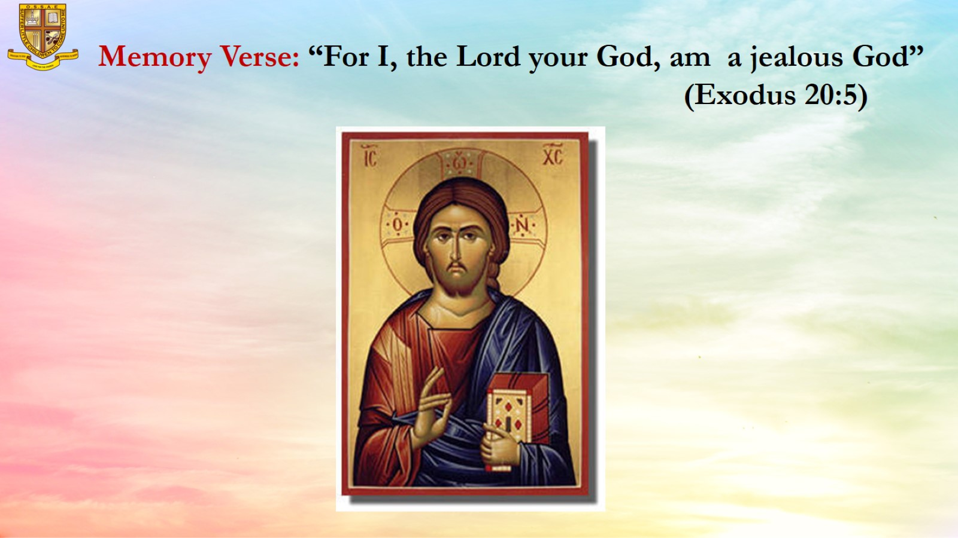
Memory Verse: “For I, the Lord your God, am a jealous God” (Exodus 20:5)

Slide 8
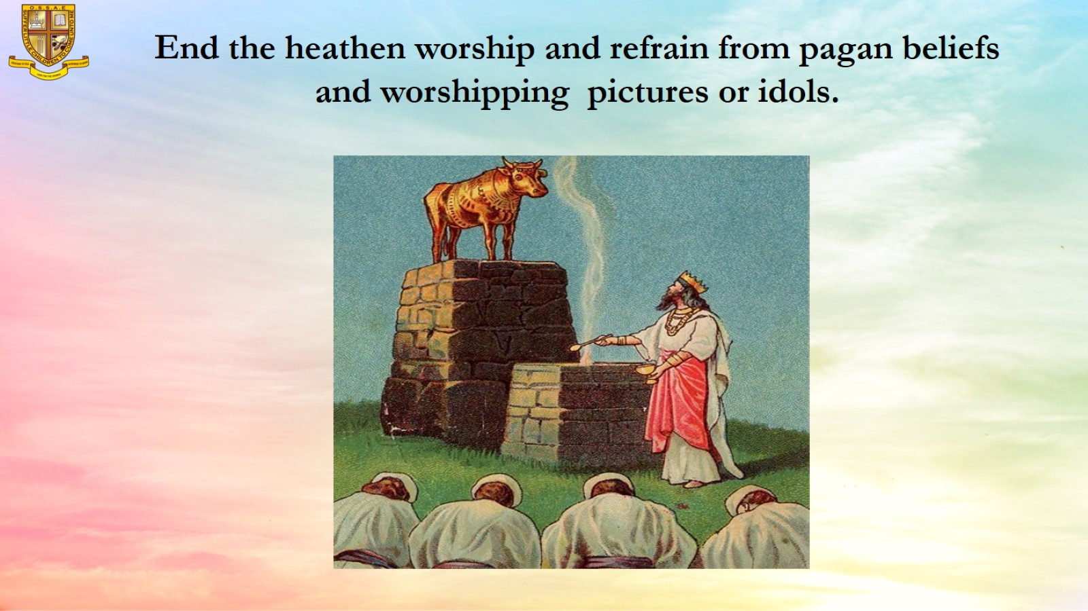
End the heathen worship and refrain from pagan beliefs and worshipping pictures or idols.

Slide 9
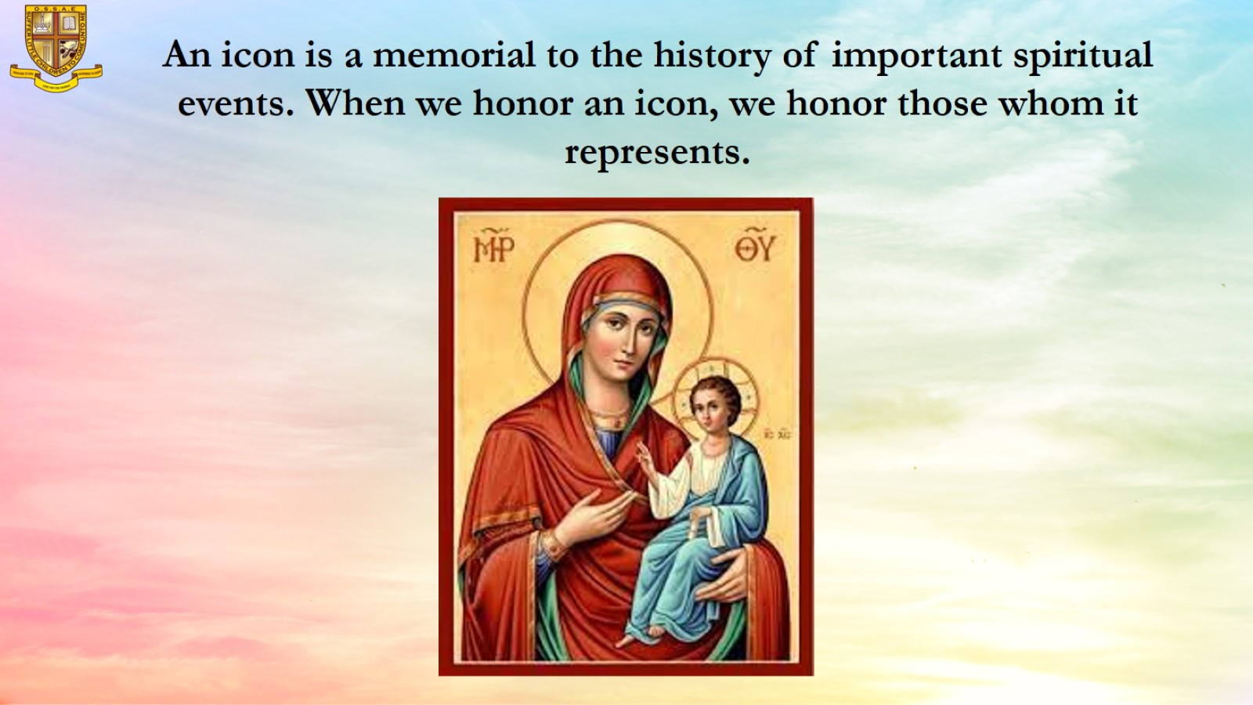
An icon is a memorial to the history of important spiritual events. When we honor an icon, we honor those whom it represents.

Slide 10
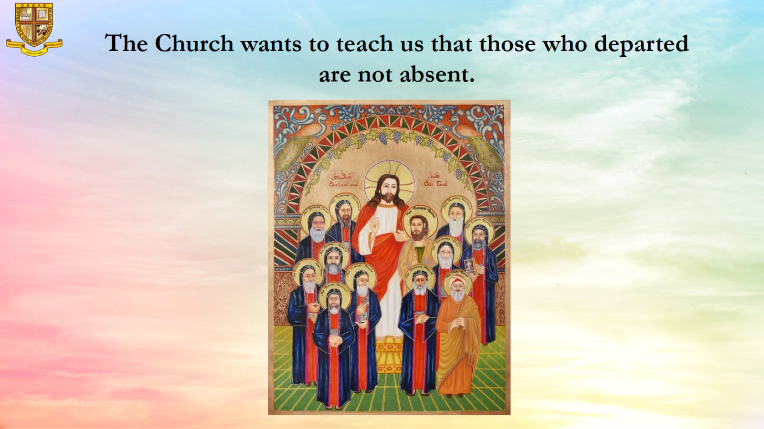
The Church wants to teach us that those who departed are not absent.

Slide 11
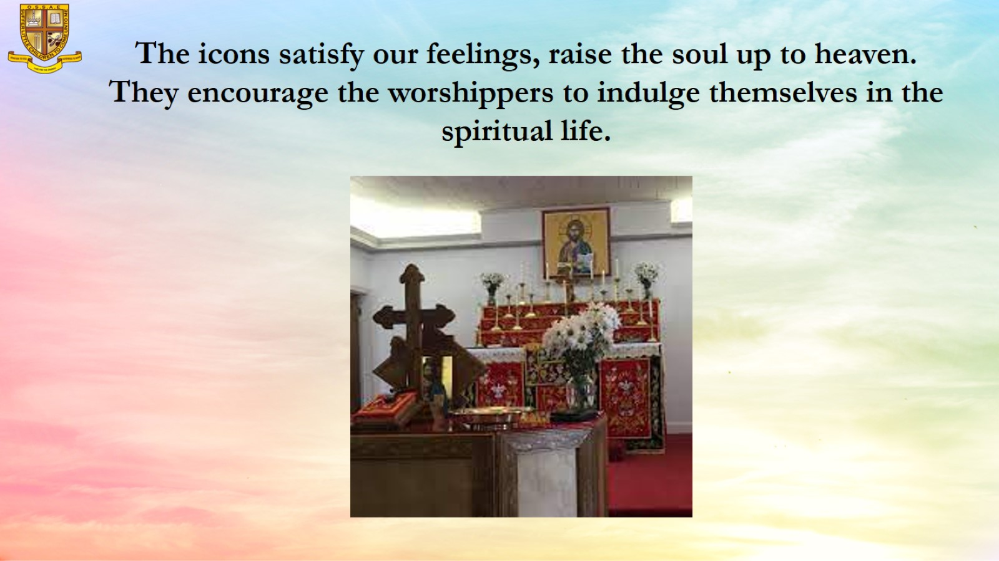
The icons satisfy our feelings, raise the soul up to heaven.
They encourage the worshippers to indulge themselves in the spiritual life.

Slide 12
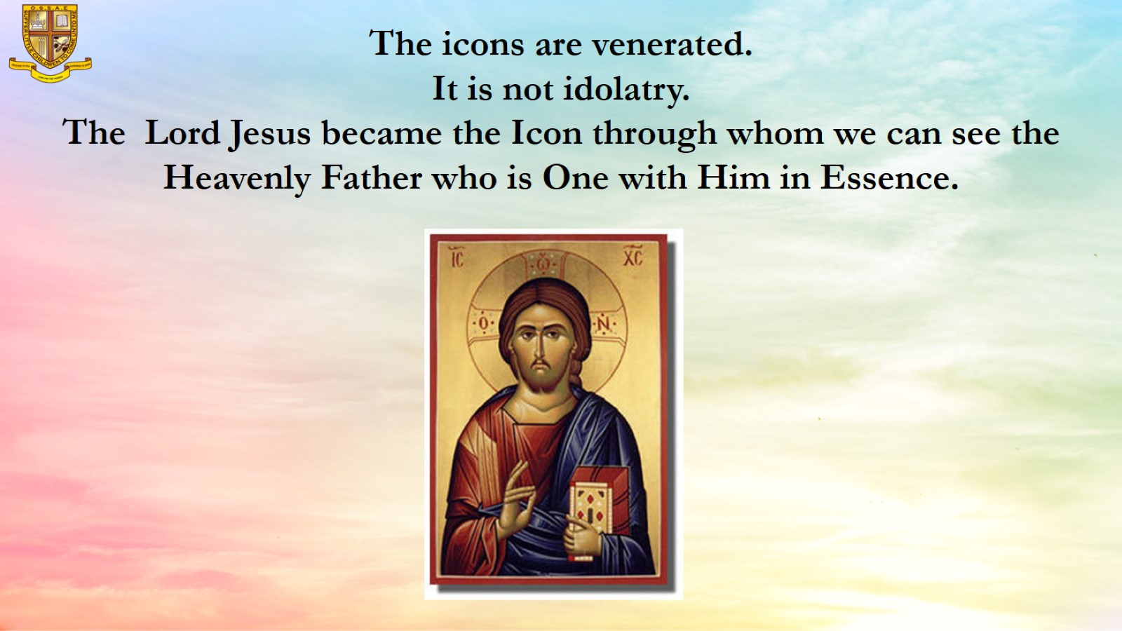
The icons are venerated.
It is not idolatry.
The Lord Jesus became the Icon through whom we can see the Heavenly Father who is One with Him in Essence.

Slide 13
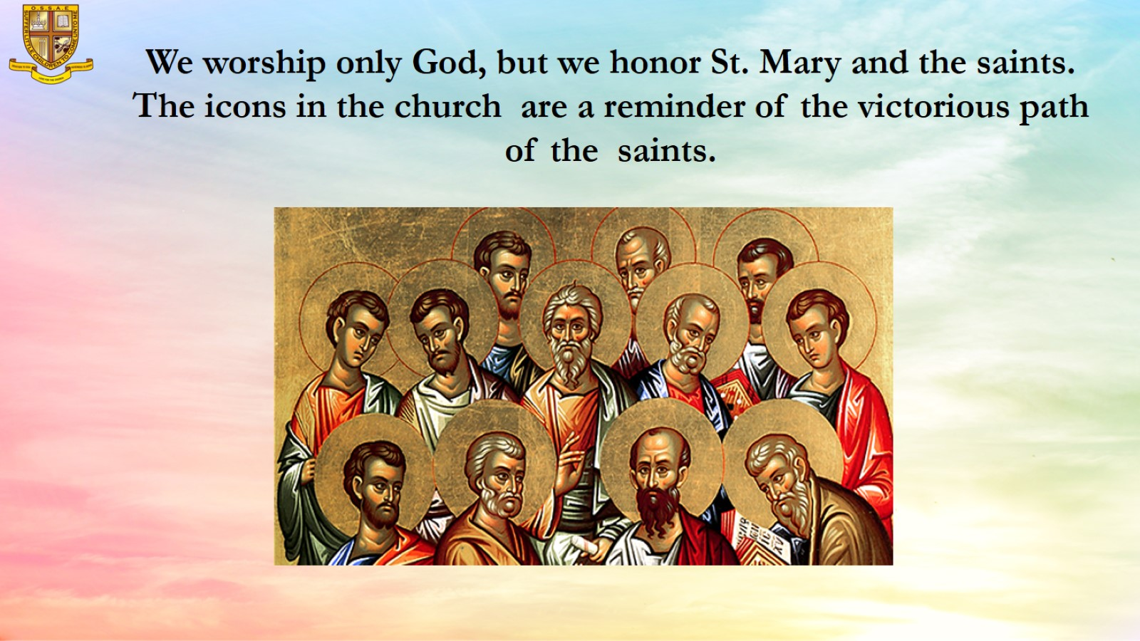
We worship only God, but we honor St. Mary and the saints.
The icons in the church are a reminder of the victorious path of the saints.

Slide 14
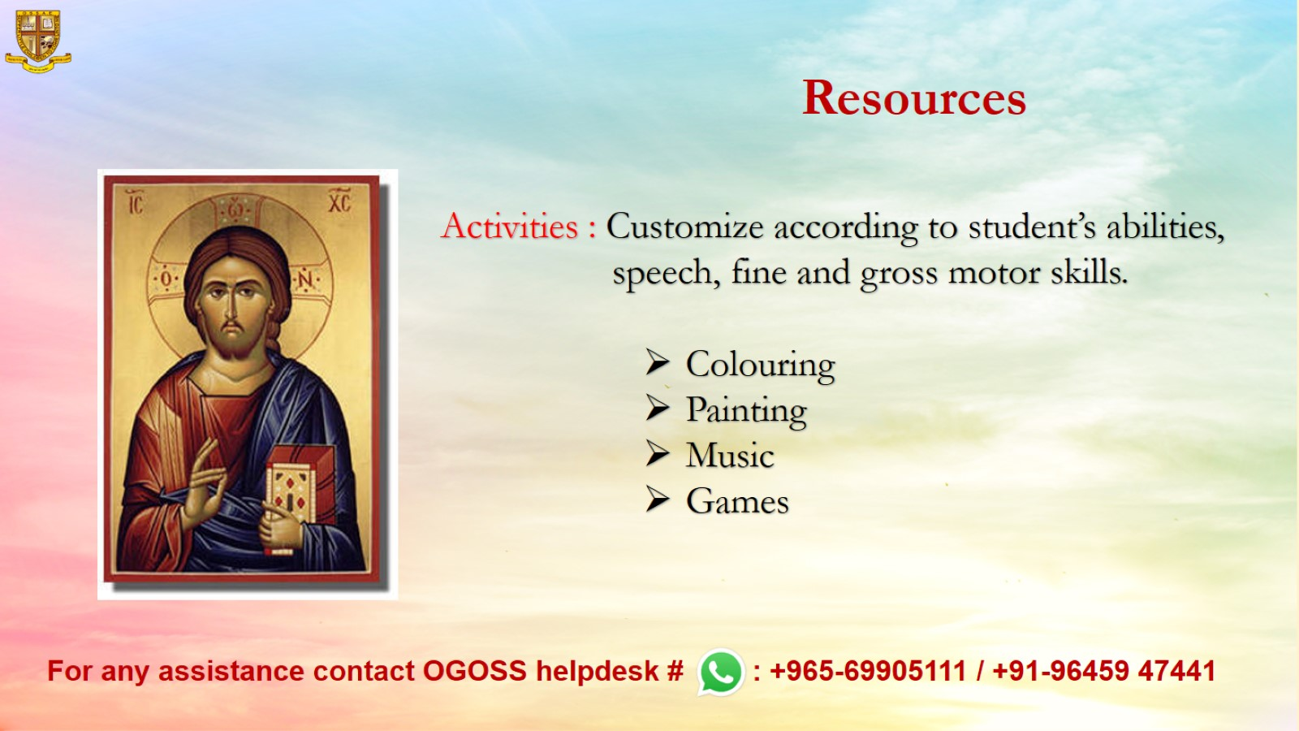
Resources

