Slide 1

Orthodox Global Online Sunday School (OGOSS)

Slide 2
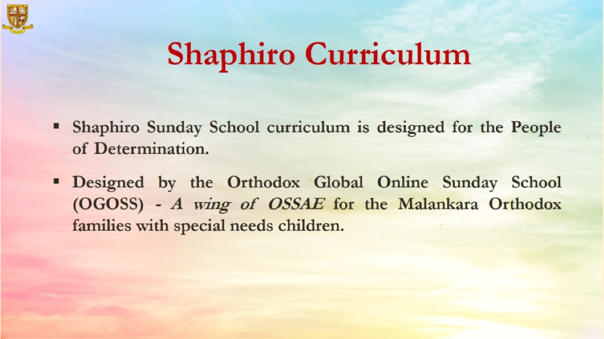

Slide 3
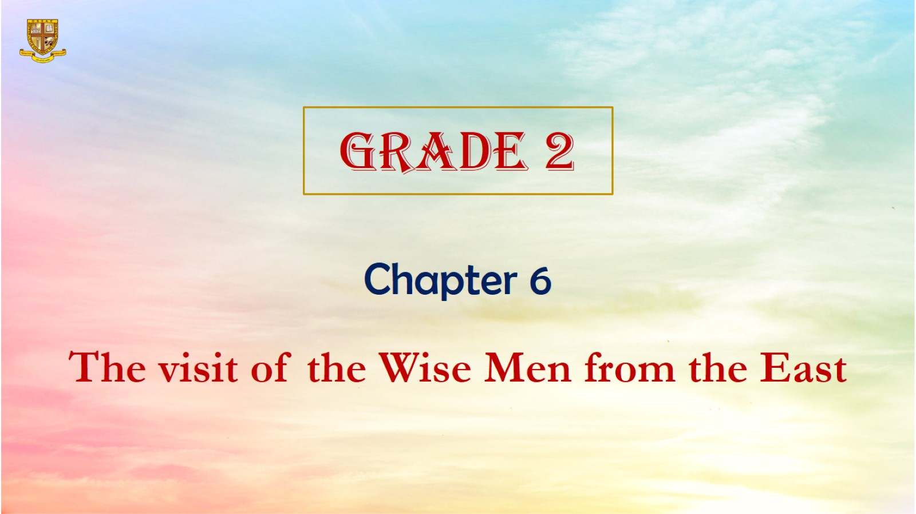

Slide 4
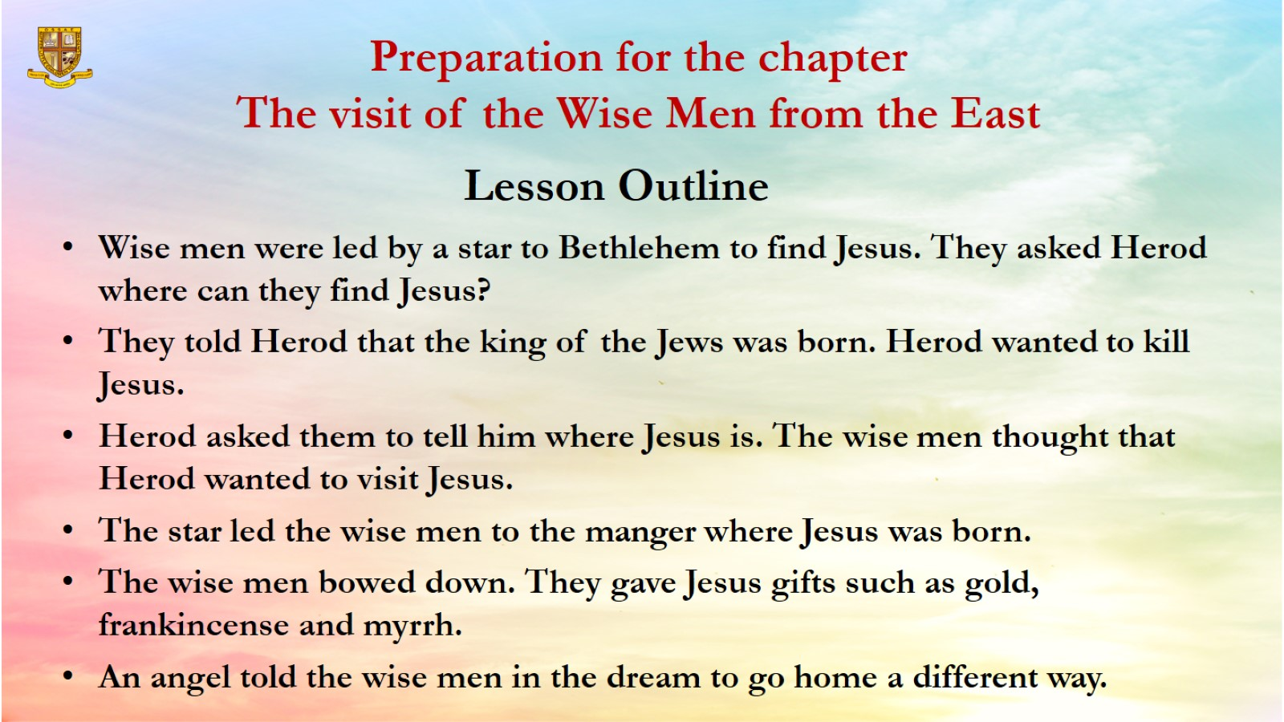
Preparation for the chapter
The visit of the Wise Men from the East

Slide 5
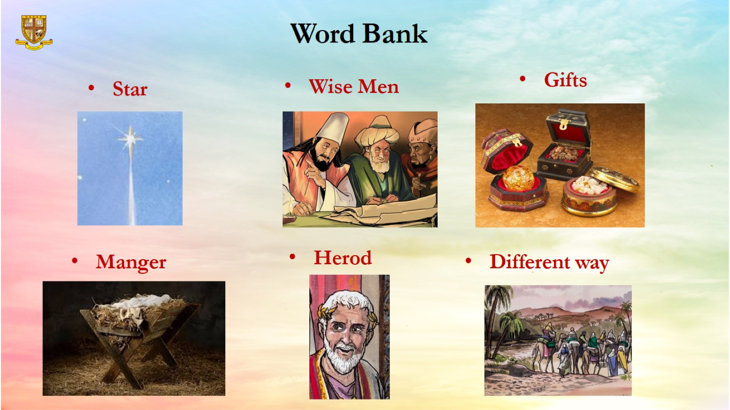
Word Bank

Slide 6
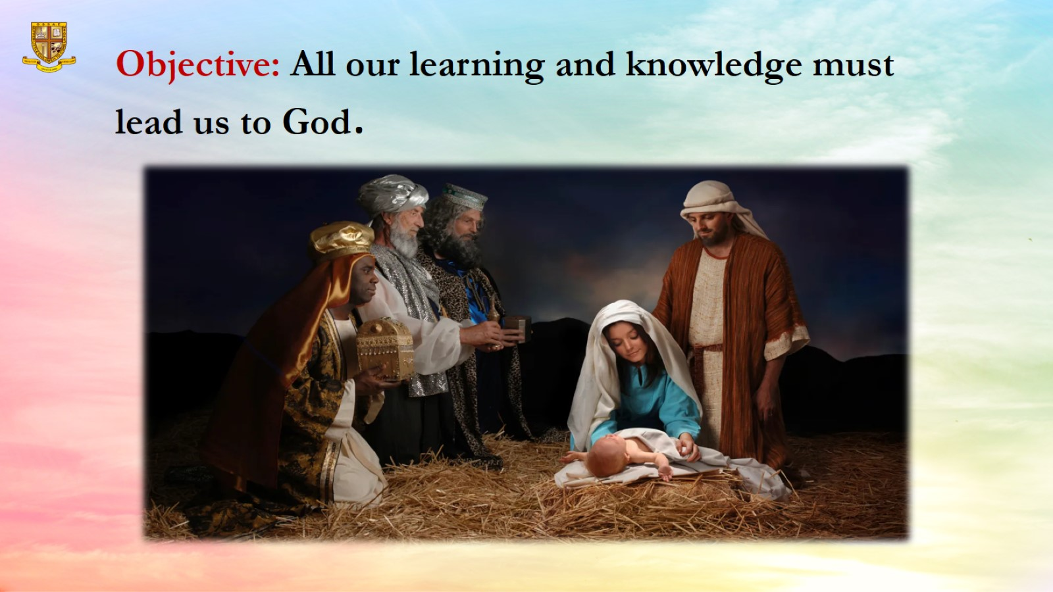
Objective: All our learning and knowledge must lead us to God.

Slide 7
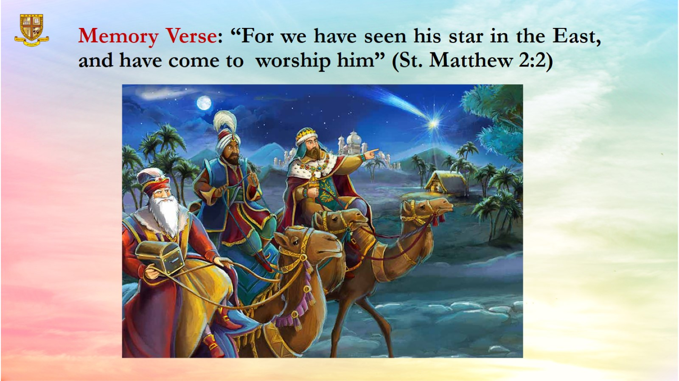
Memory Verse: “For we have seen his star in the East, and have come to worship him” (St. Matthew 2:2)

Slide 8
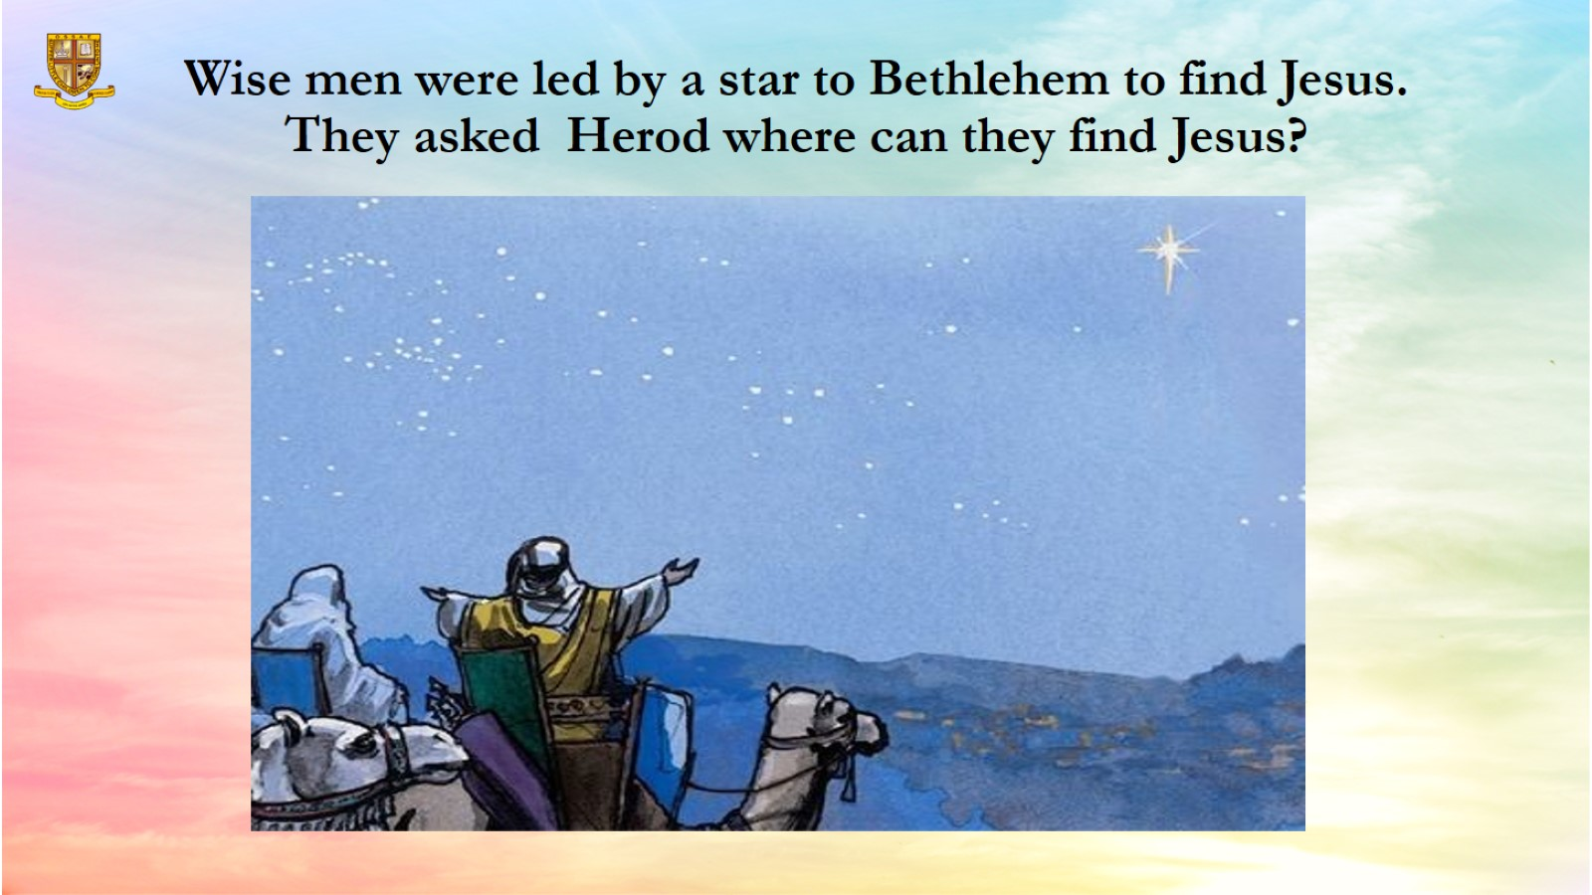
Wise men were led by a star to Bethlehem to find Jesus. They asked Herod where can they find Jesus?

Slide 9
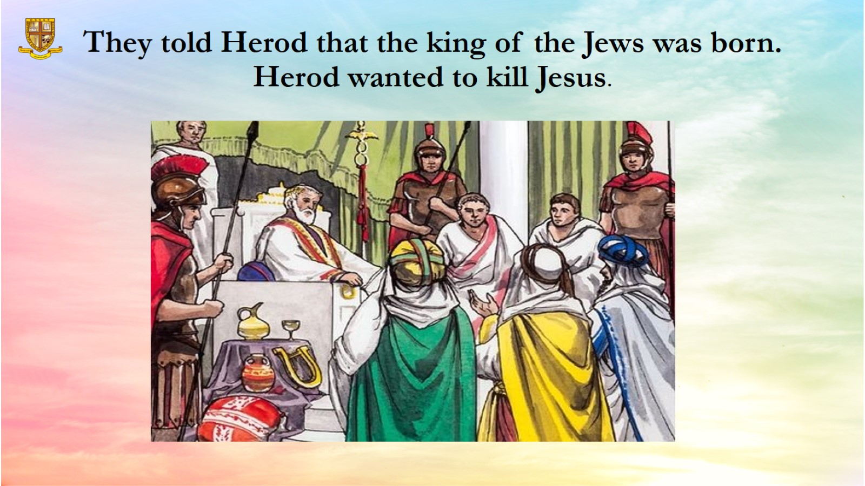
They told Herod that the king of the Jews was born.
Herod wanted to kill Jesus.

Slide 10
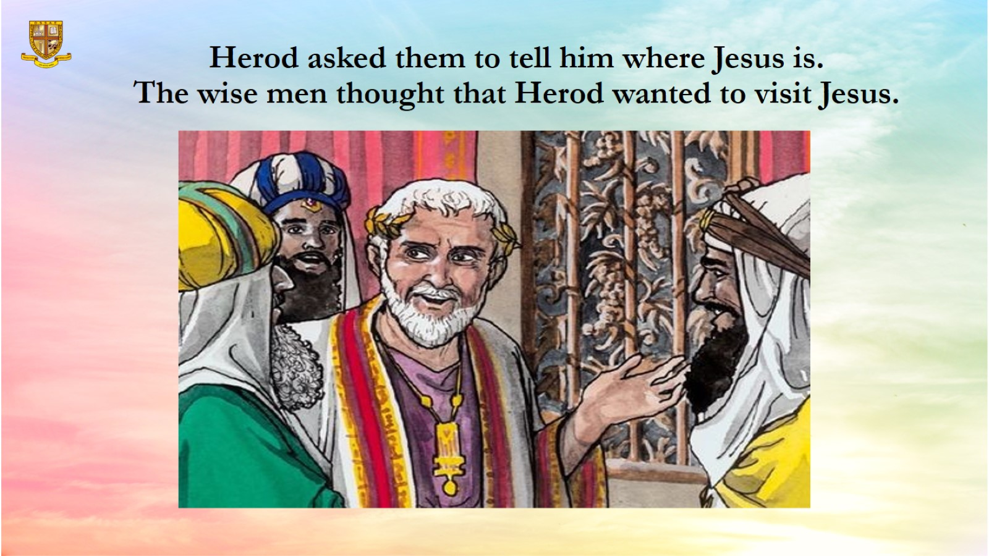
Herod asked them to tell him where Jesus is.
The wise men thought that Herod wanted to visit Jesus.

Slide 11
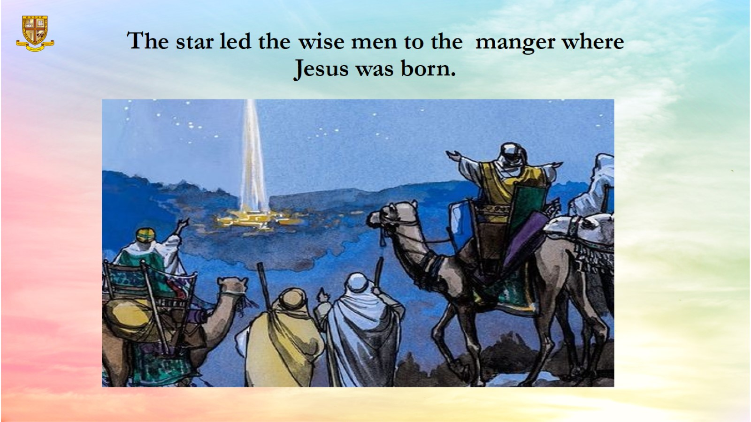
The star led the wise men to the manger where Jesus was born.

Slide 12
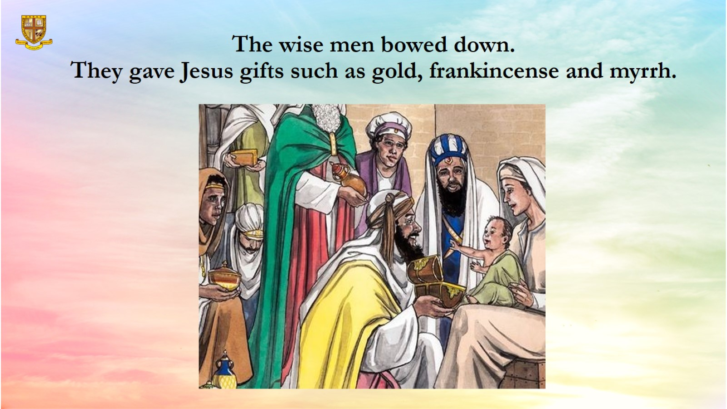
The wise men bowed down.
They gave Jesus gifts such as gold, frankincense and myrrh.

Slide 13
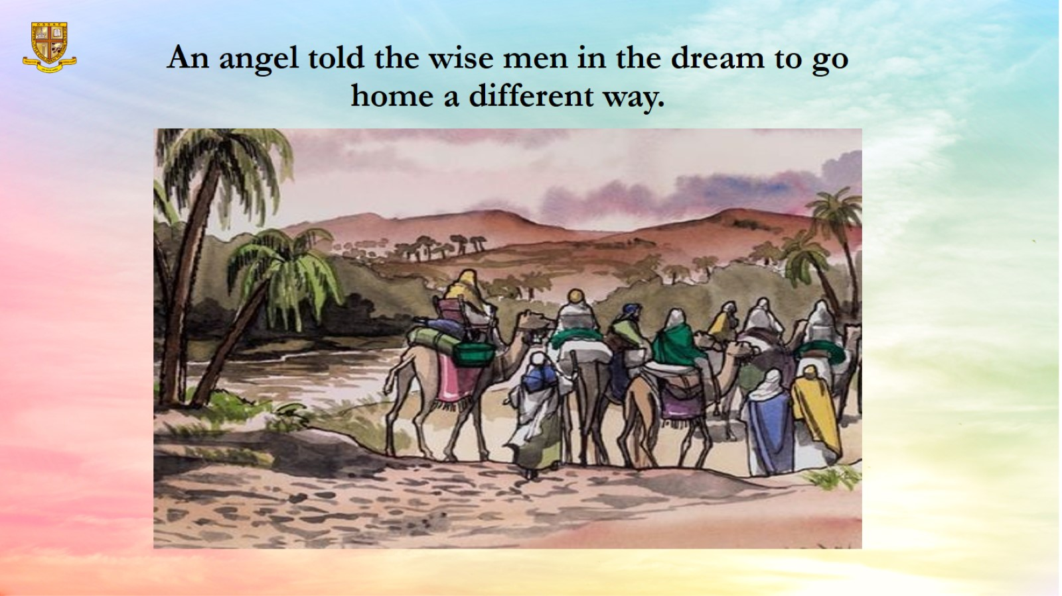
An angel told the wise men in the dream to go home a different way.

Slide 14
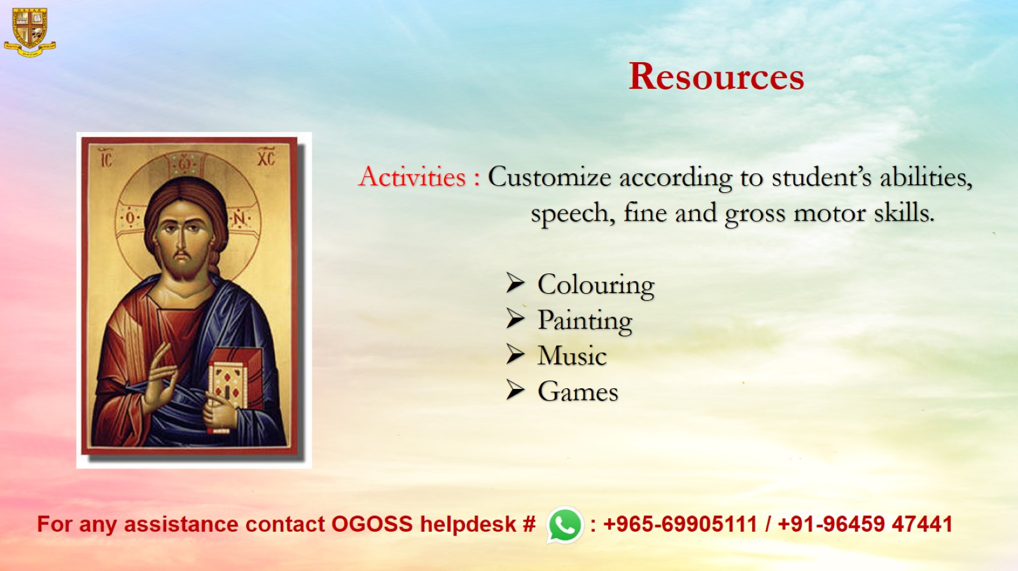
Resources

